Slide 1
Presentation by
Dr Karan Vickers-Hulse
Training Teachers of the future: the challenges for under-represented groups in the Bristol context
Dr Sarah Whitehouse
August 2022
Notes:
Both

Slide 2
About us
Dr Sarah Whitehouse
Dr Karan Vickers-Hulse
B
Notes:
Both

Slide 3
Backdrop
Trainee teachers
Belonging
Communities of Practice
Professional Identity Formation
Recruitment and retention
K
Colliander (2018) DfE (2018) Hargreaves and Goodson (1996) Lave and Wenger (1991) Wenger-Traynor and Wenger-Traynor (2015) Wright et al (2018)
Notes:
Karan

Slide 4
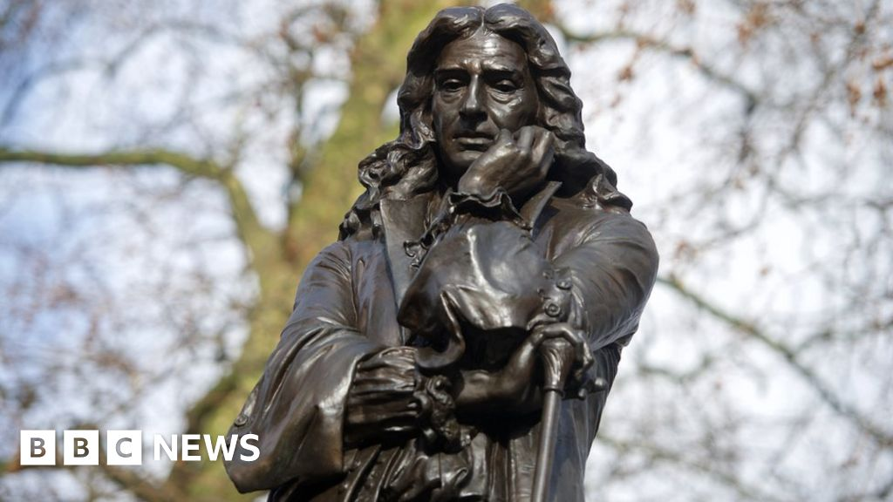
Bristol
S
Notes:
Sarah

Slide 5
Tensions and Contexts
Bristol:
Runnymede Trust Report highlighted that Bristol had fewer teachers from minoritized groups than other cities of the same demographic.
Demand for change locally: toppling of the statue of the controversial figure Colston; nationally due to the lack of diversity in the teacher workforce and internationally with regards to the activist movements of Black Lives Matter.
Positionality:
We are two English-born researchers who identify as white, straight and female in a white dominated, feminised profession and on reflection, we acknowledge that during most of our own careers as teachers we accepted the state of play with regards to the lack of diversity in the teacher workforce.
(Runnymede, 2017).
S
Notes:
Sarah

Slide 6

Teacher Education in England
K
Notes:
Karan

Slide 7
Context for the study
Small scale case study using internal funding from our institution.
Equality Diversity and Inclusion Taskforce
Recruitment of staff
Recruitment of students
Links with local communities: Bristol One Curriculum; Anti-Racist Toolkit; Racial Equality Groups
September 2021: recruited participants from PGCE and UG cohorts
Participants:
Black trainees
Trainees from Muslim community
Non-binary/LGBTQ+ trainees
Disabled trainees
Neurodivergent trainees
K
Notes:
Karan

Slide 8
OTHERED
D, black, single mother, mature
I’m the only black member of staff there so people do always look and think, oh who’s that? Because it’s like they’ve never seen a black person walk down the hallways before. So they do, everyone does always turn and have a look. So it just feels like you are being looked at a lot! [laughs] Which is really uncomfortable.
I was really scared to go into my placement cause it was all white and I looked through the school’s website and everything.
S
Notes:
Sarah

Slide 9
BIASED
J, white, non-binary (he/they pronouns)
I think because your professional identity is so intrinsically linked to your personal identity, I’m naturally going to talk about the things more that I want to talk about. So in my classroom there’ll be a huge LGBTQ+ push. But then, because I don’t have first-hand of racism for example, I’m not saying that I’m not going to be inclusive to children that aren’t white, but I think you are always going to push what you have had. So for the white guy behind me, what’s he going to push?
K
Notes:
Karan

Slide 10
INTERSECTIONALITY
F, white, disabled, neurodivergent, gay
Maybe it’s that social stigma. You are autistic, you don’t have a personality, that’s you. And you’re disabled, you’re just different, you can’t be anything else?I think it’s quite difficult cause I think it depends where the person is themselves in terms of accepting whoever they are, however different they are to the rest of society. I’m a very open person now, I’m just like yeah, cool, I’m disabled, there’s nothing wrong with that. But a lot of people, like other people I know with maybe similar conditions to me are scared of getting a new walking stick or something like that because it puts a marker on you.
S
Notes:
Sarah

Slide 11
SAFETY
C, white, non-binary (they pronoun), autistic
And in terms of my gender it was quite difficult to know what to say to the other teachers in the team, cause they didn’t have any of the information about me, and my mentor had mentioned that some of the other teachers had mentioned something about my posture or something, which I thought was really strange and gossipy. And I also didn’t know if it was true or if she was just trying to use them as like a smokescreen for her own opinions. So yeah, I don’t know. I didn’t feel safe in that environment! [laughs]
I think having some sort of opportunity for marginalised people to speak about their experience so that it’s not just us going into the classroom and being the first or the early people to be doing this. All of the cohort need to be educated about the stuff that affects so that all of the children are being educated about these things. It’s all well and good me going into the classroom and teaching my one class possibly about perhaps other pronouns or something like that, but everyone needs to know about it.
K
Notes:
Karan

Slide 12
ATTENTION
J, Muslim, ND
And there’s not even one person from ethnic minorities in my school. And I went in and it was just great, the whole experience, the children were so accepting and so open-minded and they would ask me, do you mind if I ask you a question about your headscarf? They asked me questions that were really funny, like is it specifically for your head? I was like no, it’s just a bit of silk
S
Notes:
Sarah

Slide 13
POLICY
N, Muslim, mature
…..like you were saying about talking to your teacher and not knowing what you can say to the kids, I feel like I’m in the same position. I’m like, what can be said, what can’t be said? And I think that needs to be clear. I know it may depend on the school, but from a national standpoint, what are we allowed to discuss with the children?
S
Notes:
Sarah

Slide 14
Headlines
Identity – who am I? who do people expect me to be?
Conscious decision making – what actions have I taken to protect myself?
Challenges to their placement being successful - am I the right sort of person to be a teacher?
Them as a future teacher – can I see myself as a teacher? Will I get a job?
K
Notes:
Karan

Slide 15
Accepters
Reluctant Accepters
Reluctant Challengers
Challengers
Model of student position
S
Notes:
Sarah

Slide 16
Initial findings
Students may have difficulty with the transition to a university environment
Lack of value and sense of belonging is shared
Limited networks – student often found their own support systems
Mentors were often under-prepared to support students.
Key things – nuanced and not ‘one size fits all’ – going to be complex
Intersectional bias
S
Notes:
Sarah

Slide 17
Recommendations for teacher training providers
Additional pastoral support
Safe space to offload – we want them to be challengers but recognise the complexity and potential damage of this when training in a setting.
Training for mentors – selection and deselection
Opportunity to visit school before they start
Systems are transparent and students are signposted
Putting support in place pre-arrival
Zero tolerance
Reviewing current practice with student body representatives
K

Slide 18
Building on Findings
Wider scale-more participants from more institutions
International/wider UK links.
Bidding for external bids and internal funding.
Open for discussion and Q&A

Slide 19
References
Colliander, H. (2018) The experienced newcomer - The (trans)forming of professional teacher identity in a new landscape of practices. Teaching and Teacher Education. 69 (1), pp. 168-176.
DfE (2018) Factors affecting teacher retention: qualitative investigation. Research report CooperGibson Research. Social Science in Government.
Hargreaves, A. and Goodson, I, F. (1996) Teachers’ Professional Lives: Aspirations and Actualities. In Hargreaves, A. and Goodson, I, F. (Eds) Teachers’ professional lives. London: Falmer Press.
Lave, J., and Wenger, E. (1991) Situated learning: Legitimate peripheral participation. Cambridge, UK: Cambridge University Press.
Runnymede Trust. (2017). Bristol: A city divided? Ethnic minority disadvantage in education and employment. Runnymede Trust.
https://www.runnymedetrust.org/uploads/CoDE%20Briefing%20Bristol%20v2.pdf
Wenger-Trayner, E., and Wenger-Trayner, B. (2015) Theory. In Wenger-Trayner, E., Fenton O'Creevy, M., Hutchinson, S., Kubiak, C. and Wenger-Trayner, B (Eds.), Learning in Landscapes of Practices (pp. 13-29). Oxon, UK: Routledge.
Wright, V. Loughlin, T. and Hall, V. (2018) Exploring transitions in notions of identity as perceived by beginning post-compulsory teachers. Research in Post-Compulsory Education. 23 (1) pp. 4-22

