Slide 1
Celebrities & Celebrity Culture: Role Models for High-Risk Behaviour or Sources of Credibility?
Dr Yvette Morey
Professor Lynne Eagle
Dr Gillian Kemp
Simon Jones
Dr Julia Verne

Slide 2
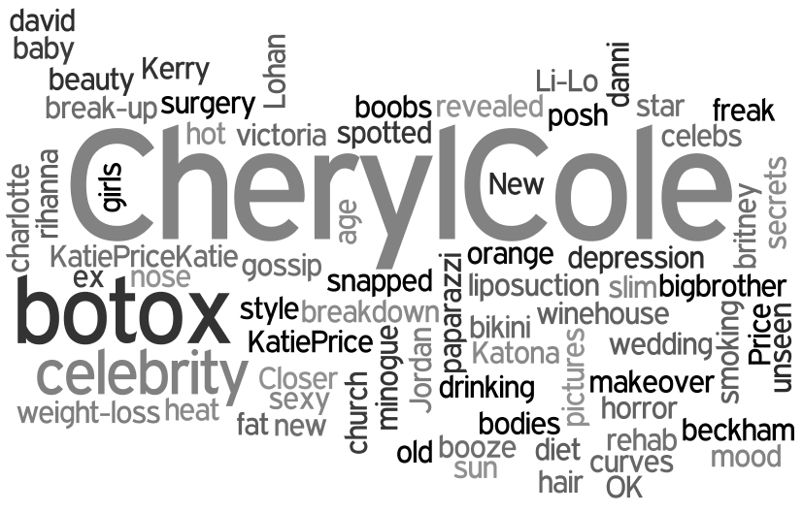
Celebrity/ies?
Celebrity participates in our lives as an ever-present current of narratives, discourses & images (Holmes, 2005: 22)

Slide 3
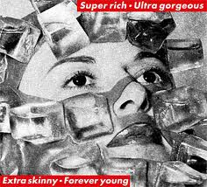
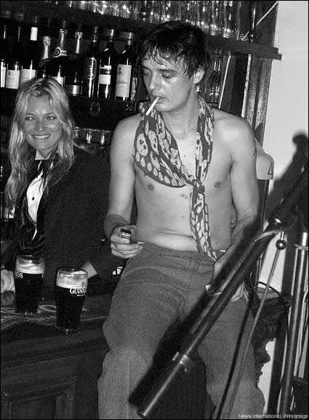
Representations & Role Models
Media images & representations:
Substantive work on media reps
→ ‘media images’, ‘stereotypes’, ‘ideals’
quantitative, causal relationships but:
how are images consumed, meaningful?
How do they translate into practice
social networks & friendships
Role Models:
Commonplace but “unclear … in a psychological sense how ‘role modelling’ might actually work” (Gauntlett, 2008)
How do role models become meaningful to people?
Social or Individual function?
One or more role models depending on contexts/behaviours (tensions?)

Slide 4
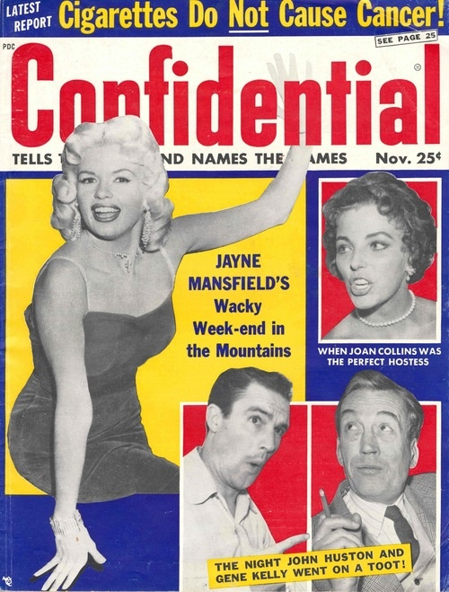
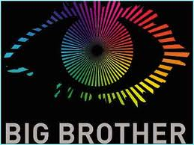
Contemporary celebrity culture
Historic, current configuration in 80s (Cashmore, 2006)
Dominates media content across formats (tabloidization of news)
Becoming/being a celebrity – accelerated, visible process
Reality TV (X Factor, Britain’s Got Talent, Big Brother)
Extraordinary Ordinariness, ‘willabees’
Taylor Herring: top 3 career aspirations
Not achievable by all, except through:
Consumption: consuming, living, behaving like a celebrity
Self-promotion: technology enables us to construct ourselves as media

Slide 5
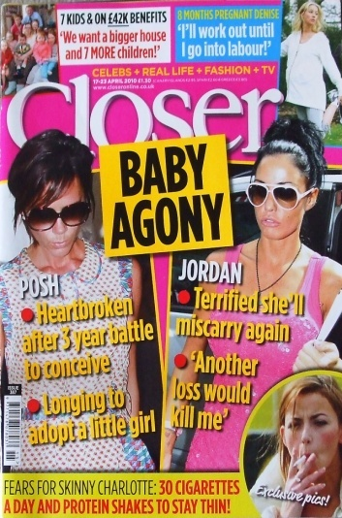
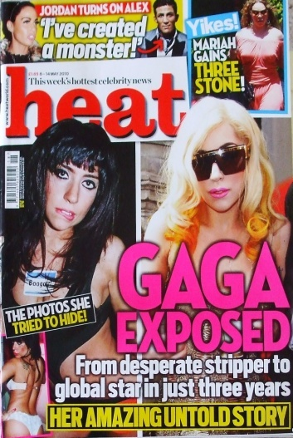
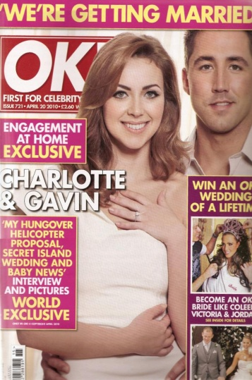
Methodology
Content & narrative analysis
heat, Closer, OK!, New!
Highest ABC circulation figures for 18 – 24yr olds (most likely to participate in high-risk behaviours)
Examine contexts & narratives about celebrity (textual & visual)
Readership survey – how is celeb content consumed in magazines?
Interviews & focus groups – how celebrity/ies are meaningful to readers?

Slide 6
Initial findings
Recycling of key, dominant narratives/stories:
Appearance (transformation: weight, cosmetic surgery, addiction)
Relationships (marriage/divorce etc.)
Pregnancy (attempts/miscarriage/adoption)
Mental/health breakdowns (mad-bad to recovering-good)
Katie Price, Kerry Katona, Cheryl Cole, Charlotte Church & Victoria Beckham – ongoing process of managing, repudiating, creating scandals that afford media attention
Celebrities routinely shown engaging in high-risk behaviours, simultaneously depicted as shameful & aspirational
Alongside ‘advertorial’ content – weight-loss, tanning, cosmetic, leisure, fitness, spiritual products

Slide 7
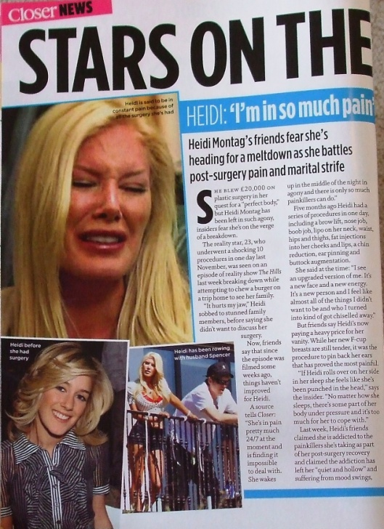
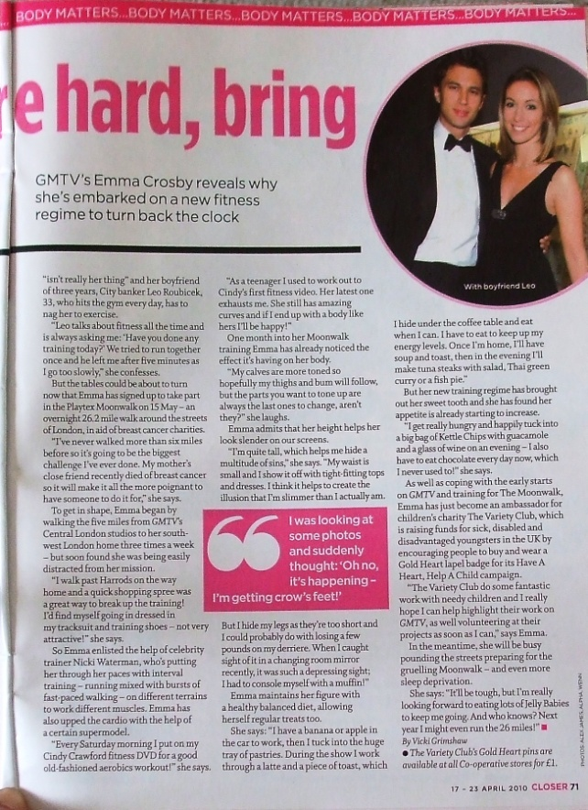

Slide 8
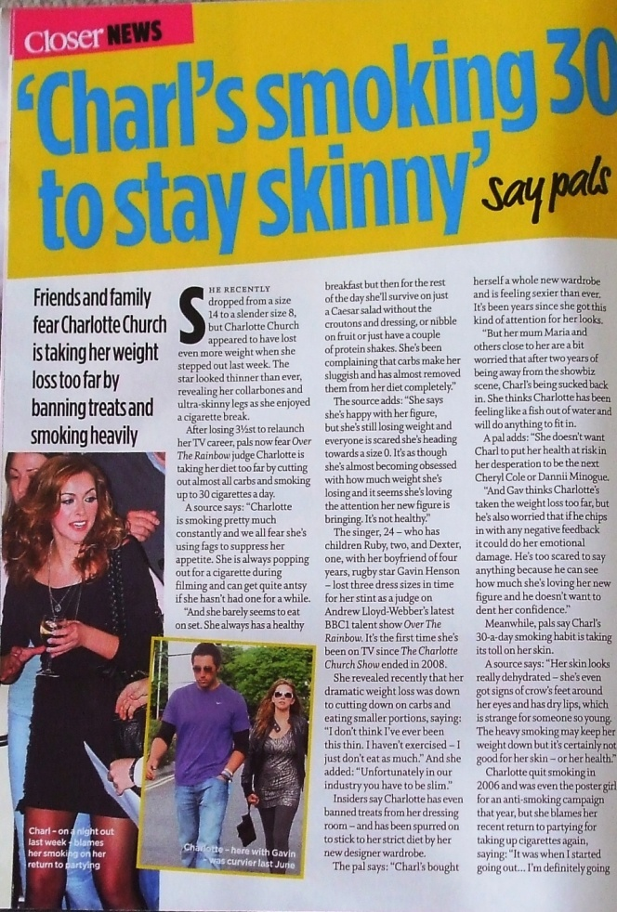
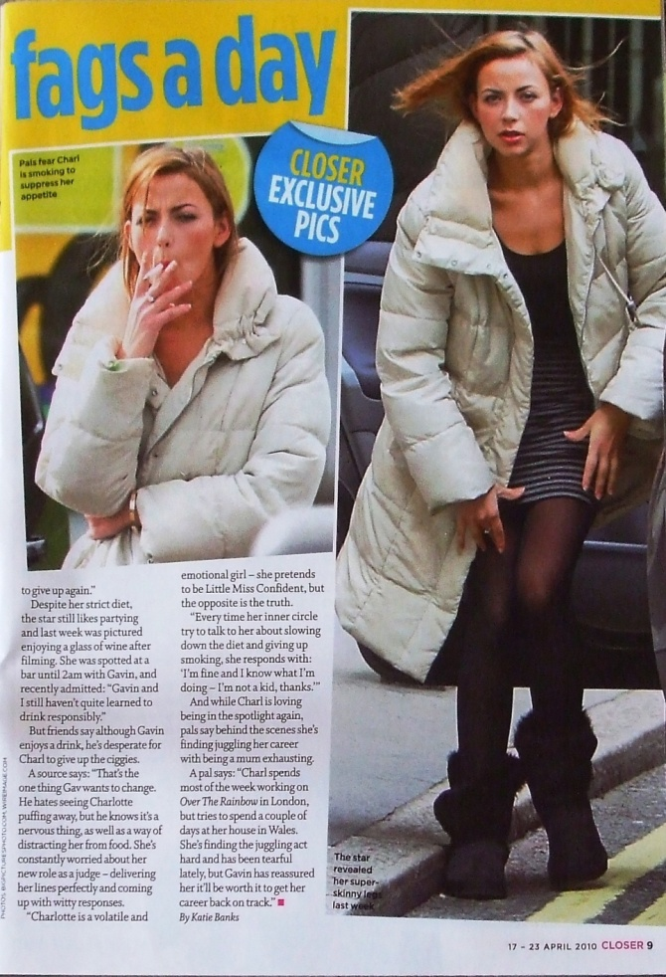

Slide 9
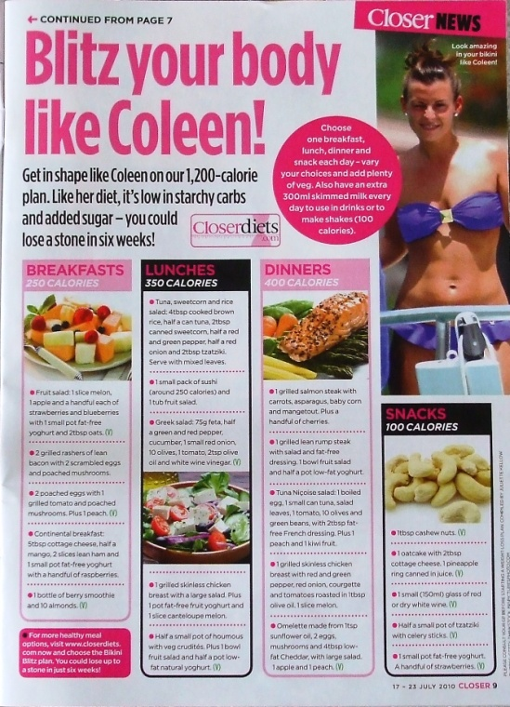

Slide 10
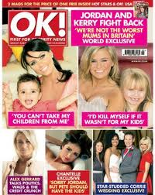
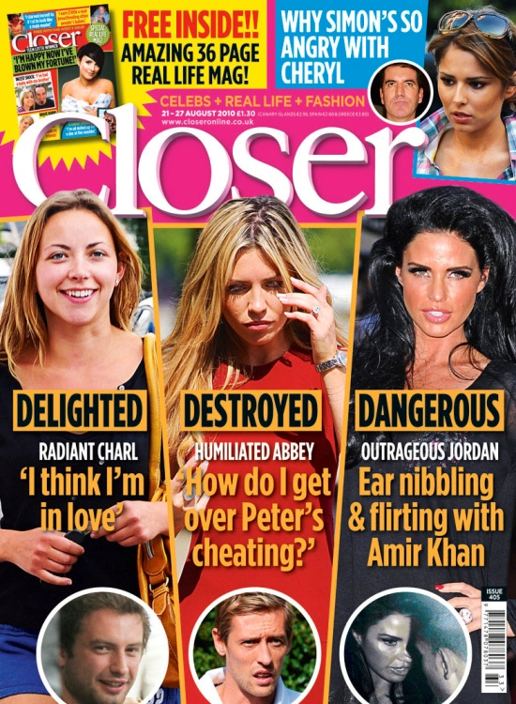
→ Ideological function of celebrity magazines - deconstruction & reconstruction of celebrity & celebrities

Slide 11
Implications for Social Marketing
Celebrities engage in high-risk behaviours shown as shameful and aspirational – how do young people engage with this?
Becoming a celebrity - aspirational identity narrative available to young people – what does this mean to them, what does it entail?
Does the ideological tension of reconstruction/deconstruction invalidate celebrities as credible sources for soc mark interventions? OR does this mirror the lives of young people in an authentic manner?
→Critical need to qualitatively expand our understanding of representations and role models
→Downstream – we need to understand what role these dominant narratives perform for any intervention to be effective
→Upstream – whose interests are served?
Celebrity is not an impartial declaration of merit or talent; it is an economic mechanism designed to keep consumers from asking questions about media ownership, control, and taste-making.

