Slide 1
A novel bacterial-based bioluminescent assay for the rapid pre-screening of chemotherapy efficacy
Ashley Martin, Mark Ruddock, Elizabeth Anderson, Habib Alloush, Vyv Salisbury, Priyanka Mehta, Ann Smith, Graham Smith, John Lamont

Slide 2
Acute Myeloid Leukaemia
AML is a condition affecting the adult population with a median age at presentation of 67 years. AML accounts for approximately 80% of acute leukaemia diagnosed in adults
Cytarabine (Ara-C) is the first line of treatment for AML even though 30-40% of patients fail to respond to initial treatment
Treatment with Ara-C is given without any pre-screening to determine sensitivity
Require the development of a rapid assay for pre-screening of patient prior to Ara-C chemotherapy

Slide 3
Biosensor Assay
Development of a novel in vitro bioluminescent biosensor assay which is capable of identifying sensitivity or resistance to Ara-C via the formation of the active metabolite Ara-CTP
Key Features of the Assay:
Predict individual response of a patient to Ara-C prior to treatment, singly or in combination with other agents
Peripheral blood or bone marrow aspirates
Results are obtained in under 1 day
Tailor dosing (low, standard or high dose)
Monitor effectiveness of treatment
Reduce treatment times and costs
Increase long term remission
Increase quality of life by reducing side effects and hospital stays

Slide 4
The scenario…
PB or BM sample
Analyses
1 day
3 to 14 days
Patient factors (age, sex…)
Functional testing
Cytogenetics Molecular markers
FLAG-Ida
DNR/Ara-C
Clofarabine/Ara-C
Leukaemia factors
Patient factors
Sensitivity
LD Ara-C
SD Ara-C
HD Ara-C
Treatment decision

Slide 5
How does it work?
Difference proportional to Ara-CTP in AML cell
Ara-C
Ara-C Ara-CTP
Ara-C
+
Ara-CTP
Cell damage and death
Cell lysis
AML cell
-phosphatase
+phosphatase
Ara-CTP
Ara-C
Ara-CTP Ara-C
Low Light
High Light
Biosensor
Biosensor

Slide 6
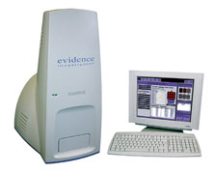
Assay protocol
Blast cells isolated from peripheral blood or bone marrow aspirates
Cells counted and adjusted to 2x10⁶/mL
Cell suspension treated with:
Ara-C (25 µM) for 30 minutes
Vehicle control for 30 minutes
Cells are washed to remove traces of drug and lysed
Lysates are applied to the biosensor in the presence/absence of IPTG and Alkaline Phosphatase (AP)
Luminescence is recorded using a CCD camera system at the peak max (t = 5.25 hours)
8 hours from cell separation to result!

Slide 7
Sensitivity of the biosensor to Ara-CTP
Biosensor tested across a range of concentrations of Ara-CTP
Results for light output following exposure to lysate spiked with Ara-CTP in the presence and absence of alkaline phosphatase (AP)
Limit of detection was 25 nM Ara-CTP (p<0.001)

Slide 8
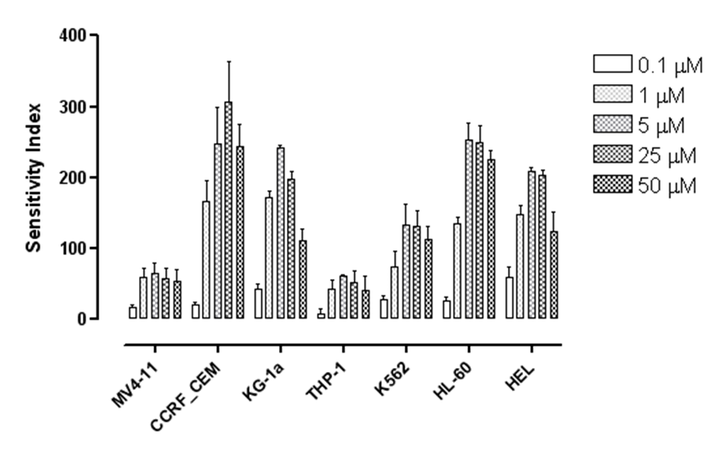
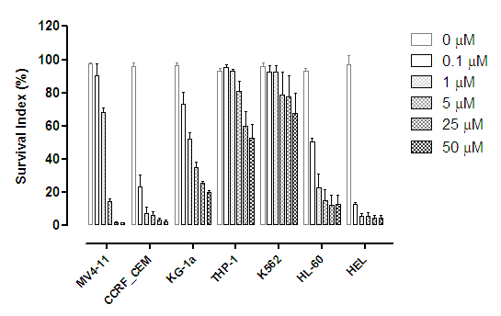
Biosensor assay analysis of cell lines

Slide 9
Biosensor assay analysis of patient samples
Sensitive patient (remission after 1st cycle)
Resistant patient (no remission)
Zero Control
Low Control
High Control
Zero Control
Low Control
High Control
Control
Minus AP
Plus AP
Control
Minus AP
Plus AP
Control
Minus AP
Plus AP
Control
Minus AP
Plus AP
Control Sample
Ara-C Treated Sample
Control Sample
Ara-C Treated Sample

Slide 10
Biosensor assay analysis of patient samples
Sensitive patient (remission after 1st cycle)
Resistant patient (no remission)
Ara-C Sensitivity Index = 33.5%
Ara-C Sensitivity Index = 0%

Slide 11
Data from preliminary testing
ANLL patient samples | Total analysed | 56
Clinical outcomes |  | 34
 | Peripheral blood | 16
 | Bone marrow | 18
 | Correct | 31
 | Incorrect | 3
Complete remission | Total correct | 13/14
 | Sensitivity range (%) | 10 to 128
 | Median (%) | 36
Non-remission | Total correct | 18/20
 | Sensitivity range (%) | -9 to 7
 | Median (%) | 3.5
13/14
18/20

Slide 12
Conclusions
This rapid and robust assay simply and accurately determines sensitivity to Ara-C in under 8-hours of receipt of the patient sample
Proof of principle analysis has shown 85% efficiency (correlation with clinical outcome and CellTiterGlo® assay) for 34 clinical samples analysed to date (p=0.052)
Represents the first assay of this type, allowing oncologists to obtain a chemosensitivity profile of a patient prior to commencement of chemotherapy with Ara-C alone or in combination
Current activities:
Retrospective testing in larger patient cohort in collaboration with National Cancer Research Institute (NCRI) UK
Testing on alternative dosing regimes used in treatment of leukaemia, including daunorubicin/Ara-C, fludarabine/Ara-C and clofarabine/Ara-C

Slide 13
Acknowledgments
Collaborators
Prof Vyv Salisbury, University of the West of England, Bristol, UK
Dr Ann Smith, Scientific Director of Stem Cell Transplant Lab, Royal Marsden, UK
Prof Graham Smith, Consultant Haematologist, Frimley Park Hospital, UK
Dr Priyanka Mehta, Haematology Consultant, University Hospital Bristol, UK
Dr Habib Alloush, American University of Beirut, Lebanon
Dr Steve Knapper, Haematology Consultant, University Hospital of Wales, UK
Funding
Randox Laboratories Ltd, UK
BBSRC (with Dr Phil Hill, Univeristy of Nottingham)
UK Technology Strategy Board
National Institute for Health Research (NIHR), UK

