Slide 1

Bridging Research and Practice – the Nursing Research Facilitator Role in BC
Linda Axen, MN, BSN,RN
Agnes Black, MPH, BSN, RN
Bubli Chakraborty, MES, BSN, RN
Lynn Cummings, MN, BNSc, RN
Katrina Plamondon, MSc, BN, RN
Charlene Ronquillo, MSN, BSN, RN

Slide 2







Canadian Nurses Association Convention June 2012
Notes:
A joint presentation of the Nursing Research Facilitators representing EACH of the BC Health Authorities

Slide 3





Once upon a time in 2008…
Notes:
$8 million allocated to support nursing health services research. Administered by MSFHR

Slide 4
BC Nursing Research Initiative was created…
Notes:
There were a series of town halls across the province and this was the vision the component programs to address nursing health services research

Slide 5
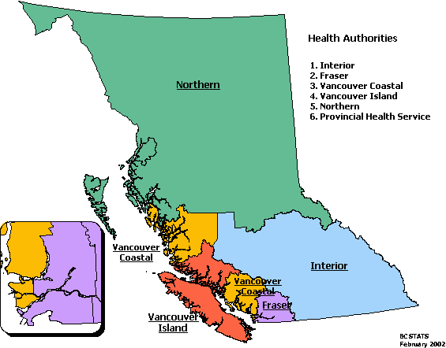

The Nursing Research Facilitators
Notes:
Each HA received grant funding to have one FT facilitator starting in April 2009 for two years. Due to the success of the role, the positions received a two year funding extension.

Slide 6
The Role of the NRF…
“Address key priorities in building nursing health services research capacity”
Notes:
Lynn’s last slide

Slide 7
Starting Point…
Plan your approach and key strategies
Identify allies (you may be a program of one)
Start building connections

Slide 8
First Steps…
Do an environmental scan & identify:
Existing resources
Research champions
Exemplars of quality research
Key areas of focus

Slide 9

Skill Set For A NRF
Notes:
From left top to right – the person should be masters prepared, creative, innately curious, be able to “hook or capture” people’s interest, be motivated and motivating, savvy about technology, and a good multi-style writer (e.g. scientific, business, blog)

Slide 10
Successful Capacity Building Ideas
Research 101/ 102 Workshops:
  Enhance research literacy skills
  Research design
  Grant and proposal writing
  Research ethics
  Publishing

Slide 11
Successful Capacity Building Ideas
Project planning support:
  Consultation: One to one or group/program
  QI and Evaluation Projects
Nursing or interdisciplinary
focused
Notes:
Key meetings with PPLs, CNEs, and people with authority to implement project and fund project

Slide 12

Capacity Building Enablers
Virtual Communities of Practice:
InspireNet Actions Teams
Nursing Education and Research Rounds (NEARR)
Virtual Journal Club
Notes:
Allows provincial collaboration, people learn at their leisure, addresses travel constraints, no limitations on the group size

Slide 13
Successful Capacity Building Ideas
“Point of Care” Research Challenge Competitions
“Evidence in Practice” Action Research Teams & Workshops
BCNRI funding calls
Nursing Research Forums and Poster Contest
Notes:
Katrina end action research teams? Aggie start with Point of Care

Slide 14

Successful Capacity Building Ideas
  Knowledge brokering via:
    Linking people to other people, groups and research networks
    Communication strategies
    Research Week
    Strategic Plans for Nursing Knowledge Transfer and Exchange
Notes:
Knowledge broker via newsletters, websites,, promoting workshops, etc. facilitating group projects

Slide 15

Positioning the NRF for success
INSERT NRF HERE
Be visible and credible
Garner support and buy in from leadership
Build links with academia and professional practice
Be accessible across the organization

Slide 16

NRF Professional Development and Competence
Notes:
Need to be able to attend conferences for networking, take courses on skill sets that need developing (MS project planning software, publisher), KT training, etc.

Slide 17
Potential Strategic Benefits of the NRF Role
Literature suggests the role may help with:
  Building capacity for nursing research (Syme & Stiles, 2012; Currey, Considine & Khaw, 2011)
  Enhanced engagement and job satisfaction among nurses (Johnson, Hong, Groth, & Parker, 2010; Drenkard, 2010)
  Recruitment and retention of nurses (Lund & Borg, 1999; Jones 2008)
  Potential increased use of evidence (Currey, Considine & Khaw, 2011) and thereby, quality of care (Melynk & Fineout-Overholt, 2005; Udod & Care, 2004)
Notes:
NOTE we haven’t evaluated if the position has helped recruitment and retention in BC, how it impacts employee engagement or job satisfaction. I would definitely point that out.
The NRF promotes, supports, and creates visibility
References are available to be e-mailed
eefere

Slide 18
NRF – Bridging Research and Practice
Notes:
Questions and comments from audience

Slide 19
Thanks!
Aggie, Bubli, Linda, Charlene, Lynn, Katrina

Slide 20
References
Currey, J., Considine, J., & Khaw, D. (2011). Clinical nurse research consultant: A clinical and academic role to advance practice and the discipline of nursing. Journal of Advanced Nursing 67(10); 2275-2283.
Drenkard, K. (2010). The business case for Magnet®. Journal of Nursing Administration 40(6): 263-271.
Johnson, A., Hong, H., Groth, M. & Parker, S. K. (2010). Learning and development: Promoting nurses' performance and work attitudes. Journal of Advanced Nursing 67 (3):609-620.
Jones, C.B. (2008). Revisiting nurse turnover costs: Adjusting for inflation. Journal of Nursing Administration 38(1): 11–18.
Lund, T. & Borg, V. (1999). Work environment and self-rated health as predictors of remaining in work 5 years later among Danish employees 35-59 years of age. Experimental Aging Research 25:429-434.
Melynk, B.M. & Fineout-Overholt, E. (2005). Making the case for evidence-based practice. In: Evidence-based practice in nursing & healthcare: A guide to best practice. (Melnyk, B.M. & Fineout-Overholt, E., Eds.), Lippincott Williams & Wilkins, Philadelphia.
Syme, R. & Stiles, C. (2012). Promoting nursing research and innovation by staff nurses. Applied Nursing Research 25: 17-24.
Udod, S.A. & Care, W.D. (2004). Setting the climate for evidence-based nursing practice: What is the leader's role? Nursing Leadership 17 (4):64-75.

Slide 21
Details on Research Challenge
At Providence Health Care the 2011 cohort of the Research Challenge attracted 86 participants, and 14 teams were funded, including 5 nurse-led teams. The 2012 cohort has attracted 56 participants, with 15 teams applying for funding, including 10 nurse-led teams. An evaluation of the Research Challenge is being conducted.
At Fraser Health Authority, the research challenge focuses on research which impacts nursing and requires a nurse to lead or co-lead research teams. 70 participants were involved in the 2010-11 cohort and 3 teams were funded. 1 team has presented at a national conference and 2 have presented at FH Research Week. The 2011-12 competition saw 39 participants with 2 teams funded.

Slide 22
Details on NEARR
NEARR was evaluated in early 2012, following its first year. Results of the evaluation showed that NEARR reached 996 participants, with 94% of survey respondents replying that NEARR content was useful to them in their practice and 96% indicating they plan to participate in future NEARR sessions.

Slide 23


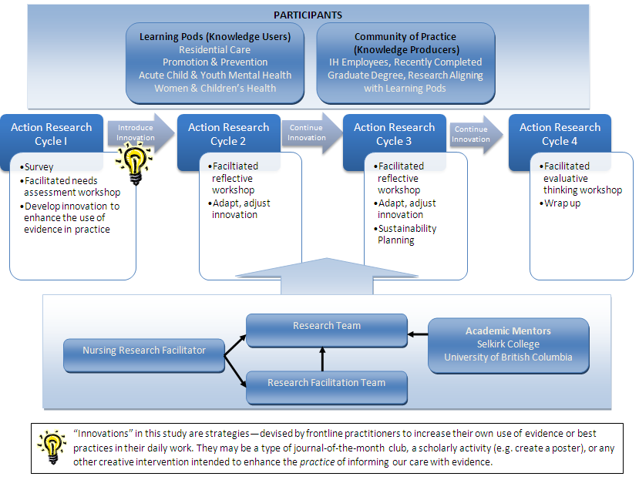
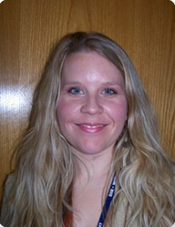
Sustainable Capacity Building through Action Research

