Slide 1


Working with Men
&
Perinatal Depression
James Costello

Slide 2
Postnatal Depression
Contested Term – distinct diagnostic entity?
Risk Factors – mirror those for depression at other times:
life events; predisposition; low social/emotional support; medical complications (i.e., hyperemesis).
Negative impact on mother & offspring
Freed et al., (2012) Families, Systems & Health, 30, 1-18.

Slide 3
Measuring Unhappiness
Affects up to 15% of women in UK (perhaps only 2 in 5 seek help)
Edinburgh Postnatal Depression Scale (EPDS)
10 Point self-report questionnaire for diagnosis, screening and research.
Cox et al., (1987). Br. J. Psych. 150, 782-786.
“Although morbid unhappiness is......universally recognised......not necessarily
seen as an illness....whose causes are medical...”
“....acceptance, understanding and social support lie at the heart of a remedy.....”
Cox et al., (2004). Br. J. Psych. 184, s10-16.

Slide 4
Supporting Fathers?
NICE Guideline 45: “.....give them [carers/families] the information and support they need.”
Mother
Father
Infant
“...family relationships are positively assisted by early interventions directed towards the father.”
Fletcher (2009). Infant Mental Health Journal, 30(1), 95-102.

Slide 5
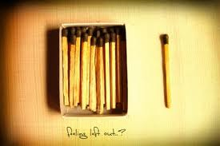
Pilot 2009
♀
For Mothers 8 x 90 min cbt workshops
♀ ♂
For Partners 3 x 60 min cbt workshops
“What could you know about postnatal depression…you’re a man....”
Milgrom et al., (1999). Treating Postnatal Depression , Wiley

Slide 6


Reflection-upon-action, Reflection-in-action
Pilot
CORE Evaluation
Narrative Case Studies
Public Consultation Group
Teaching
Expansion of Provision
Training
Supervised Practice > 15 Groups
Lees (2001), Counselling & Psych. Res., 1(2), 132-139.

Slide 7
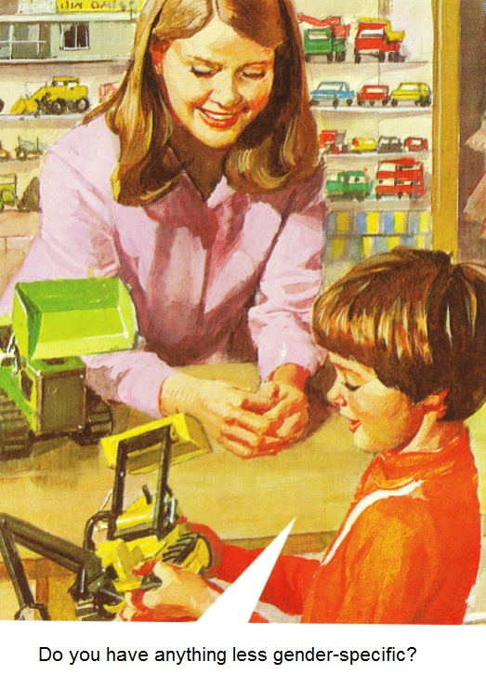

Slide 8
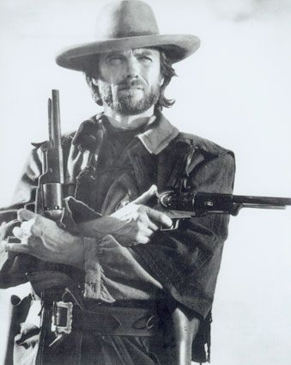
Men, Masculinity & Manhood Acts
“Men claim membership of a system of privilege via manhood acts”
Don’t seek help readily
P4: “I was desperate.... when they came round to section her, I said to the guy: “do you want to go for a curry”
Emotional withdrawal
P3: “Men just tend to knuckle down and almost shut off the emotional side of things and concentrate on the practicality’s”
Invulnerable
Seek to control
Schrock & Schwalbe (2009). Annu. Rev. Sociol., 35, 277-295.

Slide 9
Practices and Processes
When working with men:
Acknowledge the importance of manhood acts (practices).
Recognise the social cues which invite or enable healthy manhood acts (processes).

Slide 10
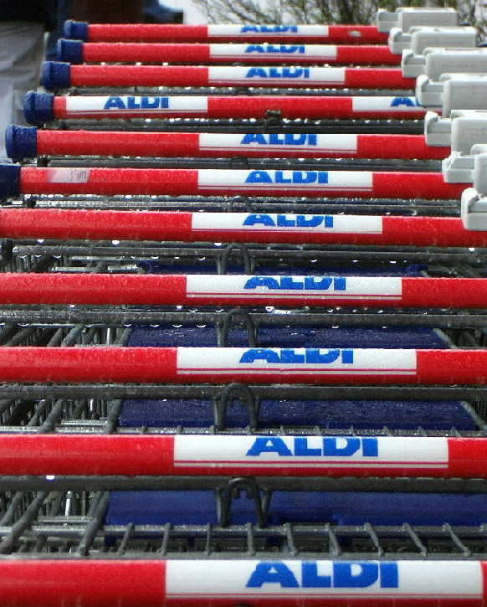
Is My Problem Normal?
Risks to self-esteem and shaming are high
when we feel our problem is not normal.
“What could I say…my wife’s gone loopy….I was afraid my mates would make a joke about it……like PMT”
Tony
All-male sub-groups for sharing experiences

Slide 11
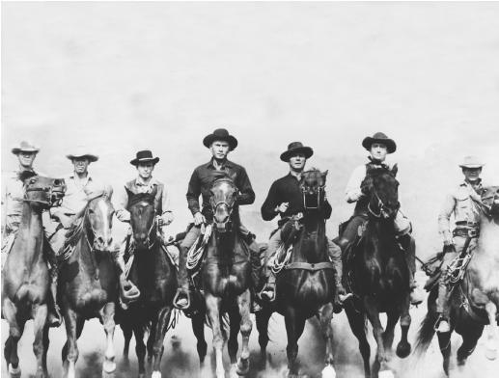
Reciprocity
Ideals of self-reliance may be preserved when indebtedness is avoided…..like a team!
“I’m here talking to you today so that others don’t go through what we went through”
Mike
All-male sub-groups enable reciprocal behaviour

Slide 12
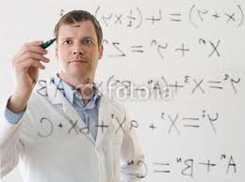
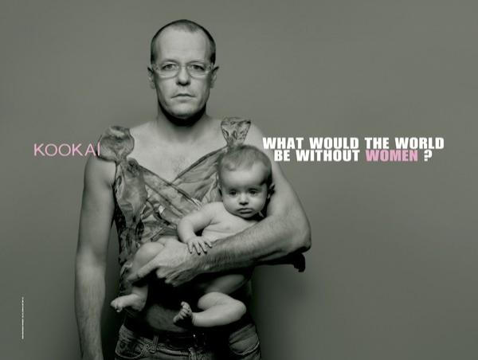
Re-Framing the Problem
Technical Focus upon external change.
“She’s ill….we can fix her with pills….right?” Joe
Adaptive Help-Seeking, Re-Negotiate Work Status
“I failed at a practical level….it wasn’t easy recognising I needed help”
Tony

Slide 13
Adapting Practice
3 x 2 hr Saturday am sessions & child care.
Whole Group Normalising
Sub Groups Normalising, Reciprocity, Reframing
→ “The Nominated B***d”
Couple Work Developing empathy,
communication skills → Reframing

Slide 14
What Next?
Addressing Stigma, Signposting Resources
One Stop Resource
Signposting
Online Resources
“TherAPPY”
Referral Information
GP Surgeries
Children & Maternity Commissioner
Bristol NHS
CPD
HV & Midwives
Distribute Information
Parent Groups/Childcare Providers/Meeting places

Slide 15
Acknowledgements
South Gloucestershire PCT
Department of Psychology, UWE
Prof Tim Bond
Bluebell Nurses
Those who shared their stories of maternal depression
james.costello@uwe.ac.uk

