Slide 1

The Redox Behaviour of Diazepam (Valium®) using a Disposable Screen-Printed Sensor and Its Determination in Drinks using a Novel Adsorptive Stripping Voltammetric Assay
Kevin C. Honeychurch, Adrian Crew, Hannah Northall, Stuart Radbourne, Owian Davies,
Sam Newman and John P. Hart

Slide 2
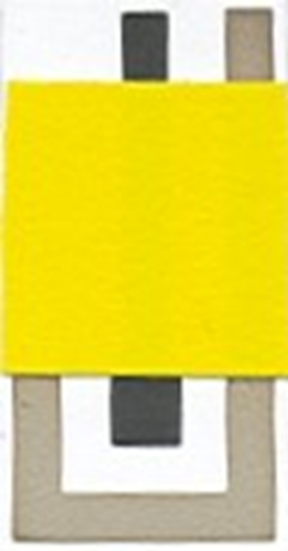
Outline of Talk
Importance of diazepam
Cyclic voltammetry at SPCEs
Adsorptive stripping voltammetry
Medium exchange
Conclusions

Slide 3
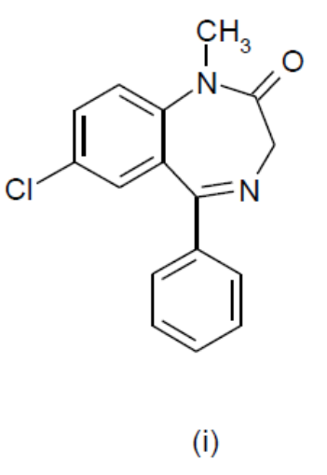
Diazepam
Diazepam (i) is commonly sold under the trade name Valium®
One of the most widely prescribed 1,4-benzodiazepines
  therapeutic treatment of anxiety, insomnia, epilepsy, alcohol withdrawal and muscular spasms.
Falling prices of diazepam and increased availability on the black market
  drug facilitated sexual assault (DFSA) and robberies
  deliberate adulteration of food, beverages and herbal medicine.
Driving under the influence of drugs (DRUID).
Concerns have also been raised regarding its occurrence in water and sewage effluents.

Slide 4
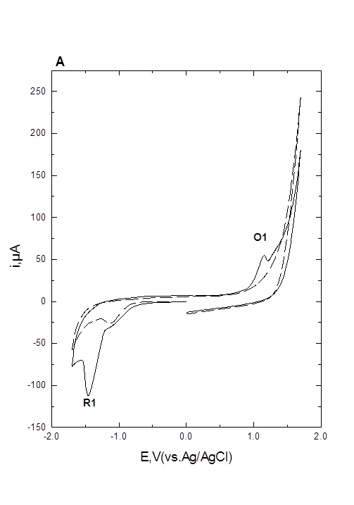
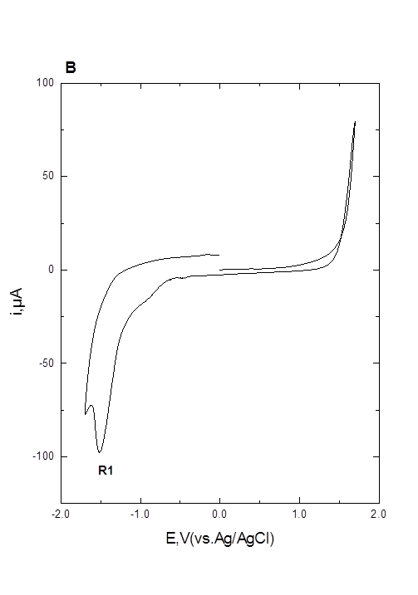
Cyclic Voltammetry
O1
R1
R1
Figure 1. Cyclic voltammograms, obtained at a scan rate of 50 mV/s, for a 1 mM solution of diazepam in 10 % ethanol, buffered with 100 mM phosphate at pH 4. (A) Starting and end potential 0.0 V, initial switching potential ‑1.7 V, second switching potential +1.7 V. (B) Starting and end potential 0.0 V, initial switching potential +1.7 V, second switching potential ‑1.7 V. Dashed line in the absence and solid line in the presence of 1 mM diazepam.

Slide 5
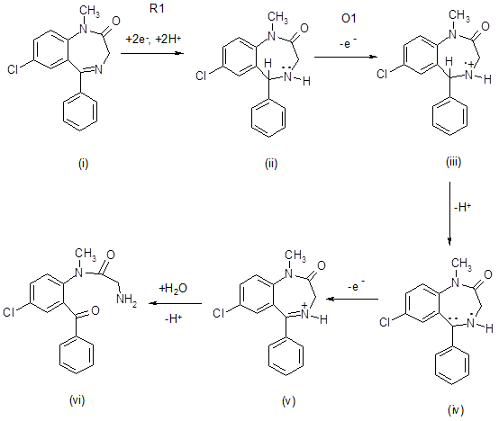
R1
O1
Scheme 1

Slide 6
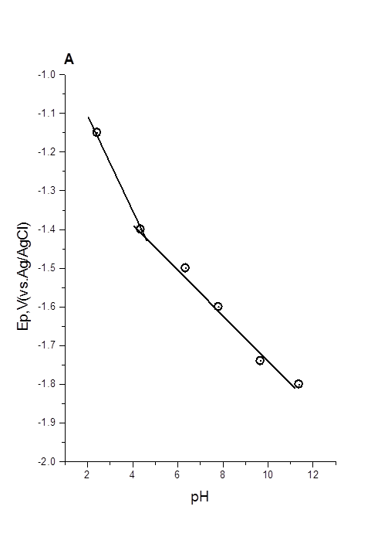
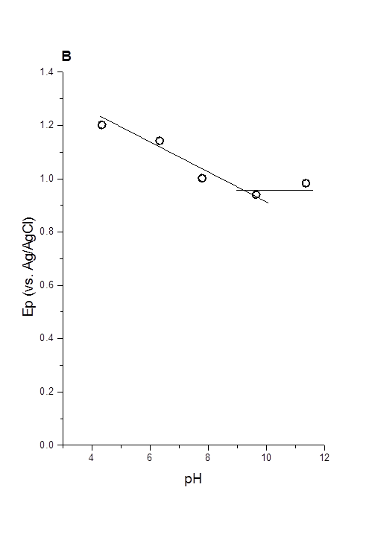
R1
O1
Figure 2. Fig. 3. Plot of Ep vs. pH for diazepam. (A) Peak R1, (B) peak O1. Voltammetric conditions as Figure 1A

Slide 7
Effect of Scan Rate
If diffusion controlled:
i_{p} α v^{½}
So slope (i_{p}/ v^{½} ) will be a constant.
A plot slope (i_{p}/ v^{½} ) vs. v^{½} will give a horizontal line.
However, adsorption this does not hold, and for reactant adsorption a positive slope is seen, as for O1.
Figure 4. Plot of current function vs. v^{½} for peak O1 in pH 6 phosphate buffer.

Slide 8
Adsorptive Stripping Voltammetry
Optimisation of accumulation potential
Figure 5. Effect of accumulation potential on the adsorptive stripping voltammetric response of a 80 μM diazepam. Accumulation time = 60 s.

Slide 9
Effect of accumulation time
Figure 6. Effect of accumulation time on the adsorptive stripping voltammetric response of 80 μM diazepam. Accumulation potential = -2.0 V.

Slide 10


Analytical Application
I,A
Sample
Optimised electrolyte
E,V
Medium Exchange Technique

Slide 11
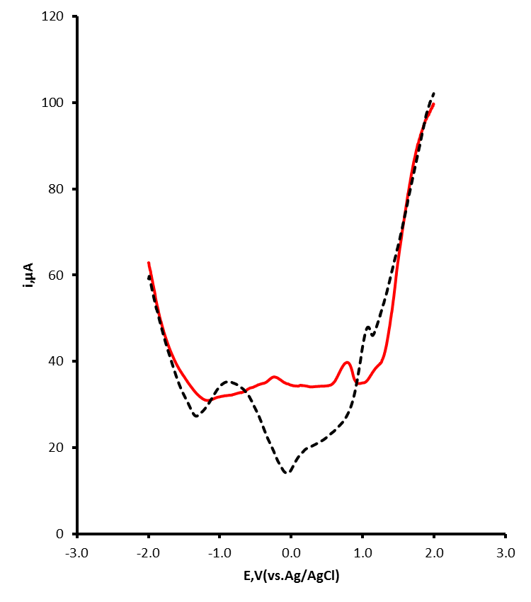
With and without medium exchange
The limit of detection, based on a signal to noise ratio of 3:1, was 1.8 μg/mL with a linear response up to 285 μg/mL (R² = 0.9969) was achieved using a 120 s accumulation time.
diazepam
Figure 8. AdSV determination of diazepam in vodka cherry alcoholic beverage. Red line with medium exchange, black dotted line without medium exchange.

Slide 12
Conclusions
Two well-defined voltammetric signals at our SPCEs via cyclic voltammetry.
On the initial going scan a single reduction peak resulting from the 2e⁻, 2H⁺ reduction of the 4,5-azomethine bond to a secondary amine
on the subsequent positive going scan a previously unreported adsorption controlled oxidation signal was found and the voltammetric redox mechanism underlying this was investigated.
This was postulated to result from the oxidation, of the secondary amine (which is formed on the negative going scan) via a 2e⁻, 2H⁺ oxidation process.
A simple and convenient assay for diazepam was developed, based on adsorptive stripping voltammetry.

Slide 13
Acknowledgements
HEFCE and the University of the West of England for funding.
They are grateful to Gwent Electronic Materials Ltd for supplying the screen-printed sensors.
University of the West of England Student Union for the gift of several beverage samples.

Slide 14
R1
O1
Figure 3. Plot of ip vs. pH for peaks R1 and O1. Voltammetric conditions as Figure 1A

Slide 15
Effect of temperature
Figure 7. Effect of temperature on the adsorptive stripping voltammetric response of 80 μM diazepam.

Slide 16
Novel adsorptive stripping voltammetry (AdSV)of diazepam at a screen printed carbon electrode.
The underlying electrochemical mechanism is suggested.
Forensically relevant concentrations of diazepam are reported (7.1–285 μg/mL, %CV = 12%).
Medium exchange was found to greatly improve both the sensitivity and selectivity of the assay.
Unlike other reported methods our approach requires only simple sample dilution prior to AdSV.

