Slide 1
Drawing in Healthcare
Dr Nicola Holt
7/12/2021

Slide 2
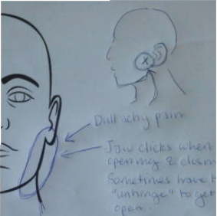
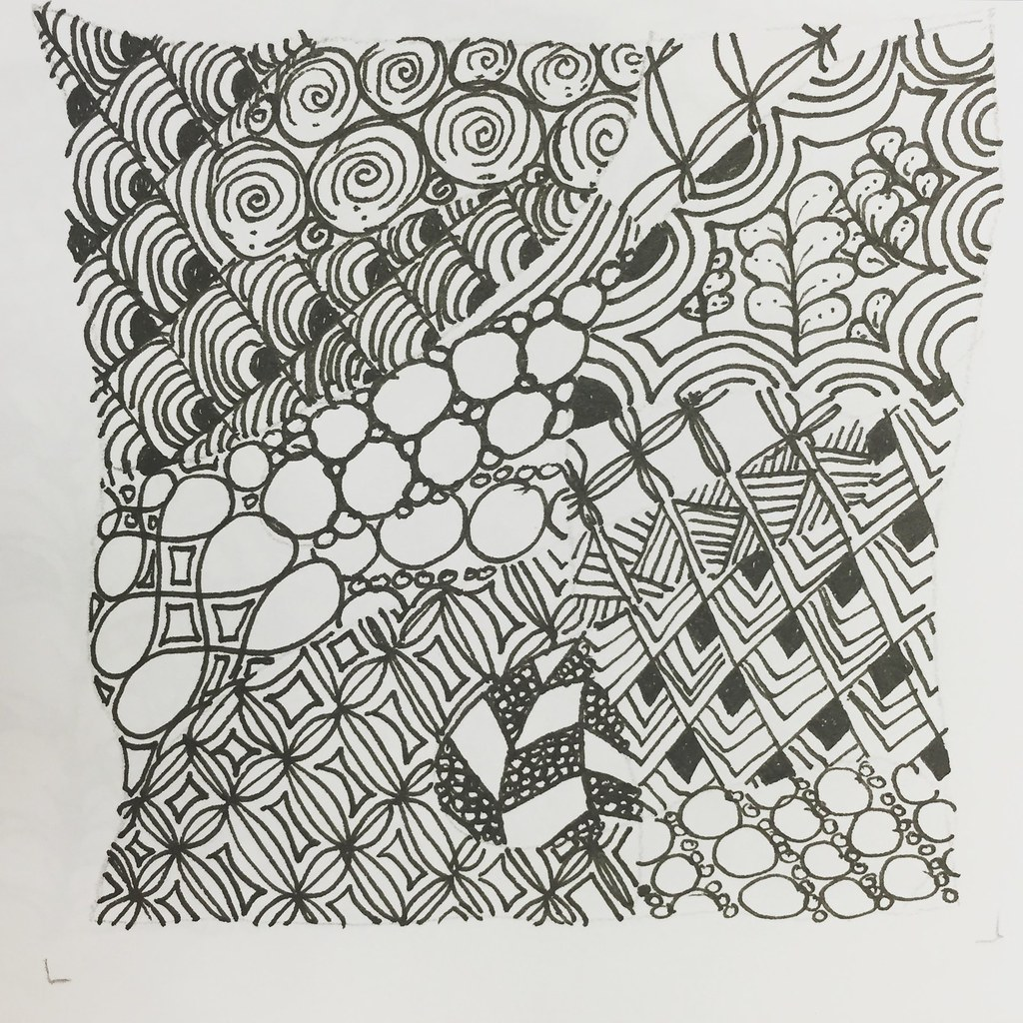
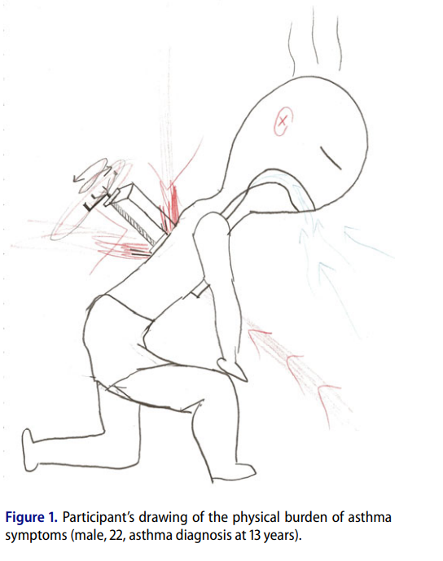
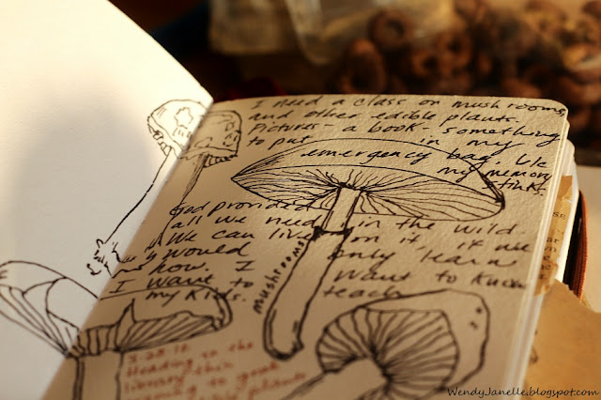
Drawing in healthcare
Informational tool (e.g., drawing location of pain)
Expressive tool (e.g., communicating nature of experience)
Wellbeing tool (doodling and observational drawing to reduce stress and anxiety)
This Photo by Unknown Author is licensed under CC BY
This Photo by Unknown Author is licensed under CC BY-SA-NC
Notes:
Drawing can be used in numerous ways in healthcare, as a communicative tool by practitioners and patients, as an observational and reportage tool, and also as a tool to help reduce stress and improve wellbeing, for both staff and patients.
Today, I will focus on the latter, reporting on the use of drawing in healthcare settings as a wellbeing tool, and on experimental research exploring how and why drawing works to reduce stress and anxiety and improve attentional focus.
Different drawing for wellbeing interventions have been developed that focus on drawing for mindfulness (e.g. drawing shapes in nature objects, focusing attention on forms and shapes in nature), free-form drawing or doodling, or structured abstract mark making or doodling activities (e.g. Zentangling).
Middle image from: Cheung, M. M. Y., Saini, B., & Smith, L. (2018). Drawing asthma: an exploration of patients' perceptions and experiences. Journal of Asthma, 55(3), 284-293.
Top image from: Jang, A., MacLean, D. L., & Heer, J. (2014, April). BodyDiagrams: improving communication of pain symptoms through drawing. In Proceedings of the SIGCHI Conference on Human Factors in Computing Systems (pp. 1153-1162).

Slide 3
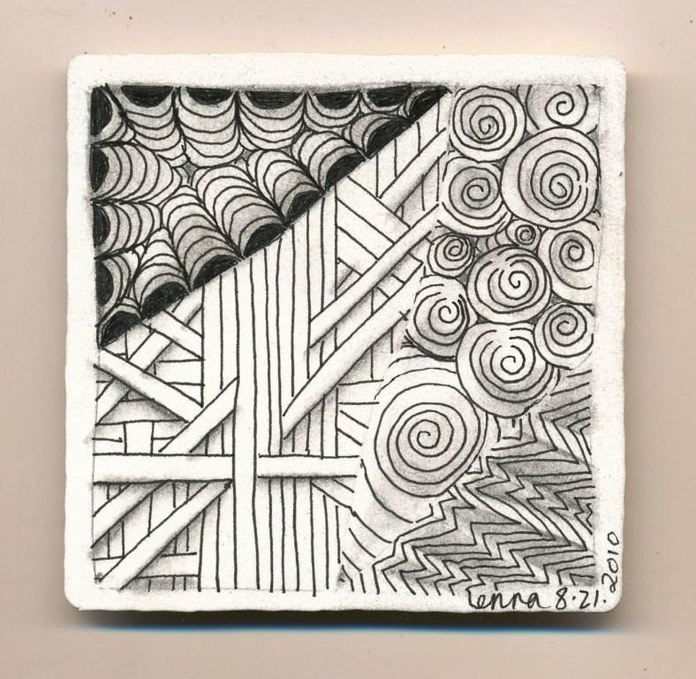
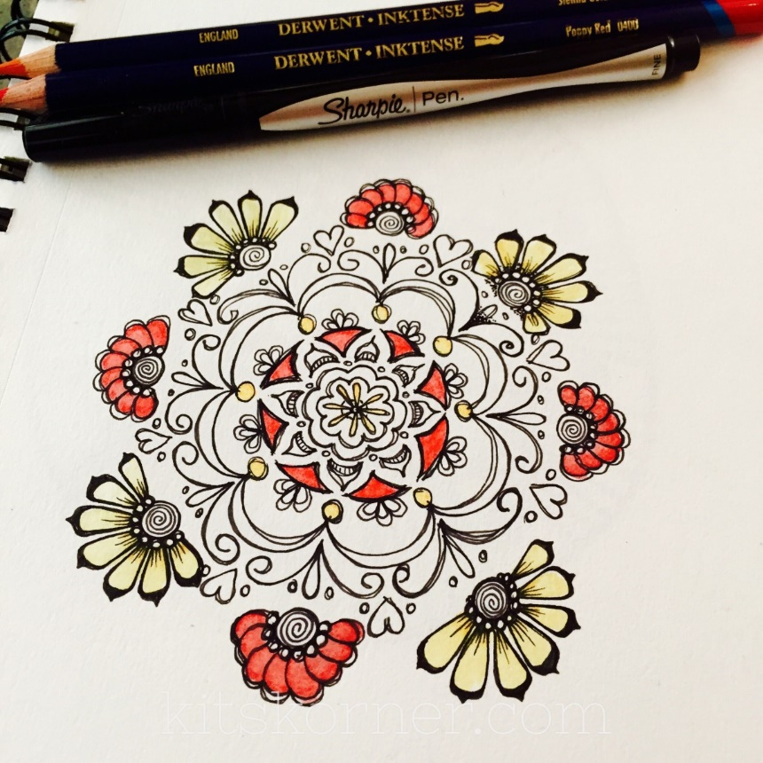
Drawing as a stress reduction intervention in healthcare settings
Increased use of art and drawing for wellbeing interventions to help reduce stress and anxiety of staff and patients in medical settings
Drawing and colouring reduced anxiety of adults in emergency department and pediatric surgery waiting rooms (Rajendran et al., 2020; Robinson et al., 2018).
Nurses who coloured in their break had lower levels of anxiety at the end of the break than nurses who did not (Maguire et al., 2020)
A Zentangling intervention (structured doodling) for healthcare workers (6 months) improved workplace stress management and self efficacy
This Photo by Unknown Author is licensed under CC BY-NC-ND
This Photo by Unknown Author is licensed under CC BY-SA
Notes:
Although there are anecdotal reports of colouring being used as wellbeing activities on hospital wards (e.g., Rigby & Taubert, 2016), there is little research on the benefits of colouring in medical settings. However, three recent studies have examined its efficacy with patients, their relatives, and nurses. Robinson et al. (2018) examined whether colouring reduced the anxiety of parents in a pediatric surgery waiting room. Parent anxiety is high in this context and interventions to reduce parental anxiety have been recommended since it has been reported to predict post-operative outcomes for the child (e.g., pain) (Fortier, Del, Martin & Kain, 2010). Each day block randomization allocated parents to a typical 30-minute wait condition or colouring condition (choosing a preferred colouring design). Parents who coloured while waiting had significantly lower levels of self-reported anxiety after waiting than those who did not, although the impact of this on children’s postoperative wellbeing was not assessed. Similarly, Rajendran et al. (2020) examined whether colouring could reduce anxiety in emergency department waiting rooms, in which anxiety can be high due to long waiting times and overcrowding. Participants were screened if they were ‘flagged’ as being anxious by medical staff (it is not clear how this flagging worked) and were invited to participate in the study if they were subsequently found to have moderate to high scores on the Hospital Anxiety and Depression Scale (HADS). Participants were randomly allocated to either a ‘colouring pack condition’ consisting of various designs and 36 colored pencils or a ‘placebo pack’ consisting of plain paper and a pen, with instructions to ‘draw or write freely’ (there were no instructions for the colouring pack). Participants were left with the packs for two hours, after which they completed the HADS again. Only those in the colouring group had significantly lower levels of anxiety at the end of this time frame. Further research has suggested that hospital staff might benefit from colouring too. Due to high levels of anxiety reported amongst nurses, especially those on medical-surgical or intensive care units, Maguire et al. (2020) examined the efficacy of colouring mandalas to reduce anxiety amongst medical-surgery nursing staff, who either coloured in their break or carried out their usual activities in their break. Again, those who coloured mandalas had significantly lower levels of anxiety at the end of their break than those who did not. Collectively, these studies suggest that colouring is a low-cost and low-risk activity that could be profitably used in hospital waiting areas and staff rooms to reduce anxiety. However, there may be self-selection processes at work in this research, and not all people in these settings might benefit from colouring. For example, half of invited participants in Rajendran et al. (2020)’s emergency department waiting room declined to participate in the study, offering various explanations for not wishing to colour, such as considering it to be an activity for children or being in too much discomfort.
Did the packs include instructions for use?
No instructions are described for the colouring pack. But the control “ instructed to draw or write freely”.
Do we know why?
The authors state, in relation to those not wishing to colour: “Various reasons were cited by patients; common anecdotes included “coloring is not for everyone,” “it's for children,” or “I am in too much discomfort to engage.” While the results of this study should prevent nonpharmacologic treatments for anxiety being trivialized by health care staff, showing evidence that alternative treatments can work may not overcome the barriers to engagement that we have observed.”
Maguire, P., Coughlan, A., Drayton, D., Lacko, H., Reich, J., & Hatfield, L. (2020). The effect of colouring mandalas on the anxiety of medical-surgical nurses and nursing support staff. Medsurg Nursing, 29(3), 192-199.
Robinson, E. M., Baker, R., & Hossain, M. M. (2018). Randomized trial evaluating the effectiveness of colouring on decreasing anxiety among parents in a pediatric surgical waiting area. Journal of Pediatric Nursing, 41, 80-83. Doi.org/10.1016/j.pedn.2018.02.001
Rajendran, N., Mitra, T. P., Shahrestani, S., & Coggins, A. (2020). Randomized controlled trial of adult therapeutic colouring for the management of significant anxiety in the emergency department. Academic Emergency Medicine, 27(2), 92-99. Doi.org/10.1111/acem.13838

Slide 4
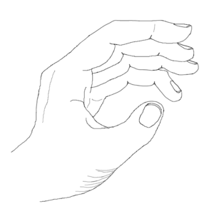
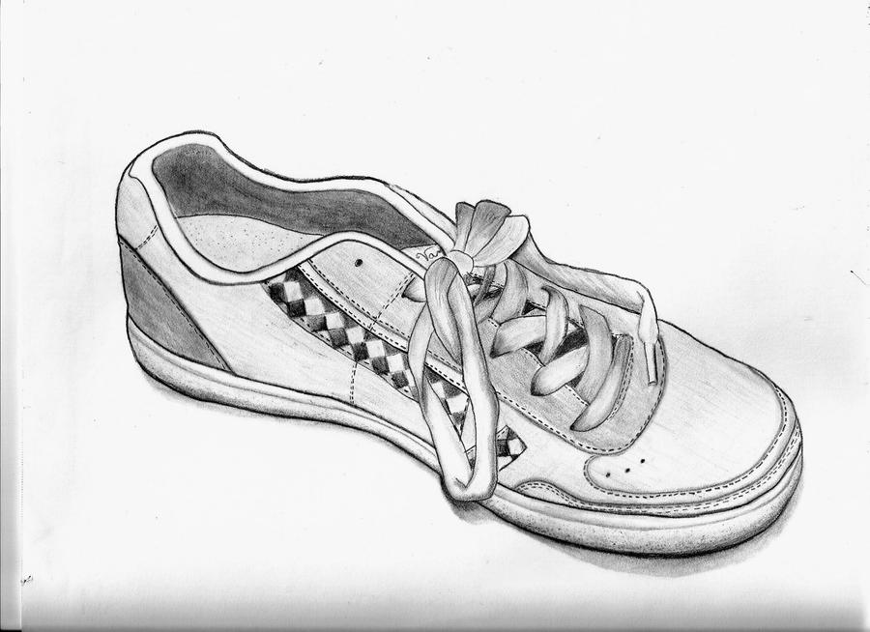
Drawing to repair mood
Drawing for 15-20 minutes repairs mood after a stressful event, heart rate decreased (Drake, 2019; Smolarski et al., 2015); more effective than completing puzzles (De Petrillo & Winner, 2005).
Drawing daily for 4 days (4 occasions)
Observational drawing (e.g. drawing one’s hands and shoes) improved mood more effectively than drawing to express one’s stressful experience (Drake et al., 2016). Life satisfaction improved over the 4 days for both drawing types.
Drawing over month (once a week)
Drawing to distract increased respiratory sinus arrhythmia (RSA) more after 1 month than a control condition (no drawing) (Drake, 2019)
RSA is a physiological marker of emotional regulation
Notes:
Drawing to express one’s feelings repairs mood less well than drawing to distract. What does this mean?
1) Research across one occasion of drawing –
2) Research across four occasions –
3) Research across one month
2) Drake, Hastedt and James (2016)
Mood induction. In order to induce a sad mood, we asked participants to “think about the saddest event you have ever experienced.” Participants recorded the event on a sheet of paper and then were guided through a 3-min visual imagery task (developed by Rusting & Nolen-Hoeksema, 1998). The visual imagery
task enabled participants to recall vividly the sad event by having them focus on the sights, sounds, thoughts, and feelings they had
experienced during the event.
Activity.
I want you to draw about the event you recalled. I want you to draw as a way to focus on, feel, and make sense of the experience you recalled. Use the drawing activity as a way to express your feelings.
I want you to look down at your shoes and draw them as you see them. I want you to draw as a way to focus, observe, and make sense of what
you see. Use the drawing activity as a way to help you look closely. On subsequent testing sessions (Day 2–4), participants in this condition were given the same instructions to using drawing “as a way to help you look closely” but they were asked to draw different objects (their hand on Day 2; an object in the testing room
on Day 3; and a different object in the testing room on Day 4).
Results
Positive affect increased following the mood induction (recalling a sad event) over time, and this change was greater for the drawing to distract condition. Those in the distract condition experienced a greater increase in positive affect after one session and four sessions of drawing than did those in the express condition.
Drawing after 4 days improved positive affect significantly more than did drawing after 1 day (as indicated by a positive contrast score). This difference was
driven by the distract condition. A one-sample t-test performed on those in the distract condition revealed that drawing after 4 days improved positive affect more than did drawing after 1 day. However, there was no difference in the effectiveness of drawing after 1 day and after 4 days for those in the express condition.
Drawing after 4 days improved negative affect significantly more than did drawing after 1 day (as indicated by a positive contrast score). Drawing after 4 days improved negative affect significantly more after 1 day for the distract, and marginally more after 1 day for the express conditions (ns).
life satisfaction increased after drawing for 4 days. There was no effect of condition,
We tested two competing hypotheses regarding the benefits of drawing over several sessions: (a) drawing to express may improve mood more than drawing to distract, presumably because it allows individuals to frame and rework their experience through images; or (b) drawing to distract may improve mood more than drawing to express, presumably because of the engaging aesthetic properties of the medium. We found that drawing to distract improved positive affect more after four drawing sessions that drawing to express. We found no difference in negative affect between conditions after four drawing sessions. This finding is inconsistent with the expressive writing literature.
he act of drawing pulls our attention toward the surface properties of color, line, texture, and so forth. We may therefore focus more on these aesthetic proper-
ties rather than on any underlying referential meaning. In short, we suggest that writing affords expression due to the referential nature of the symbol system of language, while drawing affords distraction due to the immediately engaging aesthetic properties of the medium. Future research should compare the emotion
regulation benefits of drawing and writing in the same study, using identical instructions, over several sessions. Additionally, future research should examine the psychophysiological benefits of drawing in both the short- and long-term
3) Drake (2019)
The study reported here examined the potential psychological and psychophysiological benefits of drawing once a week for 1 month. Participants were asked to recall and relive the saddest event they had ever experienced. They were then randomly assigned to an express or distract drawing condition or to a nondrawing control condition. Over 1 month, participants either drew their feelings about the saddest event they recalled (express) or drew neutral objects (distract). Those in the control condition did not engage in an activity and were given no instructions other than to return to the laboratory 1 month later for the final testing session.
Positive and negative affect was measured before and after the mood induction as well as after drawing on the first session and final session. Participants were asked to report on their overall life satisfaction after completion of the first testing session and after completion of the final testing session. Heart rate and RSA were measured during the first and final testing session.
Control (no activity), drawing to express and drawing to distract.
Instructions in the drawing to distract condition were as follows: “I want you to look down at your shoes and draw them as you see them. I want you to draw as a way to focus, observe, and make sense of what you see. Use the drawing activity as a way to help you look closely.” Participants in both drawing conditions
were given a set of colored pencils and sheet of white paper and were asked to draw for 10 min. Those in the control condition did not engage in any activity
Mood induction.
To induce a sad mood, the experimenter asked participants to “think about the saddest event you have ever experienced.” Participants recorded the event on a sheet of paper and then were guided through a 3-min visual imagery task (developed by Rusting & Nolen-Hoeksema, 1998). The visual imagery task asked participants to recall vividly the sad event by having them focus on the sights, sounds, thoughts, and feelings they had experienced during the event.
Conditions. Participants were randomly assigned to one of three conditions: express, distract, or a control condition,
After a single session
1) Those in the distract condition experienced a greater increase in positive affect after drawing than did those in the express condition,
2) Those in the distract condition experienced a greater decrease in negative affect after drawing than did those in the express condition,
3) Heart rate decreased after drawing. There was no effect of condition. Thus, both drawing conditions resulted in decreases in heart rate from during
the mood induction to after drawing.
4) Respiratory sinus arrhythmia. There was an effect of time, RSA increased after drawing. There was no effect of condition, and no interaction of time with condition,. Thus, both drawing conditions resulted in an increase in RSA from during the mood induction to after drawing.
Month
No significant change in PA, NA or life satisfaction over a month
Those in the distract condition experienced a greater
increase in RSA after 1 month than did those in the control
condition
Respiratory sinus arrhythmia (RSA) is accepted as a peripheral marker of cardiac-linked parasympathetic regulation. According to polyvagal theory, the RSA is also considered as the index of emotion regulation. The neurovisceral integration model posits that parasympathetic modulation of the heart marked by RSA is related to complex nervous regulation associated with emotional and cognitive processing. From this perspective, high resting RSA amplitude associated with a greater withdrawal during stressors and subsequent recovery could represent a flexible and adaptive physiological response system to a challenge. Conversely, low resting RSA accompanied by an inadequate reactivity to stress might reflect maladaptive regulatory mechanisms. The RSA reactivity is different with various types of stressors: while the RSA decreases to cognitive tasks indicating a vagal withdrawal, the RSA magnitude increases to emotional challenge indicating an effective cognitive processing of emotional stimuli. The RSA reactivity to stress could have important implications for several mental disorders, e.g. depressive or anxiety disorder. It seems that the study of the RSA, as a non-invasive index of 'brain-heart' communication, could provide important information on the pathway linked to mental and physical health.

Slide 5
Drawing to express versus distract (Drake, 2019)

Slide 6
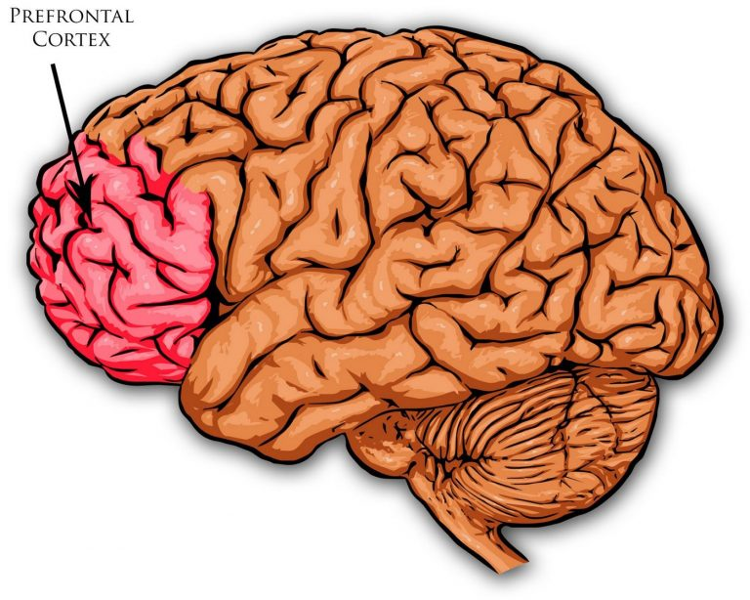
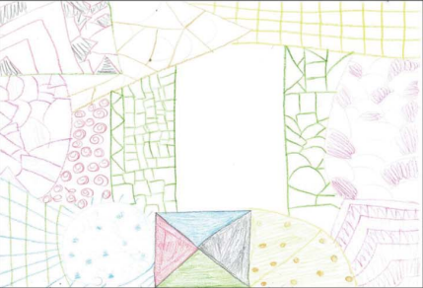
What’s happening when we draw for wellbeing?
Drawing abstract designs also repairs mood better than expressing negative affect (Forkosh & Drake, 2017)
Drake (2019) suggests that the mechanism is distraction (from worries) – attention absorbed in aesthetic experience, mindful observation or the flow state.
Brain imaging research while drawing following stress induction suggests a reduction in prefrontal cortex activity, associated with planning and cognitive control (Yan et al., 2021), and increased activity in the medial prefrontal cortex, indicative of inhibition of the stress response (Kaimal et al., 2017).
This Photo by Unknown Author is licensed under CC BY
Notes:
Yan et al (2021):
Additionally, when drawing regulated sadness, the frontopolar area and left dorsolateral prefrontal cortex showed significant deactivations. During 2–4 min, drawing resulted in minimal activation of the left dorsolateral prefrontal cortex. These brain activity changes during the drawing process demonstrate that drawing is effective in regulating negative emotions, especially sadness. These findings provide an empirical basis for drawing to improve negative emotion and also supplement the study of brain function in drawing.
This result illustrates that drawing is a process of eliminating cognitive control, which makes people more relaxed, divergent, and creative. However, drawing utilises a myriad of neurological processes that are not well understood, thus further research is needed to uncover the underlying neural mechanism(s).
Belkofer et al. (2014) used quantitative electroencephalography (qEEG) to conduct a pre- and post-survey, and found that after drawing, α waves in the posterior temporal lobe of all participants were significantly enhanced, which indicates that drawing might contribute to self-control and relaxation.
Kaimal et al. (2018) reported increased blood flow activity in the medial prefrontal cortex while drawing, compared with rest periods, an area that is associated with inhibitory control of the stress response (sympathetic nervous system, SNS) (Crozier et al., 2011).

Slide 7
Conclusions
Drawing can be a useful tool to help reduce stress and anxiety
Evidence from experiments with student populations and in medical settings
Much yet to learn:
What type of drawing works best (e.g. Zentangling, mindful nature drawing)?
Does it depend on level of drawing skill (do drawing tasks need to be scaffolded to enable interest and the flow state)?
What are the long term benefits?

Slide 8
References
Drake, J. E. (2019). Examining the psychological and psychophysiological benefits of drawing over one month. Psychology of Aesthetics, Creativity, and the Arts, 13(3), 338- 347.
Drake, J. E., Hastedt, I., & James, C. (2016). Drawing to distract: Examining the psychological benefits of drawing over time. Psychology of Aesthetics, Creativity, and the Arts, 10(3), 325-331.
Genuth, A., & Drake, J. E. (2021). The benefits of drawing to regulate sadness and anger: Distraction versus expression. Psychology of Aesthetics, Creativity, and the Arts, 15(1), 91–99. https://doi.org/10.1037/aca0000265
Smolarski, K., Leone, K., & Robbins, S. J. (2015). Reducing negative mood through drawing: Comparing venting, positive expression, and tracing. Art Therapy, 32(4), 197-201.
De Petrillo, L., & Winner, E. (2005). Does art improve mood? A test of a key assumption underlying art therapy. Art Therapy, 22(4), 205-212.
Forkosh, J., & Drake, J. E. (2017). Coloring versus drawing: Effects of cognitive demand on mood repair, flow, and enjoyment. Art Therapy, 34(2), 75-82.
Kaimal, G., Ayaz, H., Herres, J., Dieterich-Hartwell, R., Makwana, B., Kaiser, D. H., & Nasser, J. A. (2017). Functional near-infrared spectroscopy assessment of reward perception based on visual self-expression: Coloring, doodling, and free drawing. The Arts in Psychotherapy, 55, 85-92.
Notes:
Woolford, J., Patterson, T., Macleod, E., Hobbs, L., & Hayne, H. (2015). Drawing helps children to talk about their presenting problems during a mental health assessment. Clinical child psychology and psychiatry, 20(1), 68-83.
Cheung, M. M. Y., Saini, B., & Smith, L. (2020). Patients’ drawings of their asthma: adding qualitative specificity to a quantitative measure of illness perceptions. Journal of Asthma, 57(1), 95-104.
James, C., O'Connor, S., & Nagraj, S. (2017). Life drawing for medical students: Artistic, anatomical and wellbeing benefits. MedEdPublish, 6(2).
Drake, J. E., Hastedt, I., & James, C. (2016). Drawing to distract: Examining the psychological benefits of drawing over time. Psychology of Aesthetics, Creativity, and the Arts, 10(3), 325–331. https://doi.org/10.1037/aca0000064

Slide 9
References
Maguire, P., Coughlan, A., Drayton, D., Lacko, H., Reich, J., & Hatfield, L. (2020). The effect of colouring mandalas on the anxiety of medical-surgical nurses and nursing support staff. Medsurg Nursing, 29(3), 192-199.
Robinson, E. M., Baker, R., & Hossain, M. M. (2018). Randomized trial evaluating the effectiveness of colouring on decreasing anxiety among parents in a pediatric surgical waiting area. Journal of Pediatric Nursing, 41, 80-83. Doi.org/10.1016/j.pedn.2018.02.001
Rajendran, N., Mitra, T. P., Shahrestani, S., & Coggins, A. (2020). Randomized controlled trial of adult therapeutic colouring for the management of significant anxiety in the emergency department. Academic Emergency Medicine, 27(2), 92-99. Doi.org/10.1111/acem.13838
Hsu, M. F., Wang, C., Tzou, S. J., Pan, T. C., & Tang, P. L. (2021). Effects of Zentangle art workplace health promotion activities on rural healthcare workers. Public Health, 196, 217-222.
Yan, W., Zhang, M., & Liu, Y. (2021). Regulatory effect of drawing on negative emotion: A functional near-infrared spectroscopy study. The Arts in Psychotherapy, 74, 101780.

