Slide 1


Slide 2
What? So What? What Next?
#SoMe CPD for the
Advancing Practice Radiographer
Janice
St. John-Matthews
AHP Associate
Head of Department
(CPD & Workforce Learning)
@jstjohnmatthews
Wordpress: Jstjohnmatthews
07.06.2016

Slide 3
Outline
Professional use of #SoMe biography
CPD philosophy
Change of title.
Getting starting
Moving to on-line communities
Staying safe
Notes:
#SoMe biography
CPD philosophy
What is in a title?
Where do I start? Twitter- Beginners & Regulars

Slide 4
Context
  Biography
  My CPD Philosophy
  My #SoMe Philosophy
  ………does not have to be painful
  ………does not have to cost the earth
  ………should be inclusive
  ………should be continuous
  ………is the key to a patient focused pathway
Notes:
A practical person
A bias towards micro-blogging (TwitterTM) and blogging (other mediums available

Slide 5
A Change In Title Wording
  Terminology: Advanced/ Extended Practice
  “….Extended roles mean roles where registered professionals take on tasks not traditionally within their scope of practice which do not require Master’s degree level”
  “…..Advanced roles refer to roles where registered professionals take on tasks not traditionally within their scope of practice which requires Masters level training or above”
  Reshaping the workforce to deliver the care patients need
  Nuffield Trust, 2016

Slide 6
#SoMe Advantages for Advancing Practice Radiographers
The social interaction among people in which they create, share or exchange information and ideas in virtual communities and networks
Can learn alongside a wide mix of people- a service user; a support worker, other professionals, international colleagues- anyone who has an interest in subject being discussed.

Slide 7

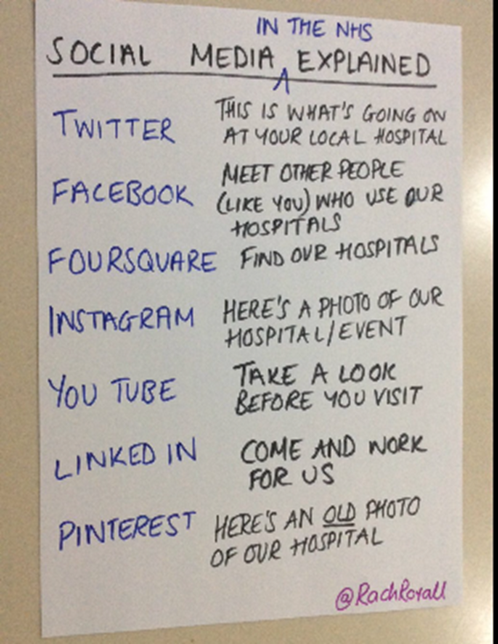
Where Do I Start Janice?

Slide 8
Beginners: Twitter Hashtags
#WeNurses
#WeAHPs
#PhysioTalk
#MedRadJClub
#TheACPRC
#Otalk
#Advancedrads*
#FOAMed
#FOAMrad
#LTWRAP*
#UKRC2016*; UKRO2016*
#AHPprescribing
#COAHP16*
#AdvancedPractice
Notes:
# is a way to refer to a topic of conversation. This enables participation in a larger linked discussion (eg, #radiotherapy, #radiography). A # is a tool that allows others to find tweets, based on topics.
By clicking on a #name it is possible to see all the tweets that mention it in real time – even from people you don't follow. This is particularly useful for conferences, study days or lectures where there is a specific # for the event (eg, the recent CoR Radiotherapy Conference was #RTConference14). Any event can be given a # and it allows those who do not attend the conference/event to see what the attendees are tweeting about and it also allows others to comment on the tweets and include other people (eg, @SCoRMembers).
These # can also refer to an idea (eg, #patient safety). # can also be seen on TV programmes where the # is seen on the screen (eg, BBC Question Time - @bbcquestiontime - #bbcqt).

Slide 9




Slide 10
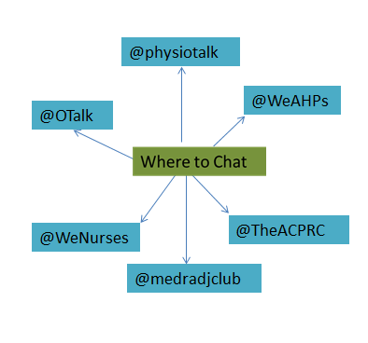
Regulars: TwitterTM Chats
Converting a Chat to CPD
Check the chat website
Be prepared
Get involved
Use the #EBP
Read the chat transcript
Write a personal summary
Reflect

Slide 11
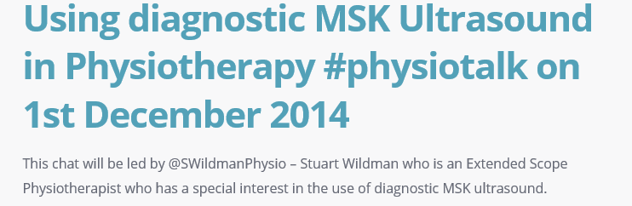

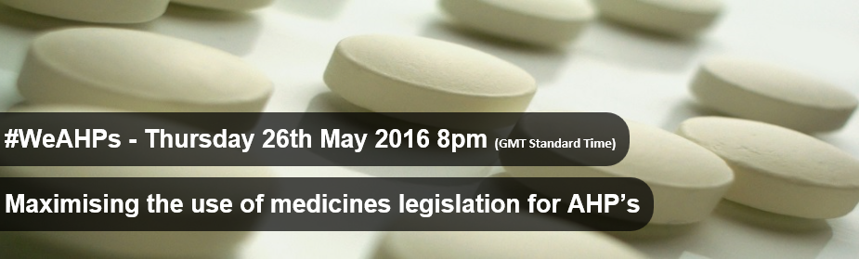
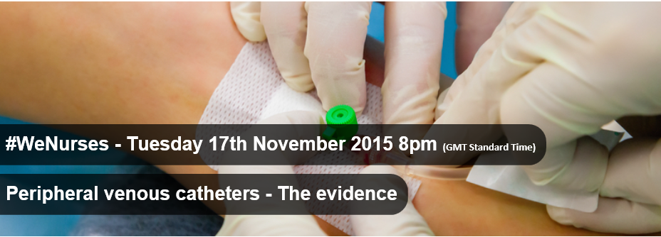
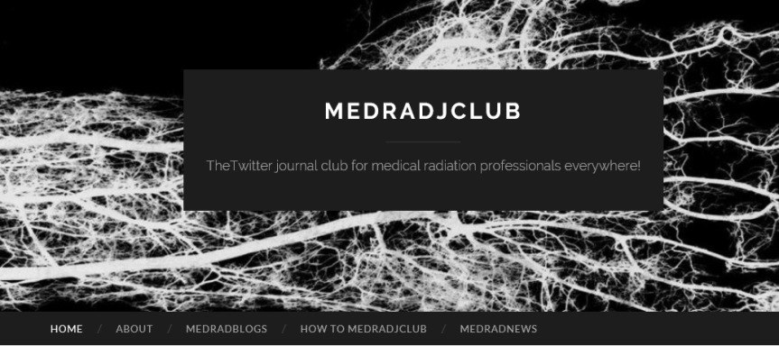
Case Studies
Notes:
Hosted by WeAHPs using #WeAHPs
This chat is guest hosted by @MarriottHelen
On Thursday 26 May at 8pm (GMT) #WeAHPs will be discussing how Allied Health Professionals (AHPs) can maximise the use of medicines legislation for the delivery of high quality, efficient care. The chat will be co-hosted by Helen Marriott @MarriottHelen
For many people accessing health and care services, AHPs are their lead clinician. Yet, they (AHPs) often do not have access to the appropriate prescribing or supply and administration of medicines mechanisms. In recent years, a wider range of AHPs have been allowed to prescribe or supply and administer medicines. Introducing these changes makes it easier for service users to get access to the medicines that they need in a timely manner so they gain maximum benefit.
Hosted by WeNurses using #WeNurses
This chat is guest hosted by @CochraneUK @SarahChapman30
Re-siting peripheral venous catheters: have you ditched the routine?
CochraneUK have recently released a new blogging series “Evidence for Everyday Nursing” #EEnursing, and one of their first articles in this series looks at a Cochrane review which found no evidence to support routinely re-siting peripheral venous catheters. A link to the blog can be found here - and is a must read before this #WeNurses discussion.

Slide 12
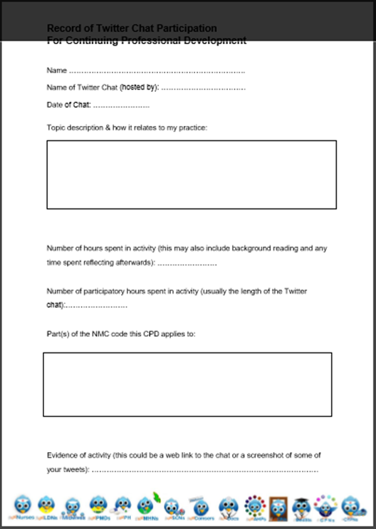

Recording

Slide 13
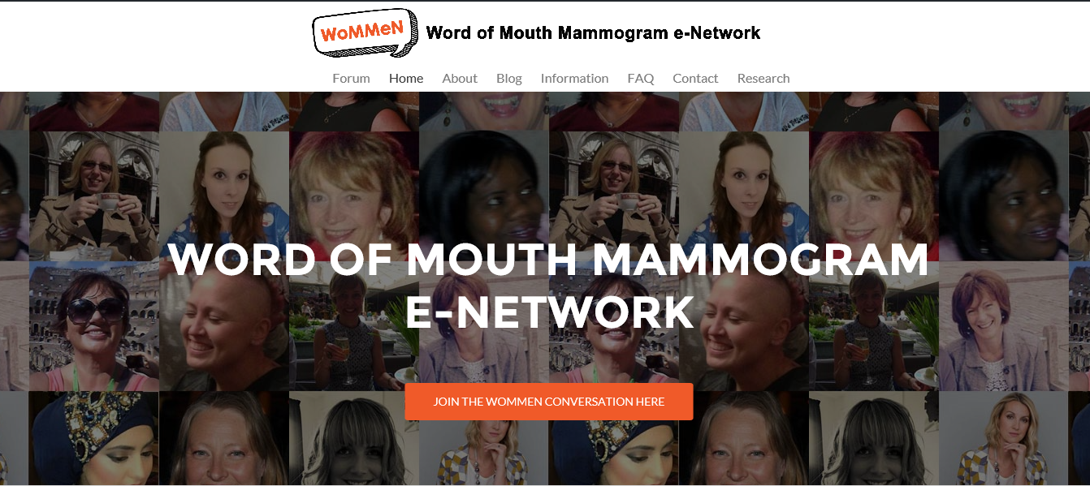
Learning Community Openness

Slide 14

Staying Safe
Health & Care Professions Council
Nursing & Midwifery Council
General Medical Council
Your Organisation
Notes:
Last year I had the opportunity to present on a twitter account linked to a module I teach. At the time there was no radiography specific document- I had to use my common sense and work to other professional guidelines. This was fine but our profession has other issues in this space mostly due to the visual nature of our work and associated patient confidentiality issues. In the last six months SCoR have created these guidelines.
There is a lesson to be learnt from creating these guidelines- mostly the value of taking our connections off-line and building human interactions. IA group of us who met in this space had an initial discussion at UKRC2015 about the lack of guidance. Lead by the inspiring @leslierobinson , a University of Salford senior lecturer, a group of like minded people came together to make those interactions more meaningful. Together an on-line group have been able to make a professional contribution.

Slide 15

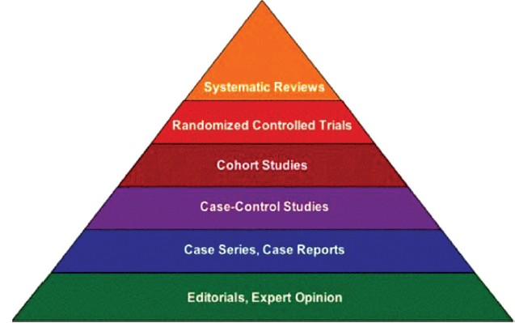
#AskForEvidence
Lawson, C. & Cowling, C. (2015) “Social media: The next frontier for professional development in radiography”, Radiography, 21, e74-80
Conclusion:
Professional development using social media includes higher education, collaboration and networking. Managed with consideration to the inherent risks, social media provides a new means of inclusive professional development.

Slide 16
Thank you.
Any Questions?

