Slide 1
Professionalizing assessment using ArcGIS Online
Michael Horswell, Harry West
University of the West of England, Bristol

Slide 2
Professionalizing

Slide 3
Practice oriented learning
opportunities to develop professional skills and dispositions, to explore ways of thinking about, and practicing, within discipline areas
opportunities to fully engage in the experiential learning cycle
planning and preparing for practice experiences
engaging in practice
reflecting, interpreting and making connections during and after practice
Technical University of Sydney (online)

Slide 4
Longitudinal curriculum
YEAR 3
create
YEAR 2
evaluate
analyse
YEAR 1
apply
understand
remember
YEAR 1: Learning by doing
Technical confidence, technical decisions, exposure to new technology, use and interpretation of data
Strong content alignment
Focussed achievable tasks
Contextualized discussion
YEAR 2: Learning by deciding
Technical confidence, project-related decisions, methodological considerations, explanation
Professionalization emphasis
Transferable skills: literacy, numeracy, graphicacy, self-confidence, responsiveness, academic rigour
Reflexivity
YEAR 3: Learning by independent endeavour
Project design, definition and implementation, reflective learning
Independent, creative work
Identifying development priorities
Theoretical extension
Industry standards
Professional self-awareness, reflexivity
Bloom’s Taxonomy of Learning: Revised Cognitive Domain (Anderson et al 2000)

Slide 5
Authentic assessment
Processes and products
Learning and instruction
Conditions
Curriculum and practice
Figurative context
Life beyond university
“complex of knowledge, skills and other attributes that are tied to the objectives of instruction or otherwise valued by society”
ArcGIS Online
Messick (1994) in Palm, T. (2008) Performance assessment and Authentic Assessment: A conceptual Analysis of the Literature. Practical Assessment, Research & Evaluation 13(4): 1-11
Notes:
Three perspectives:
Life beyond university: type of task, type of cognitive process, type of constraints
Curriculum and practice: assessment aligned with curriculum and teaching
Learning and instruction: emphasis on whether assessment is effective for learning
3 foci of authenticity:
Processes and products: are objects of assessment aligned with an acknowledged perspective (are cognitive processes being assessed that are likely to be useful outside of university, e.g. assessment by groupwork and presentation (Perspective1; Focus 1)
Conditions: do the conditions under which assessment takes place reflect the acknowledged perspective (e.g. have set of constraints for assessment been set that reflect a situation students are likely to encounter outside of University) e.g. introducing a budget (AGOL credits) for completing the task (Perspective 1, Focus 2)
Figurative context: Described context for the assessment (usually subject linked) tied to perspective, e.g. the ‘thematic conference’ assessment (Perspective 1; Focus 3)

Slide 6
Final year assessment
An opportunity for the integrated assessment of all three professional elements, technical, transferable, and dispositional
Student led:
Project design, definition and implementation
Independent, creative work
Technical enrichment:
Skills extension
Industry standards
Personal growth:
Professional self-awareness
Identifying development priorities
Reflexivity
ArcGIS Online

Slide 7
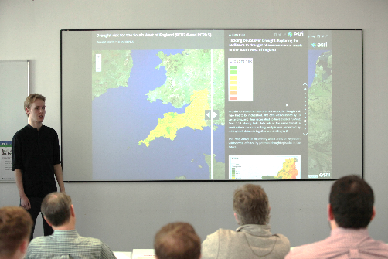
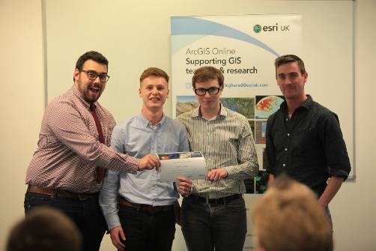
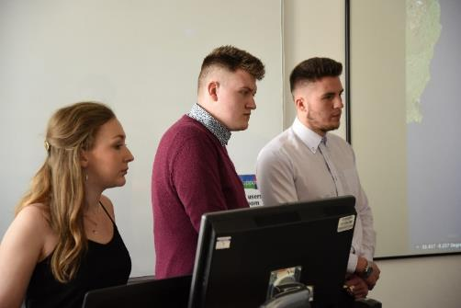
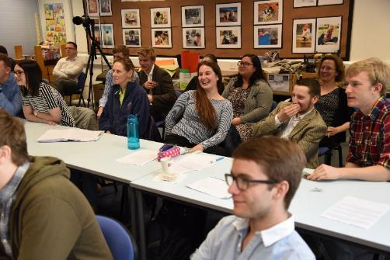
Undergraduate GIS conference

Slide 8
GIS Skills Development in ArcGIS Online Assessment
“Enhancing Ecosystem Services for Climate Change Amelioration”

Slide 9
Software Skills
ArcGIS Online provided a new platform for analysis and presentation
Integration of Desktop and Online tools
Web apps & scenes
Theoretical Knowledge
Projects require development of new knowledge through independent research
The GIS projects needed a solid theoretical and methodological foundation
Focusses selection of which data products to include in the StoryMap
Data Management
Planning the Story map focusses data management
Creation of metadata; tags and descriptions
Uploading and storing data using ArcGIS Online
Technical

Slide 10
Communication
Selecting how and when to present certain aspects – the map narrative
Selecting (combining) the best StoryMap templates considering the audience
Using interactivity to enhance user understanding
Graphicacy
Cartographic decisions influence emotive responses to information
Considerations of legibility for side panel graphics
Presenting focussed graphic information when needed by using pop-ups
Numeracy
Many methodological approaches included some degree of numeracy
Explaining complex ideas, such as Fuzzy Logic to an unknown audience requires good understanding yourself
Literacy
StoryMaps incorporate written communication
Choice over technical or layman language – considering the audience
Transferable

Slide 11
Problem Solving
New project, new requirements, new challenges
New software, new challenges
Optimising StoryMap options and overcoming restrictions
Confidence
GIS is about confidence not mastery
Having the confidence in your ability to try new software and features
Great results from using ArcGIS Online are confidence boosting
Enquiring Nature
Try new features and techniques, for example, web apps and interactive features
Platform allows extension beyond taught skills (easily?)
Go into ArcGIS Online with an open mind
Dispositional

Slide 12
Spatial Thinking
ArcGIS Online a new way to present spatial data
Trigger events?
Interactivity?
Map extents?
User experience
Analytical
Analytical narrative as important as technical process - reflexivity
Different ways to show the analytical process
Communicating complex ideas effectively
Lifelong Learning
GIS & lifelong learning
Professional self-awareness, reflexivity
The development of graduate attributes
Dispositional

Slide 13
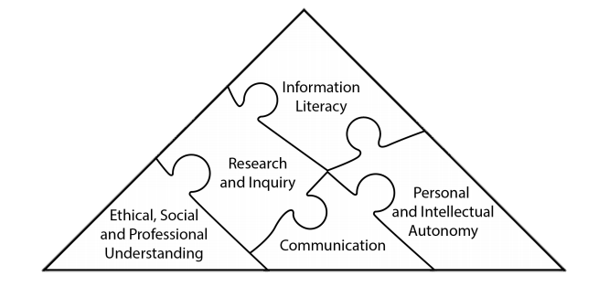
Scholarship
Lifelong Learning
Graduate attributes
Global Citizenship
Generic Graduate Attributes (Barrie, 2004)
Notes:
Barrie, S. (2004). A research-based approach to generic graduate attributes policy, Higher Education Research & Development, Vol. 23 (3), 261-275.

Slide 14
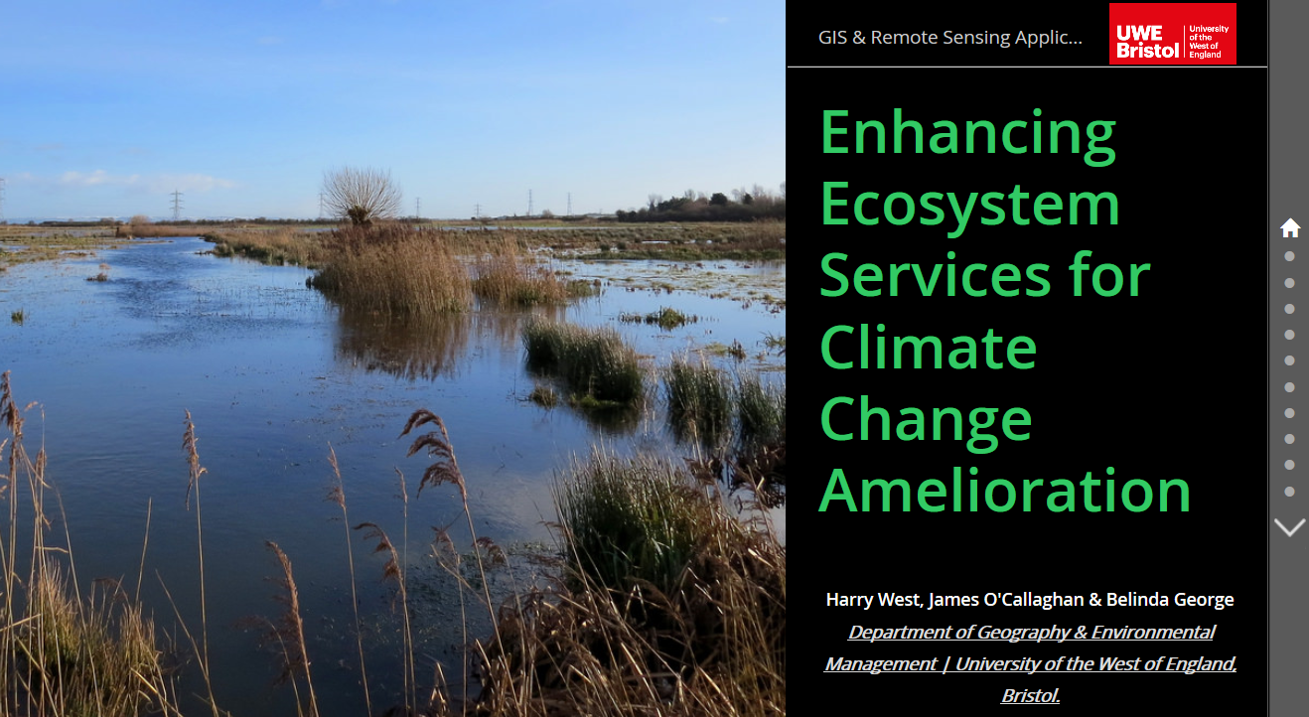
Thank-you

