Slide 1
Dementia and existential threat: negotiating the fear of a loss of control
Richard Cheston
Professor of Dementia Research
University of the West of England

Slide 2
Background
Dementia is a syndrome of progressive, global deterioration – most common forms are Alzheimer’s Disease, Vascular and Lewy-Body dementia
Arguably the major public health challenge of the 21st century - around 800,000 people living with dementia in UK and 50 million across the world – prevalence will double in 20 years
Incurable.
The diagnosis creates a profound existential challenge – can be associated with a reluctance to talk about, or even name the illness.

Slide 3
Assimilation of Problematic Experience of dementia
Increasing use of psychotherapy with people who are living with dementia
One aim is to help people living with dementia to find words to make sense of their experiences of dementia within the context of their neurological impairment
In assimilation terms:
  this may involve addressing a conflict between voices e.g. the part of self that values competence needs to enter into a dialogue with the part of self that recognises incompetence
  a transition from warding off the dementia to one in which the dementia is integrated into self
Successful outcome is one in which the person frames themselves as both changed yet still the same

Slide 4
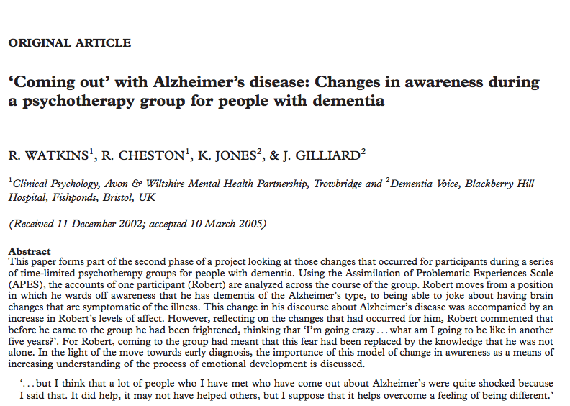

Slide 5
Research context
A short-term (ten week) psychotherapy group with people living with dementia – exploratory approach – aim was to talk about “what it’s like when your memory isn’t as good as it used to be”
Group made up of 9 participants (6 men, 3 women) all had a diagnosis of dementia within previous 2 years. Aged between 59 and 81.
Robert – 76 year old married man – a retired solicitor – at the start of the sessions he did not acknowledge that his memory problems were due to dementia

Slide 6
Data analysis
Five passages in which Robert referred to dementia
A consensus group of three clinical psychologists (one qualified and two trainees)
Given training in using Manual for Rating Assimilation in Psychotherapy (Honos-Webb, Surko, & Stiles, 1998) – included guided examples of ratings of therapy sessions.
Each extract was presented on audiotape and with detailed transcripts
Raters blinded to session order - initially rated separately, then as a group.

Slide 7
Week one (rating 0.1 “warding off”)
Janet: What about people’s names?
Robert: Generally I’m very good at it . . . err . . . I belong to PROBUS . . . there are two PROBUS clubs . . . and they are very good because everyone is in the same age bracket and half of them have got Alzheimer’s or something near so we’ve all worked out ways of reminding each other in the conversation. You don’t just stand up and say something; you lead into it so other people know what they are doing.

Slide 8
Week four (0.3 rating “warding off”)
Robert: . . you keep saying you have Alzheimer’s, has that been formally diagnosed, because it’s not the same thing as memory loss, you know?
Robert: Now there’s a premise here that I just don’t agree with. The way you’re talking, you sound as though you’ve accepted the fact that you’ve got Alzheimer’s. Now I don’t think anyone in this room has got Alzheimer’s.

Slide 9
Robert’s statement leads to discussion
Julie: I didn’t answer because I was ashamed really.
Janet: Well I’ve always come out with it, my family accept it . . .
Chris: I think shameful is perhaps the wrong word, it’s just that I wouldn’t want to publicise it
Walter: it’s unfortunate that you’ve got it.

Slide 10
Which leads Judith to say
Judith: I just wonder where it’s all going to end, that’s my fear ... Where it’s going to end, where am I going to end up, just before the end, you know … I’m worried about what comes just before [death] it could be years before, couldn’t it? I’m not frightened about that [dying], no
Facilitator: So what is frightening?
Judith: Being, being useless, you know …. Not having all my faculties, I dread that, I dread that, its as if I’m going to come to it one morning, perhaps, you know and think ‘oh my godfathers, what’s left?’

Slide 11
Week 5a (rating 2.0 “vague awareness”)
Robert: Now the problem with Alzheimer’s as it affects me is that I have no problems with retrieving the information in the long-term . . . but, I think I’ve said this before, it’s quite common for me to park a car in the car park and then I can’t remember where I’ve put the car . . . and that’s short-term memory.

Slide 12
Week 5b (rating 1.6 “unwanted thoughts”)
Robert: in these meetings we’ve had a certain … subtle suggestion … that if the intelligence goes down, the short-term memory goes down and if the short-term memory goes down, the intelligence goes down ... even the most intelligent set of people, who can still do a crossword puzzle etc can still have Alzheimer’s. It’s got nothing to do with intelligence, it’s short-term memory only ... I’ve found, that once I’ve made my mind up about that I don’t get depressed by it.

Slide 13
Week seven (rating 3.9 “problem clarification”)
Robert: Can I tell you something that’s happened to me in this last week. I’ve had a CT scan… I got the results back yesterday and it said that my brain had shrunk very, very slightly in the cavity, which is fairly symptomatic of the onset of Alzheimer’s … It’s still twice as big as everyone else’s [group laughs] so it’s quite alright.

Slide 14
Week nine –fear of loss of control marker
Robert: I’ve got a great deal of moral uplift by coming here. Meeting you, listening to the way you do it. And I don’t see the problem now, it frightened me, the problem of declining memory, until I came here, and now I’m not frightened.
Janet: You didn’t accept it then before?
Robert: Well I did accept it but it frightened me. Because I thought, well, I’m going mad, I’m going crazy. What am I going to be like in another five years? But now I realize that everybody is getting this problem.

Slide 15
Tracking Robert’s changing discourse
Movement from“half of them have got Alzheimer’s disease” to making a joke about his brain having shrunk which is “symptomatic” of AD
Pivotal event – week 4 when Robert
  Challenges the group
  Listens to others talk about shame and Judith talk of her fears of becoming useless, of losing control
Problematic experience – fear arising from belief that he is losing his intelligence/going mad?
Resolution – “once I’ve made my mind up about that [being forgetful doesn’t mean you’re stupid] I don’t get depressed by it”

Slide 16
Clinical significance
Importance of providing opportunities for people to meet others who are living with dementia, and have a safe space to discuss and make sense of their experiences
Acceptance of a diagnosis is, for some people, at least partly a psychosocial as well as a neurological achievement

Slide 17
I’d like to thank
Robert and the other participants and their families
The Mental Health Foundation
Elizabeth Bartlett, Andrea Hirons, Jo Cook Sarah Rogers and Deirdre Sutton-Smith

