Slide 1
Monitoring progress towards implementing sustainability and representing the UN Sustainable Development Goals (SDGs) in the curriculum at UWE Bristol
Presentation by
Georgina Gough (Senior Lecturer in Education for Sustainable Development)
and
Jim Longhurst (Assistant Vice Chancellor – Environment and Sustainability)
7 March 2017
Notes:
This paper will discuss the method used to identify the baseline position, consider how this knowledge will inform the development of a process to track the ongoing contribution and consider how this might inform both curriculum development and research activities within the institution.

Slide 2
Session overview
What are we trying to do?
How are we going about it?
How are we measuring how we are doing?
What has the impact been?
Recurring theme: Formal and informal

Slide 3

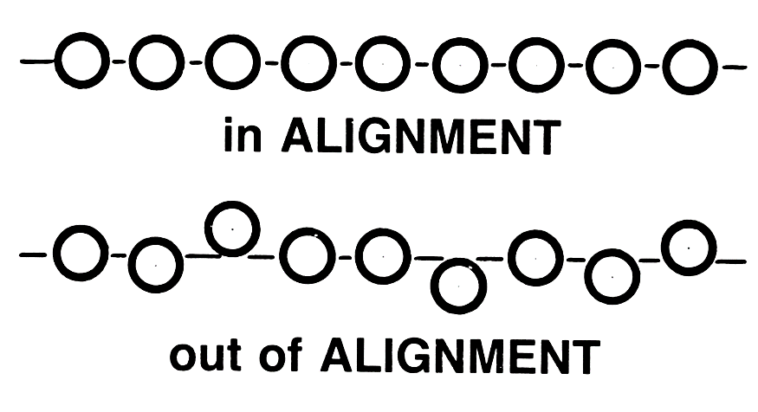
What could an HEI contribute towards achieving the SDGs?
Estate management
Operations
Education
Research and knowledge creation
Influencing others
Institutional alignment?
Purpose for being?
Notes:
UWE, Bristol welcomes the clarity and universality of the SDGs and recognises the urgency attached to their implementation.
Education is key to many of the goals and their subordinate targets. In reflecting on how it contributes to the achievement of the SDGs the university has examined its portfolio of programmes of study, its public and community engagements and its research activities. In so doing it has created a baseline assessment of the contribution of its arts, creative industries, education, health, science, business, law, environment and technology disciplines to meeting the SDGs.

Slide 4
How have we begun to assess UWE’s contribution to achieving the SDGs?
Map the value chain to identify impact areas
Select indicators and collect data
Define priorities
Define scope of goals and select KPIs
Define baseline and select goal type
Set level of ambition
Announce commitment to SDGs
Anchoring sustainability goals within the business
Embed sustainability across all functions
Engage in partnerships
Effective reporting and communication
Communicating on SDG performance
Defining priorities
Setting goals
Integrating
Reporting and communicating
Strategy 2020
Sustainability Plan
ISO 14001
ISO 14001
Risk register
Sustainability Plan
Strategy 2020
Own goal setting
Internal and external presentations
Roles and responsibilities
Terms of reference and reporting templates
Graduate attributes
Working with others
Internal and external reporting
Standards
Sharing and listening
Notes:
Core purpose of each Faculty
Alignment between SDGs and our Sustainablity Plan themes
Curriculum mapping against the SDGs

Slide 5
Sustainability in the curriculum: The ambition
100% of UWE UG and PG students exposed to ESD in their degree

Slide 6
Sustainability in the curriculum: Identifying a baseline
Scope: Relevant content in module and programme specs
Key terms and themes search
Manual process
Result: 71% of students exposed to ideas of sustainable development in their programme of study

Slide 7
Making progress
Commitment
Staff resource
Engagement
Partnerships
Students
Networks
Resources
Staff development
QMEF
Reporting
Celebrating

Slide 8
Monitoring progress
Annual meetings
Monthly meetings with internal KE group
Ad hoc meetings
Annual reporting (Jim to explain more shortly)
Surveys
Observation

Slide 9
Evidence of progress
What are we asking?
What are we measuring?
What are we looking for?
What are others looking for?
Explicit engagement with/ awareness of SDGs

Slide 10
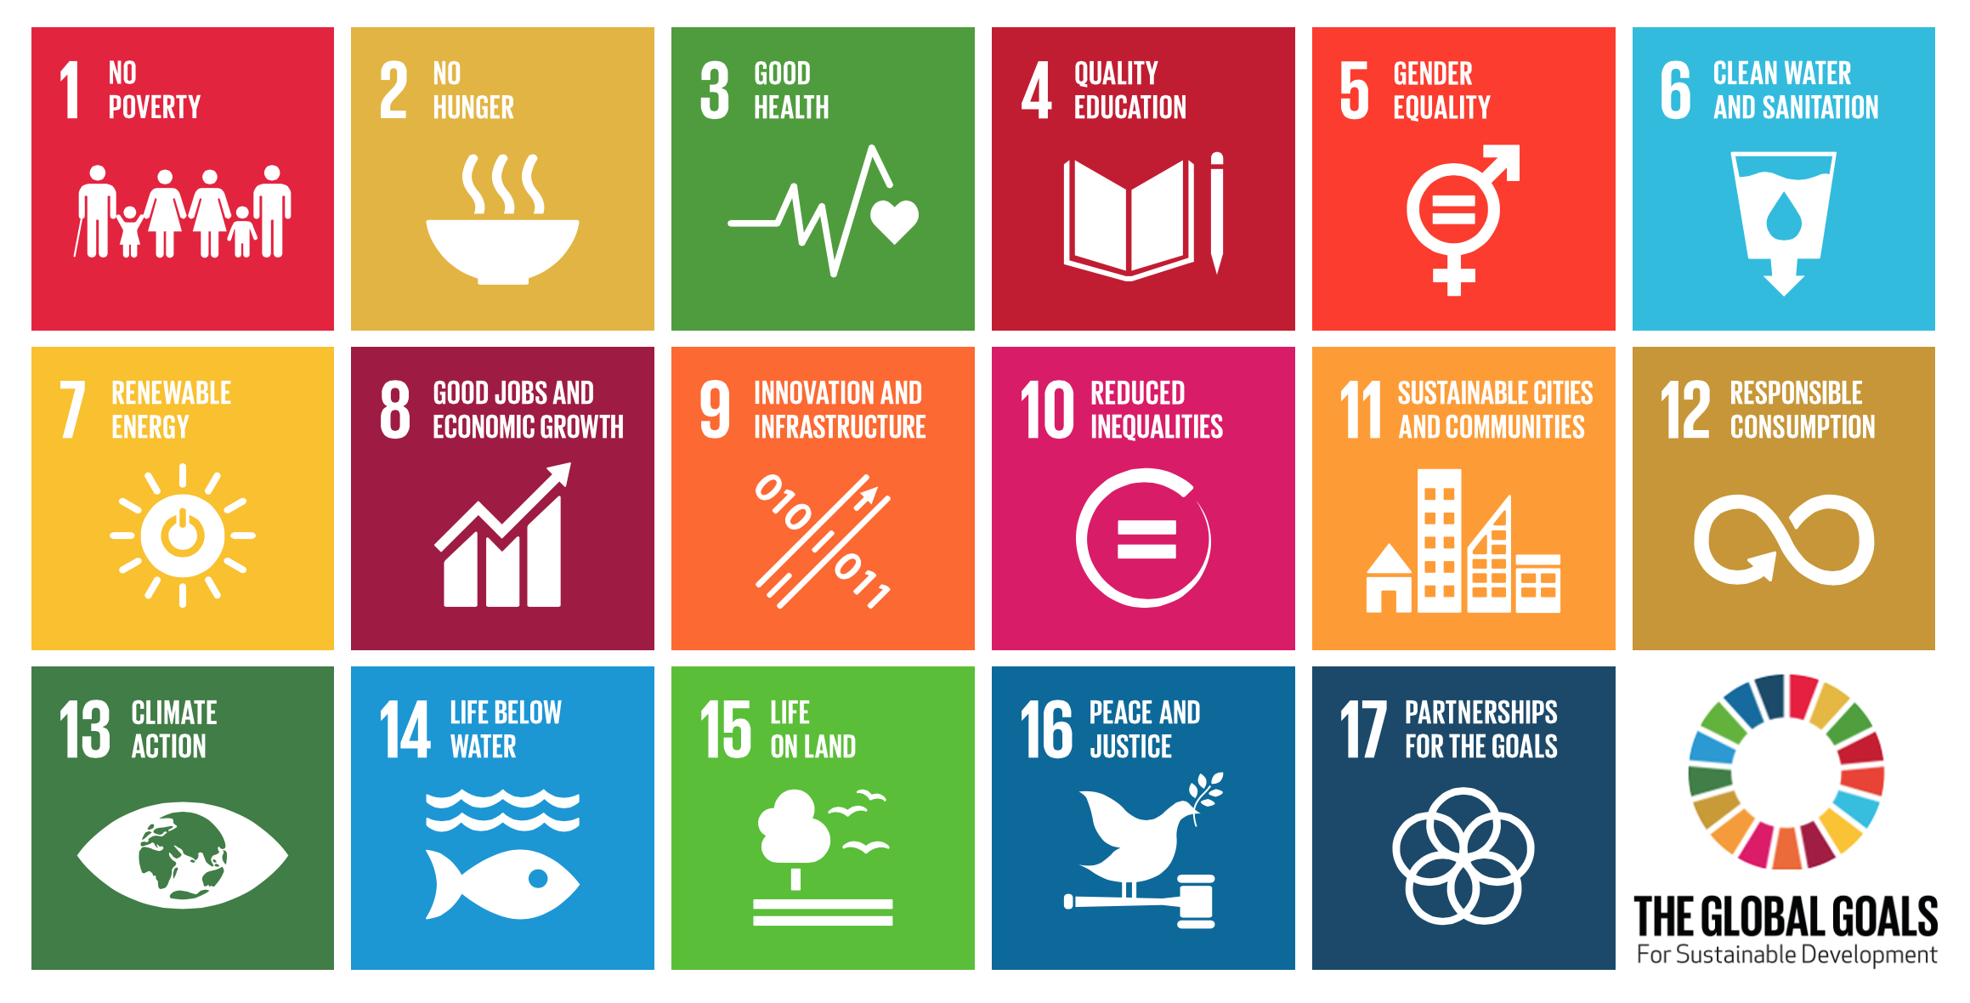
SDGs mapping:
Outcomes and outputs

Slide 11
SDGs mapping: Process
No quick wins!
Creation of template
Develop examples
Allow for local adaptation
Engagement of staff
Personal approach

Slide 12
SDGs mapping: Prompt questions
Where/how do constituent modules offer students the opportunity to learn about issues aligned to sustainable development (SDGs and their associated targets)?
Is consideration given to the ways in which these issues are relevant to the discipline and its associated professions?
How might professional practice be influenced/ affected by measures introduced to mitigate against issues such as inequality and climate change?
Notes:
Where and how do the constituent modules offer students the opportunity to learn about issues aligned to sustainable development (see UN Sustainable Development Goals and their associated targets: https://sustainabledevelopment.un.org/?menu=1300 )?
• Is consideration given to the ways in which these issues are relevant to the discipline and its associated professions?
• What opportunities are there for graduates of the programme to contribute towards sustainable development?
• How might professional practice be influence/affected by measures introduced to mitigate against issues such as inequality and climate change?
• How are students prepared for becoming future-facing and globally responsible during the course of the programme?
• Further, how are approaches to teaching and learning which align to ESD incorporated into the programme (again, see QAA-HEA ESD Guidance: http://www.qaa.ac.uk/en/Publications/Documents/ESD-guidance-consultation.pdf)?
You are likely to already have relevant ideas contained within the programme spec. In which case, these can be highlighted as being relevant to/aligned with the principles of ESD. With regard to further points, the answer to some may be that the programme does not offer such opportunities. The key thing is that some reflection has been undertaken to build in discipline-relevant ESD to enable students to contribute positively to the world, to be globally aware and responsible and future-facing (as per graduate attributes/Strategy 2020).
Where gaps in what is/can be offered within the programme have been identified, opportunities for students outside the programme may be highlighted (both within UWE, including via open seminars/presentations/events, via the SU and via other learning resources).

Slide 13
SDGs mapping: Prompt questions
How are students prepared for becoming future-facing and globally responsible during the course of the programme?
How are approaches to teaching and learning which align to ESD incorporated into the programme (QAA-HEA ESD Guidance)?
Formal and informal curriculum: The whole student experience

Slide 14
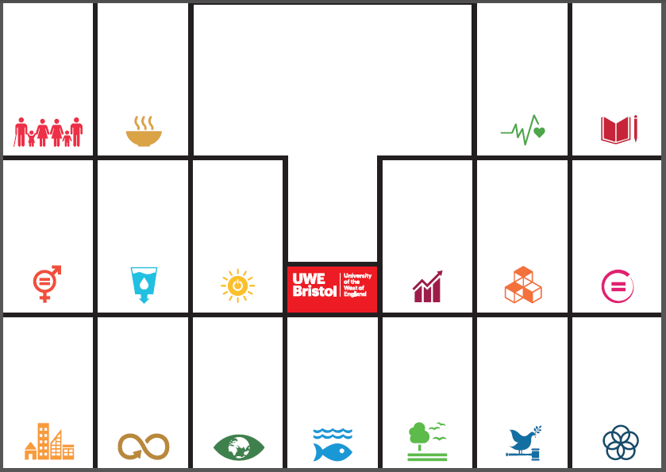

Slide 15
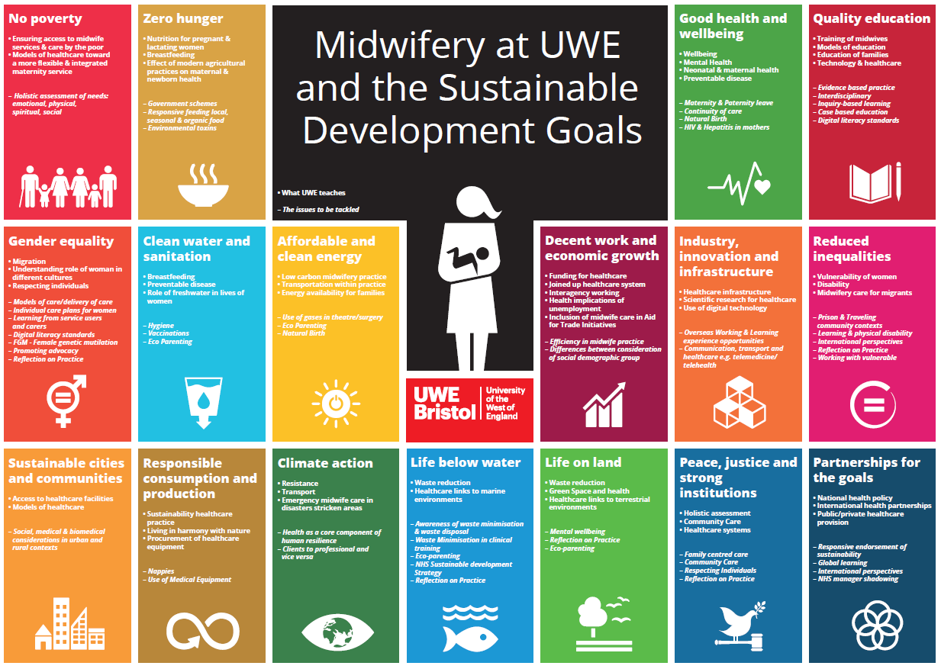
SDGs and UWE programmes/disciplines

Slide 16
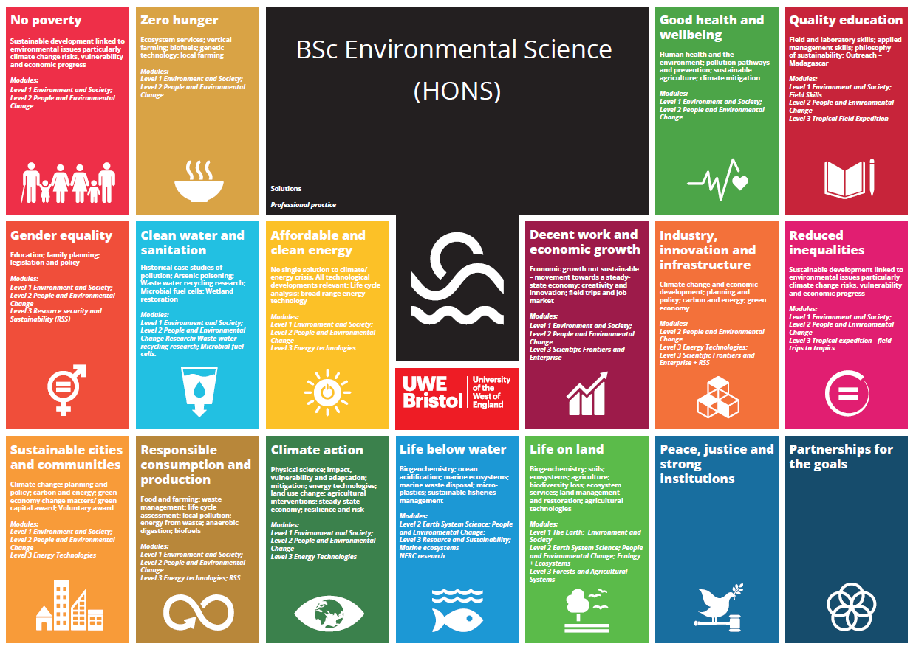

Slide 17
SDGs mapping: Outcomes
Exciting times!
Enthusiastic staff
Curriculum development
Distributed responsibility
New ambitions related to outcomes

Slide 18
New ambitions
Skills and experiences
Practice-based learning
Graduate attributes
Explicit in documentation
Student knowledge and attitudes
Alignment across institution

Slide 19

What next?
Notes:
SDGs Roadshow
Curriculum documentation
Graduate attributes

