Slide 1

Enacting Dialog through an Architecture Model
UWE Design Research Symposium
Elena Marco
Head of Department Architecture and the Built Environment
Notes:
Title page

Slide 2
the basics
The UK is inhabited at 257 people/km², and is one of the most densely populated
On average each person in the UK has 44m² of usable floor area
The UK has the 5th smallest homes in Europe, averaging 87m²
It has the joint highest number of rooms per m² -4.7
And the third smallest average room sizes- 18.5m²
Source: Williams, 2009
Notes:
CONTEXT/OUR INITIAL THOUGHTS
Parker Morris standards, RIBA research

Slide 3
so YES new dwellings are getting smaller
Source: Housing Statistics in the EU, 2005/6 (MIIR,2007)
Notes:
CONTEXT/OUR INITIAL THOUGHTS
Parker Morris standards, RIBA research

Slide 4
but………
UK has a low number of people per dwelling - 2.3
7% of households in the UK >4 people - half of the figure 30 years ago
1 person households rose from 18% to 29% over 30 years
By 2016 there will be almost 70% more single person households, nearly half of which will contain pensioners
By 2070 the UK is expected to be a ‘super-aged’ population.
Source: Williams, 2009
Notes:
CONTEXT/OUR INITIAL THOUGHTS
Parker Morris standards, RIBA research

Slide 5
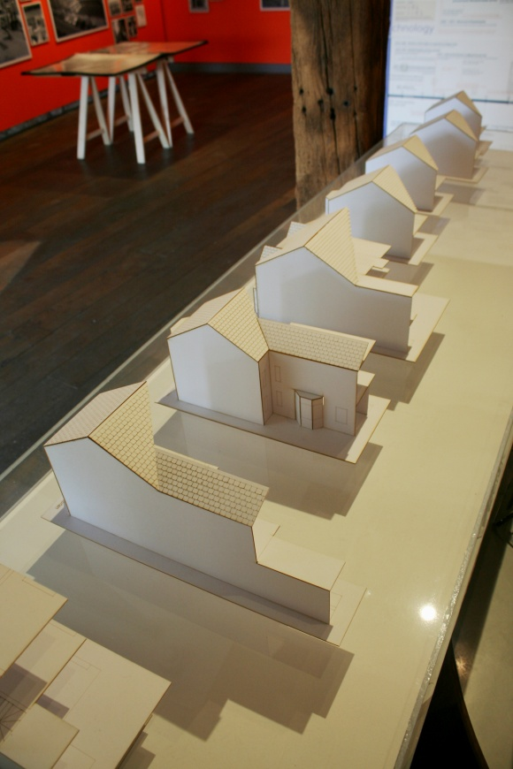
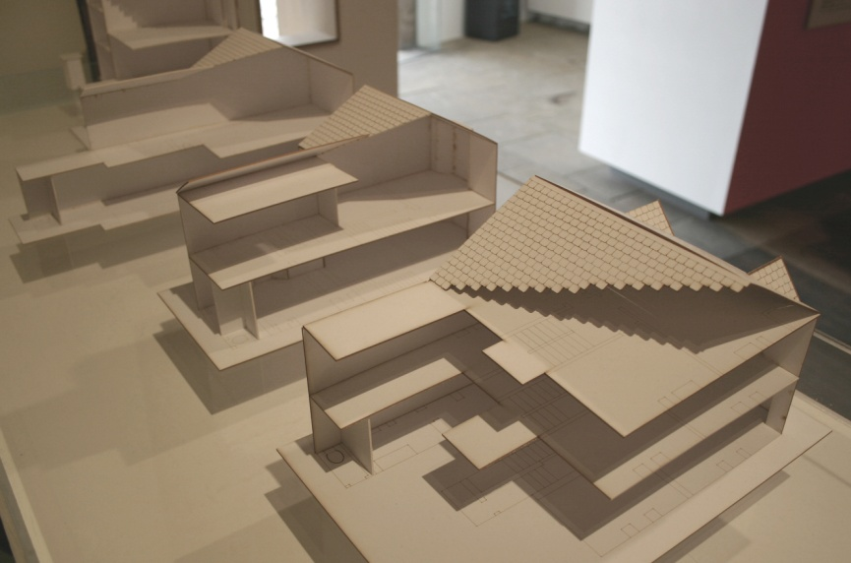
so how………
……about our house designs
what space do we have? how has it changed ?
Source: Jodie Marks
Notes:
CONTEXT/OUR INITIAL THOUGHTS
Parker Morris standards, RIBA research

Slide 6
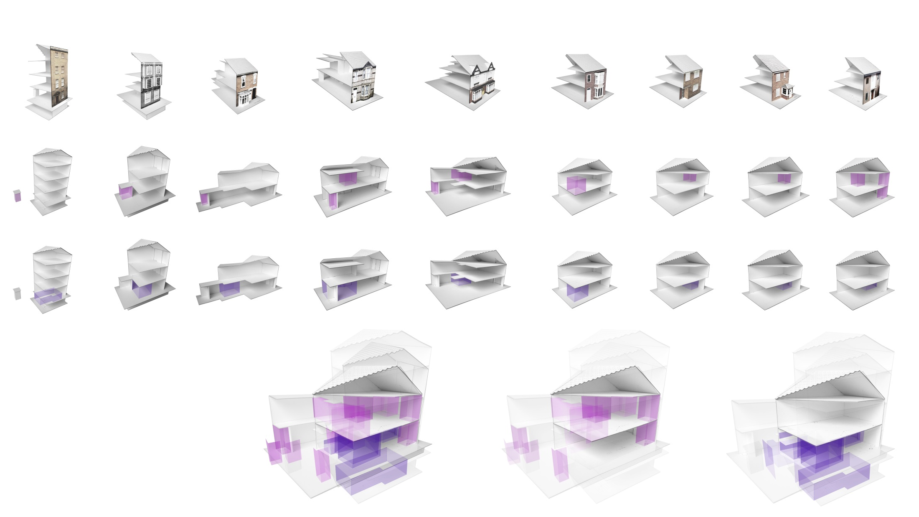
what are the minimums? does small means NO-quality?
Notes:
Parker Morris

Slide 7
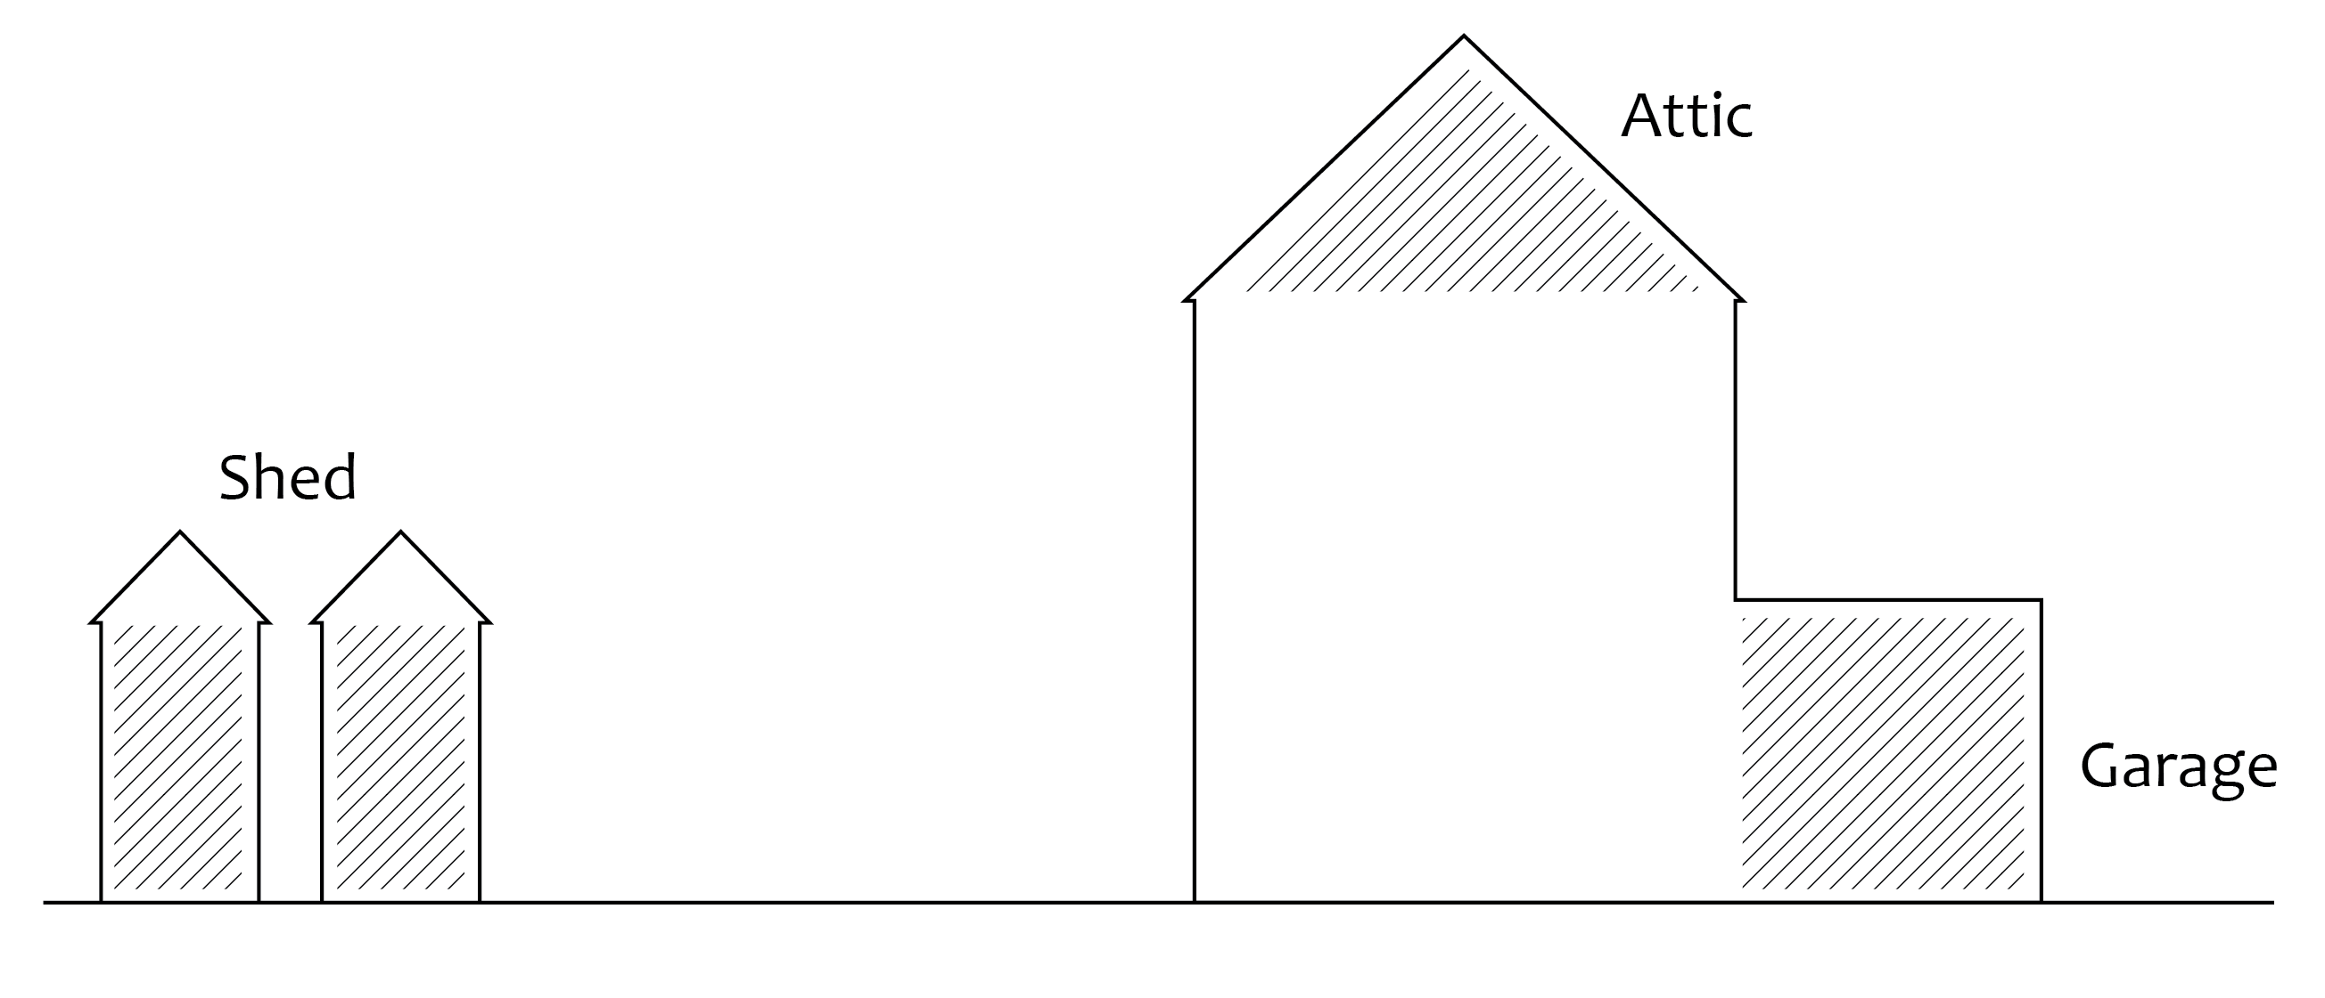
material possessions storage provision

Slide 8
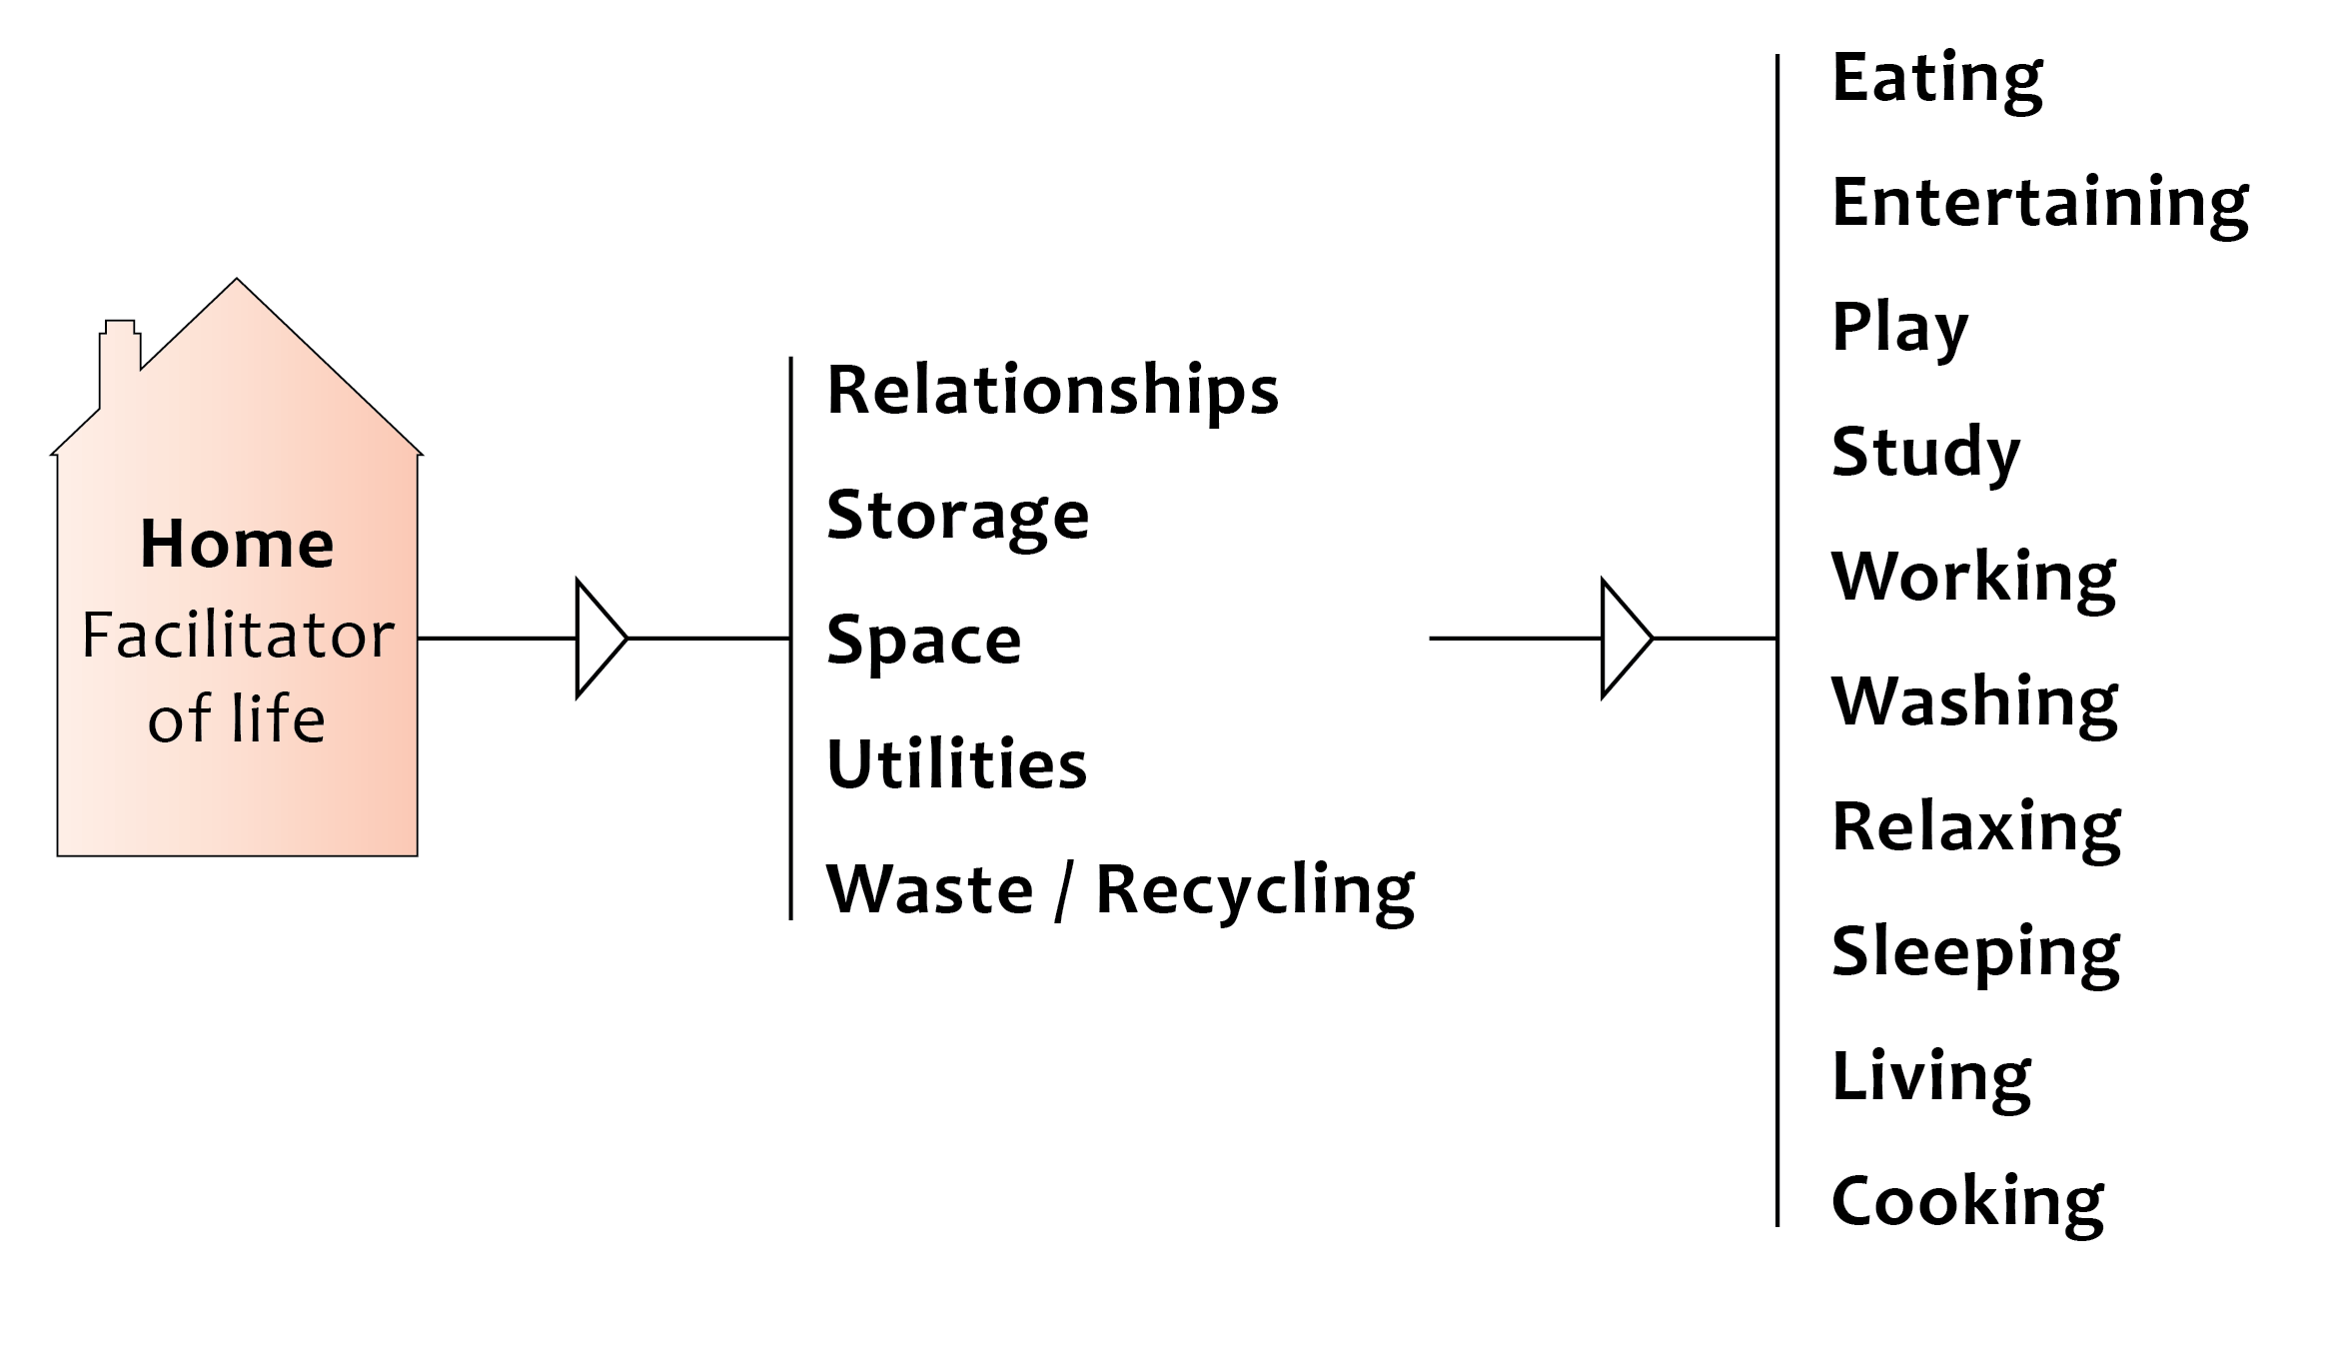

Slide 9
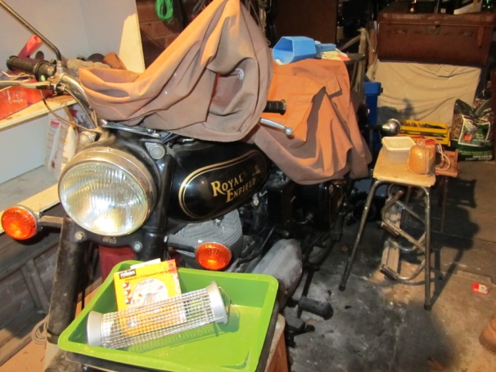
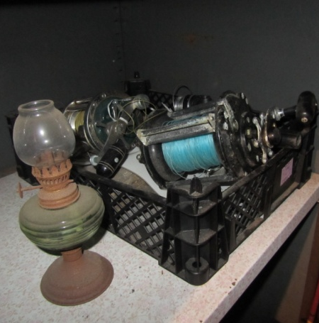
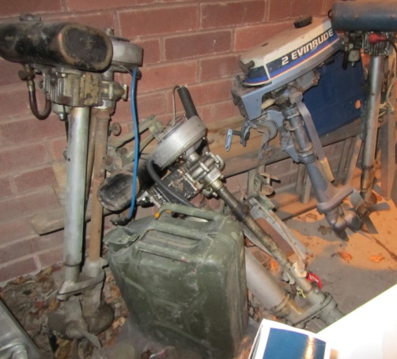
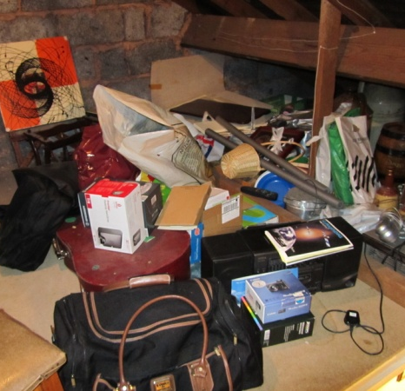
so how………
……about our houses
what do they contain? what do we collect?
STUFF
Source: Graham Shepherd Garage and Attic
Notes:
CONTEXT/OUR INITIAL THOUGHTS
Parker Morris standards, RIBA research

Slide 10
space is overwhelmed by..
not-at-present-in-use-maybe-never-again objects
DEAD- STORAGE
Notes:
CONTEXT/OUR INITIAL THOUGHTS
Parker Morris standards, RIBA research

Slide 11
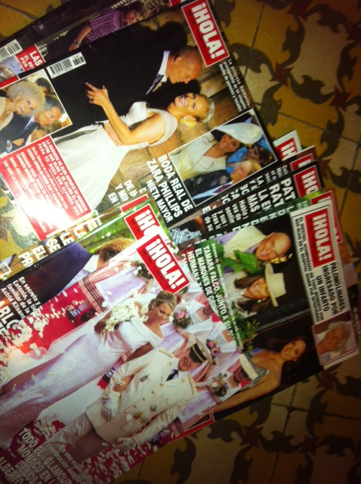
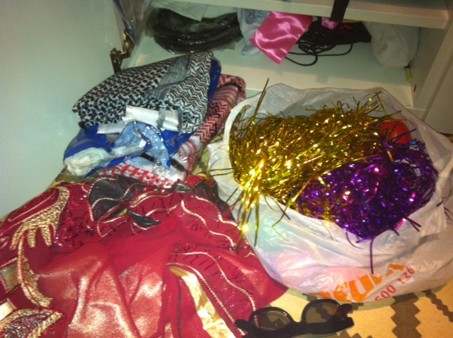
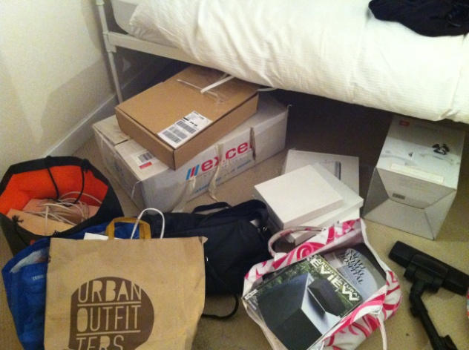
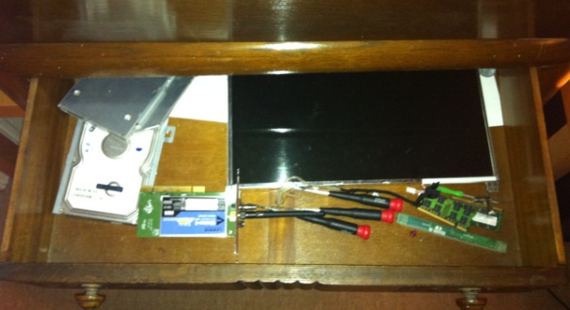
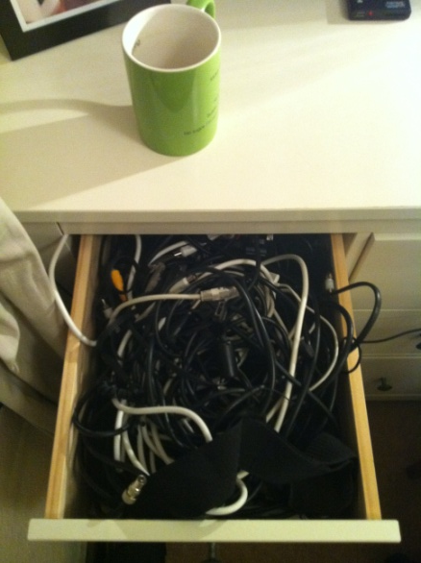
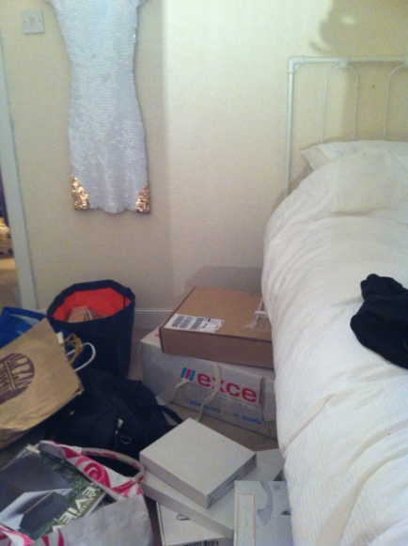
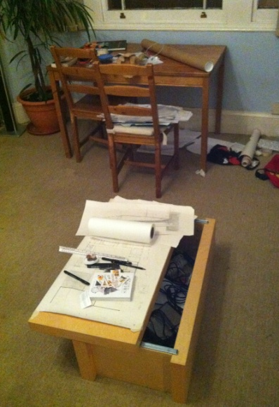
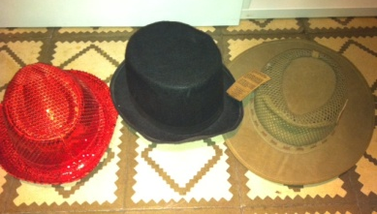
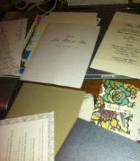

Slide 12
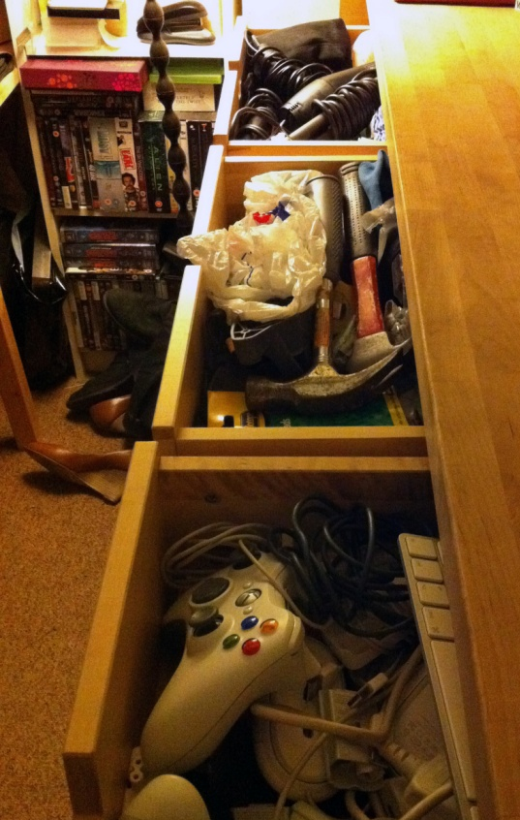
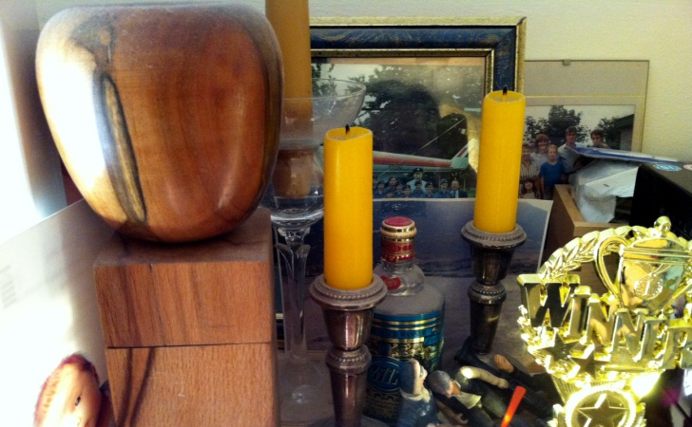
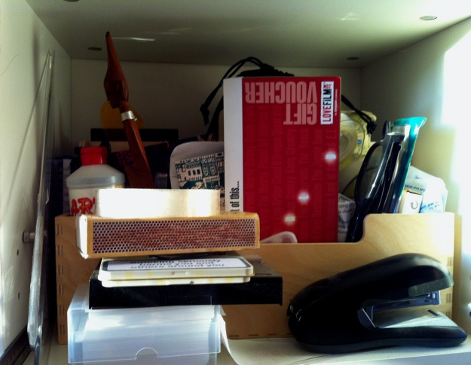
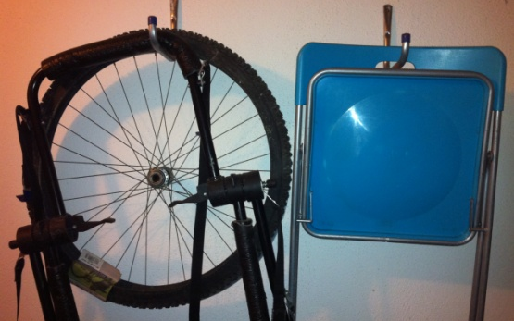
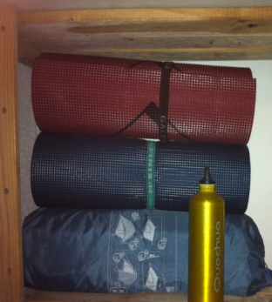
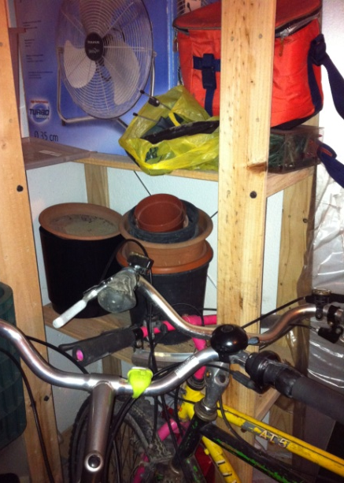
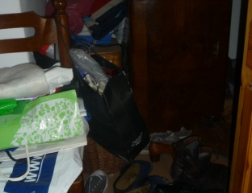
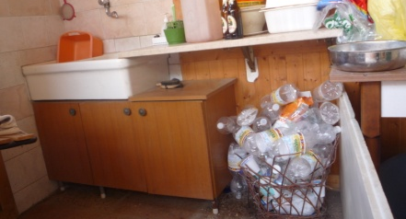
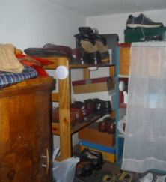
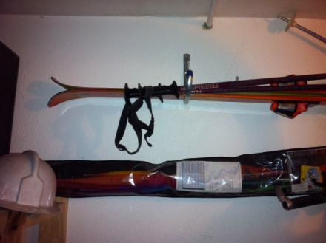

Slide 13
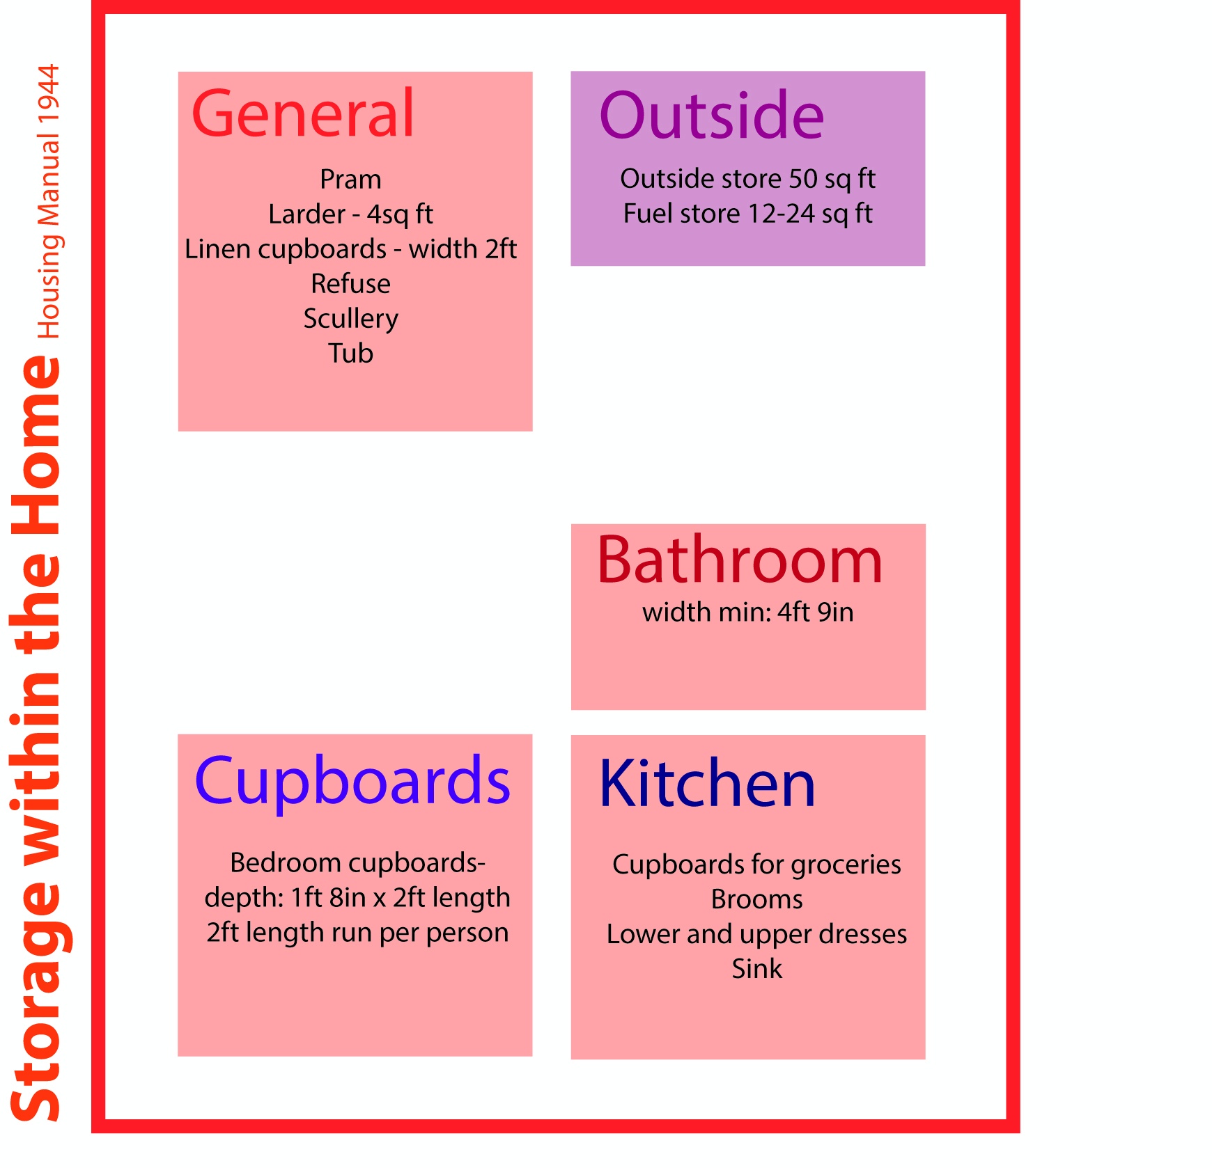
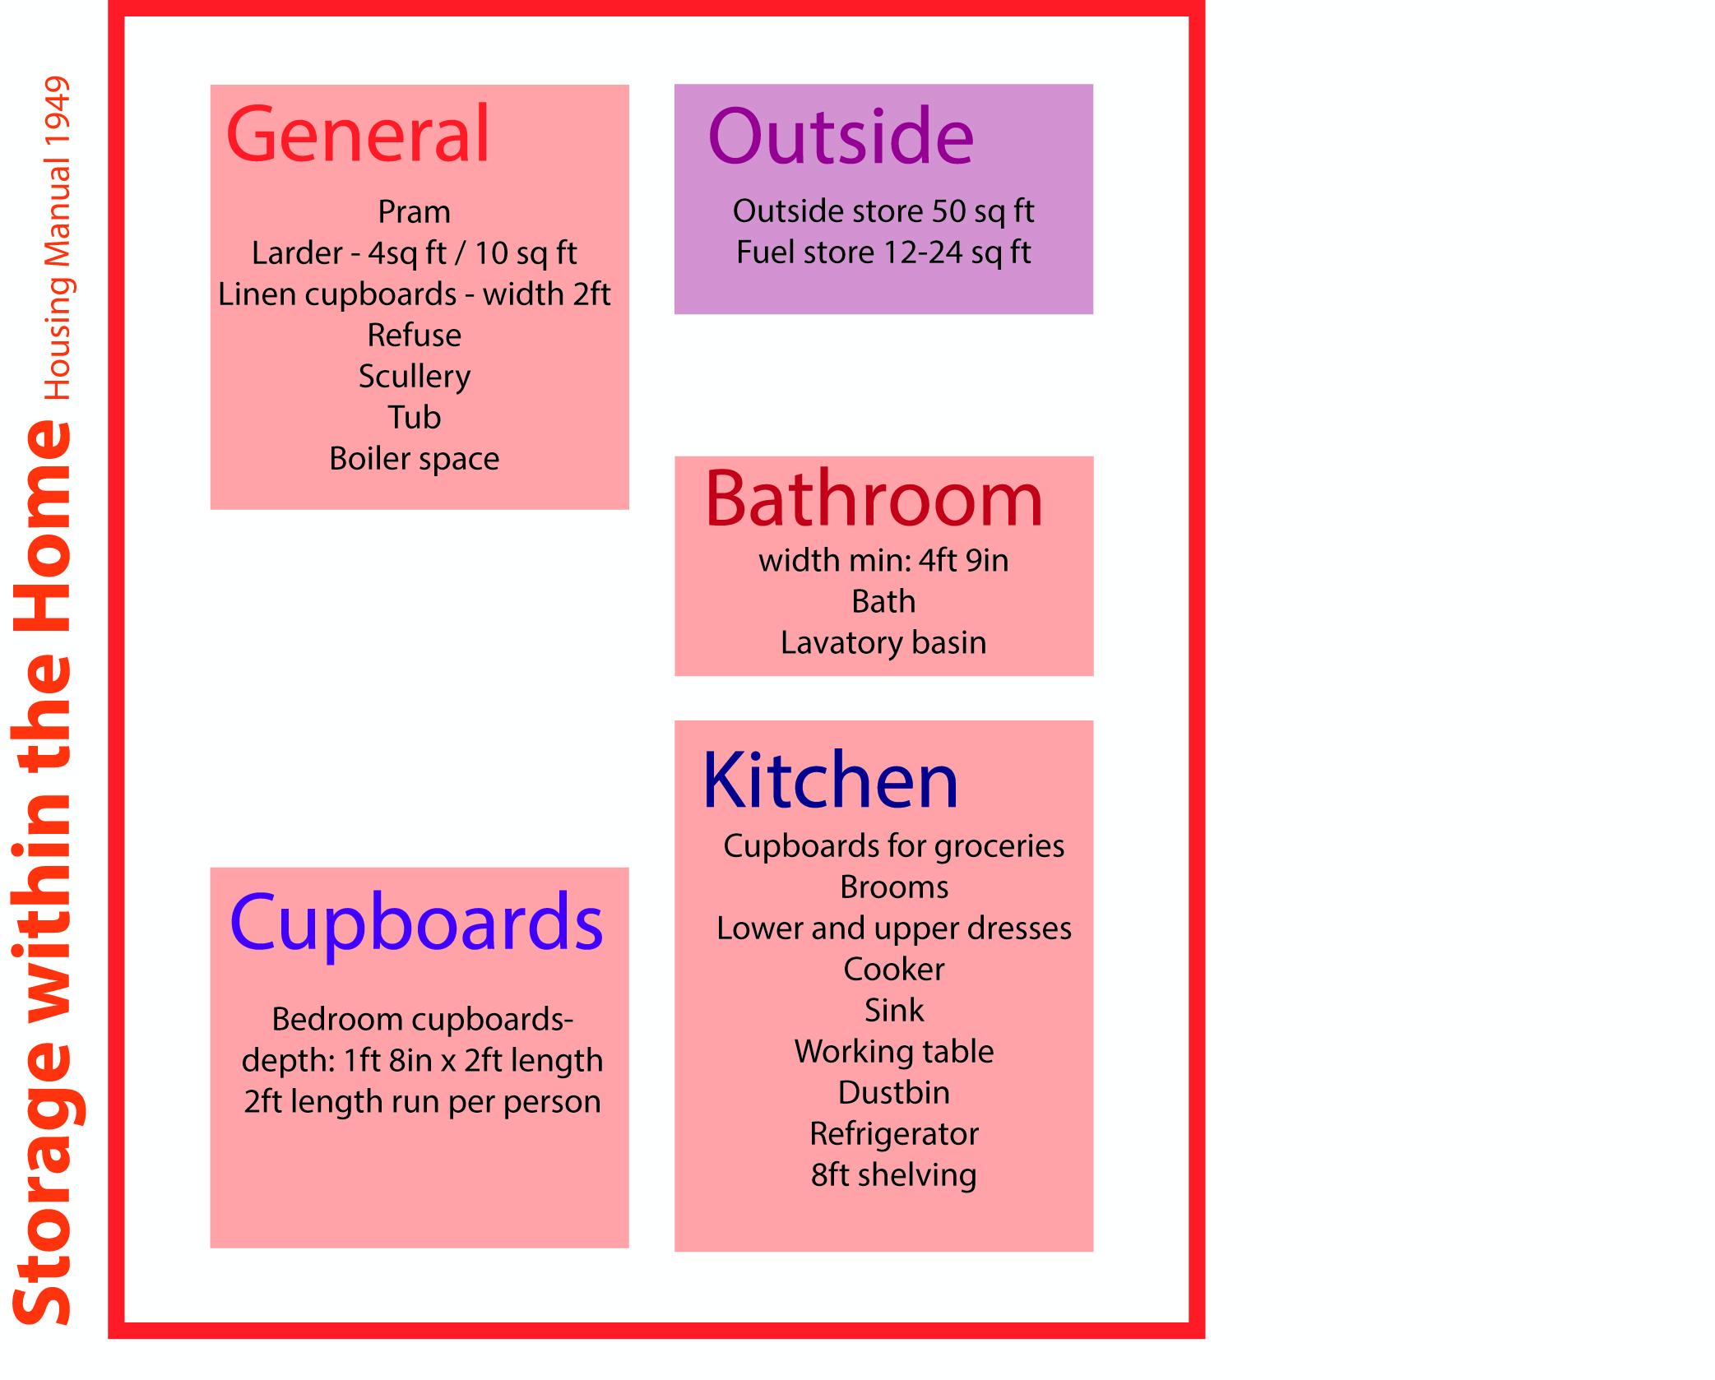
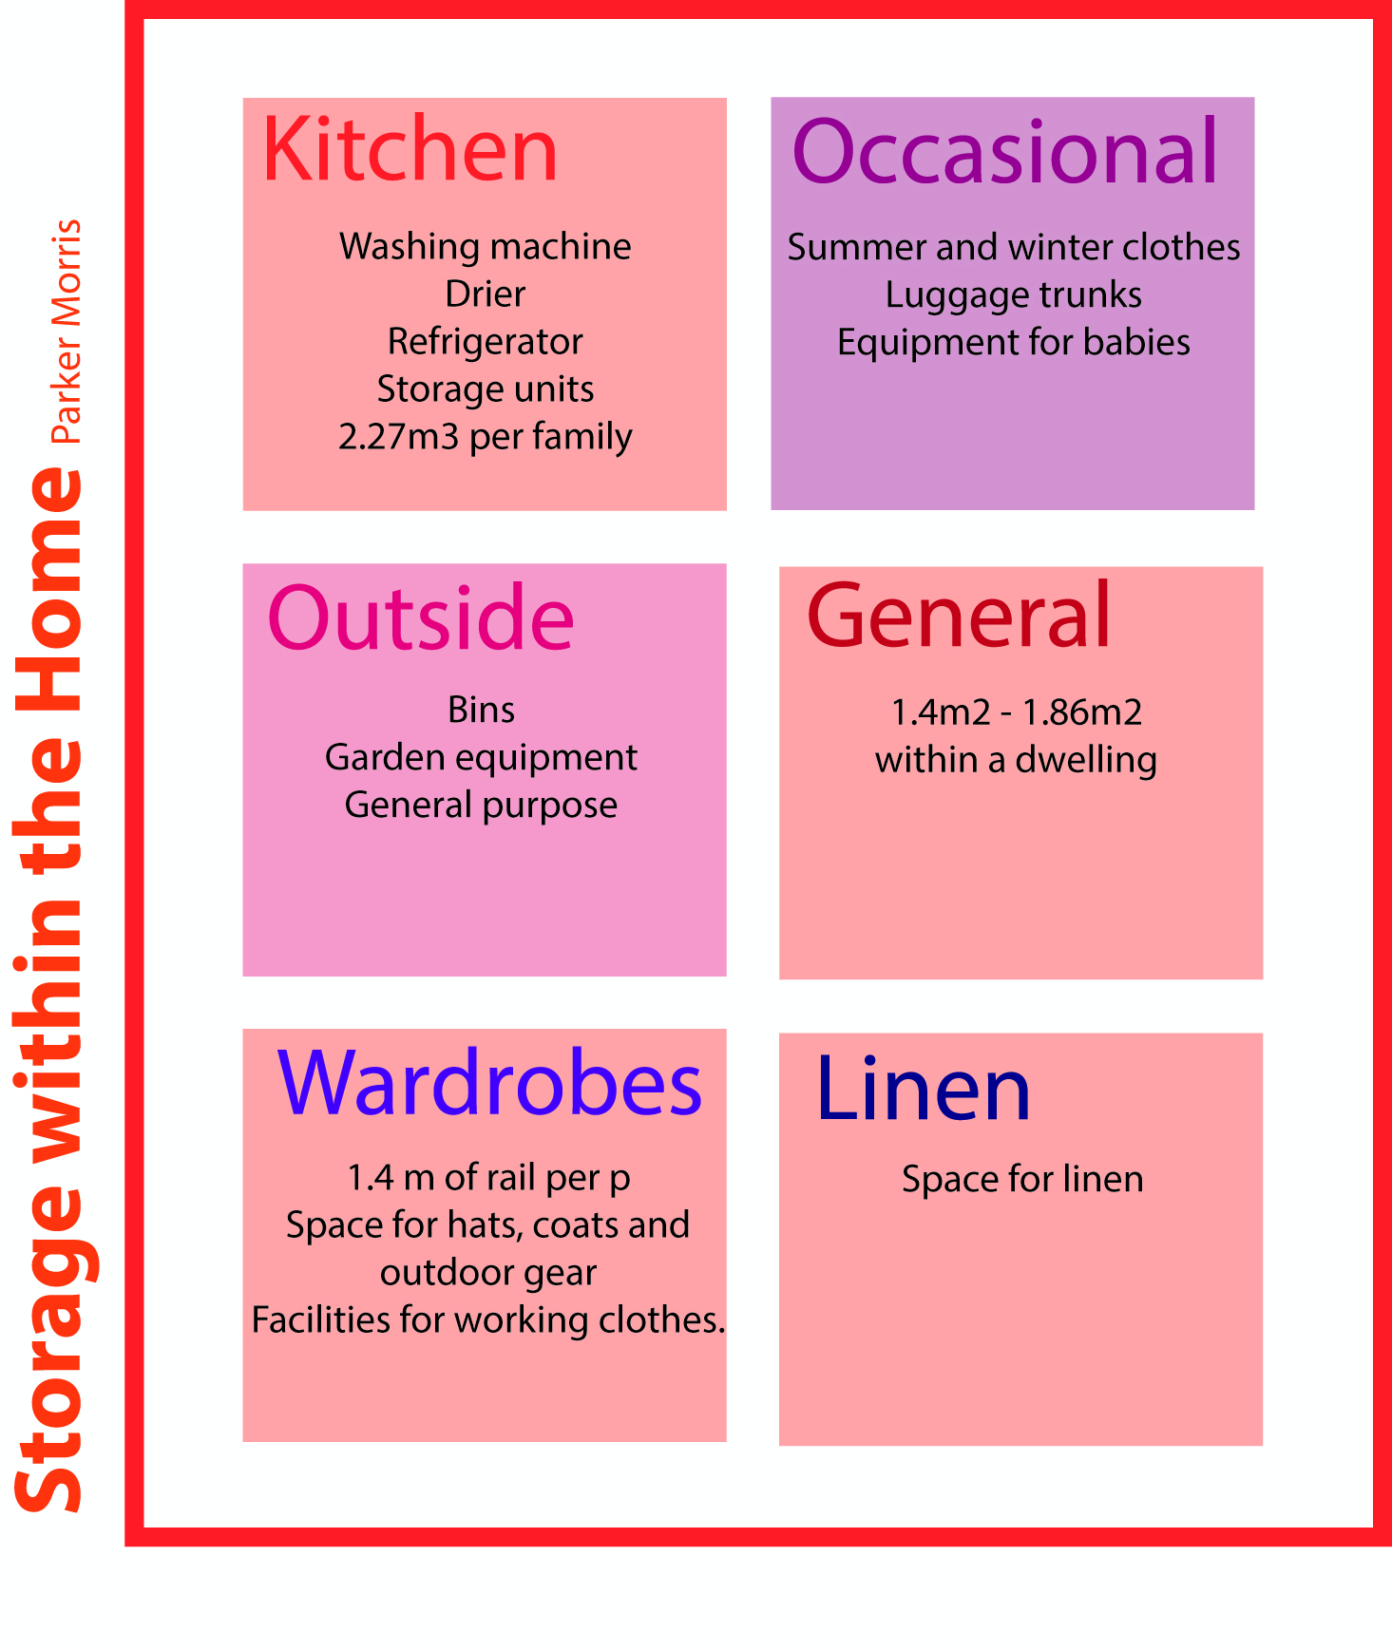
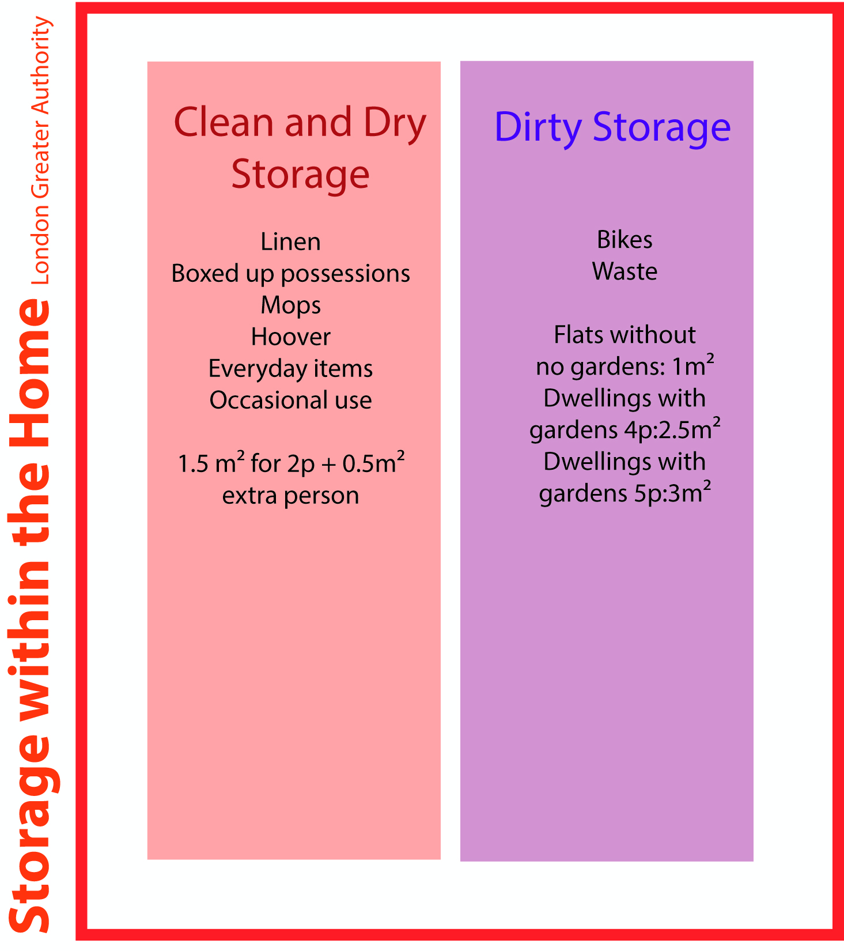

Slide 14
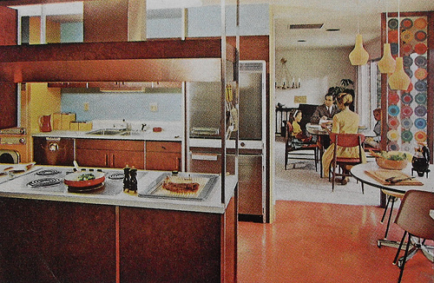
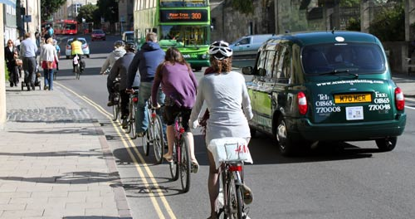



so how………
………………………………..so…..
what space do we need? how de we live?...........................
Source: Love Sixties Blog, The Irish Telegraph
Notes:
CONTEXT/OUR INITIAL THOUGHTS
Parker Morris standards, RIBA research

Slide 15
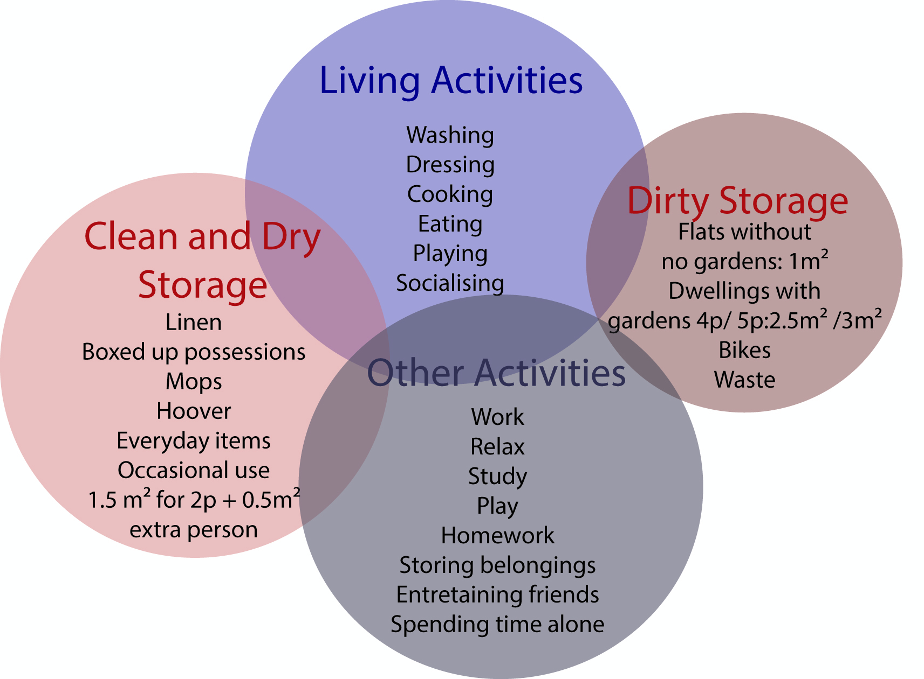
LHA

Slide 16
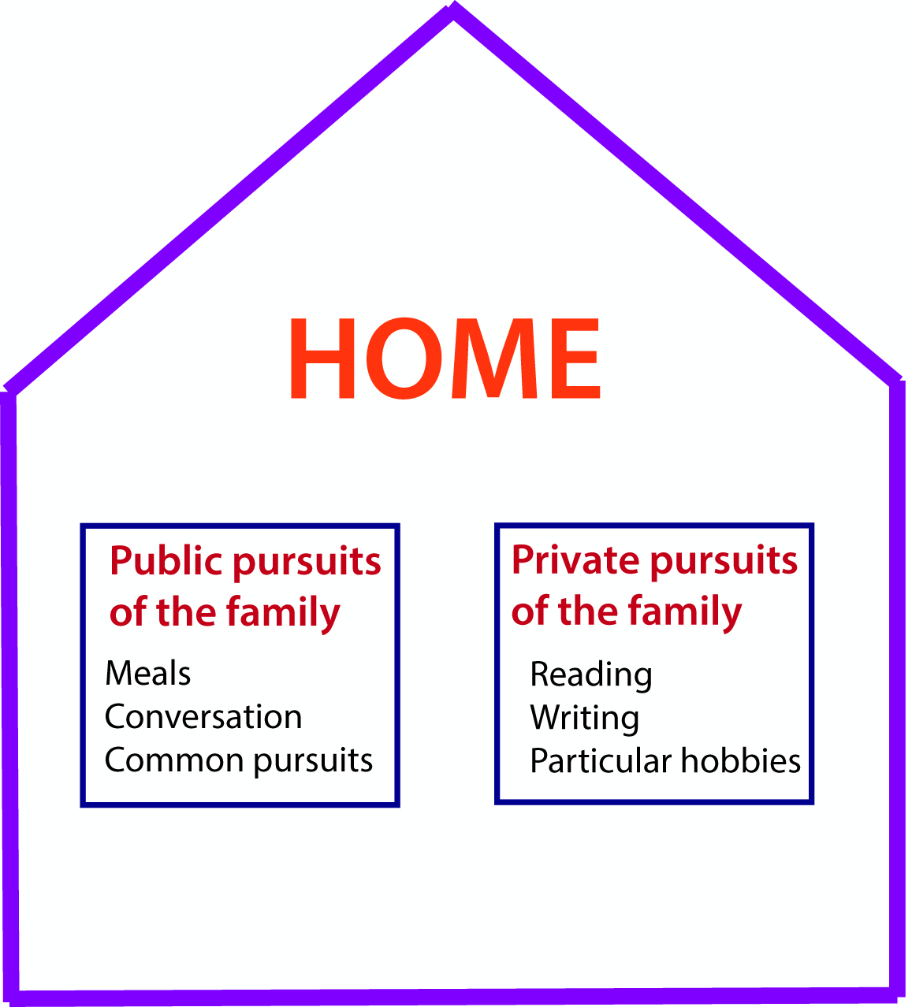
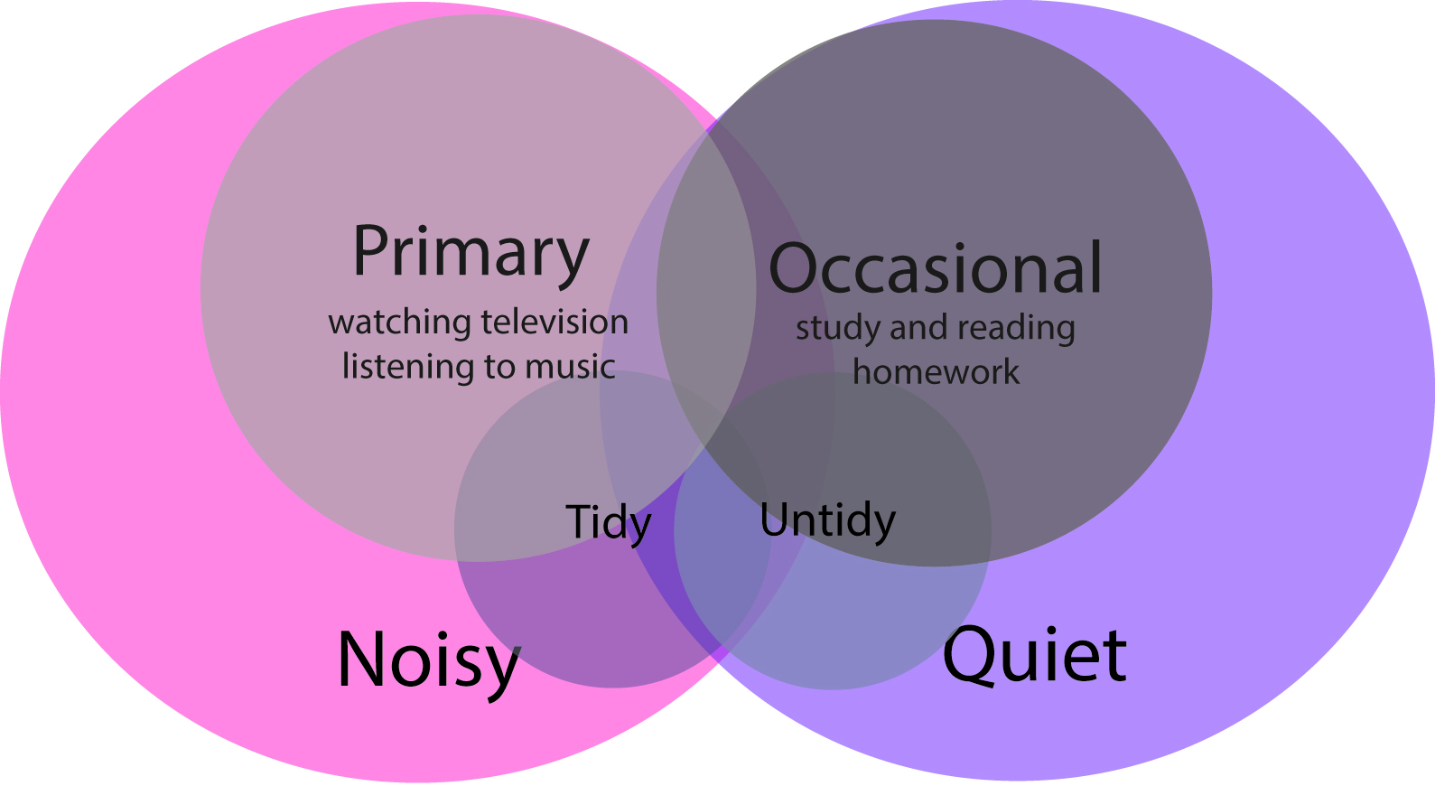
Parker Morris 1961
BRE 1993

Slide 17
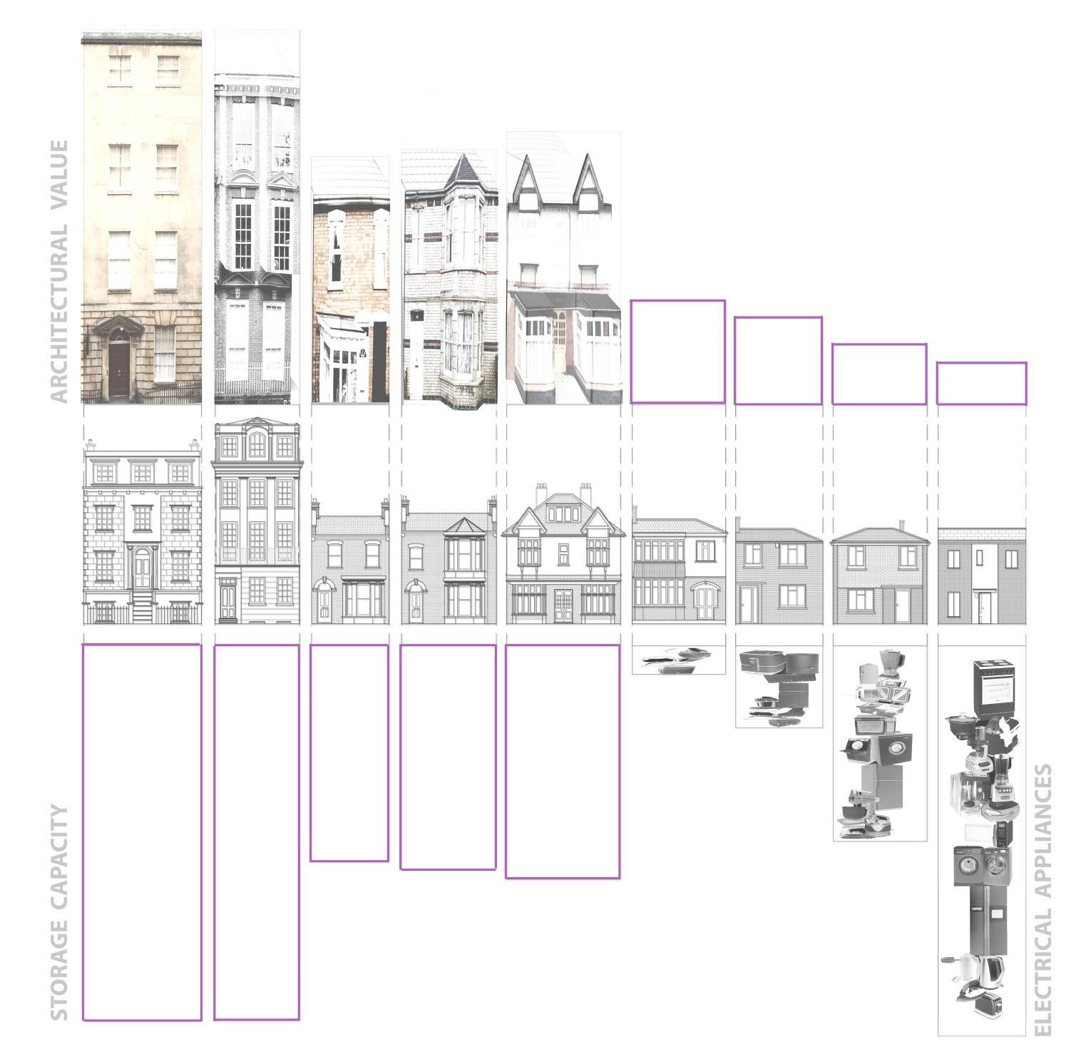
so what next? does small means NO-quality?
Notes:
Parker Morris

Slide 18
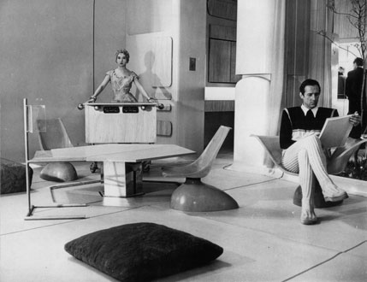
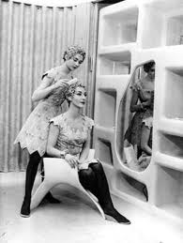
the thinkers
Source: Alison and Peter Smithson – from the House of the Future to a house of today
Notes:
In the 1990s, Peter and Alison Smithson coined the term ’glut‘ to refer to the vast amount of objects people collect, and then store, as a result of the plentiful consumerism of the end of the last century. In 1956, Peter and Alison Smithson were asked to design the ‘Future House’, thinking 25 years into the future to visualise how people would be living in a fast changing world. Two years later they sketched out ideas for an ‘Appliance House’, recognising the fact that developing technology was having an immense impact on the way people were living in the home. By 1993 they embodied this thread of their research in the ‘Put -Away House’, acknowledging the key role of storage in the lives of a house’s inhabitants. They coined the term ‘glut’ to refer to the vast amount of objects people collect, and then store, as a result of the plentiful consumerism of the end of the last century.
The Smithsons approached the problem of storage provision in the home through project-based experimentation and little research has been done in this area since. At a time of an aging population, an increase in single-households, more shared accommodation and a growing move towards home-working, it is timely that this project proposes to seek an understanding of the storage capacity in homes and to determine how people are using this space and what their storage needs are. This research also builds on the current campaign by RIBA which is looking to make a case for more space within the home⁷. The importance of health and well-being and the growing evidence about the influence of the home environment and its surroundings on health highlights the need for our homes and neighbourhoods to facilitate and promote healthy and sustainable behaviour

Slide 19
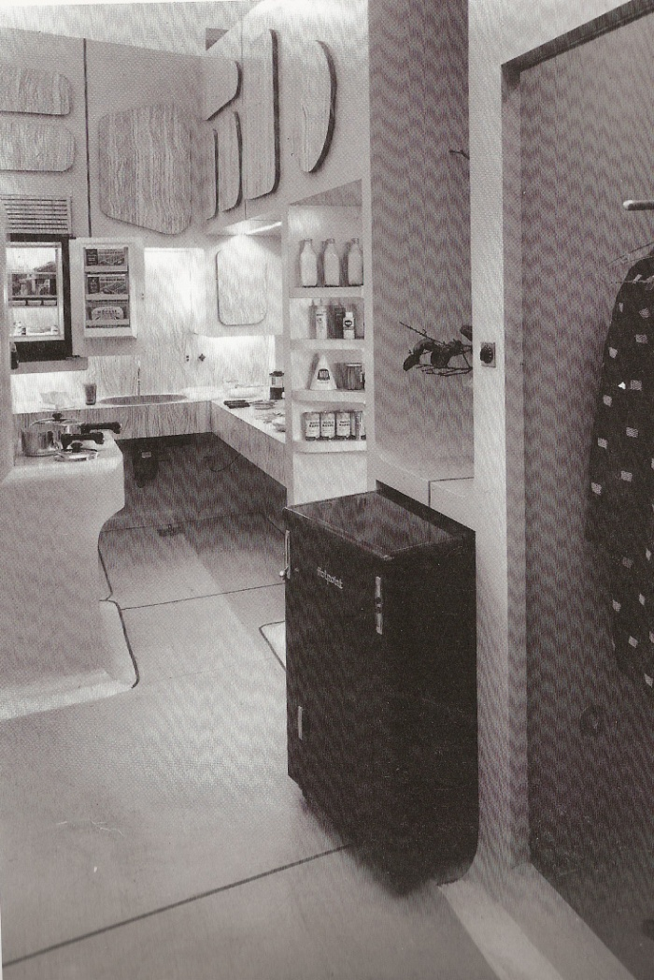
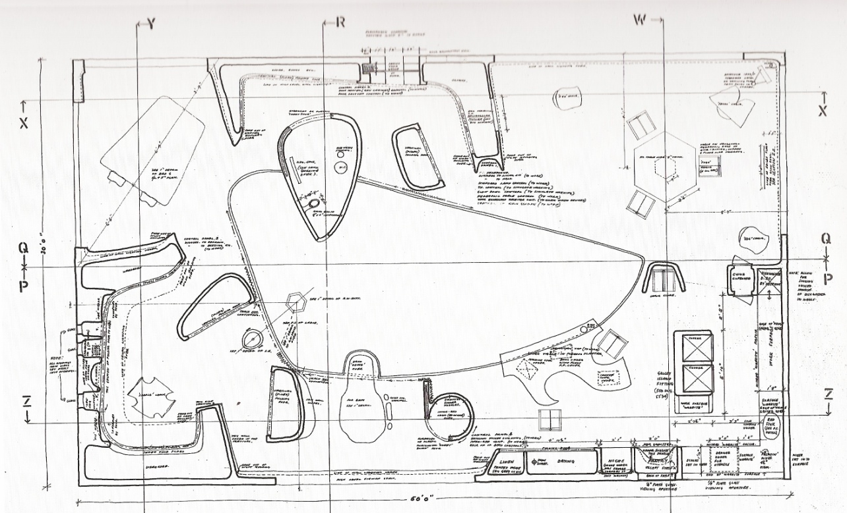
the thinkers
Source: Alison and Peter Smithson – from the House of the Future to a house of today
Notes:
In the 1990s, Peter and Alison Smithson coined the term ’glut‘ to refer to the vast amount of objects people collect, and then store, as a result of the plentiful consumerism of the end of the last century. In 1956, Peter and Alison Smithson were asked to design the ‘Future House’, thinking 25 years into the future to visualise how people would be living in a fast changing world. Two years later they sketched out ideas for an ‘Appliance House’, recognising the fact that developing technology was having an immense impact on the way people were living in the home. By 1993 they embodied this thread of their research in the ‘Put -Away House’, acknowledging the key role of storage in the lives of a house’s inhabitants. They coined the term ‘glut’ to refer to the vast amount of objects people collect, and then store, as a result of the plentiful consumerism of the end of the last century.
The Smithsons approached the problem of storage provision in the home through project-based experimentation and little research has been done in this area since. At a time of an aging population, an increase in single-households, more shared accommodation and a growing move towards home-working, it is timely that this project proposes to seek an understanding of the storage capacity in homes and to determine how people are using this space and what their storage needs are. This research also builds on the current campaign by RIBA which is looking to make a case for more space within the home⁷. The importance of health and well-being and the growing evidence about the influence of the home environment and its surroundings on health highlights the need for our homes and neighbourhoods to facilitate and promote healthy and sustainable behaviour

Slide 20
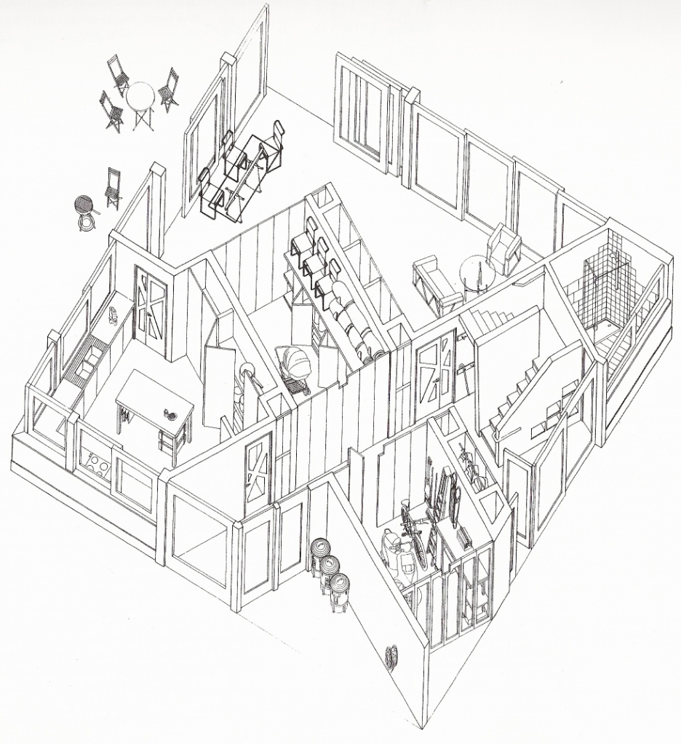
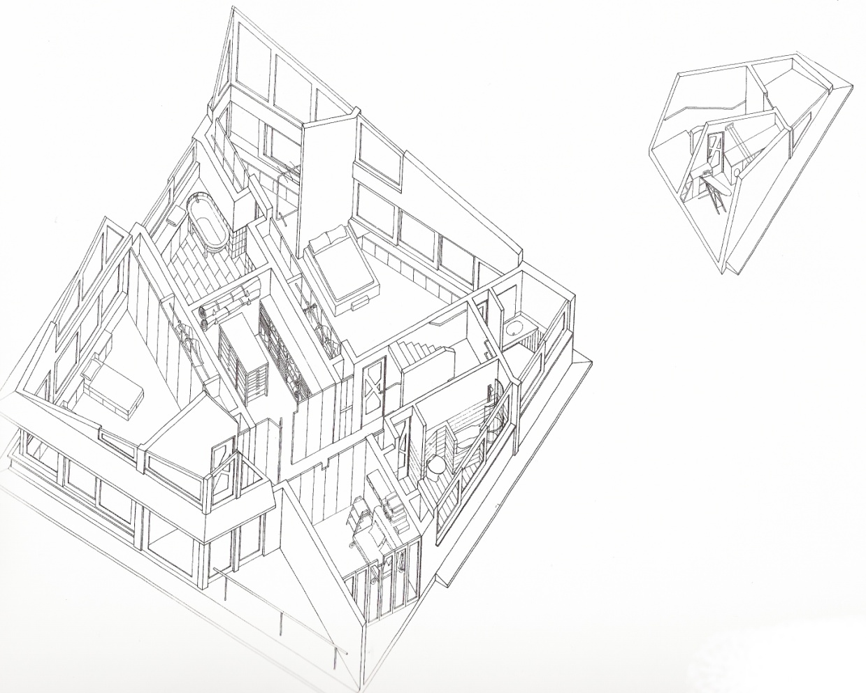
the thinkers
Notes:
The proposed research revisits the Smithsons’ study of ’glut‘ and updates it in the context of the fast-changing factors that impact on current and future lifestyles. By understanding how the proliferation of artefacts is putting pressure on space, this project will seek a new perspective on the ordinary, understanding how these collections of every day prosaic objects are having a major impact on the way we inhabit our homes. It will identify existing ’glut‘ to determine contemporary storage space requirements and will establish ways of retrofitting existing homes to meet future storage needs and encourage healthy and sustainable lifestyles. It will learn from the past, identify current trends, and propose a future strategy to deal with the ’glut‘ of our everyday lives.
The overarching objective of this project is to assess what kind of objects people will need to store in the future, and to develop evidence-based methods of promoting healthy and sustainable behaviour in existing homes through better space planning by ensuring that the equipment required for such lifestyles can be easily and accessibly stored. These creative storage solutions must be applicable to a wide range of existing housing typologies and across the full breadth of social-economic groups.
In order to achieve this, other objectives first need to be met, such as determining what people currently store around the home, and how they store it.
There is currently a huge gap in the knowledge of current trends in the proliferation of artefacts within the home. It is therefore an objective of this project to engage with real people, both individuals and community groups, to take a snapshot of current ‘glut’ and how it is stored.
It is important to also investigate and learn from the historical context, and so an in-depth knowledge of historical trends in what and how things were stored over time will also be sought. It will update our view of the everyday, cataloguing the proliferation of artefacts over time.
But perhaps most crucial of all, it is imperative that the results of this project are acted upon, and that a real change in the way people view domestic storage is initiated. Therefore a key objective of this project is to disseminate its findings as widely as possible, engaging and connecting with communities, as well as housing providers, designers, academics and educators across a range of disciplines.

Slide 21
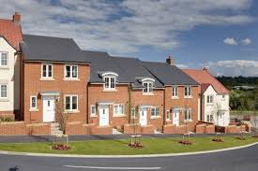
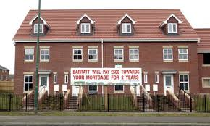
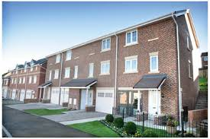
so what next? does small means NO-quality?
Notes:
Parker Morris

Slide 22
so what next?
So how do we enact dialog?
Notes:
Parker Morris

Slide 23
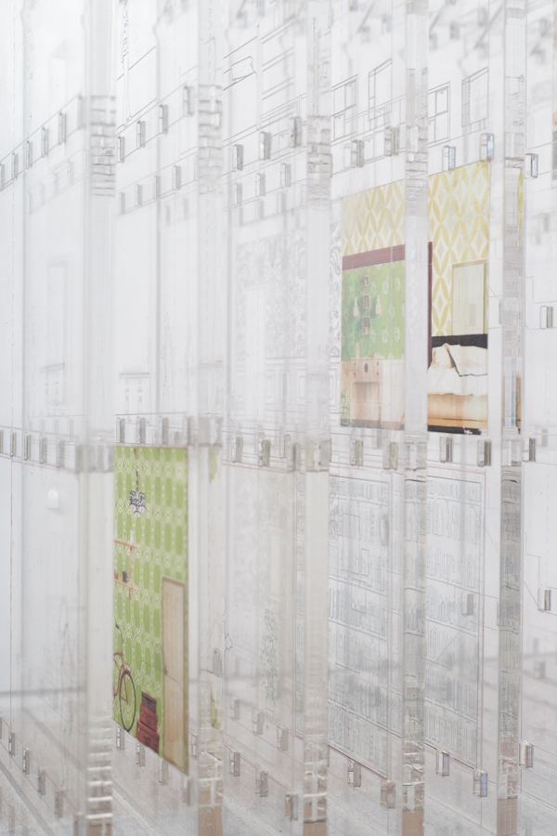
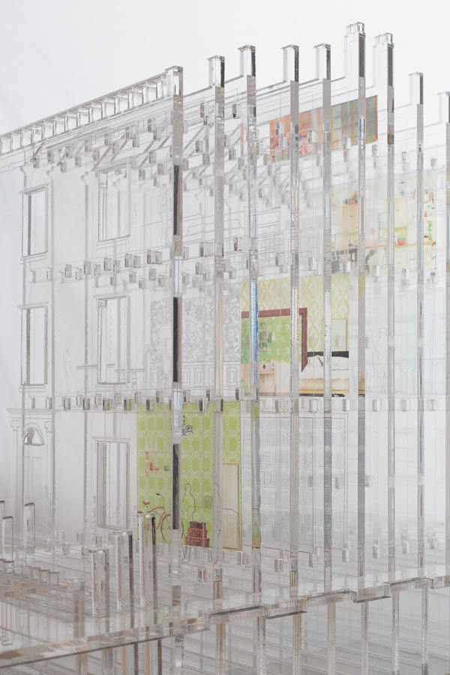
so what next?
dialog………...what dialog?
Notes:
Parker Morris

Slide 24
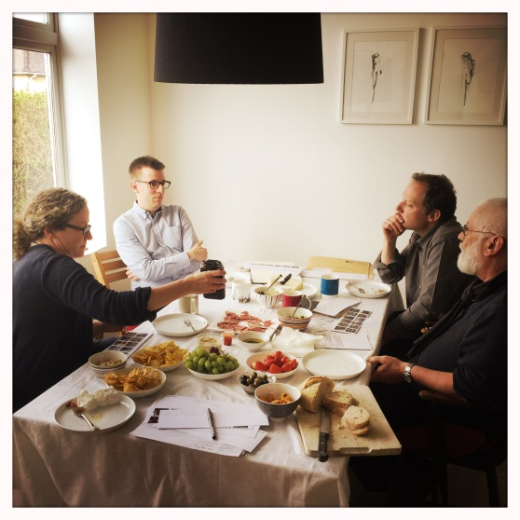



so what next? dialog………...what dialog?
Notes:
Parker Morris

Slide 25


so what next?
dialog………...what dialog?
Notes:
Parker Morris

Slide 26




so what next?
dialog………...what dialog?
Notes:
Parker Morris

Slide 27






so what next?
dialog………...what dialog?
Notes:
Parker Morris

Slide 28




so what next?
dialog………...what dialog?
Notes:
Parker Morris

Slide 29

so what next?
dialog………...what dialog?
Notes:
Parker Morris

Slide 30

so what next?
dialog………...what dialog?
Notes:
Parker Morris

Slide 31

so what next?
dialog………...what dialog?
Notes:
Parker Morris

Slide 32

so what next?
dialog………...what dialog?
Notes:
Parker Morris

