Slide 1
Towards quantification of food waste in cities: from “complete speculation!” to “it will be measured”
Ola Michalec, PG Researcher Supervisory team: Prof Jim Longhurst and Dr Enda Hayes @Ola_Michalec
Notes:
2nd year PhD Researcher at the University of the West of England, Bristol, UK
Research interests: water, energy and food at urban scale, social equity, cross-sectoral partnerships
Thematic and discourse analysis of a focus group with local food waste practitioners

Slide 2
Research questions and objectives
QUESTIONS:
How to reduce carbon footprint of food waste at the urban scale?
How to implement food waste policies in equitable way?
OBJECTIVES:
To facilitate cross-sectoral partnerships, learning and decision making;
To gather in one place those who traditionally design, manage and evaluate local actions and those who are affected by them;
To quantify environmental and social impact of innovative food waste solutions currently rolled out across the city.
Notes:
What can be learnt from the local governance and context and tradition? (or the other way round)

Slide 3
Methodological framework
Horizon Scanning
Focus group
GIS analysis of equitable policy making
Scope 3 quantification of GHG emissions
Notes:
Data on,…. on food waste volumes, participation in recycling, waste composition, social deprivation – few slides later?

Slide 4
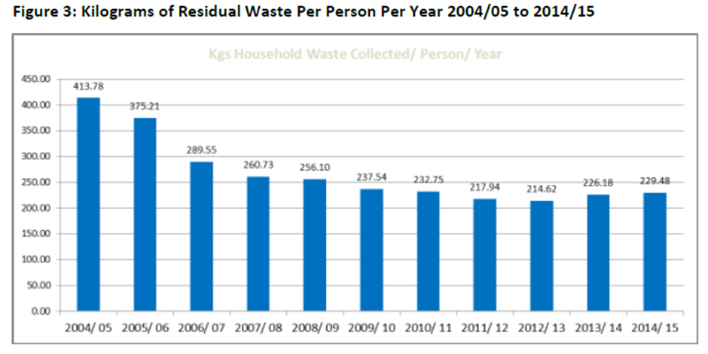
Horizon Scanning
City-wide weekly free collection of residential organic waste in Bristol (with few exceptions, e.g. some flats) since 2006;
Landfill amount of waste per person decreased dramatically since policy rollout in 2006 but stalled after 2009 - are there barriers to participation? Barriers to policy implementation?
Waste composition analysis suggests that organic waste comprises on average 39% of residential landfill bin (BCC, 2016, data from 2014)
(BCC, 2016)
Notes:
Targets: The Partnership is committed, as a minimum, to meeting
the national household waste recycling targets of 40% by 2010, 45% by 2015
and 50% by 2020. (from 2000 level?)-> what’s this in tonnage/vol?

Slide 5
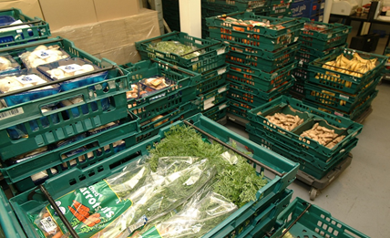
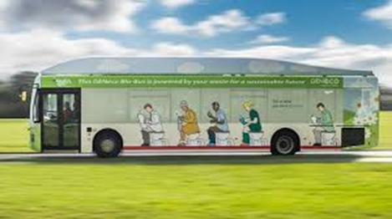
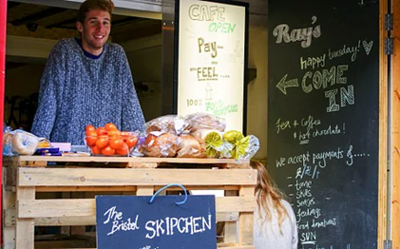
Horizon Scanning
No specific food waste policies were implemented in the UK. The issue of food waste was included in the waste-to-energy (AD) or reduction of waste policies;
UK government currently favours voluntary approach, e.g. there is no policy obligation or incentive to limit food waste. (HoC, 2016)
Fare Share – Surplus Food Redistribution Charity
Poo bus – fuelled by methane derived from organic waste

Slide 6
Focus group- Results 1/4
Theme 1: Ways of seeing the world through food waste
“I spoke to some manufacturers about that…they say for their brand, the customers expect a certain taste “
“I think if they’ve been incentivised, and whether it’s genuinely impacted them on an individual level (…); otherwise they’ve got no sense of responsibility to do it. Humans are selfish and they just care about what suits them”
“I think supermarkets dominate the market, they have so much power, so that they could actually start to change behaviour, the way we consume, the way we cook…”
“Sustainability, it shouldn’t be a luxury, but it is kinda be easier for people in the middle class, because they have time and resources to think about it”
Notes:
“P01: “
P02: “They’re always saying “we do what customers want us to do, we’re being led by the customers”… I don’t… I kinda disagree with that now, because I think they do have so much power, you know, there’s a big 5 …they dominate the market, they have so much power, so that they could actually start to change behaviour, the way we consume, the way we cook…”
P03: “The only way to break that cycle really is for consumers to either shop somewhere else – which is quite radical - or for supermarkets to take a huge risks of what they stock... but within that cycle it’s always like “we can’t buy it cause it’s not there” and “we’re not gonna supply, cause you’re not gonna buy it”. And I don’t know quite…cause it is a bit of a cycle…work out how to break it…”
P06: “I think if they’ve been incentivised, and whether it’s genuinely impacted them on an individual level, they need to know that, otherwise they’ve got no sense of responsibility to do it. People are selfish. Humans are selfish and they just care about what suits them” P03: “I think It’s recognising that for some people food waste is gonna be at down their list of priorities they have to worry about with their lives...Sustainability, it shouldn’t be a luxury, but it is kinda be easier for people in the middle class, because they have time and resources to think about it…and it can become a badge of pride, especially in Bristol, whereas I think if you look at areas of society which have far greater concerns than what they’re putting in their food waste bin”

Slide 7
Focus group- Results 2/4
Theme 2: Ways of knowing
“I don’t have any figures but you know – the colloquial evidence we’ve been given is that it’s making potentially big changes”
“Since we switched to compost on site, we're not really recording exactly what's going on...cause it's such a small team... it's very little data... “
“Obviously, we record the tonnage of Bristol. We also do waste composition analysis every 6 months…”
“We have case studies on behavioural change, we have resources for people looking to minimise their waste”

Slide 8
Focus group- Results 3/4
Theme 3: Direction of movement
“Everybody knows and talks about food waste now. You know, when we started 10 years ago in Bristol, trying to talk to people about food waste, they would think that we were diving in the bins and getting food from there!”
“I think it’s a bit of an issue when governments change or mayors change and therefore the whole focus shifts. And all the good work that might have been done beforehand is rewritten. I find it so frustrating…”
“Researcher: So can you give me an update of how does the flat policy look like in Bristol?
Participant: It’s tricky…”
Notes:
P05: “So it’s tricky because there are two types of flats in Bristol: there are houses of multiple occupancy, so it’d be like an old house converted to a flat an there you just have a normal standard kerbside collection. And also you have bigger flats – like student block or high rise building with social housing, where you have MRCs – mini recycle centres, these are bigger capacity for the number of people living there. They sometimes have a dedicated food waste area and to encourage them recycle there it’s tricky.”
P03: “I don’t know whether it’s stating completely obvious but I guess the biggest thing is, if you go back even a decade or so, just the fact that there are domestic food waste bins.”

Slide 9
Focus group- Results 4/4
Theme 4: What works and what doesn’t
“I think I’d also be tempted to say – legislation is the main one. I know that’s ironic, cause I work in the education and engagement side, so I should say it’s all about changing values (…)”
“The behaviour change advice is out there and there’s lots of options if businesses have the time and capacity to do it, but…there has to be a push…”
Notes:
Legislation P03: “I think I’d also be tempted to say – legislation is the main one. Cause I know that’s ironic, cause I work in the education and engagement side, so I should say it’s all about changing values, but it’s difficult to ignore examples like plastic bags, where people have been going on about plastic bags for years and year and then they introduced 5 p charge...so that’s the change. So I think if you do want to see a real, considerable change, then legislation would be the best way”
Incentives P06: “I think if they’ve been incentivised, and if it’d genuinely impact them on an individual level, then they need to know that. Otherwise they’ve got no sense of responsibility to do it.”
Behavioural change P04: “The behaviour change advice is out there and – you know, there’s lots of options if businesses have the time and capacity to do it...but if they don’t...there has to be a push…”
P03: “I think behavioural change can be really difficult … so I’m not an expert in it, but I am increasingly aware I need to be, because humans are incredibly complex they’re conflicting and one behavioural change activity won’t necessarily result in a behaviour expected. So I suppose it’s about realizing. (…) I think, with behavioural change -it’s very, very easy to do behavioural change badly and it’s very difficult to do it well…”
Education P05: “They don’t see it that way. It’s because it’s “dirty”…that’s the waste bin, so when you start to separate out now you’ve got 2 “smelly bins”… and it’s like…uhh [sighs]..It’s education more than anything – training people to understand – “it’s food – you would have eaten it. So there you go – and this is just another bin”
P05: “So it’s tricky because there are two types of flats in Bristol: there are houses of multiple occupancy, so it’d be like an old house converted to a flat an there you just have a normal standard kerbside collection. And also you have bigger flats – like student block or high rise building with social housing, where you have MRCs – mini recycle centres, these are bigger capacity for the number of people living there. They sometimes have a dedicated food waste area and to encourage them recycle there it’s tricky.”
P03: “I don’t know whether it’s stating completely obvious but I guess the biggest thing is, if you go back even a decade or so, just the fact that there are domestic food waste bins.”

Slide 10
Next steps
Research priorities:
Food waste recycling in flats
Measuring food waste as opposed to reliance on “colloquial evidence”
Potential data issues:
Privacy
Short term licensing
Varying data resolution
Quality of secondary datasets
(Over)reliance on external stakeholders for data provision
…or simply the reality of practice-based, inter-disciplinary, “real world” research?

Slide 11
References
Bristol City Council (2016) Towards a Zero Waste Bristol: Waste and Resource Management Strategy
Bulkeley, H., Edwards, G.A.S. & Fuller, S. (2013), "Contesting climate justice in the city: Examining politics and practice in urban climate change experiments", Global Environmental Change, vol. 25, pp. 31; 31-40; 40.
Cairns, R. & Krzywoszynska, A. (2016) "Anatomy of a buzzword: The emergence of ‘the water-energy-food nexus’ in UK natural resource debates", Environmental Science & Policy, vol. 64, pp. 164-170.
Chatterton, T., Anable, J., Barnes, J. and Yeboah, G. (2016) Mapping household direct energy consumption in the United Kingdom to provide a new perspective on energy justice. Energy Research & Social Science, 18. pp. 71-87.
House of Commons (2016) Food Waste –Briefing Paper. Number CBP07552,
Luke, T.W. 2005, "Neither sustainable nor development: reconsidering sustainability in development", Sustainable Development, vol. 13, no. 4, pp. 228-238.
Stringer, L.C.; Quinn, C.H., Berman, R.J.; Le, H.T.V.; Msuya, F.E.; Orchard S.E.; and Pezzuti, J.C.B. (2014) Combining nexus and resilience thinking in a novel framework to enable more equitable and just outcomes. Centre for Climate Change Economics and Policy Working Paper No.193. Sustainability Research Institute: Leeds
Wodak, R. & Meyer, M. (2009), Methods of critical discourse analysis, 2nd edn, SAGE, London.

Slide 12
Acknowledgements
The project is jointly funded by the University of the West of England, Bristol City Council and Lloyd’s Register Foundation, a charitable foundation helping to protect life and property by supporting engineering-related education, public engagement and application of research.
www.watersecuritynetwork.org
@Ola_Michalec e: Aleksandra.Michalec@uwe.ac.uk

