Slide 1
Achieving 100% pass rate and NSS feedback:
How we did it
Jennifer Hill
Associate Professor in Teaching & Learning | UWE, Bristol
Harry West
Associate Lecturer & Researcher | UWE, Bristol

Slide 2
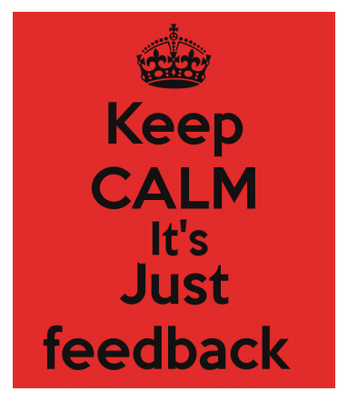
Presentation content
Feedback context
What we did
Definitions
Research aims
Module assessment structure
Data collection
Selected results
How can I adapt this for my context?
What might the future look like?

Slide 3
Feedback context
feedback should help students to:
- understand current performance
- understand how to close the ‘performance gap’ in future assignments
- have the confidence and belief they have control over their success
- maintain motivation throughout their degree
(Hattie & Timperley, 2007)
there is a recognised gap between staff perceptions of feedback and the student experience (Price et al., 2011)

Slide 4
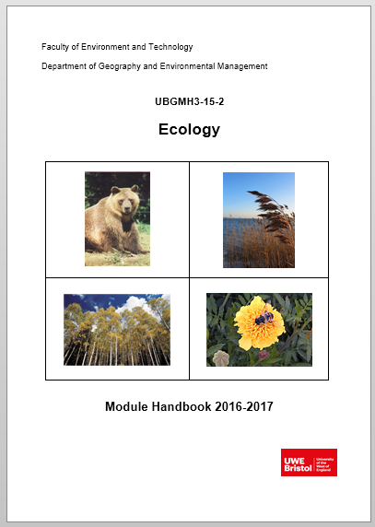
What we did
we have implemented an assessment approach on a
level 2 physical geography module to optimally support
students’ use of feedback
based on premise that feedback should occupy a central
position within a dialogic approach to learning & teaching
(Alexander, 2004; Sutton, 2009) and be future-oriented
(Sadler, 2010; Beaumont et al., 2011)

Slide 5
Definitions
dialogic feedback is the creation of meaning and understanding via spoken discourse between lecturer and student, or student to student
(Nicol, 2010)
feed-forward refers specifically to feedback given by tutors that:
- impacts upon an upcoming assignment
- is given post-assignment with more specific direction on
how this can be applied to future assignments
(Carless, 2007)

Slide 6
Research aims
Explore student perceptions of the dialogic feed-forward approach and whether it asserted a positive influence on their learning experience
Identify if and how the task-specific behaviour of students was altered by the assessment approach
Identify the extent to which students believed their self-efficacy and self-regulation skills were improved
Examine whether the assessment approach enhanced student performance and whether it could potentially raise NSS scores related to feedback

Slide 7
Module assessment structure
Supporting Lectures
Students choose essay from selection
Students write draft essay
Students submit draft and attend ‘feed-forward’ meeting
Students reflect on meeting and essay – grading their work
Students complete and submit final essay
25% module assessment
75% module assessment
Assessment discourse
Feedback
discourse
Notes:
We offered preparatory guidance, in-task guidance and performance feed-forward.
Interviews were audio-recorded and exemplar paragraphs were used during them.
Arrow on right leads on to ipsative feedback – ‘based on a comparison with the learner’s previous performance and linked to long-term progress’ (Hughes 2011, p. 353). Supports development of long-term generic skills over short-term achievement of assessment criteria.
Also undertook essay marking seminar: students work with marking criteria and match LOs to standards

Slide 8
Data collection
Qualitative case study approach
semi-structured interviews … from two consecutive level 2 cohorts at end of module (2015-16 and 2016-17)
focus groups with level 3 students elucidating post-assignment behaviour and self-efficacy
essay performance data pre- and post-assessment intervention
answers to NSS feedback questions

Slide 9
Selected results
Enhanced learning experience
conversation compels students to engage critically with their work:
‘when I have had drafts handed back to me and it’s just written over, either I don’t understand what they are trying to say, or it’s not clear enough. I can ask you questions if we’re talking to each other about it, it’s easier to see things … It’s definitely better to talk about it’ R7
‘I’ve had it before where you get electronic feedback and you might not be sure what some of the comments mean … being able to discuss it is important. You get that progress and can discuss how you can change it as opposed to just saying this is wrong’ R9
Notes:
Students can decode feedback: gain greater understanding of the written feedback through verbal clarification and use of exemplars
Cathartic spaces – ‘coming clean’ with progress
Cognitive and affective enhancement of student learning experience

Slide 10
Selected results
Enhanced learning experience
Motivational due to pertinent application:
‘the bit in between my draft and writing the final piece was the best bit because I knew what I was doing and could tweak it and I enjoyed that process of making it better. It gave me more confidence in my writing skills’ R7
‘my first draft was quite vague and I didn’t really know what direction I was going with it. Then, after speaking and having the feedback, I spent more time on it because I knew where I needed to go with it’ R8
Notes:
Students can ‘make good’ – immediate relevance of feedback for good practice
To that point students had developed a personal interpretation of the meaning and requirements of their question. The feedback allowed them to judge how far they were meeting the performance standards of the assessment criteria as interpreted by the tutor.

Slide 11
Selected results
Task-specific behaviour and self-regulation
‘it helped me to realise how to critique my own essays because I was able to sit down with you and go through the essay and know exactly why you were commenting on something … It allows me now to see in other essays the same things I’m doing’ R10
‘I never understood how good submitting a draft and getting feedback is and now that I’ve done it I’m definitely going to take advantage of it this year’ R24
Notes:
Nicol’s self-regulation
Baxter-Magolda’s self-authorship

Slide 12
Selected results
Self-efficacy and graduate attributes
students display increased self-efficacy: stronger beliefs in their capabilities to accomplish tasks in future
believe learning is carried over to other level 2 assignments
self-avow to altered level 3 behaviour
we see students displaying ready and able, future facing, and self reliant competencies

Slide 13
Selected results
Significantly higher marks 2015-17 v 2011-13 (p = < 0.0001)
Enhanced student performance
Band (%) | 2011-2012 (%) | 2012-2013 (%) | 2015-2016 (%) | 2016-2017 (%)
0-39 (inc. NS) | 16 | 5 | 0 | 5.5*
40-49 | 9 | 14 | 3* | 5.5*
50-59 | 34 | 38 | 28 | 17
60-69 | 41 | 38 | 58 | 58
70-100 | 0 | 5 | 11 | 14
Number (n) | 32 | 37 | 36 | 36
* Did not have a meeting
Dialogic assessment
Notes:
Mean increase 2011-2013 to 2015-2017 of 6.33%. Mean mark moves from roughly 56% to 62%
Increase seen most in moving students from 2:2 to 2:1. Some changes at top and bottom ends.

Slide 14
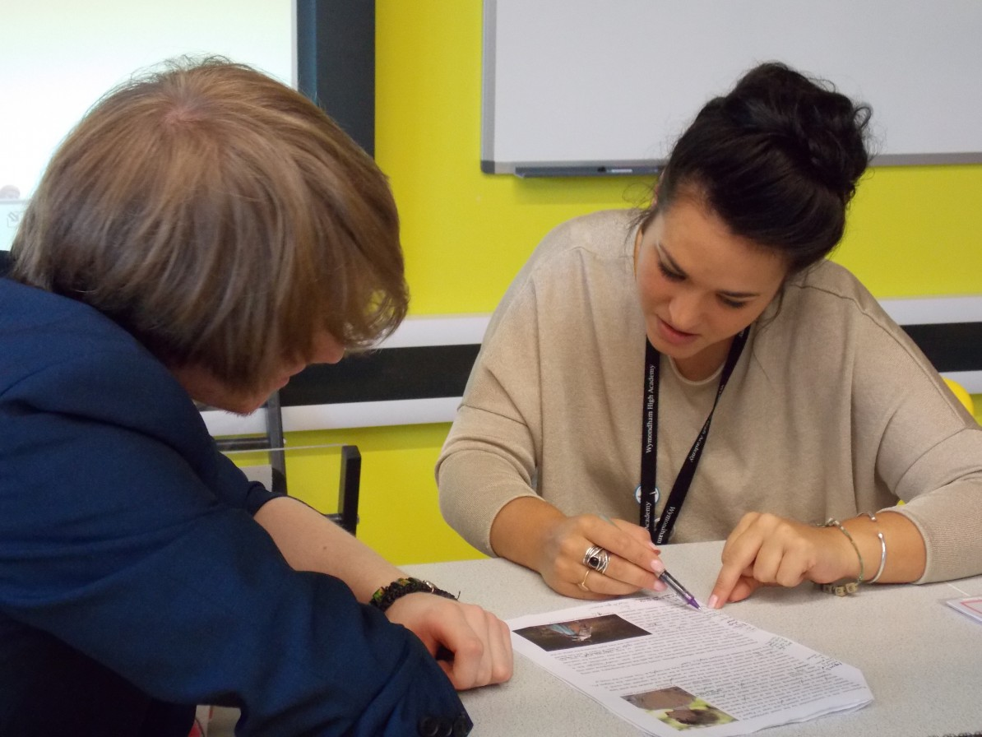
Selected results
Enhanced NSS and TEF metrics
all students rated the module as giving them high quality feedback: detailed, conversational, personalised, timely (relevant application), multi-faceted
all students said the feedback helped them clarify things
they did not understand: proactive engagement with
learning – they had to prepare for the meeting,
think about their work, ask and answer questions
Notes:
‘I felt like you cared’ R1
‘I definitely felt like you cared about what I was getting’ R7
The educational alliance, is an important influence on their perceptions of the quality of feedback

Slide 15
How can I adapt this for my context?
Place dialogic feed-forward assessment into a level 1 core module?
- 20-30 students per staff member (linked to APT?)
- re-allocate staff time: less module content and summative feedback; more
conversational feed-forward
2. Adjust this process for a level 2 module?
- ask for discretionary workload bundles
- research the outcome via LTF project – staff time
- peer to peer feedback (via PAL?), facilitated by VLE
3. Finesse elements of this approach at level 3?
- comment only upon a page of student work
- answer 3 questions only posed by students

Slide 16
What might the future look like?
We deliver all feedback before grades. When students start at UWE (e.g. field trips, lab work) they only receive comments … then marks
We offer students mastery experiences, completing phased tasks, and receiving verbal feedback and encouragement to improve their capabilities
We deliver curricula that emphasize coherence of assessment objectives and adopt standardised grading schemes in order to facilitate developmental feed-forward
We offer enhanced resource at specific, critical feedback moments when students find learning development particularly challenging

Slide 17
References
Alexander, R. (2004) Towards Dialogic Teaching: rethinking classroom talk (Third edition). University of Cambridge: Dialogos.
Beaumont, C., O’Doherty, M. & Shannon, L. (2011) Reconceptualising assessment feedback: a key to improving student learning? Studies in Higher Education, 36, 671-687.
Carless, D. (2007) Learning-oriented assessment: conceptual bases and practical implications. Innovations in Education and Teaching International, 44, 57-66.
Hattie, J. & Timperley, H. (2007) The power of feedback. Review of Educational Research, 77, 81-112.
Nicol, D. (2010) From monologue to dialogue: improving written feedback processes in mass higher education. Assessment and Evaluation in Higher Education, 35, 501-517.
Price, M., Handley, K. & Millar, J. (2011) Feedback: focussing attention on engagement. Studies in Higher Education, 36, 879-896.
Sadler, D.R. (2010) Beyond Feedback: Developing student capability in complex appraisal. Assessment and Evaluation in Higher Education, 35, 535-550.
Sutton, P. (2009) Towards dialogic feedback. Critical and Reflective Practice in Education, 1, 1-10.

Slide 18
Thank You For Listening
Questions and discussion
harry2.west@live.uwe.ac.uk | https://uk.linkedin.com/in/harrywest94
jennifer.hill@uwe.ac.uk | https://www.linkedin.com/pub/dr-jennifer-hill/a2/7a6/22

