Slide 1
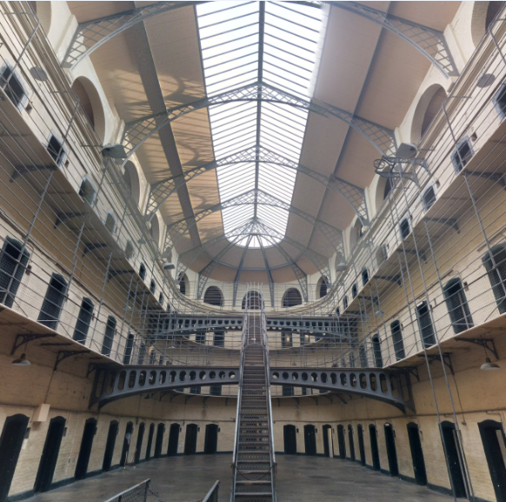


Should we use a regulation to implement the Healthy Prisons Agenda in England?
A qualitative study among prison key policymakers
Nasrul Ismail & Nick de Viggiani
20th June 2017

Slide 2

WHO Healthy Prisons Agenda (2007)
Objectives …
Reduce health risks (education, prevention, protection)
Protect human rights
Equivalent health services
Whole prison approach (justice system)
Risky lifestyles are symptoms of the social system, not root causes of poor health (Smith 2000)

Slide 3
Significant health inequalities experienced across regimes
Rising prevalence of comorbid conditions
Rising proportions presenting with complex needs
Need to recognise broad determinants of health
Impact of overcrowding
    May 2017: 84,319 prisoners (80,374 male / 3,945 female)
    Usable Operational Capacity: 98% / 85,795

Slide 4
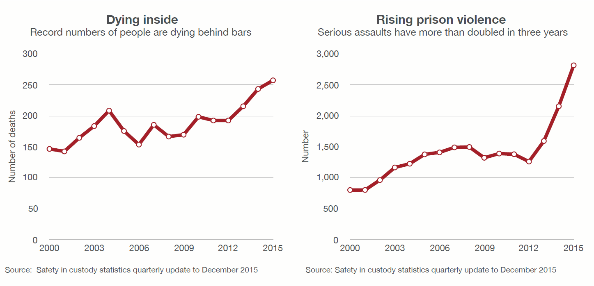

Slide 5
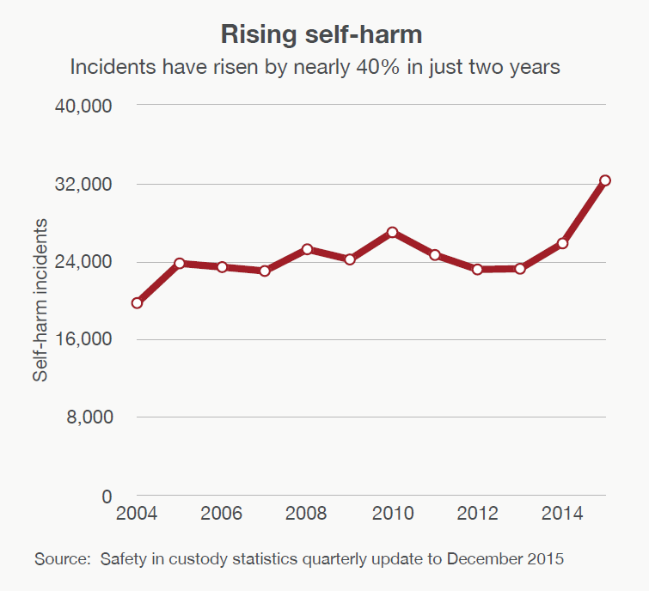

Slide 6

Why a legal framework?
  (i) UK Government legal & ethical obligations:
  human rights (ECHR; Human Rights Act, etc.)
  safety / freedom from harm
  duty of care
  healthcare equivalence, dignity, ethics
  equality and diversity
  safeguarding
  etc.

Slide 7
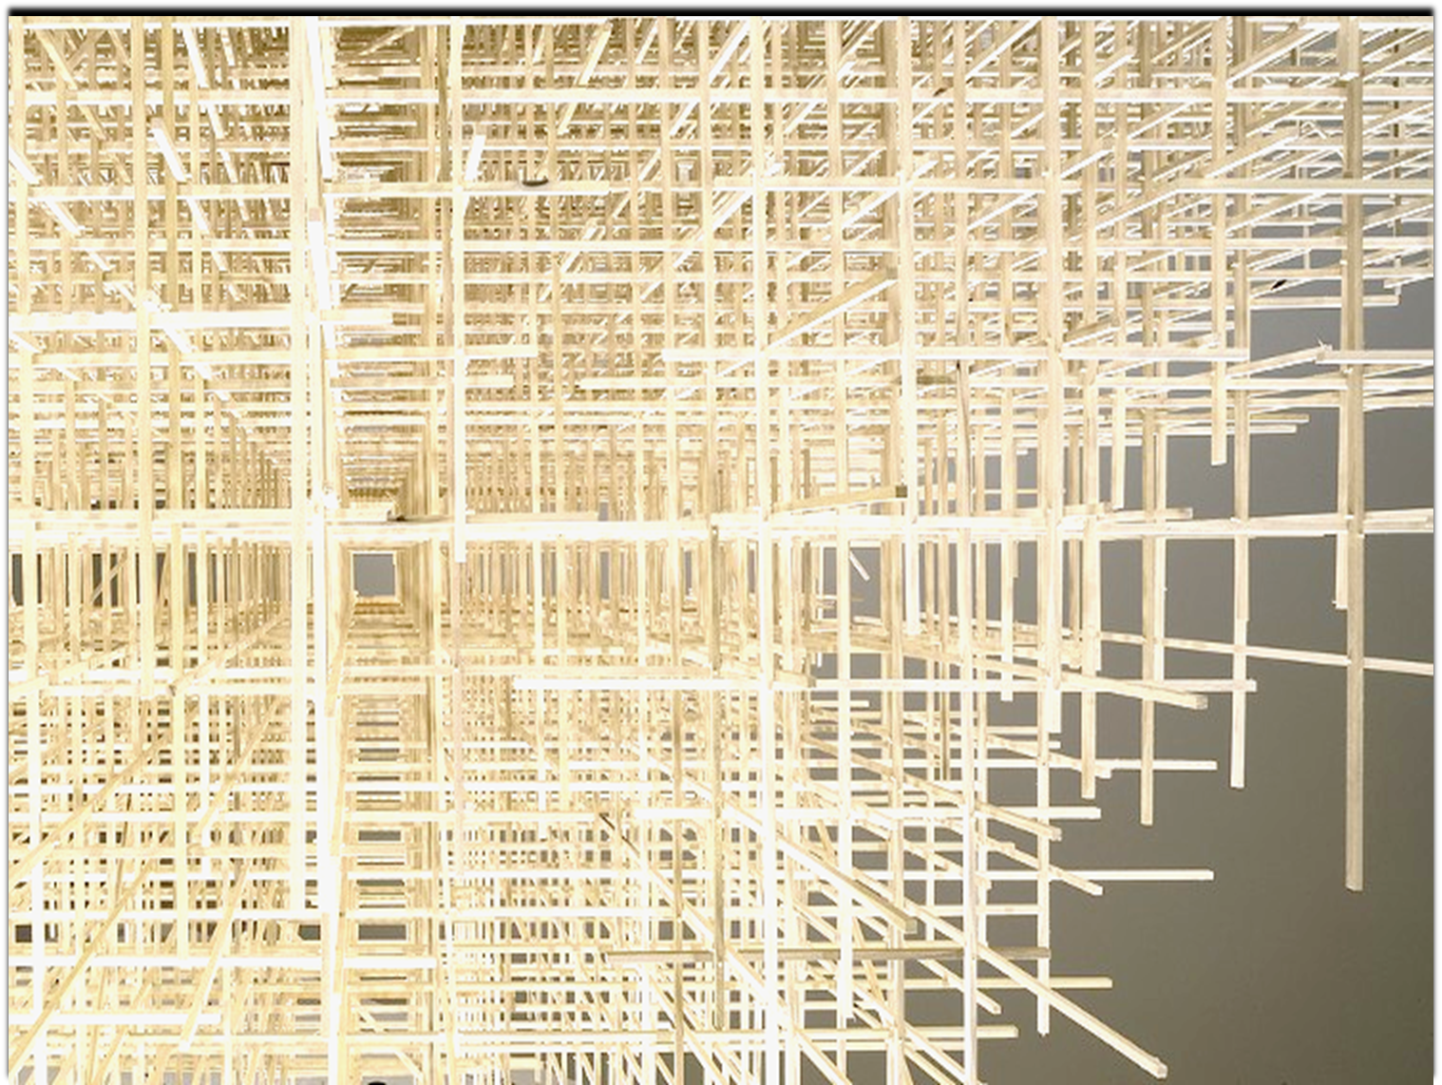
Why a legal framework?
(ii) Operationalise (& enforce)
health promotion, health protection & prevention …
(iii) Accountability & social responsibility as PH providers
(KPIs / contractual responsibilities)
(iv) Greater legitimacy for Justice Public Health

Slide 8

Research
Qualitative study (Grounded Theory approach)
May-September 2016
“Could a regulation lead to enhanced implementation of the Healthy Prisons Agenda in England?”
30 ‘elite’ participants
  Deputy Chief Inspector of a regulatory organisation
  Head of Commissioning, NHS England
  Chief Executive, Community Rehabilitation Company and CIC
  Former Chief Inspector of Probation
Semi-structured interviews
Thematic analysis (using NVivo 11)

Slide 9
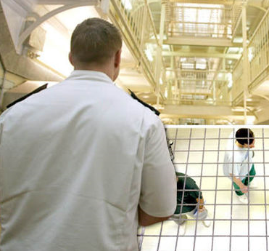
Theme 1: A regulation is too prescriptive
The broad, dynamic nature of the Healthy Prisons Agenda, along with its values of empowerment and participation, can’t be reduced to Black Letter Law.

Slide 10
The law can set minimum standards, but these may enforce inappropriately prescriptive or literal interpretation of regulations.
…[T]here’s a danger that people would think, “Eh, two hours is enough!” and that they're actually ticking all the boxes… (Prison Service Manager)
Most people who work in health do so because they want to help people; and the risk of litigation I think is something that would frighten them. (Prison Healthcare Manager)

Slide 11
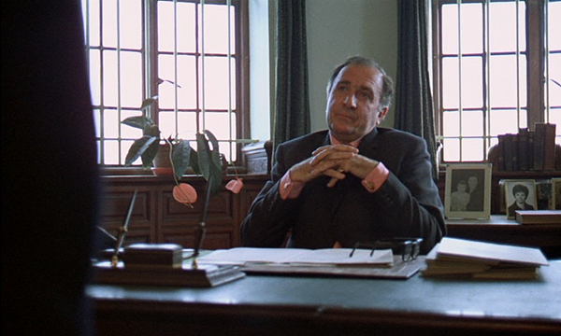
Theme 2: Institutional factors inhibit full adoption of the Healthy Prisons Agenda
I decide, as the governor of the prison, if that is my priority. And if it is my priority, then I create the culture of a healthy prison by my leadership. (Prison Governor)
… [If] they say, “no”, no means no! [laughs]. (Regional Commissioning Lead, NHS England)

Slide 12

A number of prison staff openly said they would turn a blind eye to prisoners who smoked … [that] they didn’t have the time or resources to address that, because they were dealing with more pressing issues …
Secondly, they were smokers themselves, so they didn’t really want to enforce a piece of legislation […] they themselves didn’t subscribe to. (Academic & former Probation Officer)

Slide 13
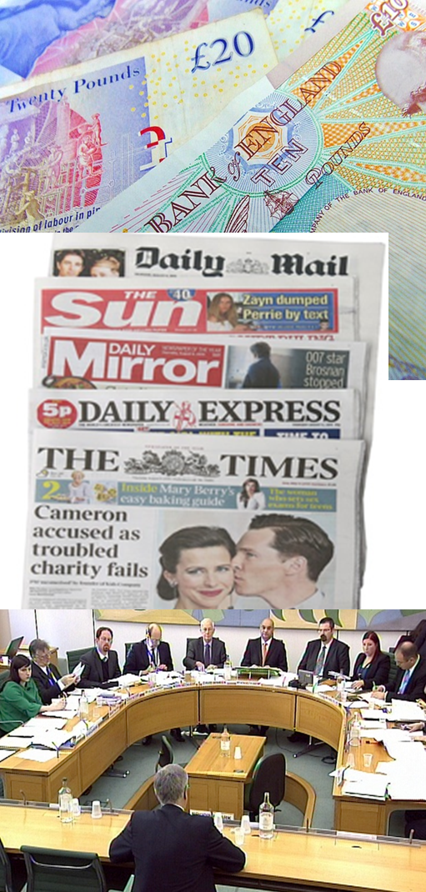
Theme 3: External factors inhibit full adoption of the Healthy Prisons Agenda
We stopped drug testing at **** prison because it was too expensive […] what message is that sending to the prisoner?
(Former Prison Governor)

Slide 14

[F]or the last 20 or 30 years, successive governments of the left and right have put pressure on the courts to pass longer and longer sentences …
[A]ny government that says “[W]ell, we're going to reduce sentences” is liable to be pilloried in this country by the Daily Mail … for being soft on crime. (Former Chief Inspector of Probation)

Slide 15

  So, what does this study add?

Slide 16
A regulation may not ensure enhanced implementation of health promotion programmes.
A self-regulation model would be a preferred approach.
There is consensus that better leadership amongst governors is necessary.
“Engaging upwards” – political establishment.
Using media to frame messages around benefits of prison rehabilitation.

Slide 17

Nasrul Ismail
nasrul2.ismail@live.uwe.ac.uk
Nick de Viggiani
nick.deviggiani@uwe.ac.uk
We’d like to thank all the study participants who made this research possible.
The views expressed here are those of the authors and not representative of UWE Bristol or South Gloucestershire Council.

