Slide 1
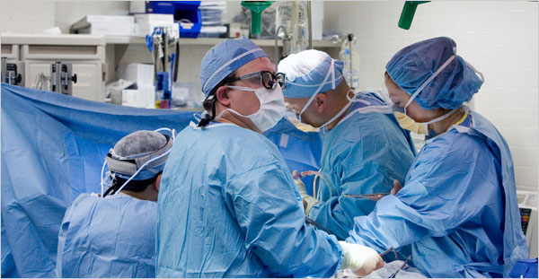
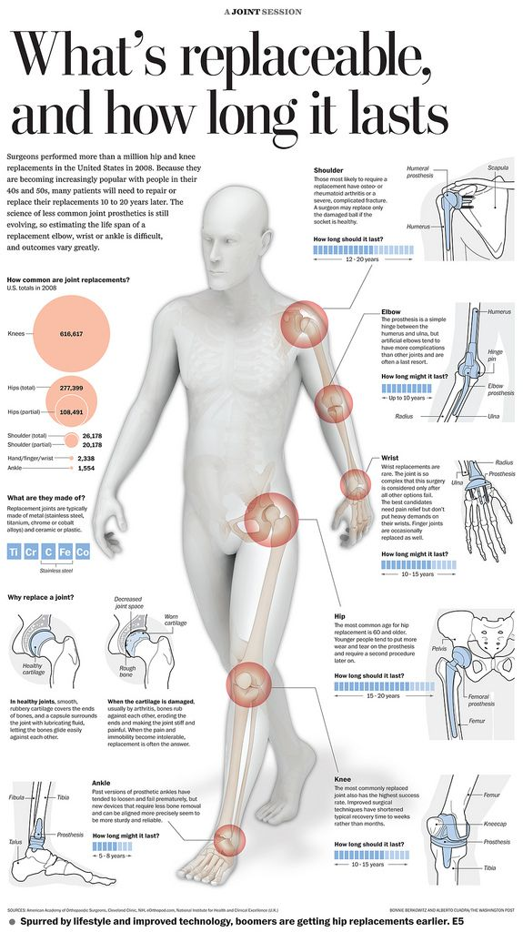
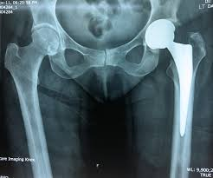
Towards UK poSt Arthroplasty Follow-up rEcommendations: UK SAFE
Czoski Murray CJ¹, Kingsbury S², Smith L³ Wright J¹, Stone M², Philip Conaghan² et al.
Background
In the current economic climate there is increasing pressure to identify cost-saving measures across the NHS. Our recent work suggests that many centres are curtailing primary hip and knee arthroplasty follow-up services to deal with the growing pressure on their services. However, such disinvestment is without evidence-base and raises questions of the consequences to patients. This project will examine the requirements for arthroplasty follow-up and produce evidence and consensus-based recommendations as to how, when and on whom follow-up should be conducted.
AIMS
This project will make use of routine data from
5 national datasets (National Joint Registry,
Hospital Episode Statistics, Patient Reported
Outcome Measures, Clinical Practice Research
Database and TPP SystmOne/ResearchOne)
together with prospective data collected on patients presenting for revision surgery and evidence gathered through a comprehensive literature search.
OBJECTIVES
NJR-PROMS-HES linked data, together with CPRD-HES and R1-HES to understand primary care involvement, will be used to examine which patients are most likely to require intervention.
NJR-HES-PROMS data will be used to model time to revision to determine when follow-up should occur. A smoothed Nelson-Aalen cumulative hazard rate will be used to identify any peak in the mid-long term revision risk.
Prospective data collected on 675 patients presenting for elective or emergency revision across 25 NHS centres will determine how patients currently present for revision surgery.
Markov modelling will be used to simulate long-term costs and quality adjusted life years associated with different follow-up care models to determine how follow-up should occur
Together with a systematic literature review, this work will inform a Delphi-consensus process, involving all stakeholders, to develop a policy document which includes a stratification algorithm to determine appropriate follow-up for an individual patient.
1 Leeds Institute of Health Sciences (c.j.czoskimurray@leeds.ac.uk)
2 LMBRU, Chapel Allerton, Leeds Teaching Hospitals NHS Trust
3. UWE Bristol & Weston Area Health NHS Trust
The UK SAFE Project is funded by the NIHR Health Service & Delivery Research Programme

