Slide 1
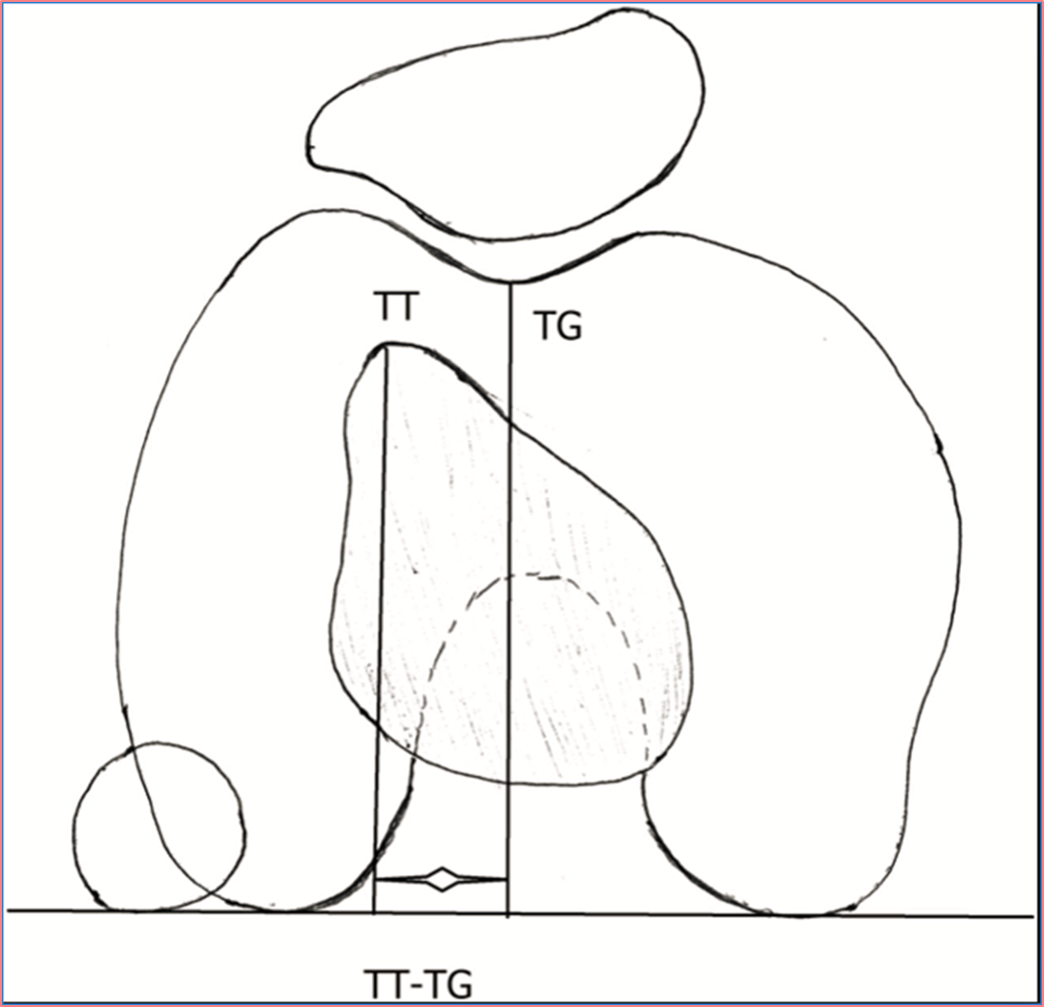
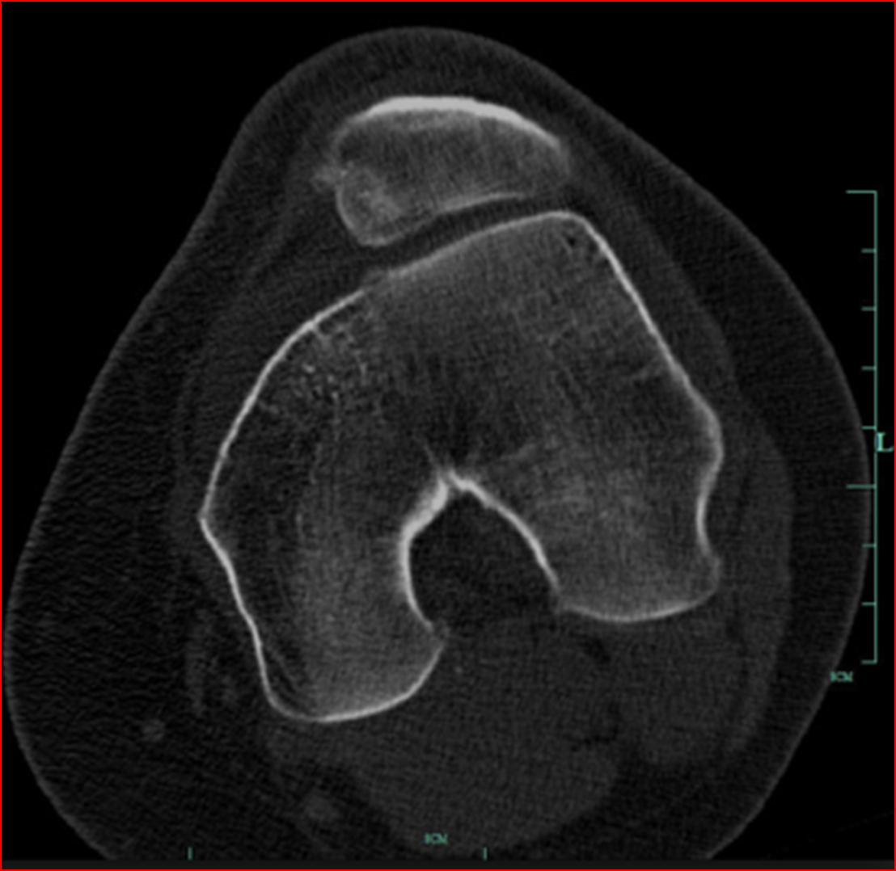
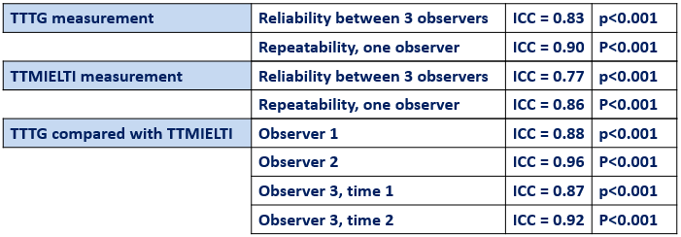
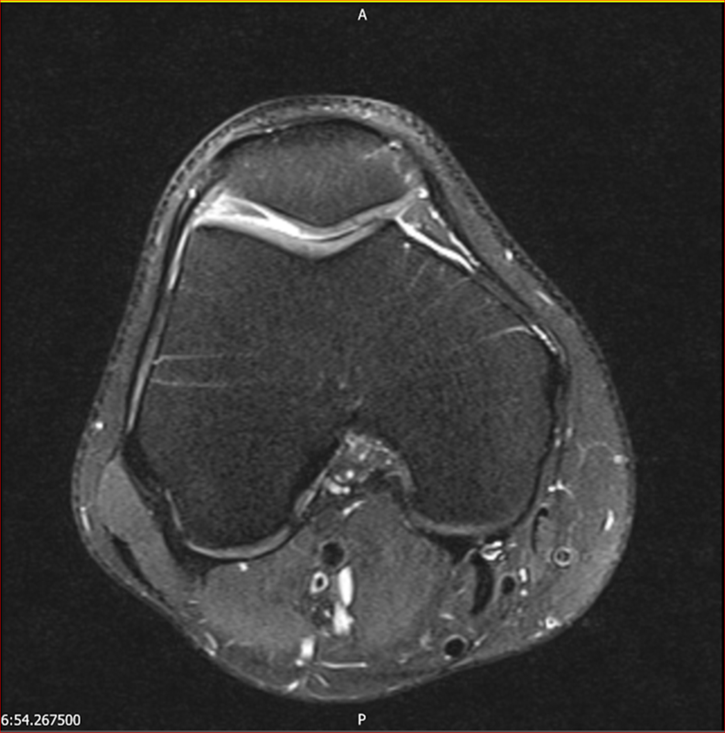

Assessment of the Tibial Tuberosity-Trochlear Groove Distance in Trochlear Dysplasia - a new radiographic method
Weston Area Healthcare Trust
R Keehan, A Gill, L Smith, R Ahmad, J Eldridge
University of Bristol
a.gill.2013@my.bristol.ac.uk
Background
Methods
The tibial tuberosity - trochlea groove distance (TT-TG, below left) is an important radiological measurement in the assessment of patellofemoral instability, and the planning of its surgical treatment.
A distance exceeding 15-20mm is abnormal, and is a risk factor for instability. It is difficult or impossible to identify the trochlear groove component of the TT-TG in the setting of trochlear dysplasia, which is a common contributing abnormality in patellofemoral instability.
Research question: In the setting of trochlear dysplasia, how can TT-TG be assessed?
30 non-dysplastic knee MRIs from a consecutive series of 92
Exclusions:
Trochlear dysplasia, sulcus angles >135°, Osgood Schlatter’s
disease, metalwork/movement artefacts, patella tendon tibial
attachments not demonstrated
3 independent observers (medical student, orthopaedic registrar, orthopaedic consultant)
Blinded measurements of TT-TG and TT-MIELTI measured by each observer on each of the 30 MRIs
1 re-measurement of TT-TG and TT-MIELTI on all 30 MRIs by medical student
Dysplastic knee with absent trochlear groove.
The TT-TG distance cannot be measured.
Results
We used the intra-class correlation coefficient (ICC) statistical test:
A value 0.75-0.90 demonstrates ‘good’ to ‘excellent’ reliability
Standard TT-TG measurement
Mid inter-epicondylar line trochlea intersection (MIELTI)
The mid inter-epicondylar line trochlea intersection (MIELTI) is located by extending a perpendicular line from the mid point of the inter-epicondylar line to the bony surface of the trochlea.
The MRI slice selected is that just distal to the diaphyseal cortical bone, at a level where the trochlear articular cartilage is well defined and articular cartilage is present on both posterior condyles.
New method using MIELTI
Conclusions
The TT-MIELTI appears to compare reliably with the TT-TG when measured by a range of observers who have varying expertise.
The TT-MIELTI may therefore be a useful alternative to the TT-TG in the assessment and management of patellar instability with associated trochlear dysplasia.
Further study is required to assess the usefulness of this landmark in the clinical setting with dysplastic knees.
References
Patellofemoral instability: Diagnosis and Management. Current issues in Sport and Exercise Medicine Chapter 3. Michael Hamlin. ISBN 978-953-51-1031-6, Published: May 15, 2013
The tibial-tuberosity trochlear groove distance: a comparative study between CT and MRI scanning. P.B. Schoettle et al. The Knee 13 (2006) 26–3128
Patellar instability in Indian population: relevance of tibial tuberosity and trochlear groove distance. S Kulkarni et al. SICOT J. 2016 (2), 14: 1-4
Reconstruction of the medial patellofemoral ligament for treatment of patellofemoral instability: a systematic review. Buckens CF, Saris DB. Am J Sports Med. 2010 Jan;38(1):181-8.
Epidemiology and natural history of acute patellar dislocation. Fithian DC, Paxton EW, Stone ML, Silva P, Davis DK, Elias DA, White LM. Am J Sports Med. 2004 Jul-Aug;32(5):1114-21.

