Slide 1
Improving the student learning experience
through dialogic feed-forward assessment
Jennifer Hill
Associate Professor | UWE Bristol
Harry West
Graduate Tutor | UWE Bristol
SRHE Annual Research Conference
6-8 December 2017
Celtic Manor, Newport, Wales

Slide 2
Feedback context
feedback should help students to:
- understand current performance
- understand how to close the ‘performance gap’ in future assignments
- have the confidence and belief they have control over their success
- maintain motivation throughout their degree
(Hattie & Timperley, 2007)
but … there is a recognised gap between staff perceptions of feedback and the student experience (Price et al., 2011)
low satisfaction scores for assessment/feedback in national student surveys

Slide 3
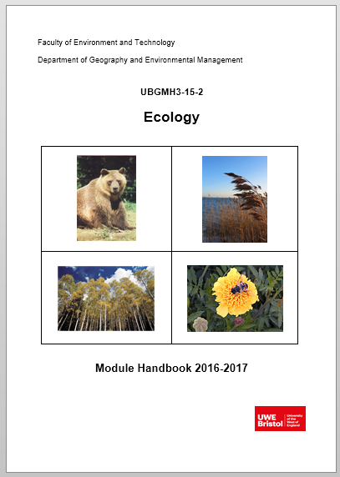
Feedback intervention
we implemented an assessment approach on a second
year physical geography module to optimally support
students’ use of feedback
based on premise that feedback should occupy a central
position within a dialogic approach to learning & teaching
(Alexander, 2004; Sutton, 2009) and be future-oriented
(Sadler, 2010; Beaumont et al., 2011)

Slide 4
Definitions
dialogic feedback is the creation of meaning and understanding via spoken discourse between lecturer and student, or student to student
(Nicol, 2010)
feed-forward refers specifically to feedback given by tutors that:
- impacts upon an upcoming assignment
- is given post-assignment with more specific direction on
how this can be applied to future assignments
(Carless, 2007)
Notes:
Dialogic feedback is the creation of meaning and understanding via spoken discourse between lecturer and student, or student to student (Wegerif 2006).
Feed-forward focuses on providing students with prior exposure to and practice with assessment in order to develop a clear sense of expectations and standards, which they can apply to future work (Carless, 2007; Baker & Zuvela, 2013).

Slide 5
Research aims
Explore student perceptions of the dialogic feed-forward approach and whether it asserted a positive influence on their learning experience
Identify if and how the task-specific behaviour of students was altered by the assessment approach
Identify the extent to which students believed their self-efficacy and self-regulation skills were improved
Examine whether the assessment approach enhanced student performance and whether it could potentially raise NSS scores related to feedback

Slide 6
Module assessment structure
Supporting Lectures
Students choose essay from selection
Students write draft essay
Students submit draft and attend ‘feed-forward’ meeting
Students reflect on meeting and essay – grading their work
Students complete and submit final essay
25% module assessment
75% module assessment
Assessment discourse
Feedback
discourse
Notes:
We offered preparatory guidance, in-task guidance and performance feed-forward.
Interviews were audio-recorded and exemplar paragraphs were used during them. Students engage with learning ‘head on’
Arrow on right leads on to ipsative feedback – ‘based on a comparison with the learner’s previous performance and linked to long-term progress’ (Hughes 2011, p. 353). Supports development of long-term generic skills over short-term achievement of assessment criteria.
Also undertook essay marking seminar: students work with marking criteria and match LOs to standards

Slide 7
Data collection
Qualitative case study approach
individual semi-structured interviews … two consecutive year 2 cohorts at end of module (2015-16 and 2016-17) … analysed thematically via grounded theory
44 interviews ( x 30 mins ), 61% response rate: male = 45% female = 55%
group semi-structured interviews with level 3 students elucidating post-assignment behaviour
essay performance data pre- and post-assessment intervention (inferential stats)
answers to NSS feedback questions
Notes:
full-time students, most aged 18-21 years
Interview average = 29.58 minutes. Range = 13.02 mins - 56.33 mins

Slide 8
Selected results
Enhanced learning experience
Point of contact pulls thinking forward - more time/thought put into assessment:
‘you don’t just have the hand-in at the end of the semester. You have something a bit earlier on to make you get more work done, which I find really good because it’s more of a motivation and driver to get work done early’ R6
‘it pushes you to get more work done before the deadline and then you can have lots of feedback and then have more time to improve. I don’t think I would have done as well without the meeting’ R21
‘I treated the feedback day as hand-in day. It made me do my essay earlier’ R38
Notes:
Slow mvt – stretches timeline

Slide 9
Selected results
Enhanced learning experience
conversation compels students to engage critically with their work:
‘when I have had drafts handed back to me and it’s just written over, either I don’t understand what they are trying to say, or it’s not clear enough. I can ask you questions if we’re talking to each other about it, it’s easier to see things … It’s definitely better to talk about it’ R7
‘I’ve had it before where you get electronic feedback and you might not be sure what some of the comments mean … being able to discuss it is important. You get that progress and can discuss how you can change it as opposed to just saying this is wrong’ R9
Notes:
Students can decode feedback: gain greater understanding of the written feedback through verbal clarification and use of exemplars
Cathartic spaces – ‘coming clean’ with progress,
Affective space - Being judged – head-on learning but they have the emotional capacity to cope with this

Slide 10
Selected results
Enhanced learning experience
Motivational and empowering due to pertinent application:
‘the bit in between my draft and writing the final piece was the best bit because I knew what I was doing and could tweak it and I enjoyed that process of making it better. It gave me more confidence in my writing skills’ R7
‘my first draft was quite vague and I didn’t really know what direction I was going with it. Then, after speaking and having the feedback, I spent more time on it because I knew where I needed to go with it’ R8
Notes:
Students can ‘make good’ – immediate relevance of feedback for good practice. Students see feedback as disempowering (high stakes) but feedforward as empowering (developmental)
To that point students had developed a personal interpretation of the meaning and requirements of their question. The feedback allowed them to judge how far they were meeting the performance standards of the assessment criteria as interpreted by the tutor.

Slide 11
Selected results
Task-specific behaviour … and self-regulation
‘it helped me to realise how to critique my own essays because I was able to sit down with you and go through the essay and know exactly why you were commenting on something … It allows me now to see in other essays the same things I’m doing’ R10
‘Now, I feel like I can evaluate at different stages throughout assessment and therefore make changes. Before, I just skimmed over work, handed it in, and got feedback at the end without really thinking about it’ R29
Notes:
Nicol’s self-regulation
Baxter-Magolda’s self-authorship

Slide 12
Selected results
Self-efficacy
students display increased self-efficacy: stronger beliefs in their capabilities to accomplish tasks in future
Altered their level 2 behaviour:
‘I’ve altered the way I approach other modules … like preparing essay plans for exams … when I was doing my plans I said ok that needs more, that needs a reference, because I had thought about it for the Ecology essay’ R28
Notes:
R28 student got 68% for the desert exam

Slide 13
Selected results
students also self-avow to altered level 3 behaviour:
‘I felt my critical analysis was improved through the feedback session and this has been helpful writing other essays and exam answers … I was able to achieve higher 2:1s and 1sts at level 3 because my understanding of critical analysis had improved’
‘Since this module I have made sure that whenever possible I meet with academics and discuss my work. This is something which prior to the Ecology module would scare me as I was embarrassed by the mistakes within my work’
Notes:
From third year semi-structured interviews

Slide 14
Selected results
Significantly higher marks 2015-17 v 2011-13 (p = < 0.0001)
Enhanced student performance
Band (%) | 2011-2012 (%) | 2012-2013 (%) | 2015-2016 (%) | 2016-2017 (%)
0-39 (inc. NS) | 16 | 5 | 0 | 5.5*
40-49 | 9 | 14 | 3* | 5.5*
50-59 | 34 | 38 | 28 | 17
60-69 | 41 | 38 | 58 | 58
70-100 | 0 | 5 | 11 | 14
Number (n) | 32 | 37 | 36 | 36
Average Ecology mark 4.5% higher than average mark for other second year optional modules
(p = 0.01)
* Did not have a meeting
Dialogic assessment
Notes:
Mean mark increase 2011-2013 to 2015-2017 of 7%: 56% to 63%
Increase seen most in moving students from 2:2 to 2:1. Reduction in students failing module. Increase in first class marks.
Mean final year mark for students taking Ecology (n=31): 61.7%
Mean final year mark for students not taking Ecology (n=12): 57.2%
Difference of 4.5% again but not significant at p=0.05

Slide 15
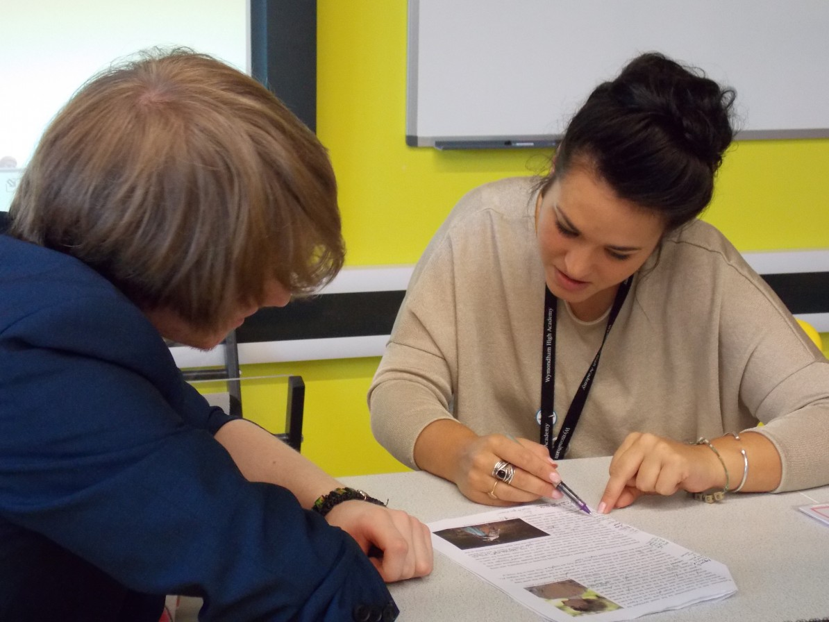
Selected results
Enhanced NSS and TEF metrics
all students rated the module as giving them high quality feedback: detailed, conversational, personalised, timely (relevant application), multi-faceted
all students said the feedback helped them clarify things
they did not understand: proactive engagement with
learning – they had to prepare for the meeting,
think about their work, ask and answer questions
Notes:
‘I felt like you cared’ R1
‘I definitely felt like you cared about what I was getting’ R7
Note 2017 NSS results for BSc Geog: Feedback on my work has been timely: 97% I have received helpful comments on my work: 97%
The educational alliance, is an important influence on student perceptions of the quality of feedback (Telio et al., 2015)

Slide 16
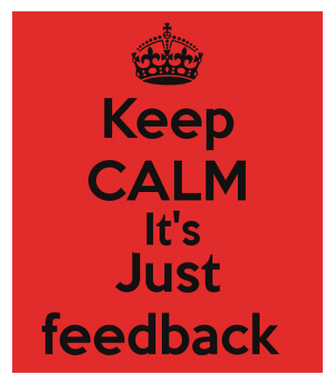
Conclusions
Dialogic feed-forward assessment enhanced the student learning experience by:
- Increasing motivation to engage with current assignment
- Increasing confidence in their ability to complete the assignment
- Solidifying good practice in-task & supporting higher grades
- Increasing satisfaction with the feedback process (potentially boosting NSS metrics)
Positively changing behaviour working towards future assignments
But … dialogic feedforward space is a borderland space (Hill et al., 2017)
Notes:
Borderland = anxiety to achievement: transformational

Slide 18
Implications for practice
To rise to the challenges for assessment and feedback in future, we could:
Deliver all feedback before formal grading, meeting with students or establishing peer feedback (Nicol, 2010)
Offer students mastery experiences (Ritchie 2016), completing phased tasks, and receiving verbal feedback and encouragement to improve their capabilities
Deliver curricula that adopt coherent assessment objectives and standardised grading schemes to facilitate developmental feed-forward (O’Donovan et al., 2016)
Offer enhanced resource at critical feedback moments when students find learning particularly challenging (O’Donovan et al., 2016)
Notes:
Borderland = anxiety to achievement

Slide 19
References
Alexander, R. (2004) Towards Dialogic Teaching: rethinking classroom talk (Third edition). University of Cambridge: Dialogos.
Barnett, R. (2007) Assessment in higher education: An impossible mission? In D. Boud and N. Falchikov (eds) Rethinking Assessment in Higher Education. London: Routledge, pp. 29-40.
Beaumont, C., O’Doherty, M. & Shannon, L. (2011) Reconceptualising assessment feedback: a key to improving student learning? Studies in Higher Education, 36, 671-687.
Blair, A. & McGinty, S. (2013) Feedback-dialogues: exploring the student perspective. Assessment and Evaluation in Higher Education, 38, 466-476.
Carless, D. (2006) Differing perceptions in the feedback process. Studies in Higher Education, 31, 219-233.
Carless, D. (2007) Learning-oriented assessment: conceptual bases and practical implications. Innovations in Education and Teaching International, 44, 57-66.
Hattie, J. & Timperley, H. (2007) The power of feedback. Review of Educational Research, 77, 81-112.
Hill, J., Thomas ,G., Diaz, A. & Simm, D. (2016) Borderland spaces for learning partnership: opportunities, benefits and challenges Journal of Geography in Higher Education, 40, 375-393.
Liu, N.-F. & Carless, D. (2006) Peer feedback: the learning element of peer assessment. Teaching in Higher Education, 11, 279-290.

Slide 20
References
Nicol, D. (2010) From monologue to dialogue: improving written feedback processes in mass higher education. Assessment and Evaluation in Higher Education, 35, 501-517.
Nicol, D.J. & Macfarlane-Dick, D. (2006) Formative assessment and self-regulated learning: a model and seven principles of good feedback practice. Studies in Higher Education, 31, 199-218.
O’Donovan, B., Rust, C. & Price, M. (2016) A scholarly approach to solving the feedback dilemma in practice. Assessment and Evaluation in Higher Education, 41, 938-949.
Price, M., Handley, K. & Millar, J. (2011) Feedback: focussing attention on engagement. Studies in HE, 36, 879-896.
Price, M., Handley, K., Millar, J. & O’Donovan, B. (2010) Feedback: all that effort, but what is the effect? Assessment and Evaluation in Higher Education, 35, 277-289.
Ritchie, L. (2016) Fostering Self-Efficacy in Higher Education Students. London: Palgrave.
Sadler, D.R. (2010) Beyond Feedback: Developing student capability in complex appraisal. Assessment and Evaluation in Higher Education, 35, 535-550.
Sutton, P. (2009) Towards dialogic feedback. Critical and Reflective Practice in Education, 1, 1-10.
Winstone, N.E., Nash, R.A., Rowntree, J. & Parker, M. (2017) ‘It’d be useful, but I wouldn’t use it’: barriers to university students’ feedback seeking and recipience. Studies in Higher Education (in print).
Yang, M. & Carless, D. (2013) The feedback triangle and the enhancement of dialogic feedback processes. Teaching in Higher Education, 18, 285-297.

Slide 21
Thank You For Listening
Questions?
jennifer.hill@uwe.ac.uk harry2.west@live.uwe.ac.uk | https://www.linkedin.com/pub/dr-jennifer-hill/a2/7a6/22 https://uk.linkedin.com/in/harrywest94

