Slide 1


Law, Outlaw and Deviancy in Bro Country
Marcus Keppel-Palmer
UWE
@marcuskeppel

Slide 2
Scope of Paper
This paper looks at a content analysis of the lyrics of albums released by artists within the “Bro Country” genre, a commercially successful male dominated sub-genre of Country music, prevalent from 2012 onwards
In USA, Country music was the most popular sales genre 2013 – 2016 with the largest sales dominated by Bro Country – 2014 33m sales
Luke Bryan’s “Crash My Party” sold 2.3m CDs in 2014 (second biggest selling album of year in USA)
Bro Country has dominated country radio
Bro Country artists tour frequently and play festivals
The lyrical themes reach a large audience

Slide 3

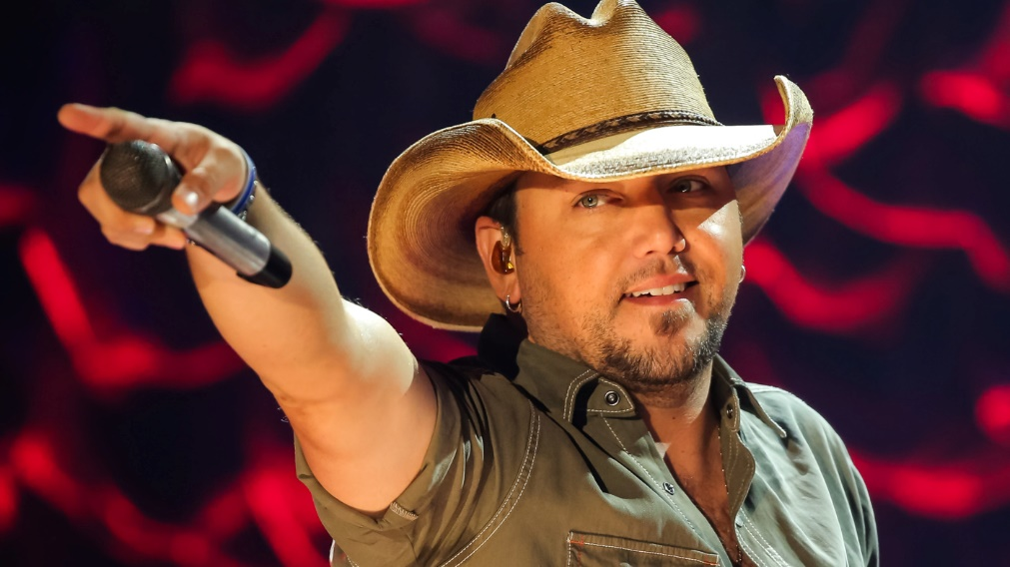
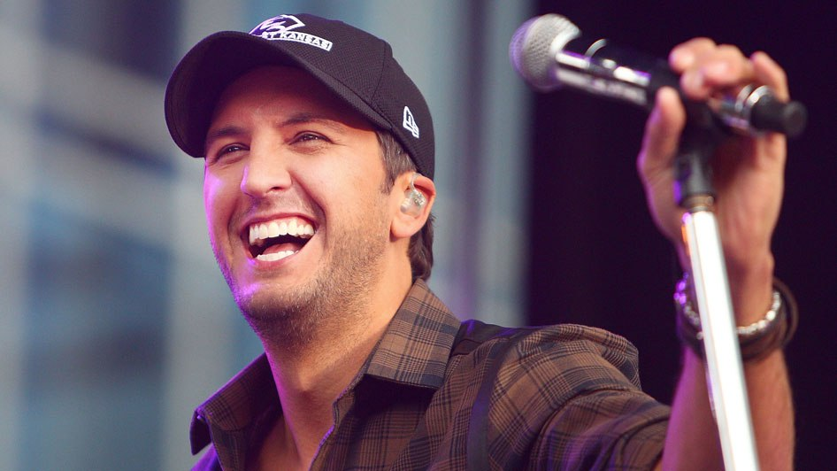
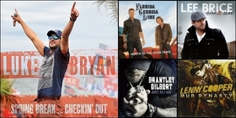
What is Bro Country?

Slide 4
Derogatory term coined by Jody Rosen in 2013
“In short, “Cruise” is bro-country: music by and of the tatted, gym-toned, party-hearty young American white dude. It’s a movement that has been gathering steam for several years now, and we may look back on “Cruise” as a turning point, the moment when the balance of power tipped from an older generation of male country stars to the bros.”
Lyrically, the Bro Country songs are male-centred, small town/ rural in outlook and involve a “raising hell” lifestyle.

Slide 5
Lyric Analysis
Analysis of lyrics of popular songs offers an insight into the social construct of both the organiser and the organised, the songwriter and the consumer. (see Armstrong (1993))
Rap music has been subject to extensive content analysis, focussing in on areas of violence, masculinity and misogyny (see Weitzer and Kubrin (2009); Hunnicutt and Andrews (2009))
Analysis has focussed on how the songwriter/performer reflects and also exaggerates the culture from which the music genre emerges
Analysis has also focussed on the effect that the messages and symbols used have on the consumer/listener (see Herd (2005) on alcohol use)

Slide 6
Rap Music has been looked at because it is successful commercially and has become a dominant form of popular culture
It is also seen as reflective in its themes of the Northern USA, urban black underclass experience often contrasting not just white culture, but also black middle class experience.
Whilst early rap music was seen to be fully reflective of the streets from which it came, with commercial success came a hyper-reality or “hall of mirrors” effect, meaning that depictions of the themes analysed became more glorified than real.

Slide 7
Hunnicutt and Andrews analysed a sample of 329 best-selling rap songs from 1989 until 2000, of which 103 contained references to homicide.
“The major themes found in these homicide-related rap lyrics were the normalisation of killing, respect maintenance, conflict with the power structure, vengeance, and masculine confrontation”.
Weitzer and Kubrin analysed a random sample of 403 songs from best selling rap albums from 1992 – 2000 looking at themes of misogyny contained in the lyrics. 90 of those contained misogyny themes, including violence against women.

Slide 8
Herd looked at 341 rap song lyrics from 1979 – 1997 and tracked the emergence of references to alcohol, with alcohol being increasingly linked to success in rap society.
Herd queried whether this was reflecting the norms of the society reflected or was driving an increase among the consumers of rap music to drink alcohol, with a concomitant link to violence.
Armstrong is the only study to draw a link between rap music and country music, in this case asking consumers to supply examples of song lyrics in both genres reflecting violent crime, homicide and also imprisonment and capital punishment.

Slide 9
By asking consumers in an ethnomusicological manner, Armstrong accepted an inexactitude in his method. On the other hand, his process allowed for the observer’s insider understanding of the musical milieu to inform occurrences of violence.

Slide 10
Country Music as appropriate for analysis
Armstrong highlights that as with rap music, “the lyrics are key to country music”; that programmatic content is central.
Not all country lyrics are meant to be taken seriously; and a section of “outlaw country” imagery is often rose-tinted and drama infused. But mush of the lyric is meant to be reflective of the milieu of country music and its consumers.
Painton (1992) identified that whereas rap was for black, urban youth, country was grounded in the experience of a Southern USA, white, rural and middle-aged audience. Bro-Country, in contrast, is aimed at a more youth-oriented audience.

Slide 11
Just as rap deals with a black underclass (and shows that success can be attained through a gangsta rap lifestyle), so too does country reflect a “blue-collar” underclass working in traditional rural agricultural pursuits.
Bro-country plays to this stereotype with its constant referencing of tractors, dirt roads, and small towns.

Slide 12
Method
Analysis was conducted on 328 songs from the biggest selling artists in the Bro Country genre, released between 2011 and 2017.
Song lyrics were analysed from the booklets with the cds or on the azlyrics.com site.
Lyrics were read to look for topics relating to deviant conduct, and the presence of the law and the outlaw in themes. Although songs were exclusively male in gaze, lyrics weren’t read for misogyny. Women played a central, but almost totally objectified and unnamed, role in many songs.

Slide 13
Themes were:-
No songs involved capital punishment
Violence | Alcohol | Law Enforcement | Speeding
Guns | Beer | Justice/ Outlaw | Drink + Driving
Death | Whiskey | Misc. Anti-Social Behaviour
Theft | Drugs
Drink + Violence | Drink + Sex

Slide 14
Analysis
Theme | Songs | Occurrences
Violence | 46 | 120
Guns | 65 | 96
Death | 36 | 109
Theft | 14 | 28
Drink + Violence | 7 | 8

Slide 15
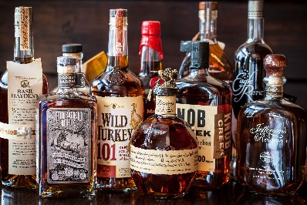
Theme | Songs | Occurrences
Alcohol | 158 | 773
Beer | 61 | 170
Whiskey | 44 | 130
Drugs | 18 | 52
Drink + Sex | 18 | 28

Slide 16
Theme | Songs | Occurrences
Law Enforcement | 19 | 39
Justice/ Outlaw | 27 | 86
Misc. Anti-Social Behaviour | 60 | 126
Speeding | 45 | 95
Drink + Driving | 12 | 21

Slide 17
Headline Analysis
Alcohol plays a major part in life/is a norm. 48% of all songs surveyed refers to alcohol, with on average 4.9 references in that song to alcohol, either directly or as a location (bar/ honky tonk).
Limited direct references to drink-driving and to drink-sex; however, in many lyrics the male is drinking with the girl, or facilitating her drink.
US studies have conservatively estimated that up to half of all sexual assaults have found that the victim was drinking, with similar figures for the perpetrator drinking (see Crowell and Burgess 1996). Furthermore, alcohol-involved sexual assaults tend to occur at parties or in bars, rather than in either person’s home (Abbey et al. 1996a).

Slide 18
Drugs are less prevalent – limited to smoking dope, often at parties
Driving features. Hardly surprising as this is a rural / small town community. Most of the partying takes place outside of town – riverbank; dirt roads; fields. Given the amount of alcohol consumption, there must be drink-driving to get there/back.
Speeding is also prevalent – either in driving fast, stated excess of speed limit, or in “raising hell”.

Slide 19
Limited concerns about law enforcement; though where it happens there is a respect for the police; acceptance that police can enforce speed limits.
Contrast with rap depictions of the police (cf “Fuck Tha Police” by NWA).
“Come on
Somebody better call the law
We done took it outside we’re about to brawl”
“Just read me my rights put me in cuffs
Take me downtown barney lock me up
I’ll do my time and raise my right hand”
(Read Me My Rights: Brantley Gilbert)

Slide 20
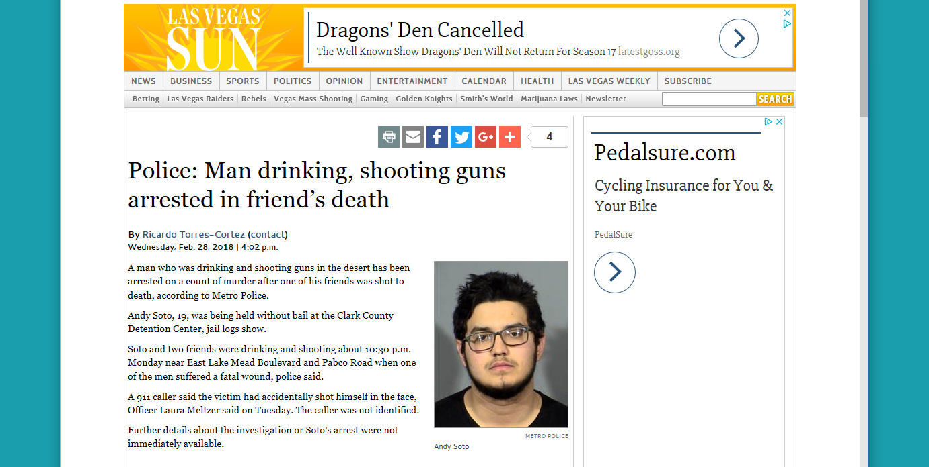
Guns play a part; but limited in the use of violence; mainly shotguns as paraphernalia in trucks; or used for hunting/recreation (cf Drinking Beer and Wasting Bullets; Luke Bryan)
Lack of research about alcohol and use of guns

Slide 21
Other deviant behaviour:
Use of fake IDs to purchase alcohol
Noise disturbance
Making and running illegal alcohol / “moonshine”
All without punishment.

Slide 22
Final Thoughts
In comparison to studies done in the 1990s/2000s Bro Country displays little representation of serious violence and crime. In a reflection of white rural underclass living, there is low level unlawful behaviour.
This contrasts with the country and rap themes which concentrated on homicide and rape
The lack of police involvement and lack of prison/judiciary is also telling
However, the excessive referencing of alcohol, especially linked to driving and partying with girls, can be seen as negative role modelling.

Slide 23
References
Abbey; Ross; McDuffie; McAuslan, Alcohol and dating risk factors for sexual assault among college women (1996) Psychology of Women Quarterly Vol 20, 169.
Armstrong, The Rhetoric of Violence in Rap and Country Music (1993) Sociological Inquiry Vol 63, 64
Crowell and Burgess, Understanding Violence Against Women (1996) National Academy Press
Herd, Changes in the Prevalence of Alcohol Use in Rap Lyrics, 1979 – 1997, (2005) Addiction 100, 1258
Hunnicutt and Andrews, Tragic Narratives in Popular Culture: Depictions of Homicide in Rap Music (2009), Sociological Forum Vol 24, 611
Weitzer and Kubrin, Misogyny in Rap Music: A Content analysis of Prevalence and Meanings (2009) Men and Masculinities Vol 12, 3

