Slide 1
De/Connoted Messages in Sports Photography in National Newspapers
Marcus Keppel-Palmer
Matthew Hall
UWE

Slide 2
Research Idea
Studies have shown that there is a clear link between the lack of reporting of women’s sports and funding
Studies have tended to concentrate on stories/reporting
We wanted to see what the reality was in terms of images
What message is given to readers of national newspapers from the visuals in the dedicated sports pages?
We wanted to look at gender, race, and disability

Slide 3
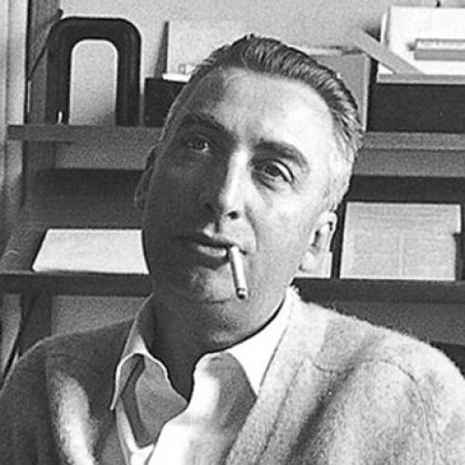
Barthes and the Denoted/Connoted Message
“The press photograph is a message … formed by a source of emission, a channel of transmission, and a point of reception.”

Slide 4
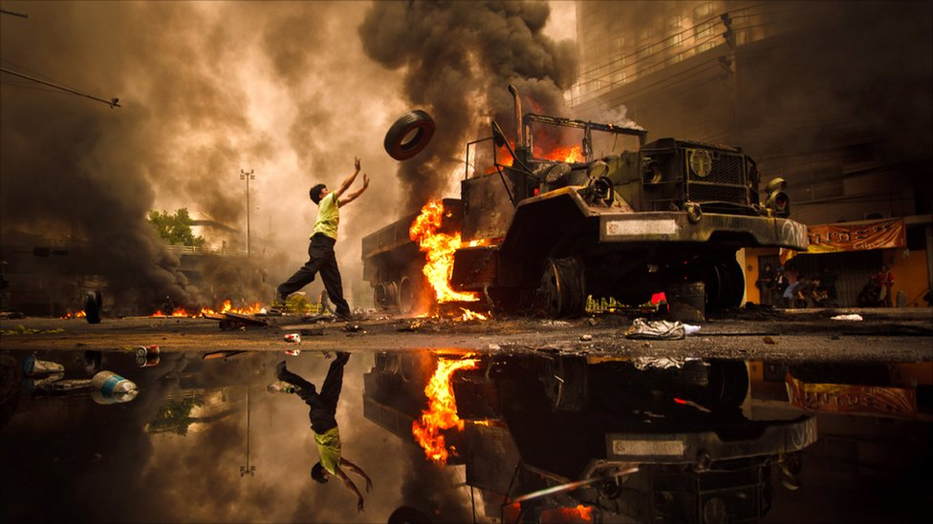
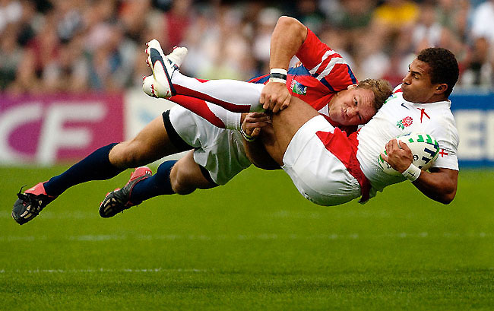
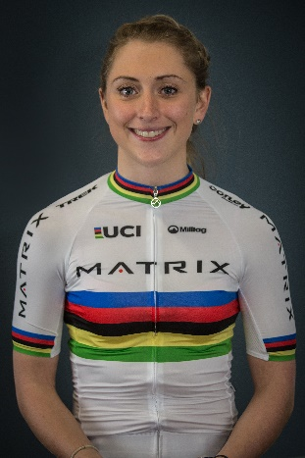
News photography v sports photography

Slide 5
Previous Studies
Press Stories
Duncan (1991)
Godoy-Pressland (2014)
Photographs
Pedersen (2002)
Hardin (2002)
Godoy-Pressland & Griggs (2014)
Delorme & Testard (2015)

Slide 6
Our Study
Newspapers sampled:-
The Sun
Daily Mail
Daily Telegraph
Jan 2016 circulation : The Sun – 1.78m; Daily Mail – 1.59m; Telegraph – 472,000
Chose not to do Metro, London Evening Standard, Daily Mirror
Three of top 4 best selling dailies.

Slide 7
During the year (2016) all three newspapers’ circulation declined and the Daily Star sales overtook the Daily Telegraph.
On average, the newspapers in the survey sample sold between 3.7m and 3.5m per day

Slide 8
Sample: Monday – Friday for a sample week in 7 months (Jan – March; August (Olympics); Sept – Nov). Weeks avoided Champions League weeks
Newspapers purchased in the Bristol area
The Sun has a Monday pullout section, and from Sept had a Wednesday pullout section
Daily Telegraph’s sports section is a pullout each day
The Sun and the Telegraph had daily pullouts for Olympics in August
Only dedicated sports coverage was considered, not sports persons in the main news sections (e.g. Adam Johnson trial)

Slide 9
Photographs not counted were :-
Advertising
Pictures of columnists
Owners of teams/Administrators of sports
Partners/Family
Crowd/Spectators
Photographs counted were of:-
Participants
Coaches/Trainers

Slide 11
Total Photos = 4512
The research team categorised them in four headings:-
XS (size = smaller than 2 inches)
S (size = 2ins – 5ins)
M (size = 5ins – 9ins)
L (size = 9ins +)
Content was analysed for gender, race, and disability. Other categories were horses, cars, and cycles, where they were featured.

Slide 12
Sports featured were football, rugby, tennis, golf, motor racing, cycling, horse racing and cricket
Olympic sports featured during Olympics week.

Slide 13
Results and Findings
Male White sporting figures dominated.

Slide 15
Overall 6345 males (92.66%) to 502 females (7.34%)
Overall 5379 white (78.46%) to 1466 BAME (21.54%)
Olympic coverage sees more equity in gender, but not ethnicity:
All coverage was 71.8% male, 28.2% female, 84.05% white, 15.95% BAME
Olympic specific coverage was 60.63% male, 39.37% female, 86.87% white, 13.13% BAME
This reflects the findings by Delorme and to a lesser extent Godoy-Pressland/Griggs

Slide 16
Did the Olympics make any difference to coverage?
Pre-Olympics:-
96.96% male, 3.04% female; 77.47% white, 22.63% BAME
After Olympics:-
96.41% male, 3.59% female; 77.44% white, 22.66% BAME
Olympics coverage is an outlier, and has no lasting effect on overall coverage.

Slide 17
What is the message given to the reader?
Aside from large events, women remain largely invisible in sports media
BAME athletes are largely underrepresented. Despite being mainly in football season, BAME athletes are not portrayed in a similar proportion to their presence in Premier League (36% in 2016/17)
33 Paralympian athletes portrayed (26 during the Paralympics 2016 week sampled) (0.005%). 24 of those were portrayed with reference to their disability (wheelchair/modified bicycle).
86 Horses, 71 cars, 28 boats were portrayed.

Slide 19
Sports newspaper photography coverage is of course dictated by the topical
Coverage is principally focussed on male sports
The message given to the reader of newspapers is that sport is mainly the preserve of male, white able-bodied participants.
Focussing on coverage of the Olympics and other major sporting festivals hides the massive imbalance of coverage in normal day-to-day coverage.

