Slide 1

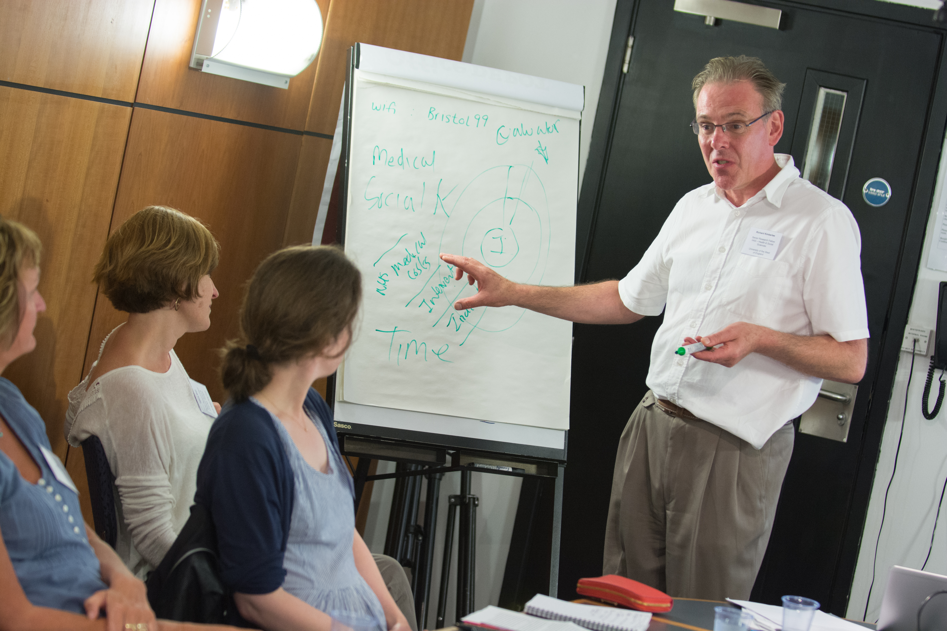
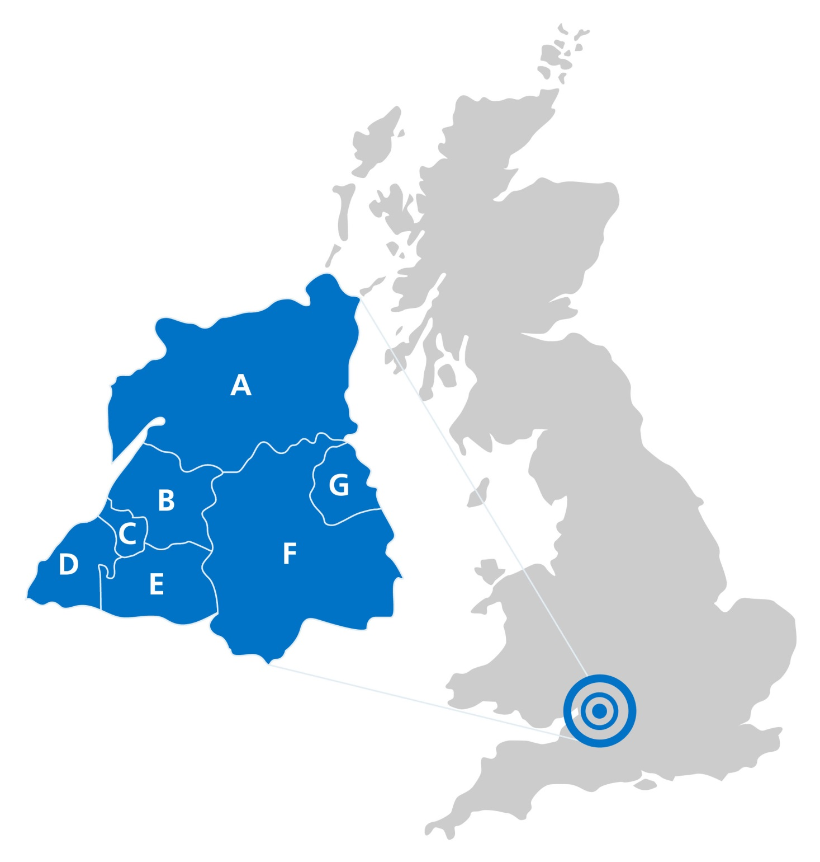
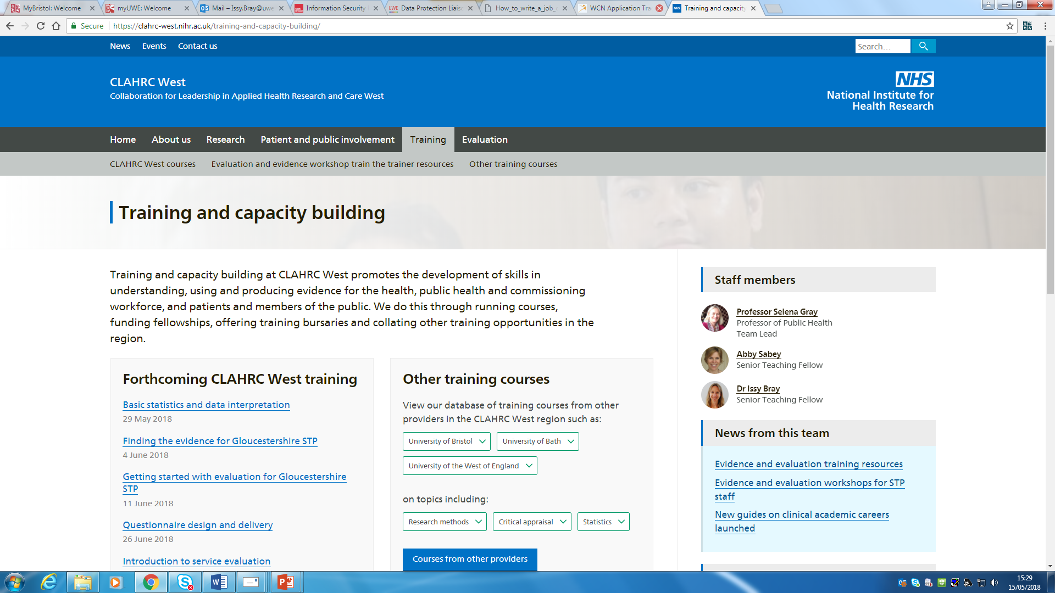

Increasing engagement with evidence in healthcare: a case study in capacity building
Abby Sabey and Issy Bray
Senior Lecturers, Faculty of Health and Applied Sciences, UWE
Senior Teaching Fellows, CLAHRC West
INTRODUCTION
RESULTS
The National Institute for Health Research Collaboration for Leadership in Applied Health Research and Care West (NIHR CLAHRC West) works with partner organisations, including the NHS, local authorities and universities, to conduct applied health research and implement research evidence, to improve health and healthcare across the West of England.
The Capacity Development Team (one Professor and two Senior Lecturers seconded from UWE) started in Sept 2014, with a broad remit to build capacity in research.
We took a qualitative and quantitative approach to investigating ‘demand and supply’ – who needed health research training and who was supplying it. We then developed an innovative capacity building programme of short courses.
Here we report on the training programme for the period May 2015 – December 2016.
Summary
We delivered 31 courses in this period with 350 participants attending. The majority (68%) of these courses were one day in duration. The mean of overall ratings on course evaluation forms was 3.6 (1 being ‘poor’, 4 being ‘excellent’). 4,503 people used the database of training opportunities.
Geographical Reach
KEY:
A – Gloucestershire
B – S. Glos.
C – Bristol
D – North Somerset
E – Bath & NE Somerset
F – Wiltshire
G – Swindon
Attendees most often came from secondary care (20%) followed by Local Authorities (18%) and the voluntary sector (18%). Professionals working in the mental health sector comprised 11% and in commissioning 6%. Less well represented were primary (3%) and community care (4%).
CONCLUSIONS
METHODS
Feedback obtained from participants suggests that the courses have been well-received, and that the opportunity to attend this free training, the experience of the training environment and the educational content are all highly valued by this varied audience.
Key features of the programme that have contributed to its success:
Free!
Bite-size training
Inter-professional groups
Small groups (interactive)
Non-academic setting
Highly relevant / timely for practice
CLAHRC West badging (NHS links)
Some courses had CPD accreditation
Core team with complementary skills
Bringing in experts e.g. Realist Evaluation course
Training Needs Assessment
1. Demand
We carried out a training needs assessment among local stakeholders. Qualitative interviews explored the views and experiences of senior staff involved in learning and development in CLAHRC’s partner organisations – public health, acute care, ambulance services and mental health services. Participants were asked about
the evidence-based culture in their organisation
access to training
barriers to using evidence and research
how training could best be delivered by CLAHRC to their staff
2. Supply
We also mapped provision of research-related training by other local organisations, which was compiled into a searchable database of training opportunities.
Programme Design
In line with the needs assessment, a programme of short courses was developed which covered topics from identifying relevant evidence, to improving research skills (e.g. designing questionnaires, data analysis), to critiquing research for practice. The aim was to provide brief, applied training for a wide range of professionals.
Job Roles
An assessment of the job titles of participants shows by far the largest group was public health professionals, followed by medical, nursing and allied health professionals in approximately equal proportions. Dentists were not well represented.
Bristol 50%
Rest of CLAHRC West area 25%
Pan-CLAHRC West area 20%
Outside CLAHRC West area 5%
FURTHER DEVELOPMENTS
Bespoke courses for Local Authorities (Public Health teams AND those working in Planning / Housing / Transport / Environmental Health)
Taster workshops for Clinical Commissioning Groups
Funding scheme for healthcare librarians to attend a residential course on ‘Teaching Evidence Based Medicine’, followed by regional networking events for librarians
Contributing to the development of freely available online toolkits to support use of evidence and evaluation - http://www.nhsevaluationtoolkit.net/ http://www.nhsevidencetoolkit.net/
Follow-up to collect evidence of impact
EB culture and training needs
Existing provision
Capacity building programme:
31 courses (May 2015-Dec 2016)
Team experience and network
The research is supported by the National Institute for Health Research (NIHR) Collaboration for Leadership in Applied Health Research and Care West (CLAHRC West) at University Hospitals Bristol NHS Foundation Trust. The views expressed are those of the authors and not necessarily those of the NHS, the NIHR or the Department of Health.

