Slide 1
STORY MAPPING & ARCGIS ONLINE:
Building bridges between students and researchers
Harry West, Michael Horswell & Nevil Quinn

Slide 2
Longitudinal Curriculum
YEAR 3
YEAR 3: Learning by independent endeavour
Project design, definition and implementation, reflective learning
Independent, creative work
Identifying development priorities
Theoretical extension
Industry standards
Professional self-awareness, reflexivity
Create
YEAR 2
Evaluate
Analyse
YEAR 2: Learning by deciding
Technical confidence, project-related decisions, methodological considerations, explanation
Professionalization emphasis
Transferable skills: literacy, numeracy, graphicacy, self-confidence, responsiveness, academic rigour
Reflexivity
YEAR 1
Apply
Understand
YEAR 1: Learning by doing
Technical confidence, technical decisions, exposure to new technology, use and interpretation of data
Strong content alignment
Focussed achievable tasks
Contextualized discussion
Remember

Slide 3
Final Year Assessment
Teaching staff source student projects
Projects are then showcased to students
Students identify groups and their project
Students start work on their chosen project
Updates and meetings with project ‘sponsors’
Creation of ArcGIS Online Story Maps
Presentation at a conference style event
Online hosting of Story Maps

Slide 4
“complex of knowledge, skills and other attributes that are tied to the objectives of instruction or otherwise valued by society”
Life beyond university
Offering final year students the opportunity to participate in research activities, and to provide something of value to the ‘project sponsors’ was a natural fit with the approach to GIS learning and teaching
Curriculum and practice
Content and instruction
Authenticity
Processes and products
Conditions
Figurative context
Messick (1994) in Palm, T. (2008) Performance assessment and Authentic Assessment: A conceptual Analysis of the Literature. Practical Assessment, Research & Evaluation 13(4): 1-11

Slide 5
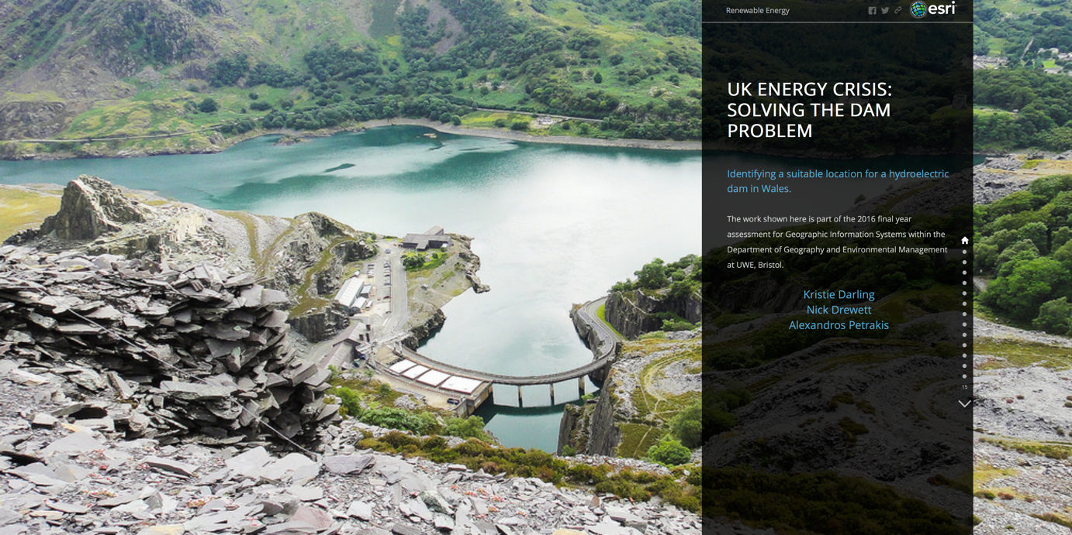

Slide 6
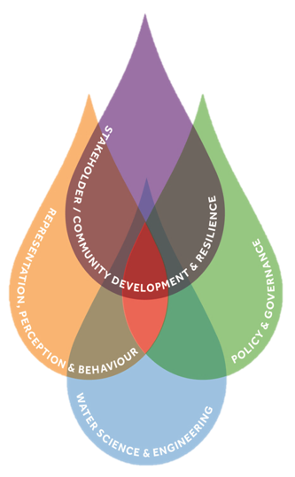
CWCR & UK Droughts & Water Scarcity Projects
Centre for Water, Communities & Resilience (UWE, Bristol)
An interdisciplinary research centre focussing on water related challenges including water security, extreme weather such as floods and droughts, as well as building socio-economic and community resilience
UK Droughts & Water Scarcity Programme (RCUK)
This is a six-year, 12 million pound research initiative funded by consortium of research councils aimed at improving understanding and response to dry weather, water scarcity and drought in the UK in the context of a changing climate.

Slide 7
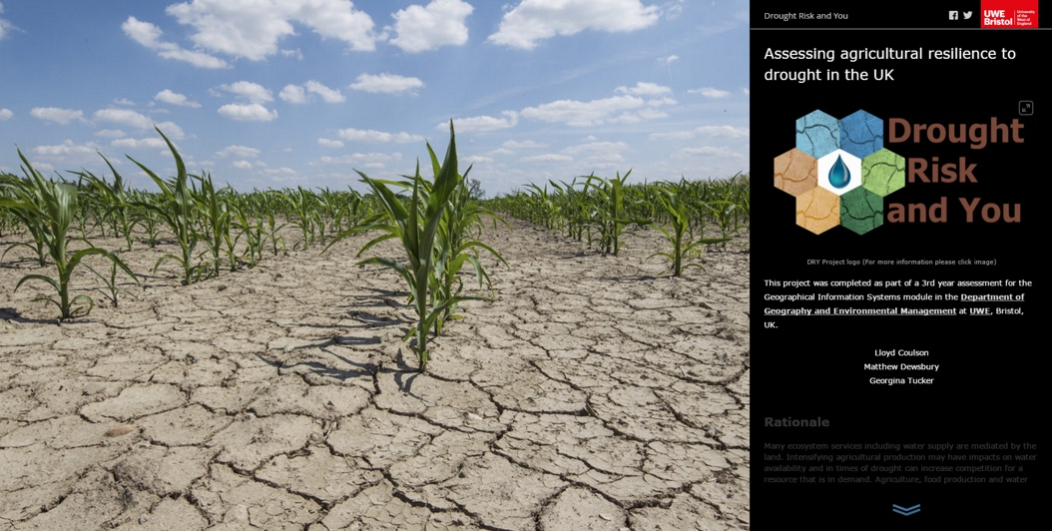
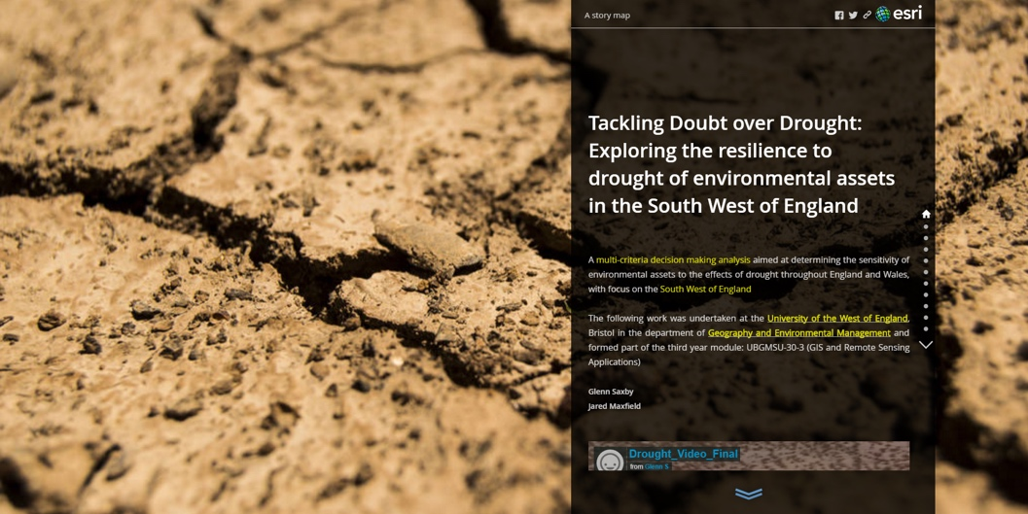
Identifying & Overcoming the Challenge
Value of the spatial view of data recognised – seven case study catchments across England, Scotland and Wales
Using location as an integrator for information from a range of stakeholders
Many opportunities for spatial analysis to reveal interrelationships and to present future scenarios
Maps and spatial visualization recognised as key tools in stakeholder engagement

Slide 8
Benefits for Students
Authentic learning experience
Sense of purpose to assessment
Challenge of effective science communication
Projects become live resources
Graduate attribute enabling
Skills development…

Slide 9
Professional & Practice Oriented Skills
KNOWING
THINKING
COMMUNICATING
ACTING

Slide 10
Benefits for Project Sponsors
New assessment format for teaching staff
Valuable engagement tools
New way to present research findings
Projects become live resources
A ‘spatial’ representation/way of thinking
New skills and expertise development

Slide 11
Potential Challenges
Expectations
Managing the expectations of both students and sponsors
Many projects are underway…. Students must hit the ground running
Clear communication and shared understanding are key
Why move into a spatial setting?
What can be achieved realistically? Will students understand the data fully?
What if a party is not happy/meeting expectations?
How do teaching staff effectively support both parties?
How do teaching staff weight the challenge of students addressing unfamiliar topics in assessment criteria?
Pedagogy / Student Learning Experience

