Slide 1
Developing an ethical evaluation strategy for assessing the wellbeing of children living in a conflict affected area
Nicola Holt
19/02/2022
Notes:
10:00 – 10:15 (15 minutes) Developing an ethical evaluation strategy for assessing the wellbeing of children living in a conflict affected area.
Nicola Holt (Associate Professor in Psychology, University of the West of England, Bristol),

Slide 2
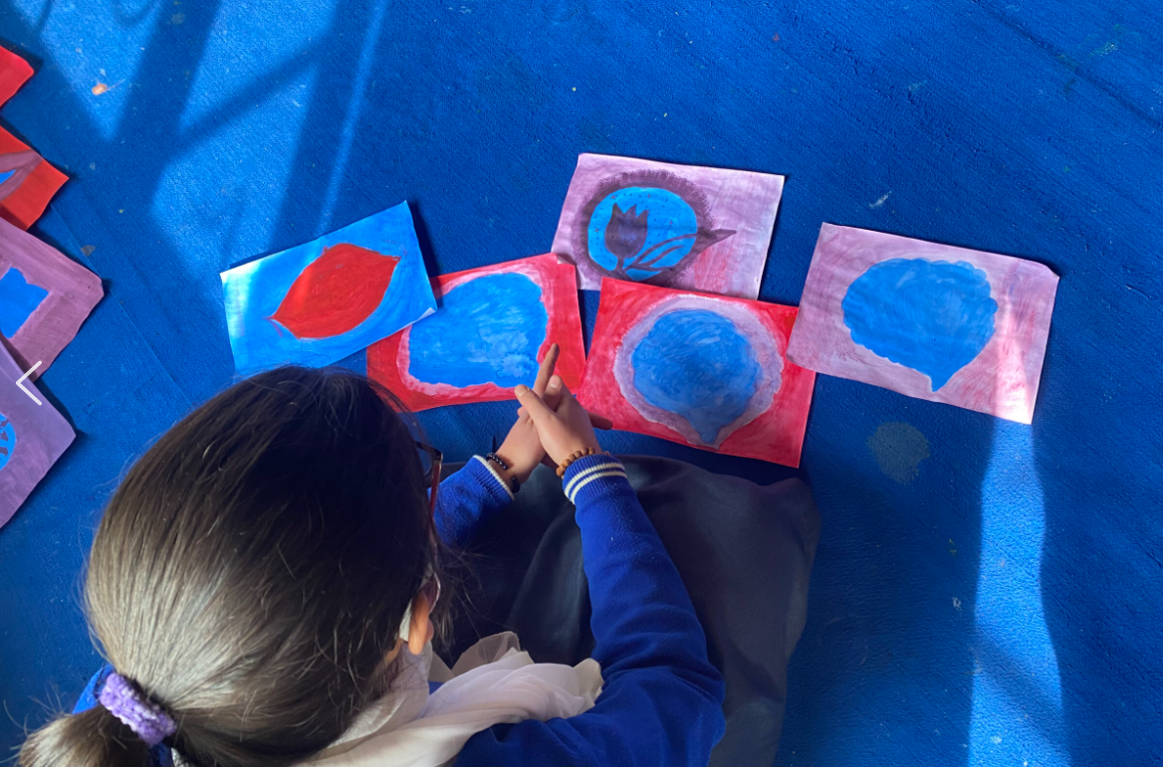
Overview
Description of quantitative methods chosen and rationale for use
Description of outcomes
Initial outcomes and next steps
Initial interpretations of data
Challenges and limitations

Slide 3
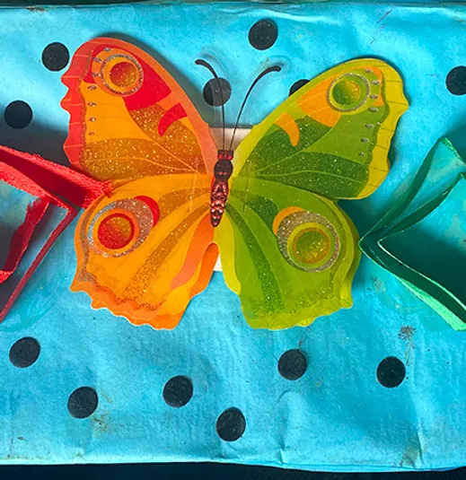
Ethical evaluation
Avoiding asking children directly about their wellbeing or traumatic experiences, which may have increased distress, especially when asked for information that is difficult to articulate verbally (Skybo, Ryan-Wenger & Su, 2007)
Using non-intrusive evaluation tools to maximise engagement with intervention and relationship building with artist facilitators (Fancourt & Poon, 2015)
Notes:
The quantitative evaluation strategy used drawings and observations of children made by school staff and artists working with the children. This approach was taken to be non-invasive, avoiding asking children directly about their wellbeing, which may have increased distress, especially when asked for information that is difficult to articulate verbally (Skybo, Ryan-Wenger & Su, 2007). The evaluation, therefore, focused on human figure drawing (Koppitz, 1968; 1989), observations of the children’s wellbeing and behaviour made by school staff (teachers, teaching aides, and administrators) (Achenbach, 1991), and observations made the artist facilitators using the Art Therapy Checklist (Save the Children, 2016). In this way it was hoped to triangulate different perspectives on the children’s wellbeing across the programme.
non-intrusive monitoring and evaluation of the impact of performing arts activities on participants for whom it is not possible or inappropriate to be administering paper questionnaires
Notes
Seedat et al.:
Research that involves individuals who have been exposed to life-threatening events (eg, childhood physical and sexual abuse, adult rape, and natural and technologic disasters) and who may have a heightened vulnerability for adverse outcomes raises a range of ethical issues. As with other areas of research, there are concerns of confidentiality, disclosure, informed consent, and risk of harm to participants.
There are several broad ethical considerations that are especially relevant to trauma populations [4•]. In research settings, trauma assessments typically comprise the use of structured or semistructured interviews and rating scales (researcher-administered or self-reported). This includes investigation of traumatic life experiences, mental health symptoms (eg, acute stress, post-traumatic stress, or depression), physical health status, health-related quality of life, and some aspects of role functioning (eg, occupational and social functioning). The question is raised as to whether, for survivors of trauma, inquiry into trauma is associated with any risks.

Slide 4
Quantitative measures selected
Indices of wellbeing
Human Figure Drawing Test (Koppitz, 1968; 1989)
Art Obs Scale (Fancourt & Poon, 2015)
Art Therapist Checklist (Save the Children, 2016)
Teacher Report Form of the Child behaviour Checklist (Achenbach, 1991)
A projective test of children’s drawings of a person thought to indicate affective disturbance, including anxiety, conflict, and impaired self-identity (Packman et al., 2003).
An observational tool based on researchers observations of participants, assessing in the moment behaviours during art workshops, indicative of positive mood and engagement vs. distraction.
An observational tool based on school staff’s retrospective ratings of the behaviour of pupils, including: anxiety, depression, inattention, rule breaking and aggression.
An observational tool based on artists’ retrospective ratings of the behaviour of pupils during art workshops, including mindful attention, communication, group interaction, and cognitive engagement with symbolic language.
Notes:
Participants
32 children (20 females, 12 males) aged between 10 and 15 years took part in the intervention and completed evaluation measures. Not all children completed measures at both time points. 15 completed the Human Figure Test at both time points (12 females, 3 males). Teachers completed observation forms for 12 children at both time points (10 females, 2 males) and artist facilitators completed checklists for 19 children at both time points (15 females, 4 males).
Measures
Human Figure Drawing Test (Koppitz, 1968; 1989). A projective test of children’s drawings of a person thought to indicate affective disturbance, including anxiety, conflict, and impaired self-identity (Packman et al., 2003). Children are given a blank piece of paper and are asked to “Draw one whole person. You can draw any kind of person you want to draw, but not a stick figure” (Koppitz, 1984, p. 10). The children are not timed. Drawings are assessed for indices of emotional disturbance, of which there are 28, for example, quality signs, such as a slanting figure (indicative of feelings of instability) or a tiny figure (indicative of insecurity), the presence of specific features (e.g., a small head), and the absence of features, such as no mouth (thought to be indicative of anxiety and withdrawal) or body missing parts (e.g., missing feet is thought to be indicative of helplessness and anxiety) (Skybo et al., 2007). Although not used as a diagnostic tool the presence of three or more indicators in a drawing is interpreted as possible emotional disturbance, represented in attitudes and feelings at the time that the drawing was made. Good inter-rater reliability has been reported (89% to 100%) (Skybo et al.,2007) and validity. In the current study the drawings were scored by two researchers with inter-rater reliability of .
Child behaviour Checklist (Achenbach, 1991) - the Teacher Report Form version. It measures the following sub-scales, based on teachers’ ratings of their pupils’ behaviour in general. The parent version has been used in evaluation of art interventions with traumatized children previously (e.g., van Westrhenen et al., 2019). It measures: Academic Competence (e.g., How hard is he/she working); and various aspects of Adaptive Functioning: Inattention (e.g., Fidgets); Hyperactivity-Impulsivity (e.g., Disturbs others); Social Problems (e.g., Too dependent); Thought Problems (e.g., Hears things); Anxious/depressed (e.g., Hurt when criticized) and WIthdrawn/depresssed ().
Art Therapy Checklist (ATC) (Save the Children, 2016). This scale has been used by artist facilitators to note their general opinion of the behaviour of children during the art sessions, according to the following sub-scales. This scale was adapted by the artists in the current study to reflect their expectations about student behaviour in relation to the programme theory, using the same scales: Body (e.g., Is physically alert and agile); Sensory (e.g., Moves freely without inhibition); Mindfulness (e.g., Able to focus on a process until a goal is achieved); Cognitive (e.g., Can tell the ‘moral/real meaning’ of a story after listening to the story); Expression (e.g., Can express him/herself through artistic media); Communication (e.g., Can disclose emotions through creative writing within a given context); and Group interaction (e.g., Contributes in team tasks so that group goals can be achieved).
Did the males drop out of the study more frequently? Did they face specific barriers to attendance? Do we have any records of attendance at the art sessions?

Slide 5
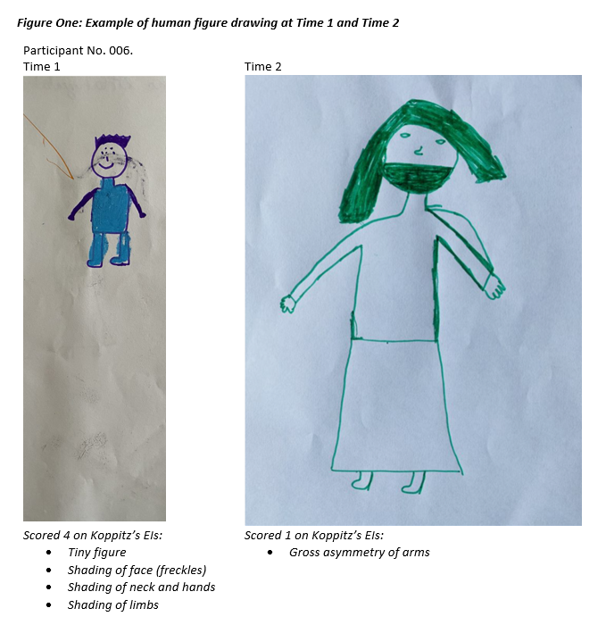
Human Figure Drawing Test (Koppitz, 1968; 1989)
Children are given a blank piece of paper and are asked to “Draw one whole person. You can draw any kind of person you want to draw, but not a stick figure” (Koppitz, 1984, p. 10).
Notes:
Human Figure Drawing Test (Koppitz, 1968; 1989).
Koppitz (8) instructions. The experimenter said, ``On this piece of paper I would like you to draw a whole person. It can be any sort of person you like, as long as you make sure that it is a whole person and not a cartoon or a stick ®gure.'' A pencil, eraser and A4 size paper were provided. The children were allowed as much time as they wished to complete their drawings. Any queries were answered in a nondirective manner.

Slide 6
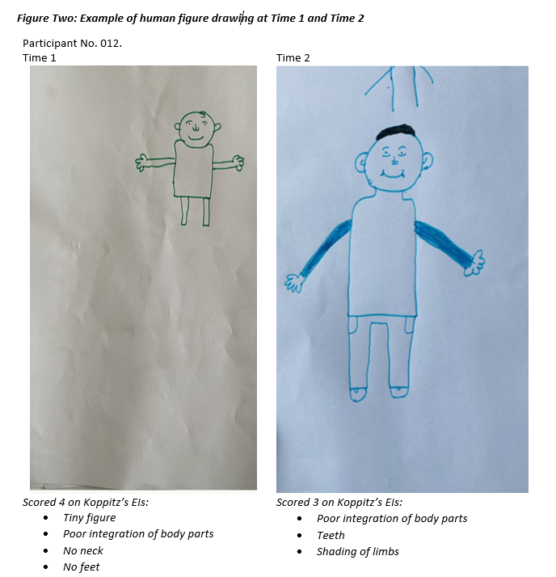
Human Figure Drawing Test (Koppitz, 1968; 1989)
Notes:
Notes:
The emotional indicators were defined by Koppitz (2004) as objective signs reflecting children’s worries or anxieties. To be considered as valid they have to meet the following characteristics: they are clinically valid, that is, they differentiate children with and without emotional problems; they are considered as exceptional according to the child’s age, that is, they occur in 15% or less of all drawings; and they are not related to developmental stage hence they do not increase with age. The normative study found that 30 items of a group of 38 initially proposed (derived from the work of Machover (1949) and Hammer (1958) and the author’s own clinical experience) have a clinical validity (Koppitz, 2004). In general, emotional indicators do not show a direct correlation with any objective scale (different from the case of developmental items with IQ); nevertheless they have been highlighted as a possible tool in multiple stressful situations, including psychiatric upsets or sexual abuse and some consider their usefulness in screening for anxiety and depression and even as a tool in the initial pediatric consultation (Skybo, RyanWenger, & Su, 2007; Sturner, Rothbaum, Visintainer, & Wolfer, 1980; Tielsch & Allen, 2005).
However, a 20-year review of the literature debate (1995–2015) on projective techniques in applied settings (Piotrowski 2015) has concluded that, although there has been a slight decrease in their use, HFDs are valuable for both clinicians and academics (e.g., Imuta et al. 2013; Lally 2001). Specifically, DAP supporters remain resolute in their beliefs concerning the clinical and diagnostic value of the DAP projective technique (Thomas and Jolley 1998) and this instrument remains one of the most used tools among child psychologists. For instance, recent studies have used the Draw-a-Person (DAP) test to provide indications for visual motor development, levels of cognitive functioning, and intellectual maturity in primary school-aged children (El-Shafie et al. 2019b). Other research has used DAP for screening emotional disturbances in children (Zeini et al. 2018) or identifying and monitoring domestic violence in children (Popa-Velea et al. 2017). Hence, it is worthwhile using the graphic projective tests because drawing is a useful way for understanding intellectual development, emotional dimensions and personality traits. Drawing may indeed facilitate children’s ability to communicate (Driessnack 2005) and to talk about their emotional experiences (Gross and Hayne 1998) in different contexts.
The total amount of indicators provides a rating that reflects the child’s emotional maturity and psychological health. Emotional maturity refers to a set of abilities (such as awareness of one’s own emotions, recognition of facial expressions and adequacy of the affective response in social interactions) that enable children to understand and manage how they respond when faced with situations that elicit an emotional reaction (Western Australian Department of Education 2018). Emotional maturity supports children to manage the demands of the social and education environments, helping to form positive relationships with peers, recover from negative emotions, develop resilience, overcome frustration, and express emotions in socially acceptable ways. B

Slide 7
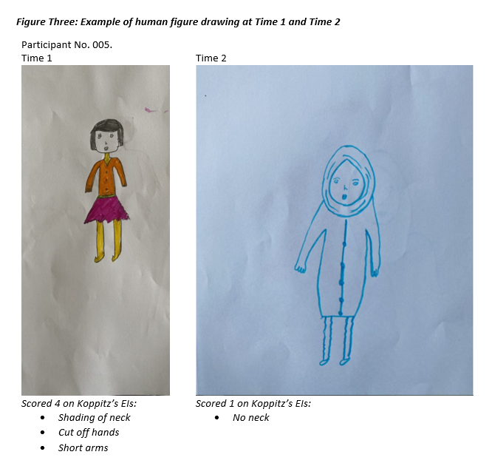
Human Figure Drawing Test (Koppitz, 1968; 1989)
At Time 1 (October, 2020) there was a median of 2 EIs per student; and at Time 2 (June, 2021) a median of 1 EI, with a statistically significant reduction (Z = -2.101, p = .036, two-tailed).
Notes:
Human figure test
24 children completed a Human Figure Drawing, 15 at both time points. At Time 1 (October 2020) there were 21 drawings, and six of these were rated for the presence of 3 or 4 emotional indicators (EIs) (indicative of emotional disturbance), with an average (median) score of 2 (and a range from 1 to 4). No students had zero emotional indicators for their drawings at Time 1. The most common indicators at Time 1 were a slanting figure (in the drawings of six children), the shading of hands or neck (5 children), shading of the face (4 children), followed by the absence of a nose, missing feet, short arms and shading of the body or limbs (all present in the drawings of 3 children).
At Time 2 (June 2021) there were 18 human figure drawings, three of which were scored for the presence of 3 emotional indicators (indicative of potential emotional disturbance) and five of which had no emotional indicators present. The average (median) score at Time 2 was 1 (with a range from 0 to 3). The most common indicators at Time 2 were a slanting figure (in the drawings of three children), the shading of hands or neck (3 children) and shading of the face (3 children).
A non-parametric Wilcoxon Signed Ranks Test was conducted to compare the number of EIs at Time 1 and Time 2, which showed a statistically significant reduction (Z = -2.101, p = .036, two-tailed).
It was noticeable from the drawings at Time 1 and Time 2 that the children seemed to have developed their artistic skills and ability to draw in representationally and confidently with more detail and elaboration in their figures. It was also noticeable that at Time 2 aspects of the pandemic were present in the children’s figures – several children drew face masks on their characters, as depicted in Figure One (which were not scored for missing mouth or facial shading due to the cultural context at that time).

Slide 8
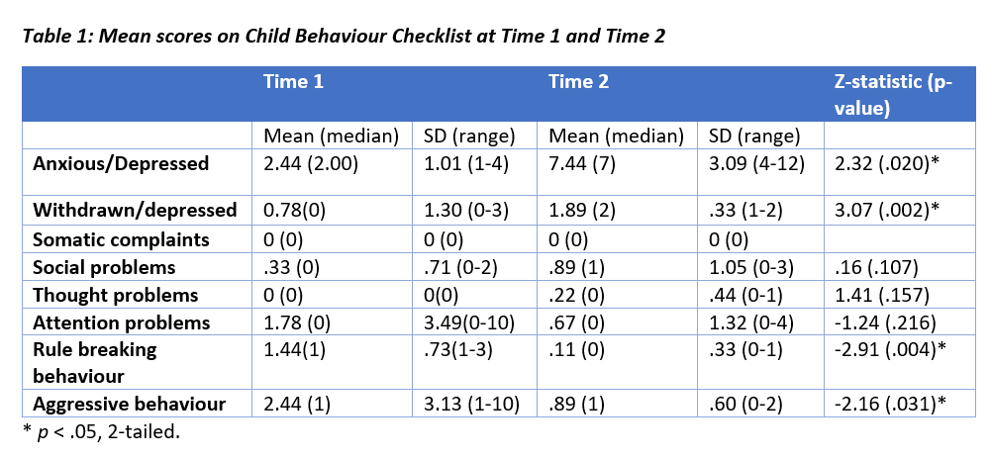
Child Behaviour Checklist: School staff
Increased anxiety (e.g., worrying, self-conscious, fears about needing to be perfect, hurt when criticised)
Increased depression (e.g., unhappy, underactive, secretive, not talking)
Decreased rule breaking (e.g., swearing, preferring to be with older children and children who get in trouble frequently)
Decreased aggression (e.g., temper tantrums, teasing, frustration, explosive behaviour, screaming, fighting, disobedience, defiance, arguing)
Notes:
Child Behaviour Checklist
Teachers, teaching aides, counsellors and school administrative staff completed the teacher’s form of the Child Behaviour Checklist at two time points: October 2020 and June 2021. On average increases were observed in children’s behaviour indicative of depression (withdrawn and anxious), social problems, and thought problems, the means and medians for which can be observed in Table 1. However, decreases where observed from Time 1 to Time 2 in behaviours indicative of attention problems, rule breaking behaviours and aggressive behaviour. Since much of the data was positively skewed, more students showing no or few indices of non-adaptive functioning, non-parametric tests (Wilcoxon Signed Ranks Test) were used to compare scores on each sub-scale at Time 1 with Time 2. This suggested that there were statistically significant increases in both Anxious/Depressed (Z = 2.32, p = .020) and Withdrawn/Depressed from Time 1 to Time 2 (Z = 3.07, p = .002), alongside statistically significant decreases in Rule Breaking Behaviour (Z = -2.91, p = .004) and Aggressive Behaviour (Z = -2.16, p = .031).
To consider: 1) A real effect? If so why might students become better behaved, but more anxious/depressed? Change from externalised to internalised processing of affective experience? Different context, e.g. lockdowns/coronavirus, conflict affecting students more at Time2?Implications for practice? 2) An artefact? Small sample size, range of different observers, teachers/aides/counsellor and time 1, administrator at time two, who may have had different perspectives on students/focus (e.g. less behaviour on in class and more on affective wellbeing).
Signs of anxiety and depression noted: Fears they might do something bad, fears they have to be perfect. afraid of making mistakes, worries, feels hurt when criticised, self-conscious or embarrassed.
Signs of withdrawal/depression noted: Withdrawn, unhappy, underactive, secretive, not talking, underactive/slow moving.
Rule breaking behaviour: swearing, preferring to be with older children, hanging out with children who tend to get in trouble
Aggressive behaviour: temper tantrums, teasing others, stubborn, easily frustrated, explosive behaviour, screaming, fighting, disobedient. Demanding attention, defiant, argues a lot.

Slide 9
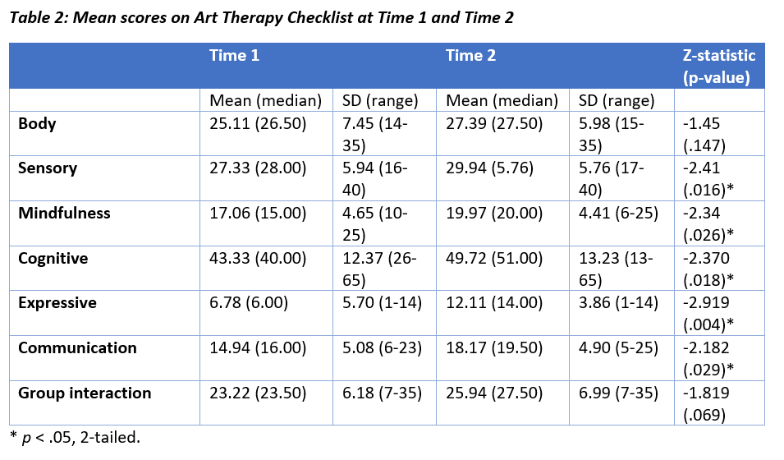
Art Therapist Checklist
Increased sensory skills (e.g., ability to interact with art materials)
Increased mindfulness (e.g., able to concentrate on the art tasks)
Increased cognitive engagement (e.g., understanding narratives, metaphors, interpreting images and stories)
Increased expression(e.g., communication through symbol and metaphor)
Increased communication (able to express emotions in group and through art)
Notes:
Art therapy checklist
An artist facilitator completed the Art Therapy Checklist at two time points (October 2020 and June 2021). Data was available for 19 children. Children showed increases on all seven dimensions from Time 1 to Time 2 (as indicated by the averages in Table 2). Non-parametric tests (Wilcoxon Signed Ranks Test) were used to compare scores on each sub-scale at Time 1 with Time 2. This suggested that there were statistically significant increases on sensory (Z = -2.41, p = .016), mindfulness (Z = -2.34, p = .026), cognitive (Z = -2.37, p = .018), expressive (Z = -2.92, p = .004) and communication (Z = -2.18, p = .029), but not body or group interaction.
Body: Motor skills and physical skills required for art tasks
Sensory: Ability to relate to and interact with the visual and performance art materials
Mindfulness: Able to concentrate on the art tasks
Cognitive: able to build and understand narratives, to express themselves non-verbally, to understand through metaphor, interpret an image or story-line
Expression: To be able to communicate through metaphor and symbolic meaning
Communication: can express opinions without triggering others, can express their emotions through art and talking in group
Group interaction: Shares and contributes in group to achieve goals

Slide 10
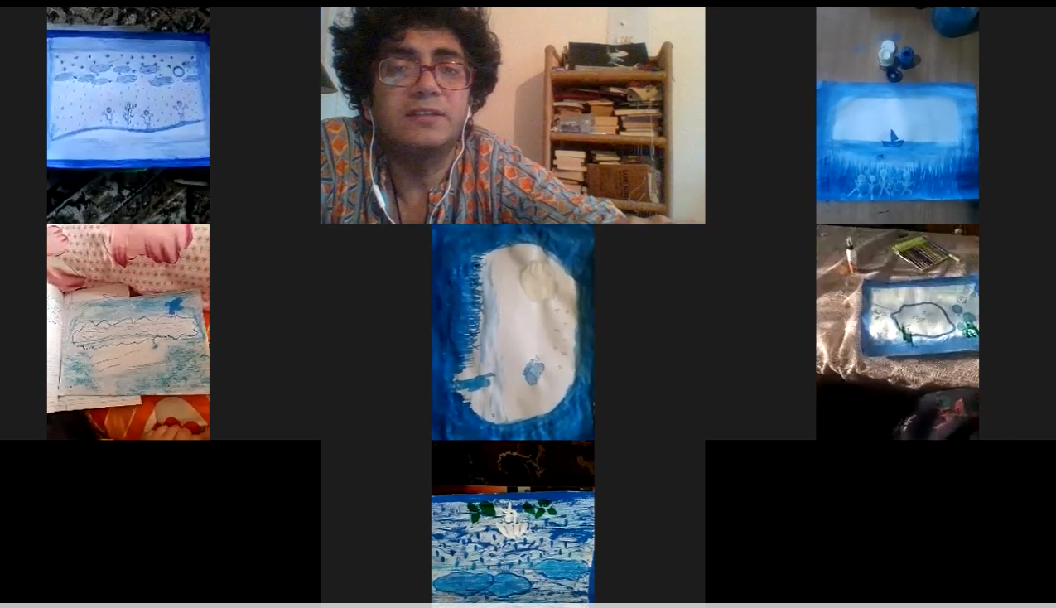
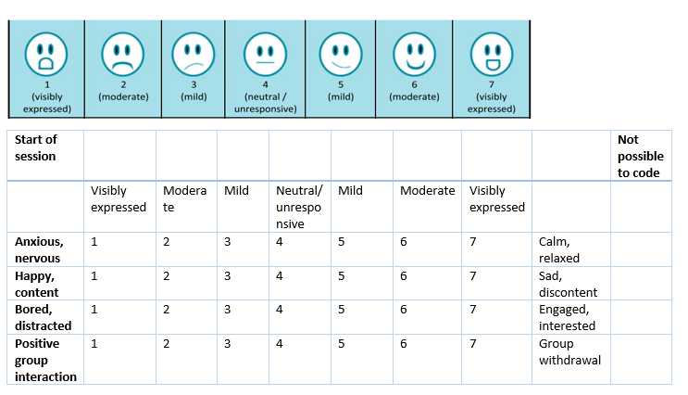
Video Observation Scale
Piloted across 9 sessions, with 5 students
Average scores at start and end of sessions:
Calm: 4.65 to 5.21
Sad: 5.28 to 5.34
Engaged: 5.42 to 5.47
Withdrawn: 5.38 to 5.42
Notes:
Expanded Art Obs Scale (Fancourt & Poon, 2015) to include to mood dimensions (anxiety and sadness) and group interaction.
Piloted use with one art group in Online art sessions in Oct-Nov 2020 (9 sessions) – 5 students
Scored each student’s behaviour according to agreed upon cues in the first and final 20 minutes of each session
Behaviours to look for
Anxious vs. calm (tense arousal)
Signs of being anxious, nervous, tense: Agitated behaviour, anxious facial expression, frowning, fiddling, restless behaviour, fast breathing, tense jaw, fidgeting, frustrated, huffing, throwing pencil down.
Signs of being calm and relaxed: Slow breathing, jaw relaxed, gentle movements, not restless, soft lips and resting tongue, muscular relaxation.
Happy vs sad (positive affect)
Signs of being happy, content, satisfied: Facial expression – smiling, with mouth/eyes, laughter, interested, expressing enthusiasm verbally, animated, use of emojis, confidence, pride/self-esteem.
Signs of being sad, depressed, discontent: frowning, mouth drawn down, head bowed, withdrawn, lack of positive verbal expression, lack of energy, use of emojis, lack of self-confidence.
Boredom versus interest (absorbed attention)
Signs of being bored and distracted: Distracted by other events in background, looking around, not engaged with the art activity or Zoom call, not appearing to produce work, attention split between activity and other events, verbal expressions of disinterest, ‘out of chair’, moved away from activity/screen, being off-task (either passively, or off task behaviour – doing something else, off-task chat).
Signs of being absorbed, engaged and interested: Minimal distraction by other events, attention entirely focused on art activity, produces work on the task, relevant verbal expressions (e.g., time passing quickly, enjoying the activity), on-task (focusing on activity, any chat relevant to activity).
Positive group interaction versus lack of participation (social bonding)
Signs of positive group interaction: Signs of belonging, sharing ideas and thoughts with others, sharing artwork, participating, participating with peers, trusting others, listening, responding appropriately, turning camera on when requested, conversations, friendly greetings, positive feedback, supportive interaction with artists, open, collaborative communication.
Signs of withdrawal from group interaction: signs of hostility, withdrawal, not sharing ideas, thoughts or artwork, not seeming to fully participate in activities, not appearing to listen, and follow instructions, ignoring suggestions from artist, not turning the camera on when requested, not responding to verbal cues, noncompliance, no positive/negative feedback, disrupting session with non-relevant chat/behaviour, misunderstandings in the group.

Slide 11
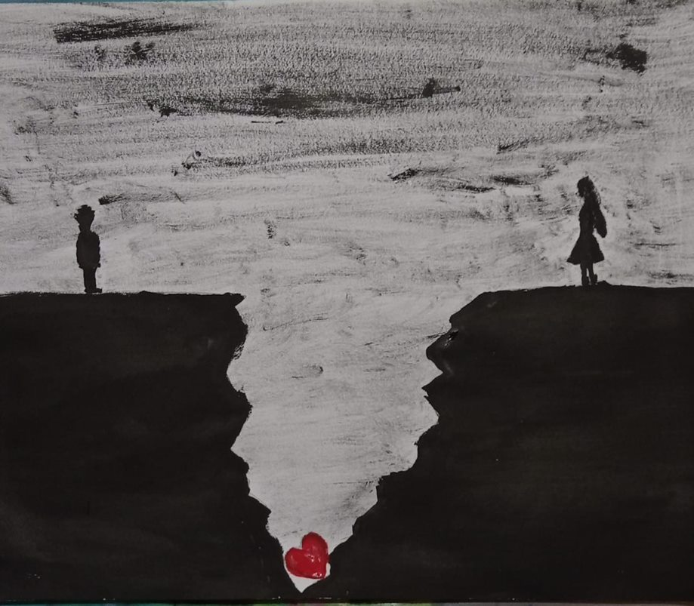
Challenges
Potential reporting biases due to different staff reporting on children at each time point and across time points (e.g., teachers, administrators, counsellors)
Challenges of interpretation due to potential increase in anxiety caused by external factors (e.g., pandemic, levels of conflict)
Interpretation of human figure drawings need to be adapted in line with cultural context, e.g. mask wearing during pandemic, social norms (van Meerbeke et al., 2011)
Video observations limited by cameras being turned off, technical issues and internet access in sessions at times
Time consuming to watch and code videos, train observers and test inter-rater reliability
Need to interpret data cautiously due to low numbers and missing data across time points
Notes:
Challenges adapting design online – and with absence of researchers onsite due to coronavirus pandemic.

Slide 12
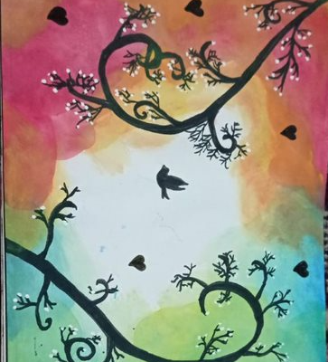
Outcome summary and potential interpretations
Over the course of the art intervention, children:
Exhibited significantly fewer signs of affective disturbance in their human figure drawings.
Had behaviour rated by school staff as being less aggressive and rule-breaking.
Had behaviour by artists described children as being better able to focus mindfully on art activities, and to use the arts to communicate and expressive emotions.
Had behaviour rated by school staff as being more anxious and depressed.
Children exposed to contexts in which violence occurs can adapt by becoming sensitive to potential threat and danger, developing a ‘hostile attribution bias’ (McLaughlin et al., 2020) – reduced through art intervention?
Three stages of recovery following traumatic experiences (Herman, 2002): 1) development of safety; 2) coming to terms with emotional impact, which can involve feelings of anxiety and depression – and feeling safe to display these.
Notes:
Over the course of the art intervention, children exhibited significantly fewer signs of affective disturbance in their human figure drawings. School staff rated their behaviour as being less aggressive and rule-breaking, but to exhibit more signs of anxiety and depression. Ratings by artist facilitators described children as being better able to focus mindfully on art activities, and to use the arts to communicate cognitive information, and as expressive and communicative tools.
Potential theoretical interpretations
Children exposed to contexts in which violence occurs can adapt by becoming sensitive to potential threat and danger, for example, increased perceptual sensitivity to anger and fear in the expressions of others, and misrepresentation of other affect (e.g., sadness) as anger (Pollak et al., 2000), affecting social information processing (McLaughlin, Colich & Rodman, 2020). For example, in ambiguous situations, children who have experienced trauma, have been shown to be more likely to make a ‘hostile attribution bias’ when interpreting affective cues, and in turn respond with hostile behaviour (McLaughlin et al., 2020). This pattern of heightened threat-detection with hostile response is one potential mechanism linking traumatic experience in childhood to subsequent development of psychopathology, named the ‘social information processing mechanism’ by McLaughlin et al. (2020). Taken at face value, the outcomes of the evaluation of the art intervention suggest that hostile behaviour has been reduced, which could be interpreted as a reduction in perceived threat in their environment, perhaps facilitated through the development of trusted relationships with the artist facilitators and through the development of peer and community relationships through art making and performance.
A second mechanism proposed by McLaughlin et al. (2020) concerns emotional processing, including increased emotional reactivity to events, especially of fear (Glaser et al., 2006) and difficulties identifying and regulating affect, for example, being more likely to use maladaptive coping strategies such as rumination and expressive suppression (Maughan & Cicchetti, 2002). Links with trait anxiety…
Herman (2002) proposes three stages of recovery following traumatic experiences, the first of which includes the development of safety, which can take weeks to years with chronic trauma. The second stage is coming to terms with the emotional impact of traumatic experiences. It may be that children were at different stages of this process, and that this intervention developed feelings of safety and belonging, but further work is necessary to help children process their emotions at an individual level. Increased feelings of psychological safety may help to explain reduced hostile behaviour, but potentially, also, increased expression of anxiety and depression, addressing which, occurs in stage two of Herman’s model.
Problems with tools and measures employed
Attrition rates
Implications for practice
Importance of social support to reduce impact on future psychopathology. Need for ongoing care to help process anxiety and depression.
Developing interventions that target appropriate mechanisms (e.g., social and emotional) (McLaughlin, Colich & Rodman, 2020).

Slide 13
Mixed methods: Triangulating with voice of children
Children with to highest reduction of scores on aggression and rule breaking
Children with to highest increase of scores on anxiety and depression
010 “ When you feel angry, the anger evokes a colour in you. So later that day I was feeling perturbed by noises from construction work going on at home. So I picked up a sketch pen. And I made a man who was very troubled, denoting his inner turmoil with red and the surroundings with green. So my anger got converted into a painting.”
020 “[Art] makes me see things more precisely and particularly. … Life is a journey which is beautiful even when it does not appear so. If it does not appear beautiful, we can paint it with our own colours.”
019 “The day I was working with red… it was a particularly bad day, and I drew the girl in the red gown. There was a [wound?] there. I put all my anger into it. … The anger that is bottled up in me gets released. … I feel relieved. A little bit relieved that at least I got it out and expressed myself or it would just have festered inside.”
024 “I feel I can do so much. This process has started and I will try to continue it through life. …There is a sense of confidence in yourself which comes when you make something. … It’s an amazing feeling, that I got to learn something and I can also teach it to others.”
009 “I used to get very angry with my grandparents and also at times with my parents. When I painted or made sculpture, that anger got released and vanished. This gave me a sense of freedom and made me much happier and less lonely. I found that paintings are my friends.”
017 “ Teenagers nowadays are given to mood swings and personally, being short-tempered, I could not control my temper, specially when people criticised or scolded me. When I paint, I feel calm and peaceful.”
Notes:
I think it has made me a lot more patient. For instance, when we mix colours, it takes patience to achieve a colour that we want to use.

Slide 14
Conclusions
Observational tools useful and broadly supported hypotheses – reduction in indicators of affective disturbance in drawings, improved expression through art, reduction in hostile aggression, but, increased anxiety and depression
However, various limitations with tools and measures employed
Further analysis using mixed methods required
Implications for practice - potential need for ongoing care to help process anxiety and depression
Notes:
Problems with tools and measures employed
Attrition rates
Implications for practice
Importance of social support to reduce impact on future psychopathology. Need for ongoing care to help process anxiety and depression.
Developing interventions that target appropriate mechanisms (e.g., social and emotional) (McLaughlin, Colich & Rodman, 2020).

Slide 15
References
Seedat, S., Pienaar, W. P., Williams, D., & Stein, D. J. (2004). Ethics of research on survivors of trauma. Current Psychiatry Reports, 6(4), 262-267.
Chu, A. T., DePrince, A. P., & Weinzierl, K. M. (2008). Children's perception of research participation: Examining trauma exposure and distress. Journal of Empirical Research on Human Research Ethics, 3(1), 49-58.
Fancourt, D. & Poon, F. (2015): Validation of the Arts Observational Scale (ArtsObS) for the evaluation of performing arts activities in health care settings, Arts & Health, DOI: 10.1080/17533015.2015.1048695
Vélez van Meerbeke A, Sandoval-Garcia C, Ibáñez M, Talero-Gutiérrez C, Fiallo D, Halliday K. Validation study of human figure drawing test in a Colombian school children population. Span J Psychol. 2011 May;14(1):464-77.
Skybo, T., Ryan-Wenger, N., & Su, Y. H. (2007). Human figure drawings as a measure of children's emotional status: Critical review for practice. Journal of Pediatric Nursing, 22(1), 15-28.
McLaughlin KA, Lambert HK. Child trauma exposure and psychopathology: mechanisms of risk and resilience. Curr Opin Psychol. 2017;14:29–34.
Koppitz, E. M., & De Moreau, M. (1968). A comparison of emotional indicators on human figure drawings of children from Mexico and from the United States. Revista Interamericana de Psicología/Interamerican Journal of Psychology, 2(1).
Achenbach, T. M., & Edelbrock, C. (1991). Child behavior checklist. Burlington (Vt), 7, 371-392.
Notes:
References
Eklund, K., Rossen, E., Koriakin, T., Chafouleas, S. M., & Resnick, C. (2018). A systematic review of trauma screening measures for children and adolescents. School Psychology Quarterly, 33(1), 30–43. https://doi.org/10.1037/spq0000244
Newman, E., Risch, E., & Kassam-Adams, N. (2006). Ethical issues in trauma-related research: A review. Journal of Empirical Research on Human Research Ethics, 1(3), 29-46.
Kissos, L., Goldner, L., Butman, M., Eliyahu, N., & Lev-Wiesel, R. (2020). Can artificial intelligence achieve human-level performance? A pilot study of childhood sexual abuse detection in self-figure drawings. Child Abuse & Neglect, 109, 104755.
Skybo, T., Ryan-Wenger, N., & Su, Y. H. (2007). Human figure drawings as a measure of children's emotional status: Critical review for practice. Journal of Pediatric Nursing, 22(1), 15-28.
McLaughlin KA, Lambert HK. Child trauma exposure and psychopathology: mechanisms of risk and resilience. Curr Opin Psychol. 2017;14:29–34 Available from: http://www.sciencedirect.com/science/article/pii/S2352250X16301361.
McLaughlin, K.A., Colich, N.L., Rodman, A.M. et al. Mechanisms linking childhood trauma exposure and psychopathology: a transdiagnostic model of risk and resilience. BMC Med 18, 96 (2020). https://doi.org/10.1186/s12916-020-01561-6
Pollak SD, Cicchetti D, Hornung K, Reed A. Recognizing emotion in faces: developmental effects of child abuse and neglect. Dev Psychol. 2000;36(5):679–88 Available from: http://doi.apa.org/getdoi.cfm?doi=10.1037/0012-1649.36.5.679.
Glaser JP, van Os J, Portegijs PJM, Myin-Germeys I. Childhood trauma and emotional reactivity to daily life stress in adult frequent attenders of general practitioners. J Psychosom Res. 2006;61(2):229–36.
Maughan A, Cicchetti D. Impact of child maltreatment and interadult violence on children’s emotion regulation abilities and socioemotional adjustment. Child Dev. 2002;73(5):1525–42.
McLaughlin KA, DeCross SN, Jovanovic T, Tottenham N. Mechanisms linking childhood adversity with psychopathology: Learning as an intervention target. Behav Res Ther. 2019;118:101–9 Available from: https://doi.org/10.1016/j.brat.2019.04.008. [cited 2019 Dec 13];.
Interventions Addressing Children Exposed to Trauma: Part 2 – Trauma Other Than Child Maltreatment and Family Violence | Effective Health Care (EHC) Program (ahrq.gov)
Recovery from psychological trauma - HERMAN - 1998 - Psychiatry and Clinical Neurosciences - Wiley Online Library

