Slide 1
Violent Impressions An investigation of slow violence in landscape through printmaking and photography
Niamh Fahy
17/11/21
Research Associate & PhD candidate
Centre for Print Research
University of the West of England

Slide 2
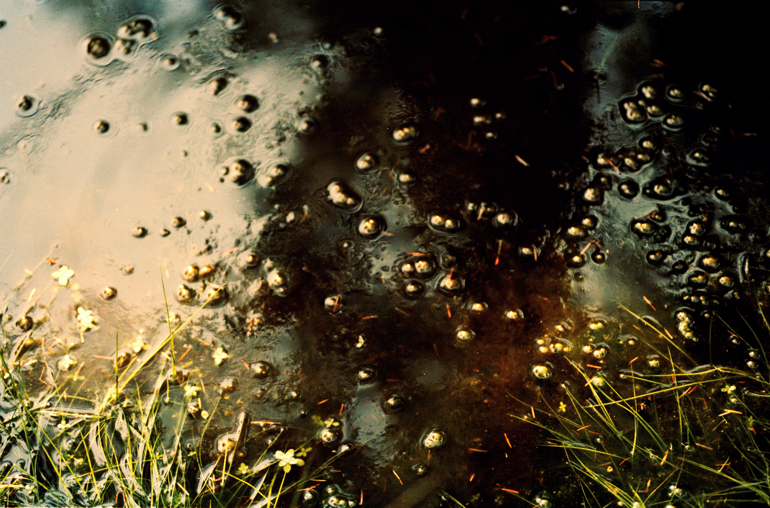
Research Question & Aims
Without the overt implication of a trace such as the evidenced in extracted landscapes , how can slow violence be recognised by the print artist ?
To establish the practical methods, creative strategies investigated by the print artist to interpret landscapes affected by environmentalchange but absent of spectacle?
To determine the capacity of the contemporary print artist to challenge and expand modes of understanding complexities within landscape change through the creation of visual narratives within print and photography that consults with landscape experts beyond art disciplines.

Slide 3
Slow Violence
The term slow violence refers to environmental destruction that takes places over a gradual period, frequently concealed, imperceptible and devoid of immediate spectacle commonly associated with notions of violence. Slow violence is often perceived as inevitable. It is too consistent to warrant the immediate scrutiny associated with disaster, presented by an image centric media.
(Nixon, 2013)

Slide 4
Violent Traces The Slieve Aughty Mountains
Niamh Fahy, Slieve Aughty Mountain, Galway, Ireland, digital photograph, 2020

Slide 5
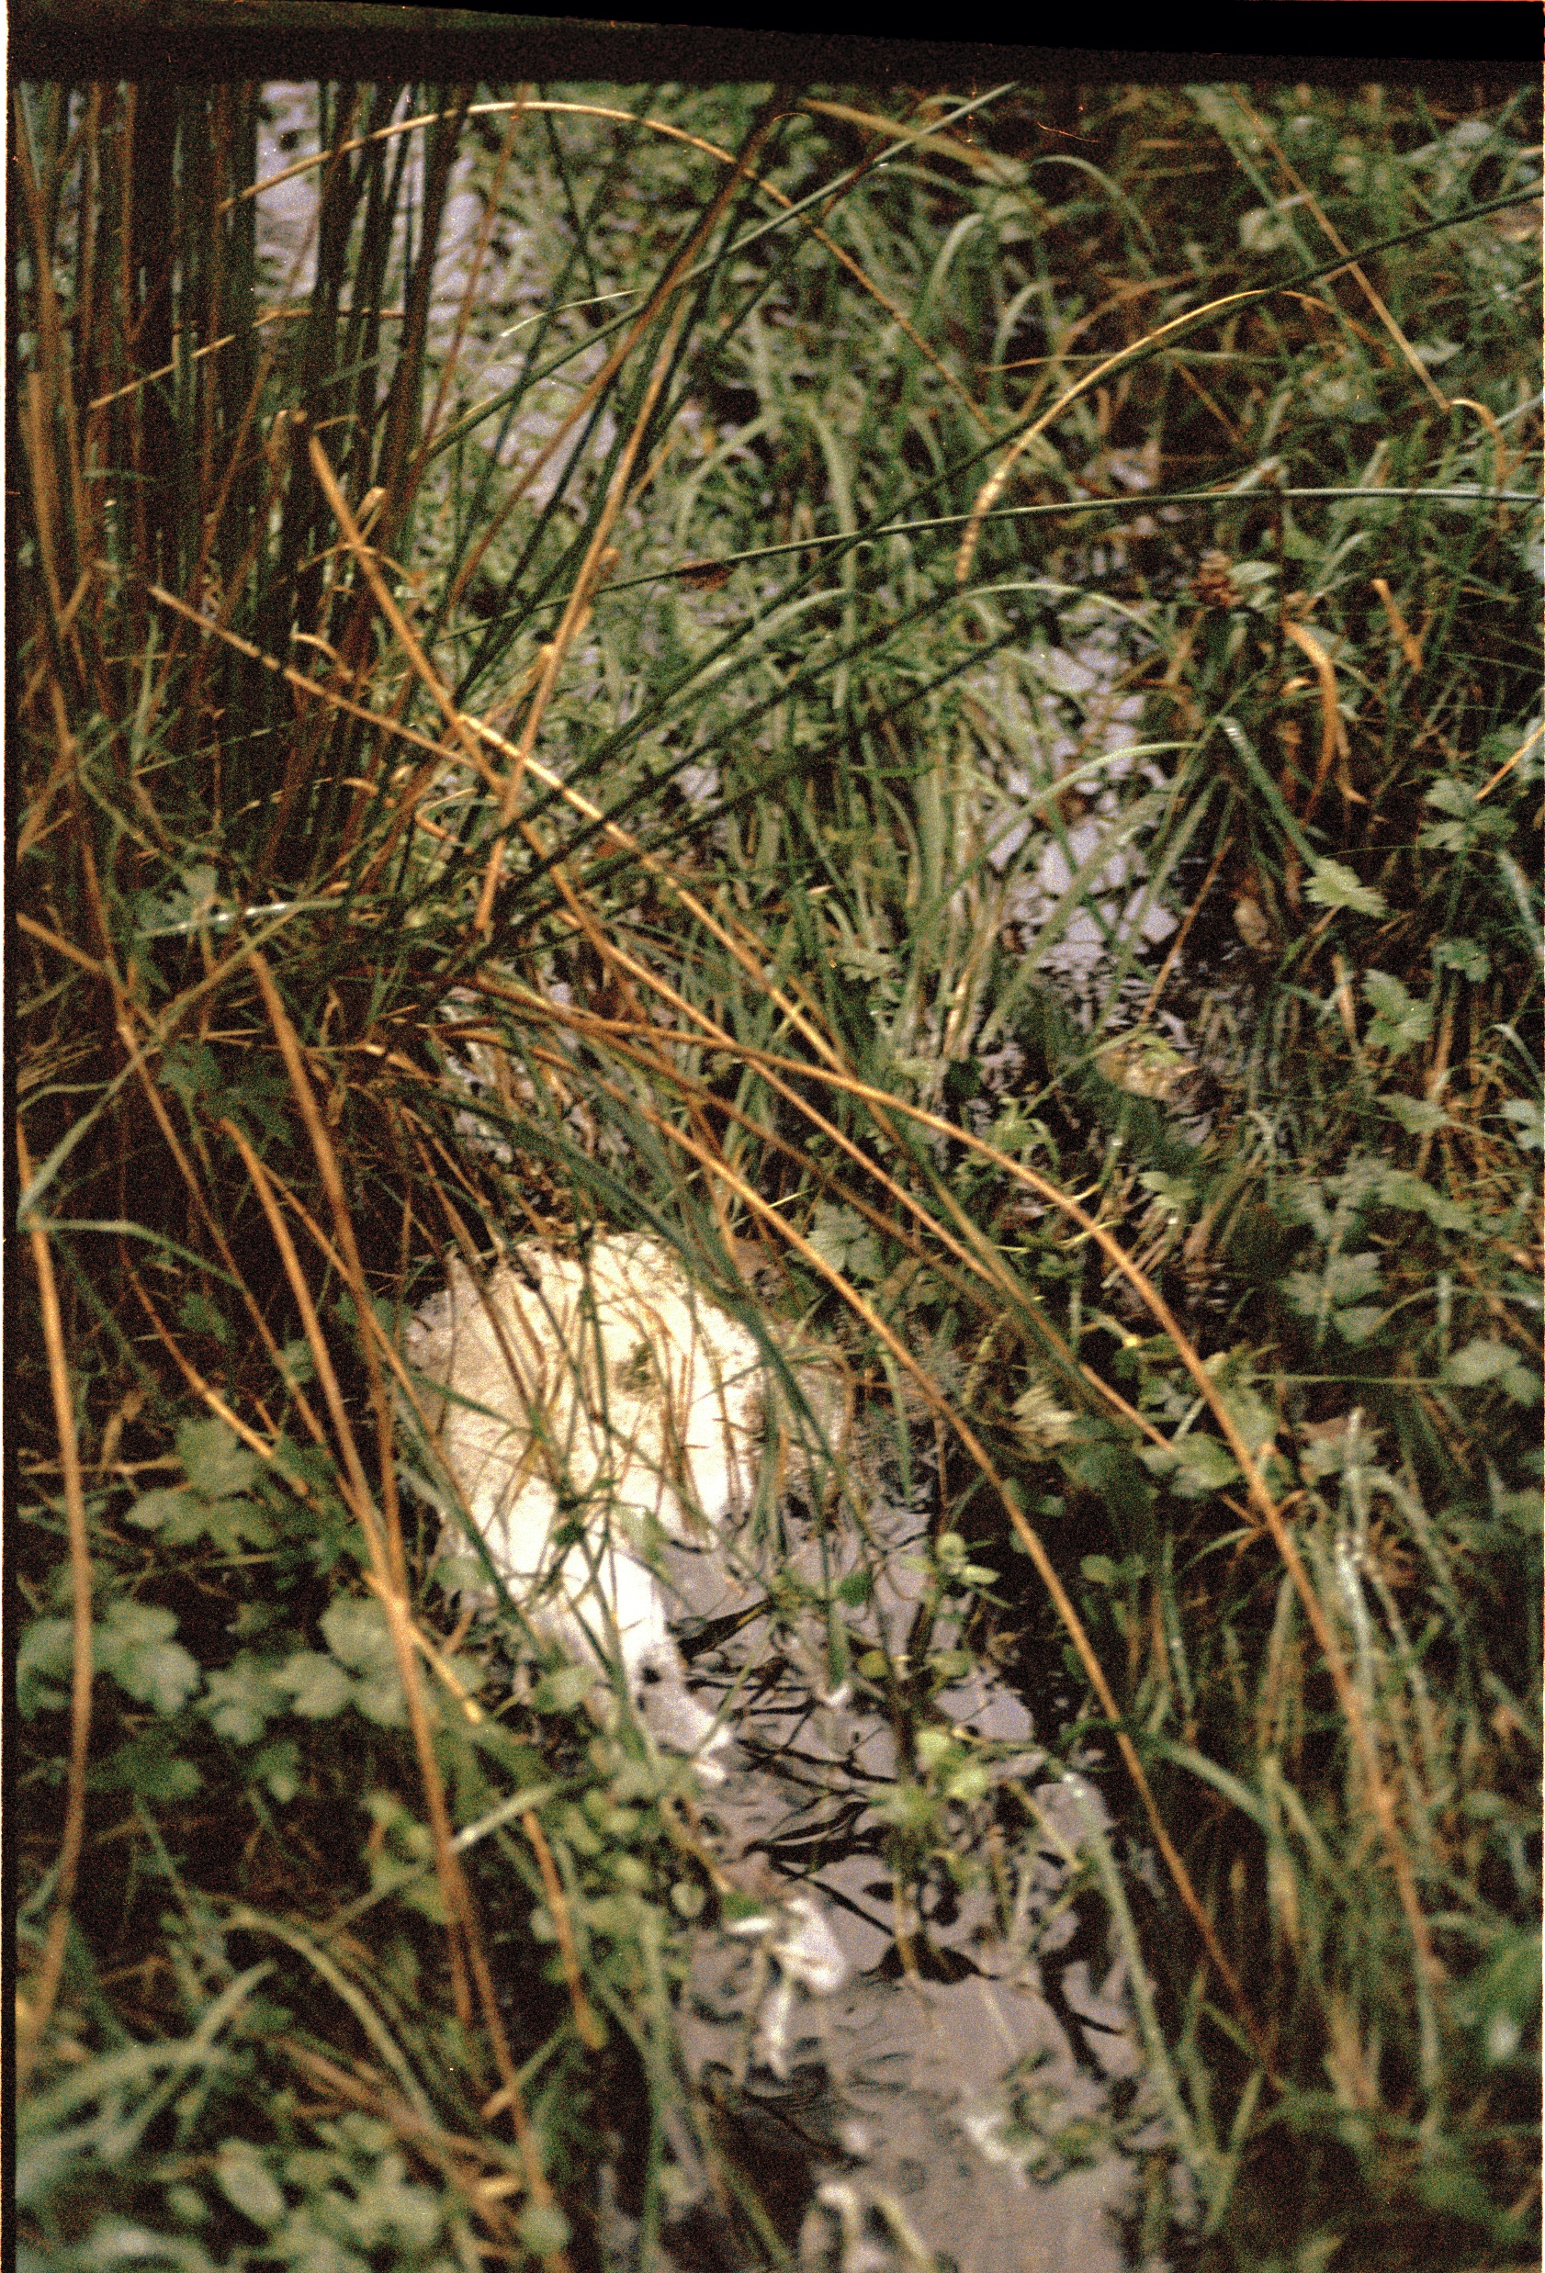
WHAT ? HOW ? WHERE ? WHO ? WHY ?
Significant changes of land use over a fifty year period
Dramatic Increase in flooding within the lowlands
Activity on Slieve Aughty Mountains impacts surrounding rivers and lowlands in South Galway
3 key Stakeholders Responsible: Coillte Forestry Commission, ESB Windfarm development , Local land users engaged in land reclamation
Changes in planting practices, flawed environmental impact assessment, non-holistic approach to commercial process

Slide 6
Shaping the Anthropocene A one-world-world?
John Law refers to a “One -world -world, a world that has granted itself the right to assimilate all other worlds and by presenting itself as exclusive, cancels possibilities for what lies beyond its limits.” ( Law cited by Cadena and Blaser, 2018, p.3)
Through expanding one world we diminish another, tipping the scale of balance, we abandon an abundance of diversity that supports the majority in favour of a limited and exclusive wealth available to few. The eradication of such worlds raises questions within my own practice, what ghosts do absent worlds create and what does it do to make them visible them through artist practice.(Tsing, 2017)

Slide 7
Slow Violence as hydro morphological change

Slide 8
Deep Mapping, Slow Residencies & Fieldwork
The term ‘deep mapping’ resists disciplinary definitions or academic boundaries. It concerns the “quality of attention” (Modeen and Biggs, 2020, p.55) that is required to care for and respond to the landscapes we inhabit.
Pr0posed as “an embodied and reflexive immersion in a life that is lived and preformed spatially. A cartography of depth. A diving within” ( Roberts 2016 cited by Modeen and Biggs, 2020, p.53).
Within this research fieldwork is adapted as a practice of “anti conclusion” where periods of immersion and reflection are applied as an attentive practice which answers to the qualities of the landscape it explores

Slide 9
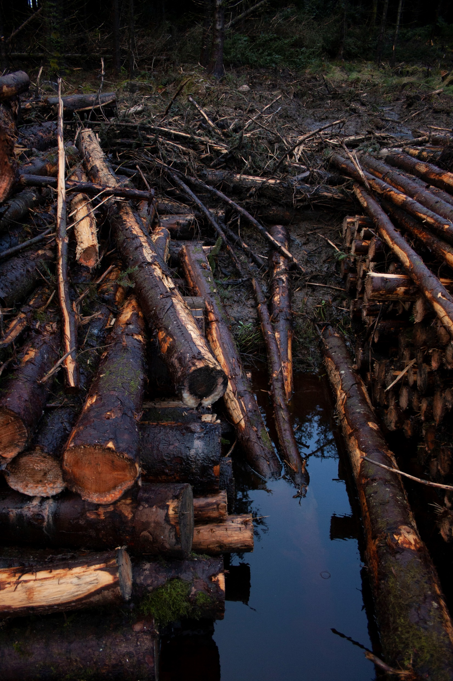
How does slow violence manifest in the Slieve Aughty Mountains ?
Niamh Fahy, Currach, Slieve Aughty Mountains, digital photograph, 2021

Slide 10
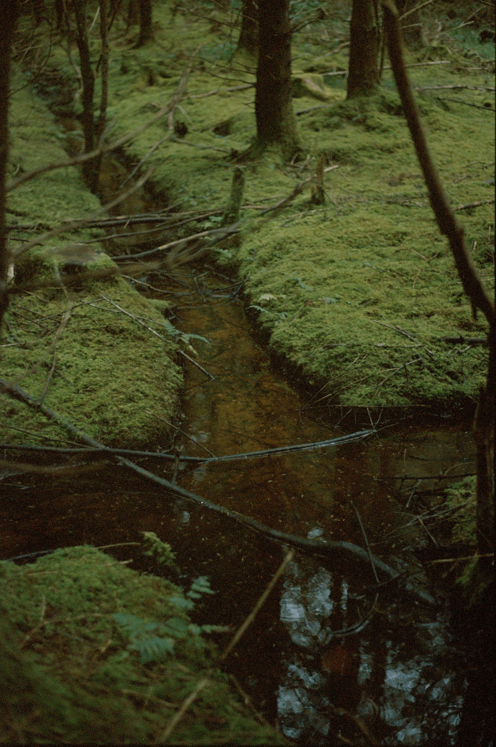

Slide 11
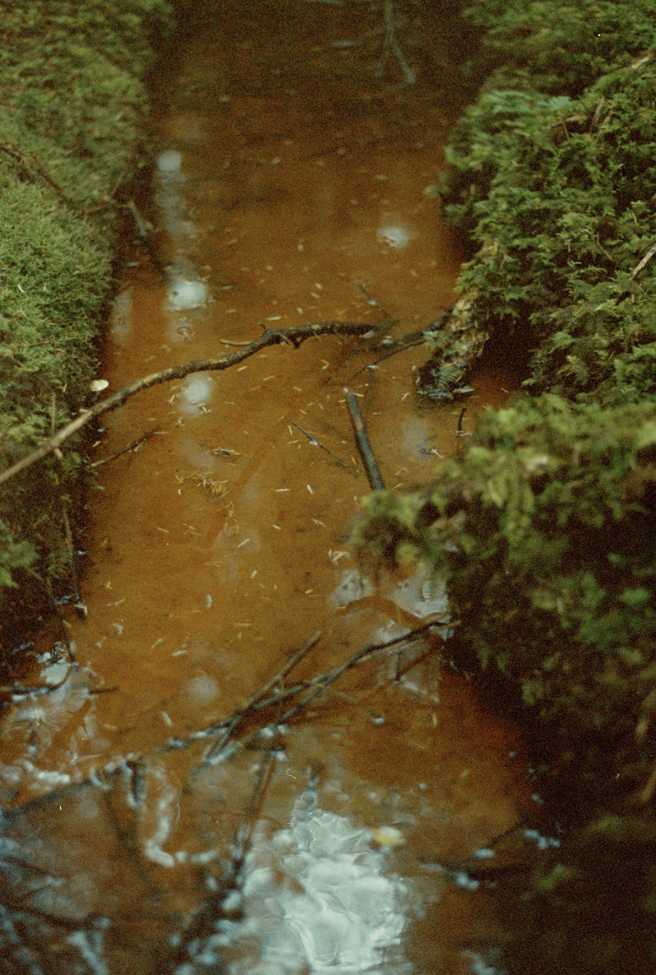
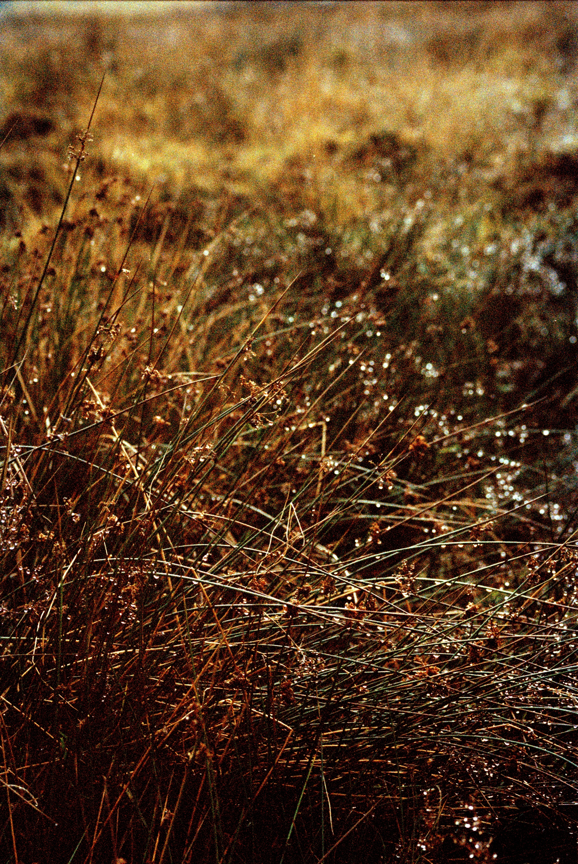

Slide 12
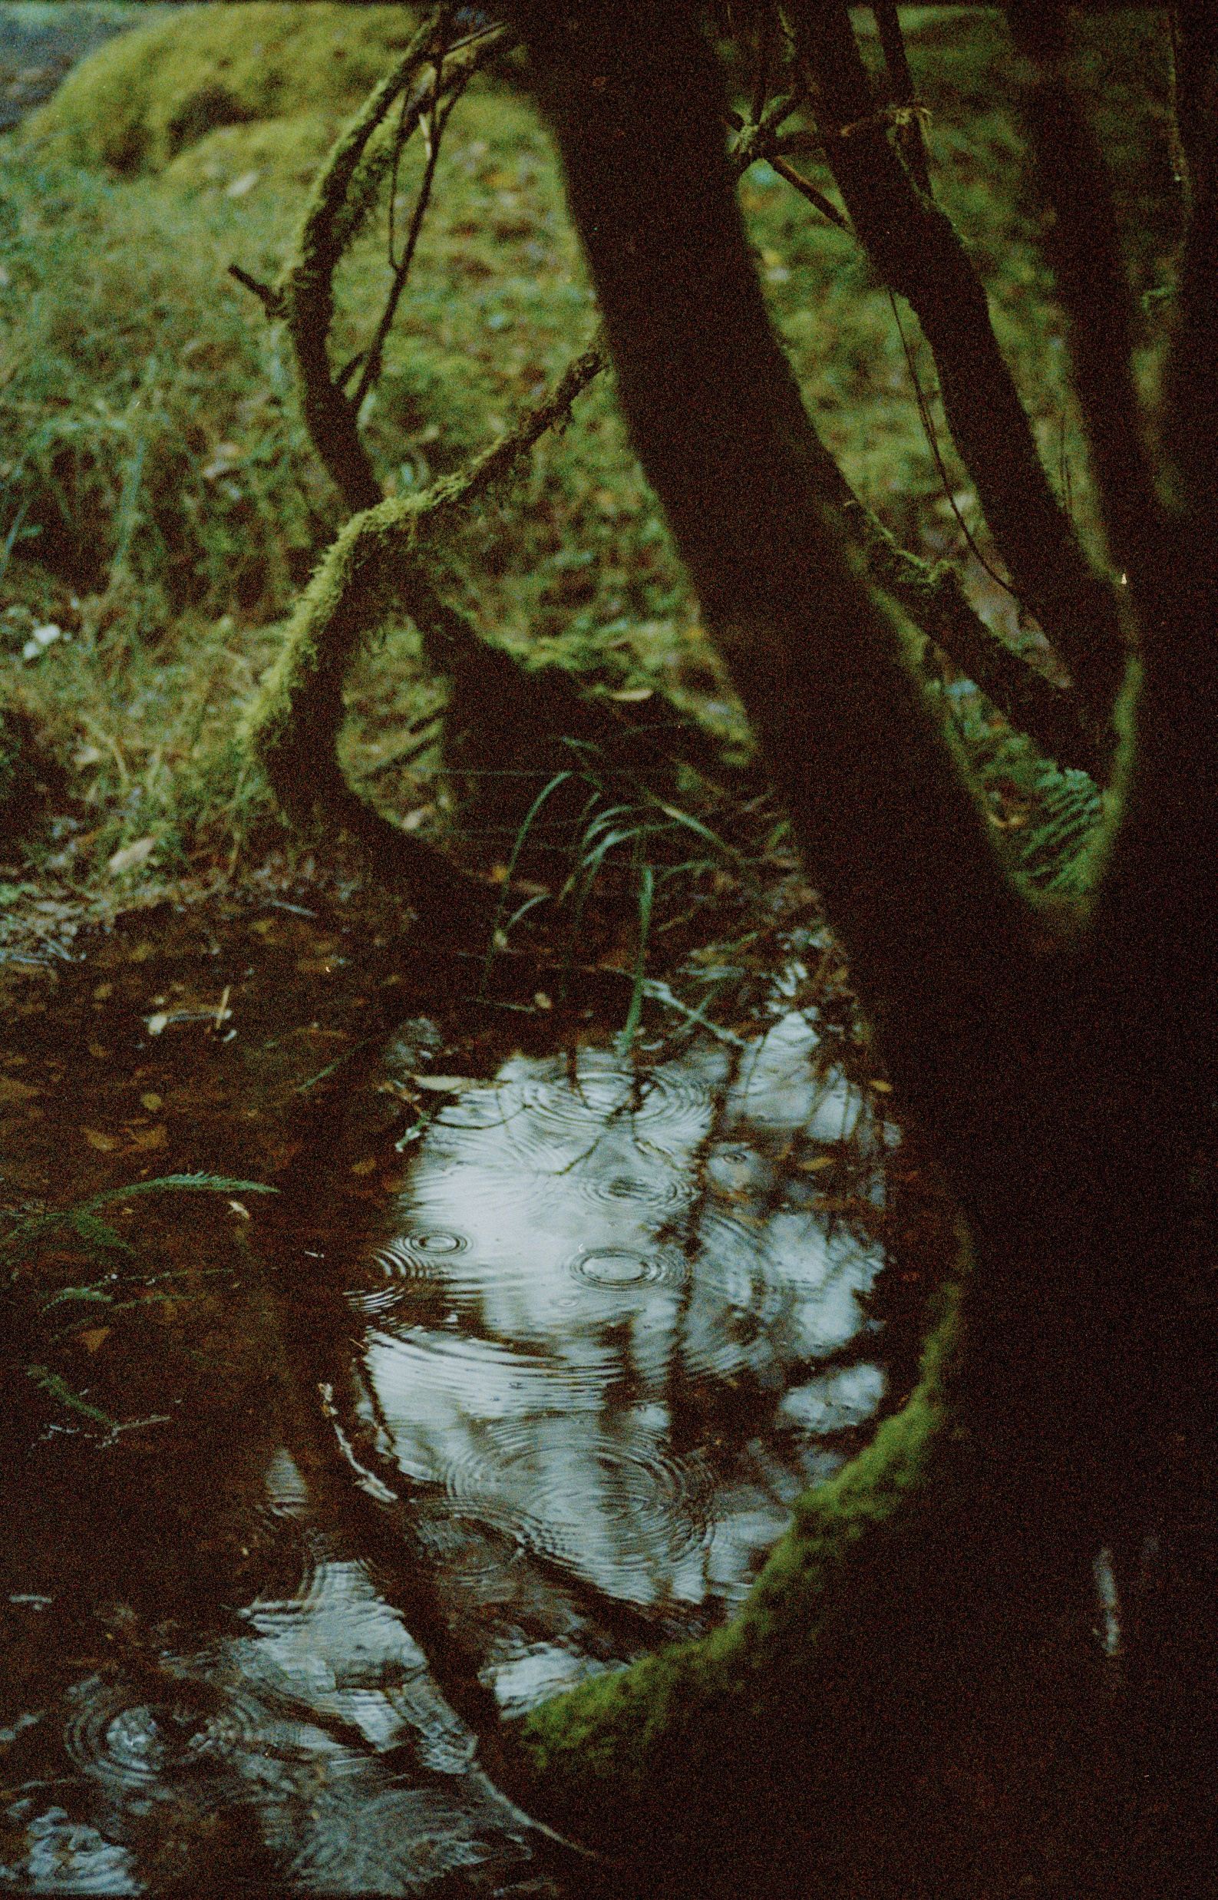
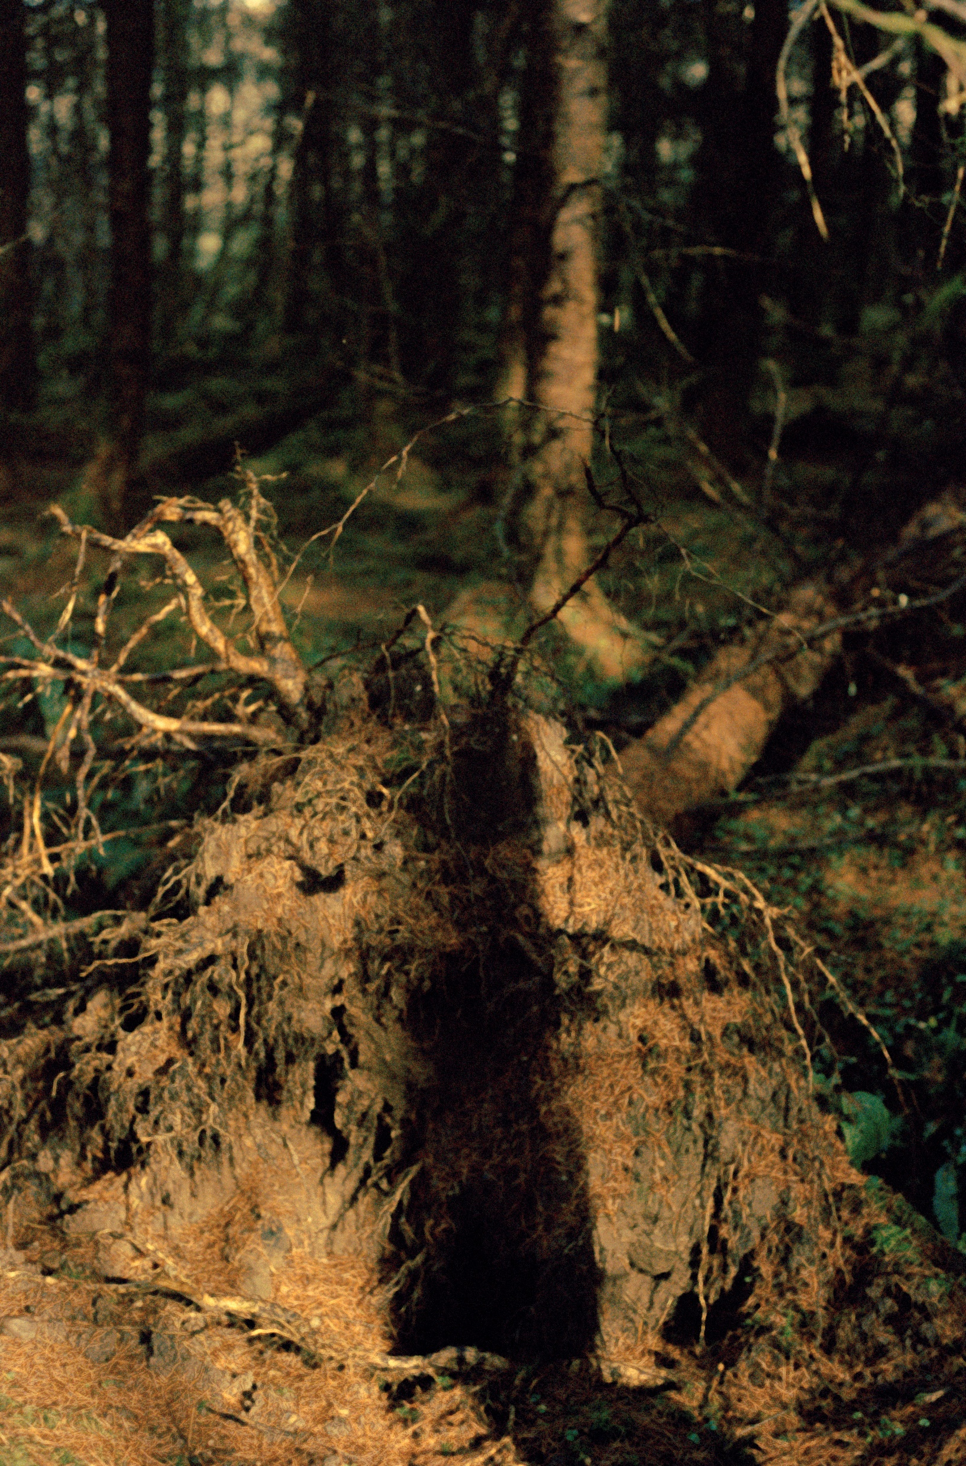

Slide 13
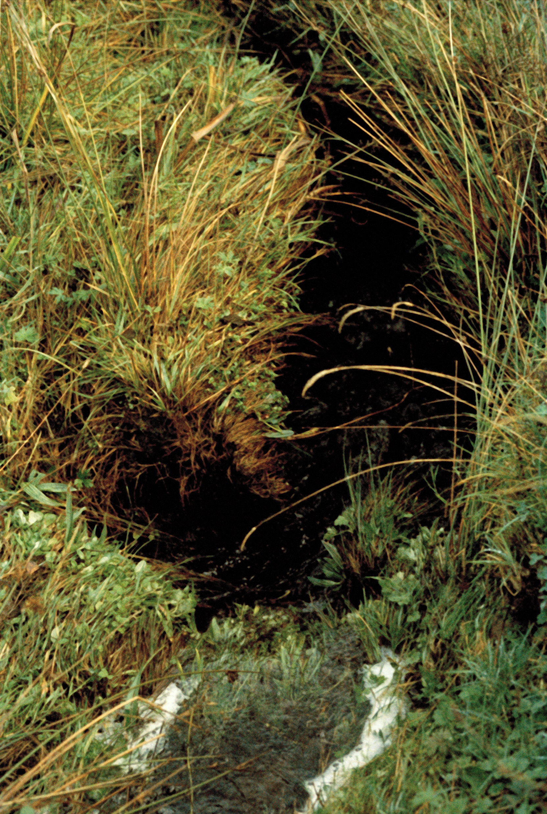
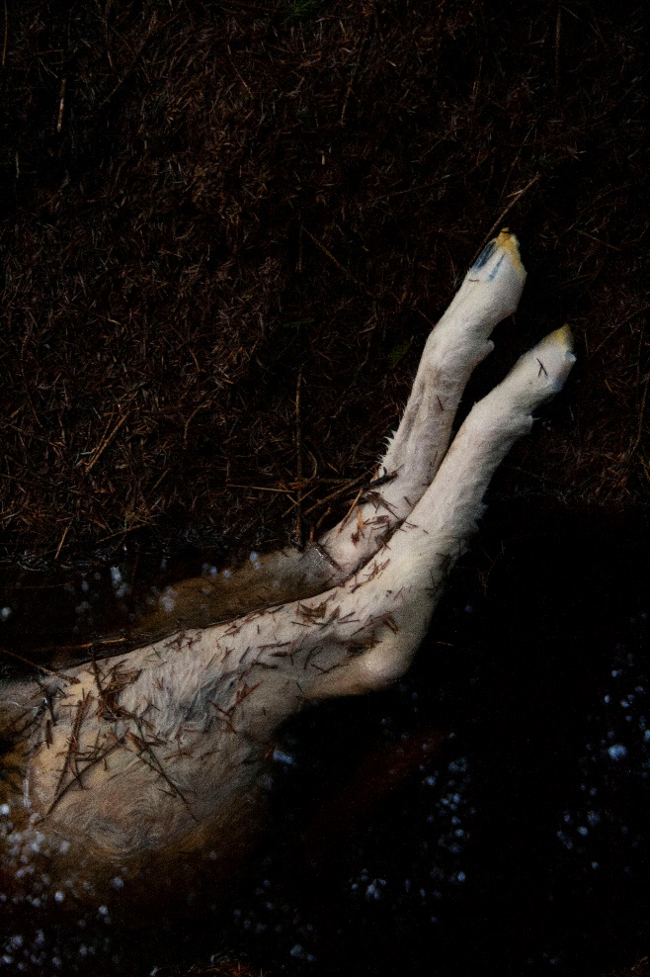
Niamh Fahy, Found Creature, Slieve Aughty Mountains, 2021

Slide 14
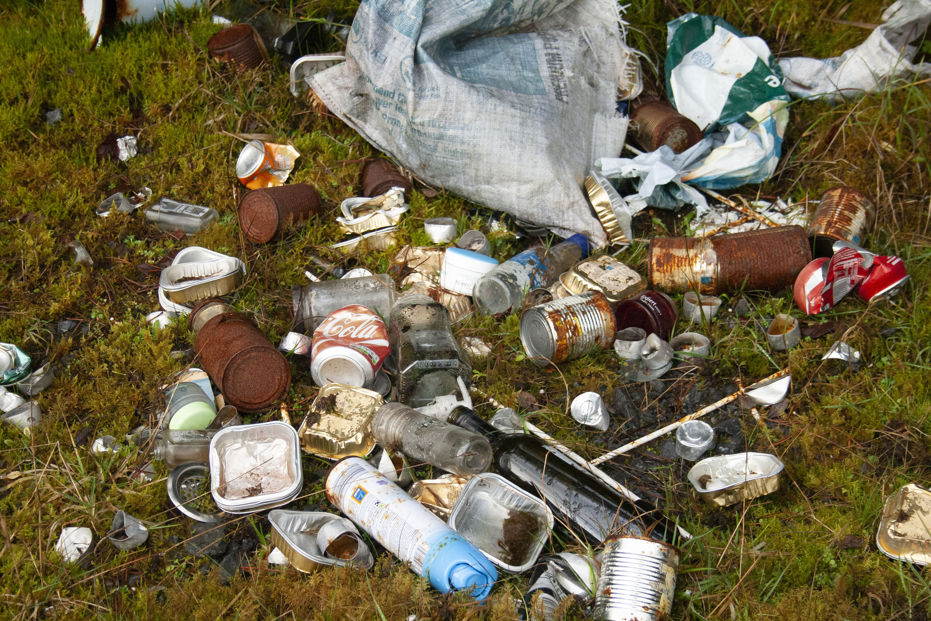
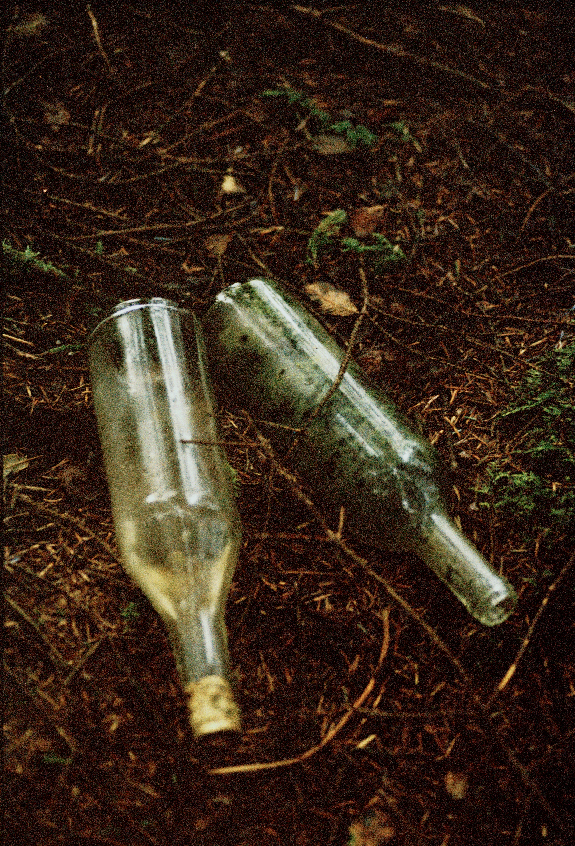
Niamh Fahy, illegal dumping, 2021

Slide 15
Niamh Fahy, Slieve Aughty Mountains, 2021

Slide 16
Dilemma 1:
Am I boring you ?
Finding a language of intimacy in practice-based research

Slide 17
Creating Pluriverse through Print ?
Pluriverse is the proposal for recognising the plural perspectives, heterogenous practices and diverse life forms that compose a world of many worlds. Pluriverse imagines and magnifies the multiple, open- ended practices that co-exist within an interconnected meshwork that allows for a multitude of worlds to emerge.
(Cadena & Blaser,2018.p.4).

Slide 18
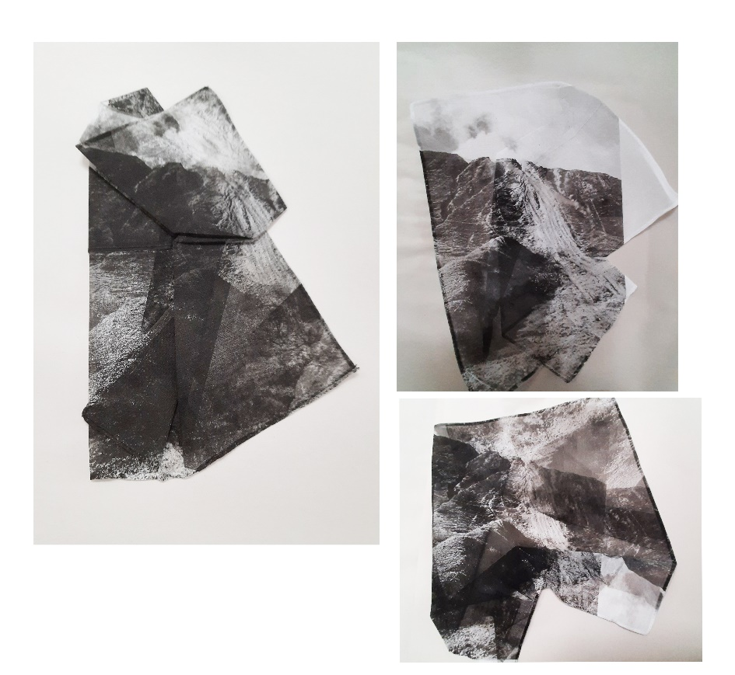
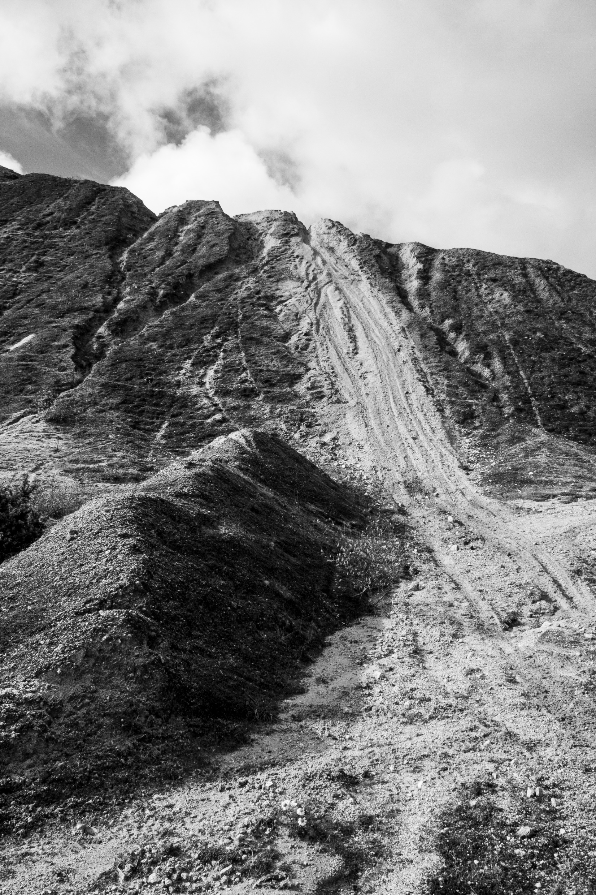
Studio work
Niamh Fahy, Shifting Impressions, lithography on cotton, 2021

Slide 19
Niamh Fahy, Polaroid tests, photo etching, 2021

Slide 20
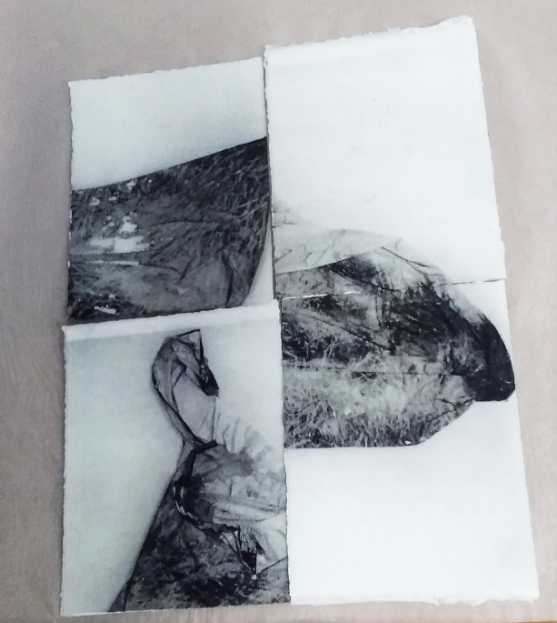
Niamh Fahy, Polaroid tests in Photo etching,2021

Slide 21
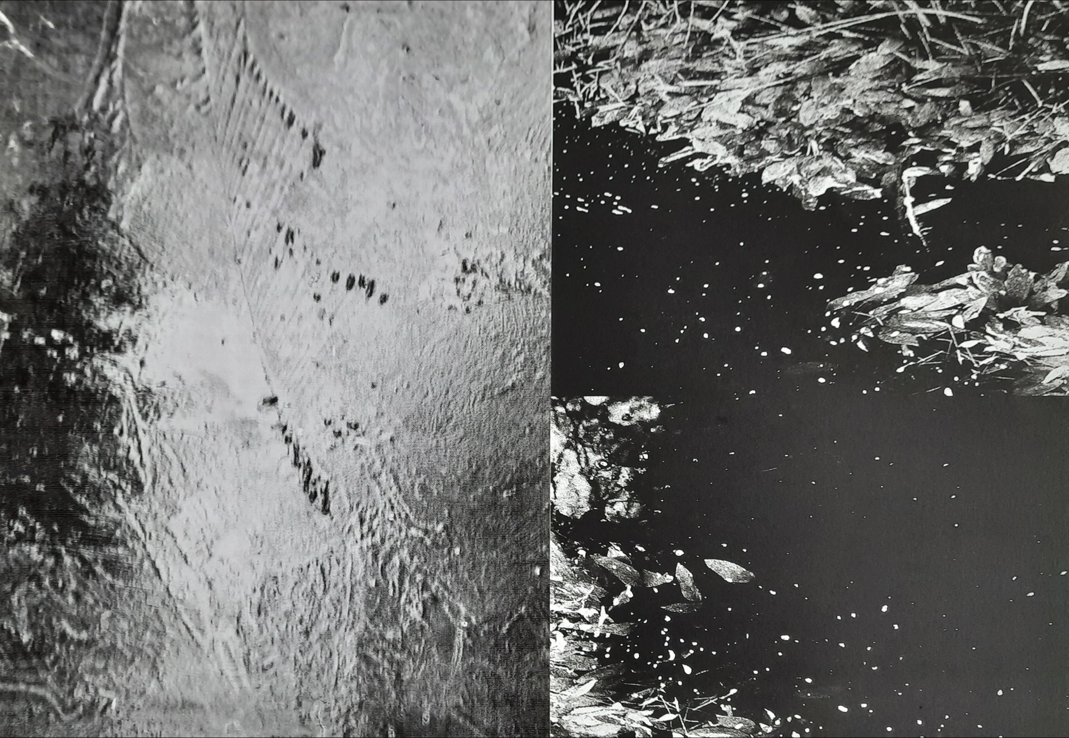
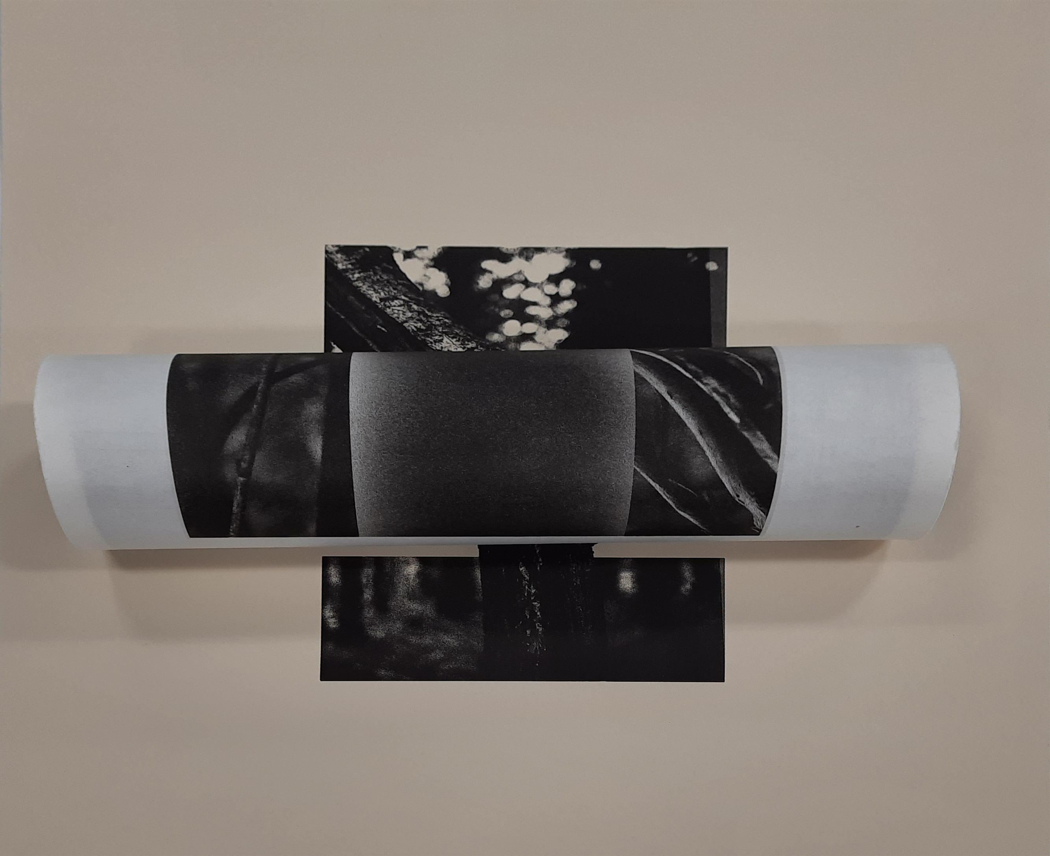
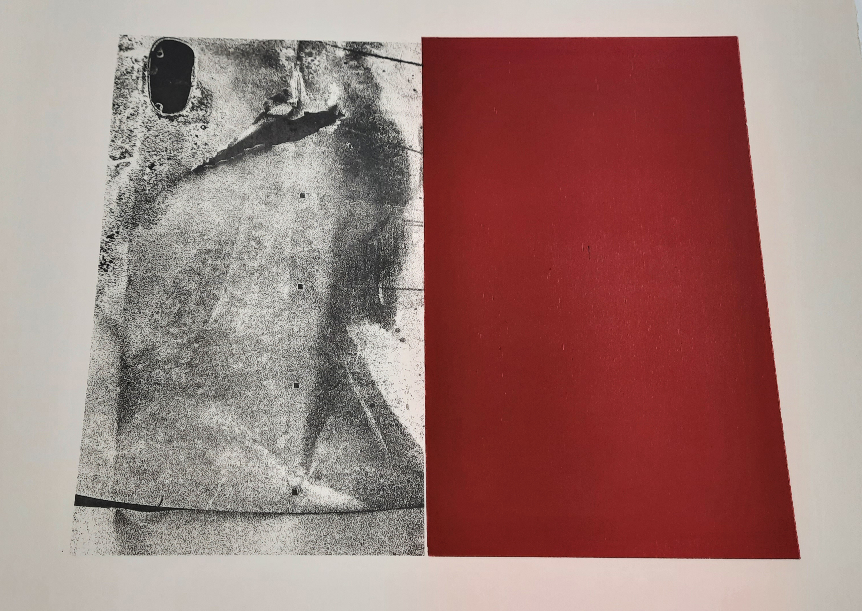

Slide 22
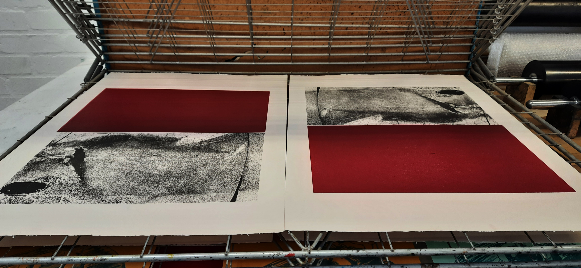
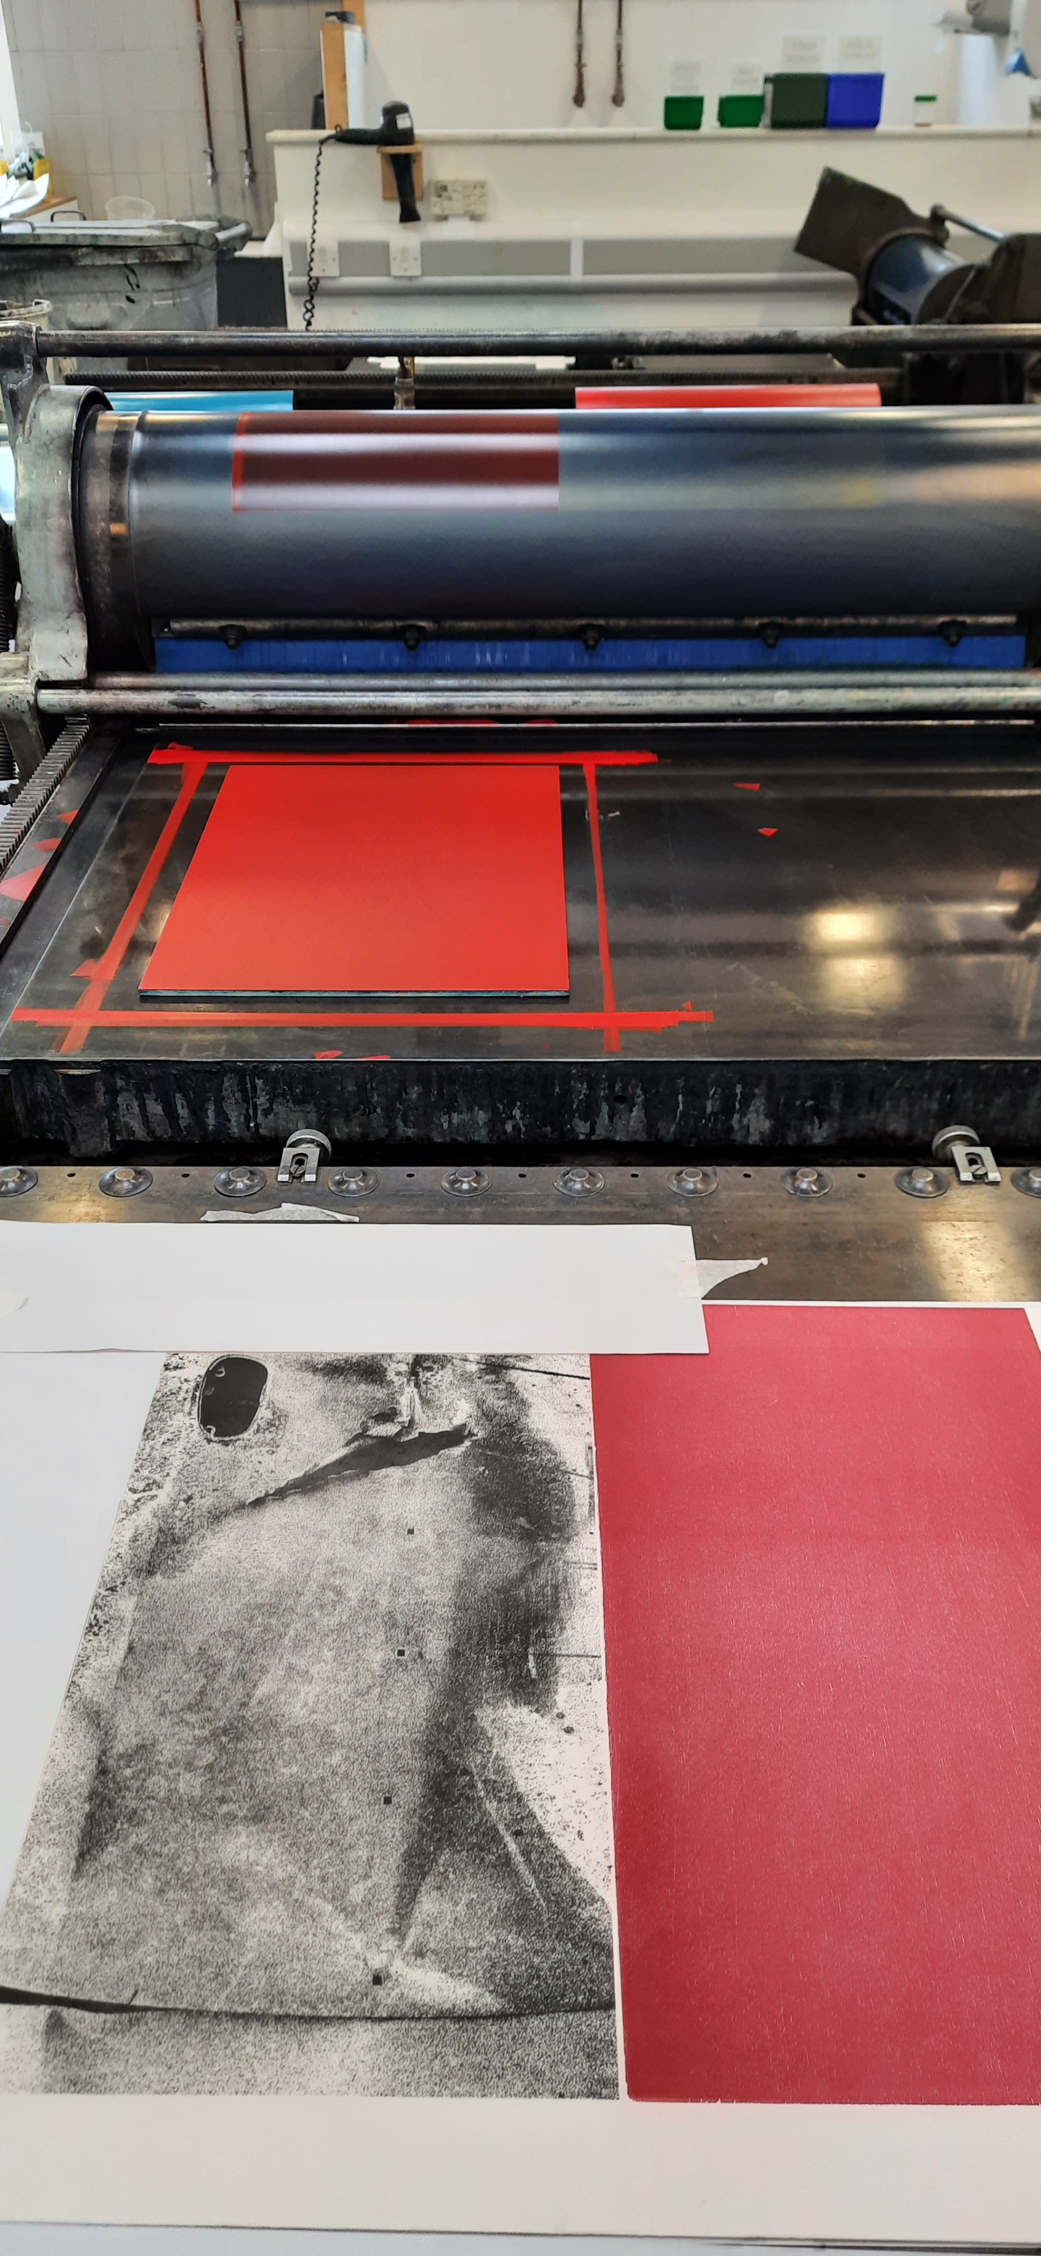
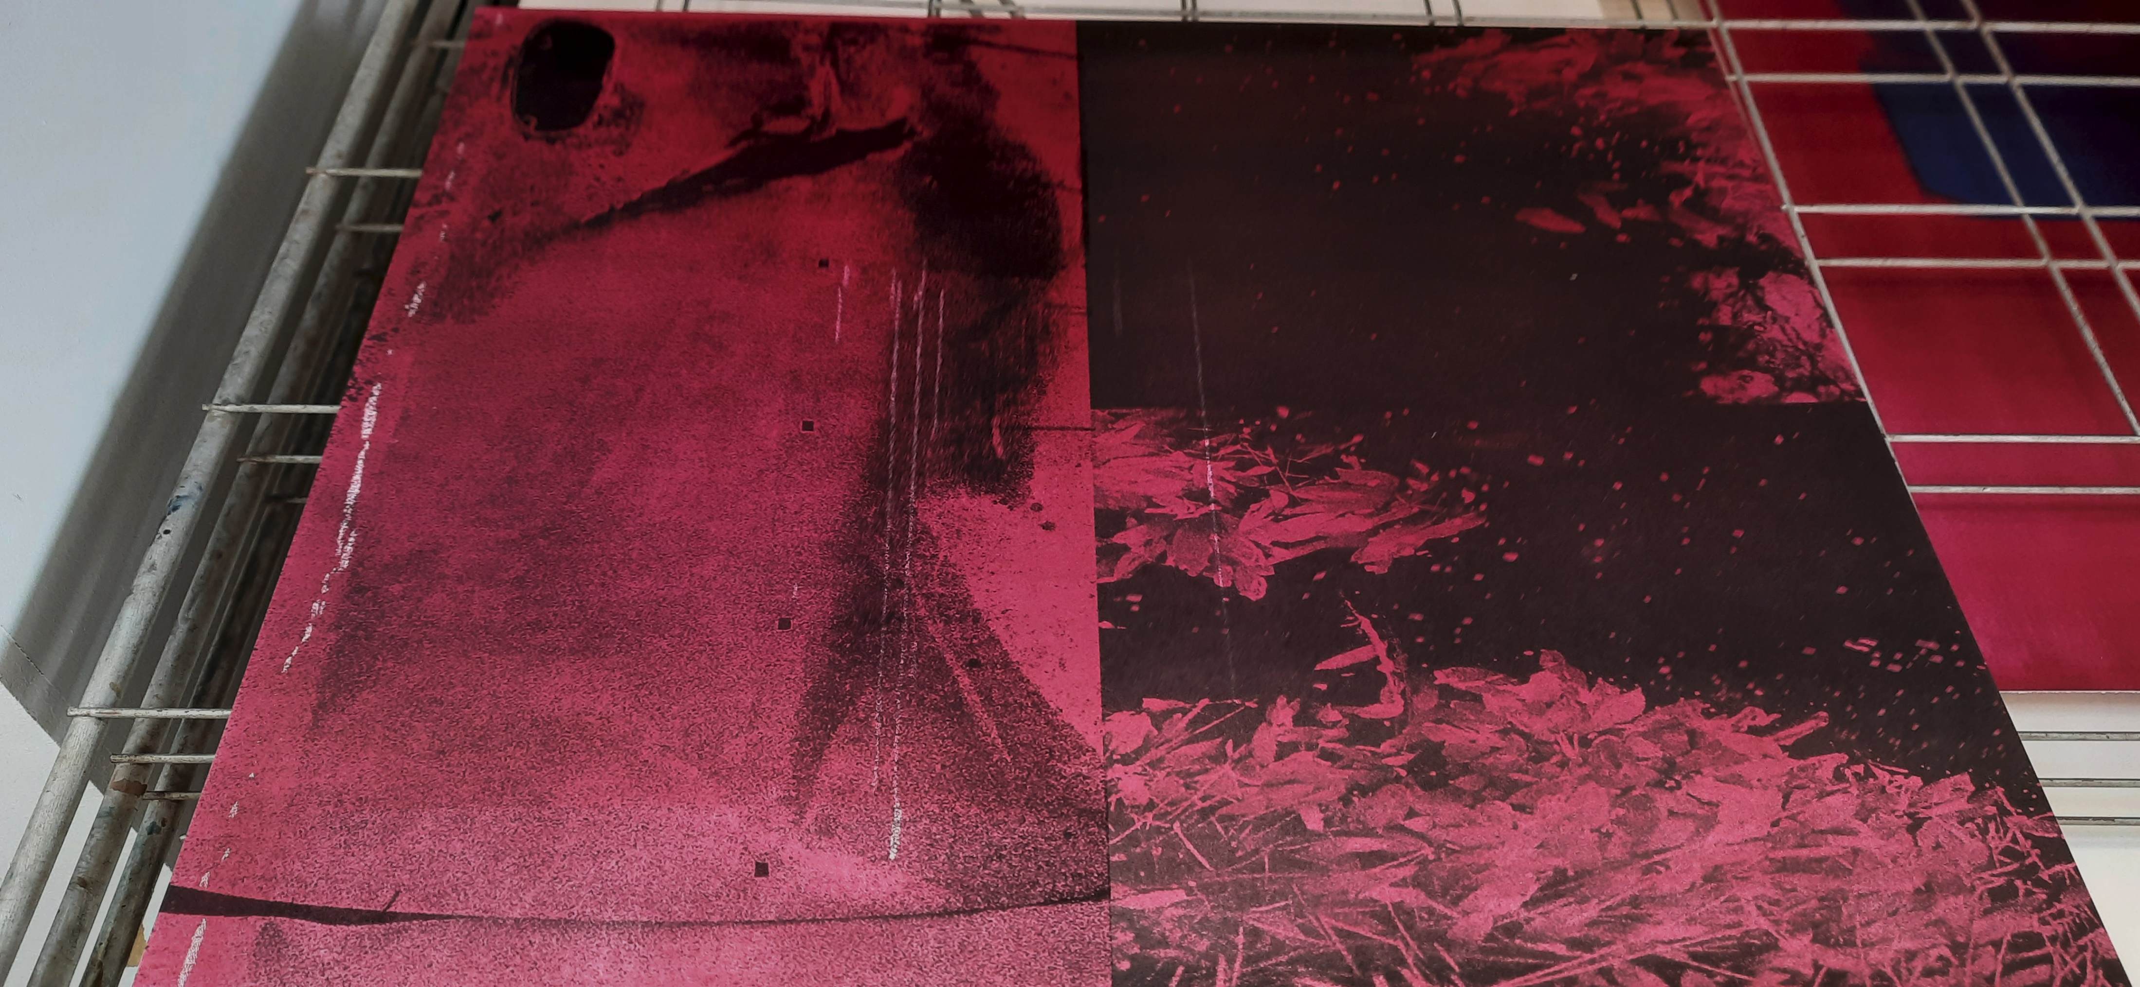

Slide 23
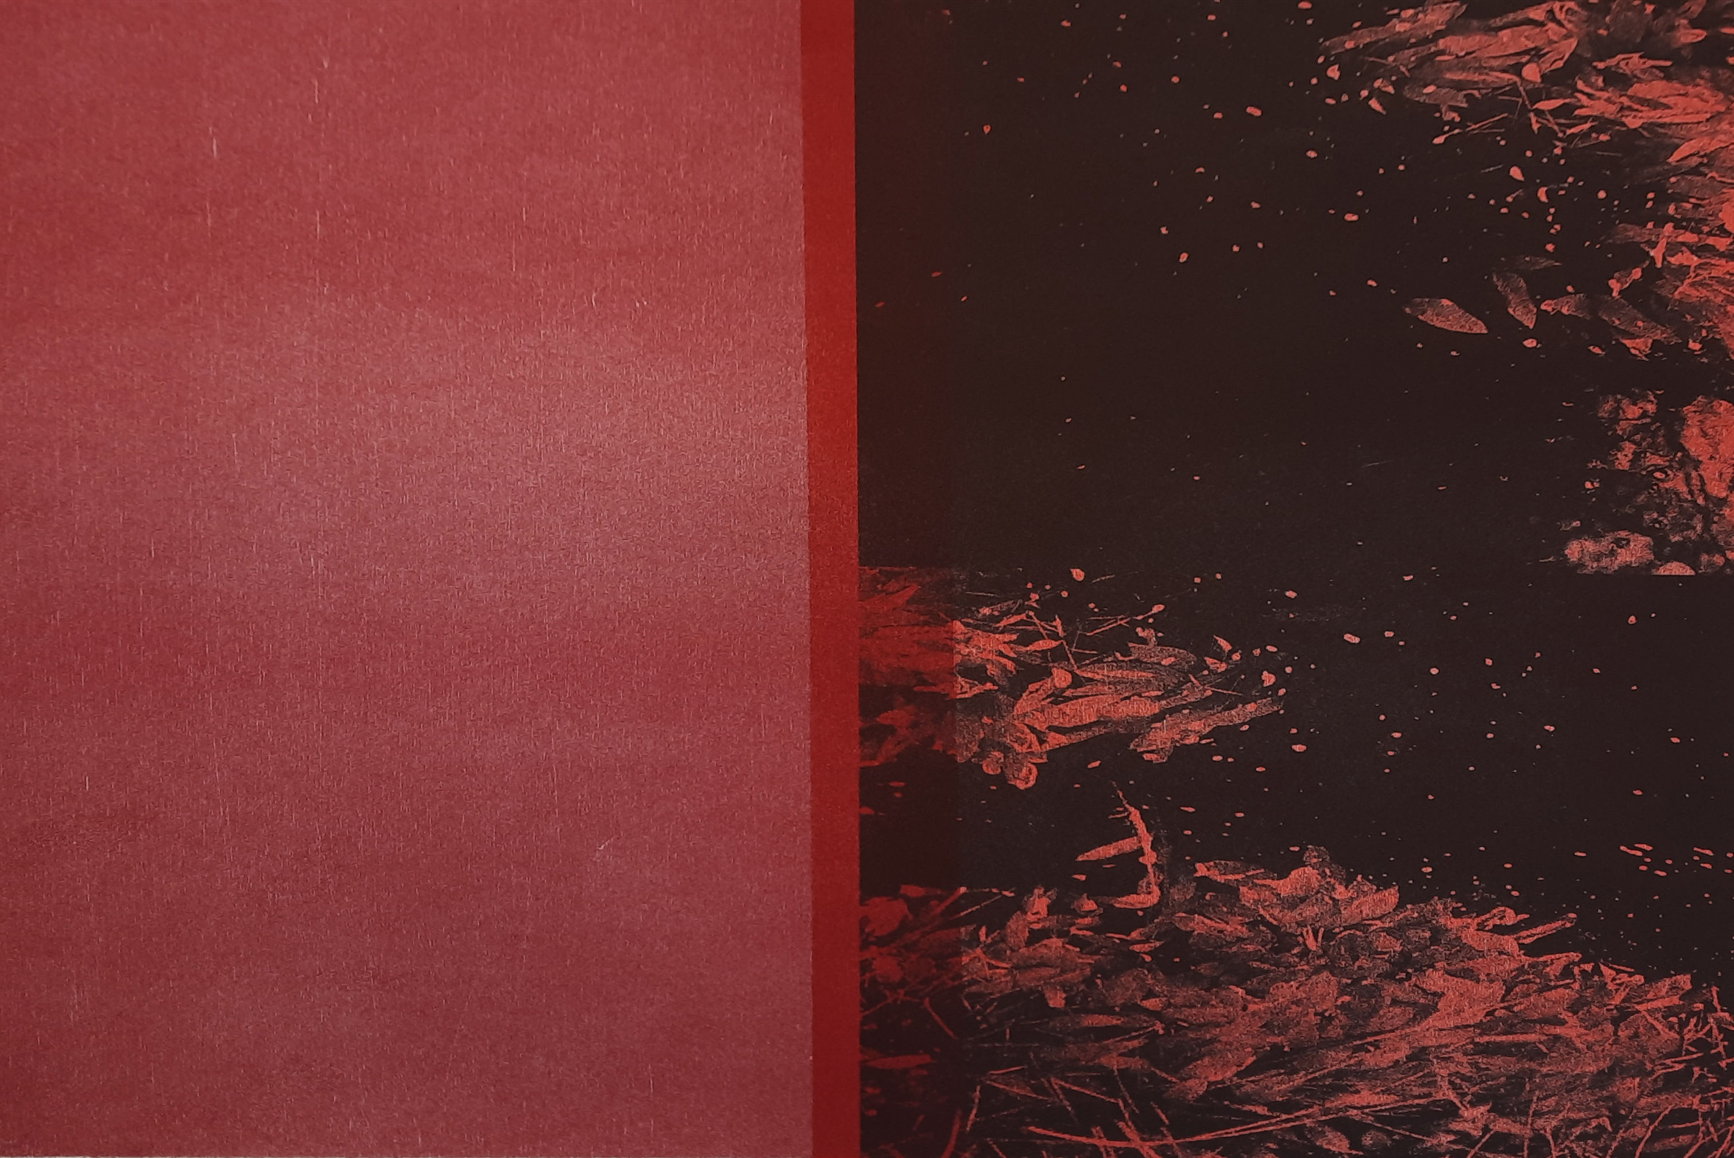
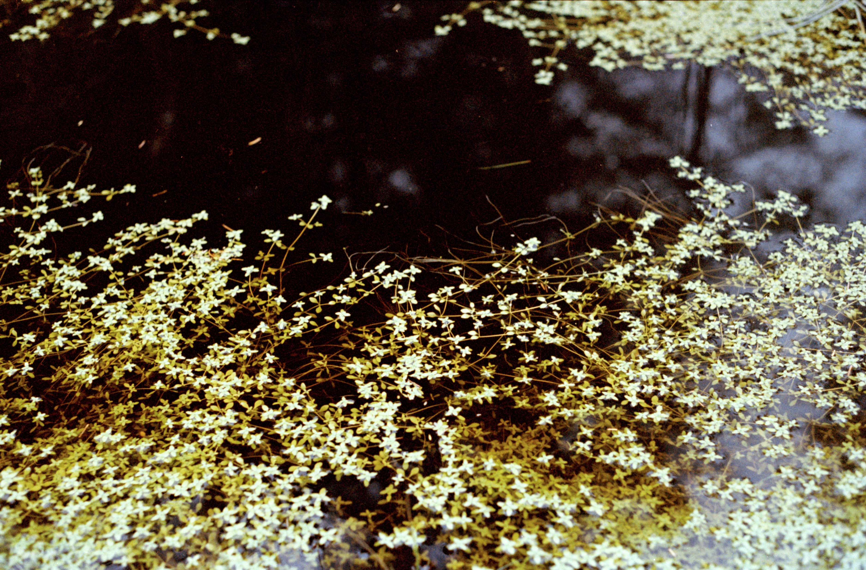
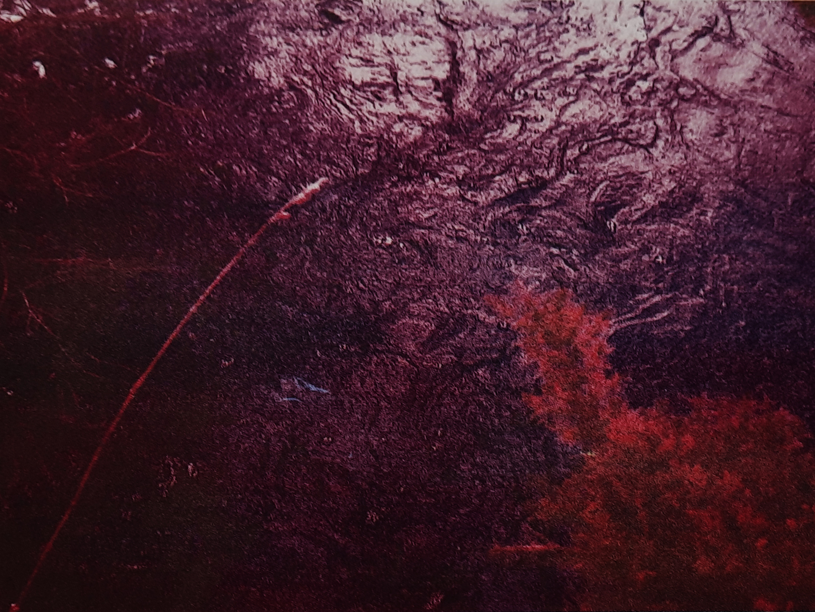
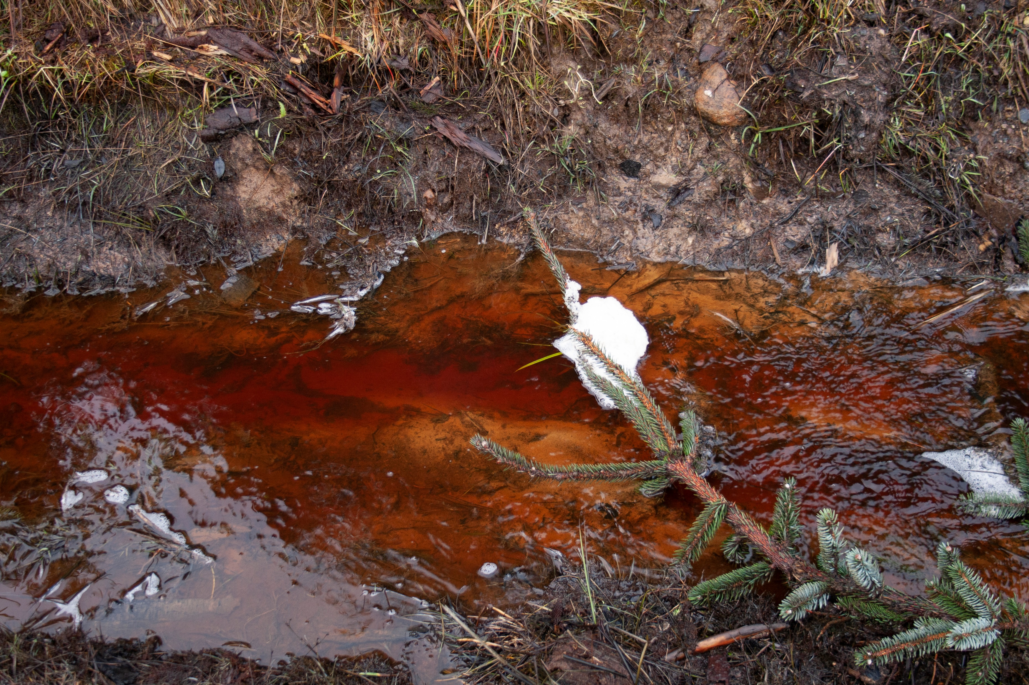

Slide 24
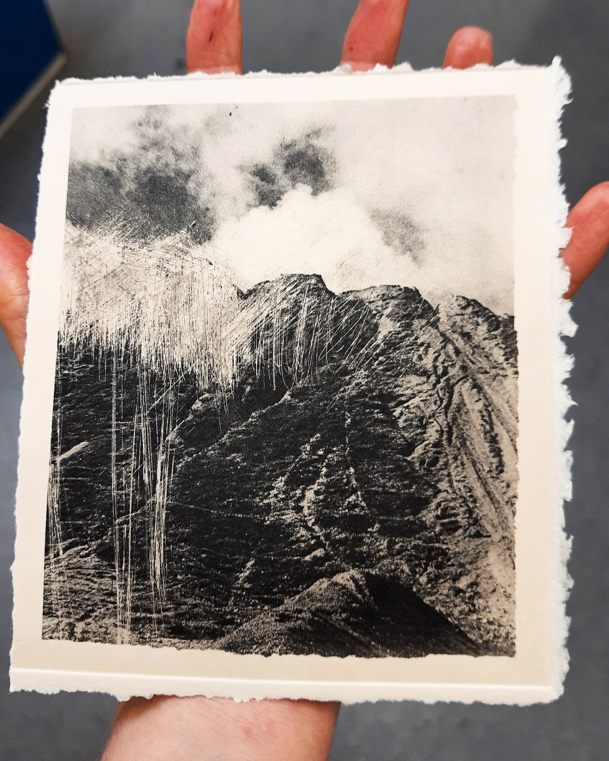
In order to carefully attend to the landscapes examined within this research it is important to reframe the notion of fieldwork as reflecting ourselves (our cells) as a component of a dynamic meshwork that exists across landscape, to recognise not only why we engage in fieldwork but “to what extent we are the fieldwork” (Modeen and Biggs, 2020, p.214). In this recognition, a responsiveness can develop that corresponds to the complex, fluid and unfolding environments we are part of (Modeen and Biggs, 2020, p.215).
Niamh Fahy, Photo etching, 2021

Slide 25
Conclusion
While slow violence has a relationship to historical narratives, it cannot be confined to a past event, the traces it leaves are more accurately an “indication of a lived present, of a mode of inhabiting both place and memory” (Bennett, 2005, p.70)

Slide 26
Bibliography
Bennett, J. (2005) Empathic vision: affect, trauma, and contemporary art Cultural memory in the present. Stanford, California: Stanford University Press.
Butler, J. (2021) The Force of Nonviolence: An Ethico-Political Bind. London, UK: Verso.
Cadena, M. de la and Blaser, M. (2018) A world of many worlds. Durham: Duke University Press.
Haraway, D.J. (2016) Staying with the trouble: making kin in the Chthulucene Experimental futures: technological lives, scientific arts, anthropological voices. Durham: Duke University Press.
Latour, B. (2018) Down to earth: politics in the new climatic regime. English edition. Cambridge, UK; Medford, MA: Polity.
Modeen, M. and Biggs, I. (2020) Creative Engagements with Ecologies of Place: Geopoetics, Deep Mapping and Slow Residencies [online]. London& New York: Routledge. [Accessed 3 May 2021].
Kupfer, P. (2019) One World for Staying and One for Going In: Nikonowicz, D. This world and others like it. Amsterdam, The Netherlands: Yoffy Press and Fw: Books. pp. 34-41.
Nikonowicz D. (2019) This World and Others Like It | Fw: Books [online]. Available from: https://fw-books.nl/product/drew-nikonowicz-this-world-and-others-like-it/ [Accessed 10 May 2021b].
Nixon, R. (2013) Slow violence and the environmentalism of the poor. Harvard Univ. Press paperback ed. Cambridge, Mass.: Harvard Univ. Press.
Nugent, Dr.P. (2006) aughty.org - history/heritage. Available from: http://www.aughty.org/heritage.htm [Accessed 3 May 2021].
Talmor, D., Mavlian, S., Smyth, C., Smith, O. and Padley, G.(Eds.) (2020) Constructed Landscapes. Amsterdam, The Neatherlands: Fw-Books.
Talmor, D. (2020) Constructed Landscapes Volume II. Available from: http://www.dafnatalmor.co.uk/ [Accessed 3 May 2021a].
Tsing, A., Swanson, H., Gan, E., & Bubandt, N. (Eds.). (2017). Arts of Living on a Damaged Planet: Ghosts and Monsters of the Anthropocene. Minneapolis: University of Minnesota Press.

Slide 27
Thank you for listening !
Niamh.Fahy@uwe.ac.uk
www.niamhfahy.com
https://cfpr.uwe.ac.uk
INSTAGRAM / niamhfahyart
INSTAGRAM / Cfpr_research

