Slide 1
Is ACT an existential therapy?
ACT AND EXISTENTIAL THERAPY
RFT
EXISTENTIAL-
PHENOMENOLOGICAL PHILOSOPHY
RADICAL BEHAVIOURISM

Slide 2
Is ACT an existential therapy?
ACT AND EXISTENTIAL THERAPY
RFT
EXISTENTIAL-
PHENOMENOLOGICAL PHILOSOPHY
RADICAL BEHAVIOURISM

Slide 3
Is ACT an Existential Therapy?
What similarities?
How? Why?
Now what?

Slide 4
A shared stance
Non-pathologising
Acceptance
Non-hierarchical
Freedom and choice
Meaning and values

Slide 10
HEIDEGGER

Slide 11
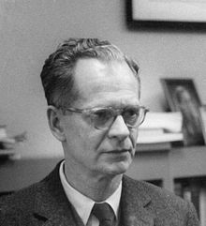
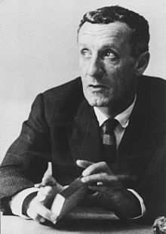

Slide 12
Thought
Emotion
Behaviour

Slide 14
Existential Therapy? Or ACT?
‘Aim of therapeutic work = helping clients to become more aware of their actual existence, and to live more in accordance with their true values
Therapists work with the concrete actuality of clients’ experiences
Clients are encouraged to acknowledge, and act on, their freedom and responsibility’

Slide 15
Existential Therapy? Or ACT?
‘Clients are encouraged to acknowledge, accept and learn from the more ‘negative’ feelings
All aspects of clients’ being are seen as fundamentally interconnected
Therapists are genuine and direct
Practice is flexible and adaptable’

Slide 18
ACT: An Existential Therapy
ACT AND EXISTENTIAL THERAPY
SHARED STANCE
RFT
SHARED PROCESSES
SHARED METAPHORS
EXISTENTIAL-
PHENOMENOLOGICAL PHILOSOPHY
RADICAL BEHAVIOURISM

Slide 20
Christine Ramsey-Wade
Christine.ramsey-wade@uwe.ac.uk

