Slide 1

Primary Pre-service teachers and Engineering Students
Learning to Teach Science-
A Match Made in Heaven or Hell?
Dr Fay Lewis Senior Lecturer in Science Education. Fay.lewis@uwe.ac.uk
Juliet Edmonds Senior Lecturer in Science Education. Juliet.edmonds@uwe.ac.uk
Laura Fogg-Rogers . Science Communication Unit.

Slide 2
Paired Peers Mentors
Undergraduate
Engineering Students
Undergraduate
Pre-service Teachers
Knowledge and Skills Exchange
Shared delivery of Enquiry based Engineering Challenges
UK Primary School Children (8-11)
Notes:
This presentation describes and evaluates a Paired Peer Mentors project, which has enabled innovative engineering education outreach in primary schools.
The project aimed to develop a model of collaborative, sustainable engineering education for Higher Education courses.
Undergraduate pre-service teachers and student engineers were paired up and shared the delivery of enquiry based engineering challenges into primary schools,
It was hoped that the complementary skills of the students could be shared and exchanged during collaborative work.
The project aimed to evaluate the impact that participation in the project had on the attitudes of the participants towards teaching and learning STEM subjects, and in particular science.

Slide 3
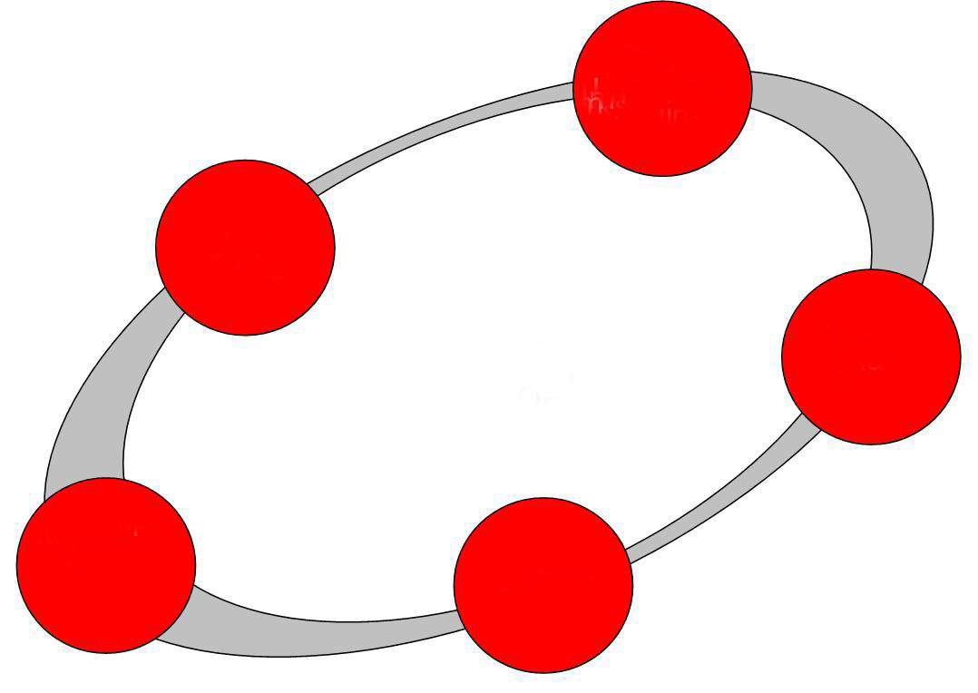
Science Through the Engineering Design Process?
Criteria
Constraints
Sci. info
Ask
Brainstorming
No evaluation
Properties of materials
Imagine
THE GOAL
Make a table from newspaper
PLAN
Get
specific
with one
idea
Science skills
IMPROVE
Forces
CREATE
And test
Notes:
The challenges delivered in schools were based on the EDP. The children were presented with ‘real-life’ scenarios which presented a problem to be solved. They are encouraged to imagine a range of possible solutions, ask questions about possible constraints and detail e.g. materials available etc, plan, create and improve on a product. In this example the challenge is to create a table using only newspaper and a small amount of sticky tape.
This provides an opportunity for directed science teaching at points where the children have a need to know and understand the concepts in order to create a successful product. E.g. in this example
properties of materials:- Strengths of different shapes, weight Rigidity, Flexibility, Waterproofing and absorbtion
forces-Gravity, Balanced forces (Newtons), Weight/mass and measuring
science skills- observing, hypothesising, controlling variables in testing.

Slide 4
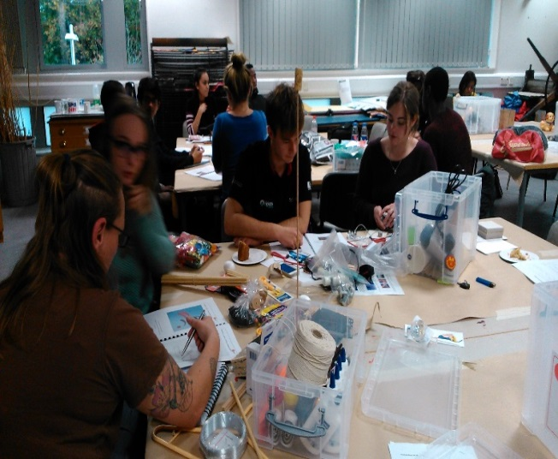
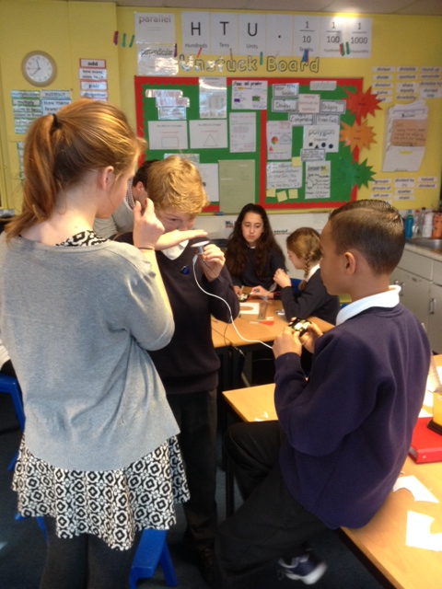
Science Education in the UK
Teachers
lack of confidence and understanding of science subject knowledge can result in didactic, ‘cautious’ teaching (Bleicher and Lindgren, 2005) which reduces pupils’ performance, and enjoyment with the subject (Ofsted, 2011)
Children
Pupils interest in science wanes as they reach the end of primary school (Murphy and Beggs, 2003)
only 5% of primary school teachers have a science related degree (DfE, 2013).
Notes:
At present in the UK science is rarely taught in this way- i.e. when there is a specific need to learn it, but rather in a more prescriptive curriculum lead way. There may be many reasons for this but the one consideration must be the levels of scientific literacy of the primary school workforce.
Only 5% of primary school teachers have a science related degree (DfE, 2013). Although subject knowledge is not seen as essential for effective pedagogy, a lack of confidence and understanding of science subject knowledge can result in didactic, ‘cautious’ teaching (Bleicher & Lindgren, 2005;) which reduces pupils’ performance, engagement and enjoyment with the subject (Ofsted, 2011).
Pupils interest in science wanes as they reach the end of primary school (Murphy and Beggs, 2003). Children’s attitudes at primary school influence later interest in science in general but also as a career; girls in particular make early value judgements (before aged 11) on the suitability of STEM as a future career choice (EngineeringUK, 2015; Jarvis & Pell, 2001; Murphy & Beggs, 2003).

Slide 5
Research Aims
Does participation in the project create a change in confidence of science subject knowledge of and attitudes towards the teaching of science in the pre-service teachers?
2) Does participation in the project create change in attitudes towards, science amongst participating children?
3) If change is seen which aspects of the project have been most influential in creating change?
Notes:
aim to create a community of practice and evaluate the impact of this on attitudes of the participating children and teachers to science
several layers of evaluative research
3) One of the possible purposes of the research is to create a tool kit which can be rolled out to other HE institutions- vital that this is evaluated in order to produce best model possible

Slide 6
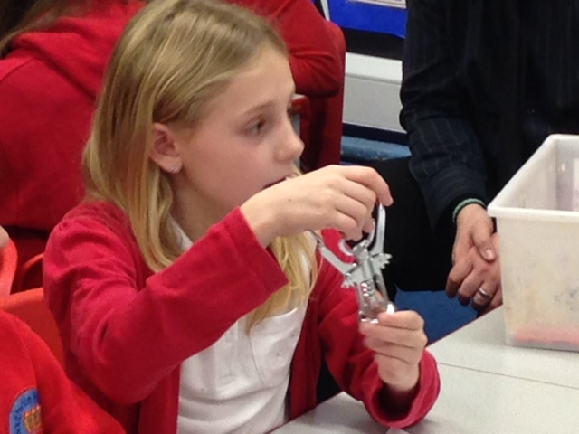
Methodology
A pre and post longitudinal mixed methods design was employed to measure:
  change in attitudes and Education Outreach Self-Efficacy in student engineers;
  attitudes, Teaching Engineering Self-Efficacy and Engineering Subject Knowledge Confidence in pre-service teachers.
  pupils’ attitudes to subjects and knowledge and confidence in science and engineering and future careers
Use of Likert type scale questionnaires and
Open ended questions
Observation, collection of pupils’ ideas and
thoughts during activities
Notes:
Interpretive research drawing on mixed methods.

Slide 7
Perceived Self-Efficacy
A belief in your own ability to perform specific actions, and it reflects a perception of capability rather than measuring actual performance (Gonzalez, Goeppinger, and Lorig 1990; Bandura et al. 1997)
Teacher PSE in science may well influence pupils’ attitudes, achievement, and motivations (McKinnon and Lamberts 2013)
Measured with a Likert scale pre and post intervention
Notes:
What is perceived self efficacy and why does it matter in this research?

Slide 8


Initial Impact
Initial results indicated that there has been a change in attitude towards STEM subjects amongst the pre-service teachers
Notes:
The relative sizes of the words relates to the frequency that they were selected by the pre-service teachers to report their feelings towards the teaching of science. It appears that initially this was seen as fascinating and challenging but also frightening, complex and in some cases daunting.
After participation in the project teaching science was still viewed as challenging, but this was not so dominant, with words such as exciting, rewarding and important also being highly favoured.
Indeed, 80% of the pre-service teachers who participated stated that they would undertake similar work with children in the future. This indicates that participation in the project was valued and has helped the pre-service teachers to develop a more positive view of teaching science. This indicated that a possible change in attitude towards science had come about- need to examine exactly what the nature of this change is.

Slide 9
Post-participation Responses
Post-participation Responses
‘I am anxious about subject knowledge, how in depth could I answer questions.’
‘I need to gain more experience in teaching science so I know how to better answer questions.’
‘I am excited but apprehensive about certain concepts arising that I may not be so confident answering.’
‘I enjoy teaching science, however a lot of questions arise that need a lot more subject knowledge than I have. ‘
‘Much more confident with knowledge and having a successful lesson.’
‘I feel OK now, I know to just recap my knowledge if I am to teach anything I am unsure of.’
‘I will be confident enough to teach like this to my primary age children.’
‘This project has made me more confident in my subject knowledge and explanations in terms of engineering.’
Notes:
Analysis of the qualitative data from open questions in the questionnaire and the reflective diaries revealed that confidence in their subject knowledge was a commonly occurring theme amongst the pre-service teachers. Prior to the project, the pre-service teachers indicated a lack of confidence in their science subject knowledge.
whereas the post project qualitative data appeared to indicated that confidence in science subject knowledge had increased

Slide 10
A statistically significant increase in the confidence that the pre-service teachers had in their subject knowledge.
Notes:
Analysis of the qualitative data confirmed that there had been a significant increase in the levels of confidence that the pre-service teachers had in their science subject knowledge.
Quantitative data indicated that the mean level of confidence in the pre-service teachers’ Science Subject Knowledge before the project was 5.5 out of 10 (SD = 1.8). Following the project, the mean Science Subject Knowledge value was 7.5 (SD = 1.1). There was therefore a highly significant increase Z = -2.82, p= .005 in Science Subject Knowledge

Slide 11
Statistically significant increase in ITE students confidence in their ability to teach science
Teacher 3: ‘I feel excited and much more confident. I think inquiry based learning makes it much more accessible and contextual to children's learning.’
Notes:
Qualitative data also showed that the pre-service teachers felt significantly more confident about their ability to teach science following participation in the project (their science teaching self-efficacy)
(Quantitative data indicated that the mean PSE for the pre-service teachers to teach science before the project was 6.3 out of 10 (SD = 0.9). Following the project, the mean PSE value was 8.2 (SD = 1.0). There was therefore a highly significant increase Z = -2.81, p= .005 in PSE for pre-service teachers to teach science following the project.)
it would therefore appear that participating in the project is beneficial for the pre-service teachers in terms of increased levels of confidence
This is significant as it has been shown that teachers who have positive attitudes and are enthusiastic about a subject, engage in research based instructional strategies, seek out growth opportunities, stay current and create connections with the subject matter that are meaningful to their students (Singh and Stoloff 2008).
This highlights the importance of addressing and positively influencing pre-service teacher’ attitudes to teaching science by cultivating positive dispositions and beliefs (Jung and Rhodes 2008) as they may be as crucial for pre-service teacher’s achievements as pedagogical and content knowledge.
However, at present teacher education programmes appear to have little impact upon the way in which new and pre-service teachers view themselves as teachers. (Ballantyne, et al, 2012). Initial teacher education therefore presents a critical opportunity to influence future capabilities for science teaching. if the successful impact of this project is to be replicated (one of its aims) then deeper analysis of which elements contributed to this change should occur. Therefore, what was it from this project that could be brought forward into ITT?

Slide 12
Theme | Code | Number of References
Childrens’ Responses | Childrens’ enjoyment | 7
 | Gender | 2
 | Inspiring children | 3
 | Childrens’ learning | 7
 | Responses to the students | 6
Materials | Resources | 5
 | Engineer materials | 6
Personal Reflections | Personal enjoyment | 6
 | Future practice of teaching | 20
 | Personal learning | 10
Working with a Peer | Shared workload | 4
 | Sharing expertise | 10
Notes:
Qualitative responses (from the reflective diaries and responses to open questions in the questionnaires) were analysed separately by two of the project researchers using Thematic Analysis (Braun & Clarke 2006) in QSR nVivo 10. Using a process of inter-coder constant comparison, the thematic hierarchies were combined, and the responses from the pre-service teachers were triangulated into one coding frame. Qualitative responses from the children were analysed separately.
Pleasingly, there was a lot of focus on the impact that the project had had on the pre-service teachers personally (i.e. subject knowledge and teaching confidence) and the enjoyment of the children, but also on the element of sharing expertise. Rather than deskilling the teachers by pairing them with an ‘expert’ the experience had in fact upskilled them.
when evaluating the project the students rated the usefulness of working with an 'expert peer' highly and the usefulness of working with a partner (M = 4.9, SD = 0.4) were rated particularly highly and the usefulness of working with a partner (M = 4.9, SD = 0.4) were rated particularly highly

Slide 13
Teacher 4: It was useful having an engineer during certain aspects of the teaching lesson, as he was able to explain the scientific terms regarding forces like: lift, weight, mass and thrust. He also supported the children’s knowledge during the testing stage as he would say to the children whether more/ less weight needed to be added.
Teacher 2: My partner and I worked well together and I felt that it helped because it meant that as he was an engineer, any knowledge needed to help describe the activity could be shared; so I would explain the task and what would need to be done and he could go into more detail about some of the technical parts.
Teacher 7: I found it very interesting and also beneficial to learn and also to work with an expert.

Slide 14
Student Training
Classroom Experience
Children as Engineers
Engineers- training on public engagement, working with children and use of effective questioning techniques.
Session 1
Introduction and working through the EDP
Pre-service teachers- training on the EDP and the roles of an engineer
Session 2
Introduction to the ‘Engineer’ challenge and science conceptual understanding
Engineers + Preservice teachers
Sharing of expertise through working with the materials and planning for classroom experience
Session 3
Supported working through then EDP and exploration of the science involved in the individual challenges.
Notes:
This has enabled us to develop a toolkit for other HE institutions

Slide 15
Children’s responses

Slide 16
Ideas about what engineers do with science

Slide 17
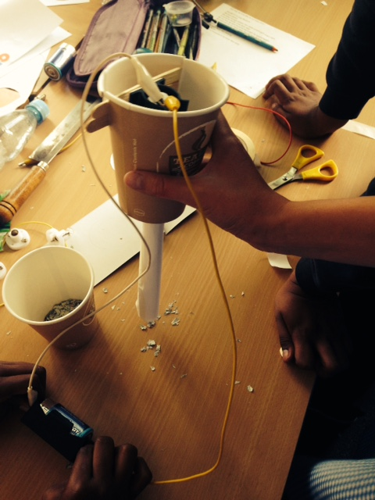
Qualitative data on pupil’s ideas about Engineering on the ideas wall
Before:
Engineers fix cars
They build bridges
They always get very oily
They use spanners
An engineer fixed my Mum’s boiler
After:
Engineers solve problems
They design and make things we need
They make things better
They keep improving

Slide 18
Future Plans
Notes:
Exciting data . We found girls particularly interested in the idea of engineering making life easier an the aspect of designing and making items.

Slide 19
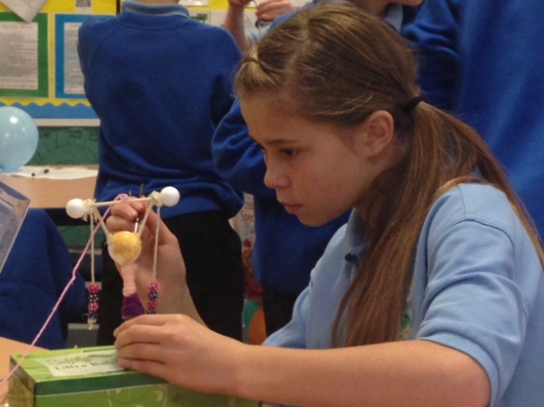
Project Outcomes for Pupils
Similar results in pupils to the EU Engineer evaluation as far as enjoyment, understanding of the range of engineering activity and gender expectations.
Had a more positive impact on their ideas about whether they would want to be an scientist. EU Engineer had no impact on ideas of future Stem careers. Perhaps the role model nearer to them in age and/or female engineer/ engineers from a range of backgrounds had an impact.
There is variety in schools’ data but small samples.

Slide 20
Questions raised
Scientific cultural capital in the ideas of Bordieau- how do some children get this if they have no one in their family with a science career or background? Does contact with an engineering student of a not- so different age/ ethnicity/gender to them help to provide some science capital?
Pairing of transforming experts from different fields appears to be an effective method of knowledge and skills exchange. Is this because the partners were peers of similar age and experience? Would the model work for non-peered pairs.
Is the model transferable to other subject areas?

Slide 21
Bibliography
Bandura, A. (1997). Self-efficacy. [Article]. Harvard Mental Health Letter, 13(9), 4.
Gonzalez, V. M., Goeppinger, J., & Lorig, K. (1990). Four psychosocial theories and their application to patient education and clinical practice. [Review]. Arthritis Care & Research, 3(3), 132-143.
McKinnon, Merryn, and Rod Lamberts. 2013. “Influencing Science Teaching Self-Efficacy Beliefs of Primary School Teachers: A Longitudinal Case Study.” International Journal of Science Education, Part B: 1–23.

