Slide 1
Westminster Briefing
Planning Healthy Communities
15 September 2015
Planning Policy’s Role in Addressing Health Challenges
Dr Laurence Carmichael
Coordinator
WHO Collaborating Centre for Healthy Urban Environments
University of the West of England, Bristol
Laurence.carmichael@uwe.ac.uk

Slide 2
Content
The impact of the built environment on health and wellbeing: concepts and evidence base
1. Built environment as a determinant of health
2. Inequalities and built environment
3. The evidence base
Re-emergence of planning to promote healthier environments and behaviour change: the case of healthy weight environments
Re-emergence of the planning process
Guidance on healthy weight environments
Local case studies
Conclusion: a few issues to consider for policy-making in health and built environment
Evidence base
Delivery mechanisms
Politics

Slide 3
The impact of the built environment on health and wellbeing: concepts and evidence base

Slide 4
What is health?
WHO definition of Health:
Health is a state of complete physical, mental and social well-being and not merely the absence of disease or infirmity
Preamble to the Constitution of the World Health Organization as adopted by the International Health Conference, New York, 19-22 June, 1946.

Slide 5
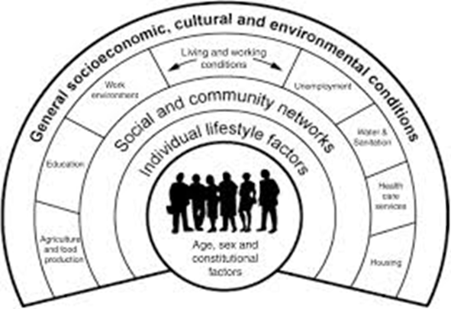
What factors influence our health?
The broader determinants of health
Social/ecological theory to health:
maps the relationship between the individual, their environment and disease.
Dahlgren and Whitehead (1991)

Slide 6
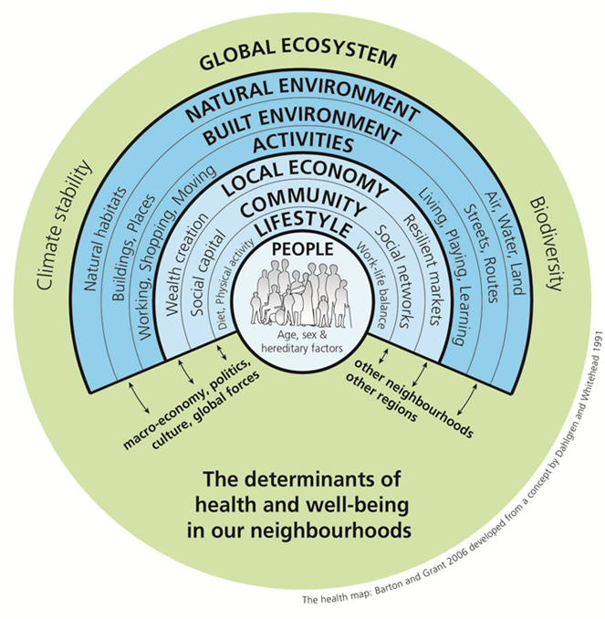
What role does the built environment play in influencing health and wellbeing?
Physical and social characteristics of communities and neighbourhoods are factors of health and can deliver health outcomes including:
Physical and mental health through:
perception of local area
social connections
physical activity
Environmental health:
air quality, water, noise
Safety, security
Health equity

Slide 8
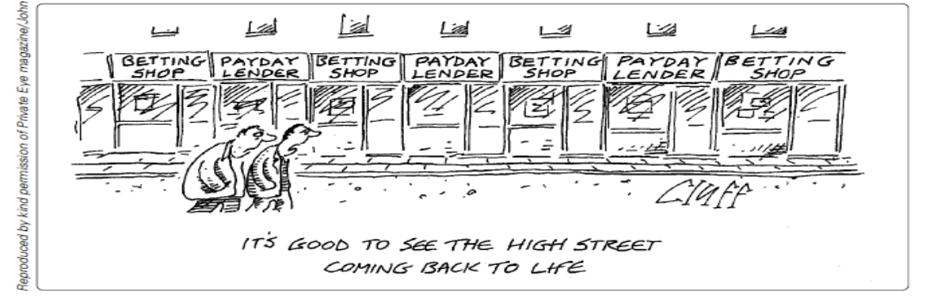
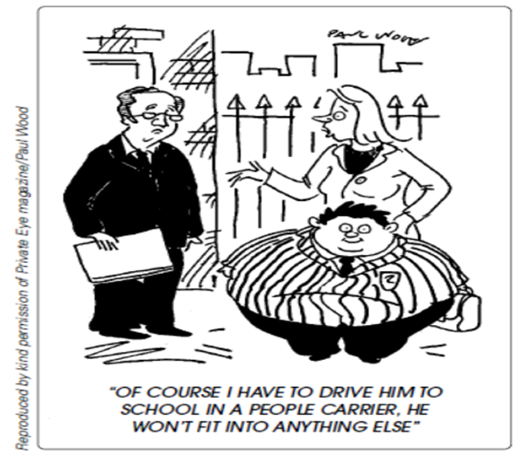
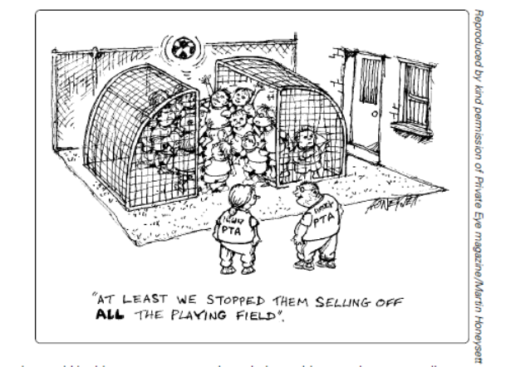
Ross and Petrokovsky, 2014, Town and Country Planning 83 (11), 468-470.

Slide 9
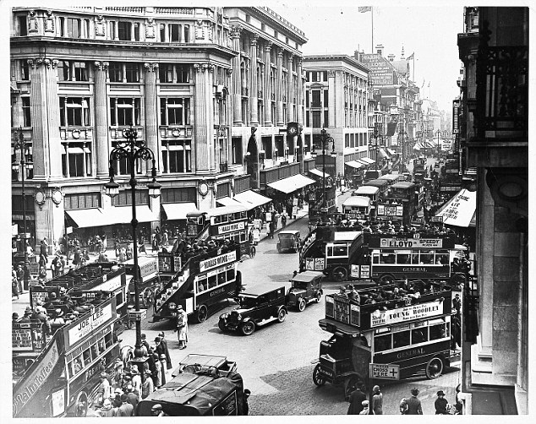
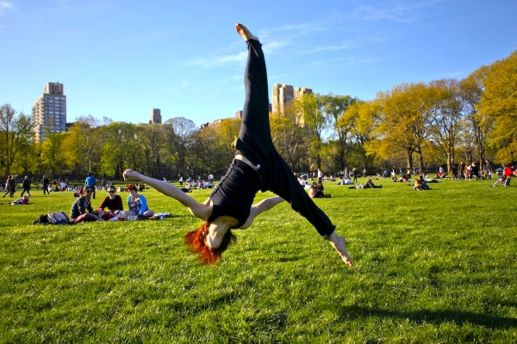
Road traffic noise is associated with increased cardiovascular morbidity and mortality and all-cause mortality in London Halonen et al.. (2015)
High quality Green space in Cities provides
Opportunities for Physical activity
Mytton et al. (2012) found a positive association between green space and physical activity levels
Ward-Thompson et al. (2012) showed that more green space is linked to less stress in deprived communities.
Evidence is particularly strong for positive associations between experience of natural environments and mental health.
Researchers reported that changing and improving park signs can increase physical activity by seven to 12 percent. (Photo : Eduardo Munoz/Reuters)
http://www.counselheal.com/articles/7242/20131018/study-finds-better-park-signs-can-increase-exercise.htm#ixzz3lEroJ32c

Slide 10
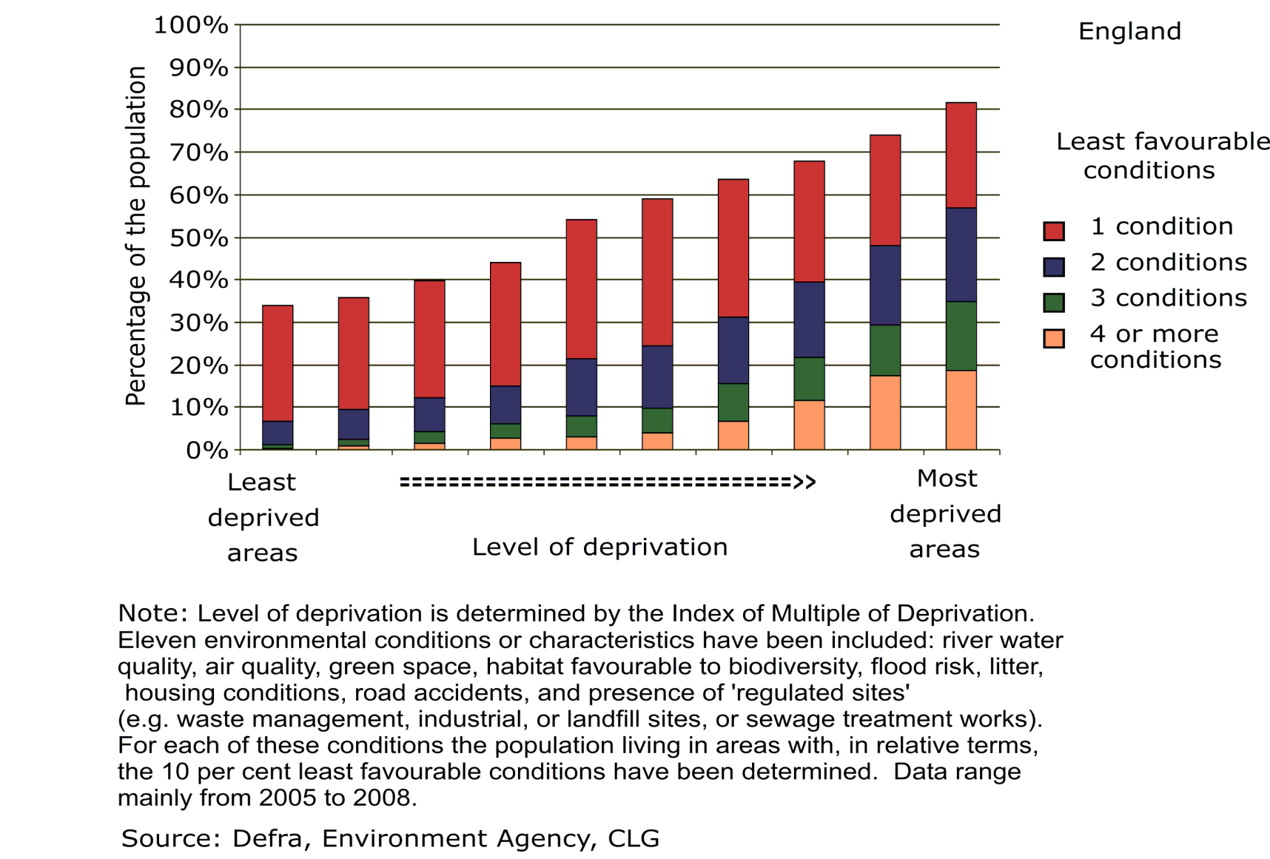
Health inequalities and the built environment
20% of most affluent neighbourhoods in England have 5 times the amount of greenspace than the most deprived 10% neighbourhoods.

Slide 11
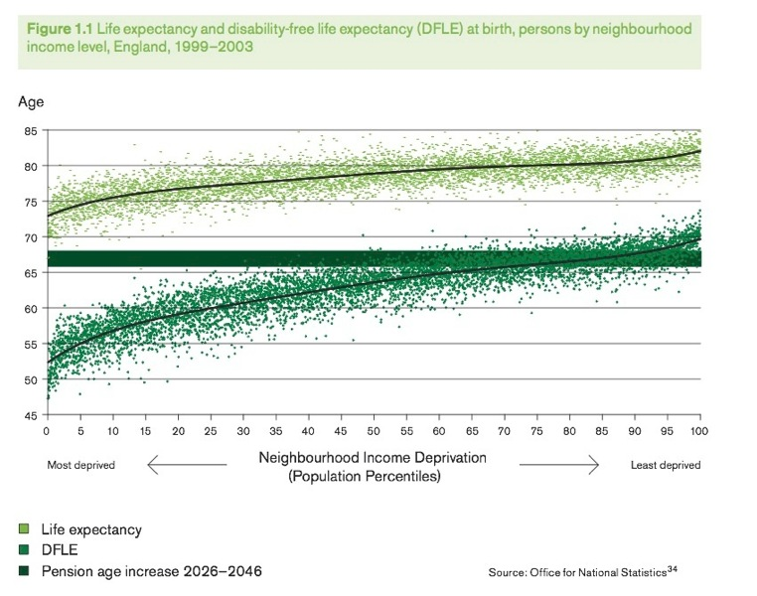
Health inequalities and the built environment

Slide 12

Obesity and healthy weight environments

Slide 13
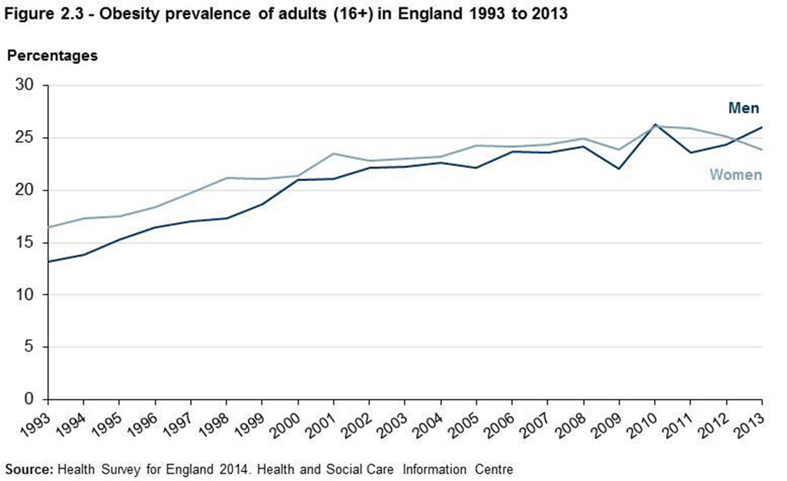

Slide 14
Costs of obesity
Calculating the future costs of elevated BMI (£ billion /year) Source: Foresight report on Tackling Obesity, 2007 | 2007 | 2015 | 2025 | 2050
Total cost to the NHS of stroke, heart disease, diabetes and related diseases | 17.4 | 19.5 | 21.5 | 22.9
NHS costs attributable to elevated BMI | 4.2 | 6.3 | 8.3 | 9.7
Wider costs of elevated BMI (through lower productivity, etc) | 16 | 27 | 37 | 50

Slide 15
Cost of obesity for local authorities
Care of house-bound residents suffering from obesity related illnesses (eg arthritis, heart disease, diabetes) and those requiring help towards walking aids and home adaptations may be considerable - and likely to increase in line with national predictions for obesity prevalence.
PHE (work in progress, 2014) suggests that local authorities spend an estimated extra £352 million per year on providing formal care for severely obese people compared to healthy weight people.
Public Health England (online www.noo.org.uk/LA/impact/economic)

Slide 16
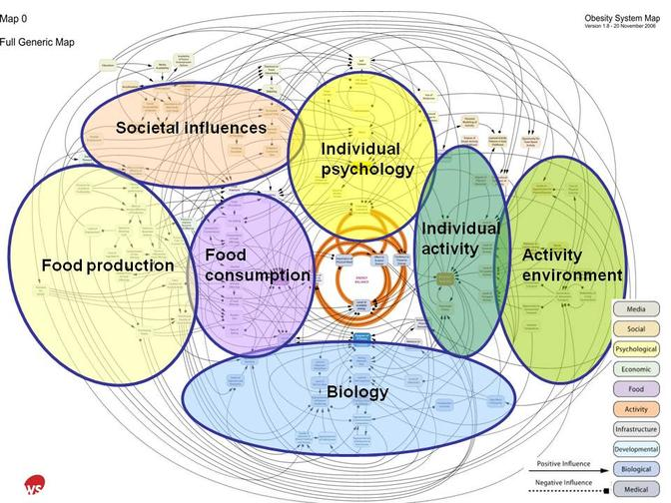
Obesity: the activity environment, part of the problem and the solution?
http://hdvchpediatricobesity.wikispaces.com/About+child+obesity

Slide 17
Built environment and physical activity
Physical activity:
Physical activity = lifestyle factor for long-term health and to tackle obesity.
people who regularly use active transport gain health benefits
Characteristics of neighbourhood design can influence individual behaviour and take up of physical activity, for instance:
  High connectivity
  mixed neighbourhoods
  Land use mixture
  public transport, pedestrian facilities or proximity
  Green spaces, signage
  Neighbourhood aesthetics used to design-in walking and cycling in our daily lives
(Saelens, Sallis and Frank, 2003; Booth, Pinkston and Carlos Poston, 2005; Warburton Nicol and Bredin 2006; Lake and Townshend, 2006; Andersen, Wedderkopp, Pucher, Buehler, Bassett and Dannenberg, 2010; Kristensen, Moller, Froberg, and Cooper, 2011; Rhodes and Nasuti, 2011; de Nazelle et al., 2011; DoH, 2011; Mytton, Townsend, Rutter and Foster, 2012; Audrey, Procter and Cooper, 2014; White et al., 2013)

Slide 18
Built environment and physical activity: warning
Supportive built environment is not enough on its own to ensure physical activity but it does facilitate it
But note: an unsupportive built environment is an effective deterrent of physical activity and exacerbates social exclusion
Source: (TRB, 2005)
Inactivity 'kills more than obesity'
http://www.bbc.co.uk/news/health-30812439

Slide 19
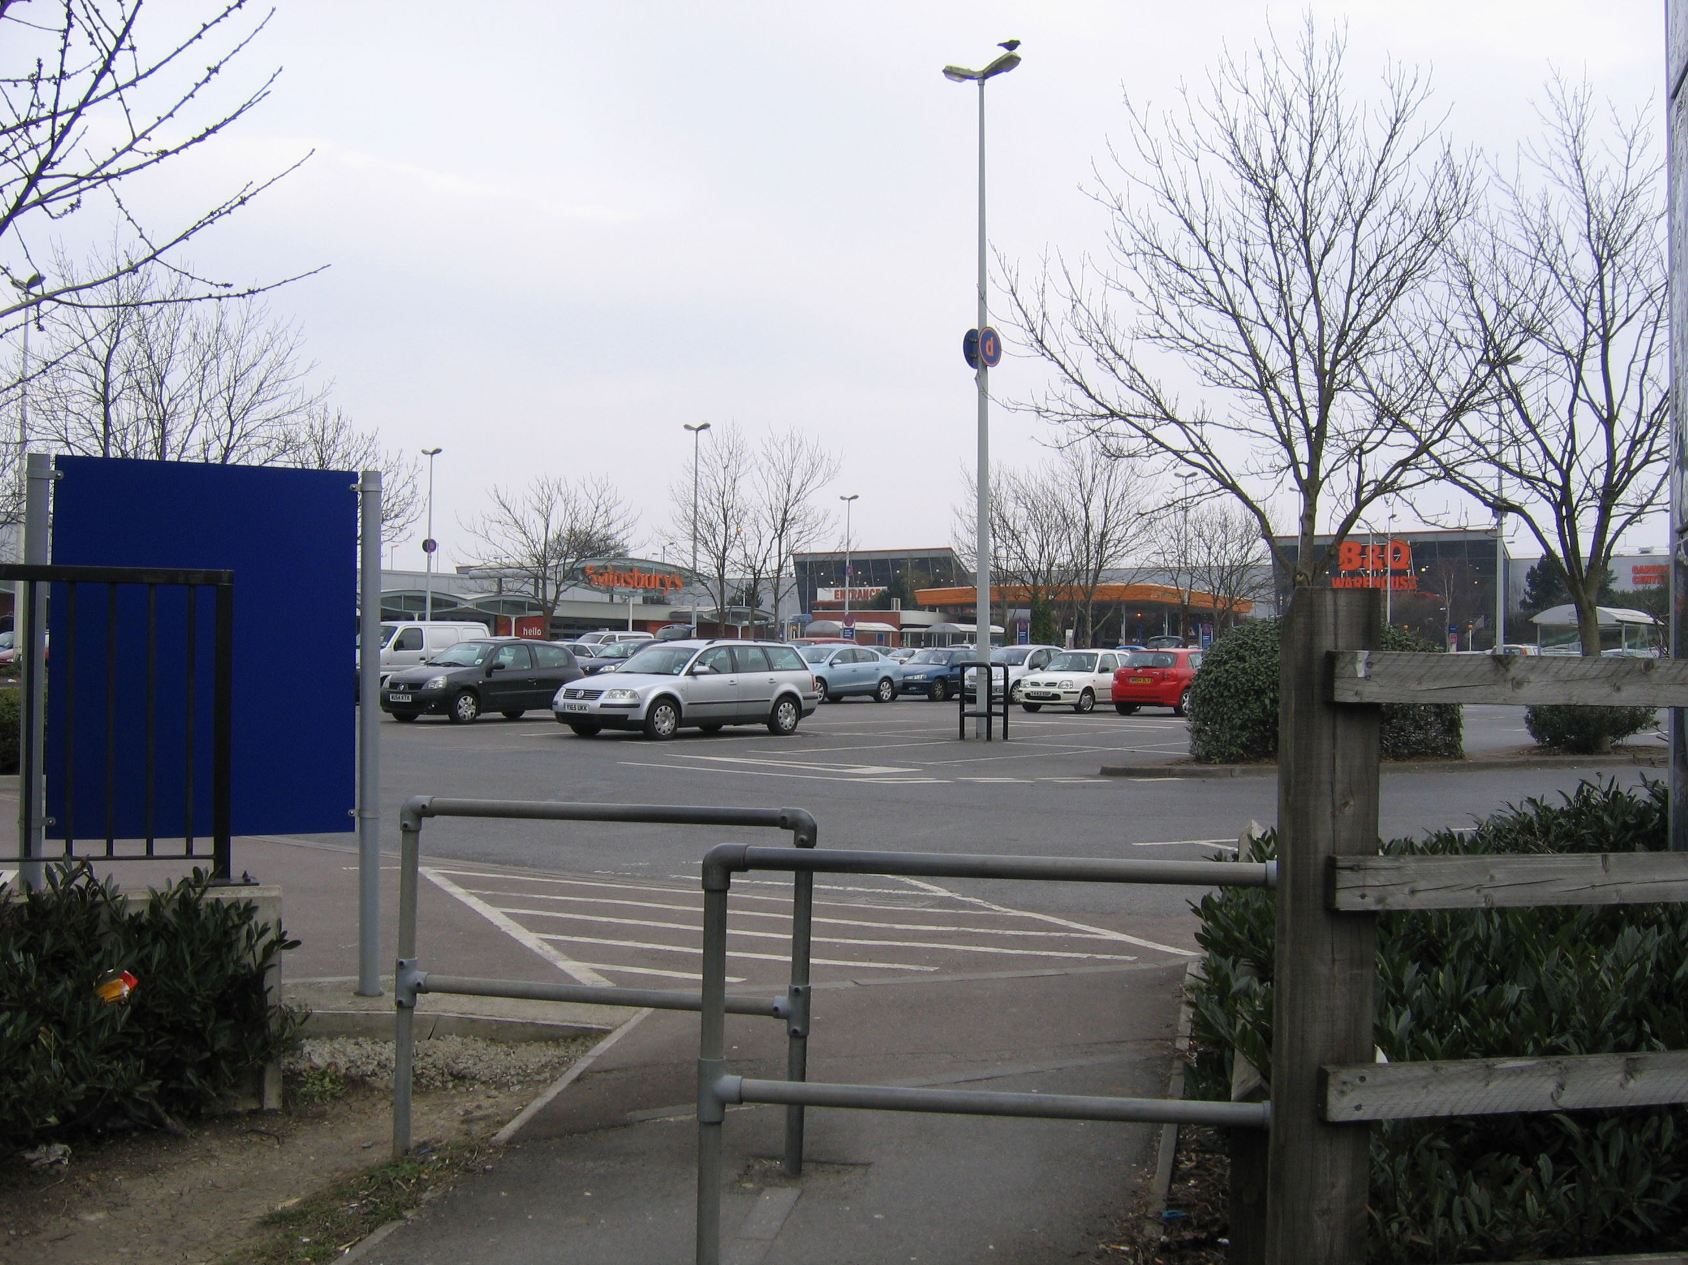

Slide 20
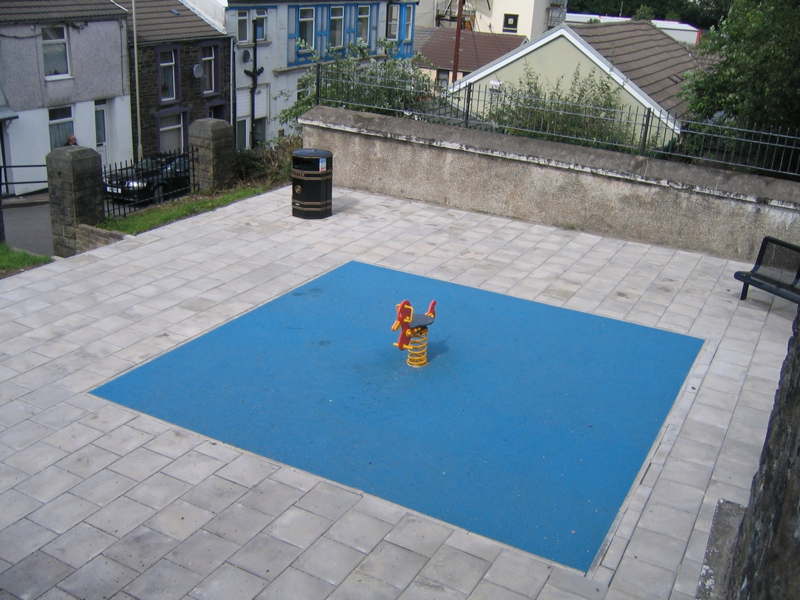

Slide 21
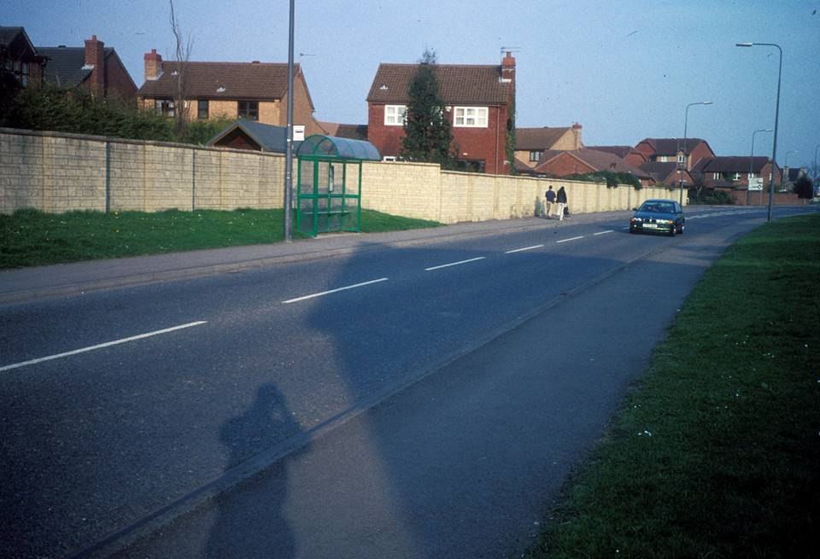

Slide 22
Re-emergence of planning to promote healthier environments and behaviour change

Slide 23
Re-emergence of the planning process to promote healthy weight environment
Have we got the right national and local policies, processes, guidance and partnerships?
Section 8 of the National Planning Policy Framework (NPPF) includes creating healthy communities.
Joint Health and Wellbeing Strategies and obesity strategies provide evidence on obesity to planners.
Obesity evidence can be used to strengthen the argument for achieving a range of existing planning policy objectives (sustainable transport, climate change adaptation/mitigation, sustainable design, local economic growth and better-designed places).
But: no national planning policy guidance focusing specifically on reducing obesity and creating healthy weight environments.

Slide 24
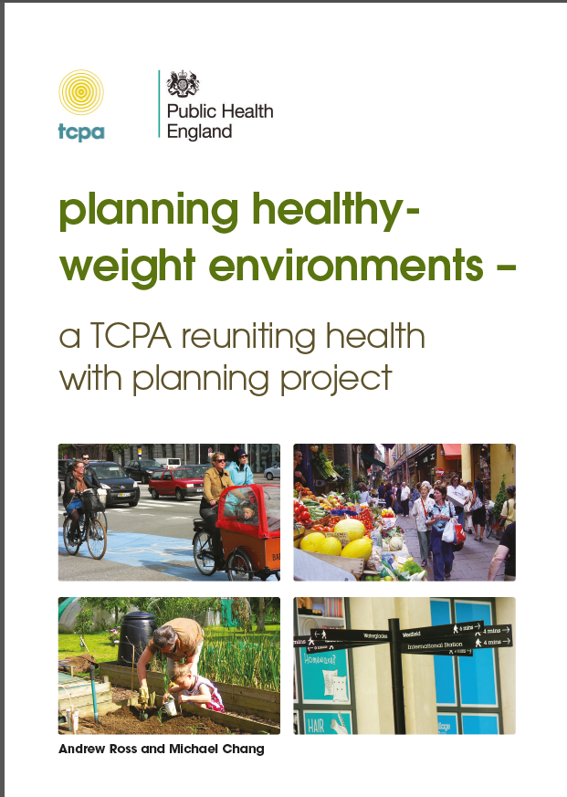
Planning Healthy Weight Environments – TCPA Guidance
Notes:
How do we do it? There is lots of guidance available, but we will use the TCPA as a starting point, as it gives a good overall picture and refelcts the strategic aims well. Also then talk through some case studies which highlight elements of both.

Slide 25
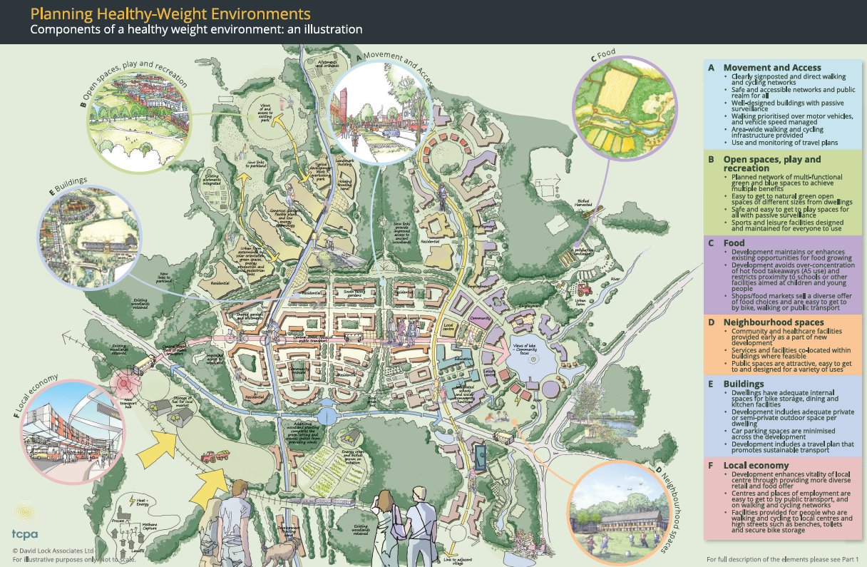

Slide 26
Themes of a Healthy Weight Environment
Movement and access: Walking and cycling environmenst; local transport services. (How is the use of walking, cycling and public transport services made easier than driving a car?)
Open spaces, recreation and play: Open spaces; natural environment; leisure and recreational spaces; play spaces. (How will new open spaces (and facilities such as playgrounds, food-growing schemes and nature walks) be managed and maintained? How will maintenance be funded?)
Food: Food retail (including production, supply and diversity); food growing; access. (What is the proposed retail/food mix, and is it likely to make healthier choices easier for residents?)
Neighbourhood spaces: Community and social infrastructure; public spaces. (Will there be spaces that enable people to meet each other and that are suitable for a range of uses, depending on community priorities?)
Building design: Homes; other buildings. (Does the design of the buildings encourage physical activity?)
Local economy: Town centres and high streets; job opportunities and access. (Does the proposal include employment, and does it prioritise creating infrastructure links to local areas of high unemployment?)

Slide 27
The dilemma of ensuring viability and deliverability
Key issue: ability for developers and land owners to receive ‘competitive returns’ from their development as they “suffer” the cumulative burden of national and local design standards and policies (NPPF, para. 173-174).
Could a healthy-weight environment create more economically thriving spaces that add value to developments, as well as fulfilling national and local health policies? TCPA refers to evidence but more needed
  Retailers report an increase in trade of up to 40% when places are made more attractive for walking.
  Places that are easier and more attractive to walk around (designed for so-called ‘walkability’) do better commercially (with an 80% increase in retail sales) and have higher housing values.
  (BUT be careful – could contribute to inequalities! )
Notes:
This economic evidence can help to build the case for development management planners to require an assessment of the health impact of a proposal, for example by requiring a Health Impact Assessment for larger schemes.

Slide 28
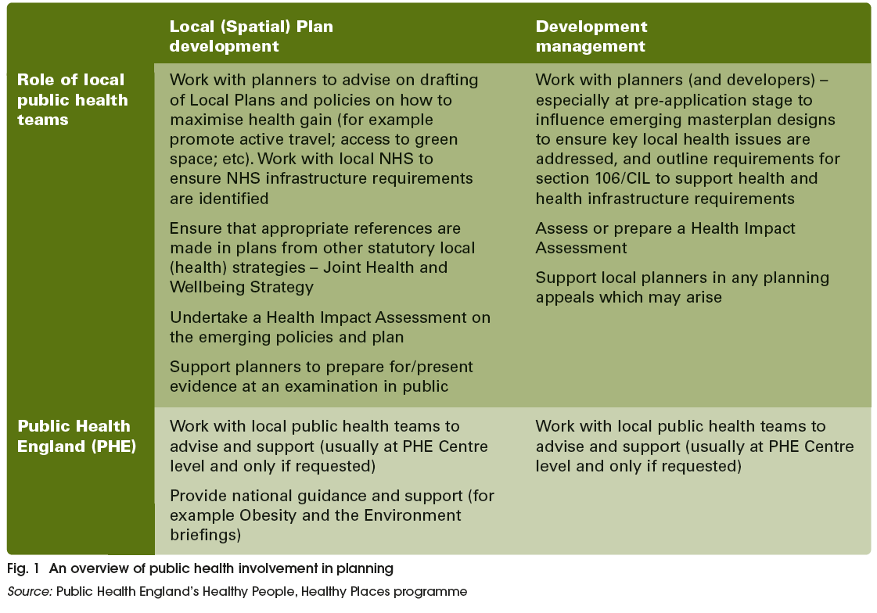
Partnerships: how can public health teams support planners?

Slide 29
How are local authorities promoting healthy living environments?
    Sandwell and West Midlands Healthy Urban Group – Partnership working
    Bristol protocol - HIA process
    Plymotion - Integrated transport/active travel
    Waltham Forest – Healthy eating
    Torbay – Greenspace Strategy
    Let’s Walk Bedminster - Community project

Slide 30
Conclusion: few issues to consider for health and built environment policy-making (planning policy/planning decisions)
Evidence base (for academics and research councils)
Methodological challenges to ensure robustness of the evidence
Generalisability vs local relevance to inform local plans, planning decisions
Change the way research priorities are set, to challenge medical paradigms and the instrumental mindset of cost effectiveness
Ensure that planners inform scope of research questions, projects
Translate the evidence so it can be material consideration in planning decisions
Delivery mechanisms for spatial planning
NPPF needs to give planning for health a higher priority
develop integrated policy-making across professions at local level
Local plan: address the issue of viability (long term impact of new development on health)
Joint Strategic Needs Assessments/ Health and Wellbeing strategies to inform local plan and vice versa
Consider health impact assessment in other forms of assessments
Politics
Public health seen as left of centre/health diplomacy needed
Leadership at local level
Realise the co-benefit of health agenda (transport, housing, education, sustainable development)

Slide 31
References
Useful resource: Barton, Thompson, Burgess and Grant (eds) (2015). The Routledge Handbook of Planning for Health and Well-being, London: Routledge.
Aboelata, 2004. The built environment and health - 11 Profiles of Neighborhood Transformation, Prevention Institute: Oakland, CA.
TRB (2005) Does the built environment influence physical activity? : examining the evidence /
Committee on Physical Activity, Health, Transportation, and Land Use, Transportation
Research Board, Institute of Medicine of the National Academies, Washington DC.
Dahlgren G, Whitehead M. 1991. Policies and strategies to promote social equity in health. Stockholm: Institute for Future Studies.
Marmot, Sir M. (2010). Fair Society, Healthy Lives – The Marmot Review. London: Department of Health.
Jackson, R., Dannenberg, A. and Frumkin, H, (2013). Health and the Built Environment: 10 Years After, American Journal of Public Health Vol. 103, No. 9 : pp. 1542-1544.
Barton, H. (2009). Land use planning and health and well-being. Land Use Policy 26S S115–S123.
Murray, L. et al. (2013). ‘UK health performance: findings of the Global Burden of Disease Study 2010’. The Lancet,2013, Vol. 381 (9,871), 997-1020. www.thelancet.com/journals/lancet/
article/PIIS0140-6736(13)60355-4/fulltext#article_upsell
The Institute of Health Equity (2013). Review of the social determinants and the health divide in the WHO European region. Copenhagen: WHO Europe.
Crew, D. (2007). The tennants’ dilemma – warning: your home is at rick if you dare complain. Liverpool: Citizen Advice Bureau.

Slide 32
References
Crisis (2011). Homelessness: a silent killer a research briefing on mortality amongst homeless people, Crisis.
Healy, J. D. (2003). Excess winter mortality in Europe: a cross country analysis identifying key risk factors. Journal of epidemiology and community health 57(10), 784-789.
Liddell, C. and Morris, C. (2010). Fuel poverty and human health: a review of recent evidence . Energy Policy 38 (6), 2987-2997.
Harker, L. and Shelter (2006). Chance of a lifetime: the impact of bad housing on children’s lives. London: Shelter.
CABE (2010a). Community green: using local spaces to tackle inequality and improve health, London: CABE.
CABE (2010b). Urban green nation: building the evidence base. London: CABE.
Croucher, L. et al. (2007). The links between greenspace and health: a critical literature review, Stirling: Greenspace Scotland.
Pretty, J. et al. (2007). Green exercise in the UK countryside: effects on health and psychological wellbeing, and implications for policy and planning. Journal of environmental planning and management 50(2), 211-231.
Clark, P. et al. (2013). Greening dementia: a literature review of the benefits a d barriers facing individuals living with dementia in accessing the natural environment and local greenspace. Worcester: Natural England.
Maas, J. et al. (2009). Morbidity is related to a green living environment. Journal of epidem. and comm. Health 63 (12), 967-973.

Slide 33
References
Andersen, L. B., Wedderkopp, N., Kristensen, P. L., Moller, N. C., Froberg, K. and Cooper, A. (2011). Cycling to School and Cardiovascular Risk Factors: A Longitudinal Study. Journal of Physical Activity and Health, 8, 1025-33.
Audrey, S., Procter, S. & Cooper, A. (2014). The contribution of walking to work to adult physical activity levels: a cross sectional study. International Journal of Behavioural Nutrition and Physical Activity, 11, 37.
Barton, H. (2009). Land use planning and health and well-being. Land Use Policy 26S S115–S123.
Bristol City Council (2011a). Bristol Development Framework Core Strategy, adopted
June 2011. Bristol: Bristol City Council.
Carmichael, L., Barton H., Gray S., Lease H . & Pilkington P. (2012). Integration of health into urban spatial planning through impact assessment: identifying governance and policy barriers and facilitators. EIA Review, 32 (1), 187-194.
Chaix, B. (2009). Geographic life environments and coronary heart disease: a literature review, theoretical contribution, methodological updates and a research agenda. Annual review of Public Health, 30, 81-105.
Commission for the Architecture and the Built Environment (2010). Improving the design of new housing: What role for standards? London: CABE.
Commission for the Architecture and the Built Environment (2010). Improving the design of new housing: What role for standards? London: CABE.
Cummins, S. & Macintyre, S. (2005). Food environments and obesity - neighbourhood or nation? International Journal of Epidemiology, 35, 100-4.

Slide 34
References
Cummins, S., Petticrew, M., Higgins, C., Findlay, A. & Sparks L. (2005). Large-scale food retailing as health intervention: quasi-experimental evaluation of a natural experiment. J. Epidemiol Community Health, 59, 1035-40.
Dahlgren, G. and Whitehead, M. (1991). Policies and strategies to promote social equity in health. Institute for Future Studies, Stockholm: Mimeo.
De Nazelle, A., Nieuwenhuijsen, M. J., Anto, J.M., Brauer, M., Briggs, D., Braun-Fahrlander, C., … Lebret, E. (2011). Improving health through policies that promote active travel : a review of evidence to support integrated health impact assessment. Environment International, 37, 766-77.
Department of Health (2011a). Start active, stay active: a report on physical activity for health from the four Home countries’ Chief Medical Officers, London: DoH.
Department of Health (2011c). Healthy Lives, Healthy People: A call to action on obesity in England. London: DoH.
Evans, G. W. (2003). The built environment and mental health. Journal of Urban Health: Bulletin of the New York Academy of Medicine 80(4), 536-55.
Foster, S., Wood, L., Christian, H., Knuimna, M. & Giles-Corti, B. (2013). Planning safer suburbs: do changes in the built environment influence residents’ perceptions of crime risk? Social Science and Medicine, 97, 87-94.
Galea, S., Ahern, J., Rudenstine, S., Wallace, Z.Vlahov D. (2005). Urban built environment and depression: a multilevel analysis. J Epidemiol Community Health, 59, 822-7.
Giles-Corti, B., Wood, G., Pikora, T., Learnihan, V., Bulsara, M., Van Niel, K., …Villanueva, K. (2011). School site and the potential to walk to school: the impact of street connectivity and traffic exposure in school neighborhoods. Health and Place, 17, 545-550.

Slide 35
References
Guite, H. F, Clark, C., & Ackrill, G. (2006). The impact of the physical and urban environment on mental well-being. Public Health, 120, 1117-26.
Halonen, J., Hansell, A.., Gulliver, J. et al. (2015). Road traffic noise is associated with increased cardiovascular morbidity and mortality and all-cause mortality in London. European Heart Journal. DOI: 10.1093/eurheartj/ehv216 - See more at: http://www.lshtm.ac.uk/newsevents/news/2015/road_traffic_noise_associated_with_deaths_and_strokes.html#sthash.nFL1cmpy.dpuf
Jackson, L. E. (2003). The Relationship of urban design to human health and condition. Landscape and Urban Planning 64(4), 191-200.
Kihal-Talantikite, W., Padilla, C., Lalloué, B., Gelormini, M., Zmirou-Navier, D. & Deguen, S. (2013). Green space, social inequalities and neonatal mortality in France. BMC Pregnancy and Childbirth, 13, 191.
Lake, A., & Townshend, T. (2006). Obesogenic environments: exploring the built and food environments. Journal of the Royal Society for the Promotion of Health, 126(6), 262-267.
Leslie, E., & Cerin, E. (2008). Are perceptions of the local environment related to neighborhood satisfaction and mental health in adults? Preventive Medicine, 47(3), 273-278.
Miles, R., Panton, L. B., Jang, M. & Haynes, E. M. (2008). Residential context, walking and obesity : two African-American neighborhoods compared. Health and Place, 14, 275-86.
Mytton, O., Townsend, N., Rutter, H. and Foster, C. (2012). Green space and physical activity: an observational study using health survey for England data. Health and Place, 18, 1034-41.
National Institute for Health and Care Excellence (2008). Physical Activity and the Environment – NICE guidelines PH8. London: NICE.

Slide 36
References
Nielsen, T. & Hansen, K. (2007). Do green areas affect health? Results from a Danish survey on the use of green areas and health indicators. Health and Place, 13, 839-50.
O’Campo, P., Salmon, C., and Burke, J. (2009). Neighbourhoods and mental well-being: What are the pathways? Health and Place, 15(1), pp. 56-68.
O’Mullane, M. (ed.) (2013). Integrating Health Impact Assessment with the policy process. Oxford: Oxford University Press.
Phillips, D. R., Siu, O., Yeh, A.G.O. & Cheng, K. H. C. (2005). The impact of dwelling conditions on older persons’ psychological well-being in Hong Kong; the mediating role of residential satisfaction. Soc. Sci. Med., 60, 2785-97.
Pucher, J., Buehler, R., Bassett, D. R. & Dannenberg, A.L. (2010). Walking and cycling to health : a comparative analysis of city, state, and international data. American Journal of Public Health, 100, 1986-92.
Rhodes, R. E. & Nasuti, G. (2011). Trends and changes in research on the psychology of physical activity across 20 years: a quantitative analysis of 10 journals. Preventive Medicine, 53 (1-2), 17-23.
Saelens, B. E., Sallis, J. F. & Frank, L. D. (2003). Environmental correlates of walking and cycling: findings from the transportation, urban design, and planning literatures. Ann Behav Med, 25, 80-91.
Spielman, S., Yoo, E.-H. & Linkletter, C. (2013). Neighbourhood contexts, health, and behaviour: understanding the role of scale and residential sorting. Environment and Planning B: Planning and Design, 40, 489-506.
Teedon, P., Gillespie, M., Lindsay, K. & Baker, K. (2014). Parental perceptions of the impacts the built environment has on young children's health: a qualitative examination and lay assessment amongst residents in four Scottish communities. Health and Place, 28, 50-57.

Slide 37
References
Town and Country Planning (2014). Special Issue Reuniting Health with Planning. Town and Country Planning, 83, 11.
Turrell, G., Haynes, M., Wilson, L.-A. & Giles-Corti, B. (2013). Can the built environment reduce health inequalities? A study of neighbourhood socioeconomic disadvantage and walking for transport. Health and Place, 19, 89-98.
Warburton, D., Nicol, C. & Bredin, S. (2006). Health benefits of physical activity: the evidence, CMAJ, 174, 801-9.
Ward-Thompson, C., Roe, J., Aspinall, P., Mitchell, R., Clow, A., Miller, D. (2012). More green space is linked to less stress in deprived communities: Evidence from salivary cortisol patterns, in Landscape and Urban Planning 105 (3) 15, 221–229.
White, M., Alcock, I., Wheeler, B. & Depledge, M. (2013). Would you be happier living in a greener urban area? A fixed-effects analysis of panel data. Psychological Science, 24, 920-928.
Wismar, M., Blau, J., Ernst, K. & Figueras, J. (eds) (2007). The Effectiveness of Health Impact Assessment: scope and limitations of supporting decision-making in Europe. Copenhagen, Denmark: World Health Organization Regional Office for Europe.
World Health Organization (2008). Air quality and health, fact sheet 313. http://www.who.int/mediacentre/factsheets/fs313/en/

