Slide 1
Sirens of the sea? Marine reserve designation on the Isle of Arran
Dr Tom Appleby
Notes:
That man sitting in the iron seat did not look like a man; gloved, goggled, rubber dust mask over nose and mouth, he was a part of the monster, a robot in the seat … The driver could not control it – straight across country it went, cutting through a dozen farms and straight back. A twitch at the controls could swerve the ‘cat, but the driver’s hands could not twitch because the monster that built the tractor, the monster that sent the tractor out, had somehow gotten into the driver’s hands, into his brain and muscle, had goggled him and muzzled him – goggled his mind, muzzled his speech, goggled his perception, muzzled his protest. He could not see the land as it was, he could not smell the land as it smelled; his feet did not stamp the clods or feel the warmth and power of the earth. He sat in an iron seat and stepped on iron pedals. He could not cheer or beat or curse or encourage the extension of his power, and because of this he could not cheer or whip or curse or encourage himself. He did not know or own or trust or beseech the land. If a seed dropped did not germinate, it was no skin off his ass. If the young thrusting plant withered in drought or drowned in a flood of rain, it was no more to the driver than to the tractor.

Slide 2
Copyright New York:Viking

Slide 3
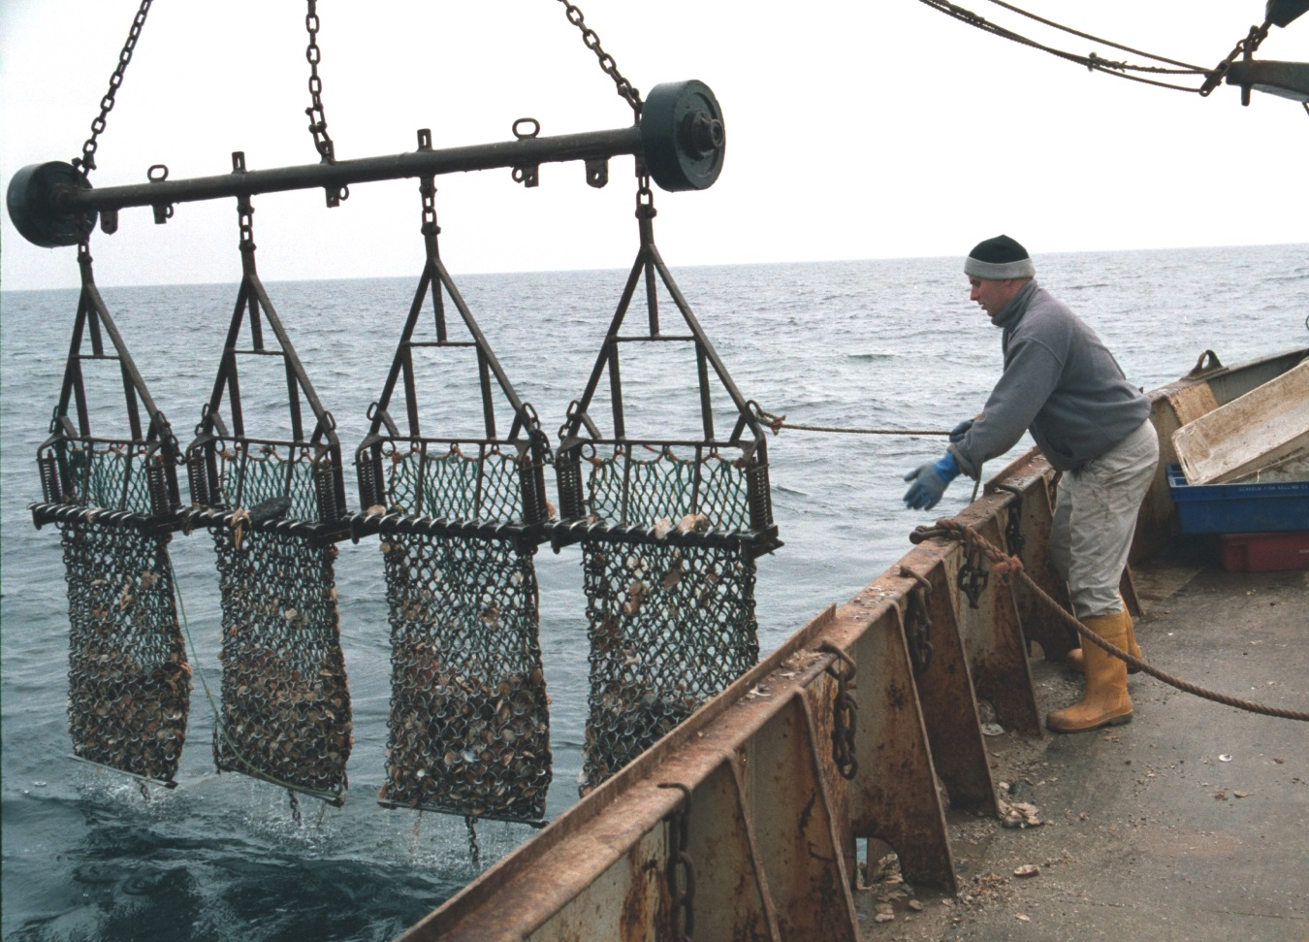
Scallop Dredging
Courtesy of Bryce Beukers-Stewart

Slide 4
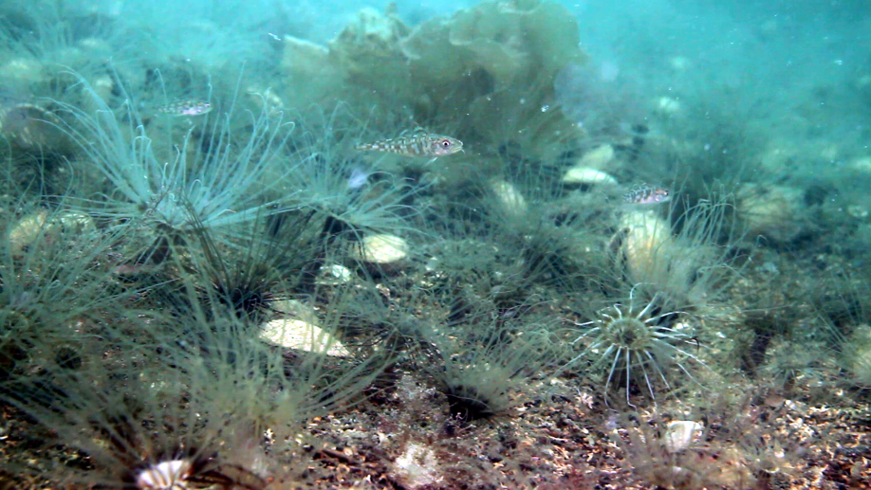
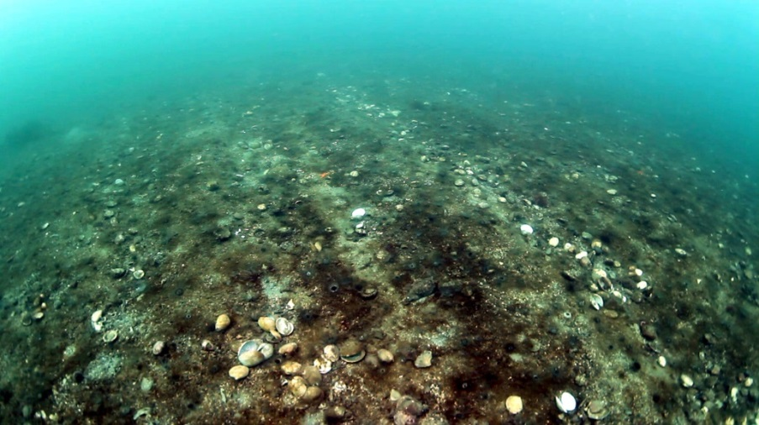
Courtesy of Howard Wood
Courtesy of Howard Wood
Courtesy of COAST

Slide 5
The Clyde Sea
Copyright the Scottish Government

Slide 6
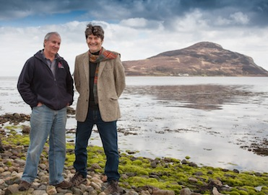
Courtesy of COAST

Slide 7
COAST Proposal

Slide 8
How would you do it?

Slide 9
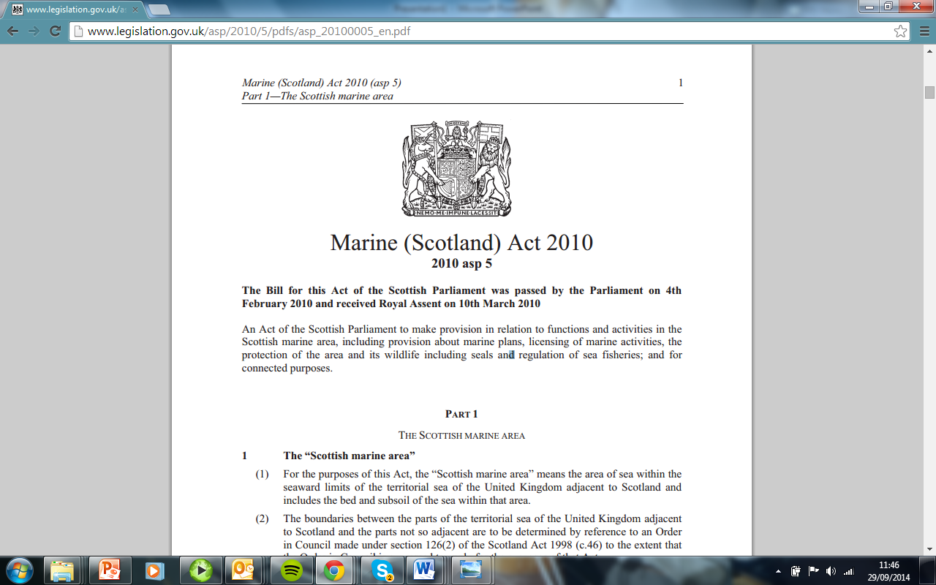
Notes:
You would not buy a house and expect your conveyancer to change the whole system.
Basic position was that the law fundamentally permitted what COAST wanted and stopped scallop dredging: The law was already wild

Slide 10
Due diligence on commercial fishing rights

Slide 11
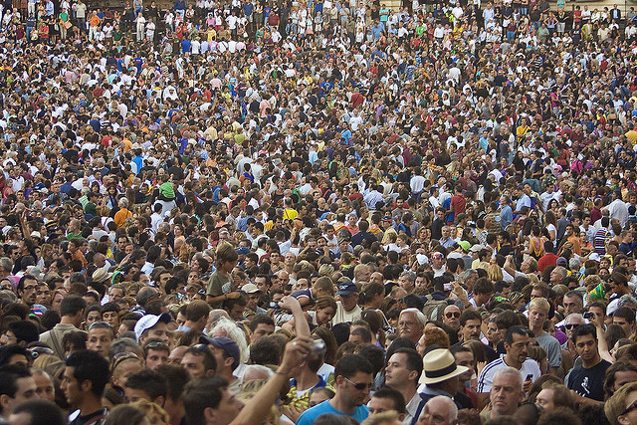
Public right to fish
Lozano Guzman cc licence

Slide 12
What do the public want?
‘Clean healthy, safe, productive and biologically diverse oceans and seas’
Source: Safeguarding our Seas (2002)
Notes:
Managing the sea as a prawn and scallop fishery does not do that.

Slide 13
Petitioned the Scottish Parliament
Pschemp cc licence
Notes:
Select Committee Recommended going ahead with COAST proposal

Slide 14
First piece of marine planning in UK
‘The Council is aware of the Community of Arran Seabed Trust (COAST) and is generally supportive of seabed regeneration and marine conservation within Lamlash Bay’
Isle of Arran Local Plan (2005) at 10.8

Slide 15
Lord Advocate

Slide 16
Eventually
The Inshore Fishing (Prohibition on Fishing) (Lamlash Bay) (Scotland) Order 2008
Notes:
After:
Fighting off a fish farm
Moving a pipeline
Putting the first line in the Arran Local plan

Slide 17
South of Arran Marine Protected Area
South Arran Nature Conservation Marine Protected Area Order 2014
Notes:
But the name is misleading only protects certain features within the MPA.

Slide 18
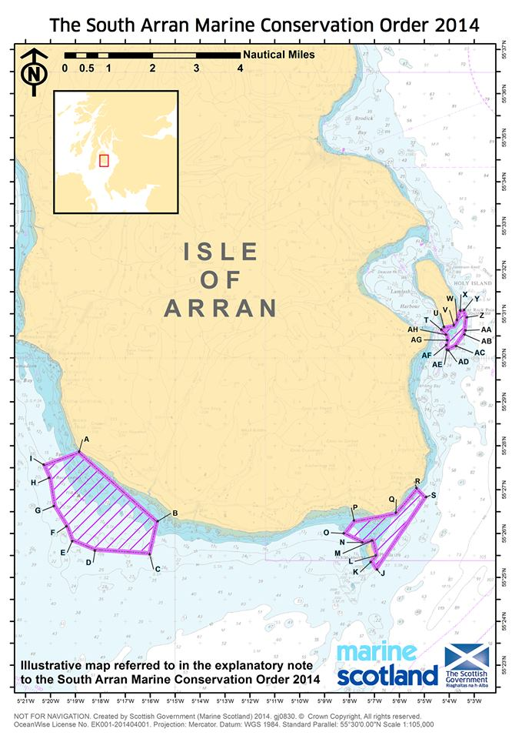

Slide 19
COAST Organisation
Notes:
COAST is now an entity in itself. It has an office, a manager, researchers and I could close the door now and it would work fine.

Slide 20
Goldman Environmental Prize

Slide 21
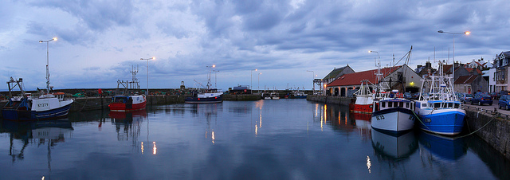
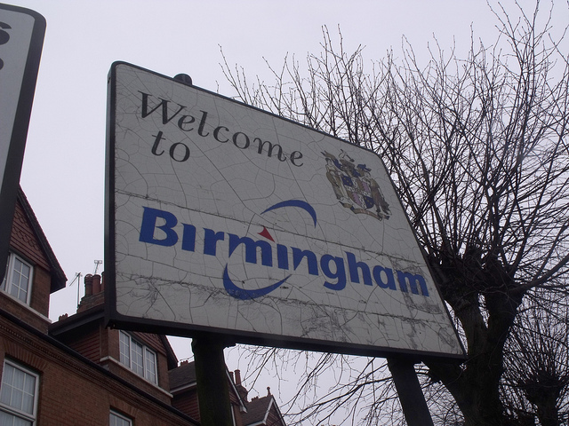
So who does the fishery belong to?
Source Swalophoto cc licence
Source Eillot Brown cc licence
Notes:
Out to the 12 mile limit the seabed and the waters above are held by the Crown under prerogative on trust for UK citizens
Outside the 12 NM limit to the edge of the EEZ and the continental shelf there are sovereign rights for exploration – again these are held on trust for the people
Outside that the seas are the ‘common heritage of mankind?’

Slide 22
Lessons for others
‘True law is right reason in agreement with nature; it is of universal application, unchanging and everlasting; it summons to duty by its commands, and averts from wrongdoing by its prohibitions’
Cicero: De Re Publica 3.33

