Slide 1
Presentation by
Not just arms and legs: Student working and the local labour market
By Whittard, D. Ritchie, F. and Drew, H
Damian
Whittard
April 8th 2019

Slide 2
Structure
Importance
Literature
Methodology
Results (preliminary)
Conclusion
Discussion

Slide 3

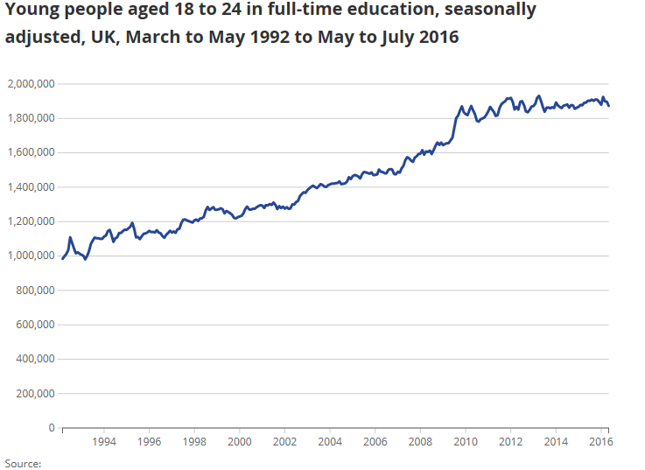
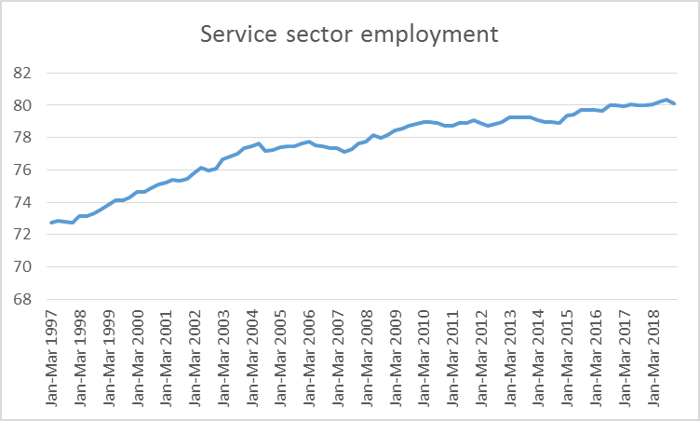


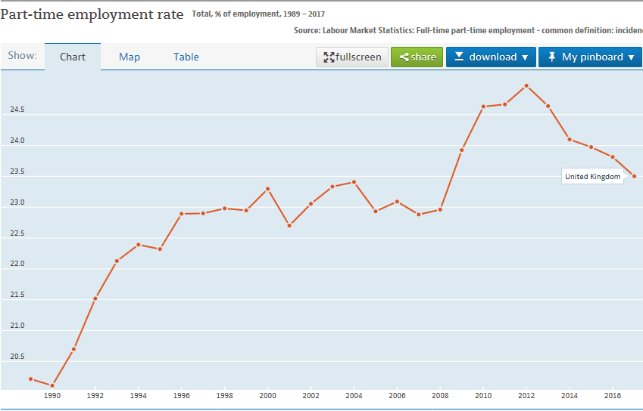


Importance
Notes:
Push Changing HE landscape
Post 1992 – mass education (working class and BAME students)
Growth in students
More diverse students
Growth in financial pressures
HE employability agenda
More savvy students – building CVs
Pull Jobs led growth - point in time - tightening of the labour market-Brexit potentially compound this problem Growth in service sector – particularly consumer services
Polarisation of growth in high and low skill services (Goos and Manning, 2007)
Changing Labour market
De-regulation of the labour market (e.g. shop opening times, zero hours contracts)
Fulltime-to part-time and self-employed employment
Flexibility (numerically, functionally and financially
Deskilling
Potentially employers perceptions of advantages over students workers

Slide 4
Empirical studies
Prior to 2000
2000-2006
2007-2013
2014 to present day
Hesketh 1999; Lucas , 1997; Lucas and Lammont, 1998; Lucas and Ralston, 1997; McMullen, 1995; Sorensen and Winn, 1993; Walsh, 1990
Canney, 2002; Curtis and Lucas, 2001; Curtis and Williams, 2002; Manthei and Gilmore; 2005; Watts and Pickering, 2000; Macintyre, 2003; Smith, 2005
Barron and Anastasiadou, 2009; Munro et al., 2009; Van Klaveren, et al., 2009; Baert, Cockx, and Verhaest, 2013
Norlund, 2018; Green, Atfield and Purcell, 2016
Drivers: students
Drivers: employer
Effects
Financial Pressures
Skills development
Job search
Increased flexibility
Developments in technology
Costs and control
Characteristics
Academic progression
Treatment (wages/benefits)
Over-education
Labour market progression
Spatial impacts
Competition - displacement
Notes:
Drivers – employer
Increased flexibility (Canney, 2002;
the growth in the demand for flexible labour has benefited young people engaged in full-time education who have over the 1990s increasingly combined study and work. Interviews with senior management in the retail grocery sector suggest that the availability of student labour has enabled them to maintain a high-quality labour force while pursuing flexible work practices. Importantly, the growth in student employment emphasises the need to consider students as a significant segment of both the youth and general labour market.
Lucas, and Ralston 1997;
This article presents a synthesis of the critical findings of an initial study[2,3]
designed to accumulate knowledge that will lead to a more informed
understanding of the supply and demand conditions governing student labour
and the nature and form of student employment, making possible an
assessment of the implications of this phenomenon in labour market, public
policy and employee relations terms.
The study examines the part-time employment of school and university
students during term-time within a thematic approach by analysing data in
terms of employment sector (hotel and catering (H&C), retail and other); age (16-
19 years old, 20-24 years old and 25+ years old) and gender. The findings are
also compared and contrasted with those established from the macro-data
analyses and other relevant literature. From this, we can posit a number of
issues to be addressed in a larger and more comprehensive research project.
Developments in technology (Van Klaveren, et al., 2009)
Wage moderation has been at the heart of the Netherlands' model of socio‐economic governance since the 1980s. Low‐paid employment has grown significantly, lower wages being constrained by declining minimum wages. Lagging incomes and consumption have depressed demand in retail, whose workforce – especially young people – accepted low‐paid, part‐time jobs. Low pay tends to reduce job quality – a phenomenon which has been heightened by the exceptionally long tail of youth minimum wages and the education grant system allowing students to work and skewing the labour market against young full‐time jobseekers. The current crisis may thwart retail's budding re‐professionalization.
Control (Curtis and Lucas, 2001; Lucas , 1997; Van Klaveren et al. 2009;)
Employers’ demands for cheap and flexible labour which can multi‐task, make decisions and act responsibly are being met by an increasing supply of students to the part‐time labour market who are having to work due to financial necessity during term‐time. This article details the results of a survey and focus group study conducted at Manchester Metropolitan University in February 1999 addressing the nature of this employment relationship. Students’ employment provides them with advantages other than money – valuable work experience, the opportunity to meet people and to take on responsibility. Employers benefit from an easily recruited workforce of intelligent, articulate young people who are numerically and functionally flexible, conscientious, accepting relatively low pay, and who are easy to control. Potential conflict is indicated as students do articulate dislikes about their work and employment conditions, yet they feel unable to challenge their employers about them.
Age conscious industries (Curtis and Lucas, 2001)
Characteristics (Barron and Anastasiadou, 2009; Munro et al., 2009)
Purpose
– The purpose of this paper is to examine the pattern of part‐time working amongst a cohort of full time hospitality and tourism students studying at a university in Scotland.
Design/methodology/approach
– Students studying hospitality and tourism management were chosen due to the vocational nature of their program and the part‐time opportunities available in the hospitality industry. A questionnaire was developed to investigate the extent of part‐time employment amongst hospitality and tourism students. The questionnaire solicited demographic information, level, type and extent of part‐time employment. The questionnaire also explored students' impressions of the benefits of part‐time working, their likes and dislikes in their part‐time employment and what they felt might be done to develop the relationship between the parties involved in part‐time work.
Findings
– Evaluating responses from 150 students, the study found that almost two thirds of this cohort were engaged in part‐time employment and had been with their current employer for an average of 14 months. Focusing on aspects of gender and nationality the study identified that females were more likely to have a part‐time job and students from Eastern European countries worked significantly longer hours than their peers.
Practical implications
– It is suggested that educators more fully recognise the constraints of contemporary student life and consider the provision of flexible teaching methods, part‐time contacts and formal credit for students' part‐time work.
Originality/value
– The paper concurs with previous research into the extent of part‐time working amongst students and it found that students from Eastern Europe were more likely to work part‐time and that all students would like more recognition of their employment commitments.
Drivers - students
Financial Pressures (Curtis and Lucas, 2001; Curtis and Williams, 2002;
Increasing numbers of full‐time undergraduates are supplementing their income by seeking paid employment during term‐time. This article details the results of a survey of 368 students at Crewe + Alsager Faculty of Manchester Metropolitan University carried out in March 2000. The survey found that 59 per cent of students were working on a part‐time basis during term‐time, with a significant majority working for financial reasons. Although many students found working to be beneficial to their studies, the students are generally reluctant to work, with many stating that they would leave their paid employment if they could afford to do so. The majority of the employed students perceived that working had a detrimental effect on their academic studies and a quarter of them considered that they could not remain at university without their term‐time jobs.
Lucas and Lammont, 1998
Increasing proportions of students in full‐time education are routinely combining work with study which muddies the waters of the school‐to‐work transition. It is no longer appropriate to divide education and work and it is more useful to conceptualise the school‐to‐work transition as part of a life‐time learning process of transferable skills accrual. In a work experience undertaken for economic and social reasons students learn to reconcile the conflicting demands of work and study. Given the funding crisis in higher education and the likely exemption of young people from the National Minimum Wage, students can be expected to become even more entrenched as cheap and flexible labour.;
Manthei and Gilmore; 2005;
Purpose
– Owing to the increasing debt students are accumulating to finance their tertiary study, many are having to work during term time. The aim of this study is to explore the impact of this paid employment on their study time and other aspects of their lives.
Design/methodology approach
– Eighty three undergraduates completed a questionnaire about their academic workload, their paid employment commitments during term time, their earnings and expenditure, and their recreational and cultural activities.
Findings
– Results indicated that 81 per cent of the students held at least one job during term time for an average of 14 hours per week. The money earned was typically spent on essential living expenses. Working left less time than desired for social activities, study and recreation.
Research limitations/implications
– The findings are limited by the relatively small sample size of self‐selected students: mainly young, female and enrolled in Arts courses.
Practical implications
– The results suggest that working is not always detrimental to students' academic efforts, particularly if the hours worked are manageable given their course load. Lecturers should be more aware of the busy lives students lead and try to structure assignments and course requirements to recognise this, including the scheduling of class times and the offering of study support services.
Originality/value
– The study adds to the growing body of international data that reports on the effects of a user‐pays approach in tertiary education. There is no similar data in New Zealand.
Sorensen and Winn, 1993)
Detailed picture of the financial position of full time second year undergraduate students at the university of Brighton – structured questionairee to 625 students on 11 courses
Increasing skills (Lucas and Lammont, 1998; Watts and Pickering, 2000)
Job search (Curtis and Lucas, 2001; Green et al., 2016)
Academic progression:
Hesketh 1999; This paper reports on an ongoing research project exploring the perceptions of finance held by undergraduate students and how these perceptions modify over time.. The final section then examines some of the implications of the research findings for the new and arguably still evolving government policy on student finance.
Watts and Pickering, 2000) research project which explores to what extent academic progress is affected by the part‐time, term‐time paid employment of full‐time undergraduates. It begins by considering changes made to the student funding mechanism over the past few decades and briefly contextualises the study in relation to other relevant studies. It then presents the initial findings of the study and discusses these in the light of the implications raised for: students; the institution; academic staff; employers..
Difference in wages/employee benefits (McMullen, 1995; Walsh, 1990)
Over-education (Norlund, 2018)
Swedish register data from 2003 to 2012, explain over-education and upward mobility among tertiary graduates. The results of this work suggest that the general increase in graduates correlates well with the increase in over-educated graduates. The increasing occurrence of over-education among graduates may not only result in a substandard utilisation of human capital (and absence of social mobility), it also seems that the presence of large numbers of over-educated graduates in low-paid work may have implications for unskilled workers, through displacement effects.
Progression (Baert, Cockx, and Verhaest, 2013)
We study whether overeducation speeds up or delays transition to an adequate job. The Timing of Events approach is adopted to account for selectivity. We find that overeducation at the start of the career is a trap. The entrapment effect is especially important early in the unemployment spell
Spatial impacts (Macintyre, 2003;
provision of student housing and considers their impact on local communities and patterns of urban regeneration. shows how and why universities are increasingly turning to collaborative arrangements with private developers. The consequences of this change for universities, students and local communities are considered. It is argued that the new student housing developments must conform to certain specific criteria if they are to assist in the processes of urban regeneration as well as serve the interest of the universities. Smith, 2005)
Competition - direct/indirect displacement (Green et al., 2016;
Drawing on a local study of migrant and student employment on opportunities for people with no/low formal qualifications in the UK city of Coventry, this paper shows how labour market restructuring in the context of neoliberalism has resulted in an increasingly compartmentalised labour market, in which some types of employment have become undesirable and often not feasible for some local workers, but attractive (or at least acceptable) for other groups, including migrant workers and students. The outcome is reduced labour market opportunities for local people with no/low qualifications, because the more flexible migrant workers and students allow employers to restructure their workforces and develop jobs that fit with the ‘frames of reference’ of these groups but match the requirements of some established local people less well.
Munro, et al. 2009)
focusing explicitly on their spatial residential patterns and impacts on labour markets in cities. It shows that students are typically highly residentially concentrated and statistically the population of students shows a high degree of segregation from nonstudents. Turnover within student neighbourhoods is argued to be sufficiently high to cause significant neighbourhood and community disruption in many cities. Students are also shown to have very distinct labour-market characteristics, being highly concentrated within particular sectors and types of occupation. Here too they have the potential for wider impacts, including displacement effects in relation to other local young people from entry-level jobs and increasing the flexibilisation of working practices. Students are also distinctive in apparently being able to find work if they wish to, although the evidence suggests that this is probably marginally easier in more buoyant labour markets. There is much unexplained variation between cities, though, which suggests the need for more detailed local work.

Slide 5








Theoretical Framework: Competition
Human Capital Theory (Becker, 1960s)
      V’s
Job Competition Model (Thurow, 1975)
Dual/segmented labour markets (Piore 1979)
High Skilled
Medium Skilled
Low skilled
Core
Periphery
Notes:
Human Capital Theory
Starting point – extension of neo classical economics
Stock of knowledge and characteristics of the employee that relates to their level of productivity
Capital theory focuses on the skills of the workers and views these as a form of marketable capital, rather than the attributes of the jobs.
Most productive worker gets the job
Job Competition Model
Mismatch model – explains over education – better bet.
More uncertain world – not exact match – heterogeneous labour market
Dual/segmented labour market
Defined into market by characteristics rather than skills

Slide 6

Literature Review
HR/management theoretical perspective
  Complement (Atkinson, 1984)

Slide 7
Literature Review
Gaps
  Changing times
    Limited literature and mostly outdated
      (e.g. Green et al., 2016 – 2010/11 students)
  Compliment or compete
    Evidence is unclear
  Spatial effects
    Limited comparative spatial analysis

Slide 8
Methodology
Interviews with 13 companies (to date)
  Hospitality, retail and contact centers
  Two city regions: Cardiff and Bristol
Interviewees have direct responsibility for employing and/or managing low pay workforce
Semi structured interviews
  Characteristics
  Treatment
  Recruitment practices
All interviews transcribed

Slide 9
Results
Are students and non-students the same?
Do employers treat them equally?
How is the job market designed for the workforce?
What effect does it have on career paths?
Are there any discernable spatial effects?

Slide 10
Results – the same
At times
  “I don’t just employ anybody with two arms and two legs. They have to show me some sort of common sense” (BH2)
But differ due to:
Flexibility
  “the benefits are that they are looking for the out of hours side of working” (BCA1)
Longevity
  “[Prefer non-students] to ensure the retention of staff.…only going to have [students] for a finite amount of time.” (CH1)
Positive characteristics
  “those who are at university seem to have more self-confidence, better social skills and cost less.” (CH1)
Negative characteristics
  “they don’t commit to the role and then the standards become a little bit less than what we are expecting.”(CH3)
IT skills
  “new channels to contact centres such as social media, web chat and all the other non-telephone” (CCC1)
Notes:
Neutral There is challenges with recruiting students. But in regards to their actual ability and skill, I don’t see a difference
(BCC1)
If you have got an element of customer service skills that does help but there is no difference whether it is a student or non-student
(BH1)
I don’t just employ anybody with two arms and two legs. They have to show me some sort of common sense and sort of positive attitude
BH2
Longevity But ultimately we want people who are going to offer us longevity, that’s our key really. So we don’t say students, no.
(CA1)
Generally, if we catch those right, within the first or second years of their study then we catch them all the way through…
CH1
[Prefer non-students] to ensure the retention of staff. There is the point with students that you know you are probably only going to have them for a finite amount of time.
(CH1)
[Negative] , I think it’s just the length of service from them. And obviously we do have that flexible approach around exam periods that sometimes can be challenging
(BCA1)
Flexibility The students work evenings and weekends.
CR1
[flexibility] that’s the good and bad thing about students.
(CH2)
Generally that is where all our students are falling into, is the evening and weekend category.
BCC1
the benefits are that they are looking for the out of hours side of working, the unsociable hours so they help us to try and make sure we have got the heads in for the whole other opening times
(BCA1)
Good characteristics [students] have a good work ethics and interpersonal skills.
(CH1)
the main benefits is because the priority that students need to work financially that makes them generally a bit more reliable I think on the whole and a bit more dedicated.
(CH1)
those who are at university seem to have more self-confidence, better social skills and cost less.
(CH1)
So I think because they are in that mind-set of learning already, they can take on more things. So there is that bonus as well
(BCA1)
A lot of them are more switched on, they will take to learning new skills… Straight away into it and they can, you can put them into different departments, train them up and they just get it straight away
BR1
Bad characteristics students or people who are studying full time is that they don’t commit to the role and then the standards become a little bit less than what we are expecting.
(CH3)
[students] have a higher level of study but how much actual practical experience there is specific to the job role
(CH1)
So 6am… a lot of students are saying it’s too early for them so we can’t supply you the number you want.
(CH3)
[naïve] sometimes you feel like, because sometimes this is their first job and they are still just got out of education
(BCC1)
Sometimes the students, not that they need reigning in but it is teaching them the way of working
(BCA1)
Some like to go out and party too much. But some go out and party and they still get up in the morning and still come in
(BH1)
I would say local people would be more prone to have interpersonal skills than students… But there is a small majority that don’t have any interpersonal skills at all.
(CH3)
Computer skills I would say in terms of their computer skills or if you give them a bit of work to do, paperwork or something like that, they [students] will be significantly faster
(CH2)
younger generation would actually bring to us some of the new channels to contact centres such as social media, web chat and all the other non-telephone work that now comes into a contact centre or are heading towards. It’s not necessarily students but people of that age would be a lot more familiar with that sort of technology dare I say than some of our older serving members of staff
CCC1
we will find the older generation that are coming in will take the longer time because they are not so technology savvy whereas the student population, they will get the technology side just like that.
(BCA1)
university things a lot of it is based on doing computers, laptops, things like that, so having that basic skill set before even coming into the role massively helps.
(BCA1)

Slide 11
Results – treated equally
At times
  “reward quite well their colleagues, everyone gets the same.”(BR1)
  “the training that they get, they get no different training and the level of expectation is exactly the same” (BH1)
But different due to:
Control
  “students need to work financially that makes them generally a bit more reliable… and a bit more dedicated.” (CH1)
Exploitation
  “I don’t think students expect to be paid as much an hour” (CH2)
Promotion and investment in training
  “[students] are not really interested in being promoted, going on training courses necessarily.” (CH1)
Different working practices
  “if they need to reduce it for exams and we will especially as we know we might get another year out of them afterwards” (BCC1)
Notes:
Financial need the main benefits is because the priority that students need to work financially that makes them generally a bit more reliable I think on the whole and a bit more dedicated.
(CH1)
Control/exploitation This also has financial benefit since as casual workers there is no pension, holiday pay etc.
(CH1)
I personally think it’s easier with a student [to offer zero hours] than someone who needs to pay bills.
(CH2)
I don’t think students expect to be paid as much an hour… if I was a student and I am 18 and you are 25, well I know I am not going to earn as much money as you. Legally I don’t have to earn as much money as you.
(CH2)
This also has financial benefit since as casual workers there is no pension, holiday pay etc.
(CH1)
Different working practices We don’t really go for students in the 16 hour or full time remit
(CH3)
we are very much office hours… So I would always assume that we would be non-students first just basically because of that clash with teaching and lecturing hours
CCC1
they [locals] are on zero hour contracts and when we explain to them a lot might drop out from the interview process because they feel it’s not for them because they want 16+.
(CH3)
we have never declined it if they need to reduce it for exams and we will especially as we know we might get another year out of them afterwards
(BCC1)
I think there has to be a balance, there has to be a certain percentage of permanent contracted full time people and then the students who aren’t particularly bothered if they do 5 hours, 10 hours, 20 hours
BH2
Equal … I would ensure that they were looked after in the same way. Same pay.
(CH1)
Its skill set and the person and its not to do with the profile of whether they are a student or not
CH4
We actually don’t differentiate. So everyone gets paid the above 25 rate…we want you to work really well therefore regardless of how old you are, I would kind of think you should be paid the same
CH4
Because we have quite a diverse group of people, backgrounds, ages, length of service and that sort of thing. They are not seen or treated any different, everybody kind of gets on quite well. So no. They do mingle and socialise quite well together
(BH1)
XXXX reward quite well their colleagues, everyone gets the same
BR1
Training It is clear when people are focused on their degrees, that’s their priority, they are not really interested in being promoted, going on training courses necessarily unless there is an opportunity to earn a bit more.
(CH1)
They do see it as their education and then they come in to do their job and then go home and have a social life. A lot of them don’t look to progress.
(BCC1)
the training that they get, they get no different training and the level of expectation is exactly the same
(BH1)
The training process can take up to 2 to 4 weeks and if they are only here for a short amount of time then go to uni its not a good investment for us because of how long it takes.
BCC1

Slide 12
Results – job market design
Complimentary Workforce
  “[students] fill those little gaps. Those little chinks in the armour, those little pieces of the jigsaw that need filling in” (BH2)
  “the local job centre…they were being forced… absolutely no interest in working… complete waste of time”(BR1)
Competitive:
  Direct displacement
    “deliberately deskilled… nonskilled labour come in and do it with what we would term, as arms and legs really” (CA1)
  Indirect displacement (frames of reference)
    “we entice the student[s]… that’s why we brought in the combi shift pattern… evenings and weekends” (BCA1)
  Recruitment (fresher's fair, IT, word of mouth & interviewing)
    “problem solving… certain local people where that isn’t something they have encountered” (CH4)
Drivers of change (knowledge & second generation)
  “they educate us… students doing different courses” (CR1)
  “because I have done it [been a fulltime student and worked part time], I have a better understanding” (CH2)
Notes:
Complimentary work force
it does help us have that balance, having a mixed age group
(CH3)
zero hour contracts definitely attract students perhaps a little bit more than others
CH4
They [students] fill those little gaps. Those little chinks in the armour, those little pieces of the jigsaw that need filling in
BH2
Hard to fill jobs
I think for us in terms of why we want to recruit students, we basically struggle to recruit and speaking with other contact centres in the area, it’s an issue they also have as well
CCC1
through the local job centre, people were clearly not interested in working. They come to this because they were being forced. They had got absolutely no interest in working so it was a complete waste of time
BR1
Competitive
De-skilling/automation
event caterings, totally deskilled completely to a point where a lot of the stadiums we supply to you push a button
CA1
There is one person on the till and a lot of people pushing buttons and they are deliberately deskilled so they can have that sort of nonskilled labour come in and do it with what we would term, as arms and legs really.
(CA1)
Frames of reference
We are very flexible, if it’s the right person then we will bend over backwards to accommodate and try and look after them. Work around people’s schedules and specific requirements
(CH1)
When their timetables change for the second year we will look at what their availability is and change that for them. So I think that’s what puts us ahead of other competitors
(BCA1)
definite drawback is we always know that we are going to get a problem through the summer months but if we flip that into a positive and if we treat people right, they come back in September/October… And we do get people [returning students] come back actually. So we have got, I think for this hotel, about 6 people who we know come back for the summer
CH4
make sure that we entice the student population that’s why we brought in the combi shift pattern where they do evenings and weekends. …So yeah, because we were having a big challenge trying to recruit for just weekends so we have actually had to target our own shift pattern so that we do bring these people in
(BCA1)
With students more than anything we have to engage them all when their timetable is changing because their shifts may change possibly. Because obviously they are going to have commitments
BR1
Recruitment practices
problem solving…perhaps students are more open to those types of [interview] questions where there will be certain local people where that isn’t something they have encountered… I can’t really say I notice the gap when people are working with us but perhaps actually there is a gap at interview stage
CH4
We use a lot of technology in our recruitment where we will send out… So basically I will go on a website, post one advert and it will go to up to 14 different job boards like facebook, Indeed,
(CA1)
Most of its word of mouth, go and see [N]. I get that, my mate Dave sent me, he worked for you 4 or 5 years ago. I get so much of that. Most of it comes through word of mouth because we are up front and honest and fair and you can come and go as you please.
(CA1)
We look at going to the Fresher’s Fayres and job recruitment fayres as well because a lot of our second years sometimes start dropping out or can’t do as many hours because they are going into their 3rd year and obviously dissertations become important so they drop down their hours.
(CH3)
it’s always been mainly students and we don’t know if it’s the way that we are now advertising the positions… We used to only do it through Facebook and social media and now we have got our own website, people are engaging with that as well.
(CH3)
works about 12 hours a week for me, she is a student. She knows that when the time comes for her to leave her sister wants a job
BH2
We do dedicated advertising. So we will go in to the college and because we know, we rely on that population to work here for those hours. They make up around 50% of our out of hours. So we do dedicated things with the [N] college and we have done open days in there and things.
(BCC1)
We rely on the student’s word of mouth for recruitment. So we make it a good place for them to work and they spread the word. We do recommend a friend and you get a £50 voucher and stuff like that
(BCA1)
We advertise online. We advertise online and all young people with any IT skills
BR1
Drivers of change
Students are a good pool of people particularly in hospitality, it’s good that you have a changing workforce… bringing in new people every year and at different parts of the year only really helps the business. You get fresh ideas, different ways of working, it forces us to look at things, to train again. If we had a very static workforce that didn’t change I think we would actually lose out.
(CH1)
So I think they educate us because we have got different students doing different courses… We have got one student down there who is fluent welsh so he will speak to our customers in welsh. So the language. They bring so much
CR1
I think being of a generation who didn’t grow up with social media and things like that, I tend to ask the students if I have got a query about social media, they help me… Yeah the social media skills. I need to do this guys on Facebook. Well you need to do this. Which is great
BH2
Managers as second generation students
my dissertation is due in. it’s understandable because I was a student once, I know how much pressure there is for all that so I don’t get grumpy
(CH3)
[Students] say I am going home at this time of the year, I can’t do this because of exams, I can’t do this because I have got to get papers in. I get it. I was part of it, I understand completely.
(CH2)
The difficulty with students is I understand that the priority for them is university, I get that completely... So I think because I have done it, I have a better understanding.
CH2
we have a responsibility as an employer to ensure our students don’t neglect their studies and they do, although we sometimes want to retain people we have to watch for that.
(CH1)

Slide 13
Results – career path
Equal opportunity for some?
  “everybody when they start is given the same information in regards to if they wanted to progress” (BCA1)
Locals Preferred
  “worry about my full time, long term staff who I want to train and develop to a high level” (CH1)
Student management track
  “We have offered more [students] over in our head office, they have offered graduate schemes” (BCA1)
  “putting them through to management positions just on a case by case, as and when the vacancy arises.” (CCC1)
Notes:
No difference management track
So everybody when they start is given the same information in regards to if they wanted to progress. Some people start as students and might then stay on full time afterwards
(BCA1)
Local management track
[Prefer to employ] Non students…Just because I think their commitment is slightly different. A non-student is more about a career and progression… if I can get good retention it’s better for me from a money point of view, for training and time
(BH1)
I don't need to worry about my part time students in the same way I may be need to worry about my full time, long term staff who I want to train and develop to a high level…I won't be looking to bring them on to maybe a management track. So I would look at them slightly differently in that one
(CH1)
Student management track
I mean, if we took any students on then if their performance was good and assuming they would do because actually the majority of the staff performance is good, then we wouldn’t have any problems taking them on in a full time basis at the end of their studies and even trying putting them through to management positions just on a case by case, as and when the vacancy arises.
CCC1
We have offered more [students] over in our head office, they have offered graduate schemes
(BCA1)
[N] who is the general manager in Newport, he actually started as a student, was graduating in hospitality and then progressed within his hotels and now he has progressed way up. So it does happen in places
(BH1)

Slide 14
Results – spatial effects
Student Profile (Bristol)
  “Bristol…don’t rely on students to fill our vacancies…46%...Bristol University…from private schools…Cardiff…under 15%...difference in funding from parents and…the need for money” (CH4)
Difficulty in recruitment (Mainly Bristol)
  “all Bristol stores are the same, they all have retention problems because there is so much work opportunity” (BR1)
Local infrastructure (Cardiff)
  “[Some students go home] around Christmas time…part of it comes down to… paying for the accommodation.” (CH1)
  “[late working] it can be especially [difficult] with the trains and the buses… it’s not like London where its 24/7, it can impact on who can work.” (CH3)
Localised employment (Bristol and Cardiff)
  Purely it’s down to catchment area… We struggle, if anything, with too many students applying (BR1)
Notes:
Student profile
but that Bristol university students tend to look for work experience related to the course they are doing versus paid employment. So I would suggest in Bristol we certainly don’t rely on students to fill our vacancies. In Cardiff, perhaps a little more
(CH4)
the last figure I looked up was 46% of students entering Bristol university come from private schools versus Cardiff which was under 15%. I would guess there is a difference in funding from parents and therefore the need for money.
CH4
Difficulty in recruitment
[Difficulty recruiting] So yeah, if we didn’t have the student population then yeah
CR1
[Difficulty recruiting] I believe so. Purely because of Bristol. If we were over the bridge we wouldn’t. It’s just employment
BR1
And all Bristol stores are the same, they all have retention problems because there is so much work opportunity
BR1
I think it’s, if it wasn’t for students I think there would be a lot of job vacancies because obviously we employ a lot of students and I know a lot of other shops do as well. It’s good for the economy
BR1
Cost of accommodation
[Some go home] around Christmas time maybe for a few days. Part of it comes down to the accommodation and paying for the accommodation.
(CH1)
Local transport infrastructure
I find a lot of the students don’t have a problem getting home and they don’t need support getting in either. Sometimes, we have a taxi firm we use on account and if it’s really needed we will get people home if we have to so long it’s not too far out of the local area
(CH3)
It can be especially with the trains and the buses, the end times around Cardiff, it’s not like in London where its 24/7, it can impact on who can work
(CH3)
Location of employment
it’s on the outskirts of Cardiff therefore the people living in the local area tend to want to work in that hotel because other people will find it difficult to get there, the transport links are not so good
(CH4)
we have got more students in this shop purely because of where we our, our position, our location, by the MOD, by the college, by the uni. We don’t find recruitment a problem because of the catchment area. What we find a problem with is retention. Students want term time only, they want to go home
BR1
Purely it’s down to catchment area. I know some stores have struggled recruiting. We struggle, if anything, with too many students applying and not enough people in the community applying… Yes. I think that’s because Bristol, there are so many jobs available… It can be to our advantage and disadvantage. We want people to build careers, we are not going to get that with students.
BR1

Slide 15
Conclusion
Limited evidence that students are directly displacing local low wage labour force – not just arms and legs
Greater evidence of indirect displacement through compartmentalisation of the labour market, increased flexibility and bias recruitment practices
All displacement effects are partially offset by the current buoyant labour market conditions
Recurring evidence that student labour is complimentary, undertaking hard to fill roles and ‘filling the gaps’
Some evidence of dynamic relationship between students and managers (second generation students) driving innovation in both working structures and practices
Some evidence that students are impacting on future career prospects (career displacement)
Evidence of localised spatial effects including:
  University specific student profiles/economic and labour market conditions/infrastructure/location of employment

Slide 16
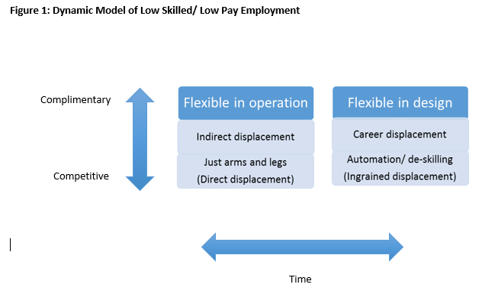
Discussion: New Model of Student Working and the Local Labour Market
Notes:
Short term
Competition on arms and legs
Limited evidence of direct displacement – some indirect
Lot of evidence of complementarity/flexibility in operation
Hard to fill jobs
What happens as we get used to ‘flexible working’? =>
Longer term
Further de-skilling/automation - Ingrained displacement
Career displacement

Slide 17
Thank You!
Any Questions?

