Slide 1
‘They know they can get away with it’:
housing development, divergent goals and the limits to trust
Housing Studies Association
15th April 2021

Slide 2
Presentation structure
Research background
Overarching findings
How did issues of trust emerge?
What do these issues reveal about the development process and trust more broadly?
Questions for the panel

Slide 3
Aspiration
The creation of high quality buildings and places is fundamental to what the planning and development process should achieve. Good design is a key aspect of sustainable development, creates better places in which to live and work and helps make development acceptable to communities. Being clear about design expectations, and how these will be tested, is essential for achieving this. So too is effective engagement between applicants, communities, local planning authorities and other interests throughout the process
National Planning Policy Framework (Para 124)

Slide 4
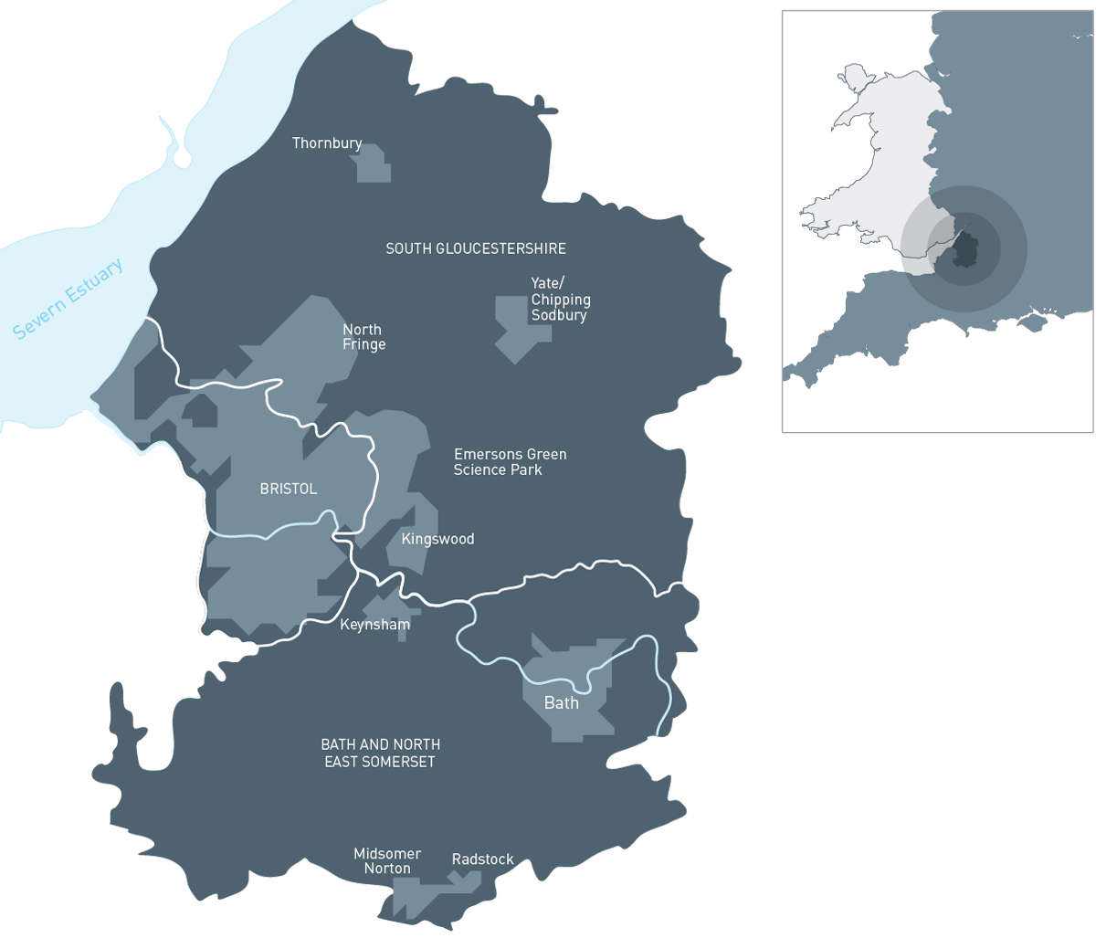
West of England
In all areas, it is vital that any development is of a high standard of design that enhances the characteristics that make B&NES such a distinctive District and protects the existing natural and built environment that supports the quality of life enjoyed by its community (BANES Core Strategy, page 11).
Development will only be permitted with the highest possible design standards (South Gloucestershire Core Strategy, Policy CS1)
High quality architecture and urban design will be sought from development demonstrating a robust design process (North Somerset Core Strategy, Policy CS12)
“New development in Bristol should deliver high quality urban design” (Bristol Core Strategy, Policy BCS21)

Slide 5
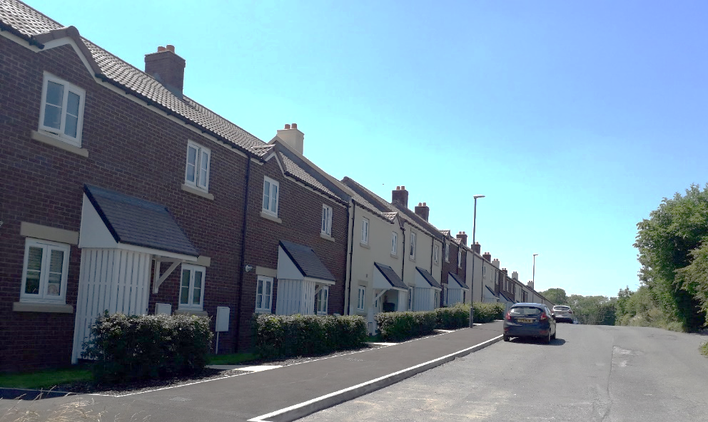
Concern
… about a drop in quality of schemes between the grant of planning permission and delivery on the ground, such that a final delivered scheme will often be quite different from the scheme as originally depicted.
Notes:
Most diagrams of the planning process end with ‘permission granted’
Little in-depth analysis of the world of post-consent
… and even less on post-consent and design quality (with some limited exceptions)
But, there is anecdotal evidence and some relatively limited press reporting (mainly in the architectural press)
And, a nod to some of these issues in the 2019 amendments to National Planning Practice Guidance, but little direction as to how to manage them
“How can local planning authorities ensure the quality of approved development is not materially diminished between permission and completion?”
stated in recognition that the design process
“continues after the granting of permission”

Slide 6
The research
Stage 1: Documentary review of national and local policy and practice
Stage 2: In-depth interviews with local authority practitioners
Stage 3: Four housing development case studies
Stage 4: Analysis of output and preparation of draft recommendations for review
Stage 5: Roundtable with local authority practitioners to review recommendations
We were commissioned to:
undertake a systematic review to understand patterns or processes which lead to a decline in quality
provide an evidence base from which to strengthen the role of UAs in ensuring quality development
draft a route-map for the West of England UAs to make improvements to the post-decision process and post-occupancy monitoring.
Notes:
Be short here …

Slide 7
Overarching findings
The way in which post-consent planning processes unfold can allow for a significant decline in the overall quality at delivery.
The aspiration for quality is not always easy to achieve in decision making. A scheme’s design might be perceived ‘good enough’ or even just ‘not harmful’ when balanced against other potential benefits.
There are numerous reasons why schemes change post-consent, development viability and knowledge gained on site being the most dominant. Developers see post consent change as inevitable and necessary.
Post consent changes observed included design detailing such as materials, fenestration, and feature detailing, through to alterations to landscaping schemes, housing density and road layouts. The cumulative impact of multiple changes is challenging to govern.
For local authority players, the management of post consent is made difficult by a lack of resource, and corporate and political interest focussed on delivery.
Notes:
Political interest focussed on delivery

Slide 8
How did issues of trust emerge?
Explicitly …
“we know the developer will seek to value engineer costly aspects out of their design’”
“we are sold a dream, that actually is a dream”
“we were trusting that these things will be possible at reserved matters … there is constant wrangling at [this] stage”
“this wasn’t what we agreed guys”
“they can get away with things”
“I think they [the developer] know that perfectly well, there probably are some things they will take a flier on”.
“[we need to] make it clear that we are watching them to keep the developers honest on site”
Notes:
Also comment on the need for enforcement – action shouldn’t be needed if high trust is present?
Need for greater due diligence – process needed before entering into an agreement – again is that needed of there is strong trust?

Slide 9
How did issues of trust emerge?
Implicitly …
“We hope that the plan speaks for itself”.
“We need a strong commitment right at the start. That’s a lot more helpful for us. Not sure it’s there at the moment”.
“Of course there is a un-stated agreement that of course they have got to do something similar otherwise yeah there will be problems but within that there is a lot of freedom to change”
“There’s a lot of leeway to make significant changes. I think that’s what people don’t understand – the power that applicant has to do that. You’ve basically lost a lot of control at that point because everyone has agreed the principle of development.
“The post-consent world is really difficult. The only safeguard you’ve got is conditions”
“We get threatened every now and again … we hope that threat of enforcement action might bring them into line but we will be met by a legal team who is prepared ”
Notes:
1. Participants spoke of ‘hope’ that design policies and the effective operation of system would enable high quality development, but recognised that neither policy nor the system would deliver on their own without key players sharing the same goals;
2. There was an unspoken sense that players did not share the same goals, with shared goals acknowledged as an important basis for trust;
3. Local authority participants spoke of the need for ‘safeguards’ within the system to manage design quality post-consent. The idea of ‘safeguards’ appears in lieu of trust; and
4. Similarly, local authority participants spoke of a loss of power once permission has been granted. Concerns about shifts in the balance of power would not be present with strong trust, where the desire for power would not be so present.

Slide 10
What do these issues reveal?
“Trust is a feeling and needs no definition because we know in our psyche what trust is" (Talvitie, 2011)
“In the planning literature it is usually not specified what the word trust actually means. Often it is left to the reader’s imagination what the author had in mind when suggesting that trust is important for successful planning processes” (Hoppner, 2008)
“Tension between treating developers as consumers and regulation of public interest – result is a crisis of trust because underlying values are not made explicit” (Tait 2011)
Notes:
Tait – three levels of trust - the individual, the institutional, and the ideological.
Thoughts are emergent
Need to things about trust in different terms …
Shouldn’t try and over talk
Do people trust developers, politicans – bringing the idea of trust into this debate – players trust in the system, between players. Reframing. Nexus / nexi?
Goals – how tools are used ….
Critically examine trust on the basis of our findings. Lots of writing, we are interested in ….
What’s the role of the system and policy in this – how do these mediate, support trust, or not?
About the development process …
Does the process actually enable an absence of trust (i.e. in providing the basis for change)???
Policy wholly insufficient as a basis for trust
Power and resource influence …
The problem of planning balance – anything can be argued
About trust more broadly …
Literature notes trust is a difficult concept to define
Existing treatment in the planning literature focus on trust in the system and in politicians – due process
Little focus on trust between local authorities and applicants

Slide 11
Questions for the Panel
Drawing on your own work, are issues of trust – particularly in relation to local authority / municipality and developer relations – meaningful / do they resonate?
What mechanisms / systems have you seen emerging to either engender or respond to the absence of trust between these players?

