Slide 1


E-Wallets, Money Laundering and Terrorism Financing: Is the Voluntary Exchange of Information the Panacea?
Dr. Nicholas Ryder
Professor in Financial Crime, Head of Research and Global Crime and Justice Security Group
Bristol Law School, UWE
Nicholas.ryder@uwe.ac.uk.

Slide 2



Research Funding
This work has been conducted under funding provided by Royal United Services Institute (Collaboration, Research and Analysis Against the Financing of Terrorism) and Innovate UK/Synalogik (Activist Financing).

Slide 3
Underpinning Research
This presentation and related findings are based on the following publications:
  Ryder, N. ‘Cryptoassets, social media platforms and defence against terrorism financing suspicious activity reports: a step into the regulatory unknown’ (2020) Journal of Business Law, 8, 668-693,
  Ryder, N. ‘Is it time to reform the counter-terrorist financing reporting obligations? A critical and comparative assessment of the counter-terrorist financing reporting obligations in the European Union and the United Kingdom’ (2018) German Law Review, 19(5), 1169-1190,
  Ryder, N. ‘Out with the old and … in with the old? A critical review of the Financial War on Terrorism on the Islamic State of Iraq and Levant’ (2018) Studies in Conflict and Terrorism, 41(2), 79-95,
  Ryder, N. The Financial War on Terror: A review of counter-terrorist financing strategies since 2001 (Routledge, 2015, 210pp)
  Ryder, N. Money laundering an endless cycle? A comparative analysis of the anti-money laundering policies in the USA, UK, Australia and Canada (Routledge, 2012, 182pp).

Slide 4
Abstract
This presentation is divided into three parts:
  Part I: a brief overview of E-Wallets, it identifies their unprecedented growth and identifies their abuse by money launderers
  Part II: an overview and commentary on the effectiveness of the traditional anti-money laundering (AML) preventative measures
  Part III: recommends that the voluntary exchange of information model could be used to address the problems of the AML preventative measures

Slide 5

Background
What is an e-Wallet?
Online storage system that holds banking information and can be used to pay for good and services
Usage has increased, whilst cash payments has decreased
Examples include:
  Apple pay
  Google pay and
  Paypal

Slide 6
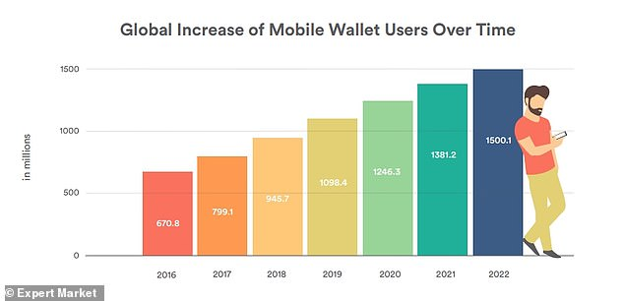

Slide 7
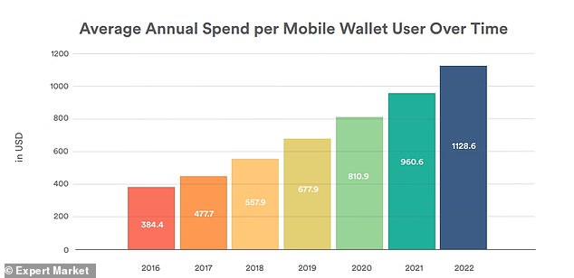

Slide 8


E-wallets and Money Laundering
Financial criminals have exploited new forms of technology to:
  Launder the proceeds of crime
  Commit fraud and
  Fund terrorism

Slide 9
E-wallets and Money Laundering
Why will money launderers use e-wallets?
  Anonymity,
  Transaction obscurity,
  Speed and
  Lack of oversight.
See generally:
  Financial Action Task Force 12 month review of the revised FATF Standards on virtual assets and virtual asset providers (Financial Action Task Force: 2020)
  Financial Action Task Force Virtual assets and virtual asset service providers (Financial Action Task Force: 2019),
  Financial Action Task Force Money Laundering Using New Payment Methods (Financial Action Task Force: 2010)

Slide 10
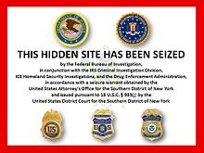


E-wallets, Cryptoassets and Social Media Platforms
Silk Road and Ross Ulbricht (US Department of Justice, 2015)
Liberty Reserve (US Department of Justice, 2016)
Western Express International (United States v Shevelev 2014 WL 495393)
Ali Shukri Amin (US Department of Justice, 2015)
Zoobia Shahnaz (US Department of Justice, 2020)
al-Qassam Brigades, Hamas’s military wing, al-Qaeda, and ISIL (US Department of Justice, 2020)
See generally Ryder (2020)

Slide 11



Money Laundering and E-wallets
Thomas White (2019)
Grant West (2019)
Seregjs Teresko (2018)

Slide 12



Are The Traditional AML Preventative Measures Effective?
Proceeds of Crime Act (2002, ss. 330-332)
Terrorism Act (2000, s. 19)
The UK’s AML and CTF strategy can be split into two main elements;
  Customer Due Diligence (CDD)
  Suspicious Activity Reports (SARs)
Problems have been recognise by:
  Home Office,
  Law Commission and
  Financial Action Task Force.

Slide 13
Suspicious Activity Reports: The Problems
Number of SARs submitted to the UK FIU has doubled since 2010
Suspicion has not been defined
Defensive reporting
High compliance costs
Low threshold reporting

Slide 14
Recent Developments in the United Kingdom
Fifth Money Laundering Directive (EU) 2018/843 (5MLD)
5MLD provides:
  “virtual currency exchange platforms as well as custodian wallet providers to the list of obliged entities within the scope of the Directive”
Money Laundering and Terrorist Financing (Amendment) Regulations (2019)
Financial Conduct Authority:
  Guidance on Cryptoassets (2019)
  Cryptoassets (2020)
  Guidance on Cryptoassets (2020)

Slide 15


Voluntary Exchange of Information
Is Joint Money Laundering Intelligence Taskforce the way forward?
  Public/private partnership with the financial sector,
  Created in February 2015,
  Seeks to improve the sharing of information between reporting entities and LEAs and
  The increased appreciation is partly achieved because JMLIT has access to 89% UK personal current accounts.

Slide 16
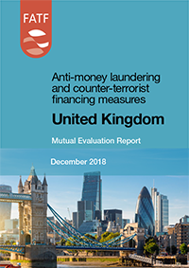
Voluntary Exchange of Information
The UK has become a global forerunner in its efforts to improve the exchange of information between reporting entities and LEAs
The UK model has been adopted in:
  Australia
  the Netherlands
  Singapore
  Hong Kong

Slide 17
Voluntary Exchange of Information
JIMLT is that it does not apply to reporting entities which are particularly vulnerable from abuse by money launderers,
Limited evidence of it engaging with other professions such as:
  accountants,
  e-money providers,
  lawyers and
  estate agents.
Social media monitoring could assist with the voluntary exchange of information and would represent a far more cost effective mechanism than extending SARs regime (Ryder, 2020).

Slide 18
Findings
SARs do not work and there is little evidence to suggest that any acts of terrorism could have been prevented by their submission
Money launderers have moved away from its traditional mechanisms towards exploiting the speed, convenience and anonymity provided by the Internet and Dark Web
The paper has identified several examples of money launderers/terrorism financiers using cryptoassets, such as Bitcoin, and a wide range of social media platforms such as YouTube, Facebook and Twitter.
This research advocates the extension of the information sharing platform, JIMLT, to include social media providers and e-wallet providers
The inclusion of social media platforms within this exchange of information model would represent a bold and innovative step into the regulatory unknown and it would go some way to redressing the current loopholes and uncertainty in the scope of the SARs regime.

