Slide 1
Sources of Pigmentless Colour in Nature – Seashells, Butterflies and Beetles
Damien.Leech@UWE.ac.uk
@dr_Djleech

Slide 2
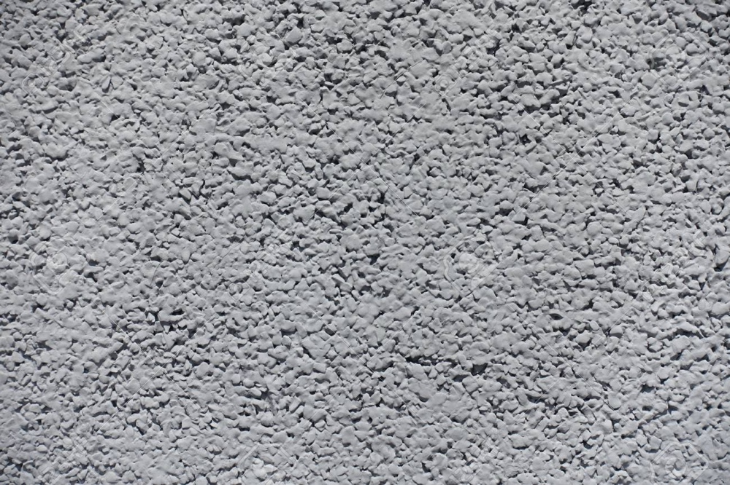
What does this look like? And why?
A surprisingly complex question!
Materials have roughly four visual qualities:
Colour
Texture
Gloss
Translucency
These can vary as well, depending on:
Lighting
Viewing angle
Distance
Observer
Can be informed by:
Size
Structure
Chemical composition

Slide 3
Colour
Colour, as we know it, is just one small part of the electromagnetic spectrum.
MiniPhysics.com

Slide 4
Colour & The Observer
By BenRG - Own work, Public Domain, https://commons.wikimedia.org/w/index.php?curid=7873848

Slide 5
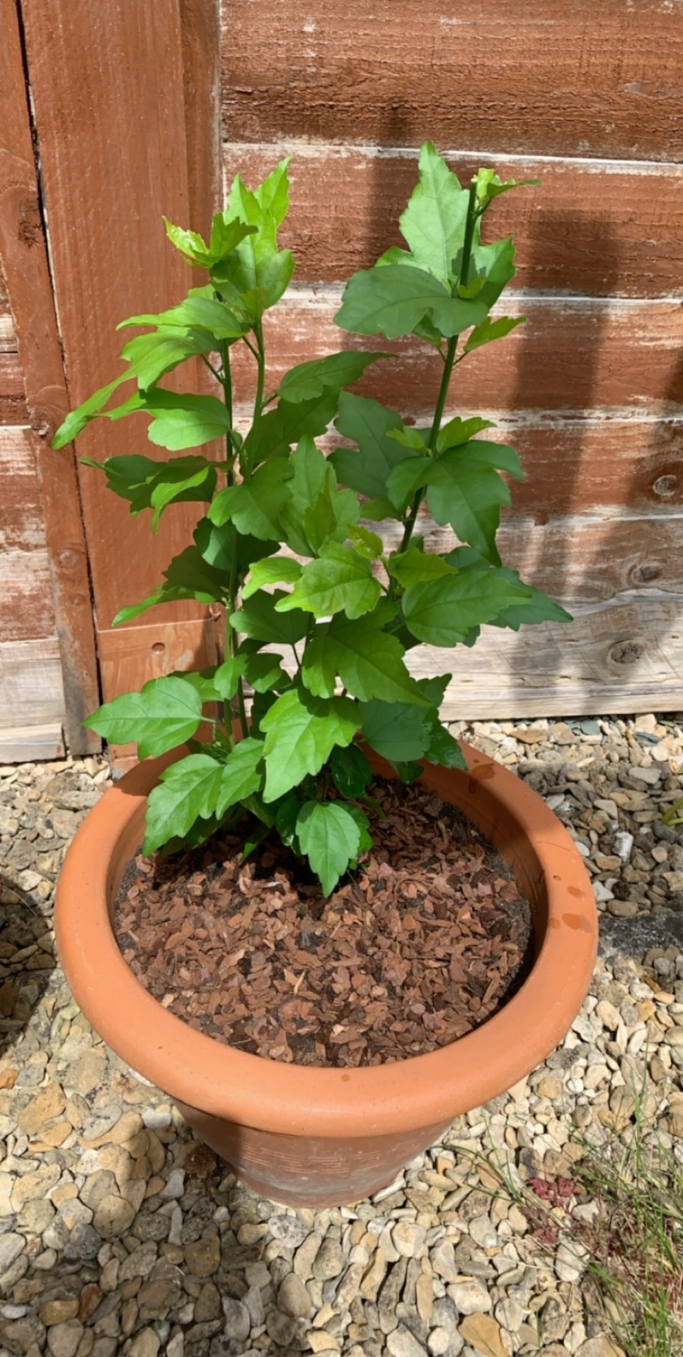
Let’s Simplify - A Leaf
So why is a leaf green? Mostly chlorophyll!
White Light In
Green Light Out
A Leaf

Slide 6
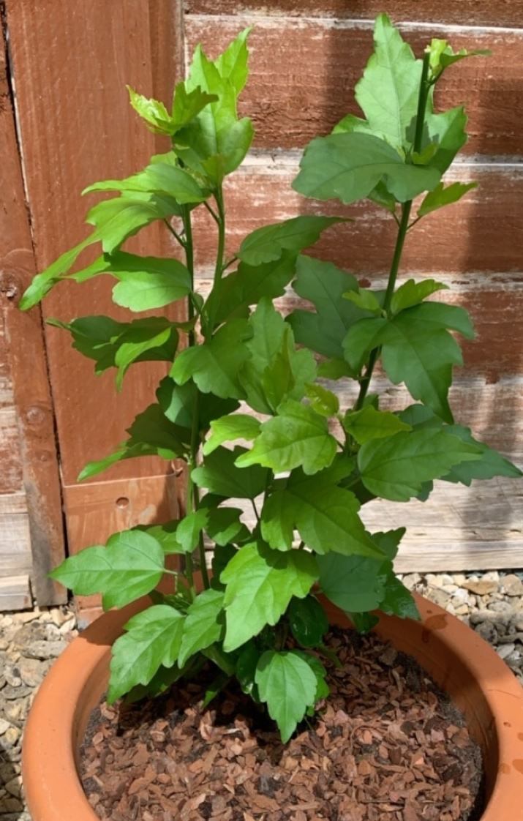
Two ‘Types’ of Green?
By Thomas Bresson - Gastrophysa viridula, CC BY 2.0, https://commons.wikimedia.org/w/index.php?curid=6606367

Slide 7
Not Just Green!
Green
Yellow
By Thomas Bresson - Gastrophysa viridula, CC BY 2.0, https://commons.wikimedia.org/w/index.php?curid=6606367
Orange
Iridescent
Iridescent
Iridescent
Iridescent

Slide 8
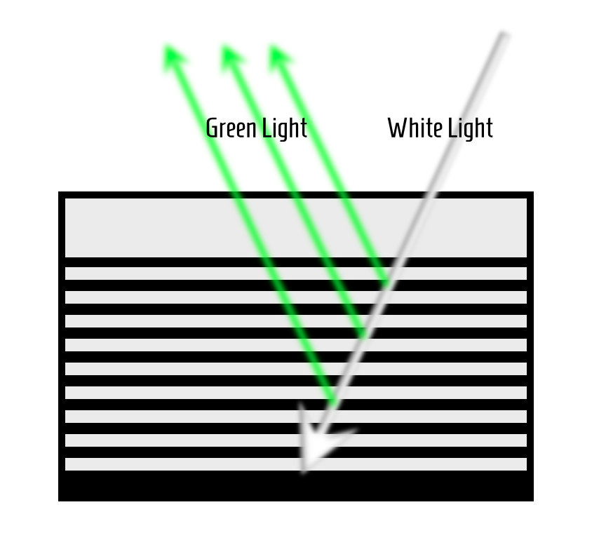
Multilayer Reflector
Within the cuticle of the beetle exists alternating layers of material.
White light enters, moves through the material and is ‘selectively reflected’.
No pigment in these layers!
The colours reflected depend on the optical properties of the material and the thickness of the layers.

Slide 9
Might sound strange…
Thin film interference – no pigment, still vivid colours!
By Brocken Inaglory - Own work, CC BY-SA 3.0, https://commons.wikimedia.org/w/index.php?curid=2109768
By John, CC BY-SA 2.5, https://commons.wikimedia.org/w/index.php?curid=4081809

Slide 10
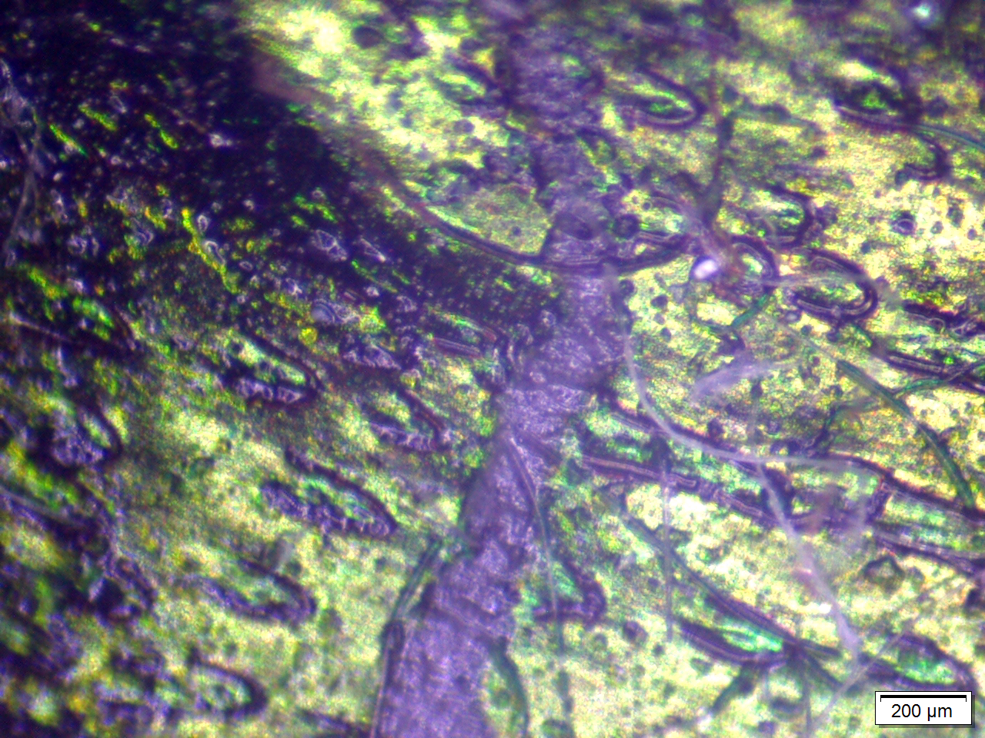
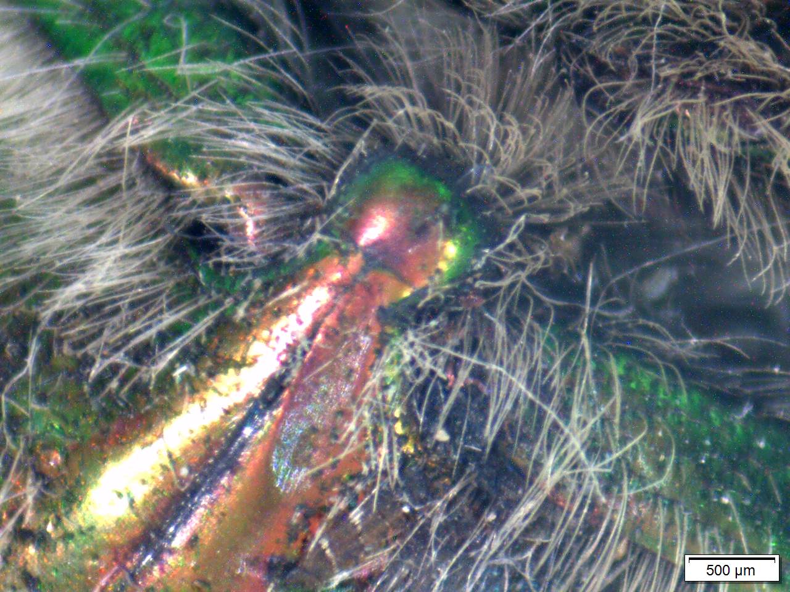
Rose Chafer (Cetonia aurata)
By I, Chrumps, CC BY-SA 3.0, https://commons.wikimedia.org/w/index.php?curid=2521547
Specimen provided by Niamh Fahy.

Slide 11
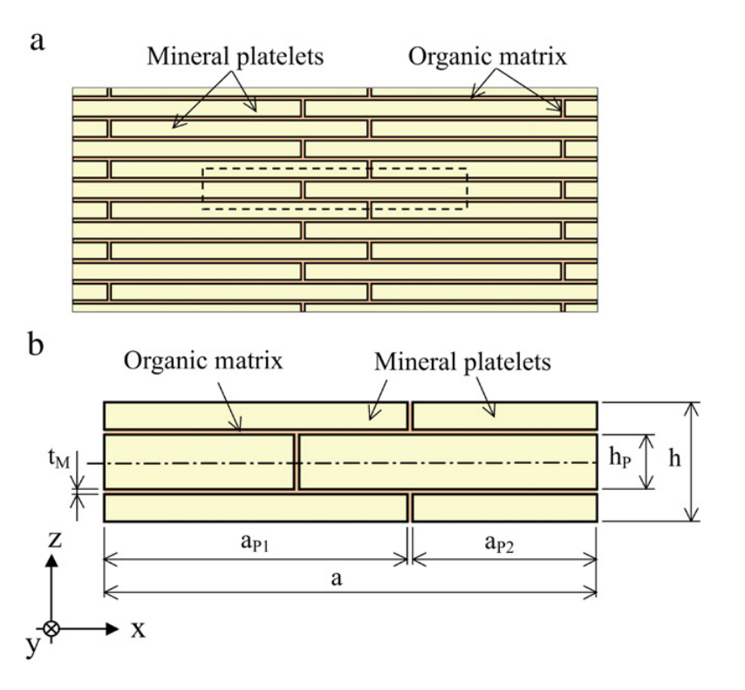
Nacre – Mother of Pearl
Organic-inorganic compound produced in some molluscs.
Platelets bound by long biopolymers – binding materials similar to before, chitin, lustrin etc.
But usually hidden?
Tushtev, K., Murck, M., & Grathwohl, G. (2008). Materials Science and Engineering: C, 28(7), 1164-1172.

Slide 12
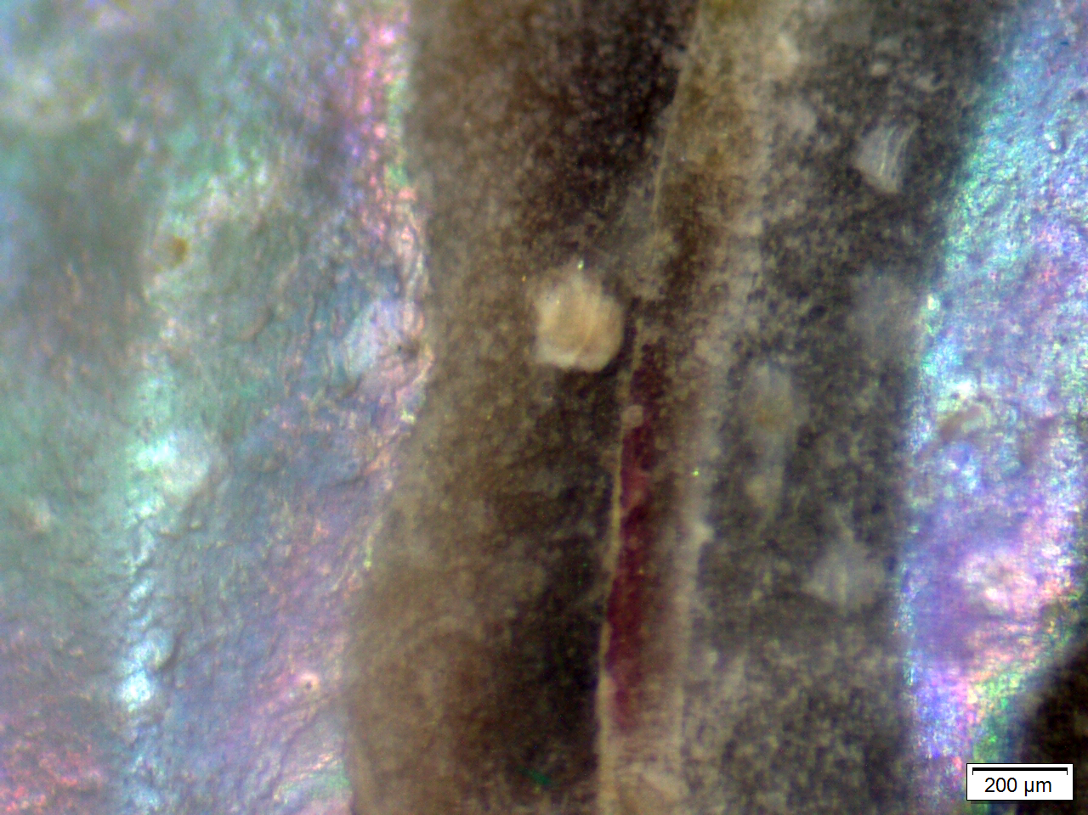
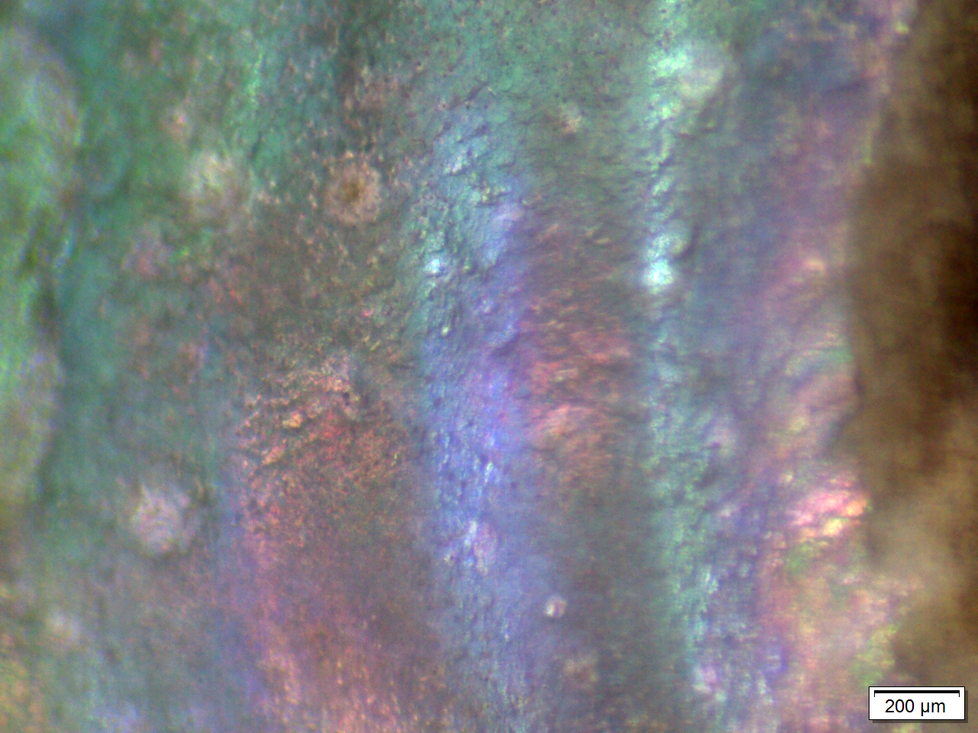
Flat Top Shell (Gibbula umbilicalis)
By H. Zell - Own work, CC BY-SA 3.0, commons.wikimedia.org/w/index.php?curid=36293793

Slide 13
Summary
Natural colour systems are complex and fascinating from a design perspective.
Use structure rather than pigment to produce colour.
How do we use bioinspiration to help with our design?

Slide 14
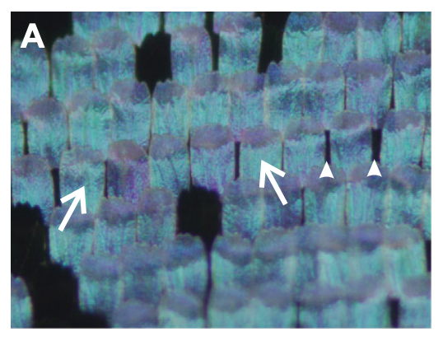
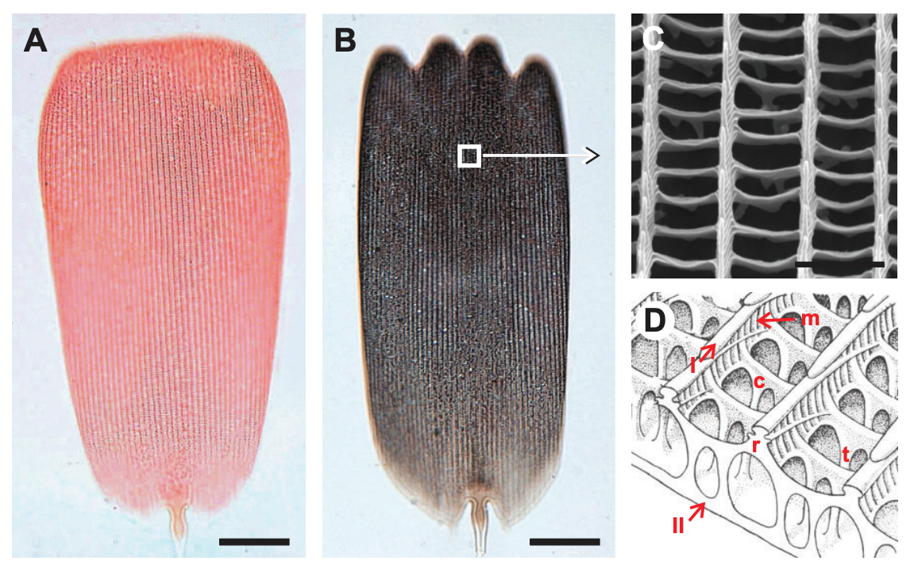
Peacock Butterfly
In this case, the colour is found to be a combination of both structure and pigment.
Each wing is covered in scales, these scales are covered in a micro-structure and pigmented.
Even more complex!
Stavenga, D. G., Leertouwer, H. L., & Wilts, B. D. (2014). Journal of Experimental Biology, 217(12), 2171-2180.

Slide 15
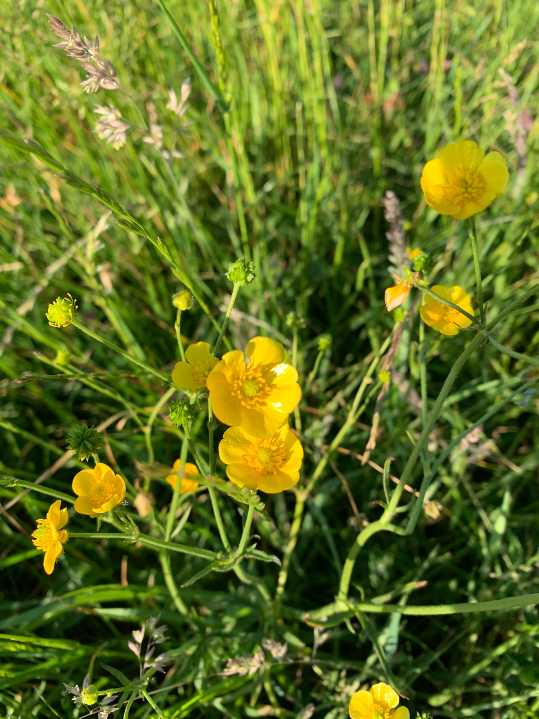
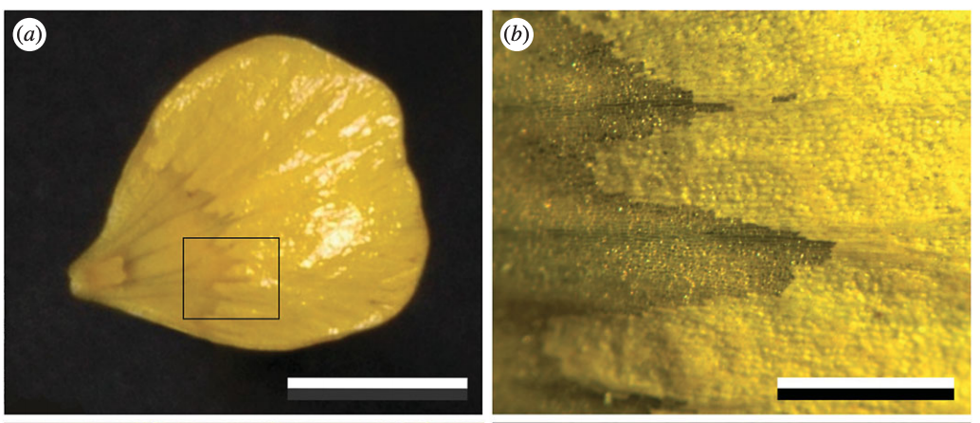
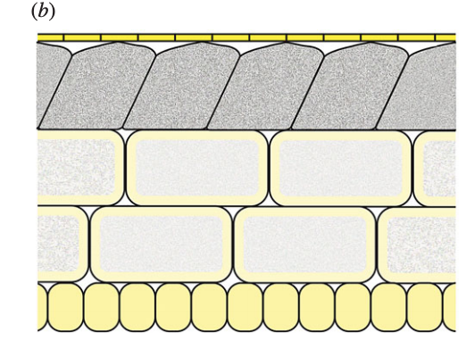
Bonus - Buttercups
Not limited to the animal kingdom – structural colour also shows up in some plant species.
van der Kooi, C. J., Elzenga, J. T. M., Dijksterhuis, J., & Stavenga, D. G. (2017). Journal of the Royal Society Interface, 14(127), 20160933.
Picture by H. Lovell.

