Slide 1
Reconceptualising Assessment and Feedback to Promote Student Wellbeing
Presentation by
Jennifer Hill
Harry West
Department of Geography & Environmental Management
University of the West of England, Bristol, UK
SRHE Annual Research Conference
11-13 December 2019
Celtic Manor, Newport, Wales
Notes:
G6 Denbigh 1: Thursday 12 December 09:00-09:30

Slide 2
1. Context – student wellbeing challenges
Number of students disclosing a mental health condition has tripled since 2007/08 (Equality Challenge Unit, 2015)
Students report significantly lower levels of mental wellbeing than the general population - more so for minority groups (Ferguson, 2017)
HE sector is experiencing a ‘mental health crisis’ (The Guardian, August 2018)
20% Australian students experiencing a mental health issue (Carter et al. 2017) and a fifth of Canadian post-secondary students identifying as depressed, anxious or battling other mental health issues (Pang, 2017)
Notes:
1. Context
Academic pressure is cited as the primary cause of stress for student (YouGov, 2016). Finding a job after university is the second highest cause of stress (YouGov, 2014).
Also: living independently, financial challenges established by high tuition and living fees, social media, social pressures (Anthoney et al., 2017).

Slide 3
2. Student learning & wellbeing
To enhance student wellbeing in HE, we need to work more closely with the emotional realm of learning
Consider how we can support students and their emotions in learning
We offer an example of success in working towards this, based in assessment practice (see Hill & West, 2019 – Assessment & Evaluation in Higher Education)
Notes:
2. Student learning and wellbeing
We view student wellbeing as an umbrella term, emanating from the achievement of a number of personal attitudes and behaviours: positive emotions, and self-regulative and self-efficacious behaviours, lead to academic resilience, in turn promoting positive wellbeing

Slide 4
3. Assessment and wellbeing – discovering positive links
AY 2015-2016 - new assessment approach implemented on a second year geography module in a British university
Aimed to improve student learning experience through dialogic feed-forward assessment
Focus was initially cognitive:
Did the approach assert a positive influence on the student learning experience?
Did it enhance student performance and raise NSS scores related to feedback?
(Hill & West, 2019)
Notes:
3. Our research
‘Fear of being judged’ came top of a list produced by Student Minds of the ten Grand Challenges in student mental health (Student Minds 2014).
Barnett (2007) identifies three connected fears that face students in a higher education context (all uncovered via assessment):
fear of failure in a given task
fear of falling short in their role (authentic student)
fear of rejection as a person
Barnett, R. (2007) A Will to Learn: Being a Student in an Age of Uncertainty. Maidenhead: Open University Press.
dialogic feedback is the creation of meaning and understanding via spoken discourse between lecturer and student, or student to student (Nicol, 2010)
feed-forward refers specifically to feedback given by tutors that:
- impacts upon an upcoming assignment
- is given post-assignment with more specific direction on how this can be applied to future assignments (Carless, 2007)

Slide 5
Module teaching and assessment structure
Supporting Lectures
25% module assessment
75% module assessment
Students choose essay from selection
Students write draft essay
Students submit draft and attend ‘feed-forward’ meeting
Students reflect on meeting and essay – grading their work
Students complete and submit final essay
Assessment discourse
Feedforward
discourse
Essay marking
Seminar
(peer assessment)
Notes:
We offered preparatory guidance, in-task guidance and performance feed-forward.
Interviews were audio-recorded and exemplar paragraphs were used. Students engage with learning ‘head on’
Also undertook essay marking seminar: students work with marking criteria and match LOs to standards

Slide 6
Qualitative case study approach
Individual semi-structured interviews … two consecutive year 2 cohorts at end of module (2015-16 and 2016-17) … analysed thematically via grounded theory
n = 44 ( x 30 mins ), 61% response rate: male = 45% female = 55%
Group semi-structured interviews with level 3 students (2016-2018) elucidating post-assignment behaviours and skills of self-efficacy and self-regulation
Essay performance data pre- and post-assessment intervention (inferential stats)
Answers to NSS feedback questions (asked in the interviews)
Notes:
We present results from a 3 year qualitative enquiry – exploring changing student emotions and learning behaviours linked to student-teacher dialogic assessment approach
Two phased … individual interviews – grounded approach , searching for commonly occurring themes
Full-time students, most aged 18-21 years
Interview average = 29.58 minutes. Range = 13.02 mins - 56.33 mins

Slide 7
Results - Enhanced learning experience
Conversation compelled students to engage critically with their work:
‘When I have had drafts handed back to me and it’s just written over, either I don’t understand what they are trying to say, or it’s not clear enough. I can ask you questions if we’re talking to each other about it, it’s easier to see things … It’s definitely better to talk about it’
‘I’ve had it before where you get electronic feedback and you might not be sure what some of the comments mean … being able to discuss it is important. You get that progress and can discuss how you can change it as opposed to just saying this is wrong’
Notes:
Students had both the volition to scrutinise their feedback and were cognisant of actions to decode and repair weaknesses, to close the performance gap.
Students commented on having a clearer ‘sense of direction’ and an opportunity to improve their work to achieve a higher grade:
‘It made me feel good because I was hopeful. I knew I had things to do that would get me a better mark, so I felt quite motivated’

Slide 8
Results - Enhanced student performance
Band (%) | 2011-2012 (%) | 2012-2013 (%) | 2015-2016 (%) | 2016-2017 (%)
0-39 (inc. NS) | 16 | 5 | 0 | 5.5*
40-49 | 9 | 14 | 3* | 5.5*
50-59 | 34 | 38 | 28 | 17
60-69 | 41 | 38 | 58 | 58
70-100 | 0 | 5 | 11 | 14
Number (n) | 32 | 37 | 36 | 36
Significantly higher marks 2015-17 v 2011-13
(p = <0.0001)
Average Ecology mark 4.5% higher than average mark for other second year optional modules
(p = 0.01)
* Did not have a meeting
Dialogic assessment
Notes:
Mean course mark 2011-2013 (pre-intervention) (n=69 students) compared with 2015-2017 (post-intervention) (n=72 students) increased by 7% from 56% to 63%.
Mean final year mark for students taking Ecology (n=31): 61.7%
Mean final year mark for students not taking Ecology (n=12): 57.2%
Difference of 4.5% again but not significant at p=0.05

Slide 9
The emergence of the affective realm
Inherently emotional experience for students of receiving assessment feedback
Clear evolution in emotions over the feed-forward process:
apprehensive, scared, disappointed, upset, ashamed
enjoyment, satisfaction, enthusiasm, motivation
For some, the meetings were cathartic, reducing their anxiety as they ‘came clean’ with their level of progress - regained in-task self-efficacy
Notes:
Affective encounters in which their work was being judged, and this required emotional capacity to receive, process and build upon.
FROM …
‘I was worried when I handed in my draft, because I knew it wasn't brilliant’ and ‘I’m definitely one of those students that avoids feedback because of fear of criticism. So, having that face-to- face meeting forces you to confront that’ and ‘It’s quite disheartening when you’re like I tried so hard on this and there is still so much more I can do’
TO …
‘The bit in between my draft and writing the final piece was the best bit because I knew what I was doing and I enjoyed that process of making it better’
Students established or regained in-task self-efficacy: ‘That was the main thing, it wasn’t the final mark; you’re done there’s the feedback. I knew I could go away and change it’
Open acknowledgement of ‘unfinishedness’ (Freire 1998) in both the students and their work seemed to nurture a growth mindset in the students

Slide 10
Students noted that the individualised nature of the meeting made them feel valued:
‘I definitely felt like you cared about what I was getting’
Consciously encountering and talking through emotions in a collaborative manner supported a personalised and inclusive learning experience
‘Generic comments can be good … but you never know whether they are applicable to you or not. So getting personalised feedback is really useful’
Notes:
Both the nature of the learner and their evaluation of the relationship between themselves and the teacher, the educational alliance (Telio, Ajjawi, and Regehr 2015), are important influences on student perceptions of feedback quality.
Super Vet, Noel Fitzpatrick (borrowing from Theodore Roosevelt:
‘Nobody cares what you now until they know that you care’
Paul Kalanithi ‘When breath becomes air’ (p. 810:
‘I was not yet with patients in their pivotal moments, I was merely at those pivotal moments’ … We meet students in an authentic relational space where we talk with them as a person – not a number on a script or a problem to be solved. We meet each student wherever they are at that time on their journey and motivate and direct them to travel as far as they can. They learn they cannot be perfect before they even try.

Slide 11
Students reported altered behaviour post-meeting, within-task and with respect to other second year work:
‘It’s altered the way I approach other modules, like essay plans for exams’
In third year, students self-avowed to increased self-efficacy, believing more strongly in their capabilities to accomplish assignments:
‘I definitely had a deeper understanding of the assessment process – not only planning for and writing an essay but being able to self-critique and understand my flaws’
Notes:
Our assessment approach built student awareness of what feedback means, developing student understanding of appropriate implementation strategies, and increasing their sense of agency to implement these strategies (Winstone, Nash, Parker, et al. 2017)
Themes emerging from the third year interviews were carrying forward a better understanding of the assessment process, producing a good draft to reflect upon, and soliciting relevant feedback via selective questioning.

Slide 12
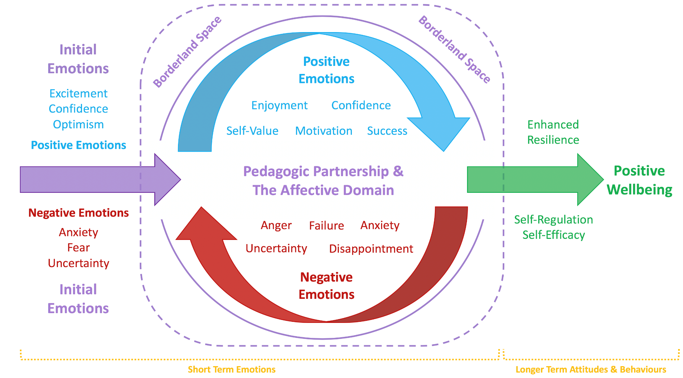
(Hill et al. 2019)
Notes:
We devised an evidence-based model summarising the potential effect of pedagogic partnership in enhancing student wellbeing.
Consciously encountering emotion within assessment can move students from negative feelings towards positive emotions, attitudes and learning behaviours, promoting their resilience and enhancing their wellbeing building. Also raises their satisfaction and performance.
By creating a safe and nurturing learning environment and a framework of positive experiences, positive beliefs were built and/or strengthened, enabling the students to approach new tasks with confidence and security and to perform well.
In essence, this Figure demonstrates a conscious displacement of learning, allowing partnership in geography to work students through the precarious nature of learning in a controlled and supported environment, scaffolding them towards security and positive wellbeing through the acquisition of resilient academic behaviours.

Slide 13
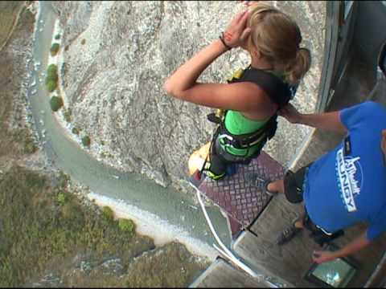
Hill et al. (2016): borderland spaces of learning
Dare to discover all that you can become
Notes:
We argue that teachers and students must be willing to work within borderland spaces of learning (Hill et al., 2016), to become comfortable with uncertainty and challenge, potentially changing their ideas and behaviours, and becoming more responsible and resilient in their learning.
This process works with ‘productive failure’ – teaching students not to be afraid to fall short or fail – we should give them permission to do so it should be a natural part of learning. Rather, they should dare to discover all that they can become – to be resilient enough to seek out who they are and who they want to become – Carol Dweck’s growth mindset (but it needs process praise) so we students to see their assignments as work in progress not a definitive statement of their worth.
Professor Laura Ritchie (Chichester – music): Learning is about taking a risk – going to the edge, doing what’s uncomfortable and taking the leap into the unknown, accepting the ‘I don’t know’ with one another. We need to create a classroom without fear of failure. We need to adopt courageous pedagogy.
IF YOU’RE NOT FALLING OFF IT, YOU’RE REALLY NOT EXPLORING THE EDGE

Slide 14
4. Conclusions
Faculty should not divorce the affective realm of learning from the cognitive as wellbeing issues rise into sharp focus in HE
Consciously uniting these two realms allows learning to be tackled holistically, supporting students to develop positive emotions and resilient academic behaviours
We recognise this may not be easy for faculty and, as such, we offer some practical advice …
Notes:
4. Conclusions

Slide 15
5. Implications for practice
Relate to students in ways that are hospitable and attuned to them as individuals
Adopt active student-centred and social pedagogic approaches such as group work and inquiry-based learning
Work with Educational Developers who can support you to work positively with the emotional aspects of learning / assessment
Notes:
5. Implications for practice
If institutions recognise the importance of supporting student engagement with dialogic assessment and offering developmental feed-forward opportunities, they can reimagine the
transformative potentialities of the educational landscape and meaningfully prepare their graduates for future learning and dynamic twenty-first century careers.

Slide 16
Embed student-teacher assessment dialogue early in the curriculum and increase peer feedback in later years e.g.
- year 2: teachers meet students individually to answer specific
questions following peer-to-peer discussion
- year 3: peer-to-peer mentoring supported by optional group /
individual teacher meetings
Use assessment approaches to support students to focus on the processes of learning and self-development (student-centred, constructivist)
How committed / able are we, within current resource constraints, to re-conceptualise assessment & feedback?
Notes:
A dialogic feed-forward approach that enhances student self-efficacy and self-regulation might at its simplest involve a re-allocation of teacher time away from transmission of content and summative feedback to phased conversational feed-forward. It might, however, necessitate a reallocation of resources in order to raise key performance indicators as teaching excellence is increasingly externally evaluated. How committed, within current resource constraints, are stakeholders to explicitly restructuring and reconceptualising feedback? A strategic approach might prove effective, in which enhanced resource is given at critical feedback moments when students are most open to learning development or find it particularly challenging. This might be in the first year when students are broad-minded about the role of feedback in higher education. They should not face a multitude of tick-box forms at this time, focussed on benchmarking and grade justification, because this acts to reinforce a belief among students that feedback has little feed-forward function.
Are we are prepared or have time to teach assessment literacy to our students, combined with our disciplinary knowledge and ways of doing?
Faculty should strive to provide opportunities for our students to monitor, regulate and attend to the quality of their work during its production. These conditions necessitate significant changes to deeply embedded practices that characterise much of teaching and learning in higher education.
If institutions recognise the importance of supporting student engagement with dialogic assessment and offering developmental feed-forward opportunities, they can reimagine the
transformative potentialities of the educational landscape and meaningfully prepare their graduates for future learning and dynamic twenty-first century careers.

Slide 17
References
Carter, M.A., Pagliano, P., Francis, A. & Thorne, M. (2017) Australian university students and mental health: Viewpoints from the literature. International Journal of Innovation, Creativity and Change, 3, 1-25.
Equality Challenge Unit (2015) Equality in Higher Education: Statistical Report 2015. https://www.ecu.ac.uk/publications/equality-higher-education-statistical-report-2015/
Ferguson, D. (2017) The rise in student mental health problems – I thought my tutor would say deal with it. The Guardian, 29th August.
Hill, J., Thomas, G., Diaz, A. & Simm, D. (2016) Borderland spaces for learning partnership: opportunities, benefits and challenges Journal of Geography in Higher Education, 40, 375-393.
Hill, J., Healey, R., West, H. & Déry C. (2019) Pedagogic partnership in higher education: Encountering emotion in learning and enhancing student wellbeing. Journal of Geography in Higher Education, in press.
Hill, J. & West, H. (2019) Improving the student learning experience through dialogic feed-forward assessment. Assessment & Evaluation in Higher Education, DOI: https://doi.org/10.1080/02602938.2019.1608908.
Pang, W. (2017) Peace of mind: Universities see spike in students seeking mental-health help. The Globe and Mail, 18th October.

Slide 18
Thank you for listening
Questions?
Contact details
Jennifer Hill - jennifer.hill@uwe.ac.uk
Harry West - harry.west@uwe.ac.uk

