Slide 1
E-Portfolios for Professional Development
(Using Pebblepad)
Wendy
Fowles-Sweet &
Oliver Haslam
November 2019
Notes:
Wendy starts

Slide 2
Professional Portfolios
Engineer
Work Experience
Societal Awareness
Academic Learning
Ethical Conduct
Equality & Diversity
Professionalism
Notes:
Portfolio records and demonstrates not just technical expertise, but also wider understanding of how the individual and their specialism fit into society

Slide 3
Recording Skills and Evidence
A live and growing profile:
A life long testimony
Demonstrable Development
Sustainability of knowledge and learning
Professional and personal recognition
Notes:
Academic learning underpins future development. Awareness that future jobs are not yet identifiable but aiming to position well. Keen to recognise both professional achievement and contentment in personal lives.

Slide 4
Reflection
D
Importance of
Critical Thinking
Reflection
Activities
Resulting Learning and Impact
Responsibility to
Self
Employer
Family
Society
Regular review of
Notes:
Importance of reviewing and extending learning and individual reaction to it. Work/life balance important

Slide 5
Assessment
Structured | Unstructured
Personal Profile | Start point: Skills Matrix
Specific Lessons/Tasks | End point: Career Plan
Skills Matrix | Open choice on other elements
Activity Logs
Gap Analysis
Action Plans
Career Plan
Assess personal insight, commitment, action planning, career plan: reflective report

Slide 6
Portfolio Use (EDM)
Current | Under Development
Modules
L6: Industrial Placements | L6: Professionalism for Engineers
L6: Engineering and Society | L4: Engineering Practice
L7/M: Professional Development Appraisal & Continuing Development | L5: Engineering Practice
Structured Records
Degree Apprenticeship – Audit Trail | APT: Academic, Personal & Professional Development

Slide 7
What students do in PebblePad
Add evidence of learning
Attach presentation files and reports
Log experiences and events
Reflect on learning, evidence and experiences
Respond to staff feedback
Skills Matrices
Career Plans
Notes:
Oli starts

Slide 8
Portfolio or workbook?
Portfolio | Workbook
Structure created by student | Structure created by staff
More freeform | Highly scaffolded
 | ‘Assessor only’ sections can be included
Suitable for higher levels | Suitable for lower levels
Manual submission only | ‘Auto-submit’ or manual submission
100% student generated content | Can be used to ‘deliver’ information as well as receive student generated content

Slide 9
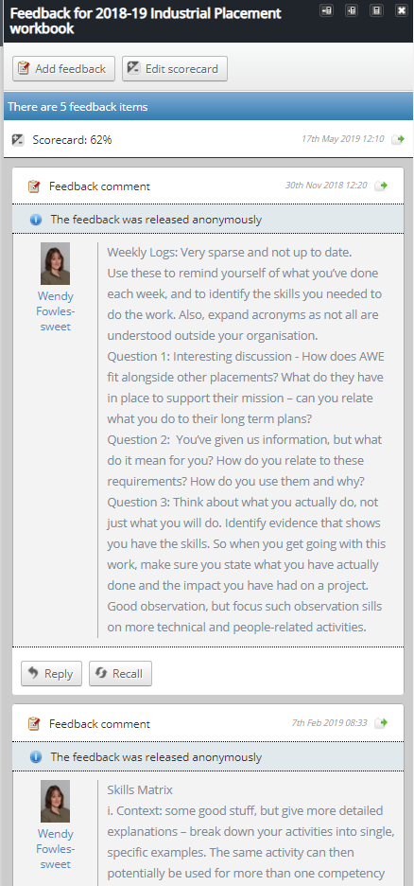
Feedback & grades
Once submitted, staff see changes as they are made by the student.
Feedback is added (via the side panel) at any time by staff. Students can reply to feedback at any time. Iterative feedback conversations are possible!
External assessors (e.g. workplace mentors) can provide feedback too.
Staff and external assessors can give grades. A single grade is fed back to Blackboard’s grade centre.

Slide 10
Feedback from participants
Here is an example of a completed ‘Industrial Placement’ workbook (the Latin text is where the student generated content would be).
http://go.uwe.ac.uk/seda1
What are the pros and cons of this approach?
What should be added/removed/changed?
Might you use this approach in your institution?
Click the comment icon at the top right of the workbook and write your ideas as a comment in the sidebar of the workbook.
Notes:
Oli will demonstrate this and leave the comments window open so the workshop participants can see the comments on the big screen.

Slide 11
Thank you
Wendy Fowles-Sweet & Oliver Haslam
Notes:
Workshop

