Slide 1



Evidence from ClairCity: Citizen demand for a clean air, low carbon, healthy city
Dr Jo Barnes
Air Quality Management Resource Centre,
University of the West of England, Bristol
Air Pollution 2019
27th International Conference on Modelling, Monitoring and Management of Air Pollution
Aveiro 26 – 28 June 2019
This project has received funding from the European Union’s Horizon 2020 research and innovation programme under grant agreement No. 689289.

Slide 2

ClairCity objectives
ClairCity is aimed at creating a major shift in public understanding towards the causes of poor air quality, inviting citizens to give their opinions on air pollution and carbon reduction to shape the cities of the future.
Our main objectives are:
Putting citizens’ behaviour and practices at the heart of the debate.
Develop a suite of innovative toolkits for enhanced quantification, engagement and impact evaluation.
Integrate citizens’ behaviours in city policies now and in the future.
Raise awareness of environment changes and their solutions

Slide 3
ClairCity work package plan
WP3
Benchmarking behaviour
WP5
Quantification of baseline
WP6
Assessment of Policy
Six city/ regions:
Amsterdam
Aveiro
Bristol
Liguria
Ljubljana
Sosnowiec
DELPHI survey & W’shop
Mutual Learning W’Shop
Skylines Game
Stakeholder Dialogue Workshop For Scenario Generation
WP5
Quantification of Impact
WP7
Scenarios Evidence Report
WP7
Policy Workshop & Report

Slide 4
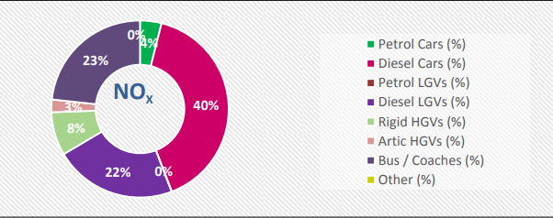
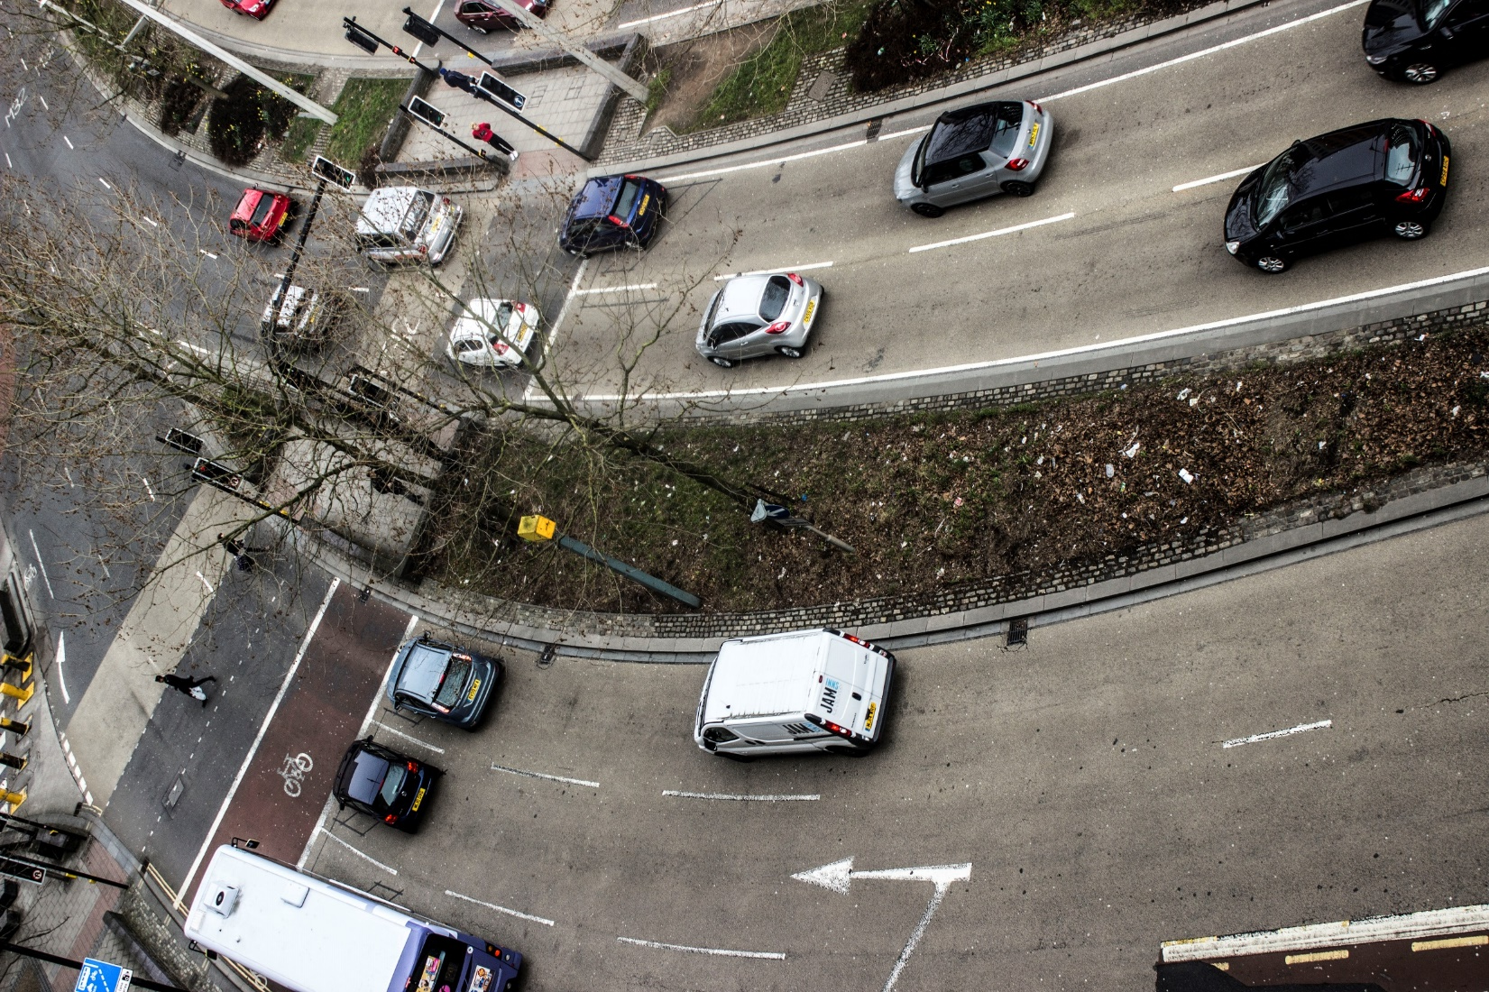
Air quality in Bristol
Bristol is typical of a UK city.
Ongoing exceedances for annual mean NO₂ limit value
Road transport is main source
96% of all NO_{X} emissions from vehicles come from diesels, with 40% from diesel cars
Traffic congestion is also major complaint of Bristol residents.
Source: CH2M (2017). Bristol Clean Air Zone Feasibility Study: Option Sifting
Notes:
202 out of 441 used some private motorised transport. Included taxis, vans, car share and motorbike.

Slide 5
How to achieve compliance: what do we need to know?
Do people want to stop using their cars?
  Are we working “against” or “with” the public?
  Implications for the types of messaging and policy that will be effective.
What stops people who use cars from switching to a (clean air) alternative?
  What are the barriers or challenges for citizens?
  What discourages them about changing?
Understanding this will shape better policy responses to reduce car use.
Notes:
202 out of 441 used some private motorised transport. Included taxis, vans, car share and motorbike.

Slide 6
Citizen Delphi
“Delphi may be characterized as a method for structuring a group communication process so that the process is effective in allowing a group of individuals, as a whole, to deal with a complex problem”.
  Linstone, H.A. and and Turoff, M., eds. (2002) The Delphi Method: Techniques and Applications [online]. Newark: New Jersey Institute of Technology.
Citizen Delphi treats citizens as the ‘experts’ in their own lives.
Round 1 survey, May – June 2017: a mix of open and closed questions presented online and face-to-face by interviewers and in self-complete forms
Round 2 survey: a mix of open and closed questions presented online
Round 3 workshop or stall, July – September 2017: a face-to-face event facilitated by ClairCity staff, with groups of between 5 – 35 citizens at a time.

Slide 7
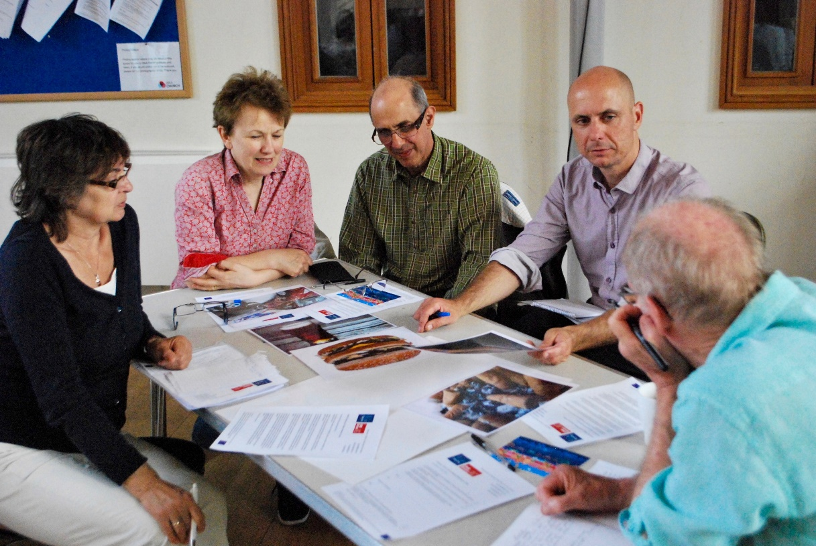
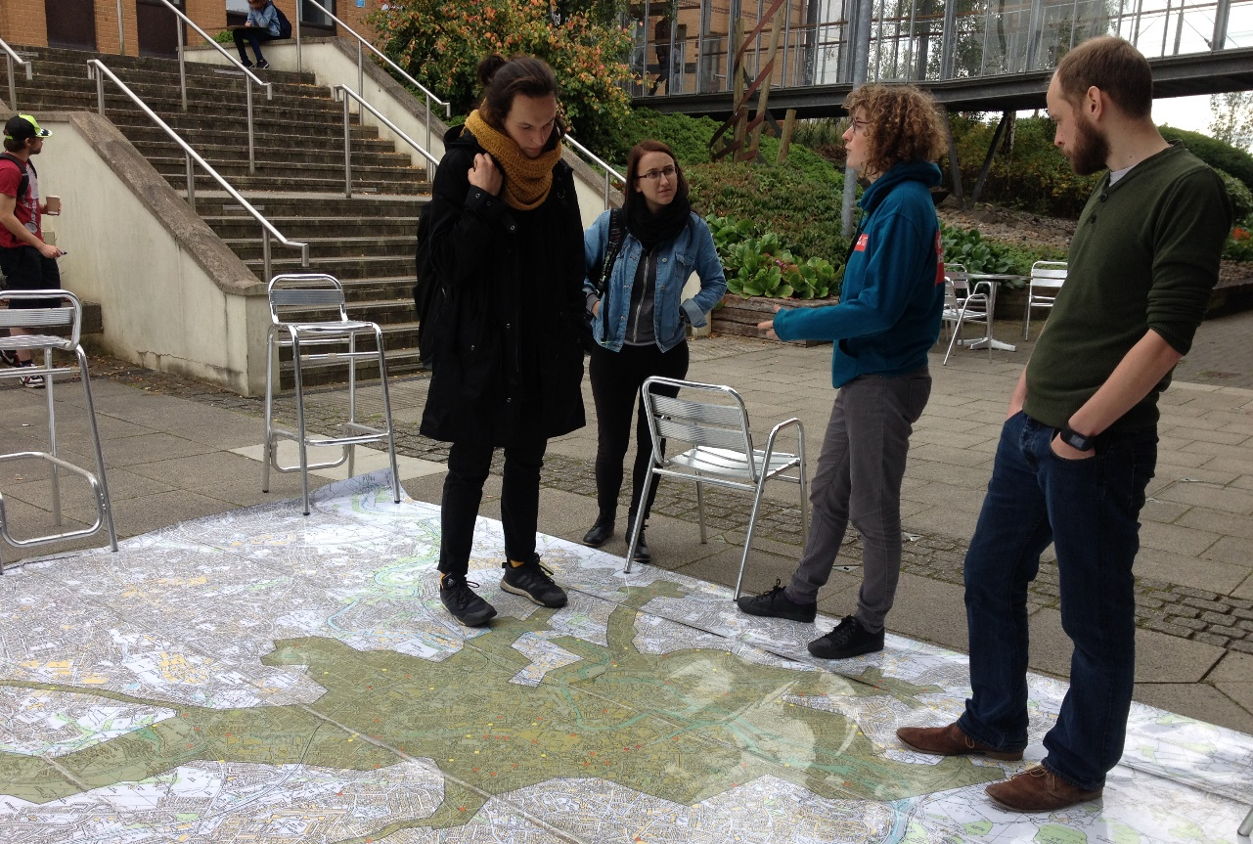
ClairCity Delphi methodology
Two surveys (and a workshop) Summer 2017
Online, face-to-face, and at events
Promoted on regional TV & local radio
500 people responded
Compared to existing city data for representivity
We asked people
  How they travel to work (commute)
  How they would like to travel
  Why they don’t travel the way they would like to

Slide 8
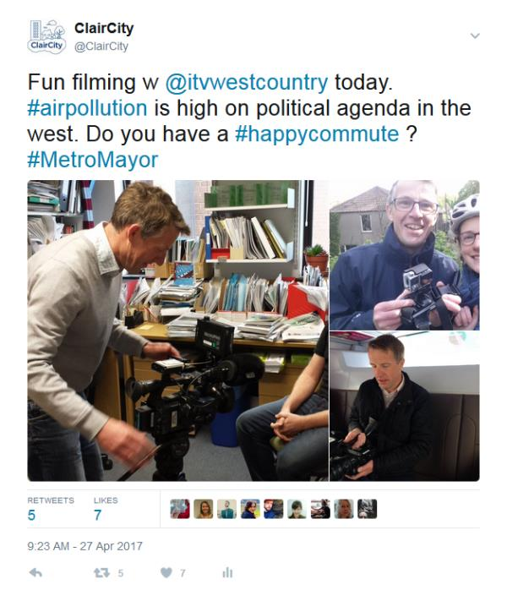
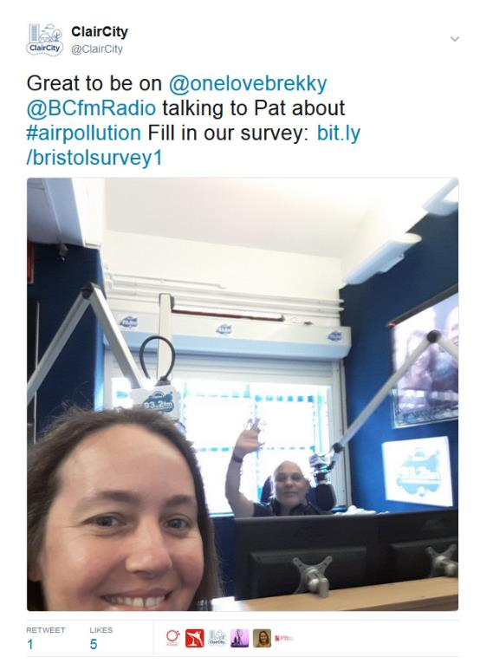
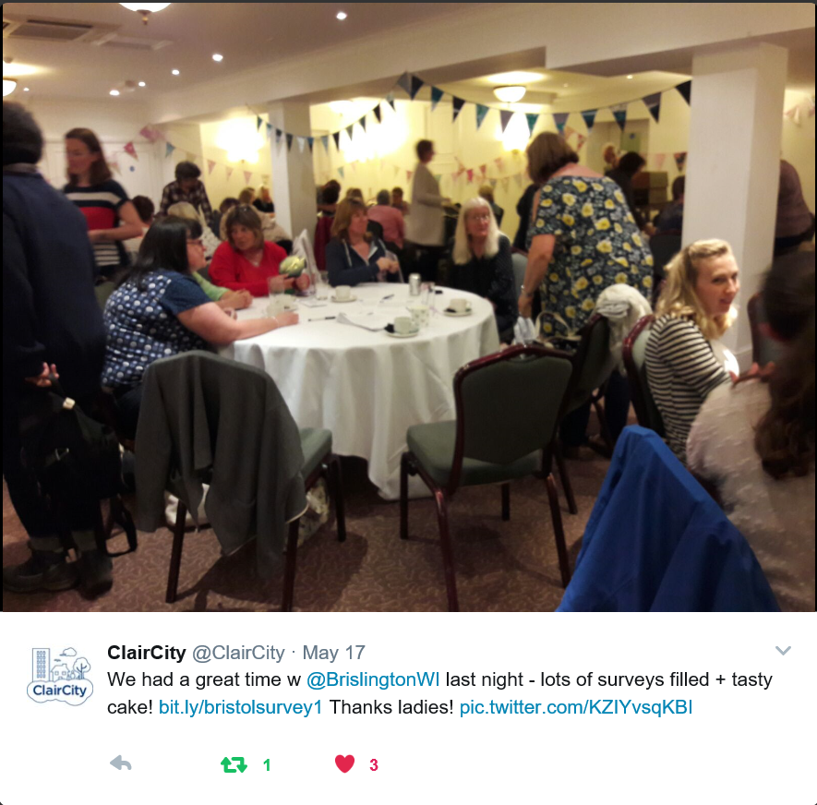
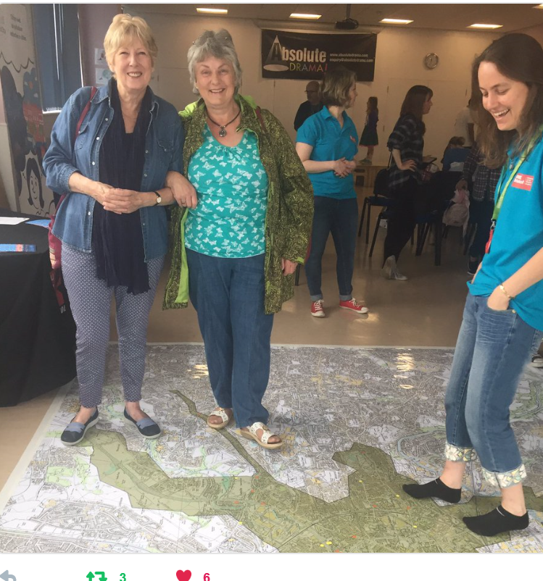
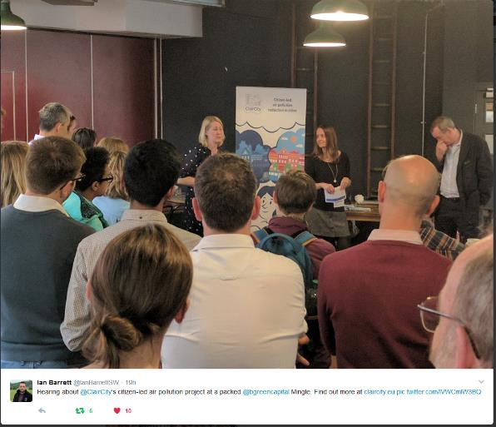

Bristol Delphi
Launched 4th May 2017
Online & face-to-face
Public and community events

Slide 9
Commuter travel: current and future
n = 440
Notes:
Although only 54% did not use a car, it is notable that another 17% used modes as well as their cars; they were not solely dependent on the car for their commute (Figure 2‑1).
Three quarters of respondents would rather not be using a car in Bristol for their commute in the future (Figure 2‑2), showing a large number of those who currently commute by car would like to stop, with a significant increase in the proportion choosing public transport (Table 2‑2). While there is some interest in electric and other cleaner technology for cars, this is weaker than interest in non-private vehicle solutions.

Slide 10
Do commuters want to change?
 | High polluting choice in future (conventional car only) | Low polluting choice in future (‘car and other’ or car and walk; walk and bus etc)
High polluting choice in present (conventional car only) | 31 Entrenched | 85 Looking for positive change
Low polluting choice in present (‘car and other’ or car and walk; walk and bus etc) | 22 Getting worse | 279 Staying positive
n = 417

Slide 11
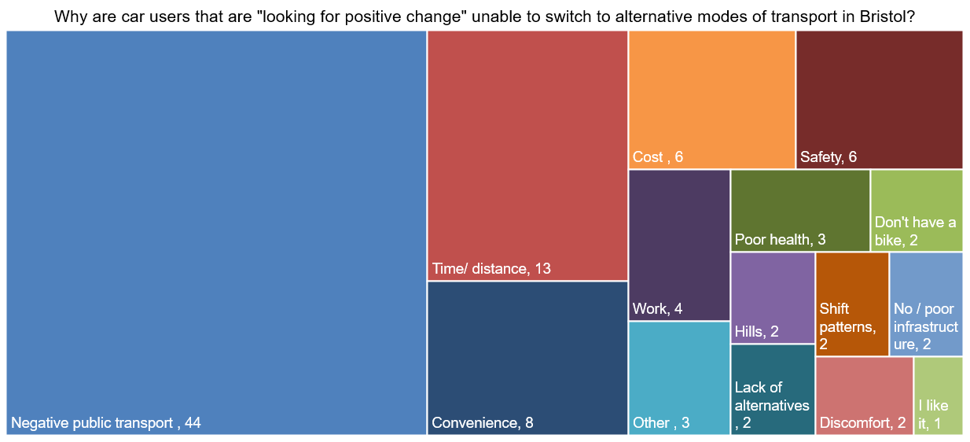
Why can’t they?
n = 85
Notes:
The most frequent responses related to negative comments about public transport (44 responses). Key themes within the “negative public transport” category included:
Cost (11 responses) with comments such as “Not enough public transports (train and bus) in terms of frequency and diversity. Current public transport are too expensive and I am living too far away from work to be able to cycle”.
Time/timetabling (15 responses), e.g. “Bus times do not fit in around working hours. Bus also takes just as long as driving. So no real incentive”.
No/unreliable service was also a key public transport criticism (19 responses), e.g. “Doesn't cover where I want to go, no direct service”.
The second largest category of responses is Time / distance. Time and distance were combined in this category as this relates to duration of journeys, e.g. “Too far away, it's too much time out of my day already travelling, to cycle and have shower etc. Would be longer: I need a job that is closer”.
The two responses coded under “shift patterns” referred to people who were looking to walk or cycle, but long hours or late shifts meant they felt unable to do this.
‘Other’ responses included references not wanting to change, laziness and over-coming the mental barriers to cycling.

Slide 12
Why do some car users feel they can’t change?
Current car user who would prefer walk/cycle/bus.
Insufficient/poor quality public transport
“Bus times do not fit with work shifts. Would have to take 2 buses and twice as long to drive. Cycling facilities at my workplace are not great, no shower. Roads feel unsafe at peak times, cycle routes are just on edge of road, often randomly stopping just before difficult areas e.g. junctions.”
Lack of changing or shower facilities
Flexible/convenient
Safety fears

Slide 13
Why do some car users not want to change?
Current car user who would prefer stay in a car.
Family commitments
“Young family, need to do multiple journeys within a set time. Need to carry goods and people.”
Flexible/convenient
Carrying materials or shopping etc

Slide 14
Current commuters by gender
Notes:
We report only the categories of “male” and “female,” as the “other” category was too small (7 respondents) to draw comparable conclusions. Overall, 283 respondents identified as female, 57% of our survey, with 192 respondents identifying as male.
In our results, women are more likely than men to travel to work by conventional car only; 33% of women compared to 21% of men who answered this question. Men were more likely not to use a conventional car at all for their commute.

Slide 15
Future commuters by gender
Notes:
For future commuting choices there is much less difference in preferences between genders than in their present behaviour (Figure 2‑5). In our sample, although women were presently more likely to rely on a conventional car to commute, they had as much interest as men in switching to public transport or active travel.
Our data suggests that policies that consider the needs of women more specifically would be relevant to reduce the number of car commuters, as women were more likely to be in a car but just as likely to want to leave it.

Slide 16
Current and future commuters by gender
Notes:
There were similar patterns in the preference change for men and women (Figure 2‑6). Around a fifth of both men and women wanted to still use a car (at least sometimes or for part of the journey) in the future. However, this is a large reduction from the present. Both genders wanted to increase their use of public transport and cycling, and fewer men and women wanted to walk in the future.
Just over half of all the men who answered questions about their future commute wanted to include cycling as one of their options. Although there was an increase in women who wanted to cycle compared to the present, the gender gap in cyclists was almost maintained (16% difference compared to 18% difference in the present).

Slide 17
Do male/ female commuters want to change?
 | High polluting choice in future (conventional car only) |  | Low polluting choice in future e.g. car and walk; walk and bus; electric vehicle
High polluting choice in present (conventional car only) | Entrenched |  | Looking for positive change
 | 5% | 9% | 14% | 23%
Low polluting choice in present e.g. car and walk; walk and bus; electric vehicle | Getting worse |  | Staying positive
 | 6% | 4% | 74% | 64%
Notes:
The results for men and women were fairly similar. A higher proportion of women were “looking for positive change” as more women than men are “conventional car only” commuters in the present. Similarly, a higher proportion of men are “staying positive” because more men were already in lower polluting modes of transport in the present. A similar proportion of both genders are “getting worse” – people not currently using cars who would like to. More women than men are “entrenched” in their cars. This matches the indications that more women are currently using conventional cars only in the present, and that some women are less likely to want or be able to reduce their car use.

Slide 18
Why are commuters “entrenched” in their cars?
Notes:
Coding the responses to “Why can’t you change” for the “entrenched” group by gender shows some differences in the answers of men (9 people) and women (21 people) (Figure 2‑7). Men were more likely to mention work as a reason, for example “Work is outside city centre - operate across region and motor car is essential.” No men mentioned family responsibilities as a reason they could not change, whereas four women mentioned it “Unable to rely on public transport. Cheaper to drive especially with other family members.”
We collected a wider range of reasons from women, but this may reflect the fact that we had twice as many responses from women than men in this category

Slide 19
Current commuters by ethnicity
Notes:
In our sample, 63 people identified themselves as Black and Minority Ethnic (BME) selecting Asian or Asian British, Black or Black British, Mixed, Chinese. BME responses represent 12.6% of our total sample. This is slightly below the city average of 15%. For the following analysis, we have aggregated the BME categories together as the number of responses in each question is too small to compare reliably.
27 people (5% of the respondents) decline to give their ethnicity. In the data presented, they have been left out of specific ethnic categories, but their answers are included when we describe “All” responses to the survey.
61 BME respondents answered the question about present commuting choices. BME respondents were more likely than the total sample not to use a car in their commute, with 54% of the total sample choosing this option compared to 64% of BME respondents. BME respondents were also less likely to travel solely by car than the total sample (Figure 2‑8).

Slide 20
Future commuters by ethnicity
Notes:
62 BME respondents answered the question about future commuting choices (Figure 2‑9). Two thirds of BME respondents said they would rather not travel by conventional car in the future. However, BME respondents were more likely than other respondents to want to travel by conventional car in the future, with an increase in those who selected “conventional car only” (23% up from 21%) for their future transport option.
Overall, there was little difference in the proportions of BME respondents choosing each category in the future compared to the present. However, on an individual level there were significant differences in the groups that wanted to move away or towards car usage.

Slide 21
Do BME commuters want to change?
 | High polluting choice in future (conventional car only) | Low polluting choice in future e.g. car and walk; walk and bus; electric vehicle
High polluting choice in present (conventional car only) | 4 Entrenched | 9 Looking for positive change
Low polluting choice in present e.g. car and walk; walk and bus; electric vehicle | 10 Getting worse | 37 Staying positive
Notes:
61 respondents answered both the present and future transport options for commuting, allowing us to investigate their responses (Figure 2‑10). Although the number of people who wanted to use only a conventional car to get to work increased slightly (from 13 to 15 respondents), in fact only four of the present “conventional car only” respondents wanted to stay in their cars. Nine of the future “conventional car only” respondents had switched from other modes of transport.

Slide 22
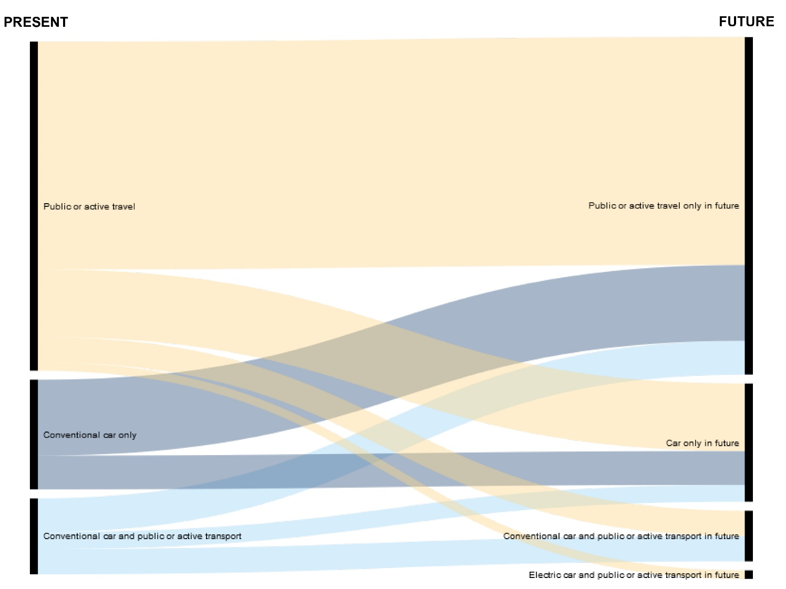
How do BME commuters want to change?
Notes:
61 respondents answered both the present and future transport options for commuting, allowing us to investigate their responses (Figure 2‑10). Although the number of people who wanted to use only a conventional car to get to work increased slightly (from 13 to 15 respondents), in fact only four of the present “conventional car only” respondents wanted to stay in their cars. Nine of the future “conventional car only” respondents had switched from other modes of transport.

Slide 23
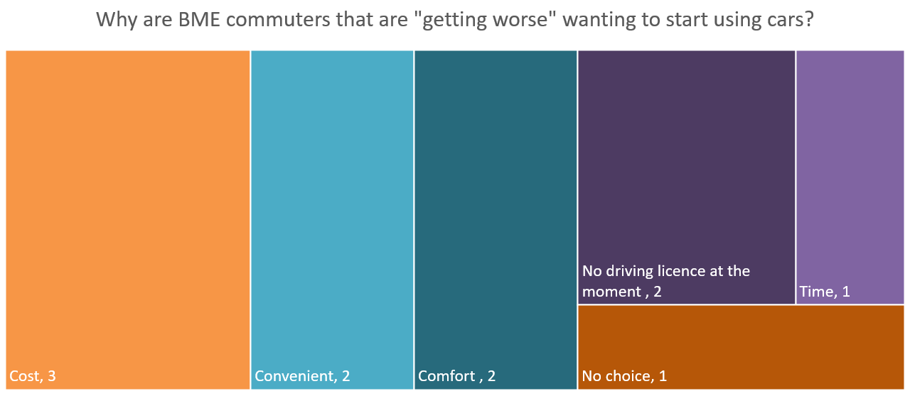
Why do BME commuters want start using cars?
Notes:
From the “getting worse” category, 6 out of 10 people currently walk to work and would like to go by car. Two others currently only use the bus. Only two used cars presently, one in a car share.
Age seemed to be a potentially influencing factor in the switch towards cars. Six out of the 10 people in the “getting worse” category were in the 16-24 age group, including two who said they did not currently have driving licences.

Slide 24
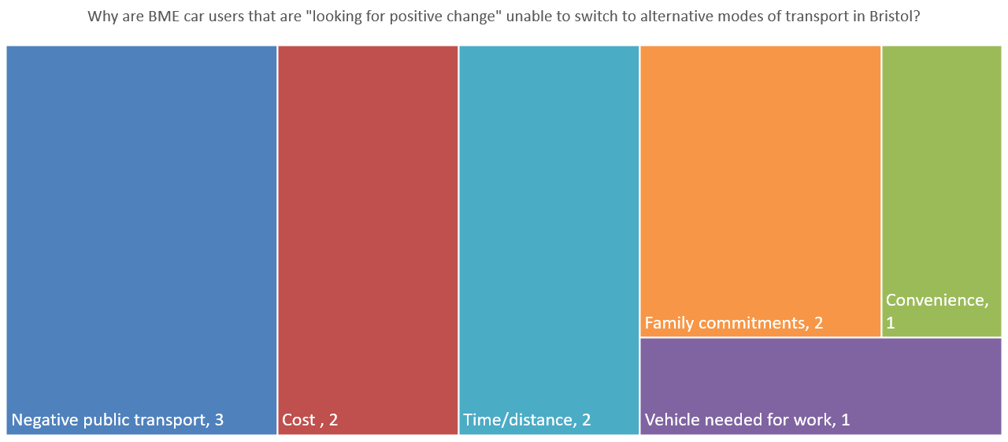
Why can’t BME commuters stop using cars?
Notes:
All three of the respondents who were negative about public transport gave public transport as their preferred option in the future, with two suggesting a tram, and one asking for “shuttle service, reliable and cheap”. One person in this group gave a more detailed answer to explain:
“Not enough public transport[s] (train and bus) in terms of frequency and diversity. Current public transport are too expensive and I am living too far away from work to be able to cycle. I do want to change! Unfortunately it's too challenging at the moment.”
In conclusion, BME respondents were less likely to commute solely by car in the present, but more likely to want to commute solely by car in the future. Although in the headline figures there is more stability in the present and future choices of BME respondents, in reality present car users did not want to stay “entrenched” in their cars. There was a larger category of people, particularly younger respondents, who were looking to start driving.

Slide 25
Current commuters by education level
Notes:
Our survey respondents are more educated than average Bristolians: 58% with a degree cf 33% in 2011 census, and 36% without a degree cf 47% in 2011 census.
157 respondents to this question were in the “below degree level qualification” group, and 264 respondents had a degree or higher degree qualification (Figure 2‑13).
There was little difference in the proportion of people with qualifications in terms of what proportion relied solely on a car for their commute. A slightly larger proportion of people with a degree (56% compared to 50%) did not use a car in their commute.

Slide 26
Future commuters by education level
Notes:
Four people in the “no qualifications” group answered the question about future commuting preferences, 154 from the “below degree level” group and 265 from the “degree or above” group (Figure 2‑14).
While both categories indicated a move away from car use, this was more pronounced in the “degree and above” group. There was an increase in respondents in the “below degree level qualifications” who wanted to use public transport or active travel, but 18% wanted to use a conventional car only.

Slide 27
Do commuters without degrees want to change?
 | High polluting choice in future (conventional car only) | Low polluting choice in future e.g. car and walk; walk and bus; electric vehicle
High polluting choice in present (conventional car only) | 15 Entrenched | 28 Looking for positive change
Low polluting choice in present e.g. car and walk; walk and bus; electric vehicle | 11 Getting worse | 91 Staying positive
Notes:
145 people in the “below degree level qualifications” group answered both their commute in the present and their preference for the future.

Slide 28
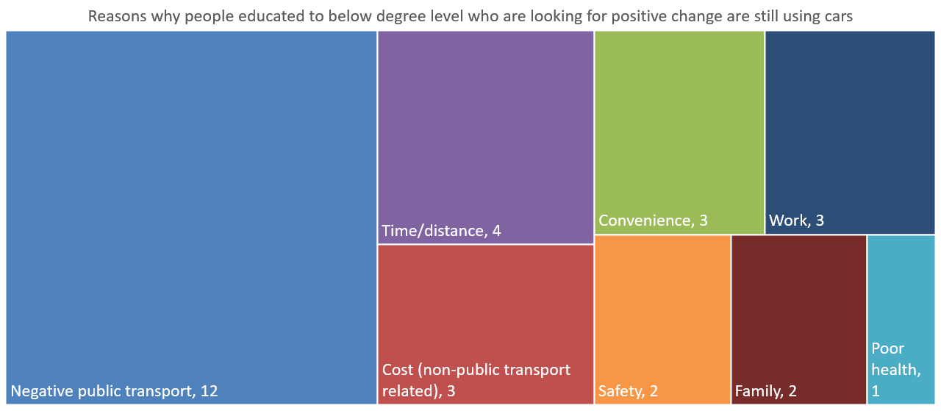
Why can’t commuters without degrees change?
Notes:
The comments related to negative public transport were a mix of reasons.
Three related to cost “Cost is prohibitive and services are unreliable”
Seven responses in the “negative public transport” category mentioned either the unreliability or lack of public transport options “Too far to walk and no direct bus service” and “No access to trains locally”.
Those who mentioned cost but not specific to public transport referred to the cost of buying a bike (1), or just a generic reference to cost (2) as the reason they did not feel they could leave their cars. Two of the three people who referred to work in their answers mentioned shift patterns or “hours at work” as part of their reason; the third that they needed to carry tools for their job

Slide 29
Home heating: current and future
n = 484
Notes:
484 people responded to this question. Nearly three quarters of respondents use gas to heat their homes in Bristol, with a further 10% relying on electric heaters (Figure 2‑16). Respondents were able to indicate more than one form of heating, so the total number of responses is higher than the total number of respondents.
There was a significant demand for renewable heating in the future, with some respondents specifying type of energy (e.g. solar, wind) others suggesting more generic responses e.g. “green” or “renewable” sources (Figure 2‑17).

Slide 30
Do people want to change their home heating?
 | Solid fuel in the future | Not solid fuel in the future
Solid fuel in the present | 17 Entrenched | 28 Looking for positive change
Not solid fuel in the present | 20 Getting worse | 377 Staying positive
Notes:
There were 17 respondents who wanted to continue using solid fuel in the future, labelled as “entrenched.” However, 15 of these wanted to combine solid fuel with other means, indicating less of a reliance on solid fuels. Similarly, of those in the “getting worse” category, 65% (13 people) were looking for a mix of either gas or renewables with solid fuel in the future. Exploring the “getting worse” data set, nearly half said that the reason they had not moved to solid fuel was due to cost, with not being a homeowner or the chimney/fireplace not being suitable also appearing for around 25%. None mentioned any concerns about the air quality impact of moving to solid fuel burning.

Slide 31
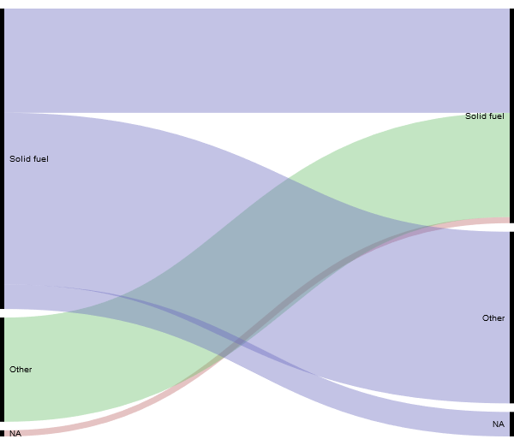
How do people want to change their home heating?
Notes:
Figure 2‑18 displays how the choice for solid fuel in the future is a mix of those who currently use it, and people who currently do not have solid fuel. It also demonstrates how more solid fuel users would rather move away from the heat source.

Slide 32
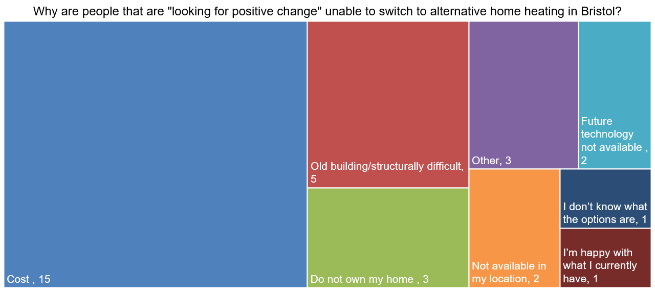
Why can’t people change their home heating?
Notes:
Understanding the motivations for those who are “looking for positive change” is useful for identifying potential low-hanging fruit to move people away from solid fuel use. In our Bristol data, 28 people wanted to move away from solid fuel. In their responses, cost was the most significant factor with more than half of respondents mentioning it (Figure 2‑19).
Comments relating to problems in converting buildings were the next largest group, for example “old building” or “roof not facing the best way.” The physical infrastructure of a relatively old housing stock in Bristol seems relevant in the renewables category implying a focus on self-generation rather than mains electricity. People are assuming their heating infrastructure would be part of the fabric of their house or building, like solar panels on their roof, rather than electric heating that could run from renewables located elsewhere.

Slide 33
What policy measures do people want in Bristol and how do they think they would affect their lives?
Notes:
The most popular responses (for both respondents’ lives and for Bristol) were improving the bus service and creating segregated cycle lanes. For many respondents making the buses free would be beneficial. Introducing trams and opening closed railway lines were also popular options. There was a good deal of support from respondents for pedestrianizing the city centre, charging older and more polluting vehicles and banning diesel cars. Scrappage schemes were seen to be popular, but many respondents recognised that this measure would not affect them personally. There was a lot more support for extending 20 mph zones than there was for their removal, however Residents’ Parking Zones were a lot more contentious. Scrapping bus and multi-occupancy lanes and cycle lanes were very unpopular (Figure 3‑1).

Slide 34
What policy measures do people want in Bristol and how do they think they would affect the city?
Notes:
There were a similar number of respondents to questions about the impact of these measures on the city/region as on their lives and, in general, the responses were similar, with strong support for improving public transport and cycle and pedestrian infrastructure, and the removal of older/more polluting vehicles and diesel cars. Residents’ Parking Zones were less contentious from a city perspective, with the majority of respondents being in favour of extending rather than scrapping them (Figure 3‑2).

Slide 35
Conclusions
Differences in travel behaviours, desires and reasons were observed to vary by gender, ethnicity and education level.
In general Bristol citizens want to move to more sustainable travel, but feel hampered by poor, inconvenient and expensive public transport, and concerns over cycle safety and distance/time.
Female respondents were more dependent on their cars, particularly for family reasons, safety concerns and cost, but want to use public transport and cycle more.
BME respondents were less likely to use a car currently, but more likely to want to in the future.
Respondents without degrees were more likely to use a car in the present and less likely to want to use non-car modes in the future, although there was a desire to shift to more sustainable modes.
Policy measures that improve public transport and cycle and pedestrian safety were popular.
Demographic analysis may not necessarily be representative, but there is significant value in using their data to understand better specific behaviours relating to transport and policy receptiveness.

Slide 36
Dr Jo Barnes
Air Quality Management Resource Centre,
University of the West of England, Bristol
jo.barnes@uwe.ac.uk
@jobarnes_uwe
Air Pollution 2019
27th International Conference on Modelling, Monitoring and Management of Air Pollution
Aveiro 26 – 28 June 2019
This project has received funding from the European Union’s Horizon 2020 research and innovation programme under grant agreement No. 689289.

