Slide 1
‘Men behaving badly’ or just ‘attempting to fit in’?: ‘Laddism’ and its impact on learning and teaching environments in higher education
Dr Richard Waller
And Dr Helen Bovill
University of the West of England, Bristol

Slide 2
Ethics in ‘personal’ research
What ethical issues present when:
Research seeks to make public the potentially deeply personal?
Ethical approval
Encouraging meaningful participation
Informed disclosure
Safeguarding and well-being

Slide 3
Context headlines
Jackson, C. and Sundaram, V. (2015) Is ‘lad culture’ a problem in higher education? Exploring the perspectives of staff working in UK universities London: Society for Research in Higher Education
‘… a ‘pack’ mentality evident in activities such as sport and heavy alcohol consumption, and ‘banter’ which was often sexist, misogynist and homophobic.
But also seen to have a positive side in:
‘the role it might play in creating strong social and emotional bonds between men, as well as allowing more disenfranchised men to feel a sense of belonging to a group.’

Slide 4
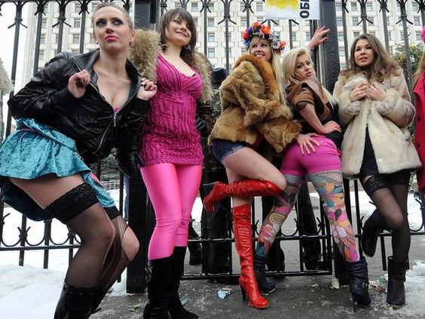
Context headlines:
‘slut dropping’.
Bates, L. (2012). ‘’Slut dropping’ and ‘pimps and hoes’ – the sexual politics of fresher’s week’, Independent. October 9th, 2012.

Slide 5
Context headlines
Young-Powell, A and Gil, N. (2015) ‘lgbt students on lad culture: will I be safe on campus today? Guardian students. October 19th
‘I’ve heard lads say that trans people are attention-seekers with mental health problems, and so deserve to die’ Mat Wilkie, 24, identifies as transsexual
‘I’ve never been to the student union with my girlfriend and not been sexually harassed’. Eleanor Alice Ring, 21, is agender and pansexual
‘There are mornings when I ask myself: am I going to be safe on campus today?’ Travis, 20, identifies as queer and non-binary

Slide 6
Context headlines
The Good university guide. (N.d.) Student experiences of sexism at uni. Available at: https://www.thecompleteuniversityguide.co.uk/universities/sexism-on-campus/student-experiences-of-sexism-at-uni/
"The boys in my halls used to sing a drinking song about rape, which obviously was just disgusting. I think there are a lot of jokes about women and a lot of so-called 'innocent' groping that goes on…”
The NUS report contains much testimony of this type, but it certainly does not suggest that all men engage in laddish behaviour … However, these ‘lads’ seem to dominate the social side of university life,
Many of the women said lad culture had damaged their personal lives

Slide 7
How do we collect data in a safe and respectful way?
Single sex focus groups
Run by a male or female (HB or RW)
One to one interviews

Slide 8
Ethical approval:
Recruitment
Recruitment strategy – ‘Please review your plans to recruit students to the study. In order to avoid peer pressure influencing the decision to participate please do not ask students to sign a consent form and decide whether or not to participate in the study in the class. You could distribute information about the study and then invite them to respond to you. Or ask for their consent for you to contact them further about the project’

Slide 9
Recruitment:
A staged approach
Email to lecturers
Short information powerpoint to potential participants
Initial sign-up sheet

Slide 10
Recruitment:
A staged approach
First contact with potential participants
Very detailed focus group information sheet and consent form
Very detailed and separate interview information sheet and consent form

Slide 11
Ethical approval: informed disclosure
‘You need to be clearer about what the circumstances of ‘taking further action’ might be in light of certain disclosures? Explain this so that a student will understand what the implications of such disclosures might be’.

Slide 12
Informed disclosure: privacy statement
Information to inform you on any disclosures you might make
Every attempt will be made to keep your disclosures confidential and your identity anonymous. We may only share relevant items of information you disclose in this research with appropriately trained staff or organisations outside of UWE in the following instances:
It is required by law
We have reasonable belief that you have breached the University’s regulations or policies
There is a serious risk of harm to yourself or others

Slide 13
Informed disclosure: privacy statement
Clarify circumstances under which we might need to breach confidentiality
You should think carefully about disclosures that you make which:
Clearly name people or places
Identify people or places involved in illegal activities such as dealing drugs, violence against others, sexual abuse against others
Identify people or places who are directly harmed by behaviours disclosed and who may need support systems put in place

Slide 14
Informed disclosure: privacy statement and meaningful data?
This research is important to more fully support student welfare and actual accounts of realistic lives and experiences are primarily important. We would ask that you protect the identity of people and places in your disclosures

Slide 15
Informed disclosure:
Privacy statement and meaningful data?
However, where you think serious incidences have occurred and in which you feel we can direct you toward sources of support, we would ask that you talk to either Richard or Helen outside of the research so that we can work with you to resolve such issues privately and with support from relevant people or organisations

Slide 16
Ethical approval: safeguarding and well-being
‘What kinds of support are you able to point students to? You seem to suggest that student participants may be ‘victims’ or ‘perpetrators’ of laddish behaviour and some further thought and explanation of how you will respond to their accounts would be useful. You refer to the wellbeing service but please consider other support mechanisms for those who may have had difficult experiences - for example sexual violence or harassment’

Slide 17
Safeguarding and well-being:
UWE support
UWE Wellbeing
mental health support: brief counselling and self-help information and resources online
Faith and Spirituality: offers pastoral care for people of all faiths or none
Emotional resilience workshops: run by students for students

Slide 18
Safeguarding and well-being:
Beyond UWE

Slide 19
Safeguarding and well-being:
Sexual violence or abuse
Victim Support
Bristol Against Violence and Abuse (BAVA)
Bristol Sexual Violence Services Pathway
SARSAS (formerly Bristol Rape Crisis) for women and girls
SARSAS (formerly Bristol Rape Crisis) for men and boys
The Bridge Sexual Assault Referral Centre
Avon and Somerset Police

Slide 20
Takeaway thoughts
Sensitive subject > sensitive data > sensitive data handling
Particular care with participants
Very time consuming
Unintended disclosure
Uninformed disclosure
Safeguarding: Impact upon self and others and institutions
Sanitising data: validity/truthfulness/meaningful?

