Slide 1
Presentation by
Where is the service user voice in our research?
Christine.ramsey-wade@uwe.ac.uk
Christine
Ramsey-Wade
Senior Lecturer in Counselling Psychology
29 June 2019

Slide 2
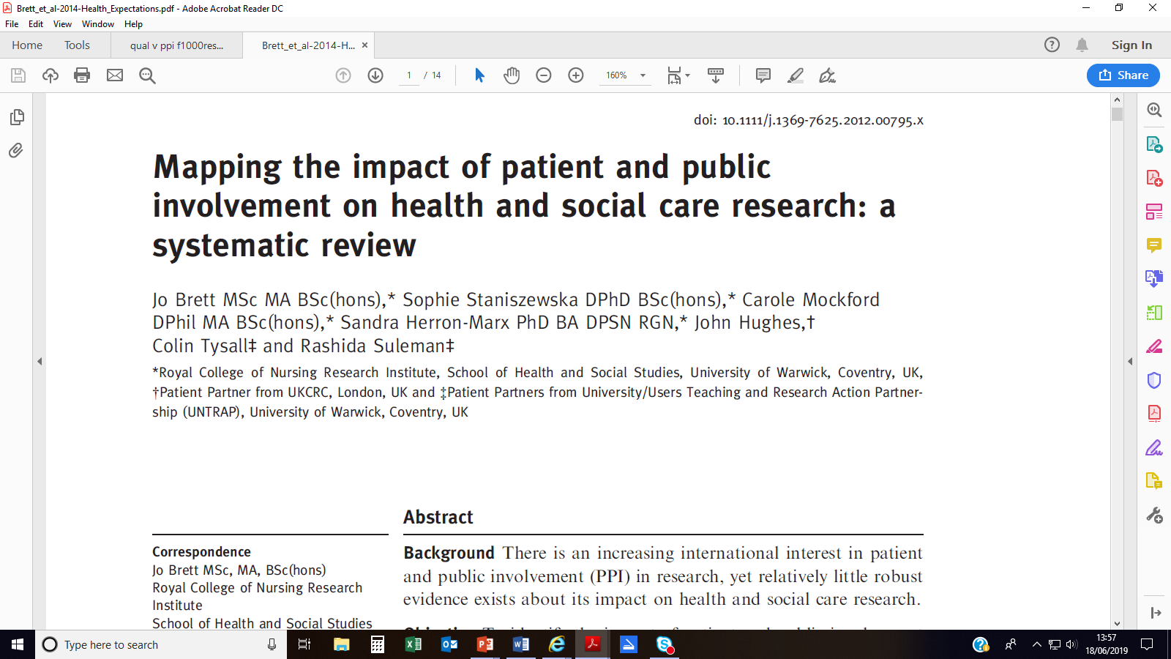

Slide 5
First impressions…
How to do it
Does it work
Service user voice?
How do we measure it

Slide 6
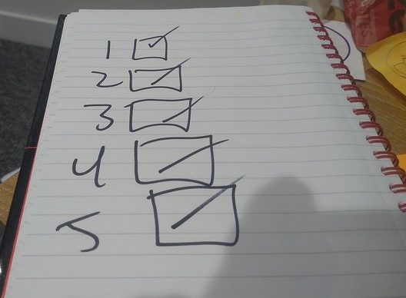
Photo credit: Flickr.com
Photo credit: Flickr.com

Slide 7
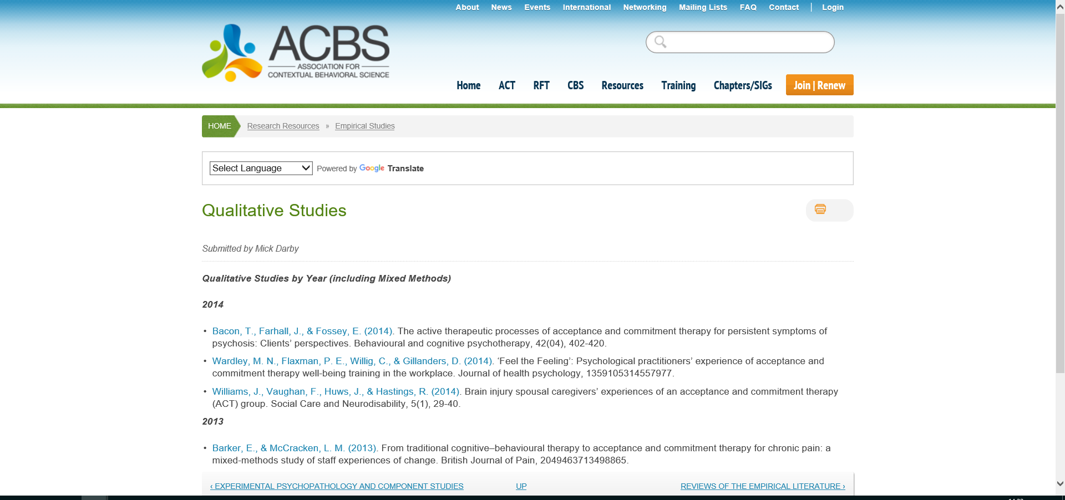
Where is the quali research?

Slide 8
How to do it:
ASK OUR CLIENTS!!

Slide 9
A wider issue …

Slide 10
… particularly in therapy?

Slide 11
Photo credit: Creative Commons

Slide 12
Involvement vs participation

Slide 13
Service user participation

Slide 15
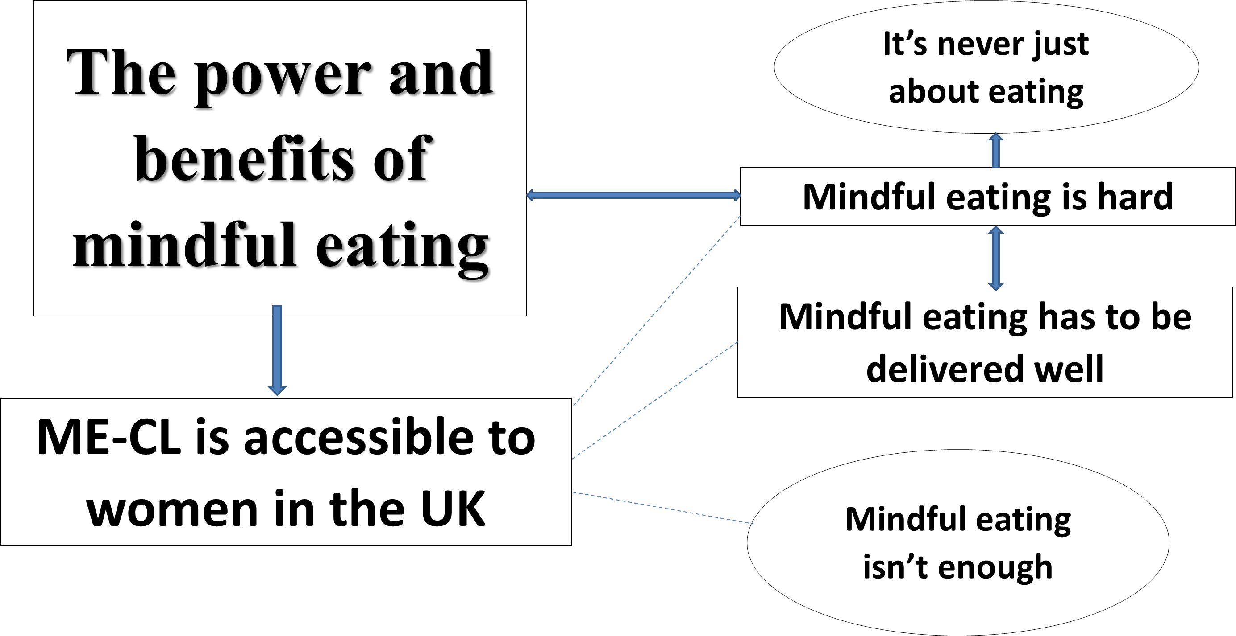

Slide 17
Service user involvement

Slide 18
Involvement + participation
Hoddinott P, Pollock A, O'Cathain A et al. How to incorporate patient and public perspectives into the design and conduct of research [version 1; referees: 1 approved] F1000Research 2018, 7:752 (doi: 10.12688/f1000research.15162.1)

Slide 19
Involvement + participation
Hoddinott P, Pollock A, O'Cathain A et al. How to incorporate patient and public perspectives into the design and conduct of research [version 1; referees: 1 approved] F1000Research 2018, 7:752 (doi: 10.12688/f1000research.15162.1)

Slide 20
Conclusion…
Be Ambitious!! ☺
Christine.Ramsey-Wade@uwe.ac.uk

