Slide 1
Presentation by
What do we know about the experience of women in the twenty-first century who breastfeed beyond twelve months of age?
A systematic review of qualitative evidence
PROSPERO registration number: CRD42019127036
Dr Sally Dowling and Tasha Cooper
June 2019

Slide 2
Introduction
Who we are, why are we working together
Outline of presentation
Notes:
Acknowledge range of fields, conferences are different, going to speak from my experience but hope it will be helpful

Slide 3
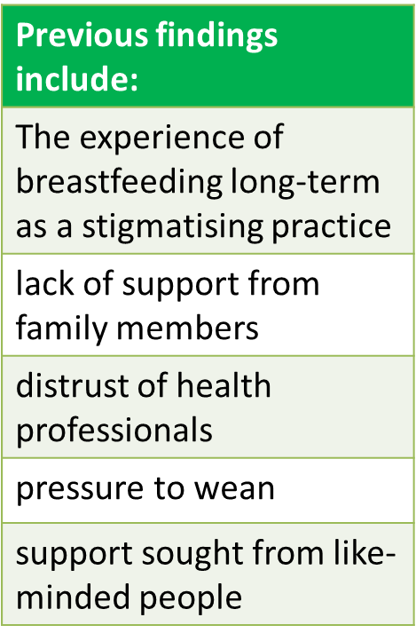
Background - long-term breastfeeding
WHO recommendations – duration (WHO, 2003)
Worldwide only 41% of babies in the richest families are breastfed at aged two (Unicef, 2018).
UK numbers uncertain:
34% of women breastfeeding at six months (McAndrew et al, 2012)
43% of babies were receiving some breastmilk at six months (Scottish Government, 2017).
Existing published research dated/from North America (Morse and Harrison, 1987; Reamer and Sugarman, 1987; Hills-Bonczyk et al., 1994)
Most other more recent research from US/Australia

Slide 4
Background
Why we wanted to undertake this study:
Has the experience of women breastfeeding long-term changed from the larger body of research which took place in the 1980s/1990s?
Long-term breastfeeding seems to be more visible - ‘Time’ magazine cover (Pickert, 2012); ‘brelfies’ (Giles, 2018; Tugwell, 2019); Facebook and blog posts; articles in the popular press.
Has this been reflected in the academic literature and is the experience different to that reported in the pre-2000 literature?
A ‘concept analysis’ (Brockway and Venturato, 2016) examined literature published up to 2013 (‘To report an analysis of the concept of breastfeeding beyond infancy’):
10/24 papers pre-2000 data
different aim
awareness of new research post-2000
Notes:
Acknowledge range of fields, conferences are different, going to speak from my experience but hope it will be helpful
Images and discussion of breastfeeding beyond twelve months have come to seem much more prevalent.

Slide 5
Aims and objectives
Finalised research question:
What do we know about the experience of women in the twenty-first century who breastfeed beyond twelve months of age?
Protocol written and review registered with Prospero (International prospective register of systematic reviews).

Slide 6
Inclusion/exclusion criteria
articles that report qualitative studies exploring the experience of breastfeeding for longer than twelve months
articles which used study designs aimed at understanding and describing experiences.
articles using any terms commonly used to describe breastfeeding duration (extended, long-term, full-term, prolonged, sustained, and variants)
literature based on research/published since 2000.
Only English language papers
articles published prior to 2000
those which use quantitative methods.
those that are predominantly about the experience of early breastfeeding or only about breastfeeding infants under 12 months of age.
reports of personal experiences published on blogs, websites and in publications from breastfeeding support organisations.

Slide 7
Methods – search strategy
Databases selected:
Maternity & Infant Care (MIDIRS)
CINAHL Plus
BND (British Nursing Database)
Medline and PsycInfo
Scopus (for follow-up citation searching)
We used:
truncation to capture all variations of terms and search terms combined using Boolean operators AND and OR.
adjacency operators to restrict the appearance of search terms in Concept 1 and 3 to within two words (N2) and improve the relevance of results.
Notes:
We designed a search strategy which aims to identify all relevant primary research on this topic published in peer-reviewed journals

Slide 8
Methods - search terms
Concept 1 | Concept 2 | Concept 3
Breastfeeding | Experiences | Extended
Breastfe* | Attitudes | Long-term OR ‘long term’
‘Breast fe’* | Perceptions | Full-term OR ‘full term’
‘Infant feeding’ | Views | Sustained
 |  | ‘12 months’
 |  | Prolonged
Adjacency operators used to connect any of the terms in 1 and 3 to appearing within two words o
Sensitivity vs specificity….

Slide 9
Methods – screening and data extraction
502 references imported for screening
155 duplicates removed
346 studies screened against title and abstract
296 studies excluded
50 studies assessed for full-text eligibility
36 studies excluded
13 Wrong study design
7 Not primary research
6 Wrong population
3 Wrong outcomes
2 Duplicate
2 Not English language
1 Wrong intervention
1 data pre-2000
1 full text unavailable
0 studies ongoing
0 studies awaiting classification
8 published studies included
6 studies in press added
Covidence – the standard production platform for Cochrane Systematic Reviews
Freely available as a trial
We used it to import references, title and abstract screening, full-text screening. Data extraction options also available
Reviewers screen separately, conflicts resolved in discussion
PRISMA chart available to export:
Notes:
Something about what we each did? How many we each screened etc? quality processes?

Slide 10
Included papers
Data extracted/quality assessment by TC
Dowling, S., Brown, A. (2013) An exploration of the experiences of mothers who breastfeed long-term: what are the issues and why does it matter? Breastfeeding Medicine 8 (1), pp. 45-52.
Dowling, S., Pontin, D. (2017) Using liminality to understand mothers' experiences of long-term breastfeeding: 'Betwixt and between', and 'matter out of place'. Health, 21 (1), pp. 57-75.
Faircloth, C.R. (2011) 'It feels right in my heart': Affective accountability in narratives of attachment. The Sociological Review, 59 (2), pp. 283-302.
Faircloth, C.R. (2010) 'If they want to risk the health and well-being of their child, that's up to them': Long-term breastfeeding, risk and maternal identity. Health, Risk & Society, 12 (4), pp. 357-367.
Jackson, J., Hallam, J. (2019) 'I felt like I was doing something wrong': key findings of a qualitative exploration of mothers' experiences breastfeeding beyond a year. Journal of Health Visiting, 7 (4), pp. 166-172.
Olanders, M. (2013) Breastfeeding feels so delicate: How mothers of breastfed preschool children experience being treated by preschool teachers. Breastfeeding Review, 21 (3), pp. 45-52.
Sailavaara, J. (submitted 2019) Long-Term Breastfeeding: Mothers’ Embodied Experiences. tbc
Data extracted/quality assessment by SD
Gribble, K.D., (2008) Long-term breastfeeding; changing attitudes and overcoming challenges. Breastfeeding Review, 16 (1), pp. 5-15.
Jackson, J., Hallam, J. (submitted 2019) 'It's quite a taboo subject': An investigation of mother's experiences of breastfeeding beyond infancy and the challenges they face.
Jackson, J., Hallam, J. (submitted 2019) Against all odds: why UK mothers' breastfeeding beyond infancy are turning to their international peers for emotional and informative support. Health Care for Women International, tbc.
Newman, K.L., Williamson, I.R., (2018). Why aren't you stopping now?!' Exploring accounts of white women breastfeeding beyond six months in the East of England. Appetite, 129, pp. 228-235.
Sailavaara, J. (2019) Relational long-term breastfeeding. Journal of Family Studies, tbc.
Stearns, C.A. (2011). Cautionary Tales About Extended Breastfeeding and Weaning. Health Care for Women International, 32 (6), pp. 538-554.
Thompson, A., Jones, L.L. (submitted 2019) 'I believe in natural-term breastfeeding. It's important that people know it's not extended, it's normal': A qualitative exploration of women's experiences of breastfeeding beyond infancy. BMC Pregnancy and Childbirth, tbc.

Slide 11
Data extraction and quality appraisal
14 studies included
9 published
5 in press
Data extracted from all 14 (seven each)
Designed data extraction form
Process carried out outside Covidence
Information about study aims and methods, findings etc.
CASP appraisal tool for qualitative research used to identify any quality issues with the papers (none excluded)
Notes:
Need to say something here or earlier about the papers we found out about outside of the searches
Say something about the quality issues we did find? And why we have included all?
Out of Covidence
rigour

Slide 12
Analysis
Thematic synthesis as outlined by Thomas and Harden (2008)
‘Findings’ or ‘results’ text extracted from each paper and imported into Nvivo for:
line-by-line coding
the organization of these codes into ‘descriptive’ themes
the development of ‘analytical’ themes (‘third order interpretations’ in meta ethnography - Noblit and Hare, 1988; Britten, et al., 2002)
This process is currently underway (SD and TC)
We report here on our preliminary findings; final review will be submitted for publication Autumn 2019.
Notes:
Final step = ‘going beyond’ the content of the original studies

Slide 13
Preliminary findings
Much of what we have found echoes the earlier work:
Long-term breastfeeding becomes more hidden as time goes on, kept within the family, the assumption is made by others that weaning has happened/pressure to wean:
‘Women experienced a contrast in perceived approval for breastfeeding as their baby transitioned from ‘baby’ to ‘toddler’. Participants felt pressured to breastfeed when their babies were young, but pressured to wean as children grew’ (Thompson and Jones, submitted 2019)
Breastfeeding older children ‘routinely stigmatised’…’pressuring and coercive behaviours’ (Newman and Williamson, 2018)
Breastfeeding is ‘an intimate thing that outsiders did not need to know about’ (Sailavaara, submitted 2019)
HCPs are not experienced as supportive:
‘The health visitor wasn’t very nice at all. When my daughter was one she basically said that she needed to go onto cow’s milk and I needed to stop breastfeeding her and she said she will just have to cry herself to sleep’ (Hallam and Jones, 2019)
Previous findings include:
The experience of breastfeeding long-term as a stigmatising practice
lack of support from family members
distrust of health professionals
pressure to wean
support sought from like-minded people
Notes:
Findings discussed here are from a first ‘broad brush’ thematic analysis of the findings as expressed in our data extractions forms; line by line coding is underway and as such, some of what we say may be further developed as we finish our review.
Emphasise that these are just examples; we’ve been looking for themes across the work and these issues come up across the body of work

Slide 14
Preliminary findings
Women who are breastfeeding long-term gain support from like-minded people, from groups like La Leche League and, increasingly, from online sources
Peer support groups were important for participants to feel ‘accepted’ and women were comforted “knowing that other people are doing it”…online groups became increasingly important as children aged (Thompson and Jones, submitted 2019)
Long term breastfeeding is felt to increase closeness and bonding and is talked about as a ‘parenting tool’
Supportive partners, mothers and mothers-in-law are very important (but support from these is not always forthcoming)
Notes:
Give examples of bottom two points:

Slide 15
Preliminary findings - new
New findings include:
Long-term breastfeeding is not always positive.
Long-term breastfeeding can unite and cause tension.
Women who breastfeed long-term can be seen as belonging to sub-culture.
Long-term breastfeeding is related both to being seen as good mother and as deviant mother.
Support from social media is very important.
There are some different/new themes in the work we reviewed:
Long-term breastfeeding is not always experienced as positive; those who breastfeed long-term are not always those who found it easy in early days:
‘This study shows that it is far from the case that long-term breastfeeders are those who have found breastfeeding easy’ Gribble, 2008)
Long-term breastfeeding can be experienced as a tie, even if the mother feels it is right:
‘breastfeeding can challenge the line between the mother as self and the child as the other that is always wanting to suck and demanding something from the mother’ (Sailavaara, submitted 2019)
Long-term breastfeeding can both unite and cause tension in families
Support from social media more important in this body of work
reduces isolation and normalises the practice.
Notes:
Findings discussed here are from a first ‘broad brush’ thematic analysis of the findings as expressed in our data extractions forms; line by line coding is underway and as such, some of what we say may be further developed as we finish our review.

Slide 16
Preliminary findings - new
New findings include:
Long-term breastfeeding is not always positive.
Long-term breastfeeding can unite and cause tension.
Women who breastfeed long-term can be seen as belonging to sub-culture.
Long-term breastfeeding is related both to being seen as good mother and as deviant mother.
Support from social media is very important.
Women who breastfeed long-term can be seen as belonging to sub-culture:
Coming to a new understanding of their social identity is hard for women whose behaviour is discussed negatively in the media or who are unable to talk about it to those around them (Dowling and Pontin, 2017)
Some women came from families where long-term breastfeeding is more usual – a sub-culture (Gribble, 2008)
Long-term breastfeeding is related both to being seen as good mother and as deviant mother:
Breastfeeding tales are cautionary in their warning to mothers that their identity as good mothers may be at stake (Stearns, 2011)
Women who breastfeed ‘to full term’ offer an extreme vantage point…they inhabit an uneasy place between ideological norms…and statistical norms (Faircloth, 2010).

Slide 17
Discussion
Research question: What do we know about the experience of women in the twenty-first century who breastfeed beyond twelve months of age?
In many ways it is very similar to the experience of those who breastfed long-term reported in the earlier literature.
Perhaps more now about the difficulties; more about social media; more about identity
Could reframing long-term breastfeeding as cultural diversity lead to a greater acceptance in society? (supporting long-term breastfeeding can be seen as promoting cultural diversity):
Recognising the importance of a gradual change in attitudes to enable society to adapt (Dowling & Brown, 2013)
Several papers talk about sub-culture (Gribble, 2010; Dowling and Pontin, 2017; Olanders 2013)
We have found a number of papers which reflect research about the experience of long-term breastfeeding in the UK; most of the pre-2000 work was from the US, Canada and Australia.
Notes:
Relate back to previous slides

Slide 18
Challenges/limitations
Finding enough literature!
Decisions around including unpublished work – could we have found more?
Methodological issues – do they matter?
Lack of reflexivity
Missing information
Limitations identified within papers (one locale, for example)
What to do if a paper doesn’t fit the inclusion criteria, but nearly does?
Time
The challenge of synthesising qualitative data

Slide 19
Any questions?
sally.dowling@uwe.ac.uk
References available on request

Slide 20
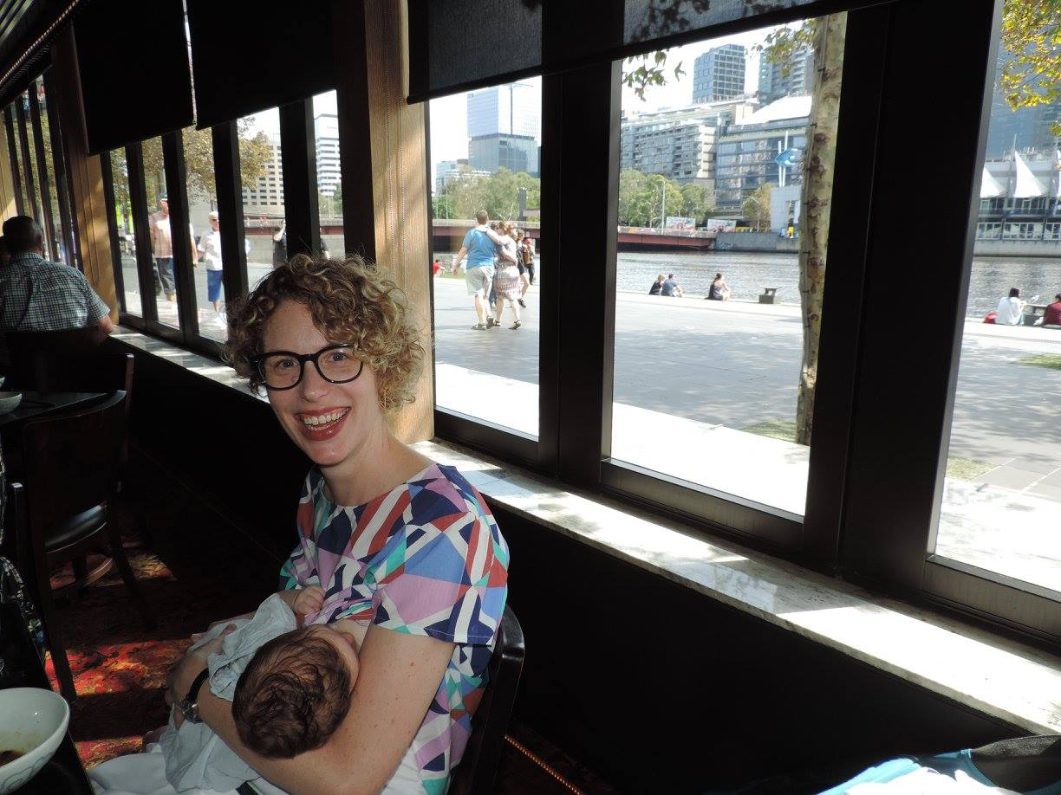
Breastfeeding in public
Thematic Series
Edited by Fiona Giles, Petra Bueskens and Sally Dowling
Authors include:
Fiona Giles, Australia
Elaine Burns & Zoi Triandafilidis, Australia
Martha Paynter & Ellen Snellgrove-Clarke, Canada
Virginia Schmied, Australia
Athena Sheehan & Karleen Gribble, Australia
Fiona Woollard, UK
Lisa Amir, Australia
#OpenAccess – online now!
https://www.biomedcentral.com/collections/BIP
Notes:
Tasha – have added this here for a quick bit of promotion – can’t do it in any other way (flyers etc) as MAINN is heavily associated with another journal

