Slide 1
Managing the Personalization-Privacy Paradox: a Systematic Literature Review
Ming-Wei Hsu
Bristol Business School, University of the West of England
with Professor Glenn Parry and Dr Alex Kharlamov

Slide 2
Tensions arise when using data for personalisation
Privacy
Control over access to personal information
Privacy paradox
People say they are concerned about privacy
……but in practice they share all of their data for free
Personalisation
Better customer satisfaction
Enhanced purchase intention

Slide 3
How do we find balance?
Personalisation-Privacy Paradox
Firms need personal information to provide personalised services
Consumers ‘express’ that they have privacy concerns
In seeking to create a personalised service to gain customers, firms may lose customers
…. and a company having too much insight into us is seen as ‘creepy’
Firms need to deal with the paradox to gain benefits
Research question:
How do organisations best manage the Personalisation-Privacy Paradox?

Slide 4
Systematic Literature Review (SLR)
Stage 1: Planning the review
Scoping work & identification research question
Originally developed in the medical field
Traditional narrative literature review
based on heuristic search
SLR aims to make the review process transparent and as reproducible as possible (Tranfield et al., 2003)
Search in databases (1714 papers)
Stage 2: Conducting the review
Apply quality criteria (309 papers)
Title and abstract review (158 papers)
Full paper review (45 papers)
Descriptive and thematic analyses
Stage 3: Reporting
Reporting and getting evidence into practice

Slide 5
Search criteria
PUT IN YOUR SEARCH TERMS AND DETAILS OF WHAT YOU DID
Construct | Keywords | Source
Personalization | personalization | Lee at al. (2011)
 | personalized | Sutanto (2013)
 | service personalization | Karwatzki et al. (2017)
 | personalization features | Awad and Krishnan (2006)
Privacy | privacy concern | Lee at al. (2011)
 | privacy calculus | Karwatzki et al. (2017)
 | privacy paradox | Baek (2014)(2014)
 | personal information | Karwatzki et al. (2017)
 | information boundary | Sutanto (2013)
 | privacy protection | Lee at al. (2011)
 | privacy policy | Hann et al. (2007)
 | willingness to share | Awad and Krishnan (2006)
Context | digital service | Karwatzki et al. (2017)
 | mobile application | Sutanto (2013)
 | information practices | Lee at al. (2011)
 | trade-off | Hann et al. (2007)
 | Online | Awad and Krishnan (2006)

Slide 6
Descriptive Analysis - Journals
Journal | Discipline | No. of studies
Information Systems Research | Information system | 7
MIS Quarterly | Information system | 7
Journal of Management Information Systems | Information system | 5
Computers in Human Behavior | Information system | 4
Decision Support Systems | Information system | 3
Journal of Marketing | Marketing | 2
Journal of the Association of Information Systems | Information system | 2
Computers and Security | Information system | 1
Expert Systems with Applications | Information system | 1
Information and Management | Management | 1
Information Technology and Management | Information system | 1
Journal of Computer‐Mediated Communication | Information system | 1
Journal of Economic Behavior and Organization | Economic | 1
Journal of Management | Management | 1
Journal of Public Policy & Marketing | Marketing | 1
Journal of Research in Interactive Marketing | Marketing | 1
Journal of social issues | Social | 1
Journal of Strategic Information Systems | Management | 1
Journal of the Academy of Marketing Science | Marketing | 1
Journal of the American Society for Information Science and Technology | Information system | 1
Marketing Science | Marketing | 1
Tourism Management | Management | 1
Total |  | 45

Slide 7
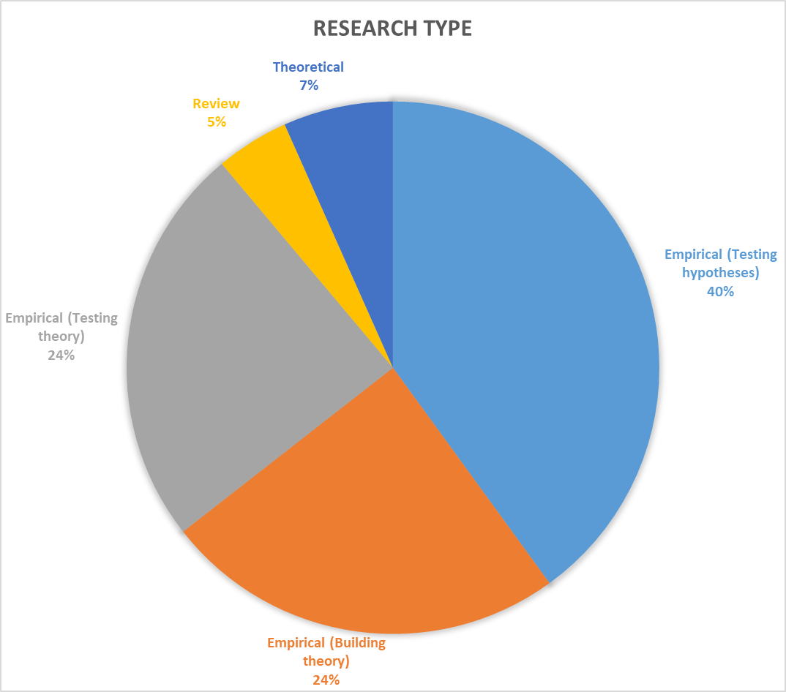
Descriptive Analysis - Research Type

Slide 8
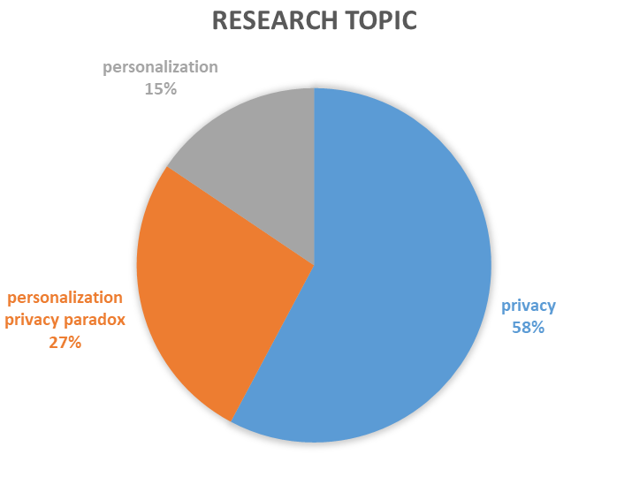
Descriptive Analysis – Research Topic

Slide 9
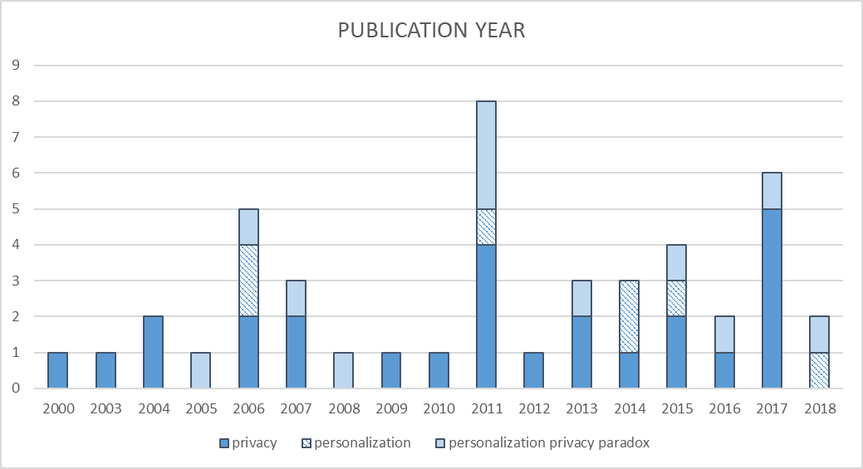
Descriptive analysis – Publication Year

Slide 10
Privacy Theories
Theory | Definitions
Privacy calculus | Individuals rationally calculate benefits and costs on the disclosure of personal information.
Communication privacy management | Individuals develop rules to form boundaries around them based on contextual factors. Concerns are raised if personal information is asked to pass a closed boundary.
Social exchange theory | Personal information is considered as intangible goods. Individuals are willing to disclose personal information when the benefits are good enough to compensate the potential risks.
Social contract theory | Due to the moral agreement between firms and the society, customers are willing to disclose personal information. Firms are responsible to provide privacy protection.
Control agency theory | Privacy concerns are affected by the perceived degree of control which can be performed by self and powerful ones, such as government and industry regulators.

Slide 11
Framework: How Individuals Make Privacy Decisions
General
Context
(e.g. Internet searching, online shopping, medical information and emergent conditions)
Perceived Benefit
Usefulness
Personalized services
Financial benefits
Social benefits
Comparison
Decision
General Privacy Concerns
Inherent need for privacy
Legislation and regulations
Knowledge
Perceived Cost
(Contextual Privacy Concerns)
Risk of data misuse (assessed by privacy policy, industry self-regulation)
Trust
Emotions

Slide 12
Suggestions from Empirical Findings
Privacy policy
Firms need to make privacy policy easy to access and understand
If customers cannot understand a privacy policy easily, their perceived control will decrease, which leads to higher privacy concerns
Usefulness/value
Firms should make their services appear as useful as possible to customers
Privacy calculus: benefit vs. privacy concerns

Slide 13
Suggestions from Empirical Findings – Cont.
Emotion
Negative emotions of privacy concerns mostly come from worry and anxiety about the potential risk in losing control over personal information
Firms need to convince customers that their data are managed in a transparent and well-designed manner
Customers are more willing to share information with those they are familiar or consider trustworthy

Slide 14
Suggestions from Empirical Findings – Cont.
Context
Context-specific privacy concerns may override general privacy concerns
Users have higher privacy concerns when using social media and debit cards than when using email and searching information on the Internet
Experimental results show that users are more willing to share personal information in an emergency context than in non-urgent situations
Higher privacy concerns about personal health information
People with negative emotions toward health status, such as depression and anxiety, are more likely to share personal information

Slide 15
Conclusion
Systematic literature review used to understand personalisation-privacy paradox
Framework proposed based on theories and empirical findings
How Individuals Make Privacy Decisions
Suggestions provided for firms to deal with personalisation-privacy paradox
Make privacy policy easy to access and understand
Improve usefulness and increase value
Avoid negative emotions and maintain trustworthy image
Understand the importance of context

Slide 16
Reference
Karwatzki, S., Dytynko, O., Trenz, M., Veit, D., 2017. Beyond the Personalization–Privacy Paradox: Privacy Valuation, Transparency Features, and Service Personalization. Journal of Management Information Systems 34, 369–400.
Lee, J.-M., Rha, J.-Y., 2016. Personalization-privacy paradox and consumer conflict with the use of location-based mobile commerce. Computers in Human Behavior 63, 453–462. https://doi.org/10.1016/j.chb.2016.05.056
Martin, K.D., Murphy, P.E., 2017. The role of data privacy in marketing. Journal of the Academy of Marketing Science 45, 135–155. https://doi.org/10.1007/s11747-016-0495-4
Tranfield, D., Denyer, D., Smart, P., 2003. Towards a methodology for developing evidence‐informed management knowledge by means of systematic review. British journal of management 14, 207–222.
White, T.B., 2004. Consumer disclosure and disclosure avoidance: A motivational framework. Journal of Consumer Psychology 14, 41–51.
Xu, H., Luo, X., Carroll, J.M., Rosson, M.B., 2011b. The personalization privacy paradox: An exploratory study of decision making process for location-aware marketing. Decision Support Systems 51, 42–52. https://doi.org/10.1016/j.dss.2010.11.017

