Slide 1


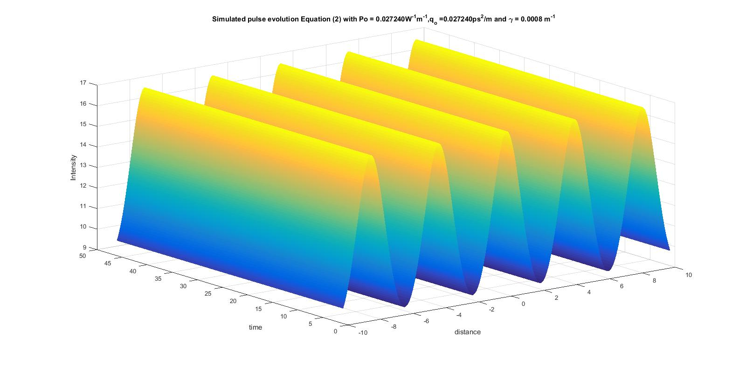
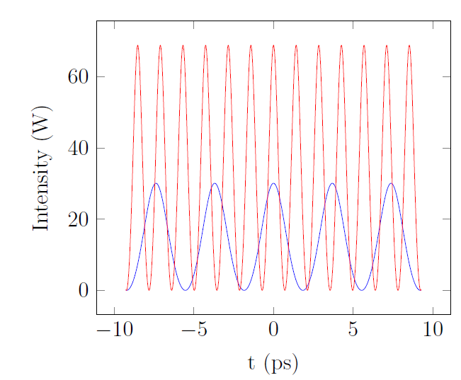
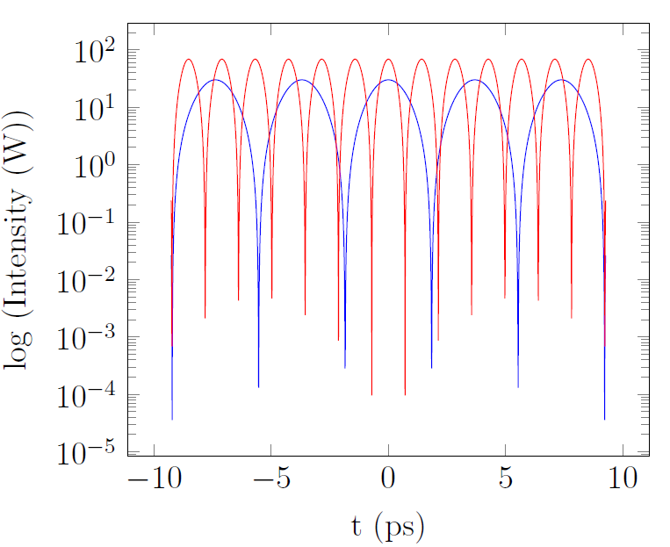
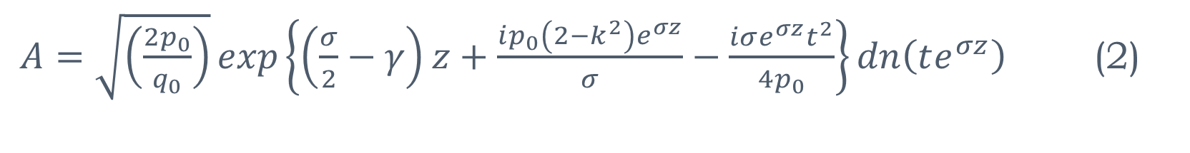
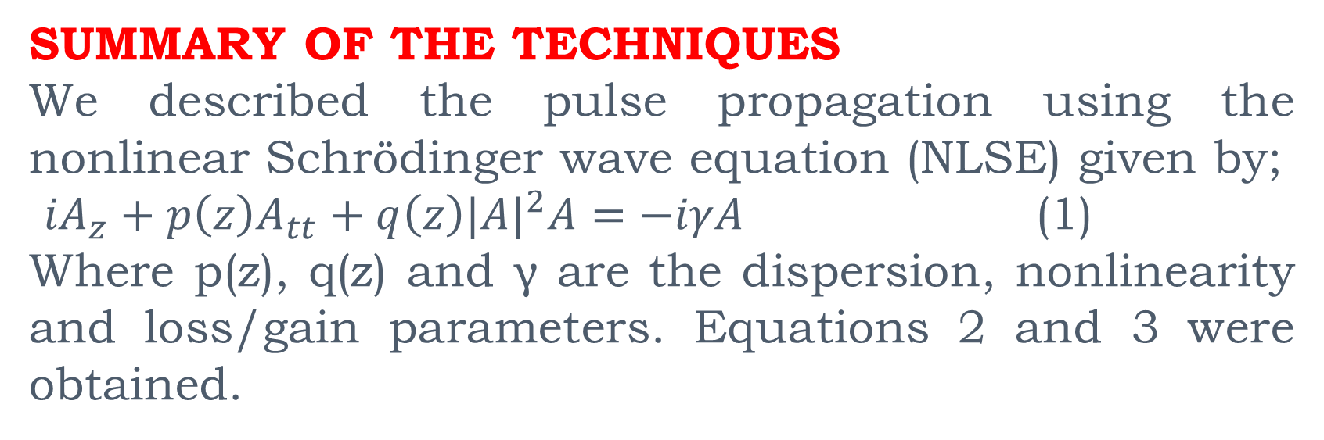
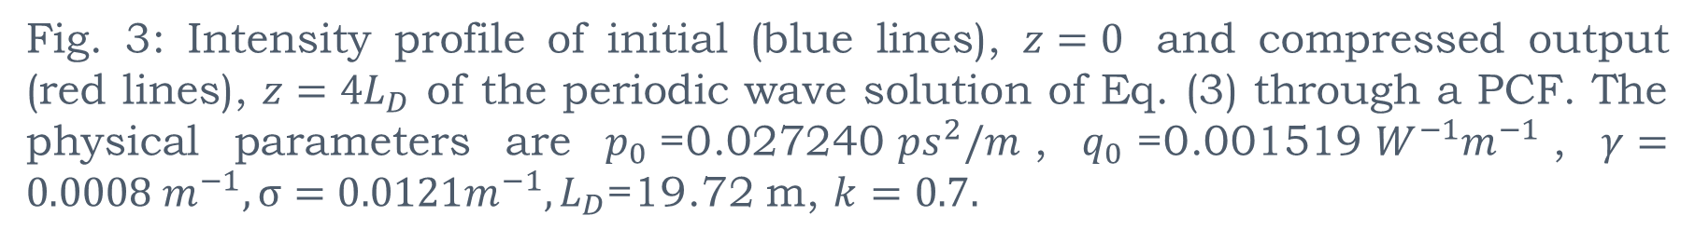
GENERATION OF TRAIN OF ULTRASHORT PULSES (USP) THROUGH THE PROPAGATION OF PERIODIC WAVE THROUGH DISPERSION DECREASING PHOTONIC CRYSTAL FIBERS (PCF)
S.O.Atuba¹, K.Nakkeeran ¹, K.W. Chow², K. Senthilnathan³, P. Ramesh Babu³ and A.Manimegalai³
¹Department of Engineering, Fraser Noble Building, King’s College, University of Aberdeen, Aberdeen AB24 3UE, U.K.
²Department of Mechanical Engineering, University of Hong Kong, Pokfulam Road, Hong Kong
³Photonics, Nuclear and Medical Physics Division, School of Advanced Sciences, VIT University, Vellore, India
INTRODUCTION
The aim of this work is to generate train of USP with high-repetition-rate. High-repetition-rate USP are widely used in optical communication, optical imaging, medicine and modern instrumentation.
METHODOLOGY
We considered a light wave propagation in tapered PCFs wherein the wave propagation is governed by the variable coefﬁcient nonlinear Schrödinger equation (NLSE). We solve it directly by means of the
Hirota bilinear method (using theta function identities )
Self-similar analysis
For both approaches, exact chirped periodic waves were obtained. These waves demand the exponentially varying dispersion and nonlinearity. We arrived at similar expressions with both techniques.
Fig 2. Pulse evolution for Eq. 1. The physical parameters are $p_{0}$=0.027240${ps}^{2}/m$, $q_{0}$=0.001519$W^{−1}m^{−1}$, $γ=0.0008 m^{−1}$
PHYSICAL APPLICATION
SUMMARY OF THE TECHNIQUES
We described the pulse propagation using the nonlinear Schrödinger wave equation (NLSE) given by;
${iA}_{z}+p\left(z\right)A_{tt}+q\left(z\right){|A|}^{2}A=−iγA$(1)
Where p(z), q(z) and γ are the dispersion, nonlinearity and loss/gain parameters. Equations 2 and 3 were obtained.
The model is used to generate ultrashort pulses without pedestals (See Fig 3. below).
$A=\sqrt{\left(\frac{2p_{0}}{q_{0}}\right)}exp\left\{\left(\frac{σ}{2}−γ\right)z+\frac{ip_{0}\left(2−k^{2}\right)e^{σz}}{σ}−\frac{iσe^{σz}t^{2}}{4p_{0}}\right\}dn\left(te^{σz}\right)$ (2)
$A=k\sqrt{\left(\frac{2p_{0}}{q_{0}}\right)}exp\left\{\left(\frac{σ}{2}−γ\right)z+\frac{ip_{0}\left(2k^{2}−1\right)e^{σz}}{σ}−\frac{iσe^{σz}t^{2}}{4p_{0}}\right\}cn\left(te^{σz}\right)$ (3)
Fig. 3: Intensity profile of initial (blue lines), $z=0$ and compressed output (red lines), $z=4L_{D}$ of the periodic wave solution of Eq. (3) through a PCF. The physical parameters are $p_{0}$=0.027240${ps}^{2}/m$, $q_{0}$=0.001519$W^{−1}m^{−1}$, $γ=0.0008 m^{−1}, σ=0.0121m^{−1}, L_{D}$=19.72 m, $k=0.7.$
At long wave limits (when k→1), solitary waves
of bright and dark components can be realised.
ANALYSIS/SUMMARY
These exact solutions are called chirped periodic waves and possess linear chirp in contrast to conventional periodic waves.
This proposed technique generates a repetition rate of 1THz and has a compression factor of approx. 1.9924.
To generate these waves, the loss coefficient has to be the same as the exponential growth rate of the nonlinearity.
4. These chirped periodic waves facilitate two-stage dynamics of wave evolution;
In the initial stage of evolution, linear effect is predominant, hence this process results in quasi-linear compression.
In the final stage, the nonlinear effect turns much pronounced compared to the linear effect. Therefore undergoing nonlinear compression.
DESIGNING TAPERED PCF USING HBT CONDITIONS
1a
1b
Fig. 1a. Structure of the proposed single mode tapered Octagonal PCF of silica core TPCF with air to hole diameter (d/Λ)= 0.4 and pitch (Λ)=3.35μm.
Fig. 1b. Mode ﬁeld distribution of the proposed single mode tapered octagonal PCF of silica core TPCF with air to hole diameter (d/Λ) = 0.4 and pitch (Λ)=3.35μm.
The proposed model design is shown in Figure 1.
Figure 2 shows how stable the train of waves are as they propagate in the fiber.
CONCLUSION
This proposed technique can generate a high-repetition rate with negligible pedestal.
ACKNOWLEDGEMENTS
This work is supported by TETFUND Nigeria.

