Slide 1
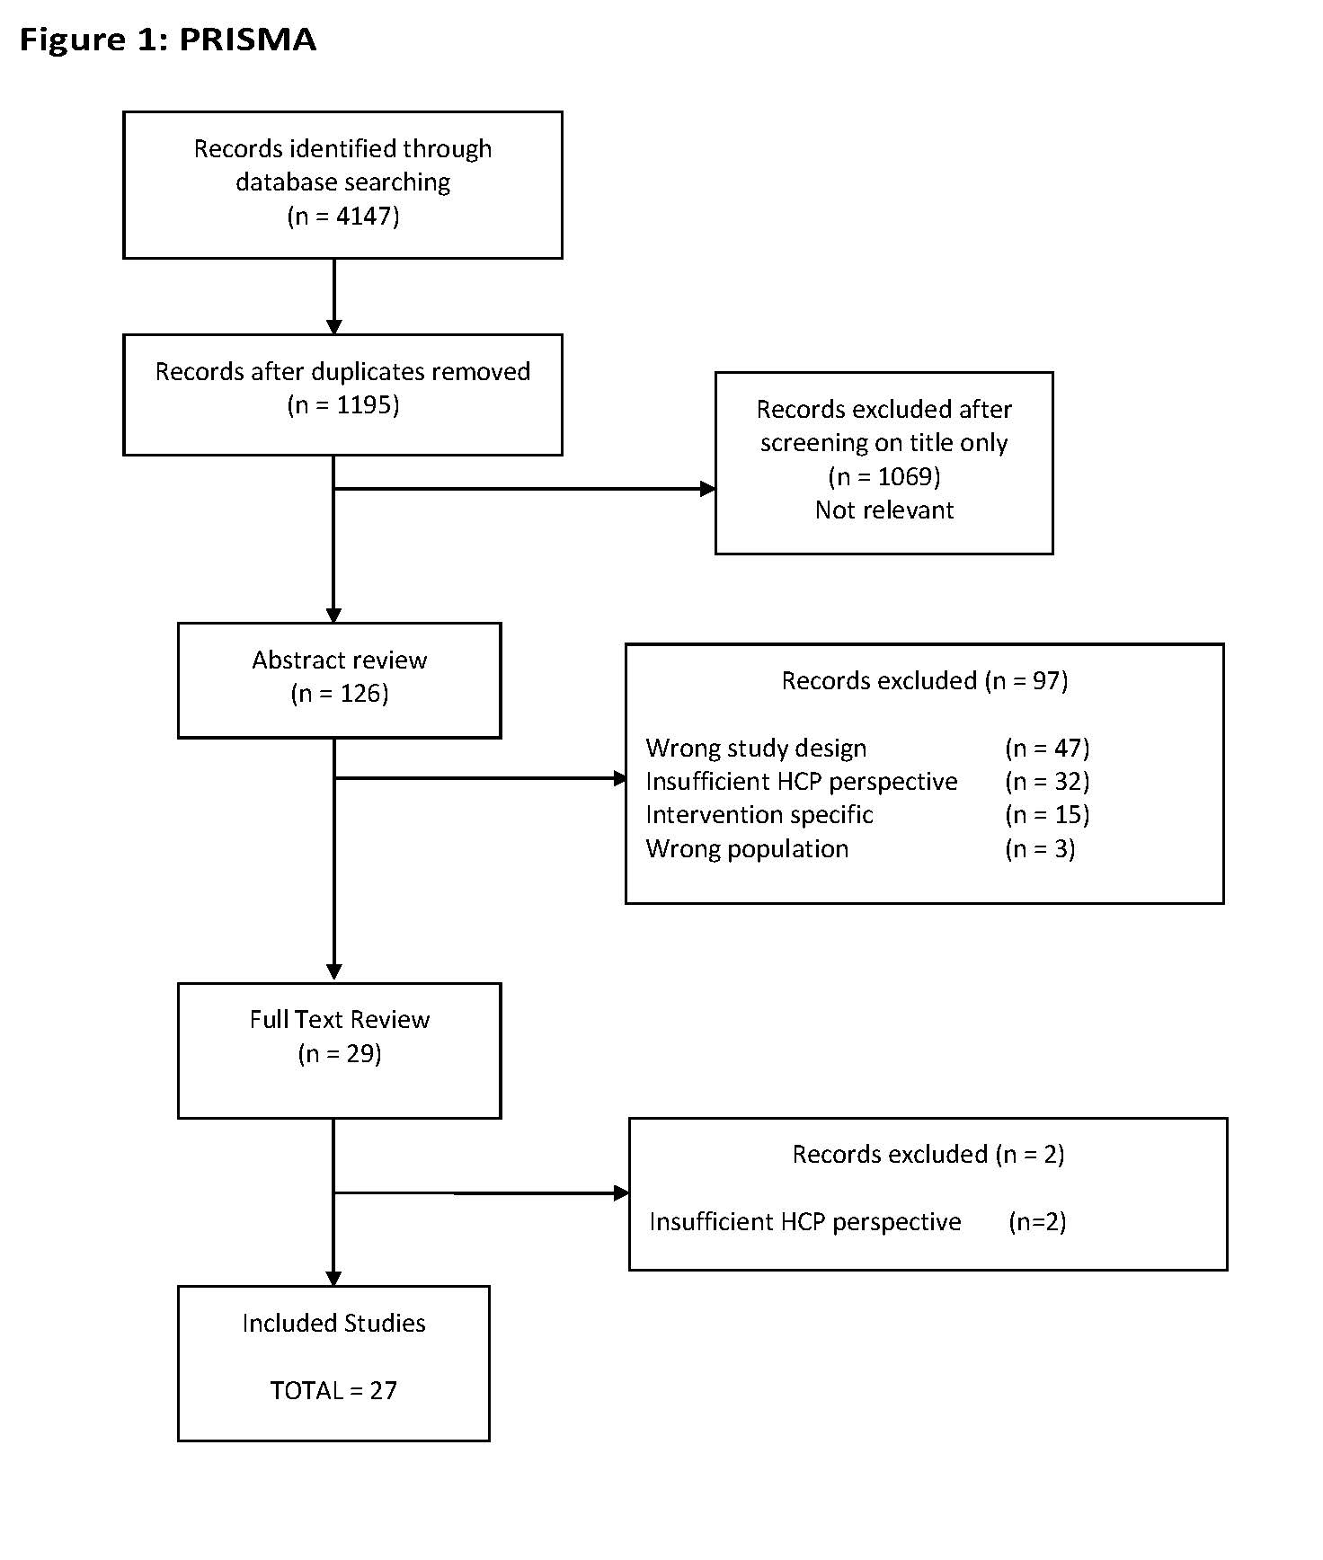
‘Use it or lose it’ vs ‘It’s just your age’ Experiences of healthcare professionals delivering exercise advice for people with musculoskeletal conditions: A Systematic Literature Review Alice Berry¹, Sam Pilkington¹, Michelle Griffiths¹ ¹School of Health and Social Wellbeing, University of the West of England, Bristol, UK.
Alice.berry@uwe.ac.uk
Background
Musculoskeletal (MSK) conditions affect over 20 million people (UK). Physical activity (PA) is recommended as a primary treatment to improve strength and mobility, yet high numbers of people with MSK conditions are inactive (1). People with MSK conditions report a lack of confidence, knowledge, and skills about what PA is appropriate (2). Healthcare professionals (HCPs) provide advice about PA; therefore, HCP attitudes and beliefs may play an integral part in PA messaging (3).
Aim: To explore the perspectives of HCPs in delivering PA messaging to patients with MSK conditions.
Methods
Databases were searched up to July 2024. PRISMA guidelines were followed (Figure 1). Studies were included if they included HCP belief, perspective, experience, motivator or barrier regarding PA advice. Conference proceedings, studies utilising asynchronous communication, intervention studies, and reviews were excluded. Titles and abstracts were screened for relevance and eligibility by two reviewers . Full texts of included studies were appraised by two reviewers.
Results
Some HCPs lack confidence (GPs have less confidence and see physiotherapists as the experts).
Lack of knowledge of shared decision-making resources and specific guidance.
Inadequate communication skills for building effective person-centred therapeutic relationships.
Facilitating PA engagement difficult due to personal, social and system level barriers (patient buy-in, misconceptions around pain, lack of motivation, previous experience, expectations, enjoyment of PA, knowledge of local services).
Need to increase awareness regarding the benefits of both strengthening and aerobic exercise (balance between functional restoration and long-term PA for wellbeing and self-management).
Training needs in communication skills and motivational interviewing, to build trust and reduce fear.
Demystifying cultural norms around PA.
Conclusions
Findings highlight factors impacting PA messaging delivered by HCPs. A greater understanding of the barriers/enablers to delivering effective PA messaging provides guidance for future HCP support and training.
References
Versus Arthritis (2023) The State of Musculoskeletal Health 2023
https://doi.org/10.1002/14651858.CD010842.pub2
https://doi.org/10.1016/j.pain.2007.11.010

