Slide 1
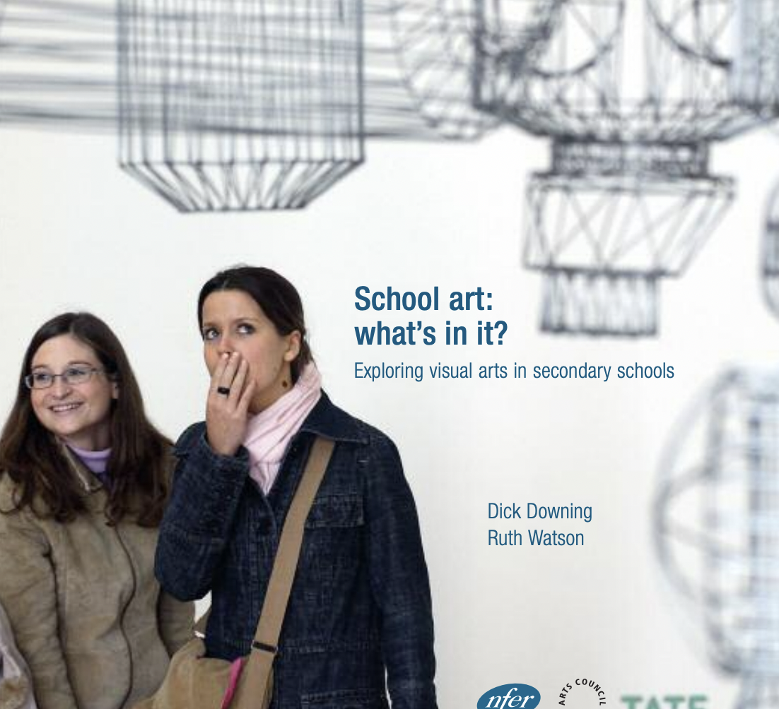
School Art 2004
A tendency towards a narrow historical canon
An emphasis on the ‘formal elements’ as ‘foundational’
A focus on skills over content.
Notes:
WILL
In 2004 Arts Council England, Tate and the National Foundation for Educational Research (NFER) funded a year long qualitative study to ascertain the content of the art curriculum in English schools at KS3 and KS4.
The research had 3 main objectives
To portray the salient contents and foci of ‘school art’ at Key stage 3 and 4, including a depiction of any programmes involving contemporary art practice
To identify factors and strategies that inhibit and facilitate the inclusion of contemporary art practice in the school curriculum
To explore the potential of contemporary art practice to make a distinctive contribution to the art curriculum and pupils learning.
The study involved a sample of 10 randomly selected schools and eight other schools identified by the research sponsors as incorporating contemporary art practice in their curriculum. In total 54 teaching staff were interviewed across the 18 schools about their curriculum design and content, and their perception of the factors affecting curriculum choice.
Their findings were:
A tendency towards a narrow historical canon
An emphasis on the ‘formal elements’ as ‘foundational’
A focus on skills over content.

Slide 2
School Art 2024:
Compliant Conciliation Or A Quiet Revolution?
How have twenty years of social change, and associated educational policy and practice positioning, impacted the taught content of the art and design curriculum?
Do the curriculum choices of art and design teachers reflect a compliant conciliation with the previous government’s anti-progressive agenda, or do they represent a quiet revolution that provides foundation for transformative art and design in schools?
Notes:
WILL
2024 marks the 20 year anniversary of publication of the School Art Report. In Autumn of 2023 Will Grant, Jo Fursman, Carol Wild had a tentative conversation about the idea of recreating the study 20 years on.
This was prompted by the continuing reference to the report in student essays on the PGCE courses we both ran and the significance of the report as a touch stone, in different ways, for each of us in our own research career. It was also prompted by our close engagement with art departments through our own student teachers and our shared feeling that whilst much may be the same in the teaching of art and design in schools as in 2004 there was also much that was different. These two questions, particularly intrigued us.
We agreed that the School Art Research Design provided an effective way to try to answer them.

Slide 3
36 Art & Design Teachers Interviewed
Inc. 16 Heads Of Department
Notes:
WILL
It did not seem necessary to have a focus on contemporary art practice in the same way as Downing and Watson’s study – the extent to which cotemporary art practice had infiltrated the curriculum generally was more interesting to us. We also did not set out to interview every art teacher in each department – and set our sights on interviewing teachers across a greater range of schools that Downing and Watson did. In total we interviewed Art and Design teachers from 33 schools in the West of England, the Midlands, Warwickshire, Oxfordshire, Milton Keynes, Cambridgeshire, and London – not a national picture, but a broad and balanced sample.
What was notable about the original report was that although it was a qualitative study and therefore it was interpretive in its scope, it was written in a very analytical ‘objective’ style – it simply presented their findings with very little speculative interpretation of their data. Perhaps the longevity of this report as a resource for researchers and students (alongside the lacuna of many alternative sources) has been the sense that it provides a relatively stable interpretation of curriculum content and teachers’ perceptions of that content at a moment in time, rather than promoting any theoretical positionality.
We are, in writing up our work, aiming to take a similar approach.
However, in presenting some of our initial findings today we want to take the opportunity to allow ourselves a little more speculation around the idea of change and struggle – and how the arena of struggle with regards curriculum choice extends beyond the walls of any art department. This is particularly true in the English context which has emerged since 2004, now often defined by very large, autonomous educational providers with multiple sites, and an increasingly centralised policy-construction space.

Slide 4
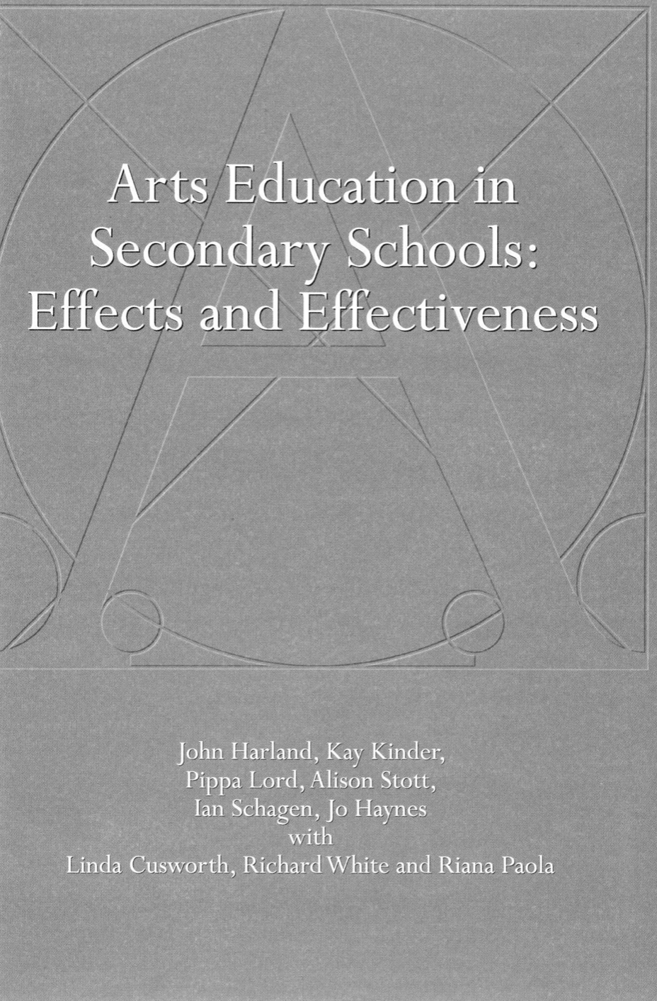
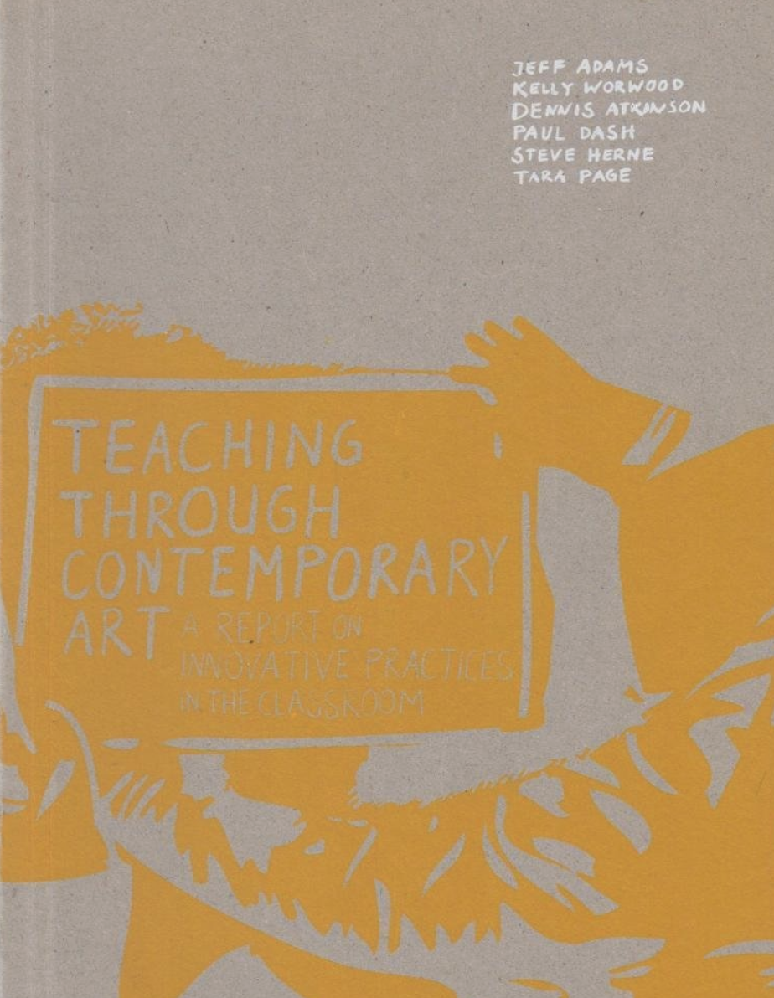
School Art 2004
Took place in a climate where it ‘felt’ like Arts Education was valued and was part of the ‘zeitgeist’
Notes:
CAROL
Because in conducting a comparative study, 20 years on, we naturally introduced an additional lens through which to consider the art and design curriculum – that of change. Each of us have lived through the last twenty years firstly as teachers in English classrooms, then moving into teaching teachers in Higher Education contexts in England, completing PhDs and establishing ourselves as researchers in the field – and are therefore very aware of the huge shifts that have taken place that have impacted on the teaching of the Subject of Art and Design in secondary schools.
The original School Art research took place at a time when it felt (in contrast to the last decade) that Art Education was valued and was part of the ‘zeitgeist’. It came off the back of the influential Harland et al report Arts Education in Secondary Schools: Effects and Effectiveness. And initiated the Goldsmiths, Tate, and National Endowment for Science, Technology and the Arts (Nesta) 2008 study ‘Teaching Through Contemporary Art: A report on innovative practices in the classroom. It was therefore one of three large-scale studies in the first 8 years of this century that confidently described the power of what innovative art and design education could do.

Slide 5

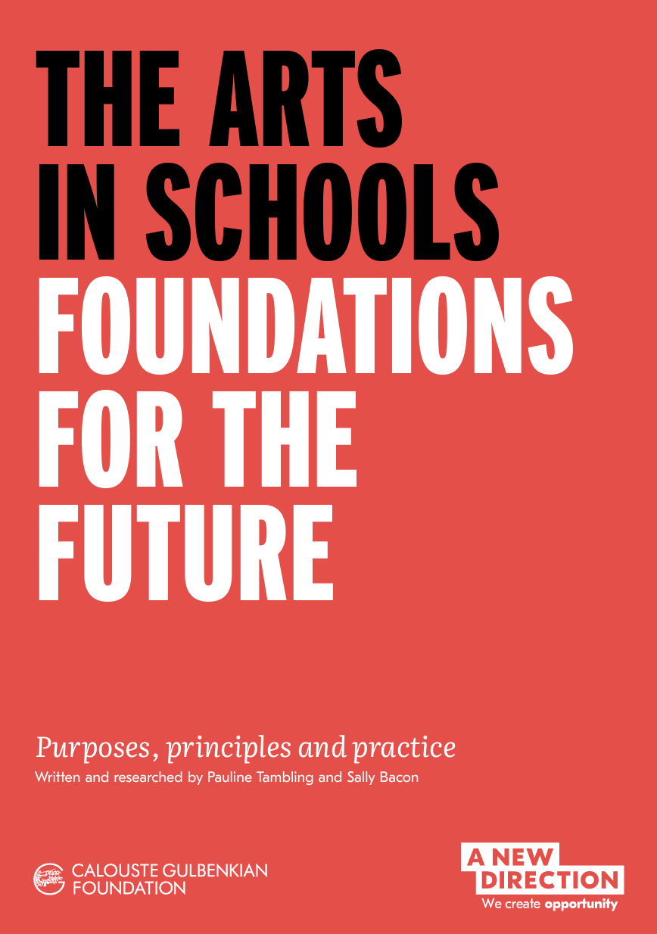

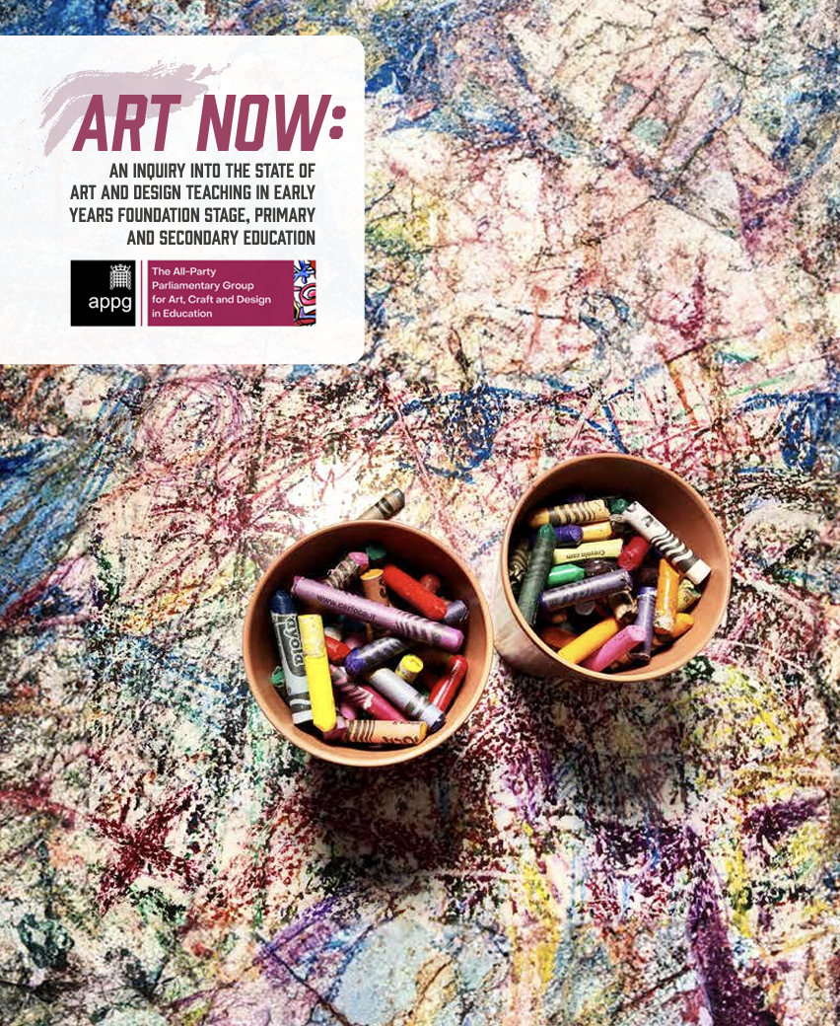
School Art 2024
Since 2024, much has changed politically, economically, and culturally
English society is arguably more liberal than twenty years ago
But simultaneously riven by the rhetoric of divisive culture wars.
Notes:
CAROL
In contrast – only two major funded research studies (that we are aware of) since 2008 have focused specifically on the teaching of Art & Design. The amazing TALE (Tracking Arts Engagement and Learning) was funded by ACE, Tate, the RSC and the University of Nottingham. Its Time to Listen report is a powerful advocacy document that is framed by the policy climate within which it was conducted I which its focus is very much NOT in line with the policy zeitgeist – recommendations include such things as making sure the school timetable makes it possible for students to choose arts options and that specialist teachers are employed to teach arts subjects (these things were assumed to be a given by the previous reports mentioned) and it includes a section on barriers to engagement (including government accountability measures, the idea of ‘facilitating subjects’, recent changes to the examination and pressure on time and budgets.
The equally amazing Visualise Report funded by the Freelands Foundation and the Runnymede Trust also begins by framing itself against a background of decline, referring to ‘plummeting’ GCSE entries and numbers of individuals choosing to train to teach the subject in secondary schools.
These two major studies are supported by other reports such as Arts in `Schools: Foundation for the Future and the Art Now APPG report that read as if the teaching of art and design is under threat.

Slide 6
Bernstein’s Struggle – The Pedagogic Device
How have twenty years of social change, and associated educational policy and practice positioning, impacted the taught content of the art and design curriculum?
Do the curriculum choices of art and design teachers reflect a compliant conciliation with the previous government’s anti-progressive agenda, or do they represent a quiet revolution that provides foundation for transformative art and design in schools?
Notes:
CAROL
The zeitgeist is very different in 2024 than it was in 2004. There is not time here to go into the very many policy changes that have led to this hostile environment – we are confident that most of you will be aware of them.
These changes that we are all aware of and also the recent change of government with its (hopefully) more positive rhetoric towards Art & Design can be understood by Bernstein’s concept of the ‘pedagogical device’
Here I am paraphrasing an extract from my recent chapter in A Practical Guide to Teaching Art and Design
BERNSTEIN’S PEDAGOGIC DEVICE
Bernstein’s premise is that sociological work in the field of education tends to pathologise relations, to identify ‘syndromes’ (the notion of ‘School Art’ as defined by the 2004 report may be such an example). He argues that, in focusing on school as a ‘pathological’ device, such studies neglect to examine the structure that creates or enables the syndrome, (Bernstein 2000, p.29); this enabling structure he calls the pedagogic device.
He describes the device as composed of three interacting fields: the field of production, the field of recontextualisation and the field of reproduction. Knowledge created in the productive field of research (the university) is selectively appropriated by agents of the official recontextualising field (government education departments and associated organisations) and the pedagogic recontextualising field (university education departments and specialised educational media) for relocation, refocusing and reproduction in school. This process separates knowledge from its social and power relations and is a site of struggle involving the ‘play of ideology’ (1990, p.180), no matter whether ‘the dominant principles of a given society celebrate capitalist, collective, or dictatorship ideologies’ (1990, p.194). The struggle of recontextualisation functions to make the knowledge to be transmitted ‘safe’, ensuring it serves rather than undermines the interests of the powerful (1990, p.192), separating it from its initial meaning and redirecting it to stand for something other than itself. This decontextualisation, relocation, refocusing and making safe, therefore, transforms and distorts the knowledge so that it ‘may not obviously correspond to the ‘original’ knowledge it derives from’ and ‘may not appear to be ‘authentic’
(Wild 2022, p.86). Significantly, it is not just some knowledge that goes through this process in school but all knowledge. The pedagogic device is not however a static model but a process of change. Bernstein explores the gradual efforts of government to change the orientation of the pedagogic device (e.g. reducing the powers of the ‘pedagogic recontextualisation field’ of teacher education).
We therefore want to resist the pathologizing of the last twenty years in cancerous terms (seeing the narrow orthodoxies of ‘School Art’ as a tumour that must be cut out of art education somehow) and see it more in terms of a struggle at the heart of the pedagogic device. And to ask to what extent has that struggle been successful in changing what goes on in the secondary art and design classroom.

Slide 7
The Struggle for Art & Design education
Creativity
Artist Teacher
Contemporary Practice
Boys’ Participation
Decolonisation
Anti-ableism
Ecopedagogies
Facilitating Subjects
Knowledge Rich Curriculum
Cognitive Science
Exam boards – the ‘wow’ drawing
OFSTED
  Curriculum Intent
  Cultural Capital
Notes:
CAROL
On this slide we have mapped out the different areas of interest for those with vested interests in the field of recontextualization – that we are aware of through our review of literature, and through our engagement in that field ourselves.
On the left we have the concerns of what Bernstein called the Pedagogic Recontextualising Field (University education departments / NSEAD etc) – with the top two priorities that informed the discourse of that field during the noughties (AT and CP) when there appeared to be alignment with the ‘official’ recontextualizing field and then below that the priorities that arguably are increasingly prevalent now. – when, as we have already stated there is more of a disconnect.
So, then on the right we have the priorities of the ‘official’ recontextualizing field over the last 14 years.
Facilitating Subjects
Knowledge Rich Curriculum
Cognitive Science
Exam boards – the wow drawing
OFSTED
Curriculum Intent
Cultural Capital

Slide 8
How long have you been teaching?
How long have you been teaching (2024)?
Category | no. | %
1-3 years | 8 | 22%
4-6 years | 6 | 17%
7-10 years | 2 | 6%
11-20 years | 12 | 33%
21+ years | 8 | 22%
Total | 36 | 100%
Notes:
WILL
To what extent will the teachers we interviewed have been exposed to these various ‘interests’ of the recontextualizing field over their careers?

Slide 9
Artist TEACHERS? (HOW DIFFERENT TO 2004?)
Do you consider yourself a practising artist (2024)?
Category | no. | %
Strong Yes | 16 | 44%
Yes | 5 | 14%
Maybe | 2 | 6%
No | 3 | 8%
Strong No | 10 | 28%
26% in 2004 compared to 58% in 2024
Right now, I feel almost like a practicing artist in sabbatical…
Teacher of art, South London school
I don’t pretend to make anything that might have a commercial value…I’m not applying to be exhibited.
Teacher of art, Birmingham school
Notes:
WILL
One notable difference between the teachers involved in our study compared to those interviewed by Downing and Watson is the number that stated that they considered themselves to be a practicing artist – with some individuals explicitly referencing concepts of the Artist/Teacher. In 2004 – the Artist Teacher Scheme was only 5 years old and so its influence was perhaps not yet felt widely across the profession. Although funding for the scheme ended just after 2020 – the growth in the numbers of teachers claiming an artist identity perhaps points to an (as yet) still enduring legacy.
Where teachers denied an artistic identity, this was frequently expressed as a temporary abandonment or pause in activity – ‘not currently’, ‘less so this year’, or:
Right now, I feel almost like a practicing artist in sabbatical…
Teacher of art, South London school
Others made explicit distinctions between their own art-making activity (variously classified as professional development, therapy, or hobbyist) and the conditions that would give them confidence to self-identifying as ‘actual’ artists:
I don’t pretend to make anything that might have a commercial value…I’m not applying to be exhibited. Teacher of art, Birmingham school
However, the fact that over half of our interviewees did claim an artistic practice (of whatever kind) is notable given the lack of time, space and value afforded to teachers by their school managers for such activity. From research conducted elsewhere (Wild 2022; Matthews 2019) we know that claiming an Artist identity can be a resistant / political act by art and design teachers and we speculate that the prevalence of ‘artist teachers’ in our study may somehow be linked to such a transgressive phenomenon.

Slide 10
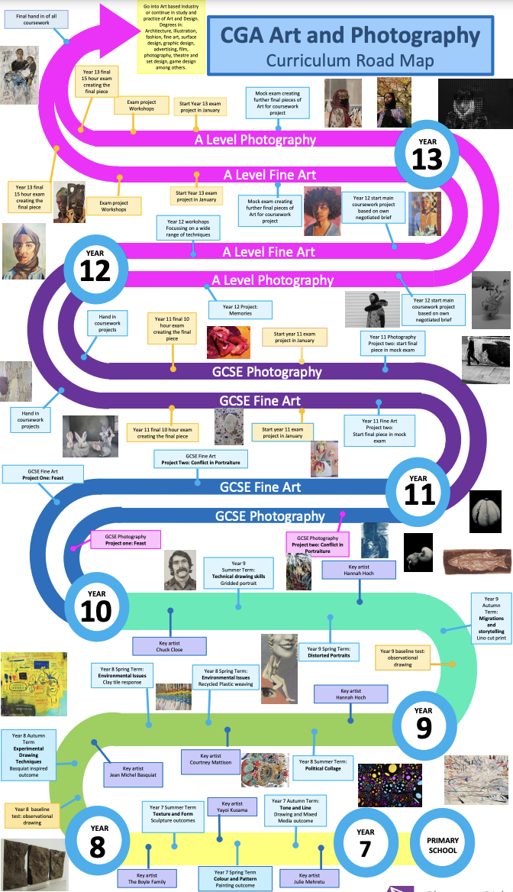
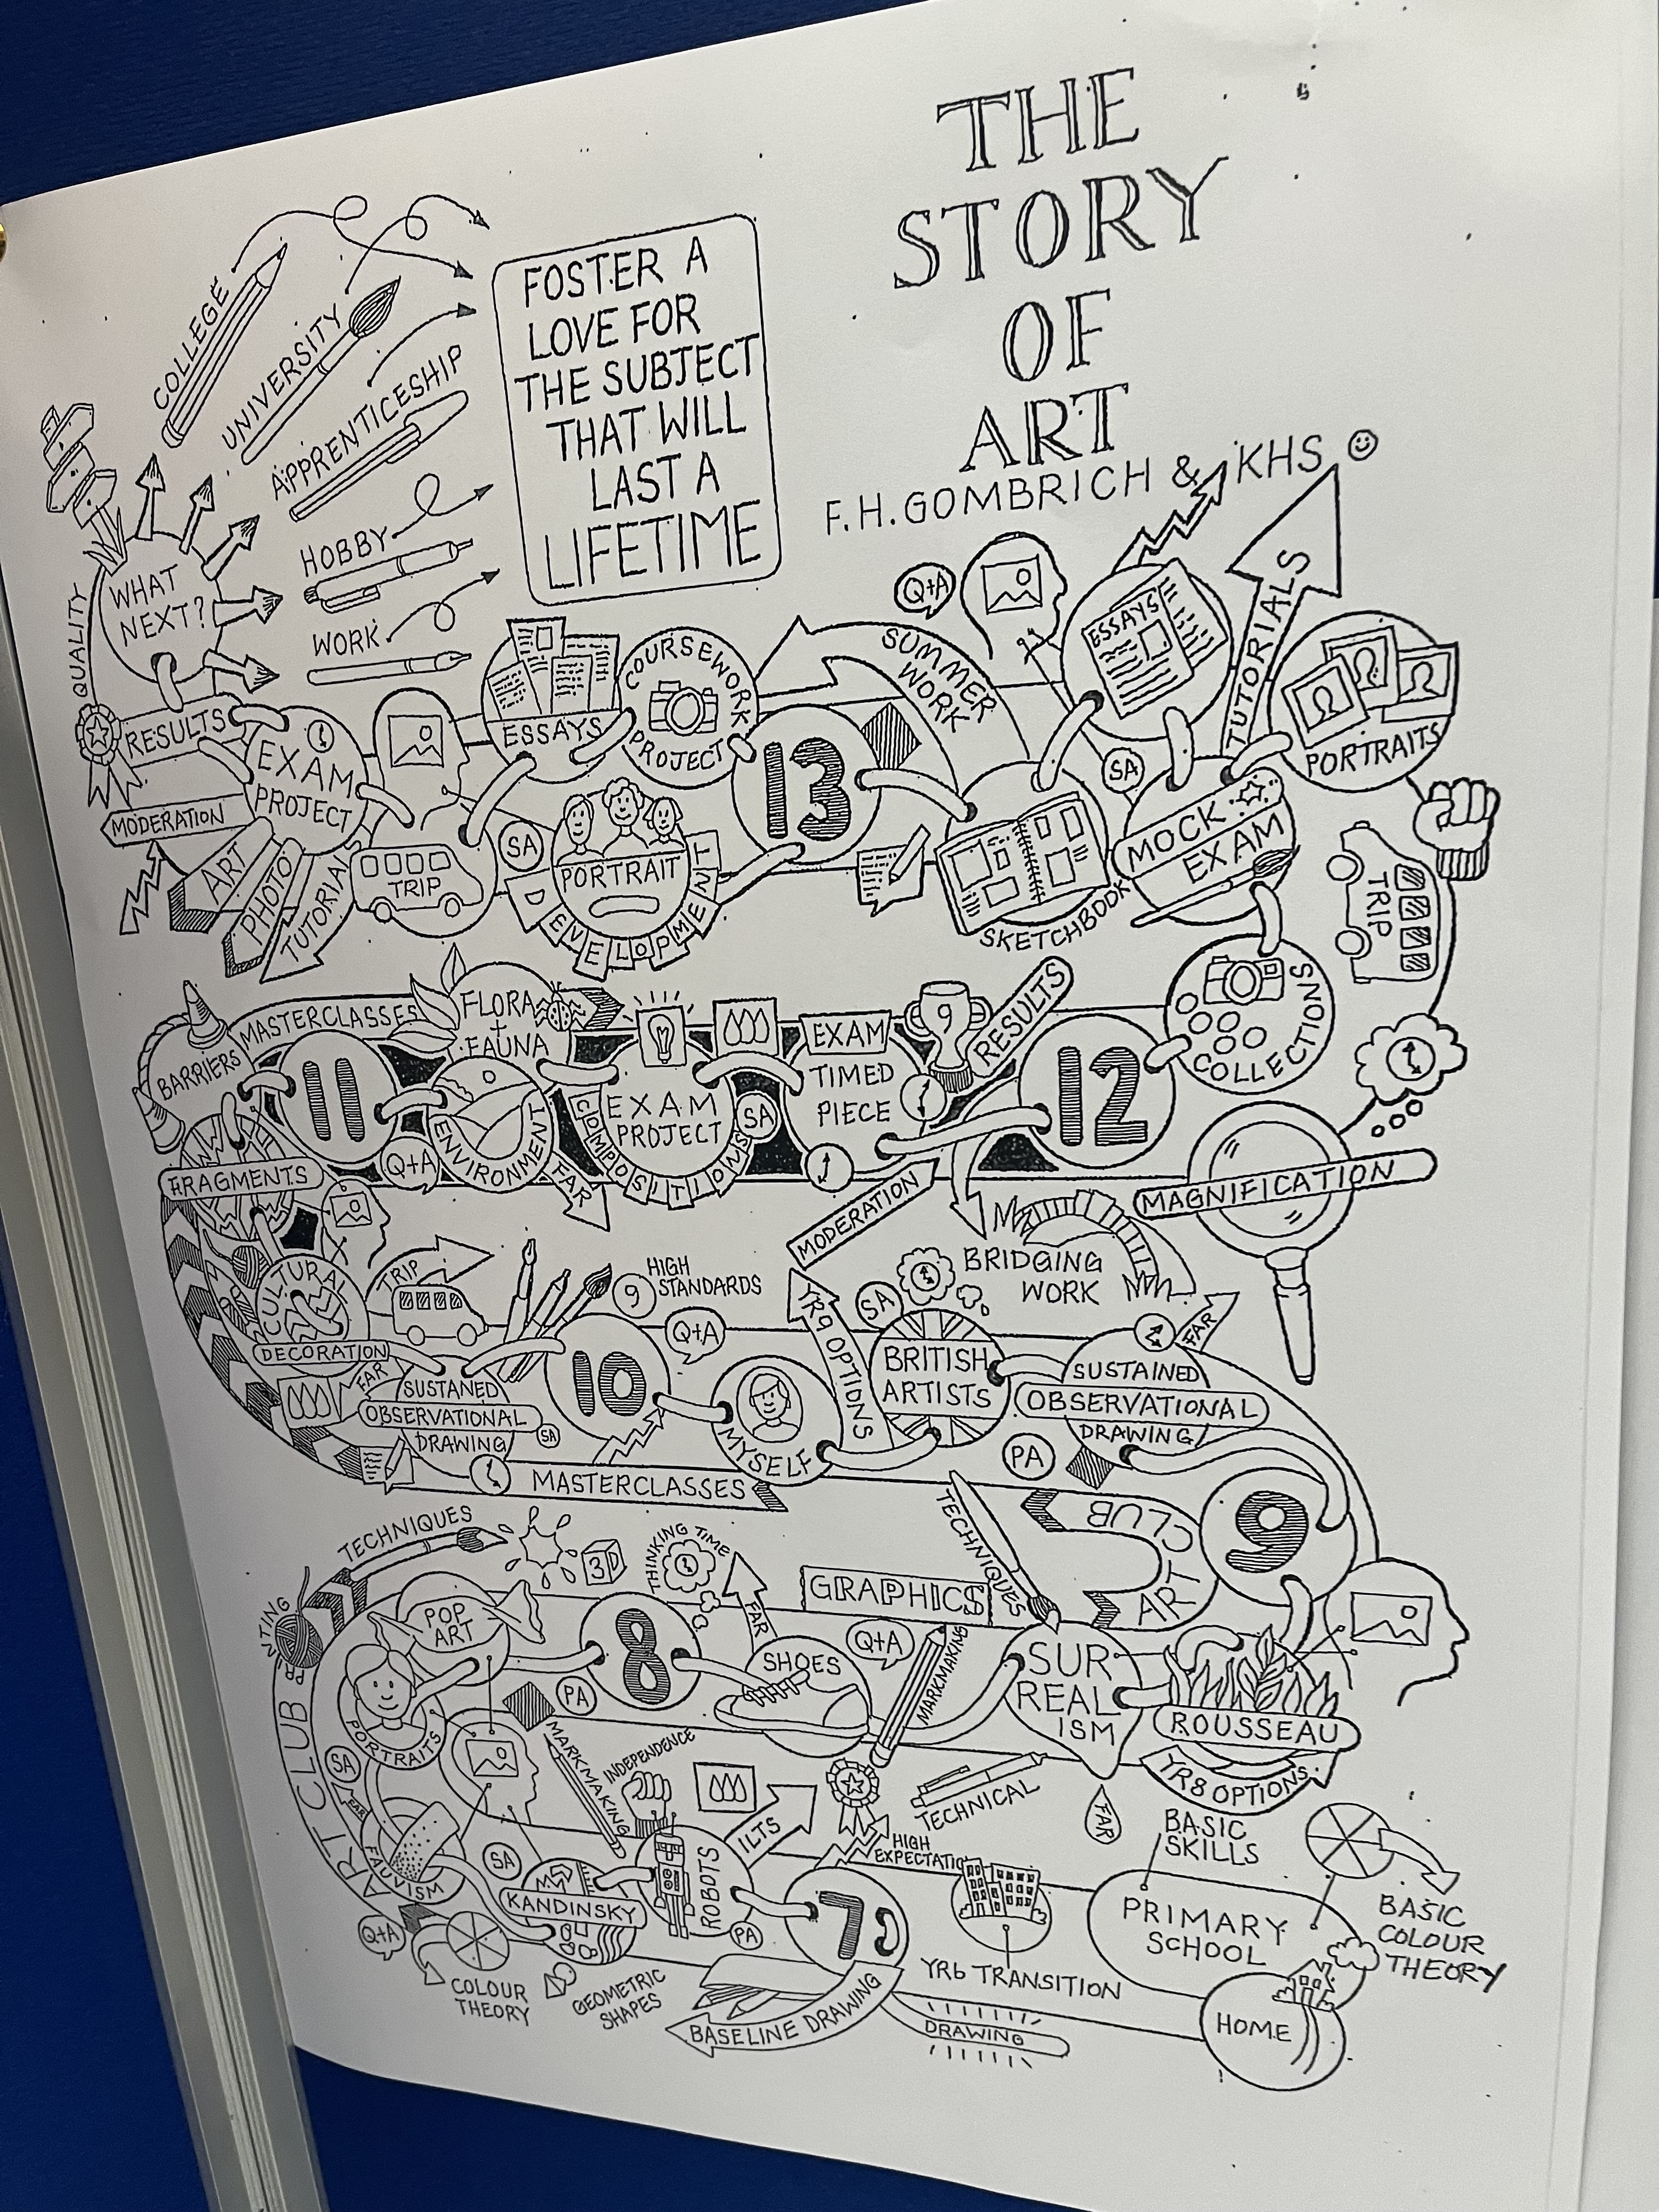
HOw is your curriculum structured (2024)?
The Curriculum Map
Notes:
WILL
Another notable introduction into our data was the ‘Curriculum Map’ to lay out the journey students take through – illustrating the department’s ‘curriculum intent’ – with one eye on OFSTED’s expectation that curricula be rationally sequenced (Made possible by advances in computer software - curriculum mapping apps?). In 2004, Downing and Watson were surprised by how few art departments could evidence a coherent philosophy or overarching curricular ethos – while in 2024, almost all – although not all - participants could relay some logical, if not rigorous, sense of curriculum intent and related structure.
In many schools it felt (to participants) like the curriculum was in flux with curriculum reviews having just taken place, or in progress, or about to take place. But the changes we perceived that the teachers were making were not necessarily that great – often at the level of which artists they were choosing to introduce to their students rather than a change of actual intent or purpose.

Slide 11
HOw is your curriculum structured (2024)?
We do have some structure, but we’re trying not to be too pinned down in what we’re doing…the reason I arrived here is because I left a school where we had this curriculum map…and it had to specify end points and outcome sand all of those things linked to when we were assessing what… (Head of department, London)
I’m not going to be pushed down a route…the centre of doing art is in yourself – we’ve got a responsibility to pull them out of themselves and notice things about themselves. (Head of department, Bristol)
The Curriculum Map
Notes:
CAROL
And there was ambivalence expressed by some teachers about the restrictiveness of tying oneself to a predetermined pathway.

Slide 12
HOw is your curriculum structured (2024)?
They're coming from primary with less skills…Less practitioners in primary schools means that they don't have the bare minimum skills that we would expect to see, and the need to kind of fast track their…how do I put it…literacy and numeracy means that things like art get very much sidelined now.... what they are being taught is wrong, we are finding that quite a lot at the moment, certainly since COVID that seems to be a massive thing...smudging instead of blending, they don't understand how to mix and blend colours. Many of them have never seen a colour wheel before. They don't understand what primary and secondary colours are. (Head of department, Oxfordshire)
A remedial curriculum
Notes:
CAROL
To make imperfect comparison to Downing and Watson’s (2004, 14) findings, the prevalence of ‘a directed, skills-oriented’ approach which moves towards a more exploratory mode of learning in key stage 4 looks to have remained broadly consistent. It might be expected that the last decade of educational policy in England, prioritising concepts such as powerful knowledge, cultural capital, and a knowledge-rich curriculum (ref.) would have led to an increase in curricula design with historical and cultural context in the fore. While this was noted, we might also suggest that this movement may have had impact on the way ‘skill’ in the art classroom is articulated. In our data, there was often a traditionalist language present in the description of ‘skill’ based curriculum design that might pass for ‘technical knowledge’ (ref.) rather than embodied knowing – for example, a curriculum that encouraged ‘basically academic drawing and theory until the middle of year 8’ (teacher of art, Bristol).
We want to draw attention to two themes that echoed strongly throughout our respondents’ answers.
First, there was an almost ubiquitous focus on the importance of key stage 3 (year 7 in particular) as a foundational space to teach remedial art-making skills and knowledge. This deficit model; dependent on the assumption that learners’ primary phase art education was inadequate, informed much content across sample departments’ curriculum design.

Slide 13
HOw is your curriculum structured (2024)?
So in year 7 we’ll still go through like, you know…really focus on the formal elements (Teacher of art, Bristol)
We’re starting the year 7 with the formal elements…kind of what they are and why they’re there (Teacher of art, Wiltshire)
Like…a lot of formal elements, it’s drawing shapes. Tone. Uh line. (Teacher of art, London)
Start with just looking at what the formal elements are (Teacher of art, Somerset)
The formal elements
Notes:
CAROL
The second, interrelated theme, that we found threaded across many sample departments was reference to the so-called ‘formal elements’ of art as either thematic focus or knowledge prioritised in year 7 – line, shape, colour, texture and so on. Nearly half of all teachers interviewed spoke directly of the ‘formal elements’ or ‘visual elements’, while others’ language was suggestive of the same. This Modernist typology of visual components appeared to be a normative presence in participants’ lexicon; a convenient, if largely simplistic and reproductive substitute for ‘theoretical knowledge’ in the subject discipline as Neil Walton 2020 has explored.

Slide 14
Did students study any particular artists in the module (2024)?
Category | no. | %
Pre-20th century | 8 | 7%
20th century | 35 | 32%
Contemporary | 61 | 56%
Cultural Practice | 4 | 4%
Male | 66 | 65%
Female | 36 | 35%
Other | 2 | 2%
White | 85 | 82%
Minoritised ethnic | 19 | 18%
Person with disability | 6 | 6%
Person without disability | 98 | 94%
Heterosexual | 98 | 94%
Other | 6 | 6%
Notes:
WILL
We asked participants to talk to us about a module of their choice for the curriculum. One of the questions asked was ‘did students study any particular artists in the module?’. We collated the 108 artists mentioned and categorised them as can be seen in this table.
Some progress since 2004 – 37% non-male compared to 11% in the 2004 report
Downing and Watson recorded the nationality of the artists mentioned in their sample; we chose to record ethnicity as we believe this a more useful metric when reflecting on the representation of artist diversity within school curricula. Outside of European (and American Pop) artists, Downing and Watson found only one reference to an artist of another nationality, the Brazilian Anna Bella Geiger. We found that 18% of artists (19) referenced identified as minoritised ethnic, mostly British.
This likely represents a more diverse curriculum offer than 2004 - but is still far from representative of the 37% minoritised ethnic pupils studying in English secondary schools (DfE 2024) – and it is not spread equally - in schools with more diverse student cohorts – there was a definite emphasis on selecting artists that represented this diversity.

Slide 15
Downing and Watson's (2004) CAP Characteristic | Freq | % | Example
Work produced using ICT and other less traditional materials | 3 | 4% | Photomontage
Artistic references from the latter 20th early 21st century (at least one contemporary artist named) | 23 | 70% | Lubna Chowdhary
International* and female artists were included (*outside of Europe/USA) | 19 | 58% | Njideka Akunyili Crosby
Wide range of art forms referenced in support of curriculum (artists named suggests more than two) | 12 | 36% | Ai Weiwei, Barbara Kruger, Andy Goldsworthy, Shephard Fairley, and Cornelia Parker
Self-expression taught as a distinct skill | 3 | 9% | Challenged to approach landscape differently...you know it can be quite personal
Pupils encouraged to use and develop creative thinking processes | 14 | 42% | We've got a girl who stitched onto her old school bag about carrying her emotional baggage around.
Curriculum included visits to galleries, museums, or visiting artists | 5 | 15% | Workshops at the New Art Gallery, Walsall
Notes:
WILL
In 2004, Downing and Watson collected two distinct data samples. One group of schools was designated as a ‘randomly selected’ (10), and the other group had been previously identified as ‘incorporating contemporary art practice in their curriculum’ (2004, 5) (8). Their intent was to compare and contrast the curriculum evident in each context. As already stated, we did not make this distinction – however, we still felt it valuable to reflect on the instances where contemporary art practice was, and was not, evident in the data we collected. In this table, we pick up Downing and Watson’s (2004, 39) own ‘list of characteristics’ which they inductively applied to describe contemporary art practice in art classrooms, and make comparison to our own sample.
While we remain sceptical of Downing and Watson’s (2004) CAP characteristics as measure of a curriculum’s authentic connection to ‘contemporary art practice’, we might tentatively suggest that the frequency of the above activities in our random sample of key stage 3 and 4 projects is indicative of an increasingly ‘contemporary’ practice. In 2004, Downing and Watson analysed their own randomly selected sample schools (10) and found – no use of ICT; just four references to contemporary artists; no ‘international’ artists and only two female artists (Georgia O’Keefe and Bridget Riley); one art form per project (predominantly painting); two references to expression of meaning; five to creative thinking; and three to gallery visits. Clearly, in 2004, contemporary art practice – as defined by Downing and Watson – was a ‘marginal’ (2004, 49) concern in secondary school curriculum – perhaps less so today.

Slide 16
Did students study any particular artists in the module (2024)?
‘Contemporary' subcategories | Freq. | % | Example
Alive, but renowned for seminal work produced in the 20th century | 17 | 33% | Frank Auerbach
Renowned for having produced seminal work very recently | 19 | 37% | Njideka Akunyili Crosby
Obscure (no gallery representation) but producing work very recently | 16 | 31% | Andrea Joseph
Total | 52
Notes:
WILL
However - We wanted to produce ‘subcategories’ of contemporary art influences in the classroom because this generic category might otherwise hide the super-diversity within. This is an imperfect resource, not least because we remain sceptical of any attempt, including our own, to slice contemporary art practice with any definitive certainty. Outliers bring into question the subcategories we chose, too. For example, there was a group of applied artists referenced; illustrators, or graphic designers – for whom cultural or social impact would not be measure in recognition from commercial galleries at all. We therefore would not want to suggest that cultural or social impact is the only legitimising factor in selecting curriculum content.
In this table we looked to subcategorise the artists our interviewees referenced into three imperfect groups. It can be seen that if the definition of ‘contemporary art practice’ were to be limited only to those individuals who recently started producing ‘seminal’ works (recognised as conceptually or commercially valuable through representation at a gallery), then just nineteen would qualify. If one chose to qualify only artists with elite gallery representation this might reduce the number to just four; Njideka Akunyilli Crosby (David Zwirner); Lucy Jones (Flowers Gallery); Rachel Jones (Thaddaeus Ropac); and Mickalene Thomas (Lehmann Maupin).
Another third of the artists considered contemporary certainly command high esteem within the arts and cultural sector (and may still be working), but perhaps produced works with the most educative impact over forty or fifty years ago; Frank Auerbach; Jim Dine; or Yayoi Kusama, for example. Finally, a third of the artists named were making work today but receiving little or no public recognition for their practice. This included some emerging artists, artist/teachers, vernacular artists, and others.
This may be a relevant space to speculate on the relationship between certain contemporary art practitioners mentioned by interviewees and the existence of a ‘school art’ style, a practice first described by Efland (1976) and explored by others (including ourselves) since.
Efland theorised that ‘art that is made in school isn’t about art as it exists beyond the school; it may be more a function of the school life-style itself’ (1976, 39). If ‘school life-style’ is accepted as a significant influence on the priorities of art teachers (as well as pupils), it may explain the predominance of accuracy, observation, and evaluation over self-expression, creativity, and critical thinking. In turn, if such concerns are allowed to lead the choice of artists attached to curriculum content, it explains why realist painters of still-life such as Janet Fish, or Jöel Penkman, are over-represented among ‘contemporary artists’ – their work retrospectively attached to curriculum to justify more traditional artistic aims.
Applying Bernstein’s notion of the pedagogic device – to the pedagogising process of curriculum design – one of the functions of this process, he suggests is to make knowledge ‘safe’ – this process we have just described (where ‘contemporary’ artists selected for curricula serve the interests of a school life-style – where accuracy, technical knowledge, and assessment criteria rule) may be indicative of such a compromise that takes two conflicting aims from the pedagogic recontextualising field and the official contextualising field and divests both of any transformative power.

Slide 17
The outliers
So the key thing at XXXX that we're all working on that at the moment is called building a culture of belonging...overarching aim being that all students feel seen and represented within our curriculum.
(Teacher of Art – London)
In Year 7 What that looks like is an introductory project - the theme of the year is how to be an artist student... learning how to be both creative risk taking, (a bit rebellious) but also yeah, expectations of a keeping to deadlines, homeworks, ... we explore the contradiction clearly at the beginning. (Head of Department – London)
IPADS have been revolutionary (Head of Department – Milton Keynes)
Notes:
CAROL
In Downing and Watson’s study, they deliberately chose schools that might otherwise have appeared as ‘outliers’ in their data – they were consciously looking for schools that were being innovative with their curriculum in their inclusion of contemporary arts practice.
In our study – although we weren’t deliberately selecting schools with any particular approach in mind – there were outliers.
For example – three schools that had very consciously decolonized their curriculum, a school that very deliberately structured their curriculum around the concept of the artist student, and a few schools where the provision of laptops or ipads to all students was having a transformational effect on curriculum, pedagogy and assessment.

Slide 18
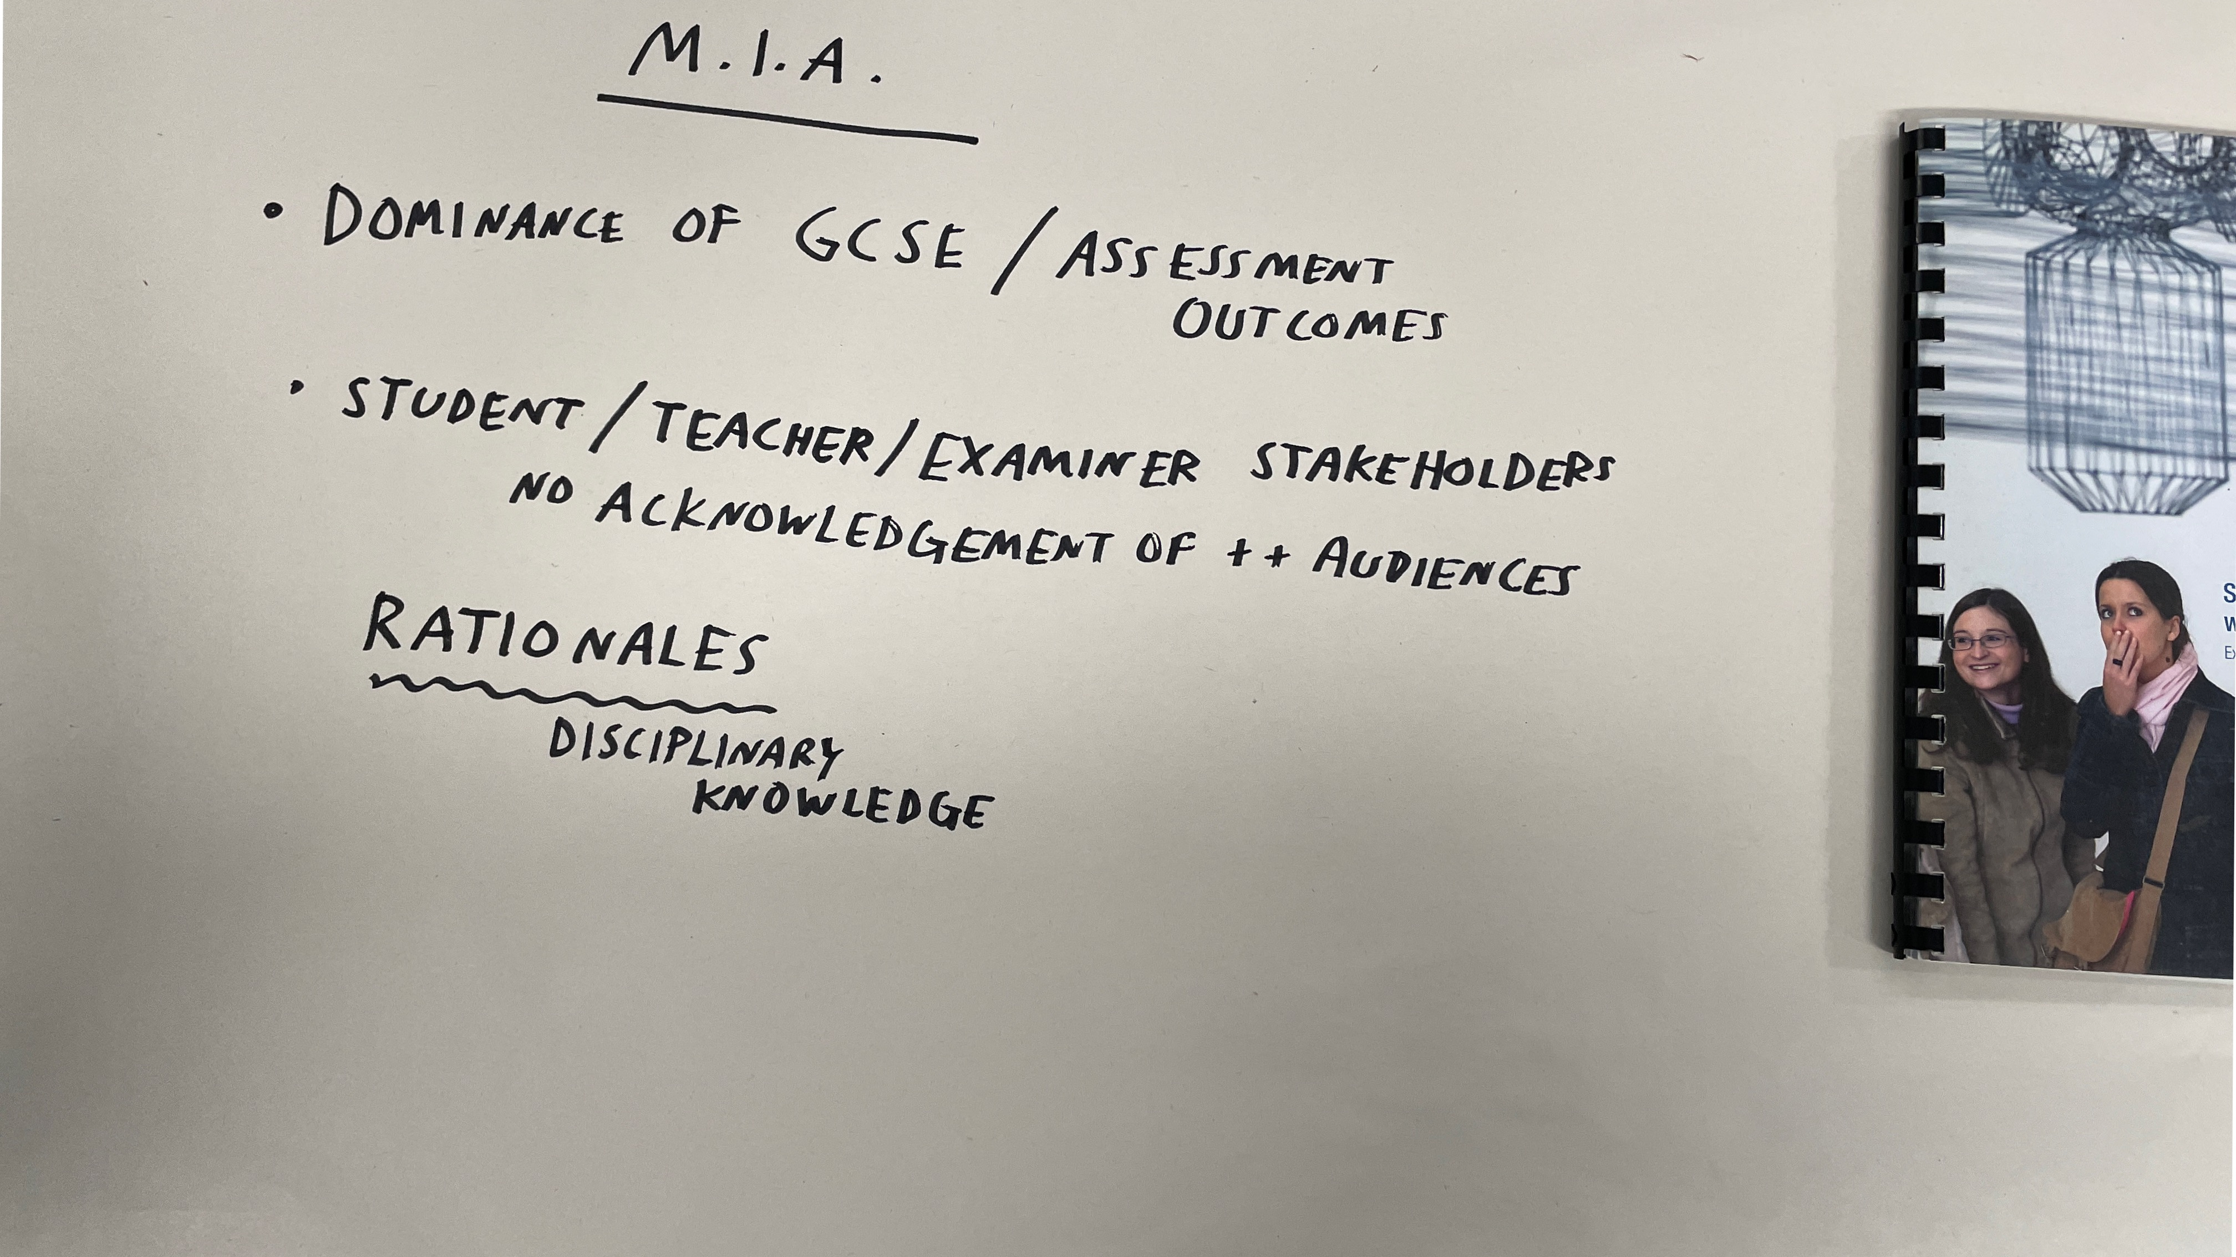
Notes:
CAROL
However, as notable as the outliers in the data is what we named ‘Missing in Action’ – particularly the dominance of GCSE / Assessment outcomes and any acknowledgement of audience – who students are creating work for. Lurking behind all that our interviewees spoke to us about was the unspoken / unseen face of the ‘examiner’ – which we suggest exerts the most powerful influence on the what, why and how of the Art & Design curriculum in secondary schools.
Though there was evidence of ’making safe’, compromise and misappropriation in regards to the other key players in the recontextualising field – it was the exam boards whose pull was exerted most directly, in an unmediated way.

