Slide 1







Exploring teacher understandings of participatory pedagogies via approaches to children's rights in Wales
EECERA, Brighton, Sept 2024
Presenters: Dr Sarah Chicken, Dr Patrizio De Rossi, Jacqui Lewis
Dr Jacky Tyrie, Prof. Jane Williams, Dr Jennie Clement,
Dr Alison Murphy, Dr Jane Waters-Davies, Louisa Roberts
Notes:
Sarah
This paper addresses the research problem that arises from evidence that, despite supportive policy contexts within Wales, enactment of pedagogies that attend to young children's participation rights in classroom settings is highly variable.
We seek to understand better the ways in which the teacher frames young children's participation and what may shape this.
We are reporting on phase-two of an ESRC-funded project, aiming to examine teachers understanding of participation and how it relates to their pedagogy in Wales.
Previous research of the team argues that understandings of participatory pedagogies are varied (Chicken and Tyrie, 2023) reflecting 'boudaried' approaches to children's enactment of rights (Clement et al, in press), The study adopted a rights-based approach (Bessell, 2017) and an axiological position with young children constructed as capable, agentic meaning-makers (Malaguzzi, 1998). Rooted in socio-constructionist interpretivism, participatory action research was utilised (Townsend, 2013) for data-generation. During collaborative dialogical workshops, Reggio Emilian pedagogy was explored as an example of a participatory pedagogy and later participants experimented with ‘projects’ investigating what ‘rights’ meant to children. Semi-structured interviews were carried out with 14 teachers before and after engagement. The research team were steered by a duty of care to participants with ‘care to do no harm’ as a guiding principle, EECERA (2015) ethical code was adhered to, and appropriate ongoing consent gained.
Initial findings suggest that teacher understandings of participative rights and associated pedagogy are underpin by a complex interrelationship between implicit constructions of (a) young children and (b) teachers (and their role) and further, with wider philosophical debates about the purpose of education.
Consequently, opportunities for teachers to explicitly unpick constructions of children and teachers may be useful in actualising a children’s right agenda, allowing an avenue through which discussions and agitations can be explored to support the increased enactment of participative rights within practice.

Slide 2
About this research
Economic and Social Research Council (ESRC) funded - budget £700,000+
3-year project - Dec 22 to Nov 25
A collaboration across four UK universities
A focus on young children’s participative rights in lower primary settings
The research aims to uncover ways to integrate participative rights into everyday teaching and learning activities, and to create classroom environments where children's voices are not only valued but actively integrated into the teaching and learning processes.
Notes:
SARAH

Slide 3

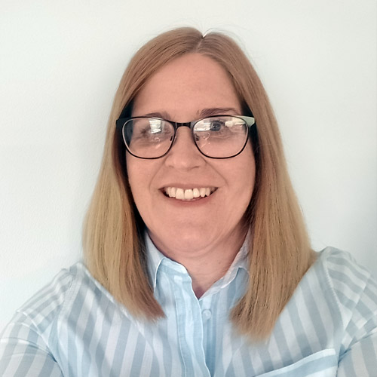

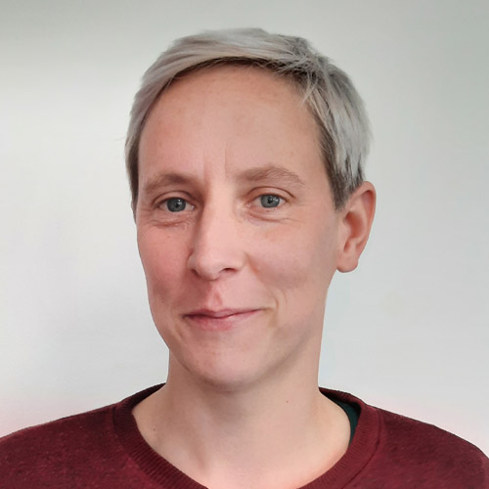

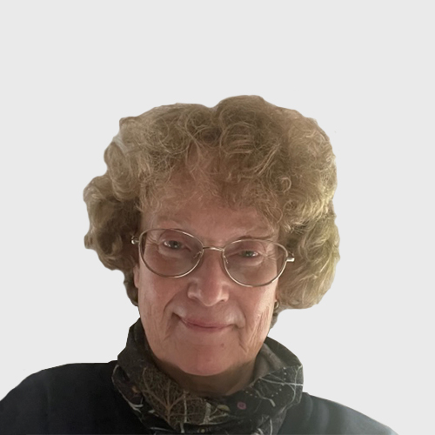
Meet the team
Dr Sarah Chicken
Principal Investigator, Associate Professor of Childhood and Social Justice, University of the West of England.
WP2 LEAD
Dr Alison Murphy
Co-Investigator, Lecturer in the Athrofa: Institute of Education, University of Wales Trinity Saint David
WP1 LEAD
Dr Jennie Clement
Co-Investigator, Senior Lecturer in Initial Teacher Education at Cardiff Metropolitan University.
Dr Jacky Tyrie
Co-Investigator, Senior Lecturer at Swansea University.
WP4 LEAD
Dr Jane Waters - Davies
Co-Investigator, Associate Professor in Early Education at University of Wales Trinity Saint David.
WP3 LEAD
Prof Jane Williams
Co-Investigator, Professor of Law at Swansea University
Notes:
SARAH

Slide 4
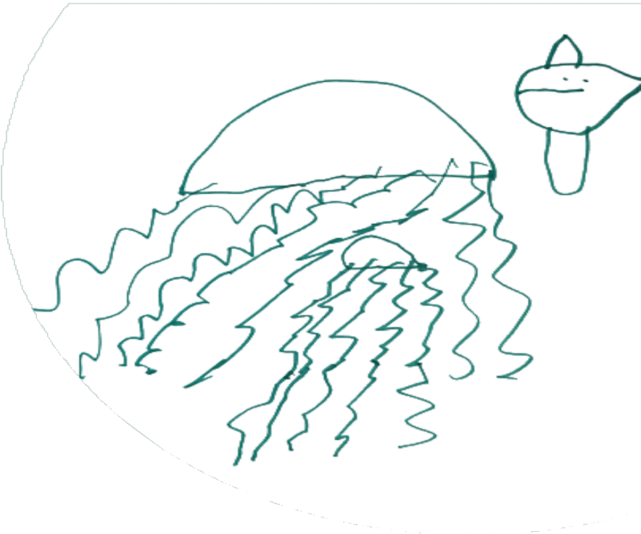
Research questions
How does the distinct Welsh policy context position teachers
in relation to young children’s participative rights in
primary schools in Wales?
To what extent do providers of professional learning (including
initial teacher education) support Welsh Government rhetoric for
pedagogic practice that embeds young children's participative rights?
How do primary teachers in Wales conceptualise and support young children’s participative rights and what are perceived enablers and barriers to practice?
How are young children's participative rights in Welsh primary schools understood and experienced by young children themselves?
How can findings from this work be drawn together to understand the process by which pedagogies can be transformed in order to embed participative rights?
Notes:
SARAH
stereoscopic view Focusing in very closely to the enablers and bariiers
If you are interested in other aspets of our work, we have a numer of papers in draft and at publiation stage.

Slide 5

Wales
A geographical and curricular context
Population: 3.1 million people. 4.8% of the UK population
Devolved Government with responsibility for education
Strong Welsh Government vision for children rights since devolution – supported by legislation (Williams, 2013)
Curriculum for Wales (3-16 yr olds)
The Four Purposes as a starting point and aspiration for all children:
Ambitious, capable learners, Ethical, informed citizens,
Enterprising, creative contributors, Healthy, confident individuals
(Welsh Government, 2021)
Notes:
Sarah
Individual school flexibility to develop their own curriculum.
Consistent learning continuum for all, but the pace of progress is individual to each learner. Progression and assessment are expressed from the learner's perspective.
Curriculum development seen as the vehicle for embedding the UNCRC in children's experiences of education.
The education system in Wales is currently amid a sustained period of reform, which began with the review of the curriculum and assessment arrangements in Wales by Donaldson (2015).
Within the Curriculum for Wales (CfW; WG, 2023) introduced in 2022, there is a commitment to uphold what has been labelled effective Foundation Phase pedagogy, as well as making sure that practice reflects current perceptions regarding how young children learn (Donaldson, 2015).
The CfW represents a re-evaluation of pedagogy and curriculum-making across the statutory school sector. It seeks to move from a prescriptive to a co-constructive stance, encouraging teachers to co-produce a localised curricular experience with learners and other community stakeholders.
The CfW framework is underpinned by the Four Purposes which are at the core of the curriculum, designed to support children to be ethical informed citizens who understand and exercise their human and democratic responsibilities and rights, and respect the needs and rights of others, as a member of a diverse society (WG, 2023). This places children's participation centrally within the curriculum, as well as supporting schools to incorporate human rights education and rights-based approaches into pedagogy and school-level curriculum design and development (WG, 2023).

Slide 6
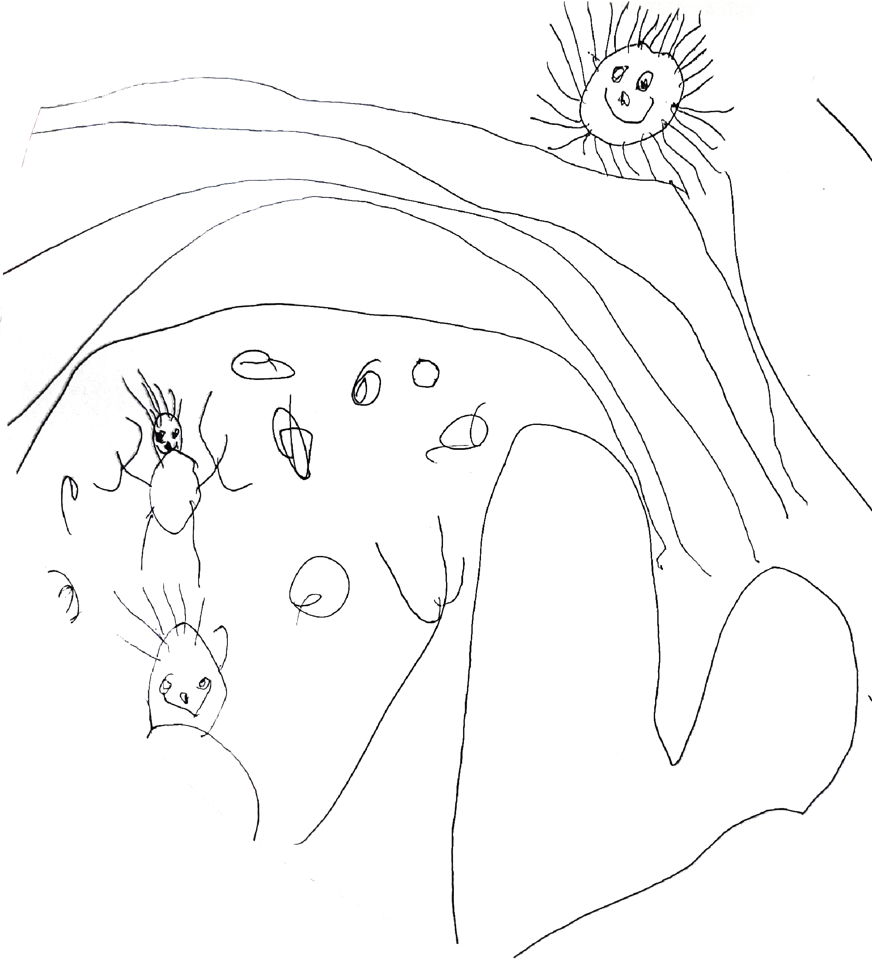
UNCRC
  The project is framed within the context of the UNCRC and the Welsh Government commitment to children’s rights
  Concerned with adult’s positioning, behaviours and attitudes relative to the child
  Including but not limited to Article 12, the ‘right to participate’
  Participative rights:
  Article 12 as indivisible from and interconnected with all children’s rights
  Participation:
  the varying ways in which children can be involved in decision-making
  Participatory pedagogies:
  the ways that educators enable participation and enact children’s participative rights
Notes:
PDR
The UNCRC was first adopted by the United Nations in 1989 and subsequently ratified by the UK government in 1991. It is described as a complete framework of standards, principles and implementation guidance in relation to the human rights of children (Children in Wales, 2014), encompassing ideas from the protectionist days of Eglantine Jebb, founder of Save the Children, and discourse arising from the horrors of the world wars (Boylan and Dalrymple, 2009). The international agreement sets out fifty-four articles which influence all aspects of a child’s life, including their economic, social, cultural, civil and political rights and are broad philosophical principles which can be interpreted and applied according to context (Jones and Walker, 2011; Kanyal, 2014). As such, it has gained a universal prominence and globally it is considered the most ratified international human rights treaty in history (UNICEF, 2019). Hart (1997) described the treaty as ‘an instrument of persuasion for those persons wishing to promote the ideas of children as independent, thinking subjects, capable and deserving of a
greater degree of participation’ (Hart, 1997, p. 37). This latter definition places emphasis on one of the more unique aspects of the treaty, which is its comprehensive focus on the ‘three Ps’ - Provision Rights; Protection Rights; Participation Rights. Unlike previous legislation, the UNCRC includes a strong focus on participation (Alderson, 2008). Advocates claim therefore that inherent within such rights is the view of children as the agents of their own lives, capable of contributing and participating in decision-making (Jones and Walker, 2011; Thomas, 2021).

Slide 7
Why was the study necessary?
  Limited research in this area (Lewis et al., 2017; Correia et al., 2019)
  Understandings of participatory pedagogies are varied (Chicken and Tyrie, 2023)
  A tension between desires to enact participation and required outcomes (Maynard and Chicken, 2010).
  Participation could be developed further by many teachers (Robinson et al., 2015)
  Research indicates a gap between the policy ambition and enactment (Murphy et al, 2024)
Notes:
PDR

Slide 8
Theoretical orientation
The study adopted a rights-based approach (Bessell, 2017).
An axiological position with young children constructed as capable, agentic meaning-makers (Malaguzzi, 1998) and as social actors (Prout, 2000)
A social-constructionist stance (Berger & Luckman, 1991) with childhood positioned as a social construction (James and Prout, 2015)
Notes:
PDR
a ‘child’ is defined in accordance with the UNCRC, as a person under the age of eighteen, which is the legal age of attaining adult status in Wales (Welsh Government, 2019) and as a fully autonomous person
Lyle / JWD et al? Realisation of UNCRC principles threat to how teachers viewed their role, power and agency. Reword or the constructs of Boundaried, capable and controlled?

Slide 9
Methodology / methods
Participatory action research (Townsend, 2013)
14 teachers of children between the ages of 3 and 7
Term 1
Semi-structured interviews with teachers
Dialogic workshops with an artist consultant using Reggio Emilian pedagogy as a provocation
Term 2
Class based projects with children
Online support sessions
Term 3
Sharing events
Post interviews with teachers
Reflexive thematic analysis ( Braun and Clark, 2022) as a tool for meaning making
Notes:
PDR
If asked why Reggio:
The image of a child with strong potentialities, child as a citizen, a rights bearer (Malaguzzi, 1993)
Noted in Foundation Phase documentation as a point of reference for pedagogy which views the child as agentic. (DCELLS, 2008)
Reggio and close links with ‘participation’ (Maccaferri, 2017), described as a ‘fundamental value’
Reggio and ‘empowerment’

Slide 10
Understanding and supporting participation
​
Supporting participation:
Democratic processes
Supporting participation:
In the classroom
Understanding participation
  Personal value base
  Response
  … but ‘boundaried’
    School councils
    Representatives
    Voting
  Knowing your children
  Following children’s interests
  Classroom environment
Notes:
PDR (first initial notes with this slide – underneath new notes taken from 2 slides Understanding Participation and Supporting Participation.
Initial slide notes
RQ4: How do primary teachers in Wales conceptualise and support young children’s participative rights and what are perceived enablers and barriers to practice? Interview schedule incl. Understandings of participative rights/child voice, Classroom and school-wide practice, Planning, Children’s role in developing the curriculum, Behaviour & discipline, Barriers and enablers, The four purposes and CfW
We asked: “What does children’s participation mean to you as a teacher?”
The aim should be to fully emerged [sic] the child in the provision. They should be given a voice, to have some ownership of the task. They should be challenged and supported to reach their full potential. (P12, age 4-5)
Pupil voice is essential and leads to improved learning experiences as children have been involved in their own learning and taken ownership of what they would like to learn. (P18, age 5-7)
The terminology was associated with the children’s involvement in curriculum in some way e.g. choosing activites, expressing preferences, having some ownership, planning of learning
Participation linked to children’s ownership over and involvement in planning of their learning through the recognition and support for ‘pupil voice'
Understanding - Participation linked to learning dispositions: For younger children dispositions and learning behaviours
Children were identified to be participating if they could be seen to be joining in and this participation was often connected to learning behaviours and dispositions.
Coming to school, listening, asking questions, giving opinions, trying their best even if it doesn't interest them fully. (P3, age 3-4)
Being curious, to observe, explore, experiment. To be present in the moment and to be able to express and share thought feelings and emotions. (P5, age 3-4)
Understanding - The spatial aspect of the learning environment
Outdoors - engaged in task, being creative, working co-operatively with others, problem solving and resilience when faced with problems (P.22, aged 6-7)
Pupil Voice on what activities are accessible outside During the Autumn Term they requested a pirate ship with a treasure chest and maps….. during Summer Term we are looking to revamp our mud kitchen. (P11 aged 4-5)
Newly trans across slides to these notes:
Understanding Participation
Children’s Rights understood through a personal value base, an ethos of respect for the child: “In a broad sense, it means children are able to feel that they can be listened to, heard, respected. They feel they can come to you, be taken seriously. (Shelly, Year 1, Age 5-6)
But boundaried…Level of teacher control, Time, space, curriculum, (congruence with our previous research see Clement et al., in press; Waters-Davies et al., 2024
Tokenistic: “They think they’ve got a choice but obviously we’ve narrowed it down… we would limit their choice.” (Freya, Year 2, Age 6-7)
Additional quotes to support
Ch Rights: “Respecting the children's views and their thoughts and their feelings and recognising that they are little humans too.” (Rebecca, Nursery, Age 3-4)
Boundaried: “... Letting them think they've got that control. Whereas obviously as the teacher... that's where we were going to go anyway. But you've just let them think that they've come up with a suggestion.” (Lizzie, Year 1 & 2, Age 5-7)
Supporting Participation Notes from deleted slide
Supporting Participation
Following children’s interests & knowing your children: Dominant discourse, central to children’s rights, ‘voice’ and participation. More so; what and where rather than how, they learn. Relational pedagogy. “It's how you know your children ... whether you're experienced enough, or you know the families well enough” (Alison, Year 1 & 2, Age 5-7).
Environment: Planning, resources, spaces, an enabler of participation, informed by observation & communication.
Democratic platforms: Action groups, individual reps, voting, modelling? “they're too young to often understand, they'd understand the practical side of things. They wouldn't necessarily understand the bigger picture stuff, like my year six girls” (Seren, Year 1, Age 5-6).
Additional quotes to support:
Childrens interests: ”It's all I do, follow what the children's interests are ... it's just from little chats on the carpet in the morning, something will crop up.” (Barbara, Year 1 & 2, Age 5-7), “I give them a spark … then they go off and do what they want...” (Barbara, Year 1 & 2, Age 5-7) “In the early years … isn't just about them speaking and communicating. It's about us observing as well.” (Eleri, Reception, Age 4-5).
Knowing your children: “To understand their rights and for them to know their rights, a lot of that just comes with dialogue, especially with the little ones.” (Florence, Reception, Age 4-5), “Visuals are huge for us … They might not be able to tell you, why they're upset or what the other child is upset for, but be able to show you. So, it's about kind of knowing your children” (Eleri, Reception, Age 4-5).
Environment: ‘The classroom itself is a way that they can show their own voice, their expression of what they want to do, when they have their choosing time in the, in the classroom.” (Karan, Reception, Age 4-5). “I plan for the skills and I plan for progression and my learning environment is enabling and progressive. The content, so their voice, the content of what is learned is their choice. It's all child participation.”(Alison, Year 1 & 2, Age 5-7), “Whatever interest they have, they get to do that in their choosing time. And that's a large amount of our day.”(Karan, Reception, Age 4-5).
Democratic Platforms: (School councils, senedd, junior leadership team, eco committee, criw cymraeg, Digital leaders, workshop leaders, sports ambassadors, head boy & girl): “obviously they will one day be part of the Senedd won’t they” (Enfys, Reception, Year 1 & Year 2, Age 4-7), “I don't know, maybe it's more of the adult’s role in nursery to make sure that the children are having their rights, you know, respected.” (Rebecca, Nursery, Age 3-4).

Slide 11

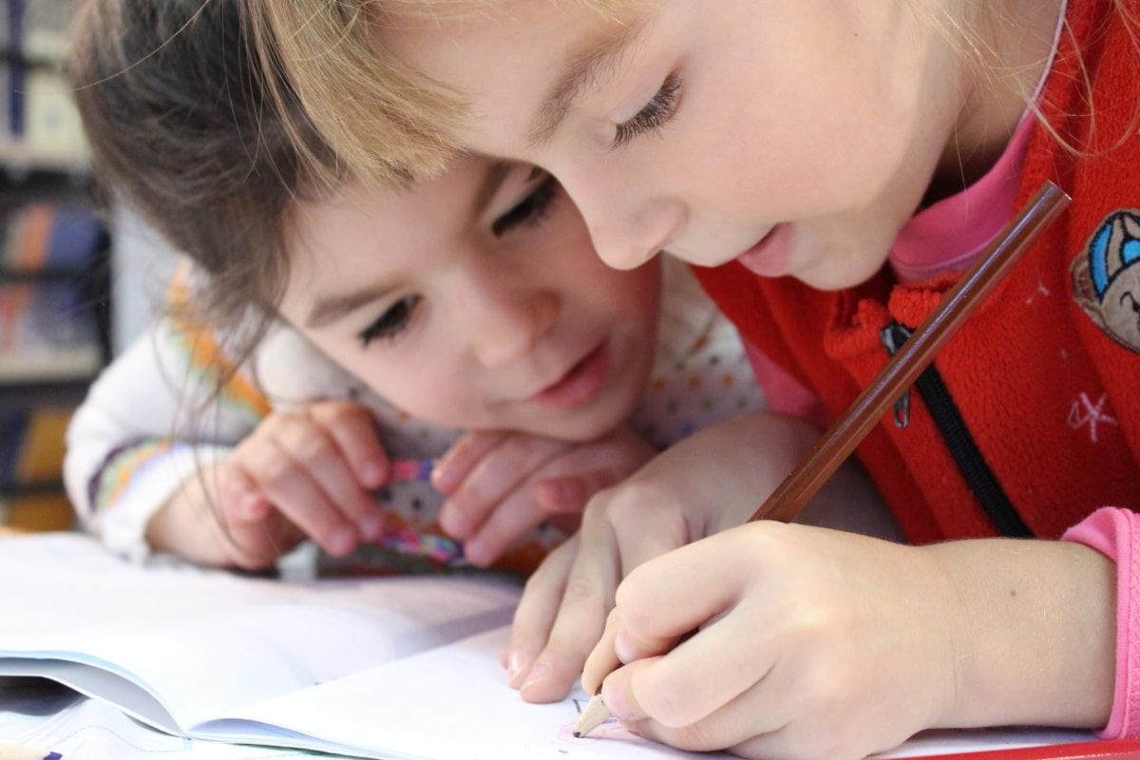
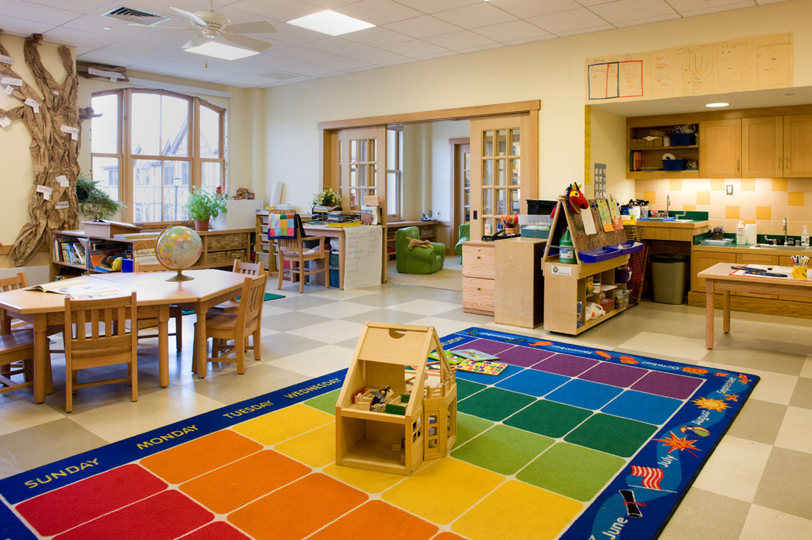
Findings
Understanding participation
Personal value base
Responses
…but boundaried*
Supporting participation across schools
Democratic processes*
Supporting participation in class
Knowing your children
Following children’s interests*
Classroom environment

Slide 12

Overarching cultural environment
Expectations
Pedagogy
Constructing roles
School community
Classroom environment
Curriculum
(local & national)
Parents & children
Teachers themselves
Senior leadership
& inspection
Consortia
Teachers
Children
Teaching & learning
Flexibility & rigidity
Planning
Time
Spaces
Notes:
PDR
Link to Jacqui: The way the role of the teacher is constructed can act as an enabler or a barrier to participation.

Slide 13

Findings – Enablers and Barriers
Overarching culture
School community
Classroom environment
Curriculum (local & national)
Pedagogy
Flexibility & rigidity
Planning
Time and space
Expectations
Parents, children, teachers
Senior leaders & inspection
Consortia
Constructing the roles of…
Children*
Teachers*
Teaching and learning
Notes:
PDR
Link to Jacqui: The way the role of the teacher is constructed can act as an enabler or a barrier to participation.

Slide 14
Constructions
Children
Teaching & learning
Teachers
  Facilitator
  Duty Bearer
  Observer
  Responder
  Controller
  Content provider
    Capable
    Boundaried
    Deficit
  Purpose of education
  Knowledge v Process oriented
  Philosophy of play
    (Waters-Davies et al 2024, Lyle (2014), Esser et al (2016)
Notes:
Jacqui
Children: At this moment in time we are building on constructs explored by (Waters-Davies et al 2024, Lyle (2014), Esser et al (2016) , we will be taking a deeper dive into constructional terms (?) after summer.
Capable: Rights holder, enactor of decisions, curriculum driver
Boundaried: by space, adult driven processes, competencies within specific contexts
Deficit: Blank Slate, developing and immature chid, incompetent.
Teachers: Responder, Observer, Facilitator, Controller, Schooled
Teaching & Learning:
Children sub themes remain on original report, updated possibilities include: Agentic, Competent, Independent, Autonomous, Respected, Citizens,
Dialogic partners, Ideas Makers, Trusted
Previous on diagram: Teaching & Learning: Purpose of education, Philosophy of play, Responsibility, Evidencing learning.

Slide 15
Constructions
Children
Capable
Boundaried
Deficit
Teachers
Facilitator
Duty Bearer
Observer
Responder
Controller
Content Provider
Teaching and Learning
Purpose of education
Knowledge vs Process Orientated
Philosophy of Play
    (Waters-Davies et al 2024, Lyle (2014), Esser et al (2016)
Notes:
Jacqui
Children: At this moment in time we are building on constructs explored by (Waters-Davies et al 2024, Lyle (2014), Esser et al (2016) , we will be taking a deeper dive into constructional terms (?) after summer.
Capable: Rights holder, enactor of decisions, curriculum driver
Boundaried: by space, adult driven processes, competencies within specific contexts
Deficit: Blank Slate, developing and immature chid, incompetent.
Teachers: Responder, Observer, Facilitator, Controller, Schooled
Teaching & Learning:
Children sub themes remain on original report, updated possibilities include: Agentic, Competent, Independent, Autonomous, Respected, Citizens,
Dialogic partners, Ideas Makers, Trusted
Previous on diagram: Teaching & Learning: Purpose of education, Philosophy of play, Responsibility, Evidencing learning.

Slide 16
Constructions of Children: Capable Child
The way the child is constructed can act as an enabler or a barrier to participation.
Capable enactor of decisions:
‘When children are involved in their own learning…when they can decide and make a choice themselves, they're motivation increases, their enjoyment …and definitely their engagement too. When they get to decide where they want to play, who they play with and what they're going to do.’
(Eleri, Teacher of 4-5yrs)
Interests drive curriculum:
‘They play the central role…. they drive the learning’ (Alison, Teacher, 5-7yrs)
Notes:
Jacqui
Some of our teacher’s voices indicate that where their constructions align with a ‘capable child’, they are perceived as enactors of decisions and centralise children's positionality as curriculum drivers, enabling participation.
We also hear how this construction of capability can inform the extent of trust and sustaining children’s initial lines of enquiry, continuing past potential tokenism into authentic agency.
‘Adult is intentionally responsive to the child's voice in the pedagogical decision-making process, an active listener and observer as well as being responsive and alert to all children. These responses were characterised by notions of inclusion, acceptance and engagement (Ree & Emilson, 2019) and receptive listening (Moss et al., 2005) by the adult to facilitate the child's agency in all aspects of the learning experience.’ JWD 24

Slide 17
Constructions of Children: Boundaried Child (spatial and temporal)
The way the child is constructed can act as an enabler or a barrier to participation.
Boundaried by adult driven processes: ‘We try and we like to listen to the pupils, but obviously we can't let them run away with it because they could go down, sometimes they go down really random paths that maybe don't lead anywhere.’ (Lizzie, Teacher of 5-7yrs).
Boundaried by space: We've got a forest school area as well … the children lead that learning.’ (Julie, Teacher of 5-7yrs)
Boundaried within time or context: ‘At the start of the year, I'll always ensure the children are involved in generating our class rules, such a simple tweak, but it's massively helped… behaviour and I think that's down to … being involved in that, that understanding really of the consequences and the rewards’. (Lizzie, Teacher of 5-7yrs).
Notes:
Jacqui
We also note the Boundaried nature of constructions with our teacher’s voices, this can be a competency boundaried by space
(forest school), or a participatory freedom -boundaried by the constraints of adult driven processes, that fall within routines and structures, or competency to have a view within a specific time or context such as at the start of the year / over to you time / or in the generating of rules.
So, a construction of children which may acknowledge a competency construction, but contradictory within enactment.
Interesting – not only the significant amount of data pointing towards a boundaried enactment, but what may inform the Boundaried nature. Is this teachers working within their own constructs of self, child and education? Start to consider an interplay of constructions…
We also hear boundaried child constructions within age, gender, ability, of power relationships, of school processes and wider policy beliefs and tensions.
Capable of democratic thought / citizens in waiting? and critical thinkers: but only from yr 2.
Subject bound? Capable of steering learning, but within project work not so much numeracy.
Belief in autonomy in environment but boundaried by conformity
Power balance: It's kind of allowing them that that freedom and knowing it's OK to express themselves however they wish to, within boundaries, obviously’ and So, if we're never to, kind of entice them over, or encourage them to come over and experience something new. They'll kind of stay where they are. They'll never progress in that sense’.
Independent, Autonomous, You’re doing this with me now and then you can go and do this or that’, v With older cohorts, participants noted choice as a motivator to increased enjoyment and engagement
Influencing directly adult led /child led

Slide 18
Constructions of Children: Deficit Child
The way the child is constructed can act as an enabler or a barrier to participation.
The incompetent child: ‘Yr ones & reception, they're too young to often understand, they'd understand the practical side of things, they wouldn't necessarily understand the.. bigger picture stuff like my year six girls.’ (Seren, Teacher of 5-6yrs)
The child as a blank slate: ‘If we're never to…entice them over or encourage them to come over and experience something new. They'll kind of stay where they are. They'll never progress in that sense’. (Eleri, Teacher of 4-5yrs)
The developing and immature child: ‘I don't think they have the language or the emotional maturity to make decisions...’ (Josey, Teacher of 5-7yrs)
Notes:
Jacqui
Lyle (2014), Esser et al (2016) previously report child constructions such as the innocent child, the child as a blank slate, the developing and immature child, later incorporated in the ‘deficit child’ with Walter-Davies et al work in ‘constructing child participation’. The child as ‘lacking’ and in need of controlling
We hear also in our teachers voices constructions which align more with a deficit model of a child, where their role becomes centralised to enable learning to occur. So again, the interplay between child and their constructions of their role as a teacher become illuminated.
Possible contribution of perception informed by tensions regarding class / school resources.
incompetent: emotionally and cognitively – ability to self-regulate conformity wrapped up in this
Deficit view of a child indoors as opposed to outdoors? Any data PDR?
We start to hear tensions and potential justifications against the new curriculum for Wales driving teachers as curriculum makers.

Slide 19
Constructions of Teachers
The way the role of the teacher is constructed can act as an enabler or a barrier to participation.
Boundaried Facilitator: ‘The role of the teacher is a facilitator…I don't put any challenges out….no star charts, nothing whatever they want to learn about and whatever they want to do, they do it within that hour. And we are there as fetchers, carriers, suggesters.’(Alison, Teacher 5-7yrs).
‘The adult is the observer…that facilitator. We don't say you have to come over here and do this worksheet …that's not our type of pedagogy’ (Rebecca, Nursery Teacher 2-4yrs)
Responder: ‘It's more of the adult's role in nursery to make sure that the children are having their rights respected.’ (Rebecca, Nursery Teacher 2-4yrs)
Notes:
Jacqui
We hear from our teachers how the constructed role of the teacher can inform the extent of listening to children and actualisation of a participatory pedagogy both (AND IN THIS CASE) in enabling agency and voice (albeit at time again boundaried (Walters-Davies et al 2024) or as (we see next) a threat to their role, power and agency as a teacher (Lyle 2014).
We heard throughout our data components of construction characterised by teacher’s which included; confidence, experience, passion, commitment, reflective practice, dialogic collaboration with peers & PL which influence and inform an enactment of children’s participative rights.
We acknowledge the literature regarding the evolving nature of teacher identity of formation, induction, and career development
We acknowledge a repositioning of the teacher’s role through the new curriculum for Wales as Curriculum designer, however tensions exist within the actuality of freedom and autonomy in this space.
Power and vulnerability: e.g. ok to express themselves within boundaries v they are the captain of the ship.
Even those teachers immersed in a participatory ethos acknowledging ch as agentic- still comment re the adult role to impart knowledge to enable progress.

Slide 20
Constructions of Teachers
The constructed role of the teacher can act as an enabler or barrier to participation.
A threat to their role, power and agency as a teacher? (Lyle 2014).
Controller: ‘We are slight control freaks, and we know we've got to get this, this, this and this done that sometimes it's training ourselves just to step back and let them have that opportunity.’ (Julie, Teacher of 5-7yrs)
Content provider: ‘It’s up to us as adults to work out what's best for them, and you know, sometimes what the children want to learn isn’t in their best interest.’ (Eleri, Teacher of 4-5yrs)
Notes:
Jacqui
We also heard the pendulum swing of power and how the role of power and control forms part of their construction and we hear the interplay of a perceived purpose of education (not their ‘best interest’
We hear also a destabilisation and a questioning of ownership of learning within evidence of learning and the approrpiatess to correct childrens contributions.
Terms taken from JWD et al 2024 (controlled, schooled, supported).

Slide 21
Constructions of Learning: Purpose of Education
The constructed role of teaching and learning can act as an enabler or barrier to participation.
Knowledge oriented: ‘We're ensuring our phonics are done every single day and our spellings are done every single day because we want to maintain those standards which is so important.’ (Lizzie, Teacher of 5-7yrs)
Pedagogically process oriented ‘If you start with the why, then naturally that participation will come through, because you know you are working, I suppose in co construction with the children rather than just filling them with irrelevant knowledge’. (Florence, Teacher of 4-5yrs).
Knowledge oriented: ‘Yes, it was a nice experience for them and there is a time and place for a nice experience, especially for some of our children. But in the case of teaching and learning, it has to be purposeful at the end of the day’. (Eleri, Teacher of 4-5yrs)
Notes:
Jacqui
Our findings acknowledge both a didactic, teacher focused, knowledge-oriented approach and a pedagogical process oriented, child centred approach.
We are theorising an evolving shift in such approaches through the early C4W and will be interesting to complete comparable exercises with our post interview data.
Constructions of learning includes professional philosophies which inform the pedagogical approaches and practices; learning environment, expectations, choice, responsivity, pertinence of play and intervention. Factors incl. accountability, enjoyment v purpose and the need and want to evidence learning featuring significantly.
Participants frequently reference approaches to teaching and learning through inquiry discourse. This is in part, to specific training that participants have received, but also contributes to a rhetoric where communities of inquiry, within socio constructs of learning, seek to promote active participation and responsibility for to support children’s socio emotional development and motivation in learning.
There is a large consensus within the participants that topic-based learning advocates a platform for voice enactment, ‘the literacy, maths and numeracy has to stay, but I can tailor that’

Slide 22
Constructions: A Complex Interplay
‘Children need to be heard. They need to be listened to. They need to be treated with kindness, and I think that should just be a norm.
Constructions
of Children
Rights Holder
‘’We don't have a set scheme and so all has had to be developed and evolved from the staff having the same ethos. So that's come through from staff training delivered by head teacher’.
PP
Purpose
of Education
Pedagogically process oriented
‘They are the captain, we are on their ship, especially in yr. 1 & 2, we are the facilitators. to provide skills and progression, but they drive the learning’
Constructions
of Teachers
Facilitator
‘
(Alison, teacher of 5-7yrs)
Notes:
Jacqui
(positive construction example) Taking one participant and hearing them through a variety of constructs
Whilst other researchers suggest that constructions of children are a threshold concept, our data suggests that this is also an overlapping interplay with constructions of teachers, teaching and learning - & purpose of education, which can correspond and or conflict, with internal and external educative factors that impact the enactment of pp with a pr agenda.
We wonder – how this interplay affects the extent of the boundaried enactment of participatory pedagogies
Interplay can be viewed through the tensions expressed through the exploration of participatory classroom cultures.
An overlapping which also interplays with the construction of teacher’s identity which influences their affordance of trust, that has the power to respond flexibly and sustain children's lines of inquiry and enact their participatory rights.
Moss: if you have a rich child in front of you, you become a rich pedagogue and you have rich parents’, but if instead you have a poor child, ‘you become a poor pedagogue and have poor parents’. ( Moss paper, quoting from Reggio)
Papadopoulou and Sidorenko (2021) argue ‘participatory space should be seen as a political arena, where different and often competing agendas are at play, where the roles and relationships between children and adults are far from fixed, and where the capacity for agentic action is always socially mediated and shaped by social structure’ (p. 354). The context of the early childhood setting is just one such political arena, in which the knowledge and position of adults are particularly relevant in affording young children's rights to participation (Theobald, 2019).

Slide 23
Conclusions
Data indicates that different constructions of children act as both enablers or barriers to the actualisation of a participatory pedagogy, this may be on a continuum.
Constructions of the child have been viewed as a threshold concept (Waters-Davies & Macdonald, 2022) and opportunities for teachers (trainee and in-service) to explicitly unpick constructions may be useful in actualising a children’s right agenda.
Our data goes further suggesting that constructions of the role of the teacher are also significant and need deconstructing. This may be particularly pertinent in the current policy context with the new Curriculum for Wales and may highlight a tension in policy around the changing role of teacher Curriculum for Wales: continuing the journey - Hwb (gov.wales)
Research findings suggest that teacher understandings of participative rights and associated pedagogy are underpinned by a complex interrelationship between implicit constructions of (a) young children and (b) teachers (and their role) and further, with wider philosophical debates about the purpose of education.
Notes:
Jacqui / Sarah
Importance of allowing an avenue through which discussions and agitations can be explored to support the increased enactment of participative rights within practice.

Slide 24
References
Berger, P. & Luckmann, T. (1991) The social construction of reality. Penguin Books
Bessell, S., 2017. Rights-based research with children: Principles and practice. Methodological Approaches Geographies of Children and Young People, 2, pp.223-240.
Chicken, S. (2023). ‘Doing Reggio?’ Exploring the complexity of ‘curriculum’ migration through a comparison of Reggio Emilia, Italy and the EYFS, England. Global Studies of Childhood, 13(4), 322-340
Chicken, S. and Tyrie, J., 2023. Can you Hear me? Problematising the Enactment of uncrc Article 12 in Welsh Early Years Classrooms: Exploring the Challenges of “Children’s Voice”. The International Journal of Children's Rights, 31(2), pp.301-325.
Correia, N., Camilo, C., Aguiar, C. and Amaro, F., 2019. Children's right to participate in early childhood education settings: A systematic review. Children and Youth Services Review, 100, pp.76-88.
Esser, F., Baader, M.S., Betz, T. and Hungerland, B., 2016. Reconceptualising agency and childhood: An introduction. In Reconceptualising agency and childhood (pp. 1-16). Routledge.
Invernizzi, A. and Williams, J. (eds) (2011) Human Rights of Children: From Visions to
Implementation, London: Routledge.
James, A. and Prout, A., 2015. Re-presenting childhood: Time and transition in the study of childhood. In Constructing and reconstructing childhood (pp. 202-219). Routledge.
Lewis, A., Sarwar, S., Tyrie, J., Waters, J., & Williams, J. (2017). Exploring the extent of enactment of young children's rights in the education system in Wales. Wales Journal of Education, 19(2), 27–50.
Lyle, S., 2014. Embracing the UNCRC in Wales (UK): Policy, pedagogy and prejudices. Educational Studies, 40(2), pp.215-232.
Malaguzzi, L., 1994. Your image of the child: Where teaching begins. Exchange, Vol 3, No: 94
Malaguzzi, L., 1998. Part I: History. The hundred languages of children: The Reggio Emilia approach--advanced reflections, 49.
Maynard, T. and Chicken, S., 2010. Through a different lens: Exploring Reggio Emilia in a Welsh context. Early Years, 30(1), pp.29-39

Slide 25
References
Murphy, A., Roberts, L., Williams, J., Chicken, S., Clement, J., Waters-Davies, J. and Tyrie, J., 2024. Participative rights in Welsh primary schools: Unpicking the policy rhetoric. Policy Futures in Education, p.14782103241257281.
Murphy, A., Roberts, L., Williams, J., Chicken, S., Clement, J., Waters-Davies, J. and Tyrie, J., 2024. Participative rights in Welsh primary schools: Unpicking the policy rhetoric. Policy Futures in Education, p.14782103241257281.
Prout, A. (2000). Childhood bodies: Construction, agency and hybridity. In The body, childhood and society (pp. 1-18). London: Palgrave Macmillan UK.
Quennerstedt, A., Robinson, C. and I’Anson, J., 2018. The UNCRC: The voice of global consensus on children’s rights?. Nordic Journal of Human Rights, 36(1), pp.38-54.
Robinson, C., 2016. Listening to the voices of young people: Working towards the genuine participating young people in discussions about school transformation. Reimagining the purpose of schools and educational organisations: Developing critical thinking, agency, beliefs in schools and educational organisations, pp.79-91.
Stewart, Sarah (2024) An Exploration of the Conceptualisation and Enactment of Children’s Rights in the Curriculum for Wales. Doctoral thesis, University of Wales Trinity Saint David.
Townsend, A., 2013. Action research: The challenges of changing and researching practice: The challenges of understanding and changing practice. McGraw-Hill Education (UK).
Waters, J., Lewis, A., Sarwar, S. and Tyrie, J., 2017. Exploring the extent of enactment of young children's rights in the education system in Wales. Wales Journal of Education, 19(2).
Waters-Davies, J. and Macdonald, N., 2022. The capable child as a threshold concept for inclusive early childhood education and care. In Inclusive Pedagogies for Early Childhood Education (pp. 164-181). Routledge.
Waters‐Davies, J., Murphy, A., Chicken, S., Tyrie, J. and Clement, J., 2024. Constructing child participation in early years classrooms: An exploration from Wales. Children & Society.
Welsh Government, 2021, Curriculum for Wales. Available at: https://hwb.gov.wales/curriculum-for-wales [Accessed 31 Jul 2024]
Williams, J. ed., 2013. The United Nations convention on the rights of the child in Wales. University of Wales Press.

Slide 26
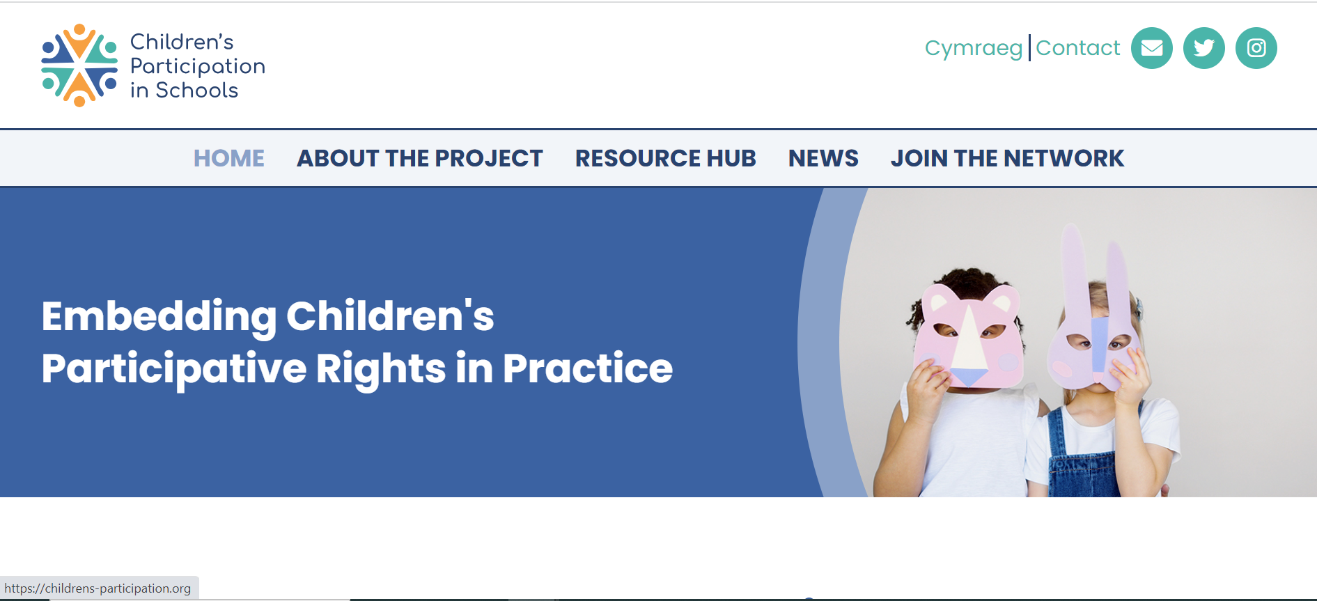



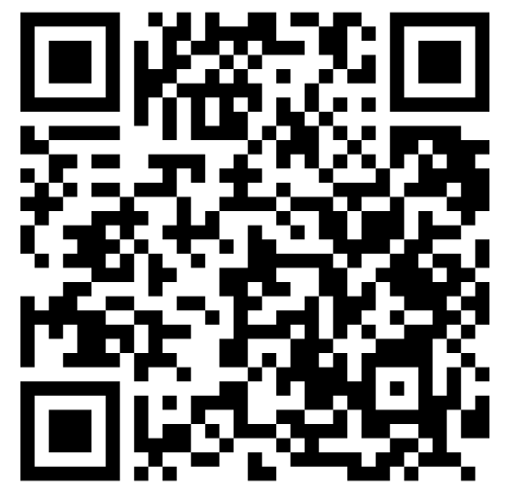
Keeping in touch with the project
  Follow us on Social Media!
@ChildPart
Children's Participation in Schools
child.participation@uwe.ac.uk
https://childrens-participation.org/
Website you can find out more about all parts of the project.
Resources Centre for all things related to children’s participation in schools
Become a Network Member - receive a monthly newsletter and invitation to our events
Latest news and events in the field such as upcoming training sessions, conferences and webinars.
Notes:
Jacqui / Sarah

