Slide 1
The organisation of mortgage fraud and its relationship to the governance, control, and regulation of financial services in England and Wales
Jonathan Gilbert
PhD Candidate
School of Social Sciences, Cardiff University
Shortlisted for 2021 PaCCS Research Snapshots Competition Early Career Researcher

Slide 2
What is mortgage fraud?
There is no statutory definition of mortgage fraud within the Fraud Act 2006
An otherwise convenient definition of mortgage fraud was proposed by the Law Commission as:
“the obtaining of mortgage advances on properties by making fraudulent statements” (1996, para.1.1)

Slide 3
The FBI defines mortgage fraud as either:
Fraud-for-property: “represented by illegal actions taken by a borrower motivated to acquire or maintain ownership of a house”
Fraud-for-profit: “misuse[s] the mortgage lending process to steal cash and equity from lenders or homeowners”

Slide 4
What has been written about the organisation of mortgage fraud?
Seminal study by Clarke, 1991
Clarke identified status and property (valuation abuse) frauds. Thematic review by the FSA (2011).
US studies from economic and anthropogeographical academics
Focused on the macro structural causes of the 2007/08 subprime crisis and wider social harm in the housing markets. See Carr (2007), Carswell & Bachtel (2009), and Fligstein & Goldstein (2010)
Organisation of crime
Body of literature available that supports a shift from an actor orientation for understanding complex financial crime to one which examines how these crimes are commissioned and how proximal/in situ and distal factors correspond with one another. See Levi & Maguire (2004), Edwards & Levi (2008)
Understanding crime through script analysis
Rational choice and routine activity theories can provide a workable theoretical framework for crime script analysis, Cornish and Clarke (2002)
Research based upon crime script analysis includes Jordanoska & Lord (2019) and their scripting of the mechanics of the LIBOR benchmark rigging scandal
Notes:
Clarke also identified systematic status abuse, and within property fraud connected it with valuation abuse and solicitor ‘going for broke’ fraud.

Slide 5
Research questions
How is mortgage fraud organised in England and Wales and what are the crime-commissioning processes for its occurrence?
How effective is the governance, control, and regulation of financial services in England and Wales in disrupting mortgage fraud?
Are the proximal causes of mortgage fraud underpinned by distal influences that are themselves related to causal, dispositional, and facilitative circuits of power?

Slide 6
Methodology
Philosophical foundations to research
Questioning, how is mortgage fraud organised implies an ontological belief in the concept-independence of mortgage fraud which has certain organised conditions that can be scripted
A critical realist approach will assist in understanding the interplay of agency (e.g. the actors, their routines and opportunity) and structure (e.g. the financial services market and regulatory frameworks)
Theory/data relationship
Layder’s adaptive theory (1998) where initial theoretical propositions guide data collection which can be adapted in accordance with findings; i.e. that mortgage fraud is perpetrated by motivated offenders targeting victim lenders in a physical space absent of capable guardians
Research design
Multiple case study
Data collection
Documents and interviews
Data analysis
Thematic and content analysis

Slide 7
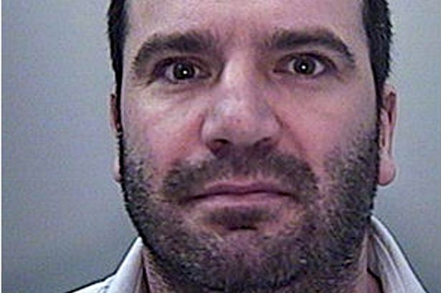
Ethical and practical considerations
Positionality: the researcher’s insider and outsider role
A new role for Convict Criminology or does the harm caused in its production outweigh the benefit?

Slide 8
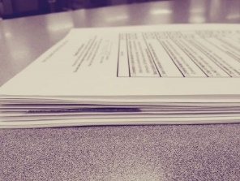
Data collected
Regulatory enforcement files
Solicitors Disciplinary Tribunal (SDT), Financial Conduct Agency (FCA), Royal Institute of Chartered Surveyors (RICS), Institute for Chartered Accountants in England and Wales (ICAEW)
Semi-structured interviews
Offenders (15), law enforcement (12), victim lenders (12), regulators (6), fraud prevention agencies (2)
Prosecution files and evidence
Operations Oyster, Azure and Cassandra
Select Committee proceedings and Hansard
Media reports
Notes:
Add here details on the number of cases identified and analysed

Slide 9
Why a case study design?
Sometimes considered as a less favourable design as they lack vigour; results are too long, indigestible; data collection is not routinised
Yin (2003) argues however that case studies:
1. cope with technically distinctive situations
2. rely on multiple sources of data, converging in a triangulating fashion
3. benefit from the prior development of theoretical propositions to guide data collection and analysis
“The case study is used in many situations to contribute to our knowledge of individual, group, organizational, social, political, and related phenomena…the distinctive need for case studies arises out of a desire to understand complex social phenomena” (ibid, p.10).
By comparing and contrasting 3 case studies of mortgage fraud the research objective is to adapt propositions about the interaction of the agents, their dispositions and facilitative conditions in order to understand the commission of mortgage fraud

Slide 10
The case studies:
Operation Oyster
A mortgage fraud conspiracy extending from 2009 until 2013, valued at £10,500,000 involving multiple enablers
Operation Azure
A mortgage fraud conspiracy extending from 2003 until 2011, valued at £5,000,000 involving principal fraudsters, an enabler, and co-conspirators
Operation Cassandra
A mortgage fraud conspiracy extending from 2005 until 2009, valued at £36,000,000 involving a principal fraudster, multiple enablers and co-conspirators

Slide 11
Operation Oyster: An overview of the organisation of a mortgage fraud conspiracy
A wide agreement between 3 conspirators, with ‘sub-agreements’ with 4 other conspirators
The fraud involved the misrepresentation of applicants’ income and the production and submission of false income information and documentation
The offending period lasted from 2009 to 2013
The prosecution asserted that at least 80 fraudulent mortgage applications were submitted, of which £5,500,000 completed, and where £5,000,000 did not
The police investigation lasted 6 years
4 pleaded guilty, the 3 remaining ran an 8 week trial that culminated in their conviction in January 2018
They were all subject to proceedings under the Proceeds of Crime Act 2002 and orders under the Serious Crime Prevention Act 2015

Slide 12
Data collected on Oyster
Prosecution case files and evidence
Media reports
Semi-structured interviews with 3 of the 7 offenders
Semi-structured interview with the Senior Investigating Officer
Semi-structured interview with the financial crime manager at Yorkshire Building Society, one of the victim lenders

Slide 13
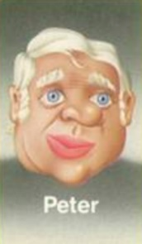
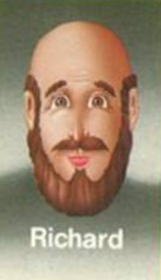
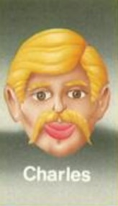
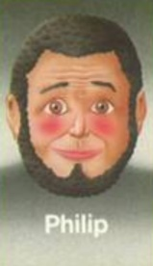
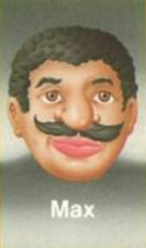
The actors, their roles and their social relations with one another
Paul | Ex bank manager, co-leading role
Peter | Mortgage broker, co-leading role
Charles | Accountant
Richard | Mortgage broker (unqualified and unauthorised) or introducer
Joe | Mortgage broker
Philip | Mortgage broker (unauthorised)
Max | Bookkeeper
Notes:
Summary script to read. Paul=Gay, Peter=Maxwell, Charles=Bacon, Richard=Pow, Joe=Bishop, Philip=Misra, Max=Mian

Slide 14
Proximal Conditions- Situational Settings
Knowledge and opportunity
Online mortgage application software
Targeting lenders who accept payslips, or accountant certificates; and those offering ‘fast-track’
CeMap and authorised brokers, Peter and Joe
Organisational dynamics
Paul was the main point of contact for all other actors
Limited or zero interaction between the other actors
Boundaries to the dishonesty, e.g. Charles refused to falsify self-assessment returns (SA302)
Local bad character referrals
Paul recruited Peter and referred him to applicants, Paul referred Peter, Joe, and Charles to one another
Criminogenic culture in the workplace
Delegating responsibilities
Employee deference

Slide 15
Distal conditions- remote settings
Competition in the financial services sector
Abuse of self-certified mortgages; the role of the Business Development Managers within the sector
Securitisation of mortgage products and the secondary mortgage market
Ignorance of red flags
Crude methods not identified by lenders
Is it a matter of risk or is it fraud?
Regulation, guardianship, and quasi-professionals
Varying qualifications amongst actors and consequently regulatory oversight
Failure of enforcement proceedings against ‘authorised’ actors, failure of regulatory deterrence strategies
Decriminalisation of mortgage fraud
Failure to report, failure to record and investigate
Criminal Justice System incapacity to prosecute

Slide 16
Paul: 3 years, 9 months
Peter: 5 years, 6 months
Charles: 5 years Sentence Range
Richard: 2 years, 2 months
Joe: 4 years
Philip: 2 years, 9 months
Max: 2 years, 5 months
NB Interviewees claimed the applicants were all complicit. The police disagreed:
“it was unique in that most of the mortgage applicants were not aware of the frauds that were being perpetrated on their behalf, to the point that ten of them were arrested by me in the first instance” DC Middleton

Slide 17
Rationalisation and techniques of neutralisation
Actor | Rationalisation, neutralisation
Peter | “I suppose I should have checked but how could I? If I called an employer to check a payslip they would probably tell me to get lost” “The majority were just Mr. and Mrs. who wanted to buy their home or remortgage it”. “When I went through the figures it came to £4,400 in fees that came from the dodgy deals. The CPS said it was so much more, but it wasn’t”
Charles | “What we did was wrong, but morally right, or should I say morally acceptable. Because it’s the norm really where everyone exaggerates or embellishes the truth, and the lenders chose to accept that in the course of their business, just like a manageable risk I suppose” “The mortgage companies are getting paid, there were no arrears on the accounts…They are all still paying their mortgages presumably”
Joe | “they [the lenders] gained business as the applicants, even though they signed off the mortgages were never asked to repay them” “these practices were rife in the sector, industry wide, particularly from the intermediaries, but the branches were involved too although they would deny it” “I remember the GMAC Star mortgage product…There was a ‘I hereby certify that I can afford the mortgage’ and that was it. We used to call them trailer park mortgages…It lit the fuse for the market to go bang!”

Slide 18
How then does Operation Oyster inform the crime script for mortgage fraud?

Slide 19
Knowledge of mortgage markets, access to speacialised software, payslip websites, victim-targeting
Local bad character referral, recruitment, complicity with other enablers
Absence of capable guardian, criminogenic culture within firms
Organisational dynamics, primary, and secondary
Proximal conditions: situational settings
Act 2: Application supported by payslips, accountant reference
Act 3: Counter enquiries raised, provide supplemental false statements, documents
Act 1: Victim targeting, coordinate enablers, identify underwriting weaknesses
Act 4: Completion or crime displacement and repeat
Offender agency: scenes
Competition in the financial services market, prudential risk failures, and a defective securitisation model
Reactive regulation, unlicensed enablers
Limitations in governance and control, impact of austerity and a constrained CJS
Absence of capable guardianship, failures in sanctioning and deterrence strategies
Distal contexts: remote settings

Slide 20
Regulatory response- an overview
Regulatory enforcement files provided data on typologies and patterns of professional misconduct
Instances of regulatory failure to sanction, as in the Oyster case study
Data suggests that regulatory outcomes are reactive in nature not proactive and are cyclical with boom and bust in the property markets
Interviews with regulators reveal the obstacles in investigating misconduct, particularly evidence seizure
Varying levels of co-operation with law enforcement and other regulators under Memorandums of Undertakings
Regulator | Period | Cases reviewed | Mortgage fraud/ Hallmarks
SRA/SDT | 2009-2015 | 532 | 121
FSA/FCA | 2009-2015 | 1,360 | 199 (118)
ICAEW | 2012-2020 | 970 | 2
RICS | 2010-2020 | 144 | 6

Slide 21
Findings
Crime scripts are an effective way of understanding how mortgage fraud is organised and how it is reproduced and disrupted
Proximal causes of mortgage fraud are underpinned by distal influences; viewing them as distinct conditions will limit understanding
The circuits of power concept helps to define and subsequently adapt theoretical propositions about the reproduction and disruption of mortgage fraud, through:
The causal agency and biographies of offenders; and
The rules of meaning and membership of the victim lenders and whether or not they buy in and mobilise themselves in the arms race with fraudsters; and
The facilitative conditions for reproduction or disruption afforded by the state’s response to the financial crisis of 2007/08, and the regulatory framework for financial services in England and Wales
This research supports a contemporary criminological understanding of the organisation of complex financial crime, that broadens the scope beyond individual actors to include other agents and facilitating conditions and their implications for fraud prevention. Additionally, it advances the sub-discipline of convict criminology to understand crime, beyond research into the Criminal Justice System exclusively.

Slide 22
References
Carr, J.H. 2007. Responding to the foreclosure crisis. Housing Policy Debate 18(4), pp. 837–860. doi: 10.1080/10511482.2007.9521623.
Carswell, A.T. and Bachtel, D.C. 2009. Mortgage fraud: A risk factor analysis of affected communities. Crime, Law and Social Change 52(4), pp. 347–364. Available at: http://link.springer.com/10.1007/s10611-008-9186-5.
Clarke, M. 1991. Mortgage Fraud. First. London: Chapman and Hall.
Cornish, D.B. and Clarke, R. V. 2002. Analyzing organized crimes. Rational choice and criminal behavior: Recent research and future challenges 16(2003), pp. 41–64.
Edwards, A. and Levi, M. 2008. Researching the organization of serious crimes. Criminology and Criminal Justice 8(4), pp. 363–388. doi: 10.1177/1748895808097403.
Edwards, A. 2016. Multi-centred governance and circuits of power in liberal modes of security. Global Crime 17(3-4), pp. 240-263. Available at Multi-centred governance and circuits of power in liberal modes of security (tandfonline.com)
Financial Services Authority. 2011. Mortgage fraud against lenders. A thematic review of lender’s systems and controls to detect and prevent mortgage fraud. Available at: fsa-mortgage-fraud-lenders.pdf (fca.org.uk)
Fligstein, N. and Goldstein, A. 2010. The anatomy of the mortgage securitization crisis. In: Markets on Trial: The Economic Sociology of the U.S. Financial Crisis., pp. 29–70. doi: 10.1108/s0733-558x(2010)000030a006
Jordanoska, A. and Lord, N. 2019. Scripting the mechanics of the benchmark manipulation corporate scandals: The ‘guardian’ paradox. European Journal of Criminology . Available at: http://journals.sagepub.com/doi/10.1177/1477370819850124.
Levi, M. and Maguire, M. 2004. Reducing and preventing organised crime: An evidence-based critique. Crime, Law and Social Change 41(5), pp. 397–469. doi: 10.1023/B:CRIS.0000039600.88691.af.
Yin, R.K. 2003. Case Study Research Design and Methods. Third. London: Sage.

