Slide 1
2024 Annual Conference
N2
Silent Suffering
The unmet sexual health needs of male sex workers
Jane Meyrick
Kevin Turner
Matt Wood
UWE
Senior Health Adviser
Northumbria University

Slide 2
?
Condoms
How can we improve offers of support from sexual health services ?
STI/HIV Testing
Vaccinations
PrEP
Notes:
The health and wellbeing need of Male Sex Workers are largely informed by misconceptions of sexual labour that drive physical health interventions to focus on perceived needs around sexual health and wellbeing.
These include condom provision, increased access to STI/HIV testing, Vaccination programmes for HAV/HBV/HPV and more recently PrEP.

Slide 3
We have to change what we are calling sex work…
OLIVER

Slide 4
SEX WORK
Notes:
Across interviews men spoke about a lack of recognition with traditional sex worker terminology often used by sexual health clinics in attempts to ‘reach them’.

Slide 5
SEX WORKERS

Slide 6
to be honest i never really thought about being a sex worker, I didn’t think about it under that guise
JOHN SMITH

Slide 7
A lot of men don’t use terms like sex worker, mostly because they don’t conceive of it as work
SIMON

Slide 8
Clinics can start by using really inclusive language…
LUKE

Slide 9
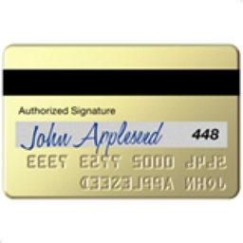
escort
stripper
porn actor
porn performer
male sex worker
masseur
adult entertainer
SEX WORKERS
content creator
creator
performer
‘only fans’
‘just for fans’
receives money for sex
Notes:
It’s not about using all of these terms, but recognising that one label doesn’t connect or speak to the people it needs to reach

Slide 10
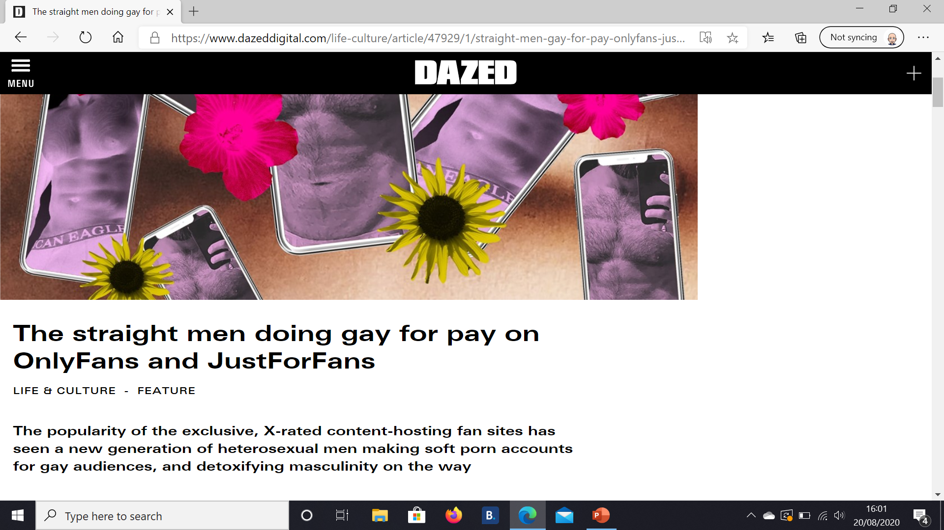

Slide 11
Accepting rewards
Notes:
Don’t label the people
Describe the behaviour-to do this we need to understand the way that they work- Bridge into tools of the trade

Slide 12
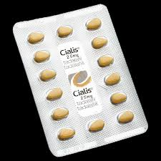
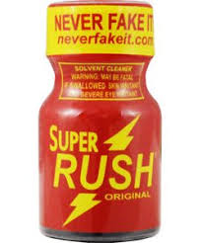
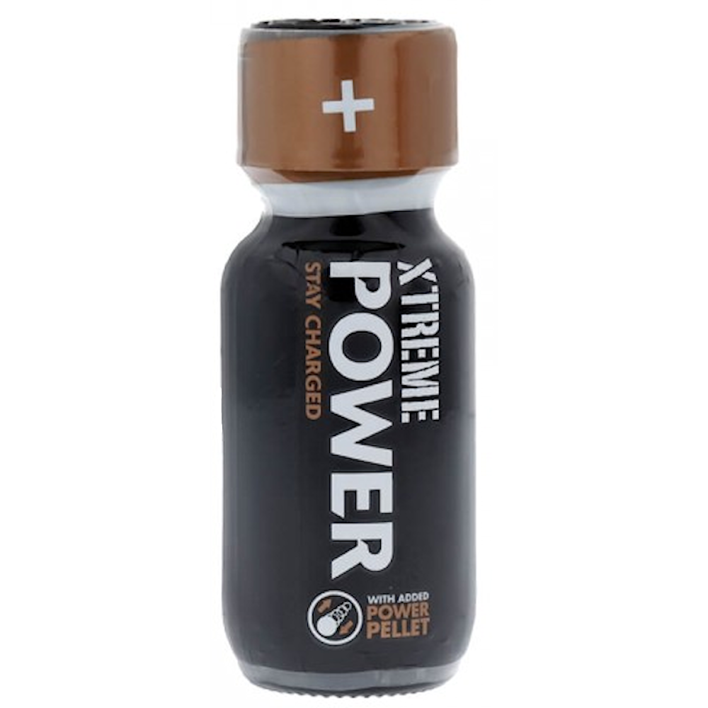
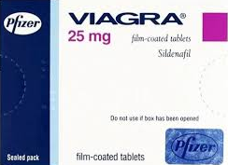
tools of the trade
Staying hard for longer- experimental drug use
Notes:
Within interviews participants spoke about the common use of drugs such as Viagra to help support maintain or improve their sexual performances for reward sex
In particular there was an interest in experimenting with and abusing substances that would help them stay harder for longer

Slide 13
It’s pretty common for guys to try out various drugs to stay hard for longer, lots of them misusing viagra are also using cocaine.
RICKY

Slide 14
If you take Viagra you just know, you don’t have to think about it, it’s coming up no matter what… I can tell you now, every guy in porn is on Viagra
MARC
Notes:
Understanding what we do

Slide 15
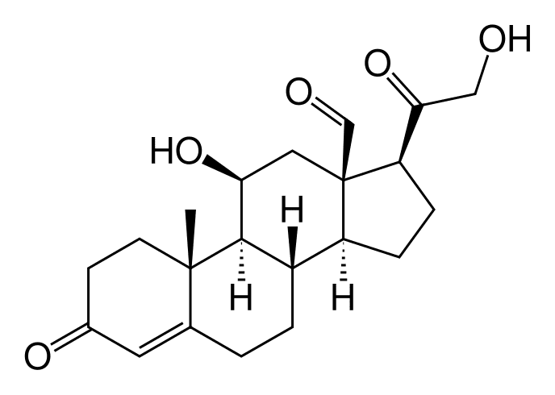
tools of the trade
Staying hard for longer- experimental drug use
Having the right look - steroids
Notes:
Having the right look- steroid use was framed outside of intravenous drug use.
Reputation

Slide 16
Body image is one I suffered with, you’re looking at other guys, they were bigger than me, I wanted to be the desired one, I ended up trying steroids which is very big in the industry
RICKY

Slide 17
I learnt how to inject from reading an article online, people don’t want to walk into Boots for needle exchange, others would continuously use needles even when they were blunt.
RICKY
Notes:
Understanding what we do

Slide 18
tools of the trade
RESULTS LETTER
Staying hard for longer- experimental drug use
Having the right look - steroids
Being reputable- certs
Notes:
Men don’t want to say why they need PrEP

Slide 19
Never use condoms, that’s why we get certed, condom scenes don’t sell, that’s why we get tested for everything
MARC

Slide 20
I’m not going to date outside of the industry anyway because it’s safer, because people are actually certed
CHRIS

Slide 21
The main problem is having to wait 16-18 days to get your results back which is not great
CHRIS

Slide 22
NHS GUM clinics are like “oh you want a letter?”, “what’s that for?”, “why do you want a letter?” you have to write it for them because they don’t know what to write
CHRIS

Slide 23
PrEP
Men do not associate themselves as being high risk due to:
Certs
Professional sexual partners
Sexual behaviours
Many felt that accessing PrEP was difficult- this led to:
Sharing supplies with others
Concentrating work to reflect rationing

Slide 24
I don’t use PrEP because I wouldn’t do high risk things
CHRIS

Slide 25
They are scared to bring it up at sexual health clinics, which means a lot of them just don’t go and get PrEP
SIMON

Slide 26
others don’t take it properly , because they are sharing it between people, so each of them has a month's dose, they will see a bunch of clients in one day.
SIMON

Slide 27
If sexual health clinics were saying “ we have PrEP and we have it for sex workers and we are not going to be weird about it”…people are too freaked out about being open with services.
SIMON
Notes:
Understanding what we do

Slide 28
barriers
Inability to access ‘certs’
Lack of cultural competency around industry requirements from sexual health staff
Assumptions from clinical staff
Notes:
An industry requirement for proof of regular testing meant that local sexual health services were an ideal destination to support the health and wellbeing of MSW’s
However an inability to provide expedited test results in the form of certificates and lack of cultural competency led to MSWs to attend a single london based clinic.
Instead, assumptions from staff further reduced capacity for men to access services.

Slide 29
I think it would be really useful if sexual health clinics had other resources that they could give out
CHRIS
Notes:
Everything is female
-health is nested in a wider support offer for women- we need to start thinking about doing the same for men

Slide 30
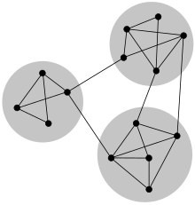
wellbeing
Isolation
Peer support- stealthing, sexual assault, non-payment
Toxic masculinities
Relationships
Pressures of desire: Sexual performance / aesthetics
Needle exchange
Notes:
Women nested in one health care offer- works- lets open it up

Slide 31
Some places will be like “oh we cater of sex workers”, but sex workers aren’t just going to show up
SIMON

Slide 32
What we need is more engagement, rather than people pretending that we don’t exist
CHRIS

Slide 33
Conclusions
Improved cultural competency within health care services
Co-production alongside lived-experience
Engagement need to be ongoing- trust is key
Deliver care that meets actual rather than perceived need
Discrete not tokenistic services

Slide 34
get in touch
Kevin Turner
kevin.turner6@nhs.net
kevinvestig8s

