Slide 1

The role of GBGI in levelling up in Bristol
Presented by
Issy Bray
Issy Bray (Associate Professor in Public Health Epidemiology)
Danielle Sinnett (Professor in Sustainable Built Environments)
Harry West (Senior Lecturer in Geography and Environmental Management)
23 May 2024

Slide 2
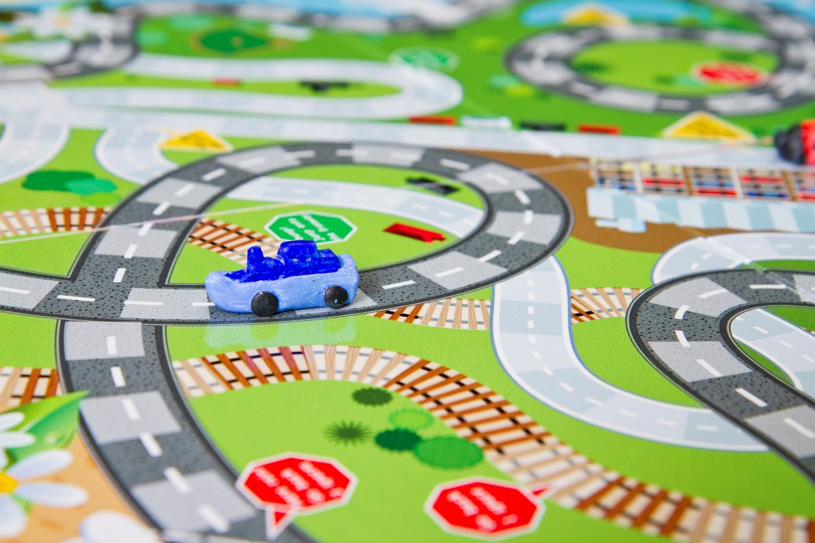
Background
Mental health, particularly for urban populations, is a growing public health concern
Understanding how people relate to and feel a sense of belonging in the urban environment is an important research agenda
There is mounting evidence about the importance of green (e.g. parks, trees) and blue (e.g. rivers, lakes) infrastructure for the health and wellbeing of urban residents
There is also emerging evidence about the benefits of certain ‘grey’ features (e.g. historic buildings, active travel routes)

Slide 3
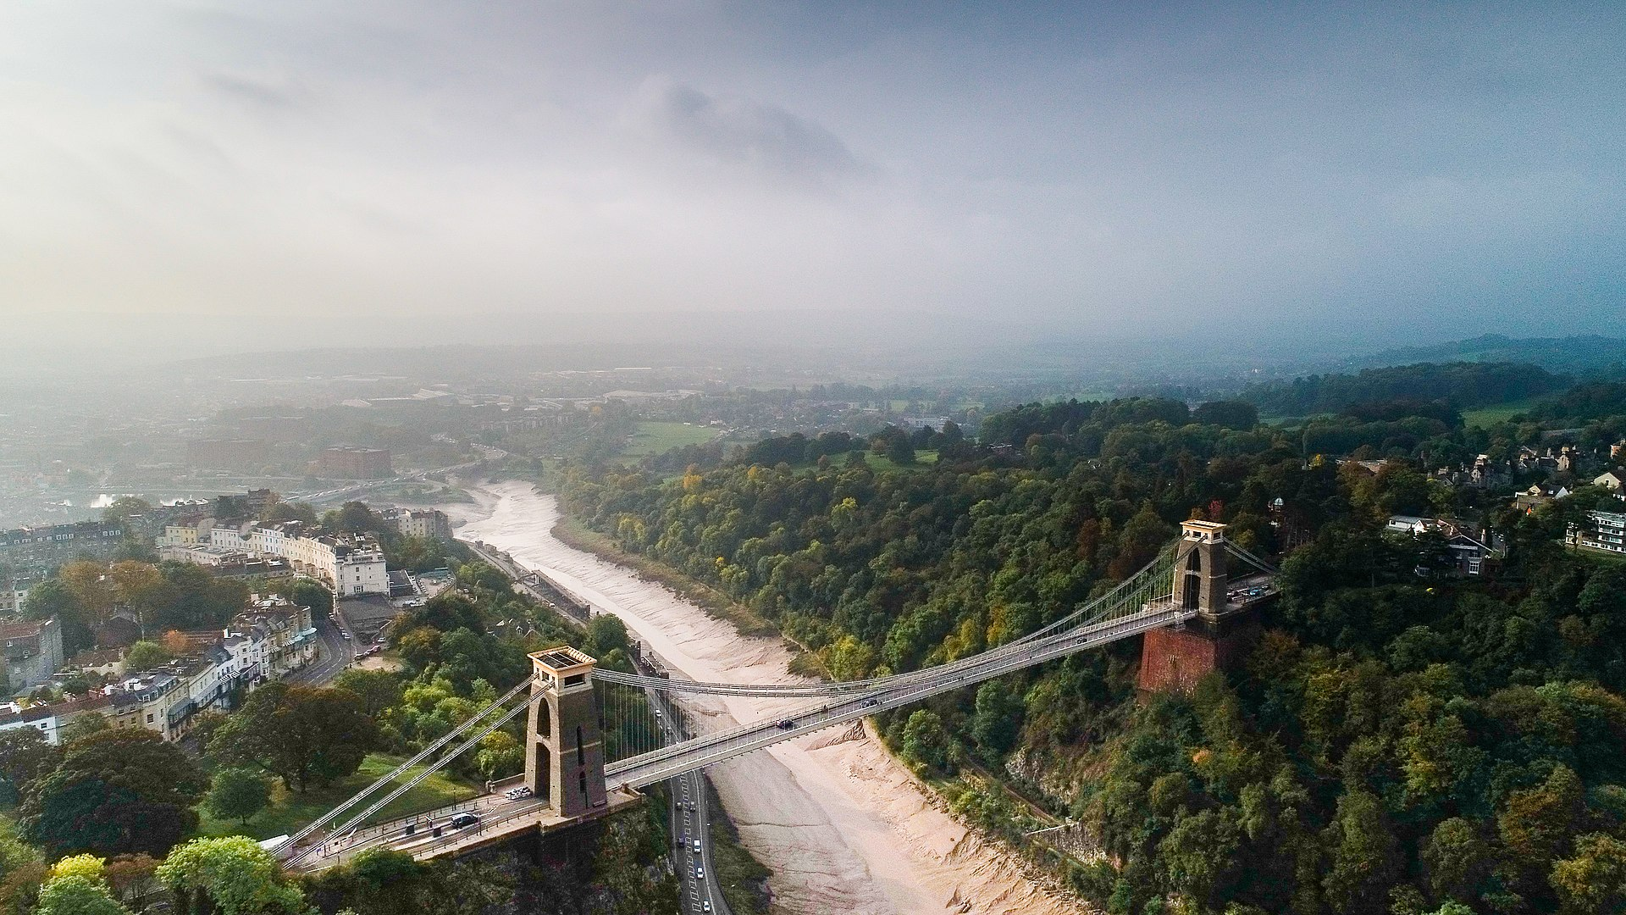
Objective
Our RECLAIM project “The role of GBGI in levelling up across Bristol” seeks to explore relationships between Green-Blue-Grey Infrastructure (GBGI) and a range of health and social outcomes in neighbourhoods across Bristol

Slide 4
Analysis of Secondary Data
GBGI provision
NDVI
GBGI experience
Satisfaction (e.g. with green spaces, leisure facilities)
Health and social outcomes
Neighbourhood satisfaction
Residential proximity of GBGI features
Life satisfaction
Wellbeing
General health
Use (of green space)

Slide 5
Analysis of Secondary Data
GBGI provision
NDVI
GBGI experience
Satisfaction (e.g. with green spaces, leisure facilities)
Health and social outcomes
Neighbourhood satisfaction
Residential proximity of GBGI features
Life satisfaction
Wellbeing
General health
Use (of green space)
Multiple open access sources
Bristol City Council Quality of Life survey

Slide 6
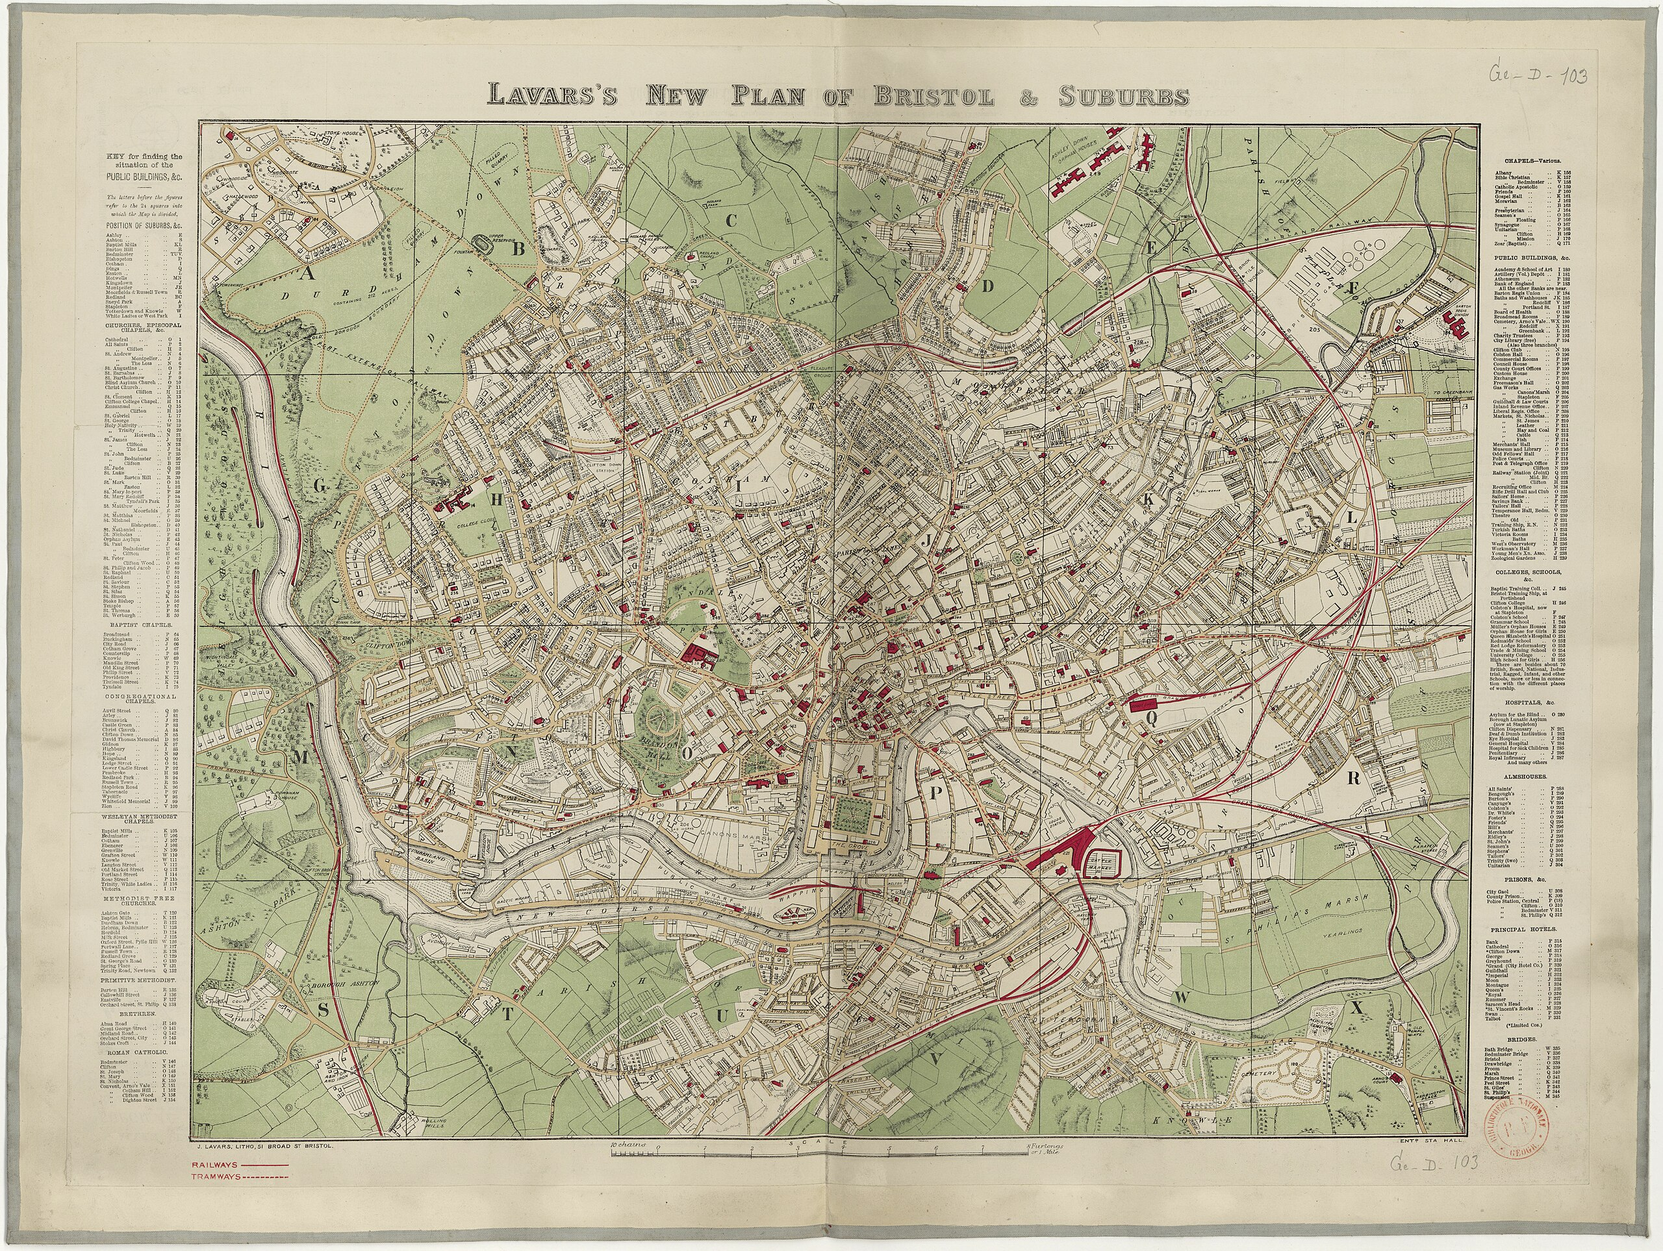
Bristol Quality of Life Survey
The Bristol City Council (BCC) Quality of Life (QoL) survey provides an annual snapshot of the quality of life across Bristol
The survey has run since 2001, with approximately 3,000-5,000 responses per year
The survey includes up to 190 indicators of QoL and wellbeing of residents
Our project analysed data from 2011-2022, supplied at postcode level to preserve anonymity of respondents

Slide 7
Analysis
Using spatial analysis and logistic regression models, we have explored associations between GBGI provision and self-reported outcomes from the Bristol Quality of Life Survey:
    Neighbourhood Satisfaction
    Life Satisfaction
    Wellbeing (Short Warwick-Edinburgh Mental Wellbeing Scale)
    General Health (self-reported over 12 months)

Slide 8
Analysis
Using spatial analysis and logistic regression models, we have explored associations between GBGI provision and self-reported outcomes from the Bristol Quality of Life Survey:
    Neighbourhood Satisfaction
    Life Satisfaction
    Wellbeing (Short Warwick-Edinburgh Mental Wellbeing Scale)
    General Health (self-reported over 12 months)
Binary outcomes

Slide 9
Analysis
Using spatial analysis and logistic regression models, we have explored associations between GBGI provision and self-reported outcomes from the Bristol Quality of Life Survey:
    Neighbourhood Satisfaction
    Life Satisfaction
    Wellbeing (Short Warwick-Edinburgh Mental Wellbeing Scale)
    General Health (self-reported over 12 months)
Including GBGI experience (satisfaction and use), and other neighbourhood issues, as predictors
Binary outcomes

Slide 10
Analysis
Using spatial analysis and logistic regression models, we have explored associations between GBGI provision and self-reported outcomes from the Bristol Quality of Life Survey:
    Neighbourhood Satisfaction
    Life Satisfaction
    Wellbeing (Short Warwick-Edinburgh Mental Wellbeing Scale)
    General Health (self-reported over 12 months)
Including GBGI experience (satisfaction and use), and other neighbourhood issues, as predictors
Controlling for demographics, socio-economic status (qualification and income) and year
Binary outcomes

Slide 11
GBGI Provision
Green | Blue | Grey
Urban tree coverage (canopy area) | Waterbody access | Cycle network access
Normalised Diff Veg Index (NDVI) |  | Rail network access
Greenspace access |  | Bus stop access
Woodland access |  | Road access and characteristics
Conservation area access |  | Social infrastructure access
Outdoor sports facility access |  | Leisure centre access
Private garden coverage |  | Density of historic/listed buildings
 |  | Building coverage
N.B. Calculated as network distance from postcode centroid and/or an areal measure based on a 10min walking area

Slide 12
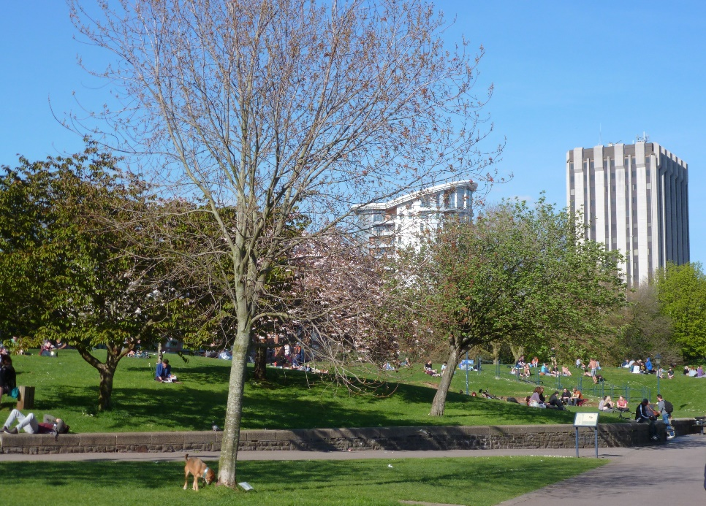
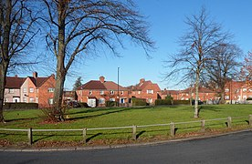
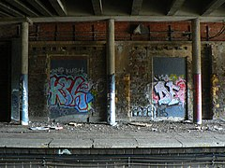
GBGI Experiences
  Green space:
  satisfaction
  frequency of use
  Neighbourhood issues:
  sense of belonging
  safety
  noise/litter/dog fouling
  Satisfaction with:
  bus service
  museums
  leisure facilities

Slide 13
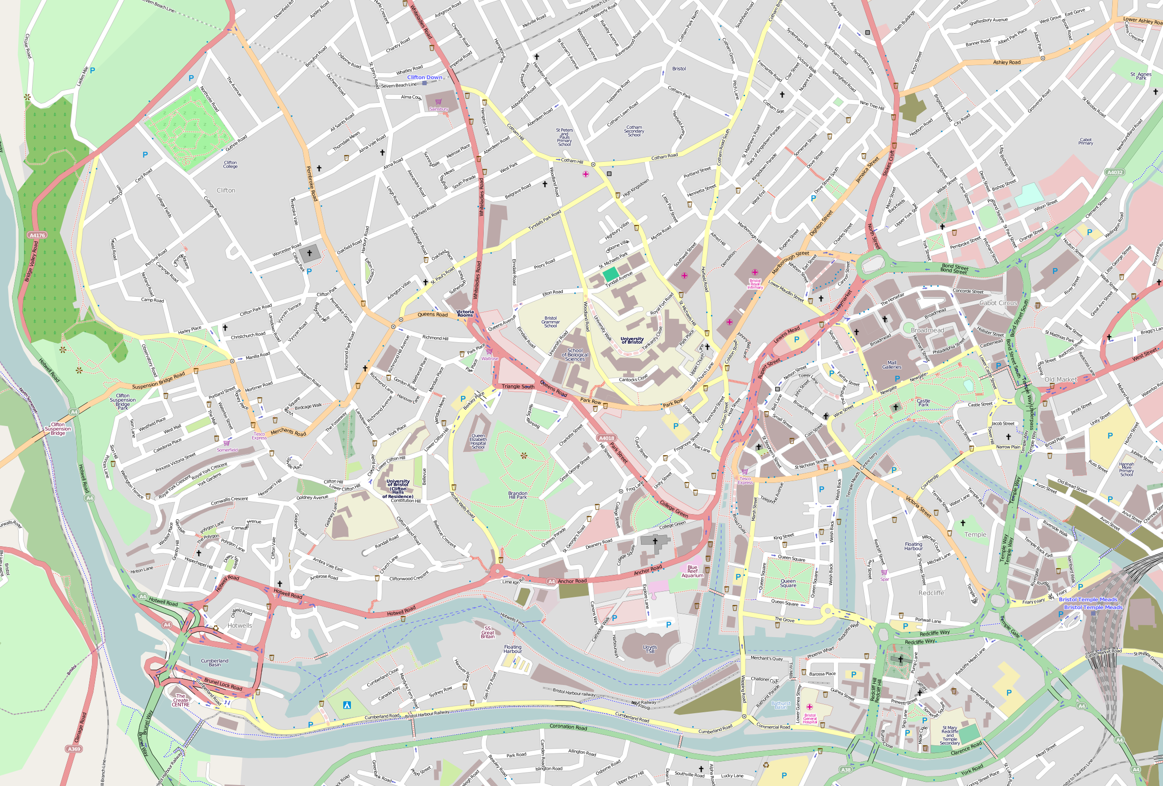
Model Fitting
For each wellbeing outcome:
  Fit model with all GBGI provision and experience variables (controlling for calendar year)
  Retain statistically significant variables
  Control for demographic variables and socio-economic status (qualifications and income)
  Interpret final model
For each wellbeing outcome:
  Fit model with all GBGI exposure and GBGI experience variables
  Retain statistically significant variables
  Control for demographic variables and socio-economic status
  Interpret final model
Summary of Model Fit
Model | Cox & Snell R² | Nagelkerke R²
1. Neighbourhood satisfaction | 0.276 | 0.438
2. Life satisfaction | 0.104 | 0.139
3. Wellbeing | 0.081 | 0.109
4. General health | 0.166 | 0.303

Slide 14
Neighbourhood Satisfaction
Variable | % increase in outcome | P-value
Neighbourhood belonging (1-5) | 51% | <.001
Neighbourhood safety (1-5) | 51% | <.001
Street litter (1-3) | 38% | <.001
Neighbourhood noise (1-3) | 30% | <.001
Greenspace satisfaction (1-5) | 28% | <.001
Museum satisfaction (1-5) | 12% | <.001
Leisure centre satisfaction (1-5) | 10% | <.001
Bus satisfaction (1-5) | 6% | 0.001
Libraries satisfaction (1-5) | 6% | 0.008
Significant predictors of neighbourhood satisfaction:
Distance to outdoor sports facility (km) | -27% | 0.006
No demographic or socio-economic variables were significant

Slide 15
Life Satisfaction
Variable | % increase in outcome | P-value
Neighbourhood belonging (1-5) | 5% | <.001
Neighbourhood safety (1-5) | 6% | <.001
Neighbourhood noise (1-3) | 6% | 0.004
Greenspace satisfaction (1-5) | 6% | <.001
Private garden coverage (10%) | -4% | <.001
Leisure centre satisfaction (1-5) | 10% | <.001
Distance to bus stop (100m) | -6% | 0.003
Density of historic/listed buildings (per 10) | -1% | 0.013
Significant predictors of life satisfaction:
Demographic factors (disability, age, sex, ethnicity, retired or permanently sick/unemployed) and socio-economic status (qualification and income) were all highly significant
After controlling for these, distance to accessible woodland (p=0.05) and NDVI (p=0.09) were marginally significant

Slide 16

Wellbeing
Significant predictors of wellbeing:
Demographic factors (disability, sex, ethnicity, retired or permanently sick/unemployed) and socio-economic status (qualification and income) were all highly significant
Variable | % increase in outcome | P-value
Greenspace satisfaction | 5% | <.001
Distance to rail station (km) | 4% | 0.02

Slide 17

General Health
No GBGI provision or experience variables were significant predictors of general health
Demographic factors (disability, sex, ethnicity, or permanently sick/unemployed) and socio-economic status (qualification and income) were all highly significant
After controlling for these, building coverage (p=0.07) was marginally significant
After that, the smallest p-values for GBGI variables were for NDVI (p=0.15) and greenspace use (p=0.17)

Slide 18
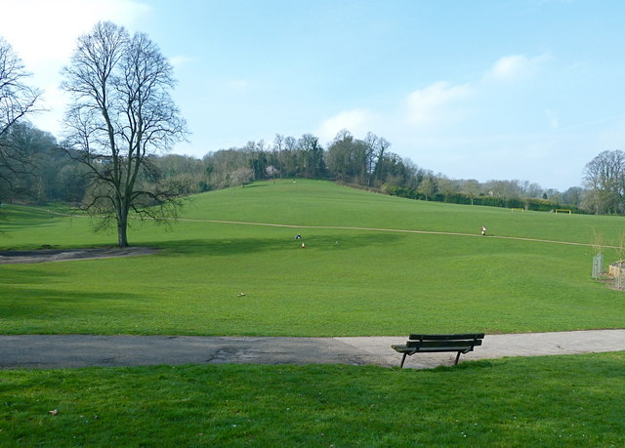
Summary of Findings
GBGI satisfaction predicts neighbourhood satisfaction (more than socio-demographics)
For life satisfaction and wellbeing, a range of GBGI provision and satisfaction variables are significant predictors, but socio-demographics were also important
There are less strong associations between GBGI variables and general health, having controlled for socio-demographics

Slide 19
Summary of Findings
Satisfaction with green space was the most consistent predictor of the outcomes considered
Areas in South Bristol have similar NDVI or green space access to areas in North Bristol, but satisfaction in these areas is much lower
Garden area had a negative relationship with life satisfaction, emphasizing that access to green space in itself is not an effective measure
Consideration must be given to the quality of green space, and other improvements to neighbourhood infrastructure

Slide 20
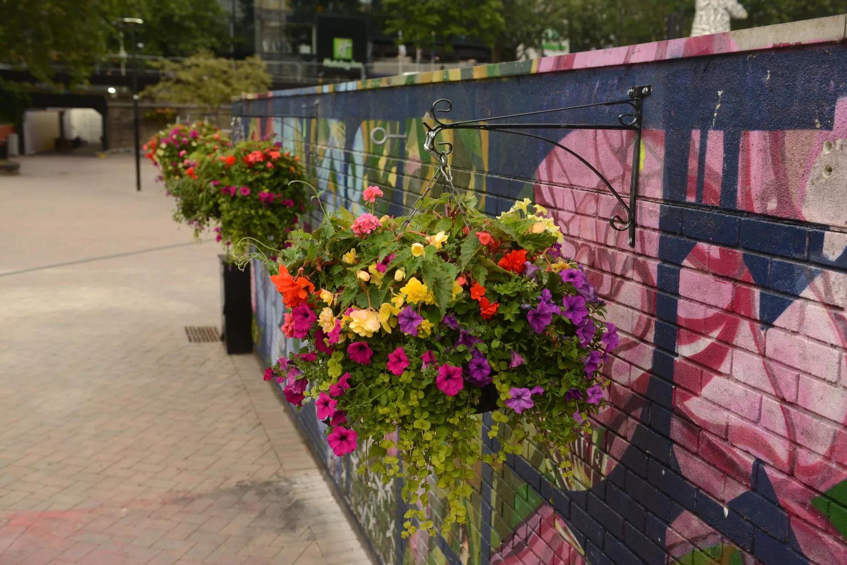
THANK YOU issy.bray@uwe.ac.uk
The Bearpit, Bristol
Renovated 2019
Source: Bristol Post

