Slide 1
Panel 2: Teaching EU Law and Policy: Variations and innovations
Teaching EU Law Using Workbooks
Christian Dadomo
Noëlle Quénivet
Bristol Law School, University of the West of England

Slide 2
Teaching Based on Workbooks
Synchro-nous and asynchro-nous
Online and on campus
Teaching
asynchronous online recorded materials (RM): recordings to watch in your own time, at your own pace before the workshop.
asynchronous online activities (OA): activities you can do in your own time, at your own pace before the workshop. Some of these activities are to be carried out after the workshop, in your own time, to test your knowledge/understanding and are indicated as such.
synchronous activities (W): activities in the form of workshops taking place in real-time and either online or on campus.

Slide 3
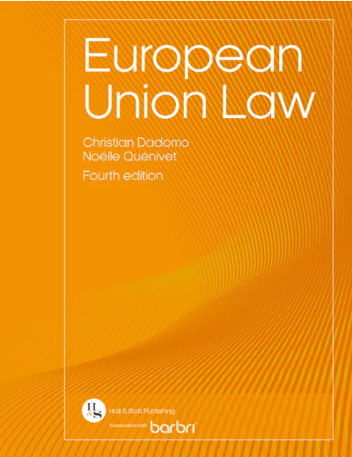
Teaching Based on Textbook

Slide 4
Workbooks – Content and Structure
Semester 1: Institutional Law and Remedies
Unit 1: Foundations and Constitutional Pillars of European Union Law
Workbook 1.1: Foundations of European Union Law
Session 1: Who Runs Europe? - History of the EU; Institutional Framework and Political Institutions
Session 2: Competences; Sources of EU Law; Law-making Process
Workbook 1.2: Constitutional Pillars of European Union Law
Session 3: Principle of Supremacy of EU Law
Session 4: Principle of Direct Effect
Unit 2: The European Judiciary and Remedies
Workbook 2.1: The Court of Justice of the European Union and Effectiveness of European Union Law
Session 5: The CJEU: Structure, Organisation, Jurisdiction and Working
Session 6: Effectiveness of EU law: Enforcement under Article 258-260 TFEU
Session 7: Effectiveness of EU law: State Liability
Workbook 2.2: Preliminary Rulings and Judicial Review
Session 8: Preliminary References and Rulings under Article 267 TFEU
Session 9: Judicial Review under Article 263 TFEU
Semester 2: The Law of the Internal Market
Unit 3 – Workbook 3: EU Citizenship and Freedom to Exercise an Economic Activity
Session 10: EU Citizenship and Free Movement of Persons (General)
Session 11: Freedom to Exercise an Economic Activity – Workers and Self-Employed Persons and Non-Discrimination
Session 12: Limits to Free Movement Rights
Unit 4 – Workbook 4: Free Movement of Goods
Session 13: The Customs Union and the Abolition of Tariff Barriers
Session 14: Prohibition of Non-Tariff Barriers
Session 15: Derogations and Justifications
Unit 5 – Workbook 5: Competition Law
Session 16: Prohibition of Anti-competitive Agreements
Session 17: Prohibition of Abuse of Dominant Position
Session 18: Public and Private Enforcement of Competition Law
Session 19: Revision / Skills

Slide 5
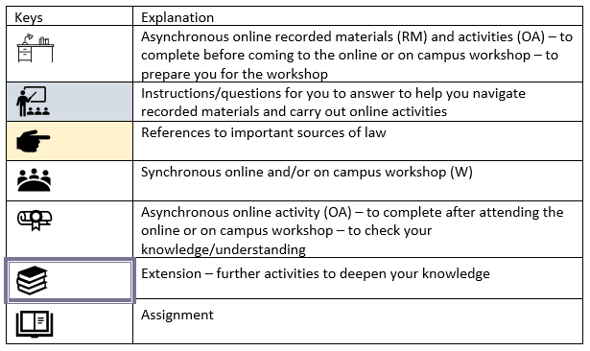
Workbooks – Section ‘Introduction’
Aims of the workbook
Learning outcomes of the workbook
Link between units
Link between the unit and the assessment
Keys to understanding the workbook
Structure

Slide 6
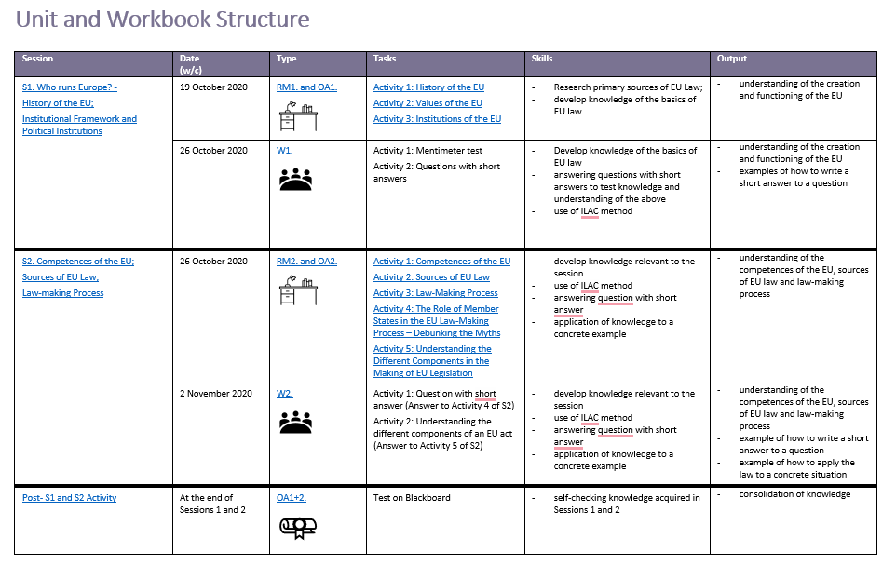

Slide 7
Asynchronous Online Recorded Materials
YouTube videos – from EU institutions and from other lecturers/experts
Recorded ‘lectures’ by ourselves
Interviews

Slide 8
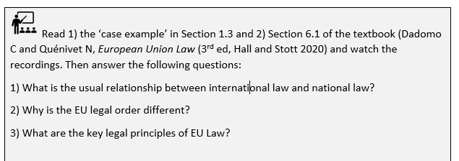
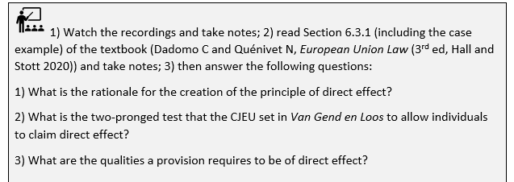
Asynchronous Activities – Pre-Workshop – Questions

Slide 9
Asynchronous Activities – Pre-Workshop – Diagrams
Analysing the law
Repeating facts
Understanding the law

Slide 10
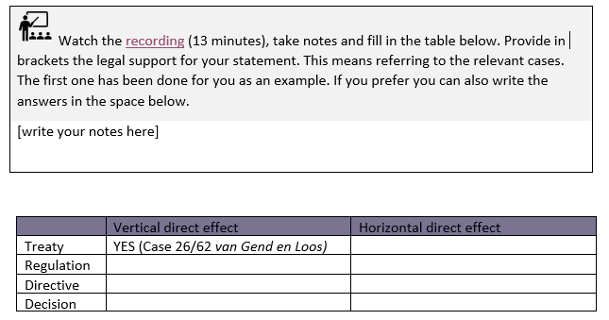
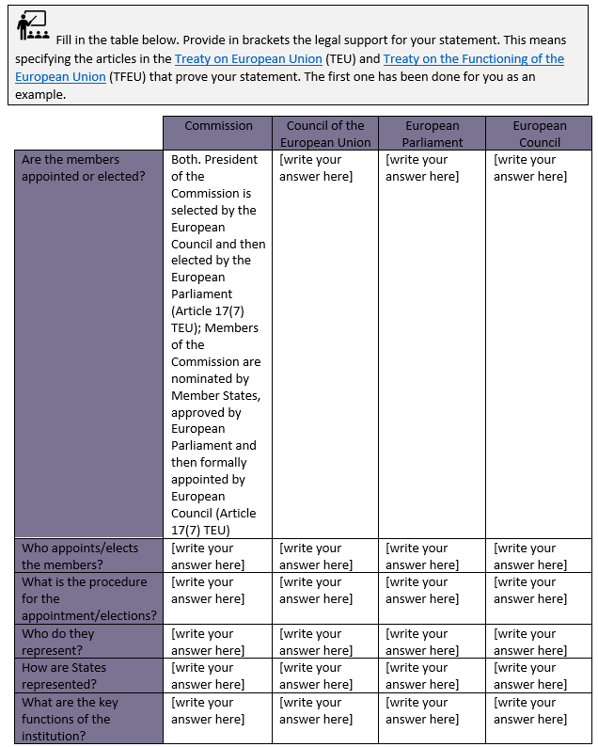
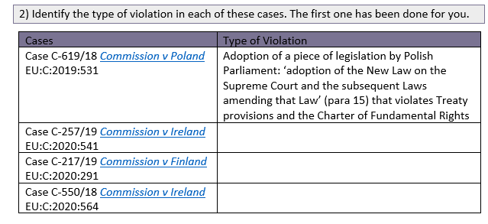
Asynchronous Activities – Pre-Workshop – Tables

Slide 11
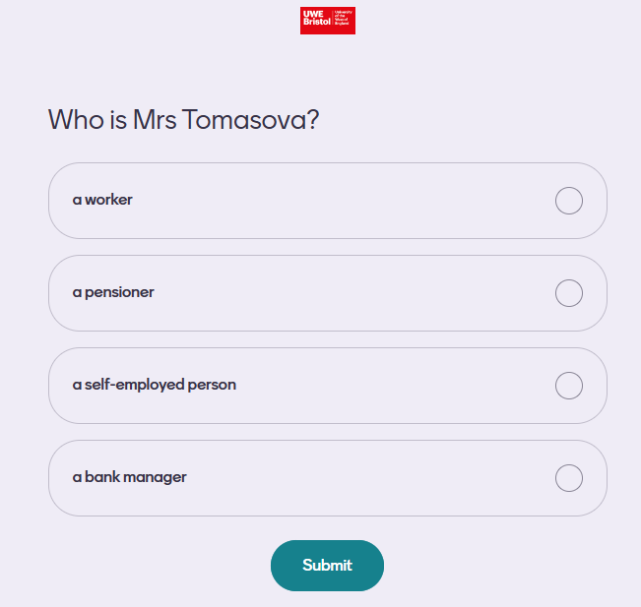
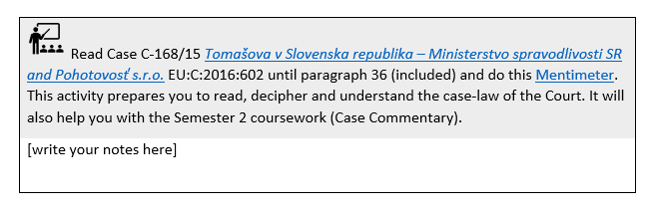
Asynchronous Activities – Pre-Workshop – Mentimeter

Slide 12
Synchronous Activities – Workshops
Mentimeter – tutor-paced
Classic essay- and problem-questions

Slide 13
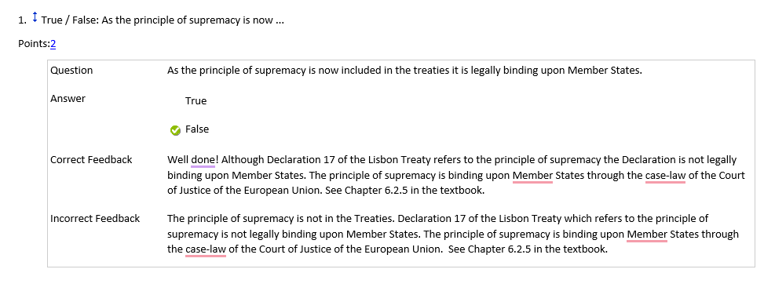
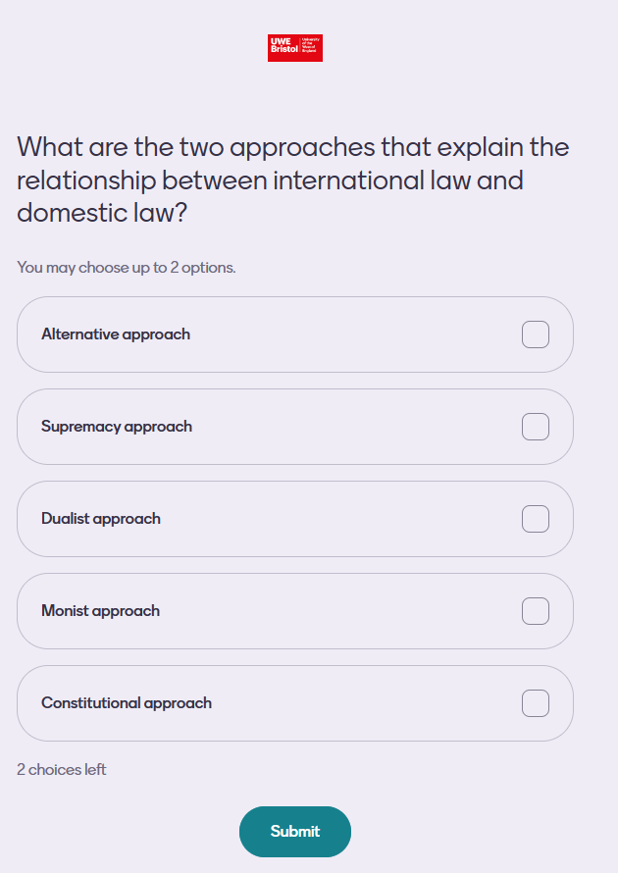
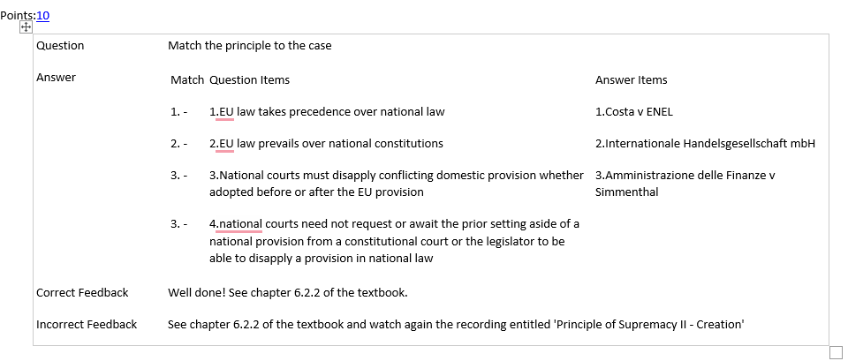
Asynchronous Activities – Post-Workshop

Slide 14
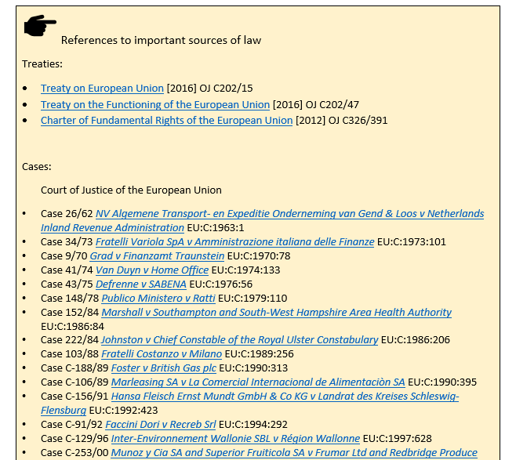
References

Slide 15
Extension
Videos
Quizlets
Further reading
Browsing of websites
Blog posts
Briefings by the European Parliamentary Research Service

