Slide 1
Economic Crime in War
Dr Branislav HOCK
Prof. Dr. Noëlle QUENIVET

Slide 2
Economic Crime and Warfare
Economic crime and warfare are closely connected
Yet their interrelation and the role of policing in disrupting harmful effects of economic crime in warfare are still poorly understood.
By highlighting key examples of how economic crime links to war, we aim here to open the discussion on specificities of policing economic crime in war and how do it effectively.
https://liveuamap.com/

Slide 3
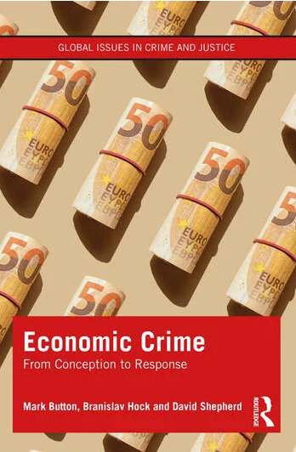
Fraud
Bribery and corruption
Cartel and antitrust offences
Economic cybercrime
IP crime and illicit trade
Industrial and economic espionage
Money laundering
‘Economic crime is a typology of financially motivated crimes and deviant acts perpetrated by corporations, groups or individuals, which take place predominantly by deception without a threat of or actual physical force against any person or entity, with the intention of making a gain or causing a loss, and where there is a prima facie case for criminal, regulatory or civil justice. It commonly includes crimes predominantly linked to the production, distribution and consumption of goods and services such as fraud, bribery, money laundering and terrorist financing, intellectual property crime, industrial (and economic) espionage, market manipulation, tax evasion, and financially motivated cybercrime’.
M Button, B Hock and D Shepherd, Economic Crime. From Conception to Response (Routledge 2022) 14

Slide 4
Economic Crime, Peace and Security
Economic crime have major impact on national security and global peace
Bribery, money laundering, and cyber-enabled fraud even fuel war crimes, including torture, terrorism and forced transfers of people
New knowledge on effective response to economic crime as a matter of national/international security is urgently needed – a major policy shift in economic crime policing from purely finance-driven to policing motivated by the protection of national security
Bribery at a time of war is “high treason”.
President of Ukraine (as cited in Reuters 2023)
Corruption allegations “pose a threat to Ukraine’s national security and undermine confidence in state institutions”.
Office of the President of Ukraine (as cited in Reuters 2023)

Slide 5
Examples of Economic Crimes in the Russo-Ukrainian War
Domestic economic crime – Ukraine: e.g. bribery; corruption associated with aid.
Ukraine's SBU security service had uncovered a corruption scheme in the purchase of arms by the country's military totalling the equivalent of about $40 million. (28 Jan 2024)
2. Transnational nature of economic crimes
War profiteering
Global sanctions and their evasion – links to UK
Traditional cross-border frauds:
Non-existent goods being falsely advertised on social media networks, phishing links deployed to capture bank card details, and bogus messages being sent to victims demanding payment to resolve fictitious problems. Victims of the 80,000-odd fraud cases recorded last year included military personnel and volunteers, families of those killed in action fighting the Russians, and people who have been internally displaced by the conflict.
Alleged theft and export of the dual use goods in the rural England – see link
3. Economic crime and their link to war-crimes

Slide 6
Economic Crimes and War Crimes – 1
States
lawful and unlawful businesses
Individuals
Enablers of war crimes

Slide 7
Economic Crimes and War Crimes – 2
In theory:
No evidence found so far – probably because of forced issuance of Russian passport
Bribery to force conscription in occupied territories (a war crime)
Bribery to confiscate property in occupied territories (if conditions are not fulfilled, a war crime)
Bribery to gain access to humanitarian aid (denial of which is a war crime)
Trade/trafficking in stolen goods (items from looting/pillage, cultural objects, etc)
In practice:
Conscription of “Russian” nationals
Confiscation of property because of lack of Russian passport
Denial of access to aid because of lack of Russian passport
Trade by Russia in stolen grains from occupied territories to Turkey and Syria; selling of stolen goods by Russian soldiers in Belarus, looting of cultural heritage in museums

Slide 8
Economic Crimes and War Crimes – 3
Economic crimes that fuel the war and war crimes
Money from economic crimes used to buy weapons that are used to commit war crimes
Money from economic crimes used to pay personnel who commit war crimes
Gaining access to information through industrial and economic espionage that is used to commit war crimes

Slide 9
Implications for Policing: Linking Economic Crimes to National Security
The intersection between economic crime and warfare impacts the competence of policing authorities (security vs finance), and presents new challenges and opportunities from the perspective of domestic and international policing cooperation
Policy – economic crime is traditionally under-policed. Realising how even small economic crime might present security concerns might lead to more prioritisation of economic crime as opposed to policing traditional crimes
International law and justice: The intersection economic crime and war can make international humanitarian law and international criminal law more active

Slide 10
Conclusion
The intersection between economic crime and warfare is seriously under researched
Policing economic crime as a matter of warfare, peace and security has serious implications in terms of
a) competence;
b) policy prioritisation; and
c) policing techniques and skill-set.
The link between economic crime and warfare opens important legal questions, including opportunities associated with international humanitarian/criminal law

