Slide 1
Criminalisation of Solidarity in the European Union – Issues, Challenges and Solutions
Noëlle Quénivet
Professor of International Law and Director of Research and Enterprise at Bristol Law School, UWE (UK)
Work conducted in collaboration with Christian Dadomo and Dr Francesco Tava

Slide 2
Objectives of the Talk
Explain the process of criminalization of solidarity in the European Union: explain how the law is used as an instrument of securitization and sanction against solidaristic acts and provide examples of State practices of the criminalization of solidarity
Propose a practical and realistic approach to the criminalization of solidarity: find within the constitutional framework solidarity-related concepts that negate/mitigate the effects of laws that reprimand solidarity practices

Slide 3
Focus of the Talk
Criminalisation of solidarity in the European Union
Why? Solidarity is a European concept
Intra-EU movement (between Italy and France) rather than movement at the external borders of the European Union
Why? Under-researched phenomenon in contrast to criminalisation of solidarity in the Mediterranean Sea
Individuals rather than organisations such as charities
Why? Charities are in the ‘business’ of solidarity

Slide 4
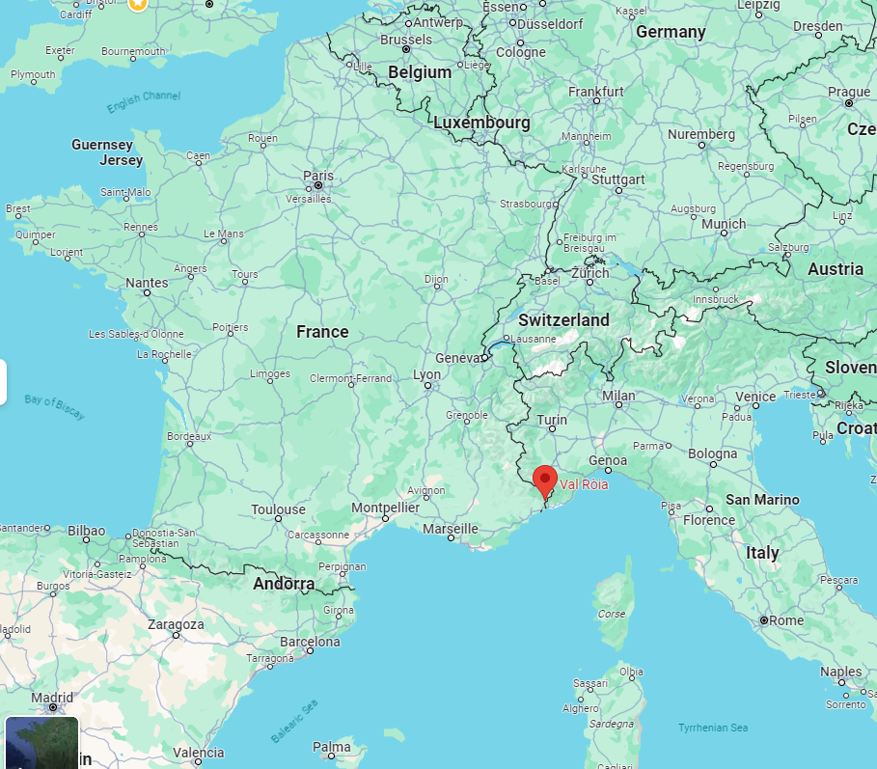
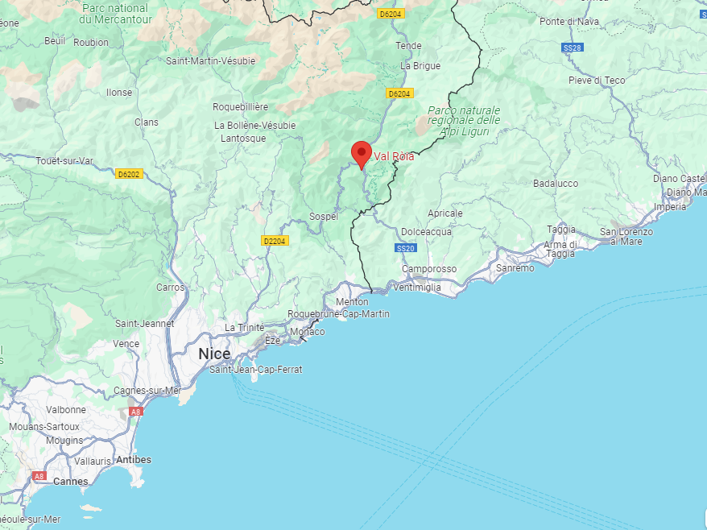
Source: Google Map

Slide 5
Structure of the Talk
The criminalization of solidarity in the EU
Decriminalising solidarity: EU or national solutions?
Using constitutional law
Concept of human dignity
The law
The practice
Concept of fraternity in the French context
Definition
The process
Challenges
Issues
Solutions

Slide 6
Issues

Slide 7
Criminalisation of Solidarity – Definition
Wide definition: covers a vast array of state activities that aim at harassing, penalising, and suppressing support for migrants.
Narrow definition: focuses on application of criminal law to any act of solidarity committed by individuals towards irregular migrants and consis-ting in helping and facilitating unauthorised entry, movement and residence of migrants.
Source: Amnesty International

Slide 8
Criminalisation of Solidarity – Definition
Purpose of the criminalisation of an act is to set out permissible standards within society and punish those who disregard these standards and who, by doing so, damage the moral fabric of society as a whole
Therefore, criminalization is a powerful tool that states can use to create a coherent and orderly society

Slide 9
Concept of Solidarity
Two trends
social solidarity grounded in a sense of similarity, identity, and belonging. People recognize themselves in one another
political solidarity informed by mutual agency aimed at social change. People who share and are committed to jointly achieve certain political goals and ideals form this kind of solidarity despite their differences

Slide 10
Concept of Solidarity
Solidarity: a social bond characterized by a sense of agreement and togetherness among those who form it
Charity: one-sided and implies detachment and disparity between those who express it and the recipients of its benefits

Slide 11
Criminalisation of Solidarity – The Process
Sovereignty and securitisation of borders
War on smuggling and discourse of deterrence of migration
Creation of ‘hot spots’
Activists filling in the protection gap
Emergence of networks of activists who become politicised
Discourse of migrants seen as threats to social cohesion and discourse equating humanitarian support to smuggling
Campaigns of government intimidation
Criminalisation of solidarity
Limitation or withdrawal of access to support

Slide 12
Criminalisation of Solidarity – The Law
EU Facilitators Package: Facilitation Directive and the Council Framework Decision (2002)
Directive obliges States to impose sanctions on individuals who aid irregular migrants but also includes a humanitarian assistance exemption
Under EU law, obligation to implement the Directive in national law

Slide 13
Criminalisation of Solidarity – The Law
Issues in the implementation:
Poor phrasing and lack of definitions misused
Implementation against the wording: ‘financial gain’; distinction between assistance relating to residence on the one hand and entry and transit on the other
Voluntary humanitarian assistance exemption
Criminalisation of solidarity in national law and in practice

Slide 14
Criminalisation of Solidarity – Practice
Prosecution
Activities in hotspots
Simple, temporal acts
Ordinary citizens
Narrow interpretation of ‘humanitarian assistance’
Consequences
Psychological effect, reputational damage, surveillance, financial burdens on individuals
Stigmatisation of individuals
Undermining citizen initiatives that challenge migration policies

Slide 15
Challenges

Slide 16
At the European Level
Amending the Facilitation Directive
Using the Concept of Solidarity
Logic of securitisation
Hostile environment
Ideal solution but not feasible because:
Solidarity as an EU value but too controversial and vague in EU law
Rallying cry that cannot be enforced
Member States fighting against concept of solidarity
Proposal by Commission in November 2023

Slide 17
At the National Level
Issue is the national criminal legislation
It should reflect societal normative expectations but clashes with fundamental constitutional principles and values
It is used for political purposes and this undermines public faith in liberal democracy

Slide 18
At the National Level
Two methods to decriminalise solidarity
Remove or amend the law that criminalises acts of solidarity
Use national courts and refer to higher, shared values and principles at constitutional level

Slide 19
Solutions

Slide 20
Fraternity and Solidarity
Similarities | Differences
Originated during French Revolution Politically performative ‘Horizontal’ in nature | Fraternity: implies ‘con-sanguineity’ Solidarity: based on agency rather than identity

Slide 21
Using Fraternity
French Constitutional Court decision 2018 in the case Herrou
Fraternity as a principle of constitutional value
Significance of the case
Legislation (CESEDA) swiftly amended
Humanitarian exemption
French law must now comply with principle of fraternity
Fewer prosecution
Helps catalyse change
Limitations
Humanitarian exemption does not apply to facilitation of entry
‘Purely exclusively humanitarian purpose’

Slide 22
‘the example that France has set in the celebrated Cedric Herrou case is worthy of widespread emulation and replication’
United Nations Independent Expert on International Solidarity

Slide 23
Solidarity and Human Dignity
Post WWII - survivors find new moral imperative to unite and support each other: to ensure that what happened never happens again and that human dignity is respected.
Human dignity as a prerequisite for human coexistence and solidarity

Slide 24
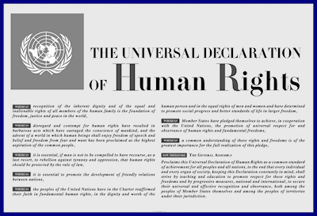
‘All human beings are born free and equal in dignity and rights. They are endowed with reason and conscience and should act towards one another in a spirit of brotherhood’.
Universal Declaration of Human Rights, 1948, article 1
‘We the peoples of the United Nations determined to save succeeding generations from the scourge of war, which twice in our lifetime has brought untold sorrow to mankind, and to reaffirm faith in fundamental human rights, in the dignity and worth of the human person, in the equal rights of men and women and of nations large and small.’
UN Charter, 1945, Preamble

Slide 25
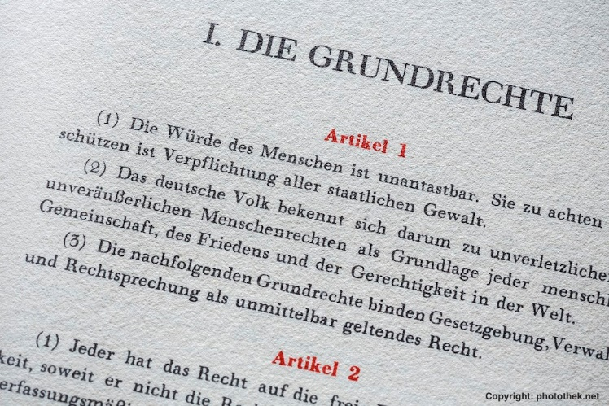
Human Dignity in Law
Human dignity as a constitutional principle related to human rights
Human dignity as the foundation of human rights
Human dignity in many post-WWII constitutions in Europe
Source: German Foreign Office, X, 23 May 2016

Slide 26
Using Human Dignity
Human rights approach to human dignity - concrete substance
Bridging generations of human rights
Negative and positive obligations of States
Vulnerable groups
Constitutional principle used to strike down incompatible legislation

Slide 27
Using Human Dignity
Limitations to the proposal
Interpretation of human dignity
- vague and thus open-ended
- absolute v relative
- linked to public morality
Human dignity to be balanced against other principles
- supreme v relative
- other principles of constitutional value, e.g. principle of protection of the public order, principle of public interest, principle of constitutional identity, etc

Slide 28
Thank you!

