Slide 1
Factory Digital Twinning with Model Driven Engineering Methodology
Sripad Sahu
and
Yaseen Zaidi
School of Engineering
University of the West of England
Bristol
sripadssahu@gmail.com yaseen.zaidi@uwe.ac.uk
Notes:
1
Introduction we will be focusing on very specific part of Model Driven ENgineering

Slide 2
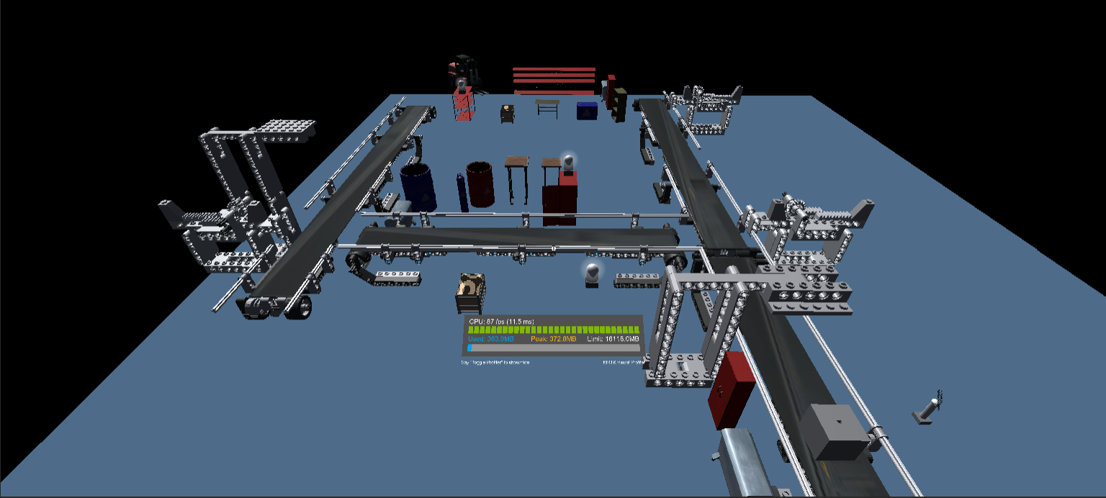
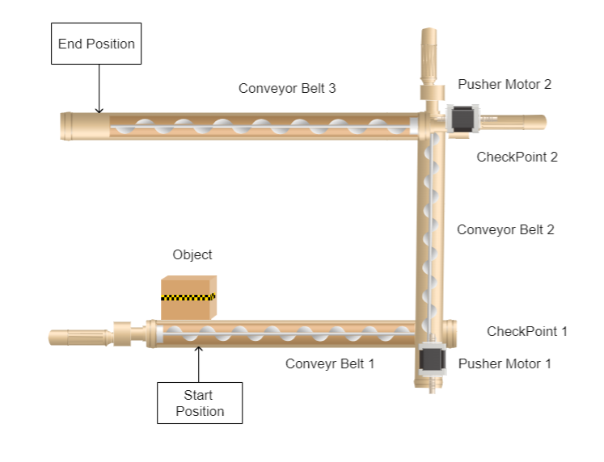
Factory Digital Twinning
Conveyor belt system in Virtual world
Diagram of Conveyor Belt system
Encompasses machinery, workflows, and processes in a virtual model.
Represents a holistic view of manufacturing cycle.
But, what about the manufacturing Product?
Notes:
I was working on a digital twin factory last year as apart of my dissertation project where I had to model a small section of the a factory for our industrial partner. In the process of creating the virtual twin I realized that we can model the machinery used, we get information on the process, wo0rkflows etc. but we don’t have any actual information on the product being manufactured. The purpose of a factory digital twin is to give a complete picture of entire manufacturing cycle, which is incomplete without the manufacturing product’s information.

Slide 3
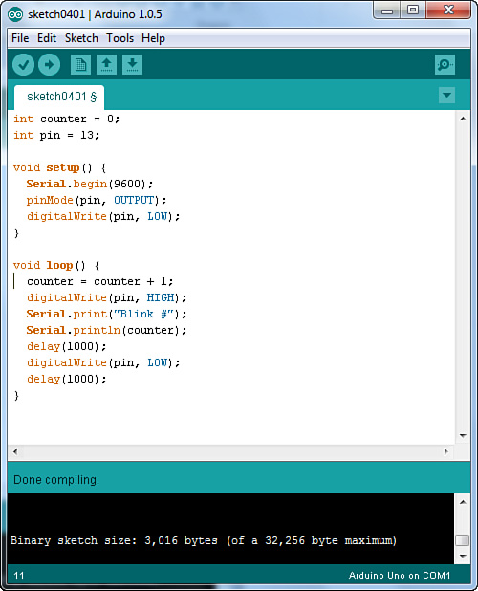
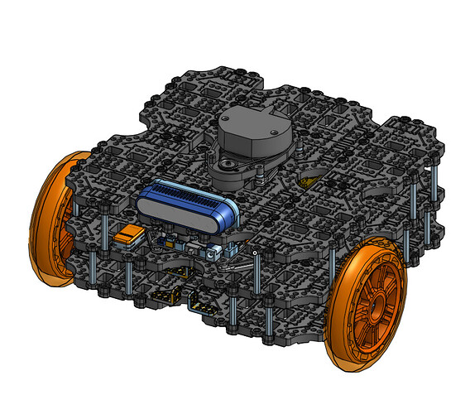
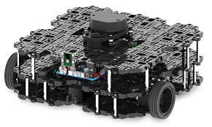
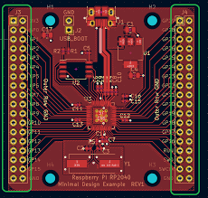
Digital Thread in Manufacturing
Unraveling the Role of Digital Thread in Manufacturing Systems
A seamless digital narrative across the product manufacturing lifecycle.
=
+
+
Hardware
Electronics
Software
Connects various data types for enhanced communication and efficiency.
Notes:
In this project we are exploring how digital thread can be established in a digital twin that contains all the required information of the said product. So when we talk about manufacturing a product, let’s say a small toy. We can dissect the toy into its individual components like the outer covering/case of the toy, the electronics components and the program or the script running inside the the toy. Now, each of these individual components are interdependent on each other, so lets say if the length of a side changes in CAD model, then it might affect the electronic component which in turn might affect the automation script. It is the role of the Digital thread to connect all of these individual information sitting in silos and provide us with an in depth view of the product.

Slide 4
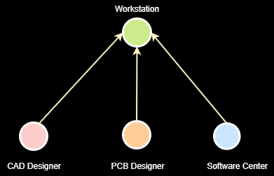
Digital Twins Definition Language
A structured JSON based language for defining digital twins.
Uses classes(Interfaces, Relationships,telemetry etc ) to define behaviour of Digital Twins.
Used only to define the structure of Digital twin.
New classes can be added to define Digital Thread, extending capabilities of DTDL.
{
"@context": "dtmi:dtdl:context;3",
"@id": "dtmi:com:example:CAD Designer;1",
"@type": "Interface",
"displayName": "Building",
"contents": [
{
"@type": "Property",
"name": "name",
"schema": "string",
"writable": true
},
{
"@type": "Relationship",
"name": "contains",
"target": "dtmi:com:example:Workstation;1"
}
]
}
DTDL Graph
DTDL Json File

Slide 5
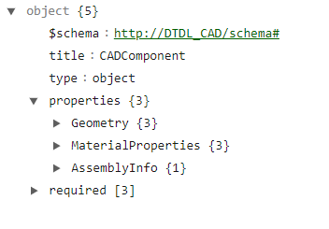
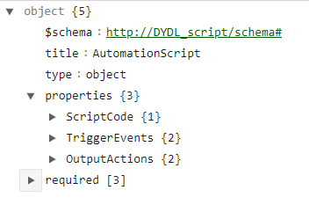
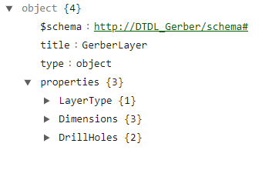
Extending DTDL
Approach -1 : Create separate classes for each file type (CAD, Gerber and C++).
CAD Class Schema
C++ Class Schema
Gerber Class Schema
Wide range of Filetype.
Mapping every properties in DTDL would be difficult

Slide 6
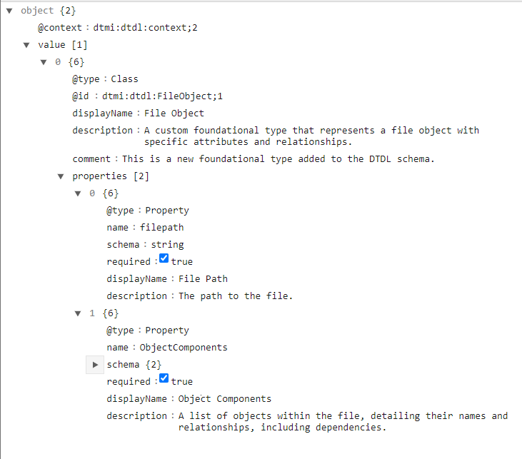
Extending DTDL
Approach 2 :
FileObject Class :
Single class to carry additional file information for each Node.
Defines individual component of the product and relationship with the other components.

Slide 7
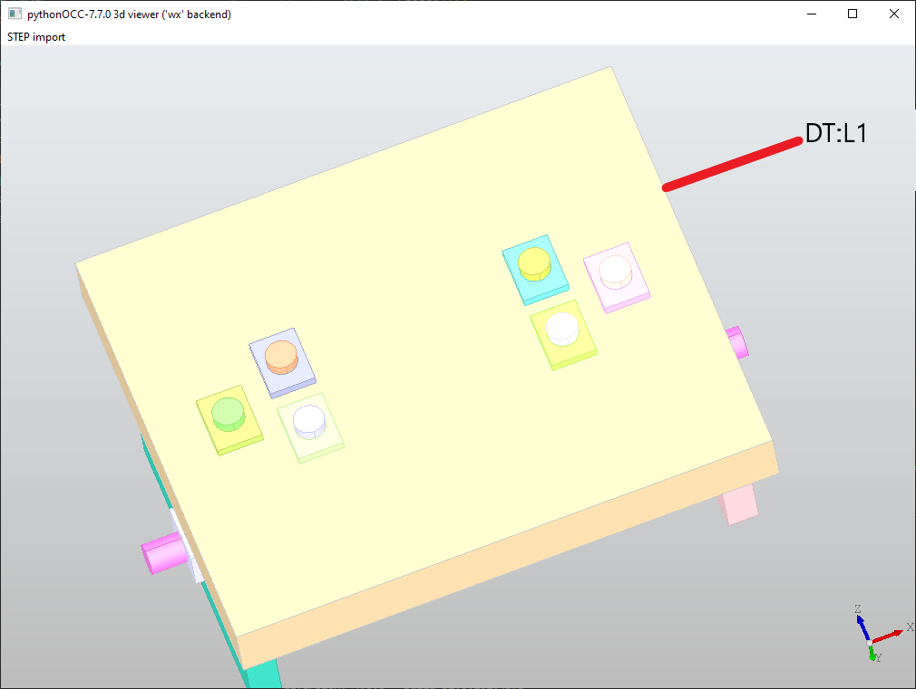
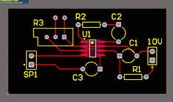
Example
Example : The length(L1) of plane (P1) is renamed to DT:L1 and R2 in Gerber File is renamed to DT:R2. Relationship between them : DT:L1 = 1.5*DT:R2.
Add Prefix to components
Create a file parser to pick up the components using the Prefix
Define Relationship.

Slide 8
A working example

Slide 9
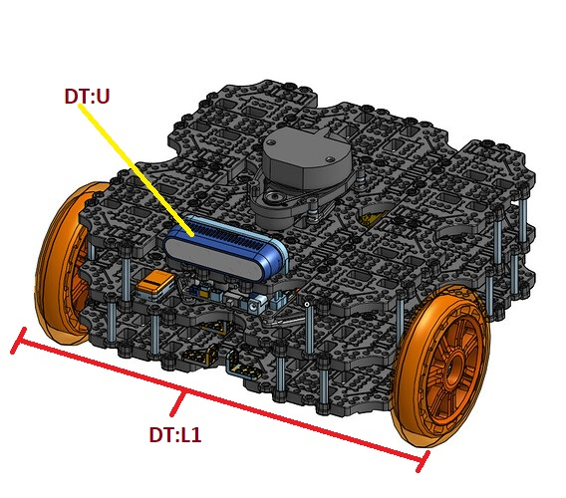
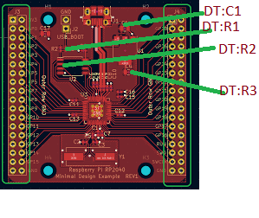
Types of Relationship
Dependency Relation:
DT:U is dependent on DT:C1,DT:R1 and DT:R2
Synchronization Relation:
Value of DT:R3 is dependent on Value of DT:L1
Spatial Relation:
DT:U is placed above DT:L1
Compatibility Relation:
DT:C1,DT:R1 and DT:R2 should be compatible with DT:U type.
Notes:
For dependency : Use turtle bot cad and show that if there is LED, in the design, then only add the Resistor for that LED. Front ultrasonic : DT:U1 is dependent on DT:R2 and DT:R3 (two resistors in gerber)
For synconisation Use the same LED concepth and show that longer the LED strip higher is the value of the resistor.Show line length L1 for the cad file
Spatial : show the relative arrangement
Compatibility : Show the type of resistor smd, flatbed or etc.

Slide 10
Advantages
Can be used in various other domains :
Healthcare
Finance
Education etc.
Easy to extend.
Create New File parser
Minimal changes to DTDL.

Slide 11
Questions ?

